Slide 1

Site Verification and Safety
PREA
March 4, 2025 1:30 PM – 2:45 PM
Perry Lawton
Notes:
1

Slide 2

Site Verification: Why should we invest our limited meter service resources here
These customers represent a disproportionately large amount of the overall revenue for every utility in North America.
For some utilities, the ten percent of their customers who have transformer rated metering services can represent over 70% of their overall revenue.
While these numbers will vary from utility to utility the basic premise should be the same for all utilities regarding where Meter Services should focus their efforts
This is perhaps one of the larger benefits that AMI can provide for our Utilities – more time to spend on C&I metering and less on residential
Easy Answer:
Money.

Slide 3

Potential list of tasks to be completed during a Site Verification of a Transformer Rated Metering Site
Double check the meter number, the location the test result and the meter record
Perform a visual safety inspection of the site. This includes utility and customer equipment. Things to look for include intact down ground on pole, properly attached enclosure, unwanted voltage on enclosure, proper trimming and site tidiness (absence of discarded seals, etc.)
Visually inspect for energy diversions (intentional and not). This includes broken or missing wires, jumpers, open test switch, unconnected wires and foreign objects on meters or other metering equipment. Broken or missing wires can seriously cause the under measurement of energy. A simple broken wire on a CT or VT can cause the loss of 1/3 to 1/2 of the registration on either 3 element or 2 element metering, respectively.

Slide 4

Site Verification Checklist (cont)
Visually check lightning arrestors and transformers for damage or leaks.
Check for proper grounding and bonding of metering equipment. Poor grounding and bonding practices may result in inaccurate measurements that go undetected for long periods of time. Implementing a single point ground policy and practice can reduce or eliminate this issue.
Burden test CTs and voltage check PTs.
Verify service voltage. Stuck regulator or seasonal capacitor
can impact service voltage.
Verify condition of metering control wire. This includes looking
for cracks in insulation, broken wires, loose connections, etc.
Confirm we have a Blondel compliant metering set up
Compare the test switch wiring with the wiring at the CTs and VTs. Verify CTs and VTs not cross wired. Be sure CTs are grounded in one location (test switch) only.

Slide 5
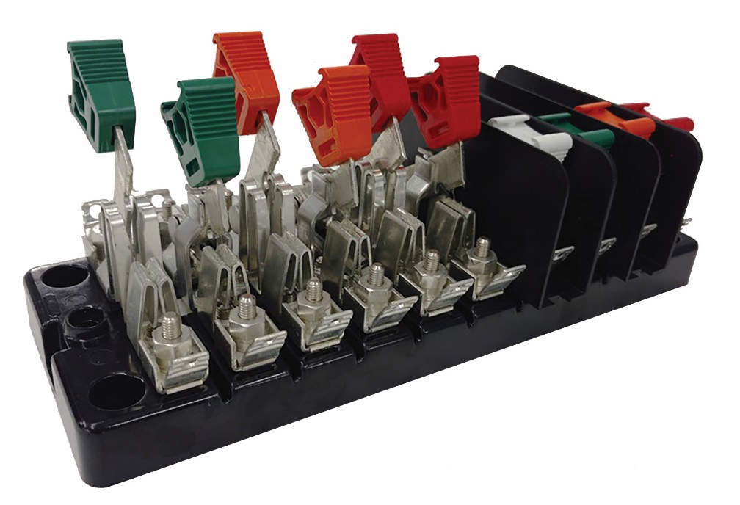
Site Verification Checklist (cont)
Check for bad test switch by examining voltage at the top and bottom of the switch. Also verify amps using amp probe on both sides of the test switch. Verify neutral connection to cabinet (voltage).
Check rotation by closing in one phase at a time at the test switch and observing the phase meter for forward rotation. If forward rotation is not observed measurements may be significantly impacted as the phases are most likely cancelling each other out.

Slide 6

Site Verification Checklist (cont)
Test meter for accuracy. Verify demand if applicable with observed load. If meter is performing compensation (line and/or transformer losses) the compensation should be verified either through direct testing at the site or by examining recorded pulse data.
Loss compensation is generally a very small percentage of the overall measurement and would not be caught under utilities normal high/low checks. However, the small percentages when applied to large loads or generation can really add up overtime. Billing adjustments can easily be in the $million range if not caught early.

Slide 7

Site Verification Checklist (cont)
Verify metering vectors. Traditionally this has been done using instruments such as a circuit analyzer. Many solid state meters today can provide vector diagrams along with volt/amp/pf and values using meter manufacturer software or meter displays. Many of these desired values are programmed into the meters Alternate/Utility display. Examining these values can provide much information about the metering integrity. It may also assist in determining if unbalanced loads are present and if CTs are sized properly. The vendor software generally has the ability to capture both diagnostic and vector information electronically. These electronic records should be kept in the meter shop for future comparisons.
If metering is providing pulses/EOI pulse to customers, SCADA systems or other meters for totalization they also should be verified vs. the known load on the meter. If present test/inspect isolation relays/pulse splitters for things like blown fuses to ensure they are operating properly.
Verify meter information including meter multiplier, serial number, dials/decimals, Mp, Ke, Primary Kh, Kr and Rate. Errors in this type of information can also cause a adverse impact on measured/reported values.
Verify CT shunts are all opened.
Look for signs of excessive heat on the meter base e.g.
melted plastic or discoloration related to heat

Slide 8
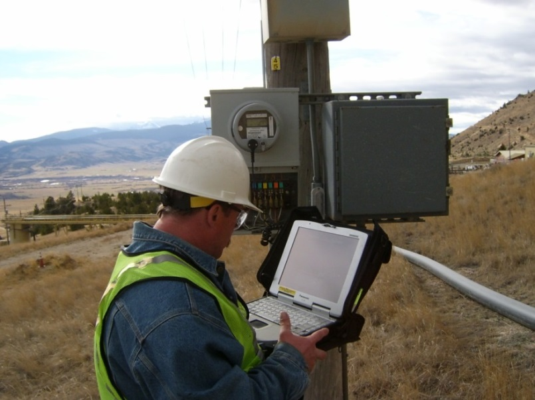
Periodic Site Inspections…..
….Can Discover or Prevent:
Billing Errors
Bad Metering set-up
Detect Current Diversion
Identify Potential Safety Issues
Metering Issues (issues not
related to meter accuracy)
AMR/AMI Communications Issues
The need for Unscheduled Truck Rolls due to Undetected Field Related Issues
Discrepancies between what is believed to be at a given site versus the actual setup and equipment at the site

Slide 9
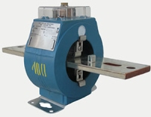
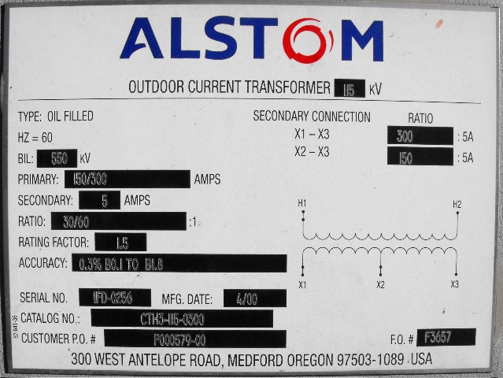
Ct Testing
Ratio, Burden, and Admittance

Slide 10
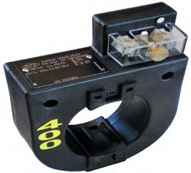
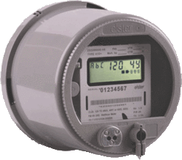
Example Application
SOURCE
LOAD
PHASE A
400A
PHASE B
400A
PHASE C
400A
9S Meter Installation
5A
5A
5A

Slide 11
Faceplate Specifications

Slide 12
Faceplate Specifications
Ratio

Slide 13
CT’s Ratio
For instance, a CT with a 400:5 ratio will produce 5A on the secondary, when 400A are applied to the primary.

Slide 14
Faceplate Specifications
Thermal factor

Slide 15
CT’s – Functions and Terminology
Thermal Rating factor
A value representing the amount by which the primary current can be increased without exceeding the allowable temperature rise.
For instance, a RF of 4.0 at 30° ambient on a 400:5 ratio CT would allow for a primary current up to 1600A.

Slide 16
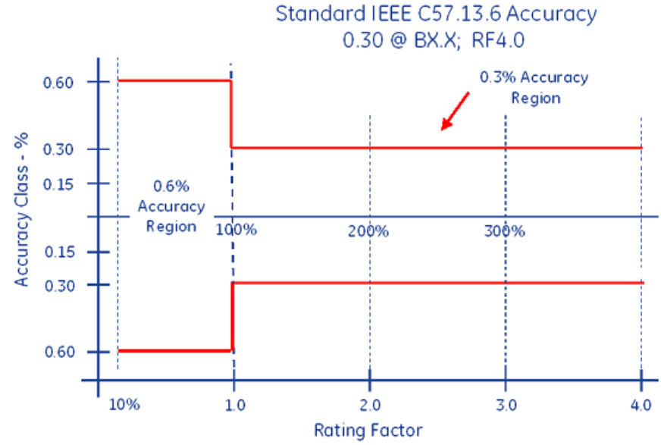
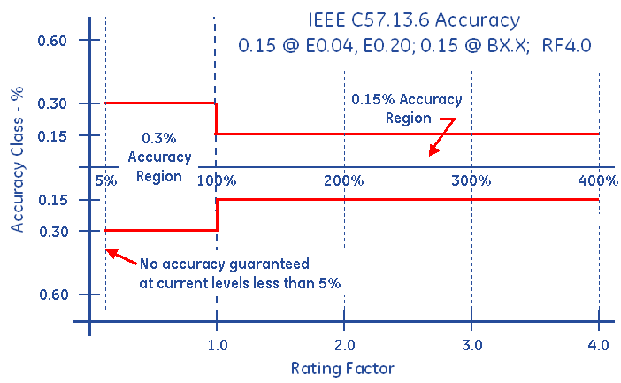
Faceplate Specifications
Accuracy Classifications
All CT’s fall within an accuracy class.
IEEE Standards have defined accuracy classes.

Slide 17
Faceplate Specifications
BurdenRating

Slide 18
Burden Rating
The burden range, present in the secondary circuit, that the manufacturer will guarantee their CT’s will still accurately function, in regard to the ratio specification.

Slide 19
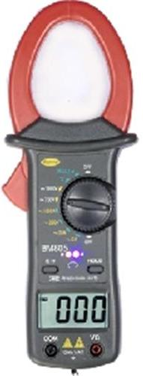
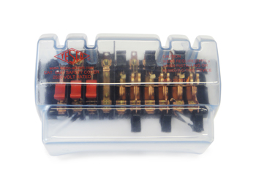
Ratio Testing
Ratio of Primary Current to Secondary Current
SOURCE
LOAD
PHASE A
400A
400A
400A
5A
5A
5A
Calculate Ratio

Slide 20
Burden Testing
Functionality with Burden Present on the Secondary Loop
PHASE A
Some burden will always be present – junctions, meter coils, test switches, cables, etc.
CT’s must be able to maintain an accurate ratio with burden on the secondary.

Slide 21
Burden Testing
Functionality with Burden Present on the Secondary Loop
PHASE A
Some burden will always be present – junctions, meter coils, test switches, cables, etc.
CT’s must be able to maintain an accurate ratio with burden on the secondary.

Slide 22
Burden Testing
Functionality with Burden Present on the Secondary Loop
Example Burden Spec:
0.3% @ B0.1, B0.2, B0.5
or
There should be less than the 0.3% change in secondary current from initial (“0” burden) reading, when up to 0.5Ohms of burden is applied

Slide 23
Burden Testing
Functionality with Burden Present on the Secondary Loop
ANSI Burden Values
0.1 Ohms
0.2 Ohms
0.5 Ohms
1 Ohms
2 Ohms
4 Ohms
8 Ohms

Slide 24
Burden Testing
0.3% @ B0.1, B0.2, B0.5
Initial Reading = 5Amps
0.3% x 5A = 0.015A
5A – 0.015 = 4.985A
Burden | Reading
0 | 5.0000
0.1 | 4.9999
0.2 | 4.9950
0.5 | 4.9900
1 | 4.9800
2 | 4.9500
4 | 4.0000
8 | 0.8000

Slide 25
Burden Testing
0.3% @ B0.1, B0.2, B0.5
Initial Reading = 5Amps
0.3% x 5A = 0.015A
5A – 0.015 = 4.985A
Burden | Reading
0 | 5.0000
0.1 | 4.9999
0.2 | 4.9950
0.5 | 4.9900
1 | 4.9800
2 | 4.9500
4 | 4.0000
8 | 0.8000
At 0.5Ohms of Burden
the secondary current is still at 4.990A – Less than 0.3% change – Good CT!

Slide 26
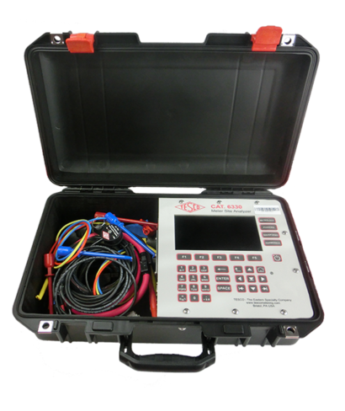
Admittance Testing
What is Admittance?
Admittance testing measures the overall “health” of the secondary loop of the CT.
Measured in units of MiliSiemens (mS)
Admittance is the inverse of impedance.
Impedance is the opposition to current.
Therefore, admittance testing measures the overall “health” of the secondary loop of the CT.

Slide 27

Admittance Testing
Admittance testing devices inject an audio sine wave signal into the secondary loop of the CT.
The resulting current is measured.
The voltage of the initial signal is known.
From these two parameters, the impedance, and thus the admittance can be calculated.

Slide 28

Admittance Testing
Admittance test results are not immediately intuitive.
Some analysis and interpretation is need.
What do all these mS values mean?

Slide 29

Admittance Testing
Three phase process is recommended.
Test each CT individually
Test the matched sets
Test over time

Slide 30
De-magnetization
CT’s can become magnetized, due to a number of reasons, including leaving the shorting clip open, near lightning strikes, and harmonic content.
CT’s can be demagnitized by slowly and smoothly increasing the secondary resistance until saturation occurs, and then slowly and smoothly decreasing the secondary resistance.
A resistance that will cause a secondary current reduction of 65% to 75% will typically put the CT into saturation.
*Some information has been taken from Radian Research’s Application Note 1109A: Admittance Testing Verifies CT Testing Integrity

Slide 31
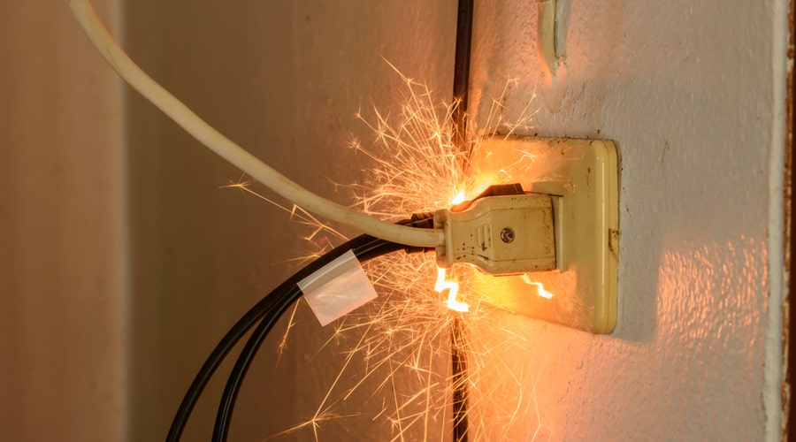
Metering Safety
Fatal Electrical Injuries
The highest rate of fatal electrical injury in 2019 occurred in the Construction industry (0.7/100,000), followed closely by the Utility industry (0.4/100,000).
In 2019, there was one electrical fatality for every 33 fatalities from all causes. The long-term trend
has declined from
one electrical fatality
for each 23 fatalities
from all causes in 2003
to the 2019 level of
one in 33.

Slide 32
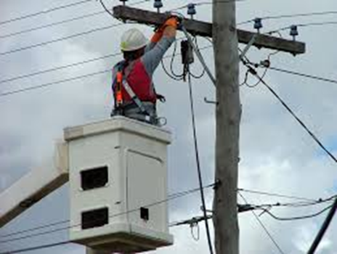
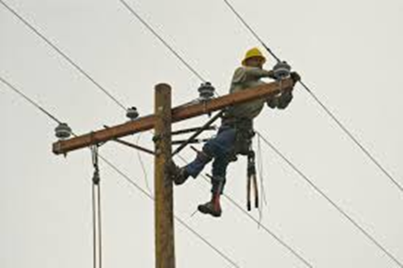
Does Age Matter – Or Experience?
Fatal Electrical Injuries
In 2019, 8% of all electrical injuries were fatal.
By age group Fatalities tend to go down with age and experience (and perhaps a healthier respect for electricity).
    16 to 17 – 5.4 times as likely as the average worker to experience an electrical injury on the job site.
    18 to 19 years age group – 2.4 times
    20 to 24 years age group - 1.8 times
    25 to 34 years age group - 1.5 times
    35 to 44 years age group – 1.1 times, and;
    those 45 years and up are at or below the average frequency of electrical injury.

Slide 33
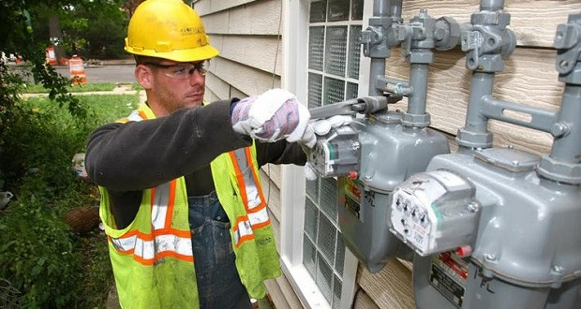
Non-Fatal Electrical Injuries
The median number of days away from work for nonfatal electrical injuries was 9 in 2019.
Electrical injuries are typically classified as burn or shock. For non-fatal injuries, electrical shock injuries were nearly triple the electrical burn injuries in 2019.
The Utility industry rate of nonfatal electrical injury involving days away from work (0.9/10,000) surpassed the Construction industry rate (0.7/10,000) in 2016.
The Mining industry had rate of nonfatal electrical burn injury of 1.0/10,000 for 2016, followed by the Utility industry (0.9) followed by the construction industry (0.4). The rate for all of Private industry remained consistent at 0.1.

Slide 34
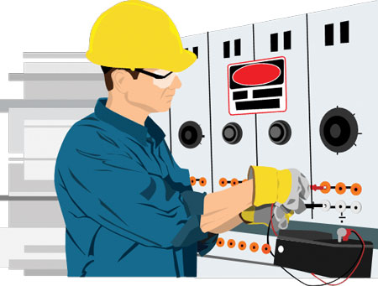
How Dangerous is Metering?
Electricity is Organized Lightning – George Carlin
Any Voltage without current will not kill you, but any voltage with current can kill you.

Slide 35
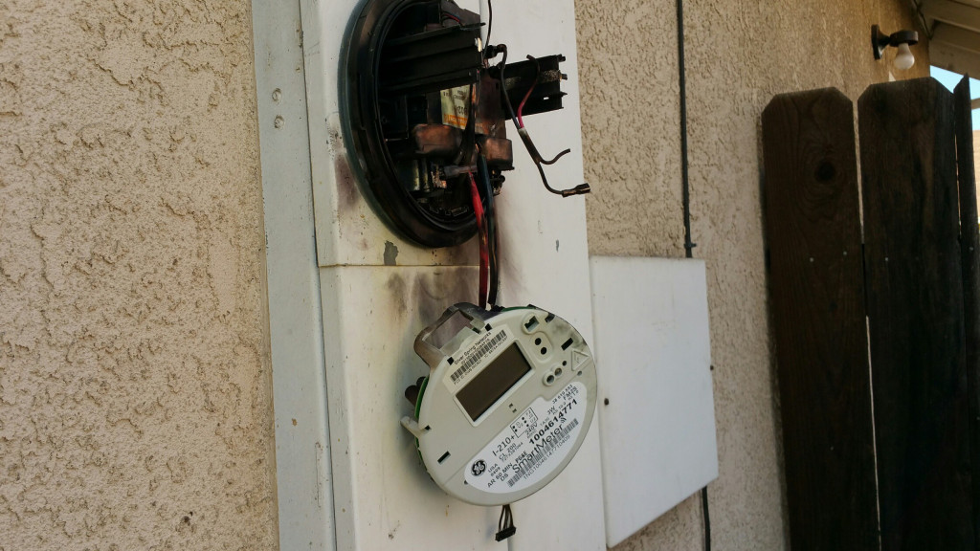
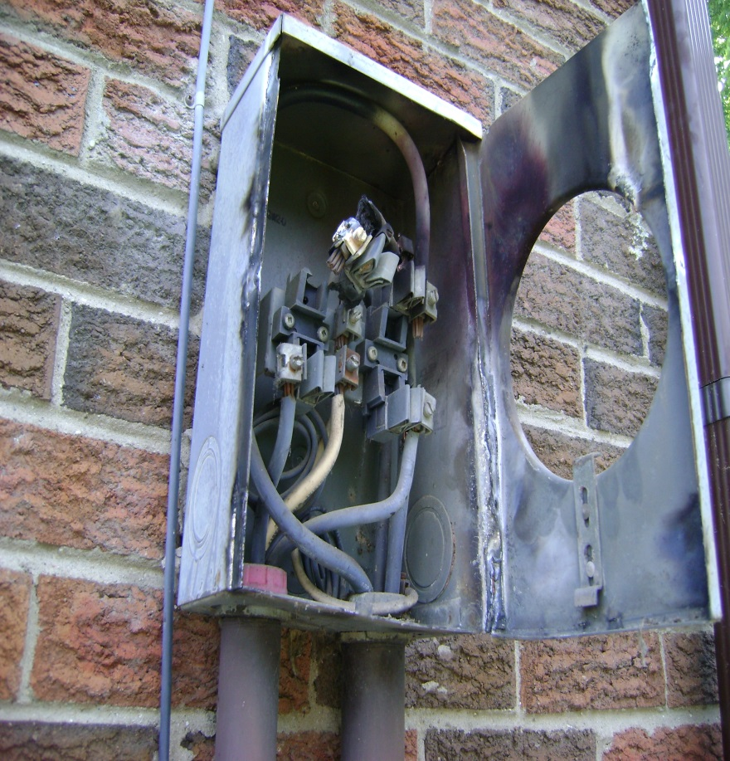
How Dangerous is Metering?

Slide 36


Safety First - PPE
Personal Protective Equipment
Leathers
Rubber Gloves
Face Shield
FR Clothing
Safety Shoes

Slide 37
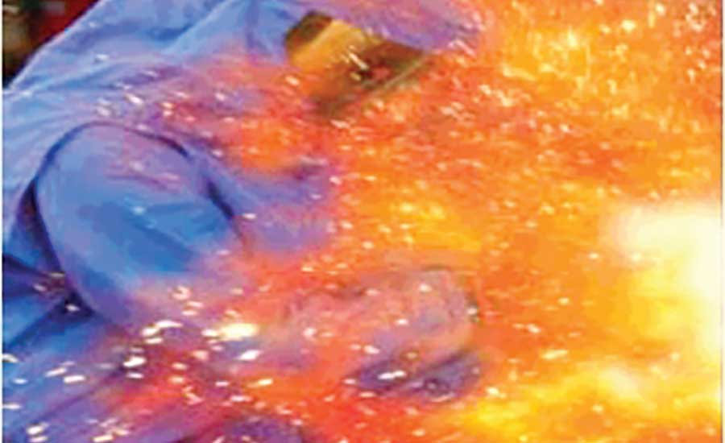
Arc Flash
What is Arc Flash?
While an arc flash is sometimes used interchangeably with “arc fault”, an arc flash is more accurately defined as the light produced during an arc fault. An arc fault is a type of electrical fault that results from the breakdown of an insulating medium between two conductors where the energy is sufficient to sustain an arc across the insulator (often air) and can cause extreme amounts of light (arc flash), immense heat upwards of 19,000 degrees C, and a resulting explosive pressure wave (arc blast). These forces combine to create a hazardous condition that can vaporize metal, destroy equipment, and pose a significant hazard to anyone in the vicinity.

Slide 38
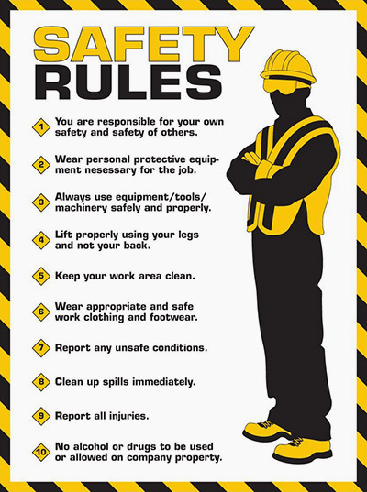
Covering the Basics

Slide 39
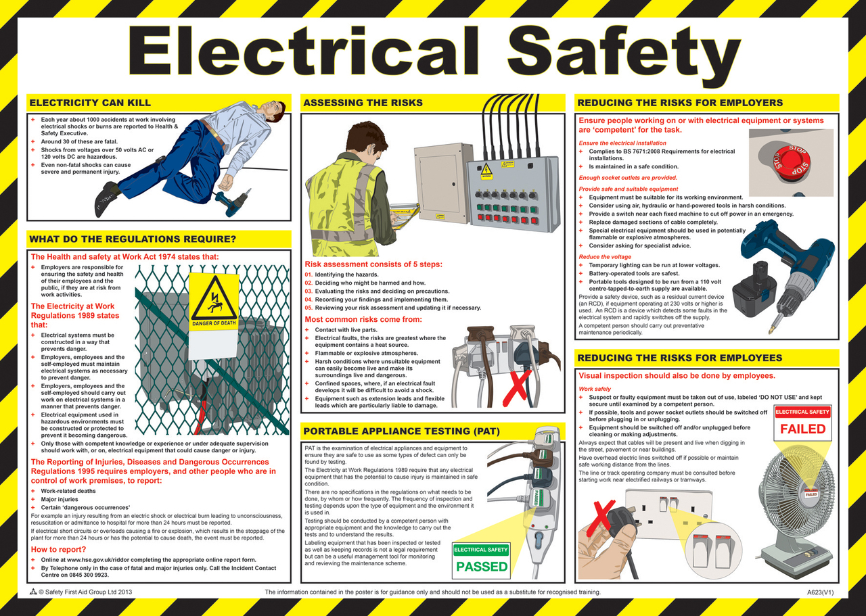
More of the Basics

Slide 40
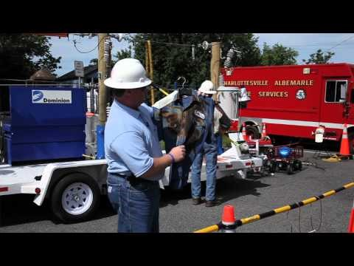
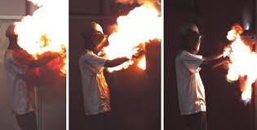
How Bad Can Things Get?
Many thanks to Dominion Power
https://youtu.be/2Xoyb9M5-EA
Rubber Gloves and FR 4:10
Meter enclosure – shorted out 10:48
Thanks to Meter Grabber
https://youtu.be/Azuu8VnM36g

Slide 41
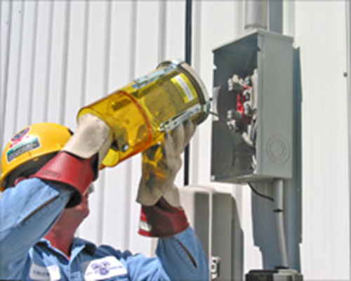
Field Audits, Trouble Shooting and Testing
Always approach an electrical service with caution and while wearing your full PPE. Why?
Never stand directly in front of the meter when removing the meter
Before you even open the box or get the cover off….
  Live box
  Bees
  Other live animals
Broken Seal
Cover dropping off

Slide 42
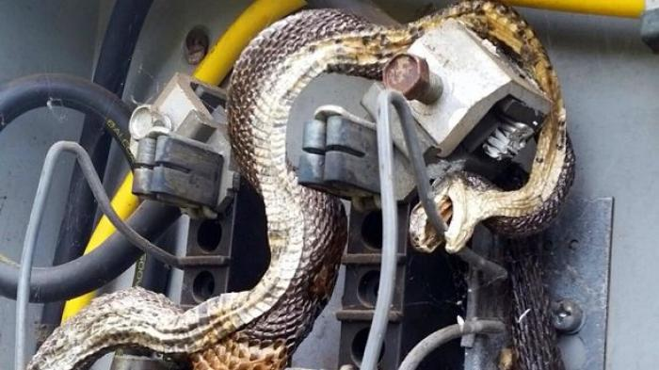
Field Audits, Trouble Shooting and Testing 2

Slide 43
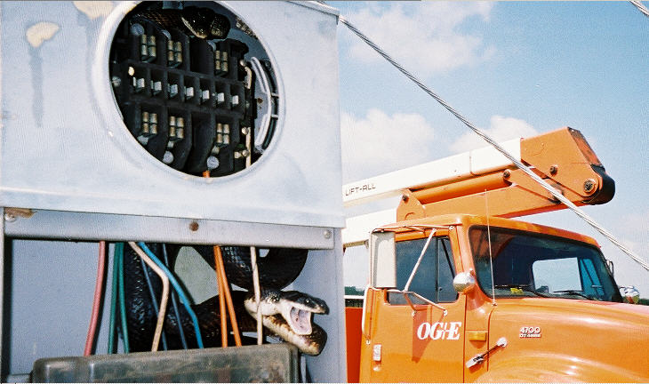
Field Audits, Trouble Shooting and Testing 3

Slide 44

Once the box is Open: Issues to Look For
Open line – open line side connection to the meter socket.
Missing neutral – missing neutral connection to the center lug in the meter socket
Cross phase condition – cross wiring between the test block and the meter socket.
Hidden jumpers line to load – diversion on both legs.
Dead Short - dead short phase to ground on the load side of one leg of the socket.
Partial Short - partial short phase to ground on the load side of one leg of the socket

Slide 45
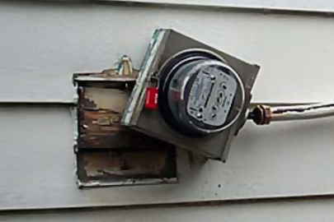
Backfeed, Ground Fault and other Issues to Look For
Back fed meter socket
Ground fault
Phase to phase fault
Pulling a meter jaw with the meter

Slide 46
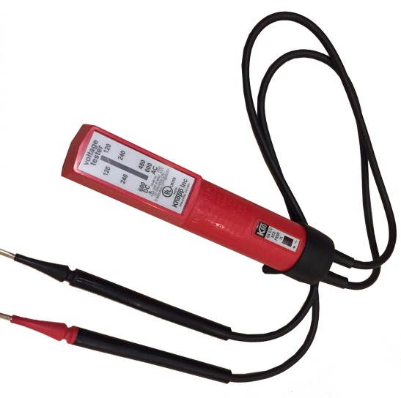
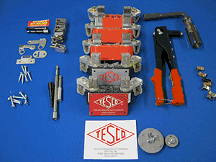
Tools
Socket Pullers
Volt meters
Specialized tools

Slide 47
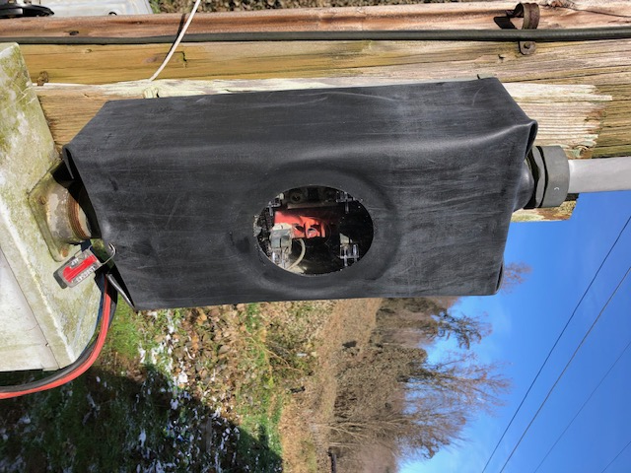

Tools
Temporary Service Cover

Slide 48
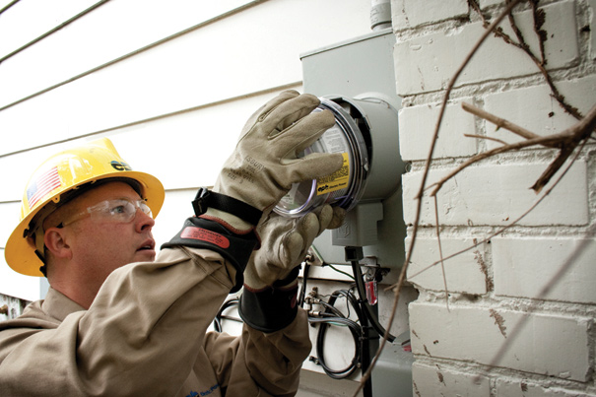
Summary
Be Careful
Assume the box is live
Assume there is something live in the box
Treat electricity with respect
Treat all meter boxes with respect

Slide 49
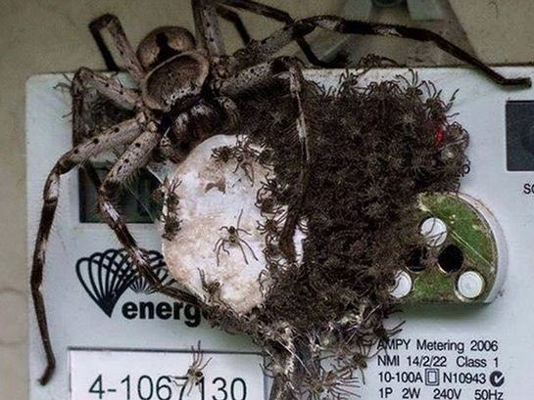
Around the room
Issues that you may
have seen in your
metering career
already?
Safety Issues not yet
brought up?
Closing
Are you not only following the rules but actively making suggestions?

Slide 50




Most Importantly…
We test and verify the sites to make sure
we are not losing money and to make sure
the sites are safe.

Slide 51

Questions and Discussion
Perry Lawton
Northeastern Regional Sales Manager
perry.lawton@tescometering.com
TESCO – The Eastern Specialty Company
Bristol, PA
215.228.0500
This presentation can also be found under Meter Conferences and Schools on the TESCO website: tescometering.com
ISO 9001:2015 Certified Quality Company
ISO 17025:2017 Accredited Laboratory

