Slide 1

AMI Technology Overview
Presented by Tom Lawton, TESCO
The Eastern Specialty Company
for Pennsylvania Rural Electric Association
March 4th, 2025

Slide 2
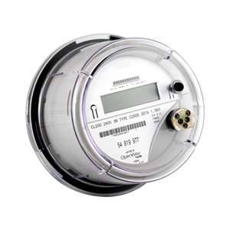
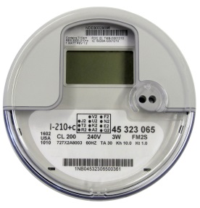
Topics We Will Cover
Benefits of AMI and where we are starting from
Overview of technologies
How AMI is changing Meter Service Departments and metering jobs
Metering and the Future of AMI

Slide 3
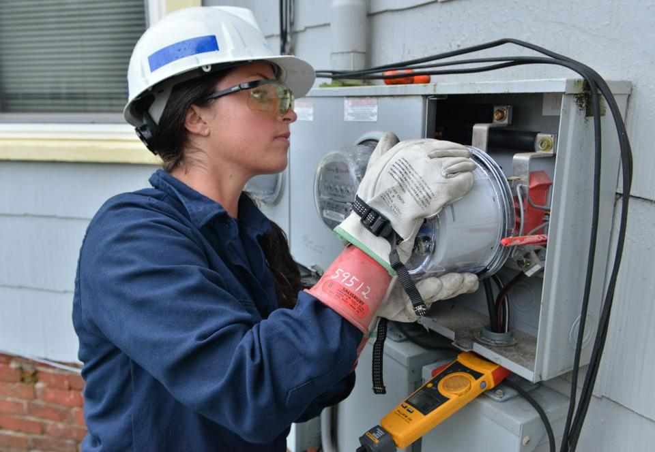
AMI Benefits
Two-way communication to the meter
  Why is this important or desirable?
Usage
Voltage
Current
Power Quality
Disconnect/Reconnect
Outages
The Future
  Location
  Displays

Slide 4
Pre-AMI Meter Operations
Common Features and Common Sources of Concern
Fewer meter techs in the field and in the shop than there were 25 years ago
Fewer Field checks and site verifications due to lack of personnel, lack of experience and lack of expertise
More features under glass in the meters even before AMI deployed
Significantly more features under glass in every AMR and AMI system being considered or being deployed
Metering losses starting to be identified “by accident” as opposed to being “by design”.

Slide 5

The Pendulum Starts to Move
Meter Operations. Prior to deployment many larger utilities take an attitude of “this is only metering – how hard can that be?”. Over the course of deployment Meter Operations gains a stature and a respect from the rest of the organization that was not previously accorded them – even if this is only begrudging respect.
New tests for AMI meters (e.g. communication, disconnect) are identified
The complexity and issues around high revenue metering are at least acknowledged by the rest of the organization
Tests which have not been performed in years are suddenly back in vogue

Slide 6
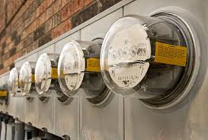
The New Realities
Electro-Mechanical Meters typically lasted 30 years and more. Electronic AMI meters are typically envisioned to have a life span of fifteen years and given the pace of technology advances in metering are not expected to last much longer than this.
This means entire systems are envisioned to be exchanged every fifteen years or so. In the interim the meter population and communication network inherent in the infrastructure for each utility must be maintained.
Meter communication and meter data management are becoming as important to metering operations as meter accuracy.
Firmware upgrades, firmware stability and cyber security are becoming increasingly important to metering departments

Slide 7

What Technologies Are We Using?
RF Mesh
Power Line Carrier (PLC)
LTL Back Haul

Slide 8
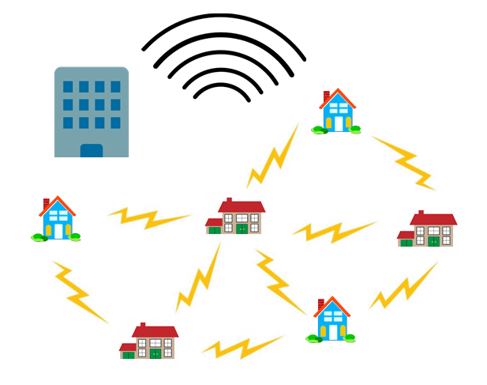
RF Mesh
True RF Mesh
Meters and collectors
Software and firmware
Head End Systems
The difference
between frequencies
  Proprietary and non-proprietary
  frequencies
  Penetration vs. distance trade-off

Slide 9
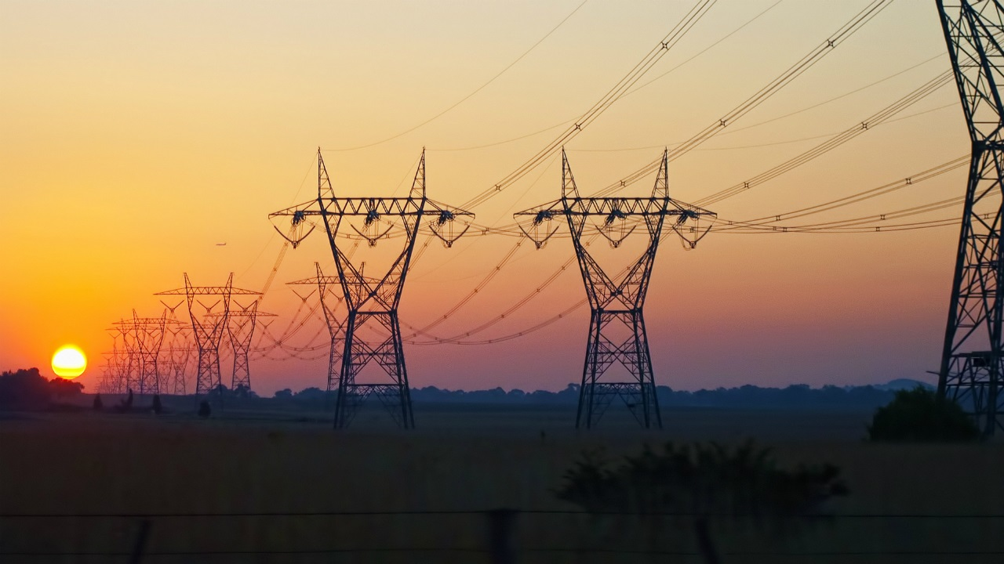
Power Line Carrier
Pros and Cons
  Copper Wires
  Amount of data – now and in the future

Slide 10

LTL Back Haul
Infrastructure will win
  IoT vs. number of meters
    New IoT devices are being installed at a rate of 127 per second or 11 million per day
  165 million connected electric meter customers in the U.S. and Canada
    After 12 years we are 60% complete or roughly 100 million done
But never discount the fact that Electric Utilities will always own the Copper Wires. LTL and PLC will displace RF in the mid term and eliminate RF in the long term – strictly because of infrastructure and not on the merits of technology.

Slide 11

Questions and Discussion
Tom Lawton
tom.lawton@tescometering.com
TESCO – The Eastern Specialty Company
Bristol, PA
215-228-0500
This presentation can also be found under Meter Conferences and Schools on the TESCO website: tescometering.com
ISO 9001:2015 Certified Quality Company
ISO 17025:2017 Accredited Laboratory

