Slide 1

Intro to Self Contained Metering,Transformer Rated Metering, and Testing
PREA
March 2025
Rob Reese, TESCO

Slide 2
Topics
What is a meter?
Electro-mechanical versus Solid State
Forms and Services
Self Contained Metering
Transformer Rated Metering

Slide 3
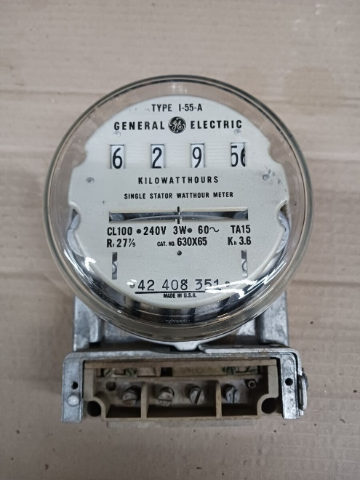
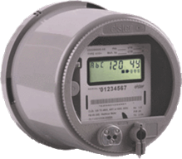
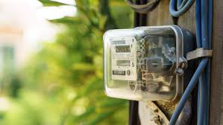
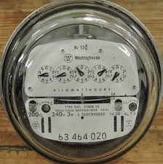
Meters 101 – What is a meter?
Energy Revenue Billing Meter
Measures Watt-hours (Wh)
Used to quantify the amount of energy that was provided to the customer for billing purposes
NIST Traceability – Verification of Accuracy

Slide 4
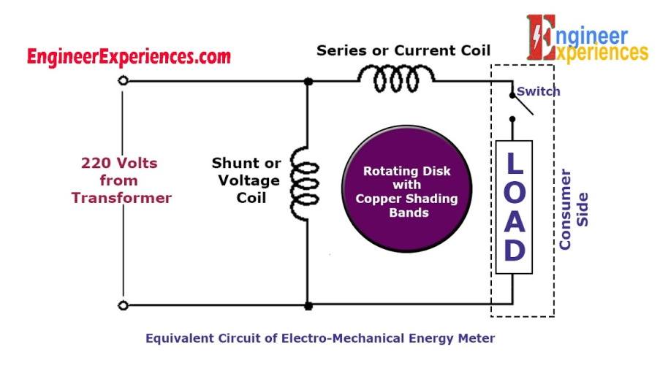
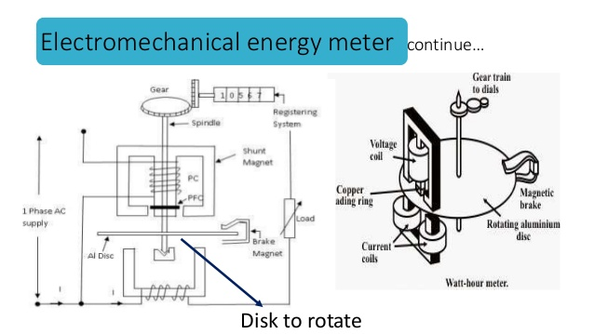
Meters 101 – Electro-mechanical
Overview of Functionality
The electromechanical induction meter operates through electromagnetic induction
A non-magnetic, but electrically conductive, metal disc which is made to rotate at a speed proportional to the power passing through the meter
The disc is acted upon by two sets of induction coils, which form, in effect, a two phase linear induction motor.
One coil is connected in such a way that it produces a magnetic flux in proportion to the voltage
The other coil produces a magnetic flux in proportion to the current.
The field of the voltage coil is delayed by 90 degrees, due to the coil's inductive nature, and calibrated using a lag coil
This produces eddy currents in the disc and the effect is such that a force is exerted on the disc in proportion to the product of the instantaneous current and instantaneous voltage
A permanent magnet acts as an eddy current brake, exerting an opposing force proportional to the speed of rotation of the disc
The equilibrium between these two opposing forces results in the disc rotating at a speed proportional to the power or rate of energy usage
The disc drives a register mechanism which counts revolutions, much like the odometer in a car, in order to render a measurement of the total energy used.
The amount of energy represented by one revolution of the disc is denoted by the symbol Kh which is given in units of watt-hours per revolution.
A Kh of 7.2 is typical. In this example, each full rotation of the disk is equivalent to 7.2Wh of energy.

Slide 5
Meters 101 – Solid-state
Overview of Functionality
Potential and Current is scaled down and conditioned with transformers and filters
ADC’s (analog to digital converters) digitize the signals
A micro-processor or DSP executes the calculations
Resulting data is displayed, sent externally via the communication circuits, and used for the calibrated pulse output
MICRO
PROC
CURRENT TRANSFORMER
DISPLAY
FILTER
ADC
COMM
POTENTIAL TRANSFORMER
FILTER
ADC
PULSE

Slide 6
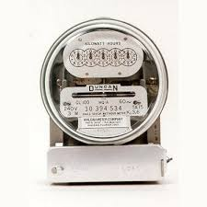
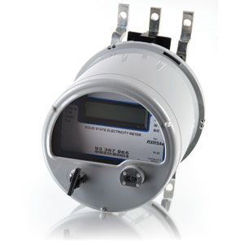

Meters 101 – A-Base, K-Base, S-Base
K-base
A-base
S-base

Slide 7
Self-Contained vs. Transformer-Rated
PAGES 19-22, 31-50
14S
39S
17S
1S
2S
3S
12S
35S
4S
25S
10S
76S
46S
45S
66S
11S
32S
5S
26S
6S
16S
9S
15S
56S
24S
13S

Slide 8
Self-Contained vs. Transformer-Rated
SELF-CONTAINED
TRANSFORMER RATED
1S
39S
7S
14S
36S
3S
2S
12S
29S
76S
5S
35S
25S
4S
46S
8S
16S
11S
26S
17S
66S
6S
45S
9S
13S
10S
15S
32S
56S
24S

Slide 9
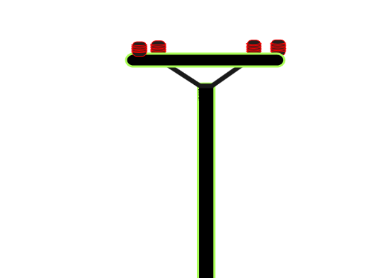
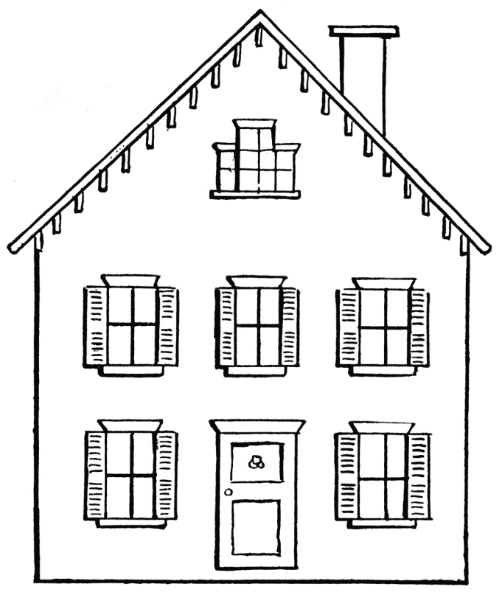
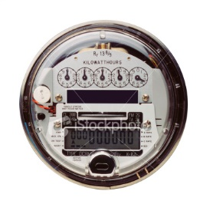
Self-Contained vs. Transformer-Rated
Primarily Residential
(1S, 2S, 12S)
Relatively Low Current
Example: 100A

Slide 10
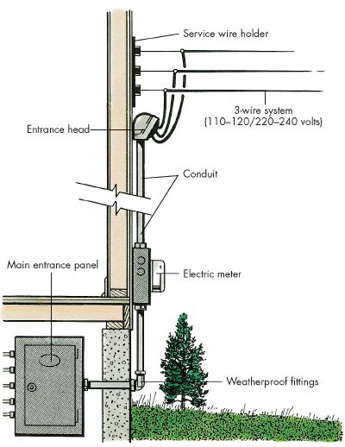
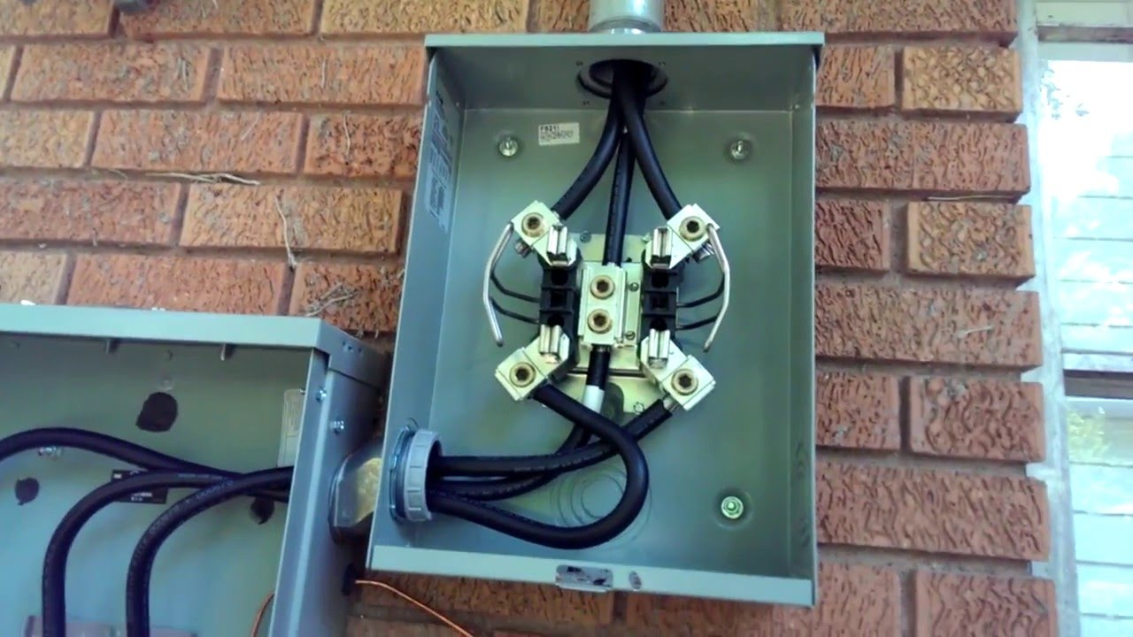
Self-Contained vs. Transformer-Rated
Primarily Residential
(1S, 2S, 12S)

Slide 11
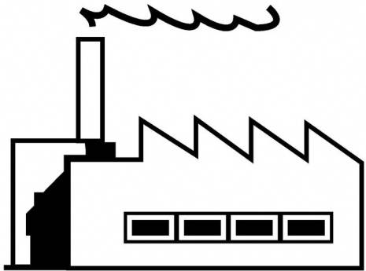
Self-Contained vs. Transformer-Rated
Primarily Commercial/Industrial
(9S)
Relatively High Current
Example: 2000A

Slide 12
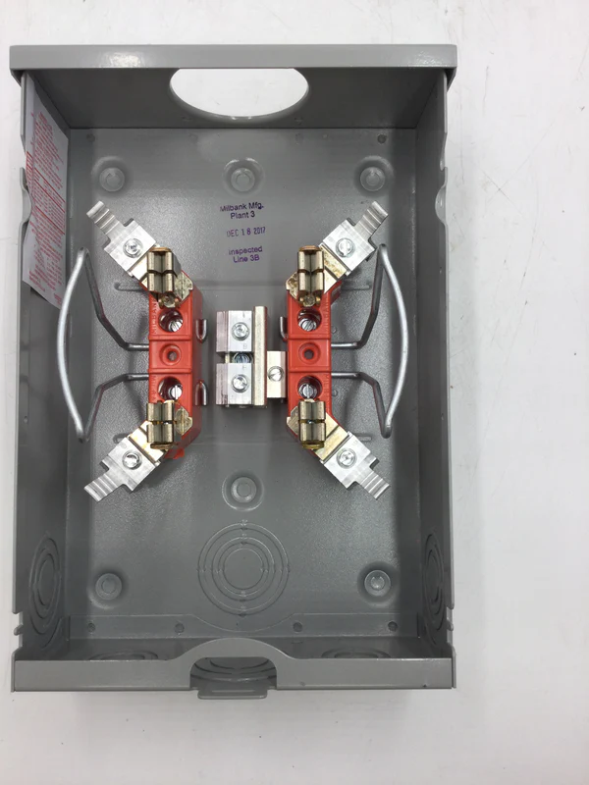
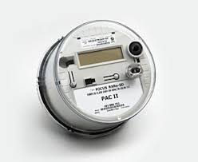
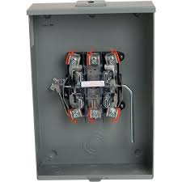
Self-Contained Metering
Primarily Residential
(2S)

Slide 13
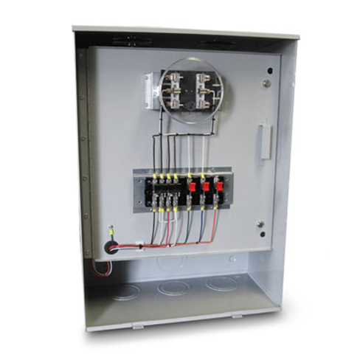
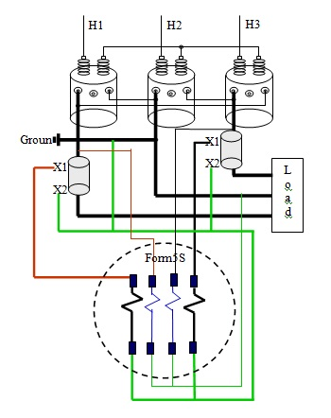
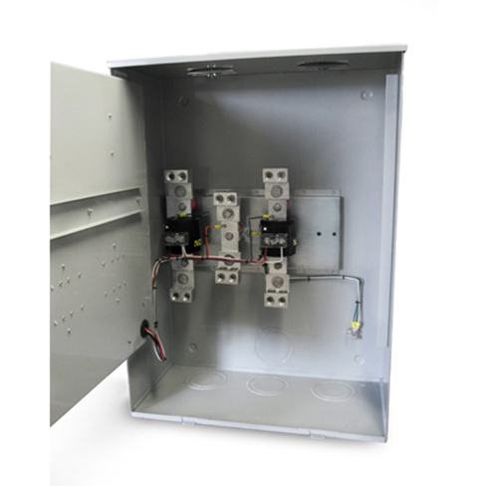
Transformer-Rated Metering
Primarily Commercial/Industrial
(9S)

Slide 14
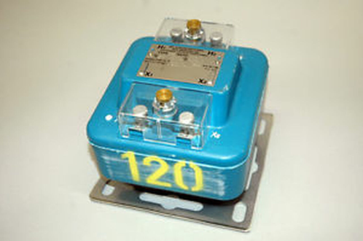
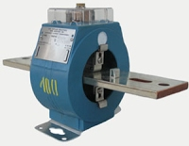
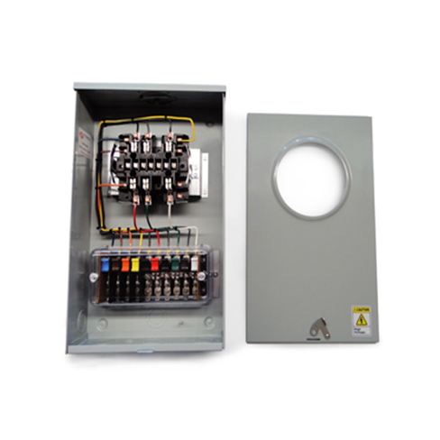
Transformer-Rated Metering
Typical Components of an Installation

Slide 15
Transformer-Rated Metering
Meter

Slide 16
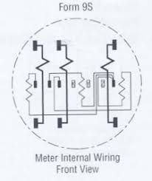
Transformer-Rated Metering
Meter

Slide 17
Transformer-Rated Metering
Enclosure, Socket, Test Switch

Slide 18
Transformer-Rated Metering
Enclosure, Socket, Test Switch
Enclosure
Painted Steel or Aluminum
One or Two Piece Lid
Many, Many Configurations

Slide 19
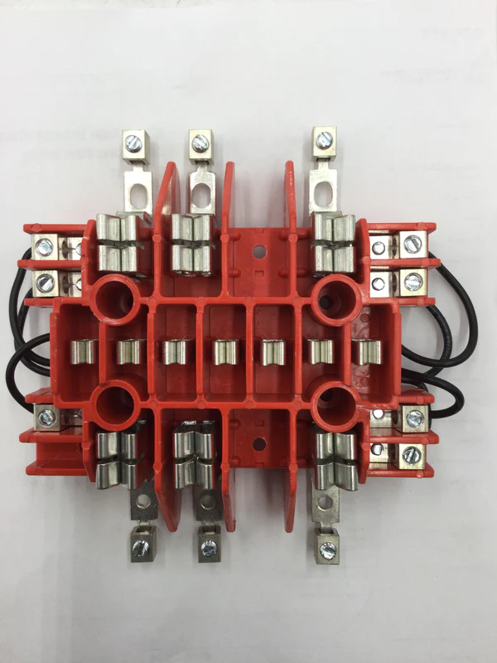
Transformer-Rated Metering
Enclosure, Socket, Test Switch
Socket
Configured for Specific Form

Slide 20
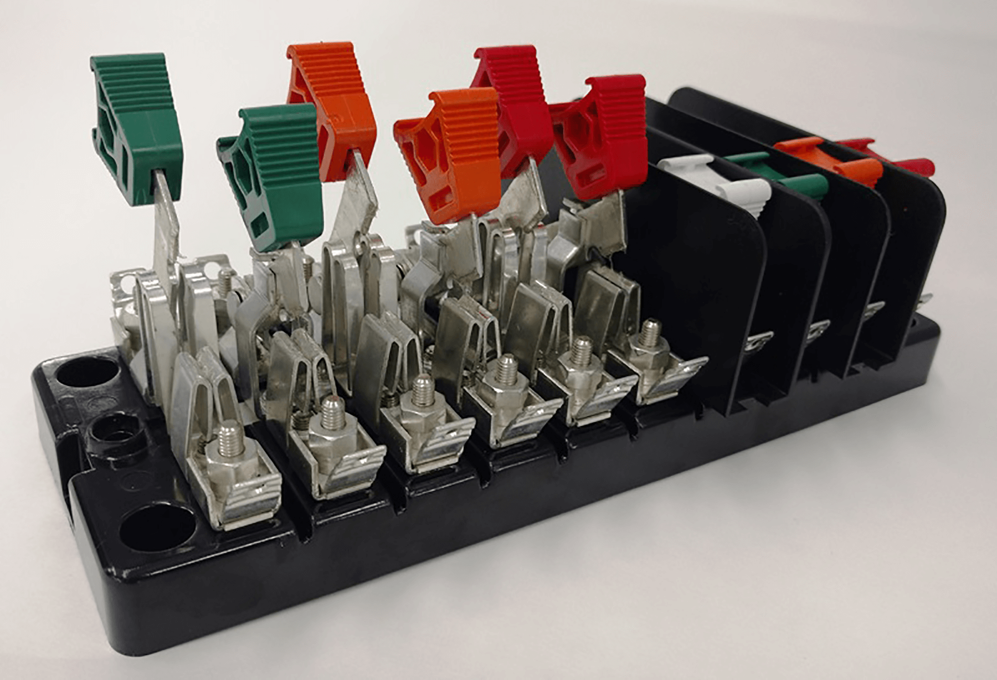
Transformer-Rated Metering
Enclosure, Socket, Test Switch
Test Switch
Upmost Safety
Shuts the CT
Isolates the Meter from the Service During Testing

Slide 21
Transformer-Rated Metering
PT/VT –Voltage Transformer

Slide 22
Transformer-Rated Metering
PT/VT –Voltage Transformer
PT/VT
Scales Down the Voltage
4:1
480V:120V
PAGES 23-26

Slide 23
Transformer-Rated Metering
CT – Current Transformer
PAGES 23-26

Slide 24
Transformer-Rated Metering
CT – Current Transformer
CT
Scales Down the Current
400:5
800A:10A
PAGES 23-26

Slide 25
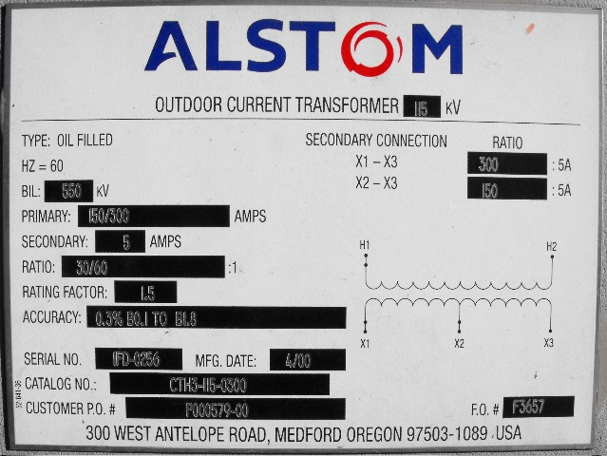
Faceplate Specifications

Slide 26
Faceplate Specifications
Ratio

Slide 27
Faceplate Specifications
Thermal factor

Slide 28
CT’s – Functions and Terminology
Thermal Rating factor
A value representing the amount by which the primary current can be increased without exceeding the allowable temperature rise.
For instance, a RF of 4.0 at 30° ambient on a 400:5 ratio CT would allow for a primary current up to 1600A.

Slide 29
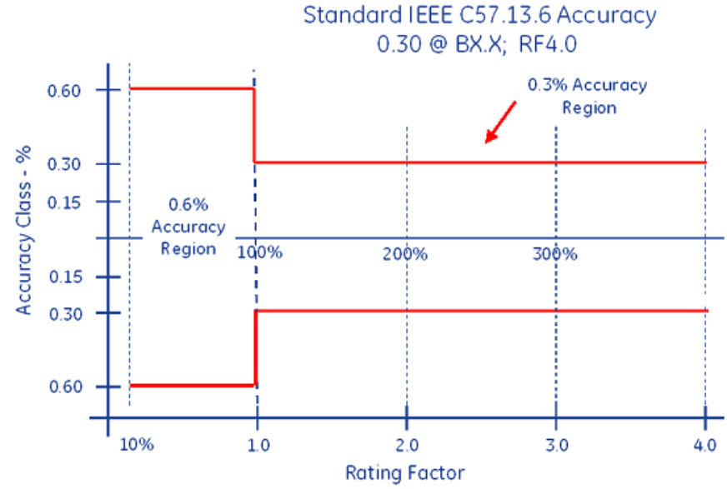
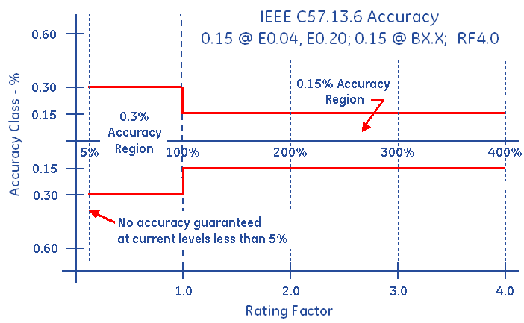
Faceplate Specifications
Accuracy Classifications
All CT’s fall within an accuracy class.
IEEE Standards have defined accuracy classes.

Slide 30
Faceplate Specifications
BurdenRating

Slide 31
Burden Rating
.3@B0.1,B0.2
The burden range, present in the secondary circuit, that the manufacturer will guarantee their CT’s will still accurately function, in regards to the ratio specification.

Slide 32

Questions and Discussion
Rob Reese
Midwest Regional Sales Manager
rob.reese@tescometering.com
TESCO – The Eastern Specialty Company
Bristol, PA
215.310.8809
This presentation can also be found under Meter Conferences and Schools on the TESCO website: tescometering.com
ISO 9001:2015 Certified Quality Company
ISO 17025:2017 Accredited Laboratory

