Slide 1

Current Events in Metering
Electric Vehicles and Effect on Distribution Networks
Renewables, DER’s, and Energy Storage
AMI 2.0
PREA
March 4, 2025 3:00 PM-4:30 PM
Tom Lawton and Perry Lawton, TESCO

Slide 2
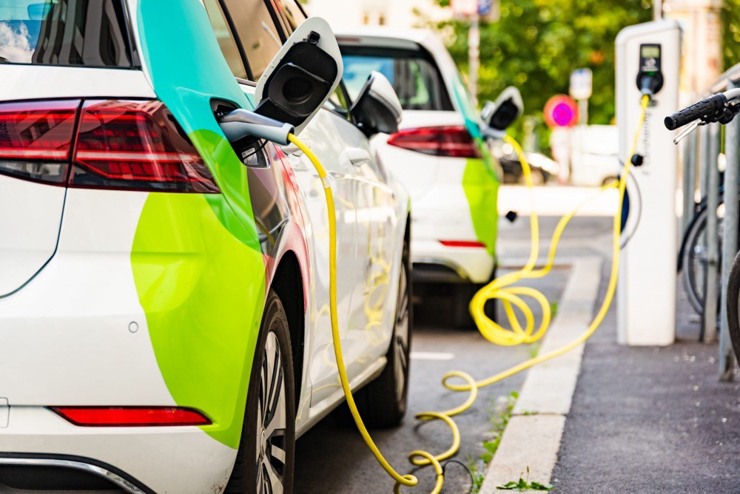

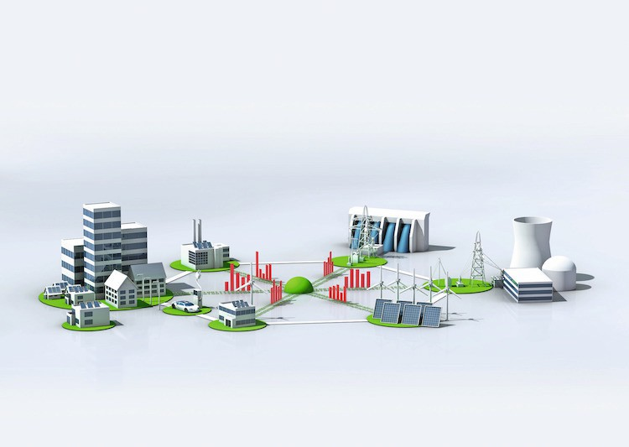
PREA Current Events
Topics we will be covering:
Electric vehicles and their effect on Distribution Networks
Renewables, DER’s and Energy Storage
AMI 2.0 (and an AMI Technology Primer)

Slide 3


Electric vehicles and their impact on
Distribution Networks
Perry Lawton
tescometering.com

Slide 4
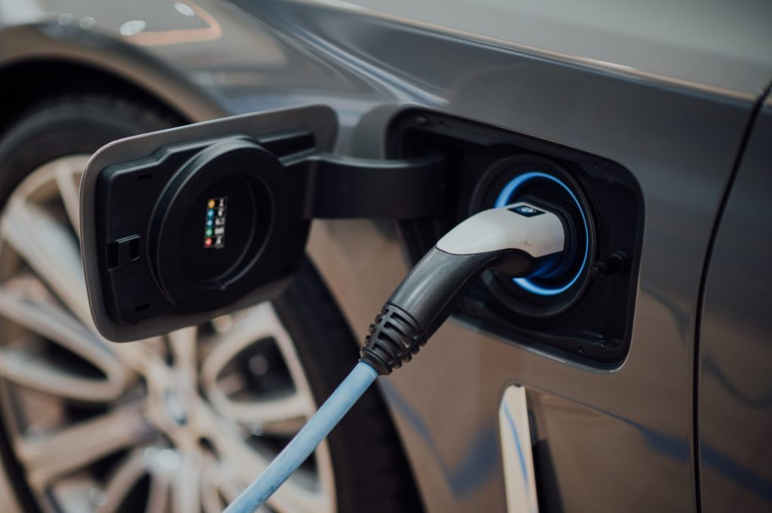

EV Topic List
Basic impact on electric grid
Residential application
  How would does impact me and my personal energy consumption?
Commercial Application
  How does it impact my community and my utility?

Slide 5
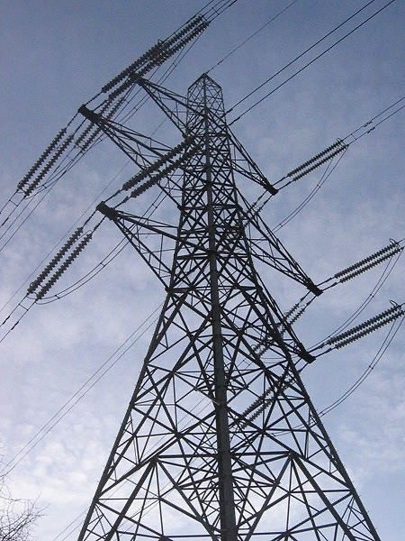
Basic impact on electric grid
Increasing Demand
Equipment Aging/Upgrades Renewable Alignment Providing Grid Services

Slide 6
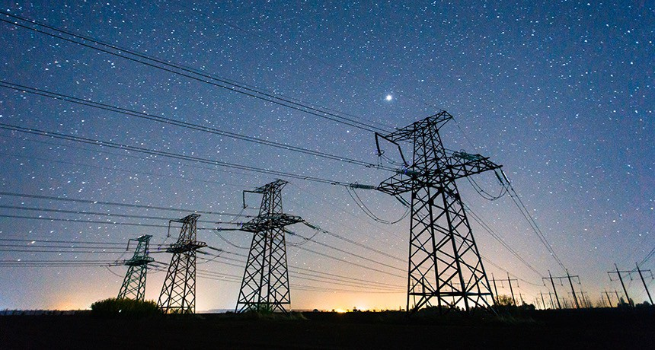
US TOTAL ENERGY CONSUMPTION
January 2023:
Generated 352,140.3 GWh
Average Residential retail price: 13.75* cents/kwh
Based on these figures, how much do you think home charging is worth to utilities per year?

Slide 7
US ELECTRIC ENERGY CONSUMPTION
Americans drove 3.236 trillion miles in 2023. If this was all done in electric vehicles getting 3 mi/kWh, then we would need 1.1 GWh of energy just to charge cars.
Average household uses 10.7 MWh/yr (2021).
Charging our cars could use an additional 8.8 MWh/yr.
Charging at home is a potential market worth $145 billion per year in added revenue to electric utilities

Slide 8
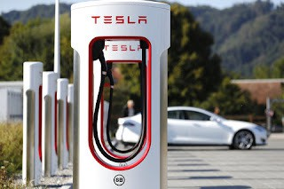
Commercial Application
EXAMPLE: TESLA Supercharger
Example of station requirements/capability:
Example of total usage/site:
In 2022, TESLA reported 1.5M (214,000/day) charging sessions, accounting for 9TWh of charging from superchargers alone.
Per Cabinet: 192A max on each of 3 phases at 277Y480V, ~160kW (AC)
Typical site has: 6-10 stalls
Fed by a dedicated transformer that is rated at 500kVA to 750kVA
On average, each site is seeing
192,389 KWh/year
or 527 KWh/day

Slide 9
US ELECTRIC ENERGY CONSUMPTION
TESLA saw an average of 192,389 KWh per Supercharger site
If you had ONE Supercharger in your service territory, it would account for $26,453.48/year (13.75₵) in utility revenue.

Slide 10


















Renewables, DER’s and Energy Storage and what they mean to a Smart grid
Tom Lawton
tescometering.com

Slide 11




Sources of Generation in the US
In 2023, about 4.18 trillion kilowatthours (kWh) of electricity were generated at utility-scale electricity generation facilities in the United States.
60.0% of this electricity generation was from fossil fuels—coal, natural gas, petroleum, and other gases.
Natural Gas is 43.1% Coal is 16.2%
Everything else 0.7%
18.6% was from nuclear energy
21.4% was from renewable energy sources.
Wind 10.2%; Hydro 5.7%; Solar 3.9%;
everything else 1.6%.

Slide 12

ENERGY STORAGE - THE KEY TO RENEWABLES
Without Energy Storage, renewables do not help us
Energy storage – capture of energy for use at a later time
Types of energy storage
Chemical reaction - Batteries
Mechanical reaction – Hydro/Reservoir
Electricity – Capacitors
There are many ways to store energy – Coal, Oil, Wood are all ways to store energy
The key is to store in ways that are easy to use at a future date and are as efficient as possible

Slide 13

DER – Distributed Energy Resource
A distributed energy resource (DER) is a small-scale unit of power generation that operates locally and is connected to a larger power grid at the distribution level.
  solar panels
  small natural gas-fueled generators
  electric vehicles
The key here is that the energy produced by a DER is typically consumed close to the source.

Slide 14
What does this all mean to my Utility?
DER’s may have the largest effect on a small utility in the immediate future.
Not under your control
Not a part of your grid planning
But the Utility must include this into their grid management without knowing when or if this DER may come on or off-line
Energy storage and Renewables
Smaller Utilities can begin to generate more power locally
If the same utility implements energy storage this can become even more lucrative
Inter-Tie Metering and meter testing starts to become more important
Utilities have the option to provide equipment for local generation on homes or community generation (e.g. solar on residential homes; solar farm on a community’s open space or even a wind turbine; batteries in homes for charging electric vehicles and accepting power from EV’s)

Slide 15
New areas to consider – the future is here
Large Industrial DER’s
Large Commercial DER’s Large Community Der’s DC Metering requests
Batteries on Vehicle Charging Facilities

Slide 16







AMI 2.0 and an AMI Technology Overview
Tom Lawton

Slide 17




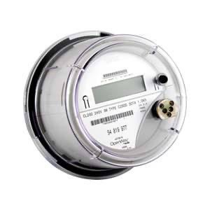
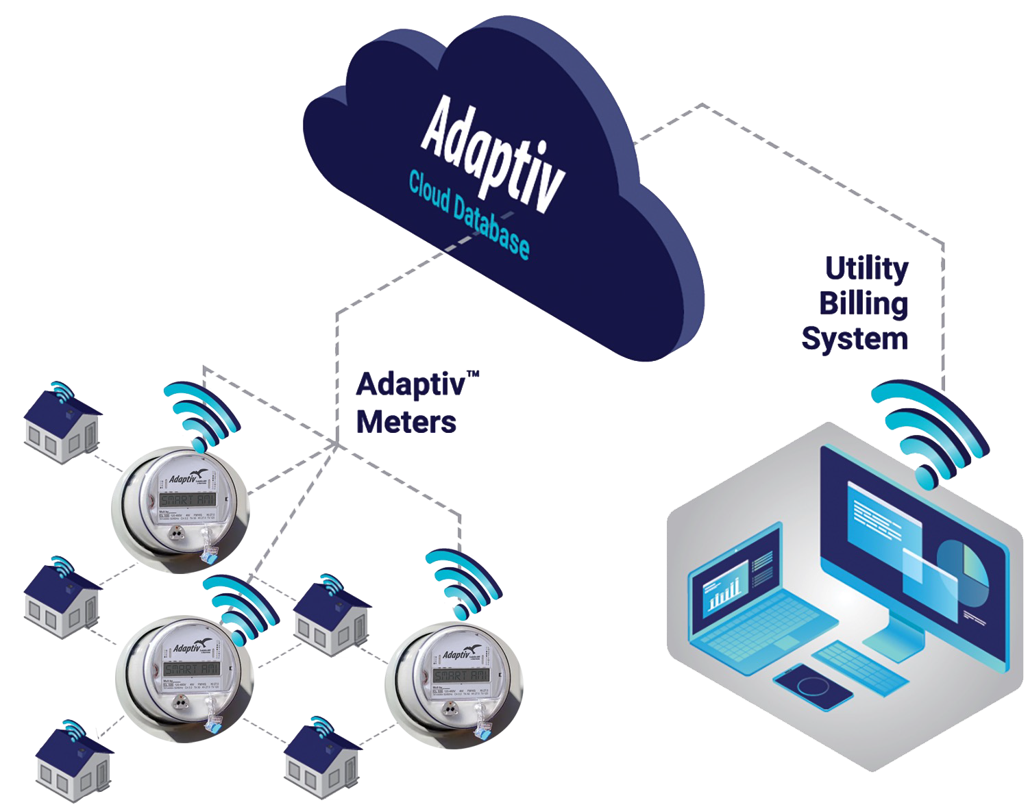
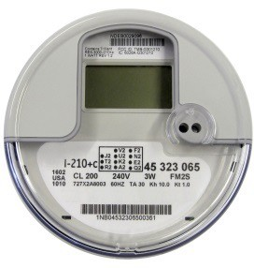
Topics We Will Cover
Benefits of AMI and where we are starting from
Overview of technologies
Challenges
AMI 2.0

Slide 18
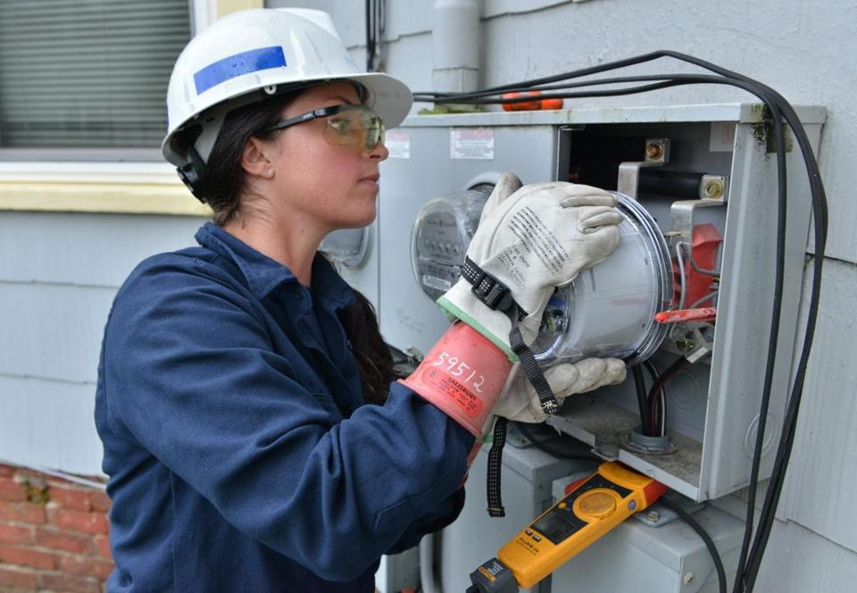
AMI Benefits
Information / Data
  Usage
  Voltage/Current
  Predictive Analytics
Reduced Field Visits
Disconnect/Reconnect
Outages
Net Metering
Future Developments

Slide 19
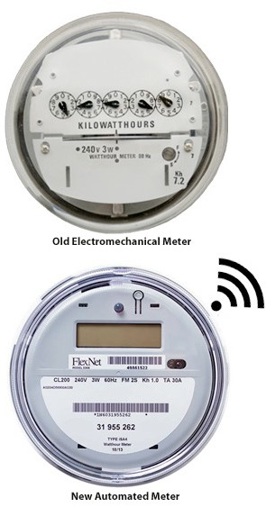
Pre-AMI Meter Operations
Common Features and Common Sources of Concern
Fewer meter techs in the field and in the shop than there were 25 years ago
Fewer Field checks and site verifications due to lack of personnel, lack of experience and lack of expertise
More features under glass in the meters even before AMI deployed
Significantly more features under glass in every AMR and AMI system being considered or being deployed
Metering losses starting to be identified “by accident” as opposed to being “by design”.

Slide 20

The Pendulum Starts to Move
Meter Operations. Prior to deployment many larger utilities take an attitude of “this is only metering – how hard can that be?”. Over the course of deployment Meter Operations gains a stature and a respect from the rest of the organization
that was not previously accorded them – even if this is only begrudging respect.
New tests for AMI meters (e.g. communication, disconnect) are identified
The complexity and issues around high revenue metering are at least acknowledged by the rest of the organization
Tests which have not been performed in years are suddenly back in vogue

Slide 21
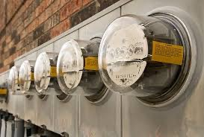
The New Realities
Electro-Mechanical Meters typically lasted 30 years and more. Electronic AMI meters are typically envisioned to have a life span of fifteen years and given the
pace of technology advances in metering are not expected to last much longer than this.
This means entire systems are envisioned to be exchanged every fifteen years or so. In the interim the meter population and communication network inherent in the infrastructure for each utility must be maintained.
Meter communication and meter data management are becoming as important to metering operations as meter accuracy.
Firmware upgrades, firmware stability and cyber security are becoming increasingly important to metering departments

Slide 22

What Technologies Are We Using?
Private Networks
Cellular/Public Networks
RF Mesh

Slide 23

Private Networks
Dedicated Infrastructure
  Allows a great deal of data and frequency of data collection
  Requires the utility to manage a new technology

Slide 24
LTE Back Haul
Infrastructure will win
  IoT vs. number of meters
    New IoT devices are being installed at a rate of 127 per second or 11 million per day
  165 million connected electric meter customers in the U.S. and Canada

Slide 25
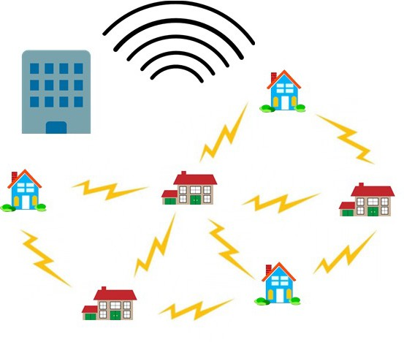
RF MESH
True RF Mesh
Meters and collectors
Software and firmware
Head End Systems
The difference between frequencies
  Proprietary and non-proprietary frequencies
  Penetration vs. distance trade-off

Slide 26
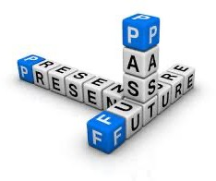
Challenges
Expected:
The AMI deployment team will declare victory at some point and move on. Clean-up will be left for the meter service department, and these will be the hardest meters to access and to get reliably on the network
Firmware upgrades must be checked and tested before mass deployment
What was previously a straightforward device has become complex with thousands of lines of code with more points of failure
Meter Acceptance testing including far more than accuracy testing for every deployment
Unexpected:
  Meter Certification Testing never slowed down over the course of any of the deployments

Slide 27

Why do AMI Meters Fail?
Looking back at various deployments – what are the chief causes to reject meter shipments?
Meter functional test failures including but not limited to;
Incorrect firmware
Bad settings
Alarms and errors that do not clear
Communication test failures
Bad tables
Failed disconnect switches

Slide 28
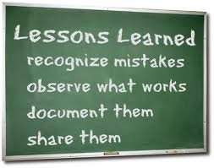
Lessons for the Future?
Are these infant mortality issues or are these issues to be concerned about going forward?
What was NEVER the reason for rejecting a shipment – meter accuracy.
Which are the most difficult meters for every deployment – the transformer rated meters. Often these forms are not available until very late in the deployment and sometimes not until the deployment has officially ended.

Slide 29



Commercial and Industrial Metering Challenges
Most AMI deployments utilize third party contractors to handle the residential and some self contained non-2S services. The balance is typically handled by the meter service department of the utility.
As these services are evaluated for new metering technology, issues are being found at some accounts. These issues represent revenue losses due to inappropriate metering schemes or partially failed metering components (e.g. transformers, electronic components).

Slide 30


How are these new realities starting to affect metering operations?
Metering is becoming more about IT. Some metering departments have been reorganized after AMI as part of the IT department.
Metering emphasis will shift strongly toward C&I customers and further and further away from residential meters
Metering resources are being refocused on C&I accounts.
There are fewer levels of meter tech. Every meter tech needs to be at the higher level as there is not enough lower level work to warrant full time employees
Utility commissions are being less forgiving of allowing rate relief for project over runs and metering inaccuracies

Slide 31
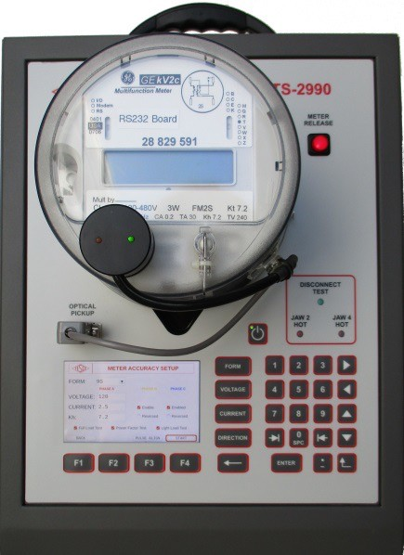
New or expanded roles for metering departments of all sizes
Responsible for either reviewing ANSI Tests or even performing some of these ANSI Tests
Perform Meter Functionality testing on new and returned AMI meters
Register and communication module energy measurement comparison
Disconnect/Reconnect Functionality
Outage Performance
Meter Communications Performance
Consumer safety and combating real and perceived issues
Near continuous research into the “next” technology and the next deployment

Slide 32
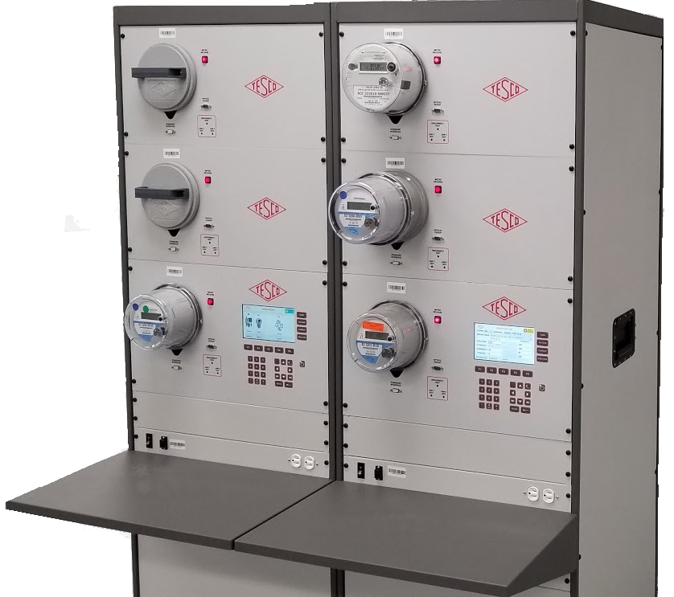
Shop Testing
Accuracy testing
Meter Communications Performance
Software and firmware verification
Setting verification
Functional testing
Disconnect/reconnect Functionality and as left setting

Slide 33
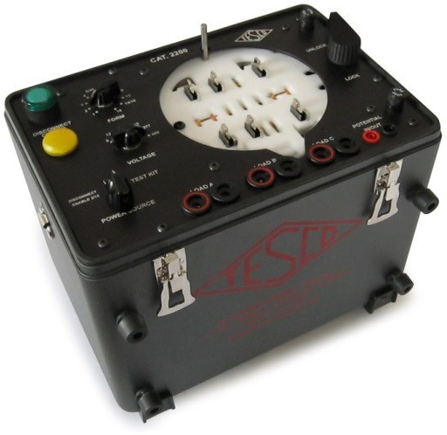
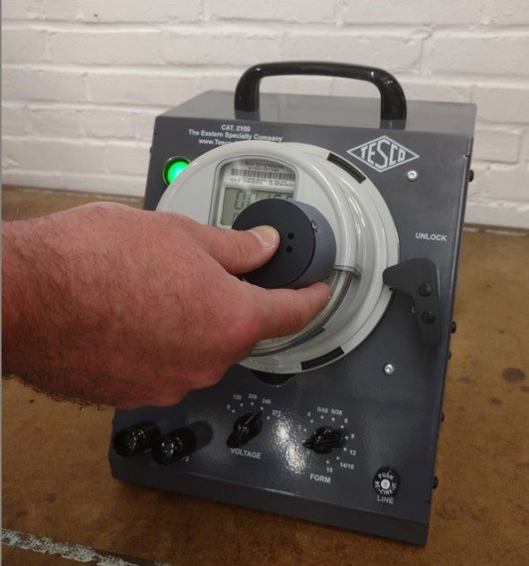
Field Testing and Inspection
Work with third party deployment vendor or perform the deployment
  Self contained
  Transformer Rated
Accuracy Testing
Meter Communications Performance
Software & Firmware Verification
Setting Verification
Functional Testing
Disconnect/Reconnect Functionality and as left setting
Tamper Verification
Site Audits appropriate to the type of meter

Slide 34
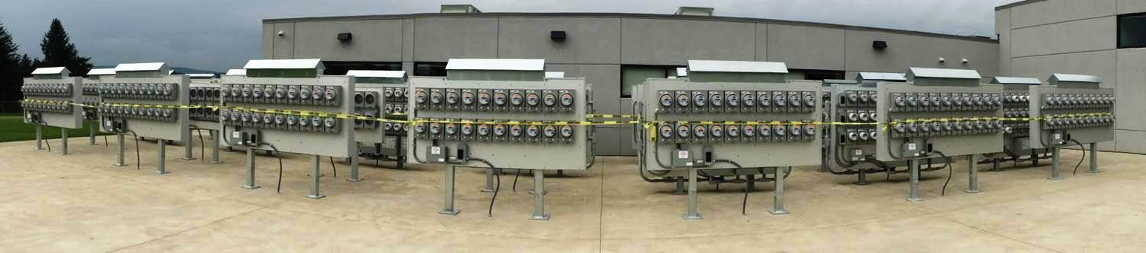
Meter Farm Testing
You will use and install a multitude of different generations of meter / firmware.
Having a small population in a controlled area that can be assessed for performance over time can be extremely helpful.
It’s better for the utility to find an address the problem before you become a ‘news story’

Slide 35
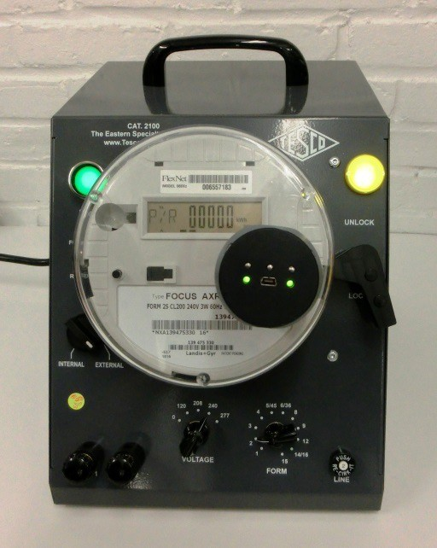
Real Life Examples of Change Management in Action
Issues in the system not the components – what is the definition of a meter and when did the meter change?
  Meter and communication device interface
Feature Creep – every manufacturer wants to differentiate themselves – sometimes this works in unanticipated ways
  Recovery from power outages
  Short and long demand periods
But we only changed….lessons we should have learned from Microsoft
  Over the air upgrades
Thank Goodness for test plans – right?
  Half closed disconnect devices
  Disconnect devices of unknown state
  Meters with incorrect firmware

Slide 36
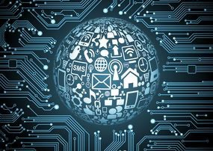
AMI 2.0
Enhanced Computing Power
Greater Communication Capability
Integration with customer devices
Independent Operation

Slide 37
AMI 2.0
The disaggregation software gives consumers a home energy management solution that can be integrated with smart home devices.
Utilities will be able to provide customers a way to better control power usage.
For a consumer with distributed energy resources (DER)—such as solar panels, home batteries, or electric vehicles that can discharge to the grid or use smart inverters—disaggregation software on the meter lets the customer manage the demands on DER equipment according to their preferences.

Slide 38
AMI 2.0
Real Time dynamic energy data. Allow utilities to engage a variety of micro- generation sources to balance load and shave peak demand.
AMI 2.0 solves the problem of identifying the location of a high-voltage residential electric vehicle (EV) charger and determining whether or not the circuit it’s on can handle it.

Slide 39



AMI 2.0
This will bring a range of challenges for meter departments requiring them to understand a broad array of technologies.
Meter department staffs are envisioned to have less work with AMI but often it is just the opposite.
It will be even more important to ensure operations at C&I customers as they will become energy generators as well as consumers.

Slide 40
Summary
Benefits of AMI
Far more information than just accurate energy usage
Fewer but more complicated field visits
Allows Meter Services to focus field resources on Transformer Rated Services
Overview of the Technologies
Meters are more complex with increased points of failure
Communications choices become very important as you will have to manage and work with them for a long time.
How AMI is changing Meter Service Departments
Challenges Meter Services to provide far more value to the organization by providing better analytics of the data being received from the new meters
Meter Services must add telecommunications tools and expertise
The meter man of the future knows not only metering but they are communication experts and are involved with handling, reporting and analyzing far more customer and system data
There are fewer “routine jobs” in the field and many of the standard tasks are no longer required. This will lead to fewer classifications of meter techs going forward and the need for a more highly trained tech.

Slide 41
Summary (cont.)
Metering and the Future of AMI
Metering will be in a near constant cycle of looking for the next technology, evaluating those technologies, planning for deploying these technologies, and cleaning up the aftermath of the deployment of
these technologies.
Metering will begin to run non-metering operational groups
Each Utility must take a far more active role as part of checking, certifying, and rechecking the functionality of their meters.

Slide 42

Questions and Discussion
Tom Lawton
President
tom.lawton@tescometering.com
Perry Lawton
Northeastern Regional Sales Manager
perry.lawton@tescometering.com
TESCO – The Eastern Specialty Company
Bristol, PA
215.228.0500
This presentation can also be found under Meter Conferences and Schools on the TESCO website: tescometering.com
ISO 9001:2015 Certified Quality Company
ISO 17025:2017 Accredited Laboratory

