Slide 1

Site Analysis and Testing for Transformer Rated Service
44th Annual Mississippi Power and Meter School
Tuesday February 11, 2025 - 10:30 AM
Tom Lawton

Slide 2

Objective
understand the need and best practices for instrument transformer testing in an AMI world
Instrument Transformer Testing (in shop and in field)
Why do we test?
How do we test?
What range of tests/checks should be
done in the shop?
What range of tests/checks should be
done in the field?
Where is the biggest pay back for our limited meter service resources
(field and shop)?
2

Slide 3
Why Do We Test?
Our regulatory commissions require us to test meters. Our customers expect that we have tested their meters.
But only for accuracy. State regulatory commissions want electric utilities to ensure that no customer is being billed unfairly and that no subset of customers is being unfairly subsidized by the rest of the rate payers. Some states mandate only accuracy tests and others require demand and time of use accuracy tests.
Any tests beyond accuracy tests are tests that are simply good business practice.
No tests are mandated for functional or accuracy testing of the instrument transformers that are an integral part of the metering circuit nor are inspections and testing of the metering site as a whole.
3

Slide 4
Why Do We Test?
So Why would we test Instrument Transformers and Transformer Rated Metering Sites?
4

Slide 5

Why?
Because the Transformer-Rated Services are where the money is!

Slide 6
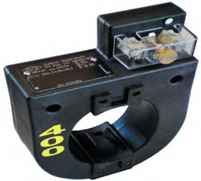
The Importance of CT Testing in the Field
One transformer in 3 wired backwards will give the customer a bill of 1/3rd the actual bill.
One broken wire to a single transformer will give the customer a bill of 2/3rd the actual bill
One dual ratio transformer inappropriately marked in the billing system as 400:5 instead of 800:5 provides a bill that is ½ of the actual bill. And the inverse will give a bill double of what should have been sent. Both are lose-lose situations for the utility.

Slide 7
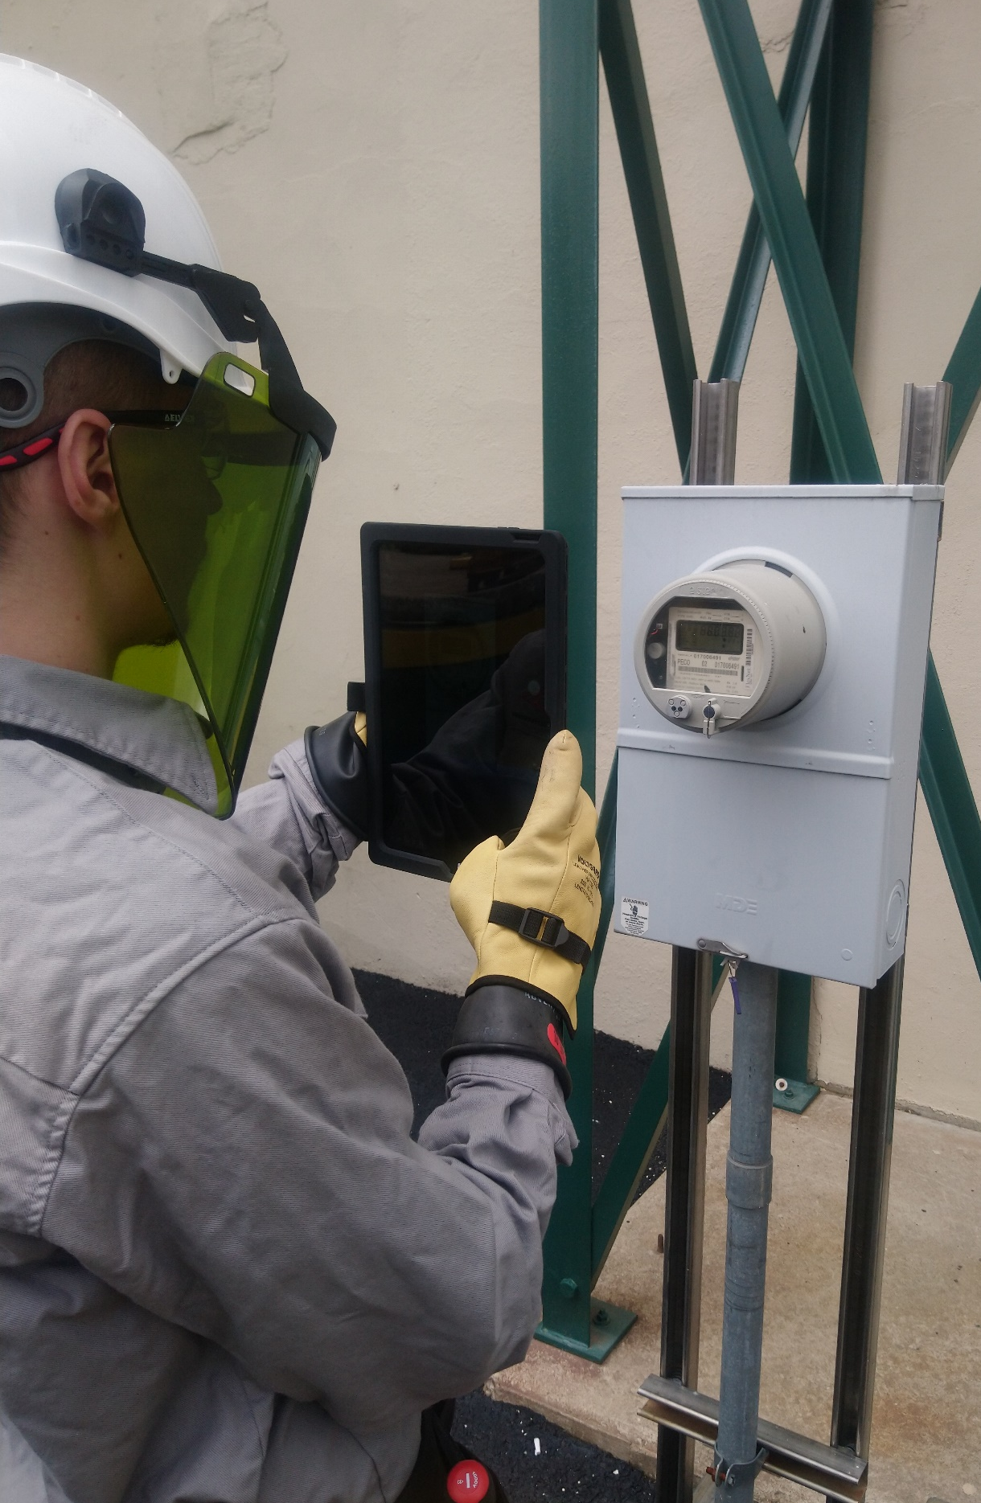
The Importance of CT Testing in the Field (cont)
Cross Phasing (wiring errors)
Loose or Corroded Connections
CT Mounted Backwards
CT’s with Shorted Turns
Wrong Selection of Dual Ratio CT
Detect Magnetized CT’s
Burden Failure in Secondary Circuit
Open or Shorted Secondary
Mislabeled CT’s
Ensures all Shorting Blocks
have been Removed
7

Slide 8
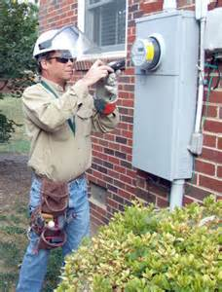
Testing at Transformer Rated Sites
Meter Accuracy
Full Load
Light Load
Power Factor
CT Health
Burden Testing
Ratio Testing
Admittance Testing
Site Verification
8

Slide 9

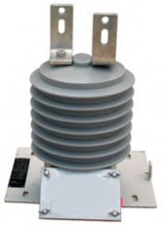
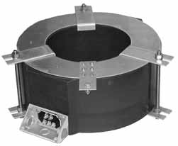
Properly Sizing Conventional and Extended Range CT’s
  CT Ratings/Parameters
  Standard Accuracy Classes
  Extended-Range Ratings/Types
  Applying ERCTs
  Advantages of ERCT
  The historic revenue metering class is 0.3, with 0.15 being used with increasing frequency.
  0.15 “high accuracy” classes were introduced under IEEE C57.13.6.
9

Slide 10
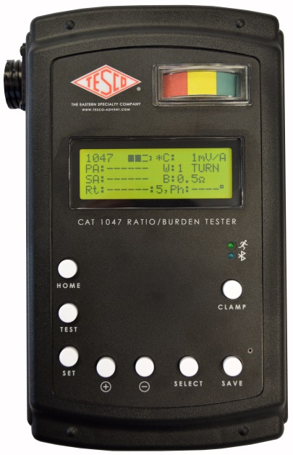
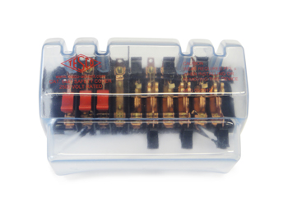
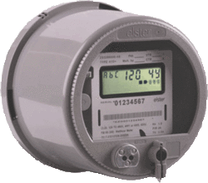
Fundamentals of Polyphase Field Meter
Testing and Site Verification
Functionality with Burden Present on the Secondary Loop
PHASE A
Some burden will always be present – junctions, meter coils, test switches, cables, etc.
CT’s must be able to maintain an accurate ratio with burden on the secondary.
10

Slide 11

Metering Accuracy Rating
0.3B1.8
Accuracy Class
0.15S (High Accuracy)
0.15 (High Accuracy)
0.3 (Metering Accuracy)
0.6 (Indication Accuracy)
1.2 (Indication Accuracy)
Burden Designation
B0.1
B0.2
B0.5
B0.9
B1.8
11

Slide 12
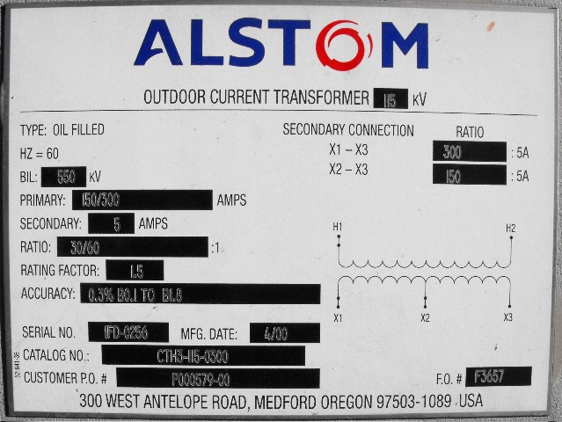
Fundamentals of Polyphase Field Meter Testing and Site Verification
Functionality with Burden Present on the Secondary Loop
Example Burden Spec:
0.3% @ B0.1, B0.2, B0.5
or
There should be less than the 0.3% change in secondary current from initial (“0” burden) reading, when up to 0.5 Ohms of burden is applied
12

Slide 13
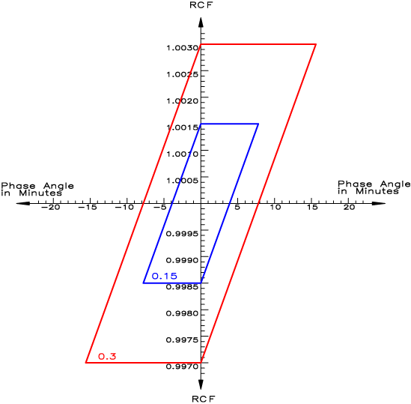
Current Transformer Accuracy Classes
13

Slide 14
CT Error
CT error is always negative…meaning less current in the secondary than there “should” be by the defined ratio.
CT error becomes increasingly negative as the primary current level decreases.
Negative Error = Lost Revenue
14

Slide 15
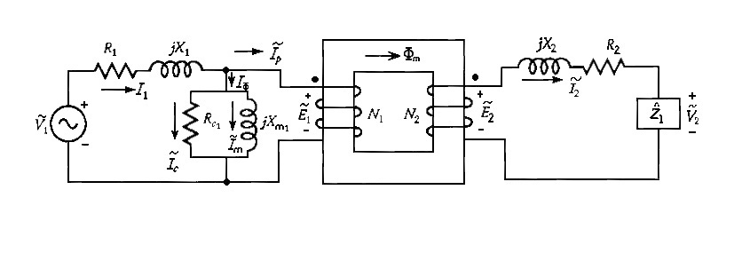
Idealized Transformer Circuit
Primary Winding Impedance
Secondary Winding Impedance
Core Loss Branch
(function of core mat’l, core size, number of sec turns)
Ideal Transformer
This is an illustration that the excitation current is the current lost from the primary current that does not get to the meter. Accuracy is largely a function of minimizing this excitation current and why transformer accuracy is typically negative.

Slide 16
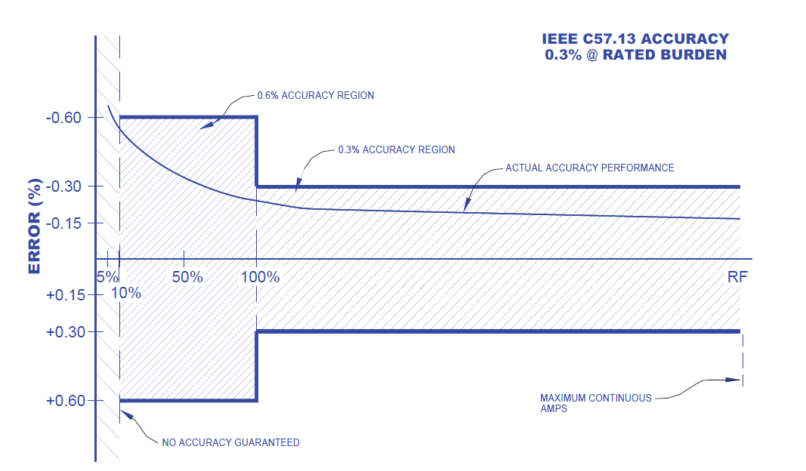
CT 0.3 Accuracy Class

Slide 17
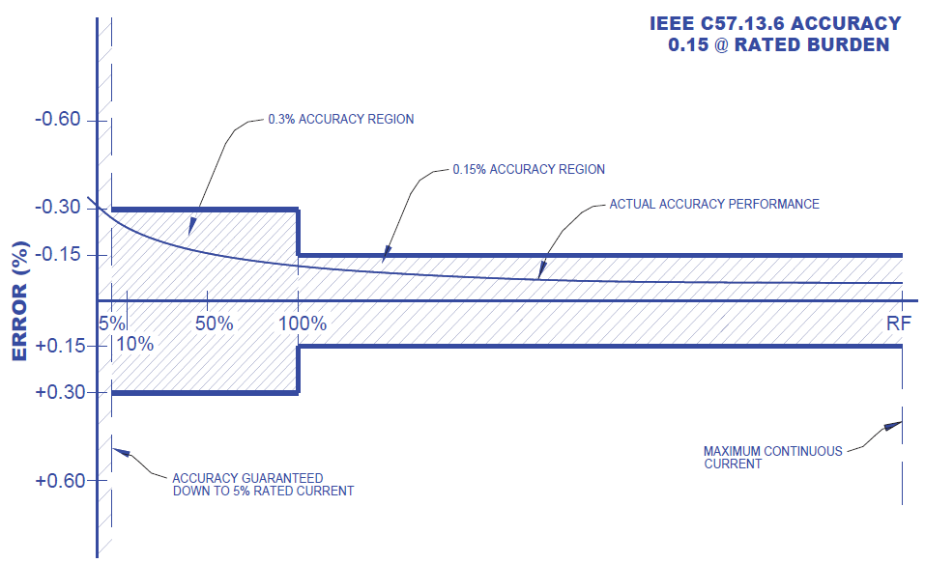
CT 0.15 Accuracy Class
17

Slide 18
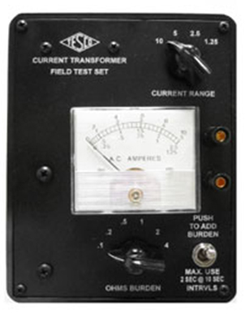
Burden Test – the quick indicator

Slide 19
Fundamentals of Polyphase Field Meter
Testing and Site Verification
Functionality with Burden Present on the Secondary Loop
Initial Reading = 5Amps
0.3% x 5A = 0.015A
5A – 0.015 = 4.985A
0.3% @ B0.1, B0.2, B0.5
Burden | Reading
0 | 5.0000
0.1 | 4.9999
0.2 | 4.9950
0.5 | 4.9900
1 | 4.9800
2 | 4.9500
4 | 4.0000
8 | 0.8000
19

Slide 20

Site Verification: Potential Site Check List
Double check the meter number, the location the test result and the meter record.
Perform a visual safety inspection of the site. This includes utility and customer equipment. Things to look for include intact down ground on pole, properly attached enclosure, unwanted voltage on enclosure, proper trimming and site tidiness (absence of discarded seals, etc.).
Visually inspect for energy diversions (intentional and not). This includes broken or missing wires, jumpers, open test switch, unconnected wires and foreign objects on meters or other metering equipment. Broken or missing wires can seriously cause the under measurement of energy. A simple broken wire on a CT or VT can cause the loss of 1/3 to 1/2 of the registration on either 3 element or 2 element metering, respectively.
20

Slide 21
Potential Site Check List (cont)
Visually check lightning arrestors and transformers for damage or leaks.
Check for proper grounding and bonding of metering equipment. Poor grounding and bonding practices may result in inaccurate measurements that go undetected for long periods of time. Implementing a single point ground policy and practice can reduce or eliminate this type of issue.
Burden test CTs and voltage check PTs.
21

Slide 22
Potential Site Check List (cont)
Verify service voltage. Stuck regulator or seasonal capacitor can impact service voltage.
Verify condition of metering control wire. This includes looking for cracks in insulation, broken wires, loose connections, etc.
Compare the test switch wiring with the wiring at the CTs and VTs. Verify CTs and VTs not cross wired. Be sure CTs are grounded in one location (test switch) only.
Check for bad test switch by examining voltage at the top and bottom of the switch. Also verify amps using amp probe on both sides of the test switch. Verify neutral connection to cabinet (voltage).
22

Slide 23
Potential Site Check List (cont)
Check rotation by closing in one phase at a time at the test switch and observing the phase meter for forward rotation. If forward rotation is not observed measurements may be significantly impacted as the phases are most likely cancelling each other out.
Test meter for accuracy. Verify demand if applicable with observed load. If meter is performing compensation (line and/or transformer losses) the compensation should be verified either through direct testing at the site or by examining recorded pulse data.
Loss compensation is generally a very small percentage of the overall measurement and would not be caught under utilities normal high/low checks. However, the small percentages when applied to large loads or generation can really add up overtime. Billing adjustments can easily be in the $million range if not caught early.
23

Slide 24

Potential Site Check List (cont)
Verify metering vectors. Traditionally this has been done using modern field test equipment or instruments such as a circuit analyzer. Most new transformer rated meters now provide vector diagrams along with volt/amp/pf and values using meter manufacturer software or meter displays. Many of these desired values are programmed into the meters Alternate/Utility display. Examining these values can provide much information about the metering integrity. It may also assist in determining if unbalanced loads are present and if CTs are sized properly. The vendor software generally has the ability to capture both diagnostic and vector information electronically. These electronic records should be kept in the meter shop for future comparisons.
If metering is providing pulses/EOI pulse to customers, SCADA systems or other meters for totalization they also should be verified vs. the known load on the meter.
Verify meter information including meter multiplier (rework it), serial number, dials/decimals, Mp, Ke, Primary Kh, Kr and Rate. Errors in this type of information can also cause a adverse impact on measured/reported values.
Verify CT shunts are all opened.
24

Slide 25
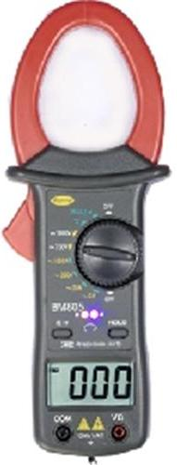

Fundamentals of Polyphase Field Meter Testing and Site Verification
Ratio of Primary Current to Secondary Current
SOURCE
LOAD
PHASE A
400A
400A
400A
5A
5A
Calculate Ratio

Slide 26
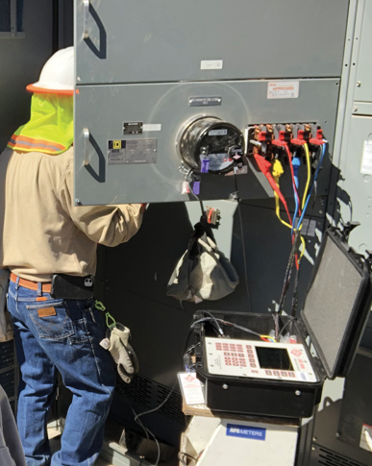
Periodic Site Inspections…
….Can Discover or Prevent:
Billing Errors
Bad Metering set-up
Detect Current Diversion
Identify Potential Safety Issues
Metering Issues (issues not
related to meter accuracy)
AMR/AMI Communications Issues
The need for Unscheduled Truck Rolls due to Undetected Field Related Issues
Discrepancies between what is believed to be at a given site versus the actual setup and equipment at the site
26

Slide 27
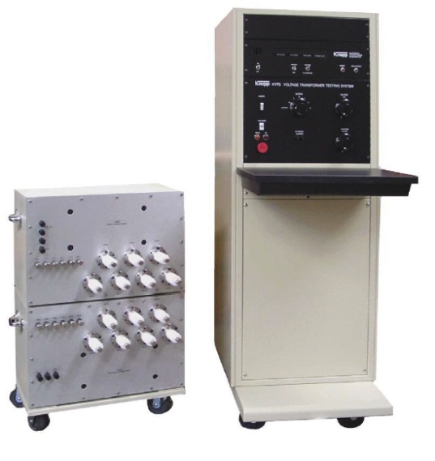
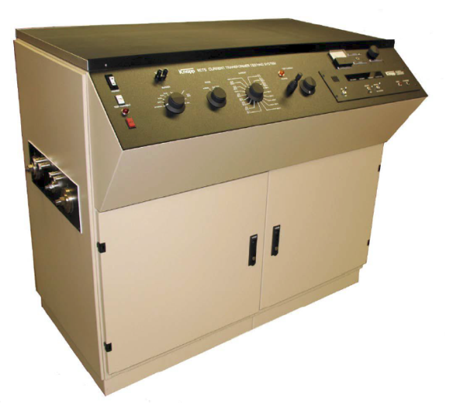
Shop Testing
Accuracy Testing
Meter Communications Performance
Software & Firmware Verification
Setting Verification
Functional Testing
Disconnect/Reconnect Functionality
and as left setting
Ratio and accuracy testing
Polarity checking
Accuracy class determination
27

Slide 28
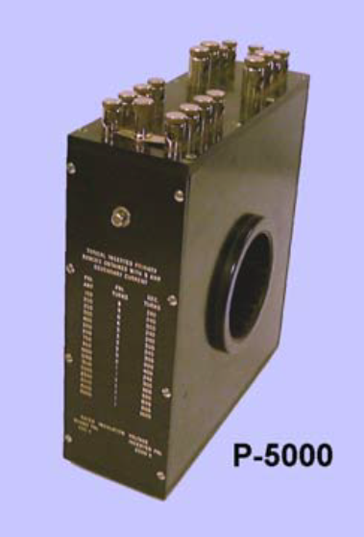
Shop Testing Programs
100% of all Transformers
  If not possible then sample testing of all and 100% of all those over a certain size for CT’s and all VT’s (generally not a large volume)
Transformer testing should include
  Ratio and accuracy testing
  Polarity checking
  Accuracy class determination
100% of all transformer rated meters
  If not possible then sample testing of all transformer rated meters and 100% of all those going into a certain size service and over
Meter testing should include:
  Software & Firmware Verification
  Setting Verification
  Functional Testing
  Disconnect/Reconnect Functionality
  and as left setting
28

Slide 29
Summary
Perform a shop test of every meter going into a transformer rated service. This includes a functional test as well as an accuracy test.
Perform a shop test of every CT going into a transformer rated service.
Perform a shop test of every VT going into a transformer rated service.
Perform a base line site verification of every transformer rated service in your service territory.
Use your AMI analytics to determine where there are misses:
  No draw on one leg
  Intermittent draw on one leg
  Performing outside the rated range for the installed transformers
  Reversed polarity
Start checking for field issues all over again.
Reduce the resources spent on self-contained metering by leveraging your AMI data as much as possible and creating new systems and procedures to replace older processes that did not have the availability of this type of data.
29

Slide 30

Questions and Discussion
Tom Lawton
President
tom.lawton@tescometering.com
TESCO Metering
Bristol, PA
215.228.0500
This presentation can also be found under Meter Conferences and Schools on the TESCO website: tescometering.com
ISO 9001:2015 Certified Quality Company
ISO 17025:2017 Accredited Laboratory

