Slide 1

Principles of Polyphase Metering
44th Annual Mississippi Power and Meter School
Tuesday February 11, 2025 - 8:30 AM
Tom Lawton
Notes:
1

Slide 2








Thank You Mississippi State & The SEC!
Jalen Hurts (Quarterback) – University of Alabama
Landon Dickerson (Guard) – University of Alabama
DeVonta Smith (Wide Receiver) – University of Alabama
A.J. Brown (Wide Receiver) – University of Mississippi (Ole Miss)
Darius Slay Jr. (Cornerback) – Mississippi State University
Jalen Carter (Defensive Tackle) – University of Georgia
Jordan Davis (Defensive Tackle) – University of Georgia
Nakobe Dean (Linebacker) – University of Georgia
Kelee Ringo (Cornerback) – University of Georgia
Lewis Cine (Safety) – University of Georgia
Haason Reddick (Linebacker) – University of Tennessee
Sydney Brown (Safety) – University of Florida
Oren Burks (Linebacker) – Vanderbilt University
Grant Calcaterra (Tight End) – University of Oklahoma
Parris Campbell (Wide Receiver) – University of Florida
Darius Slay, Jr.

Slide 3
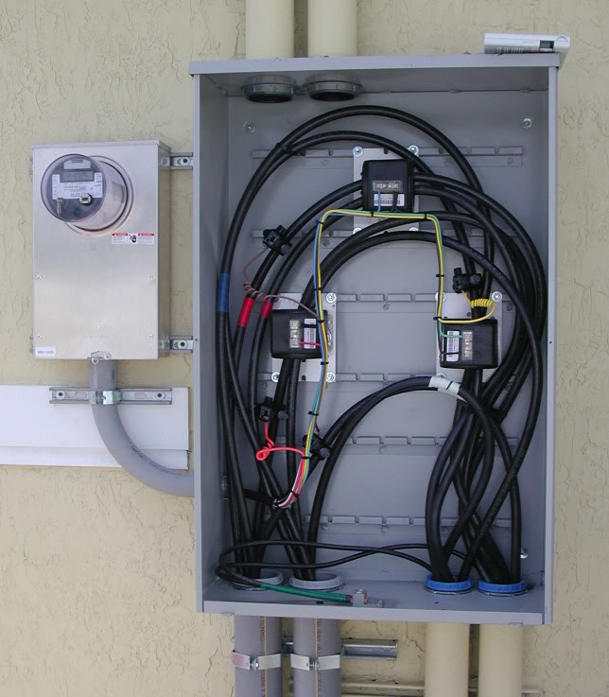
Topics we will be covering
The Basics- Differences Between Self Contained and Transformer or Instrument Rated Meter Sites
Brief Discussion of polyphase metering for self-contained and transformer rated applications
Transformer Rated Meter Forms
Test Switches and CT’s
Blondel’s Theorem and why this matters to us in metering
Meter Accuracy Testing in the Field
Checking the Health of your CT’s and PT’s
Site Verification and not just meter testing
tescometering.com

Slide 4
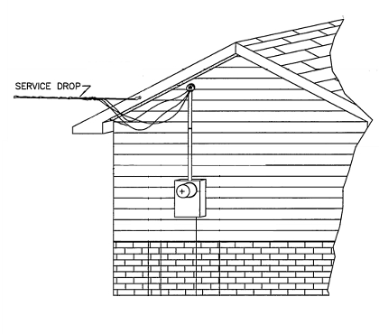
Self Contained Metering
Typically found in residential metering
Meters are capable of handling the direct incoming amperage
Meter is connected directly to the load being measured
Meter is part of the circuit
When the meter is removed from the socket, power to the customer is interrupted
tescometering.com

Slide 5
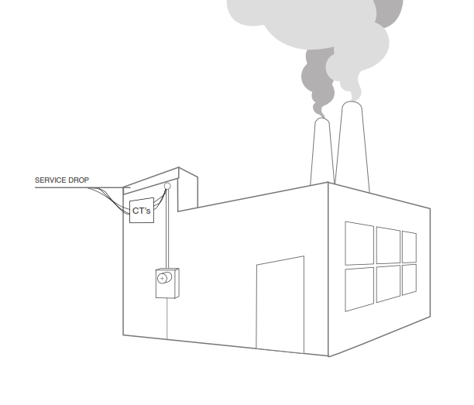
Transformer Rated Metering
Meter measures scaled down representation of the load.
Scaling is accomplished by the use of external current transformers (CTs) and sometimes voltage transformers or PTs).
The meter is NOT part of the circuit
When the meter is removed from the socket, power to the customer is not affected.
tescometering.com

Slide 6
1-Phase and 3-Phase Power
V
0 30 60 90 120 150 180 210 240 270 300 330 360
Voltage = V_{max} sine α

Slide 7
1-Phase and 3-Phase Power
V_{C}
120⁰
120⁰ ₁₂₀₀
V_{A}
0 30 60 90 120 150 180 210 240 270 300 330 360
V_{B}
Volts Phase A Volts Phase B Volts Phase C
Forward Rotation, ABC
tescometering.com

Slide 8
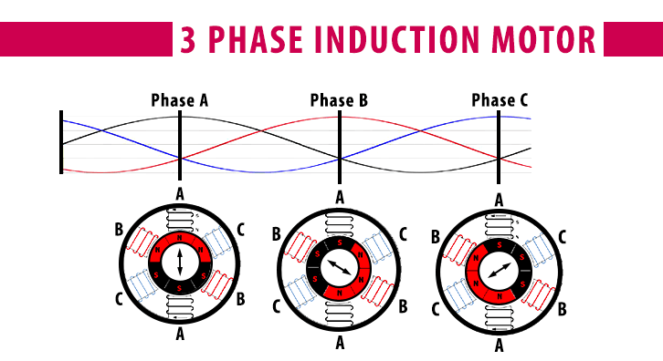
The Need for 3-Phase Power
Single-phase motors provide a pulsating torque to a mechanical load. Loads which require more than 10 horsepower generally also require the steadier torque of a
3-phase motor.

Slide 9
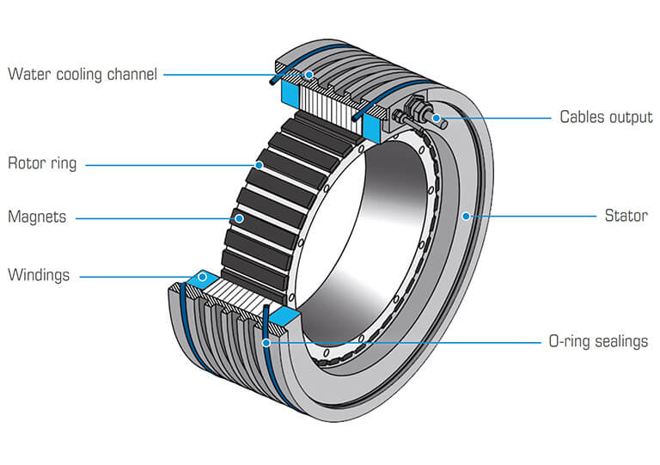
Benefits of 3-Phase Power
Steadier motor torque
Less vibration in machinery
Greater mechanical efficiency
Better voltage regulation
Lower heat losses
Lighter weight conductors

Slide 10
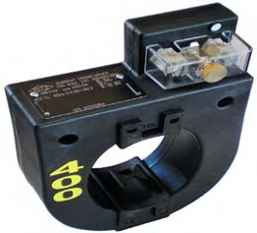
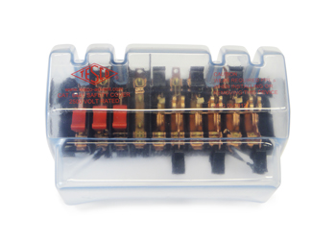
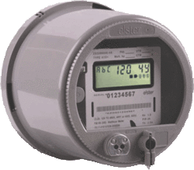
Transformer Rated - The Basic Components
9S Meter Installation with 400:5 CT’s
SOURCE
400A
LOAD
PHASE A
PHASE B
400A
PHASE C
400A
5A
5A
5A
tescometering.com

Slide 11
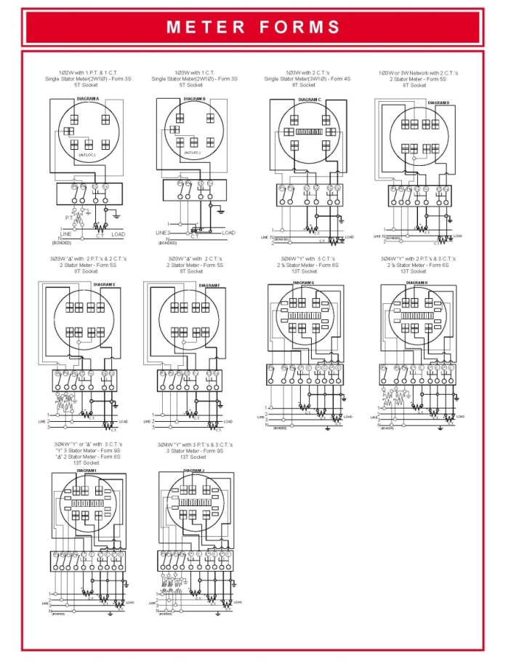
Typical Connections
Typical Connections for Common Transformer (Instrument) Rated Meter Forms
Note: See Chapter 4 of the Power Measurement Handbook for more detailed form by form information
tescometering.com

Slide 12
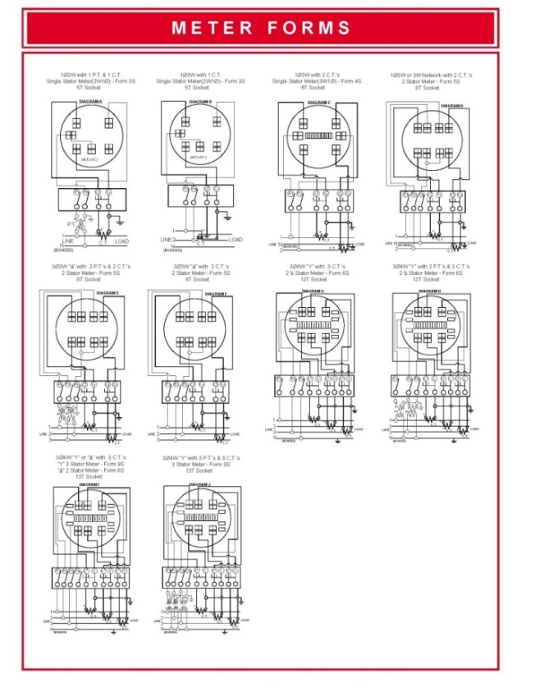
Selecting the right meter form
Select the meter form based on the source, not the load.
  The “service type” is not always obvious.
  Loads other than the “known” load can be connected and may be unmetered.
Meter form numbers describe certain meter characteristics not the service or application
Consider that ground can be a current carrying conductor when applying Blondel’s Theorem.
Understand the operation of present day, polyphase solid state meters and how they may be used to advantage

Slide 13

Three Phase Power: Blondel’s Theorem
The theory of polyphase watthour metering was first set forth on a scientific basis in 1893 by Andre E. Blondel, engineer and mathematician. His theorem applies to the measurement of real power in a polyphase system of any number of wires. The theorem is as follows:
  - If energy is supplied to any system of conductors through N wires, the total power in the system is given by the algebraic sum of the readings of N wattmeters, so arranged that each of the N wires contains one current coil, the corresponding voltage coil being connected between that wire and some common point. If this common point is on one of the N wires, the measurement may be made by the use of N-1 wattmeters.

Slide 14
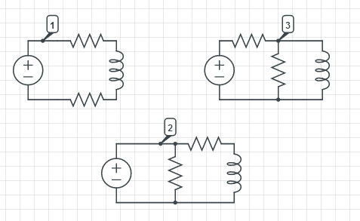
Three Phase Power: Blondel’s Theorem
Simply – We can measure the power in a
N wire system by measuring the power in N-1 conductors.
For example, in a 4-wire, 3-phase system we need to measure the power in 3 circuits.

Slide 15

Three Phase Power: Blondel’s Theorem
If a meter installation meets Blondel’s Theorem then we will get accurate power measurements under all circumstances.
If a metering system does not meet Blondel’s Theorem then we will only get accurate measurements if certain assumptions are met.

Slide 16
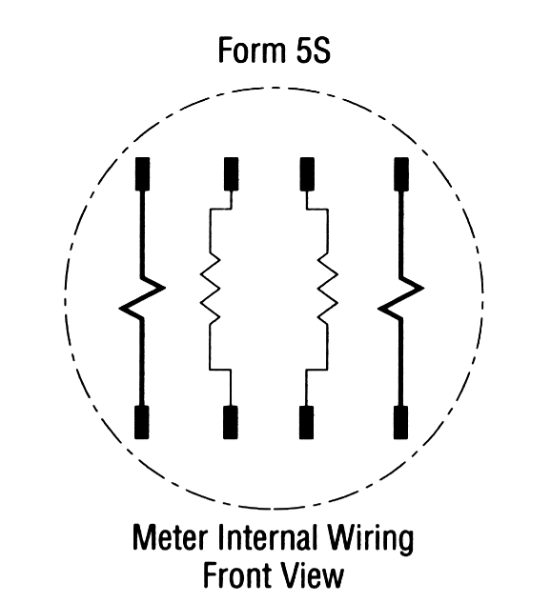
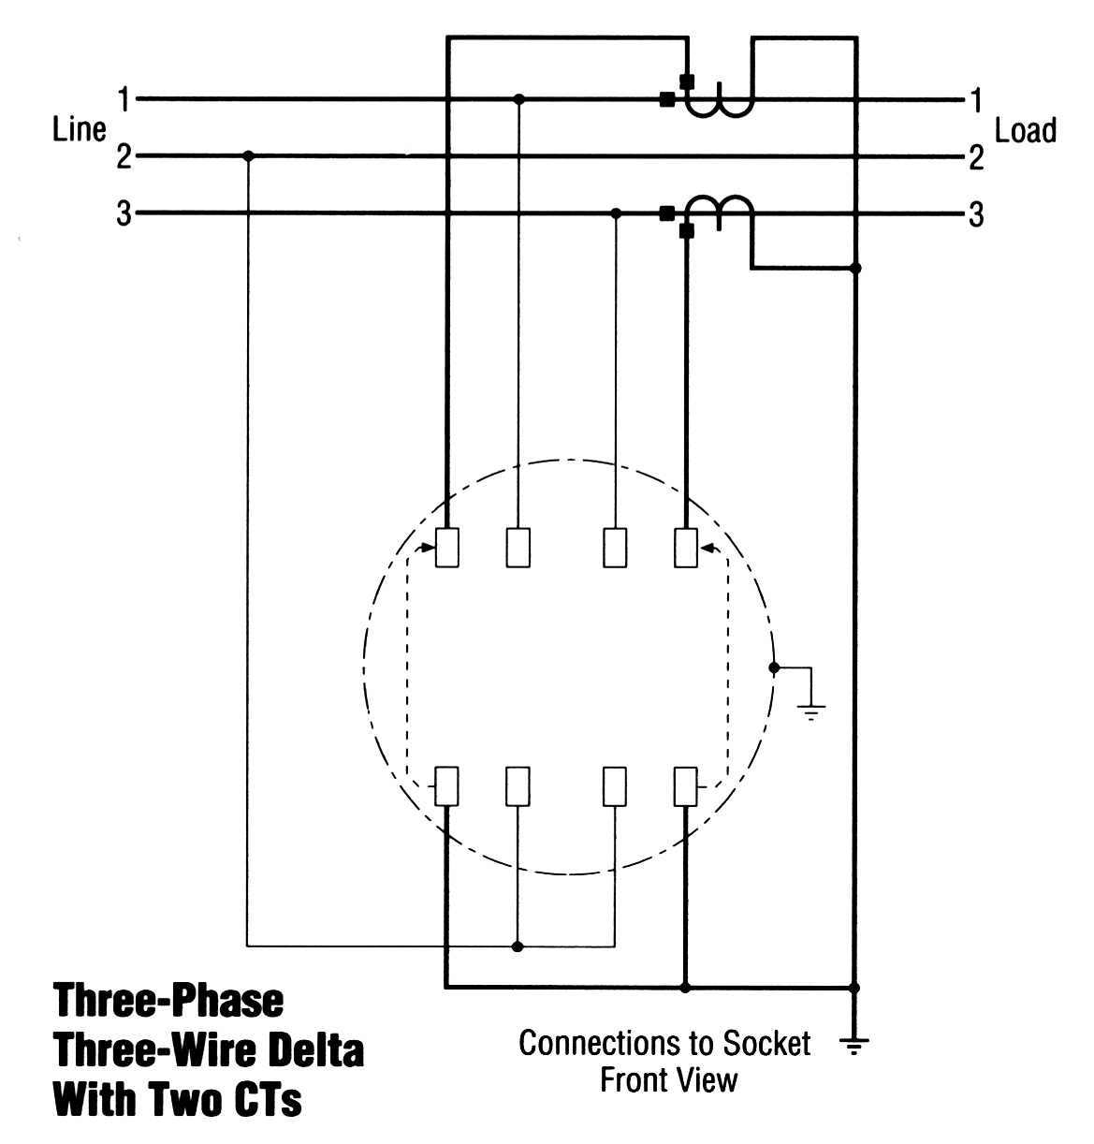

Blondel’s Theorem
Three wires
Two voltage measurements with one side common to Line 2
Current measurements on lines 1 & 3.
This satisfies Blondel’s Theorem.

Slide 17
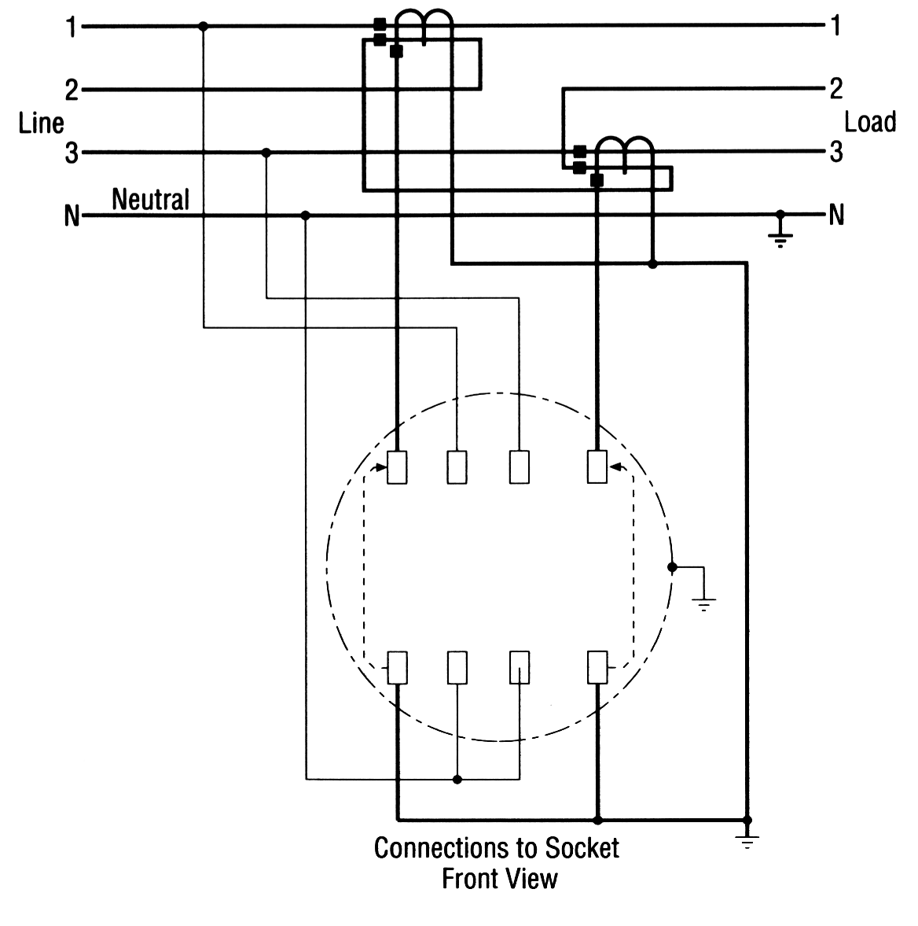

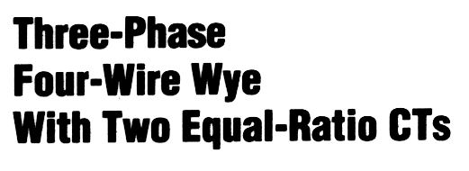
Blondel’s Theorem
Four wires
Two voltage measurements to neutral
Current measurements on lines 1 & 3. How about line 2?
This DOES NOT satisfy Blondel’s Theorem.

Slide 18

Blondel’s Theorem
In the previous example:
  What are the “ASSUMPTIONS”?
  When do we get errors?
What would the “Right Answer” be?
What did we measure?

Slide 19

Blondel’s Theorem
Phase B power would be:
  P = Vb Ib cosθ
But we aren’t measuring Vb
What we are measuring is:
  IbVacos(60- θ) + IbVccos(60+ θ)
cos(α + β) = cos(α)cos(β) - sin(α)sin(β)
cos(α - β) = cos(α)cos(β) + sin(α)sin(β)
So

Slide 20

Blondel’s Theorem
Pb = Ib Va cos(60- θ) + Ib Vc cos(60+ θ)
Applying the trig identity
  IbVa(cos(60)cos(θ) + sin(60)sin(θ))
  IbVc (cos(60)cos(θ) - sin(60)sin(θ))
  Ib(Va+Vc)0.5cos(θ) + Ib(Vc-Va) 0.866sin(θ)
Assuming
  Assume Vb = Va = Vc
  And, they are exactly 120° apart
Pb = Ib(2Vb)(0.5cosθ) = IbVbcosθ

Slide 21
Blondel’s Theorem
If Va ≠ Vb ≠ Vc then the error is
%Error =
-Ib{(Va+Vc)/(2Vb) - (Va-Vc) 0.866sin(θ)/(Vbcos(θ))
How big is this in reality? If
Va=117, Vb=120, Vc=119, PF=1 then E=-1.67%
Va=117, Vb=116, Vc=119, PF=.866 then E=-1.67%

Slide 22
Blondel’s Theorem
Power Measurements Handbook
Condition | % V | % I | Phase A |  |  |  | Phase B |  |  |  | non-Blondel
 | Imb | Imb | V | φvan | I | φian | V | φvbn | I | φibn | % Err
All balanced | 0 | 0 | 120 | 0 | 100 | 0 | 120 | 180 | 100 | 180 | 0.00%
Unbalanced voltages PF=1 | 18% | 0% | 108 | 0 | 100 | 0 | 132 | 180 | 100 | 180 | 0.00%
Unbalanced current PF=1 | 0% | 18% | 120 | 0 | 90 | 0 | 120 | 180 | 110 | 180 | 0.00%
Unbalanced V&I PF=1 | 5% | 18% | 117 | 0 | 90 | 0 | 123 | 180 | 110 | 180 | -0.25%
Unbalanced V&I PF=1 | 8% | 18% | 110 | 0 | 90 | 0 | 120 | 180 | 110 | 180 | -0.43%
Unbalanced V&I PF=1 | 8% | 50% | 110 | 0 | 50 | 0 | 120 | 180 | 100 | 180 | -1.43%
Unbalanced V&I PF=1 | 18% | 40% | 108 | 0 | 75 | 0 | 132 | 180 | 125 | 180 | -2.44%
Unbalanced voltages PF≠1 PFa = PFb | 18% | 0% | 108 | 0 | 100 | 30 | 132 | 180 | 100 | 210 | 0.00%
Unbalanced current PF≠1 PFa = PFb | 0% | 18% | 120 | 0 | 90 | 30 | 120 | 180 | 110 | 210 | 0.00%
Unbalanced V&I PF≠1 PFa = PFb | 18% | 18% | 108 | 0 | 90 | 30 | 132 | 180 | 110 | 210 | -0.99%
Unbalanced V&I PF≠1 PFa = PFb | 18% | 40% | 108 | 0 | 75 | 30 | 132 | 180 | 125 | 210 | -2.44%
Unbalanced voltages PF≠1 PFa ≠ PFb | 18% | 0% | 108 | 0 | 100 | 60 | 132 | 180 | 100 | 210 | -2.61%
Unbalanced current PF≠1 PFa ≠ PFb | 0% | 18% | 120 | 0 | 90 | 60 | 120 | 180 | 110 | 210 | 0.00%
Unbalanced V&I PF≠1 PFa ≠ PFb | 18% | 18% | 108 | 0 | 90 | 60 | 132 | 180 | 110 | 210 | -3.46%
Unbalanced V&I PF≠1 PFa ≠ PFb | 18% | 40% | 108 | 0 | 75 | 60 | 132 | 180 | 125 | 210 | -4.63%

Slide 23
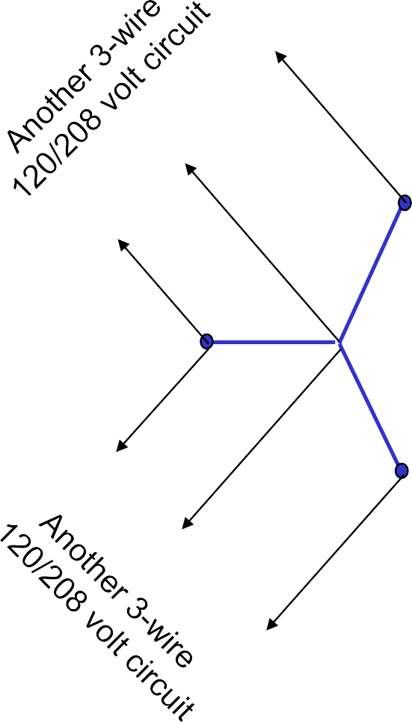
Network Service & Loads
A
N
A
A
C
120 and 208 volt loads
N
C
N
C
B
B
N
B

Slide 24
3-Wire Delta Service & Loads
C
B-C
C-A
A-B-C
B
A
A-B
Need to meter single phase line-line loads, as well as three phase loads. Form 12 for Self Contained and Form for Transformer Rated. You need a two element meter only. Network metering is less expensive than Transformer rated. If you need to be transformer rated you save by using a single bushing VT and one less PT since you are only two element (typically do not meter B element).
tescometering.com

Slide 25
4-Wire Delta Service & Loads
A
A-B-C
C
A-N
C-A
A-B
N
B-N
B
B-C
Need to meter single phase line-neutral and line-line loads, as well as three phase loads. For self contained a Form 16 network meter and Transformer rated a 9S meter. We need to be Blondel Compliant and use a three-element meter. Note: For electro-mechanicals common practice was a Form 15S which was not Blondel compliant. Similarly, a 5S is not Blondel compliant for these services.

Slide 26
4-Wire Wye Service & Loads
C
A-B-C
C-N
C-A
B-C
A
N
A-N
A-B
B
B-N
Need to meter single phase line-neutral and line-line loads, as well as three phase loads. Use a Form 16 Network meter and a Form 9S Current Meter.

Slide 27

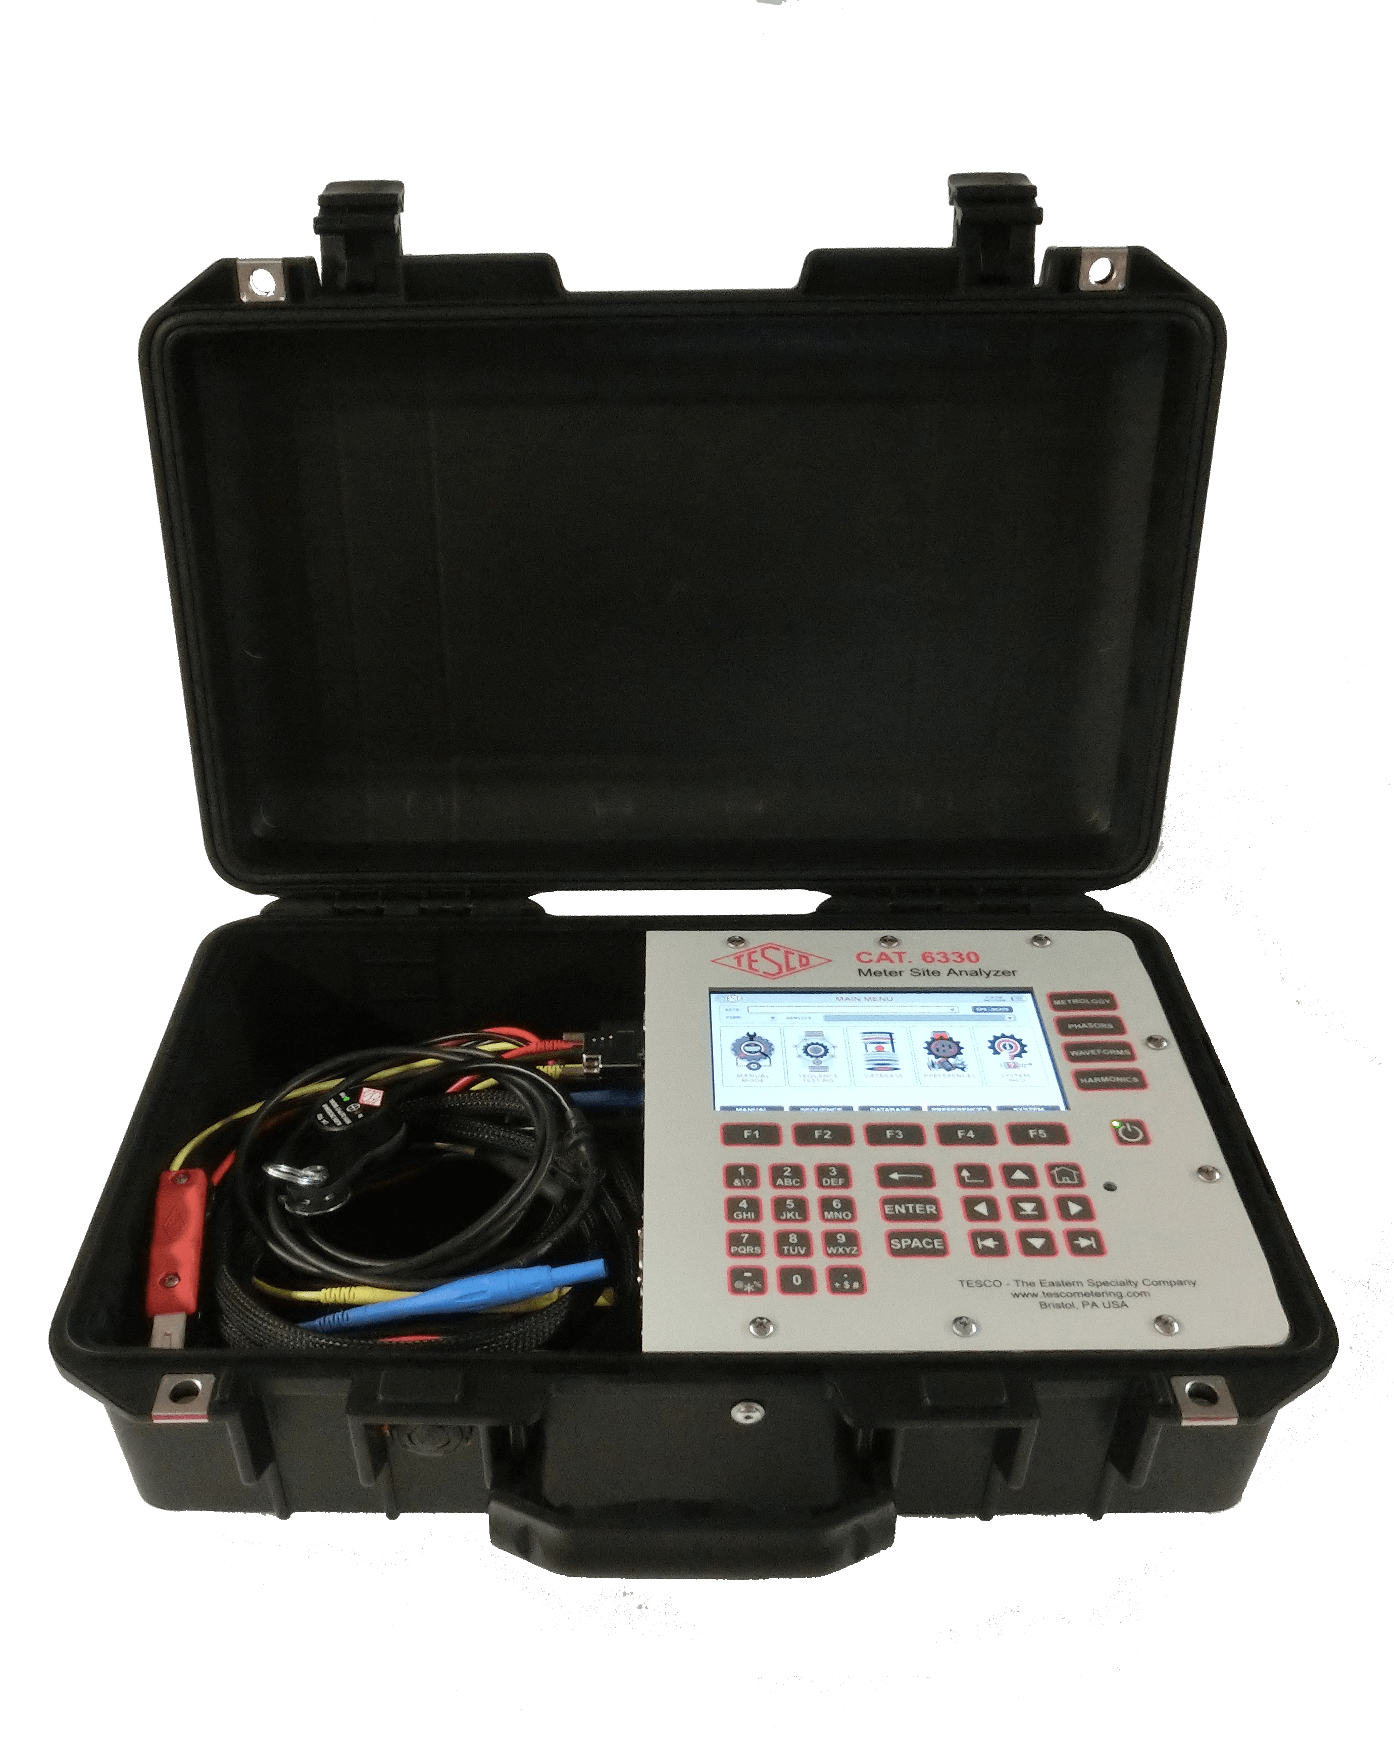
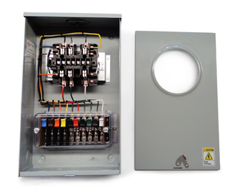
Meter Accuracy Testing
Meter Accuracy Testing in a Nutshell
Full Load
Light Load
Power Factor
27

Slide 28
The Importance of CT Testing in the Field
One transformer in three wired backwards will give the customer a bill of 1/3rd the actual bill.
One broken wire to a single transformer will give the customer a bill of 2/3rd the actual bill
One dual ratio transformer inappropriately marked in the billing system as 400:5 instead of 800:5 provides a bill that is ½ of the actual bill. And the inverse will give a bill double of what should have been sent. Both are lose-lose situations for the utility.

Slide 29

The Importance of CT Testing in the Field (cont)
Cross Phasing (wiring errors)
Loose or Corroded Connections
CT Mounted Backwards
CT’s with Shorted Turns
Wrong Selection of Dual Ratio CT
Detect Magnetized CT’s
Burden Failure in Secondary Circuit
Open or Shorted Secondary
Mislabeled CT’s
Ensures all Shorting Blocks have been Removed

Slide 30
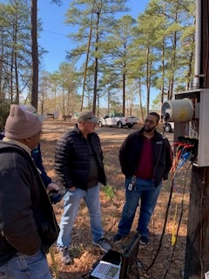
Testing at Transformer Rated Sites
Meter Accuracy
Full Load
Light Load
Power Factor
CT Health
Burden Testing
Ratio Testing
Admittance Testing
Site Verification

Slide 31
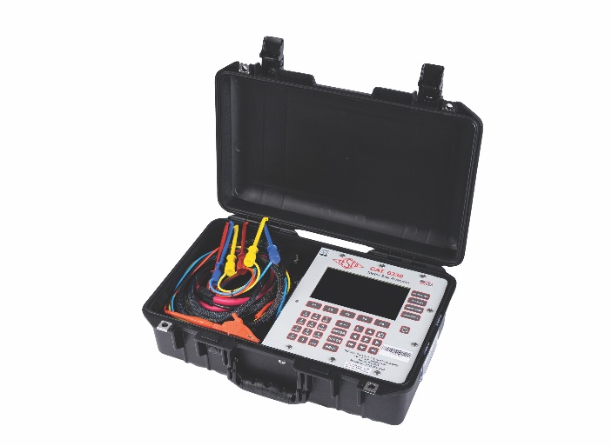
Fundamentals of Polyphase Field Meter Testing and Site Verification
Functionality with Burden Present on the Secondary Loop
PHASE A
Some burden will always be present – junctions, meter coils, test switches, cables, etc.
CT’s must be able to maintain an accurate ratio with burden on the secondary.
Admittance testing?

Slide 32
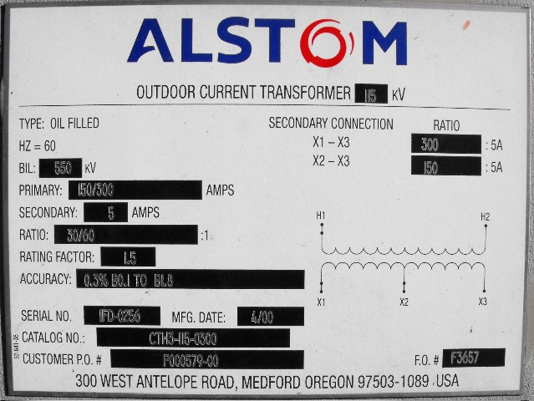
Fundamentals of Polyphase Field Meter Testing and Site Verification (Cont)
Functionality with Burden Present on the Secondary Loop
Example Burden Spec:
0.3% @ B0.1, B0.2, B0.5
or
There should be less than the 0.3% change in secondary current from initial (“0” burden) reading, when up to 0.5 Ohms of burden is applied

Slide 33
Fundamentals of Polyphase Field Meter Testing and Site Verification (Cont)
Ideal. No losses
Real, with core losses

Slide 34
Fundamentals of Polyphase Field Meter Testing and Site Verification (Cont)
Functionality with Burden Present on the Secondary Loop
Initial Reading = 5Amps
0.3% x 5A = 0.015A
5A – 0.015 = 4.985A
0.3% @ B0.1, B0.2, B0.5
Burden | Reading
0 | 5.0000
0.1 | 4.9999
0.2 | 4.9950
0.5 | 4.9900
1 | 4.9800
2 | 4.9500
4 | 4.0000
8 | 0.8000

Slide 35
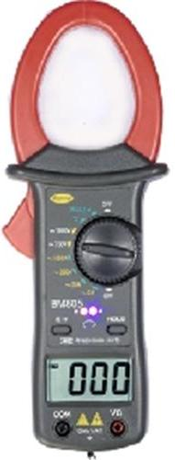
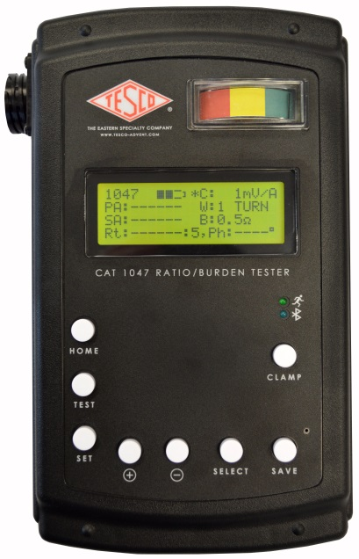
Fundamentals of Polyphase Field Meter Testing and Site Verification (Cont)
Ratio of Primary Current to Secondary Current
SOURCE
LOAD
PHASE A
400A
400A
400A
5A
5A
Calculate Ratio

Slide 36

Questions and Discussion
Tom Lawton
President
tom.lawton@tescometering.com
TESCO Metering
Bristol, PA
215.228.0500
This presentation can also be found under Meter Conferences and Schools on the TESCO website: tescometering.com
ISO 9001:2015 Certified Quality Company
ISO 17025:2017 Accredited Laboratory

