Slide 1
Hot Socket Issues: Causes and Best Practices
Presented by:
Tom Lawton
President, TESCO
The Eastern Specialty Company
Session:

Slide 2
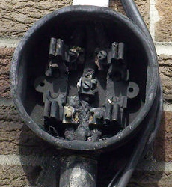
The Issue
Hot Sockets are not a new phenomenon. Virtually every meter man has pulled a meter with a portion of the meter base around a blade melted and virtually every utility has been called to assist in the investigation of a fire at a meter box.
AMI deployments because of the volume of meters involved put a spotlight on this issue.
What causes a hot socket?
Are the meters ever the cause of a meter box failure?
What are the things to look for when inspecting an existing meter installation?
What are the best practices for handling potential hot sockets?
This presentation will cover the results of our lab investigation into the sources for hot sockets, the development of a fixture to simulate hot sockets, the tests and data gleaned from hot sockets, and a discussion of “best practices” regarding hot sockets.

Slide 3
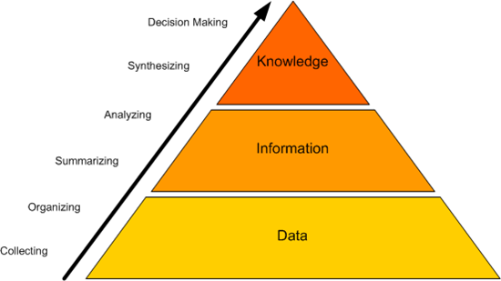
Why Do We Know Anything About Hot Sockets?
TESCO has been fortunate enough to be involved in several meter deployments where we supplied full-time and part-time meter engineers and project managers to our customer’s AMI deployment teams. In this capacity we have been involved in evaluating hot socket issues and helping to determine an appropriate response to actual or potential hot sockets.
TESCO’s meter lab has been contracted to develop a laboratory fixture that would simulate the various features common to most hot sockets found in the field.
TESCO developed and refined a fixture to simulate Hot Sockets. Over the past five years TESCO has been gathering data on the effect of hot sockets on meters. Sensus has also been using a TESCO Hot Socket Simulator to develop more robust meters that will withstand these type of field conditions for longer durations without endangering the home owner.
TESCO has access to a large number of meters which have been exposed to hot sockets both before and after catastrophic failure.
We have access to a limited number of sockets that were hot sockets and did not yet fail catastrophically.

Slide 4
What are Likely Socket Concerns?
Sprung/damaged jaw
Loose wire termination at line or load side jaw
Meter blade beside and not into socket jaw
Worn line/load wire insulation arcing over to grounded mounting box
Total load exceeding socket capacity – lots of older 60 and 100 amp services in the field

Slide 5
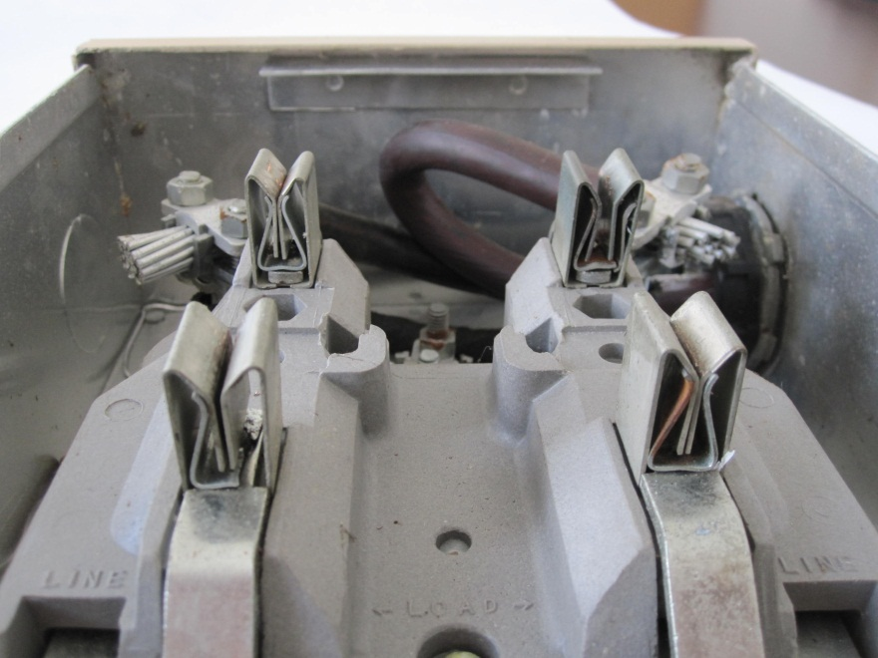
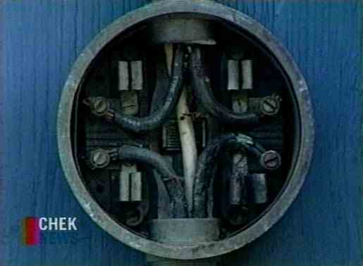
Searching for Hot Socket Sources
Common Features and Common Sources of Concern
Pitted and discolored meter blades
Melted plastic around one or more of the meter stabs (typically the plastic around one stab is where the deformation starts)
Pitted and discolored socket jaws
Loss of spring tension in the socket jaws

Slide 6
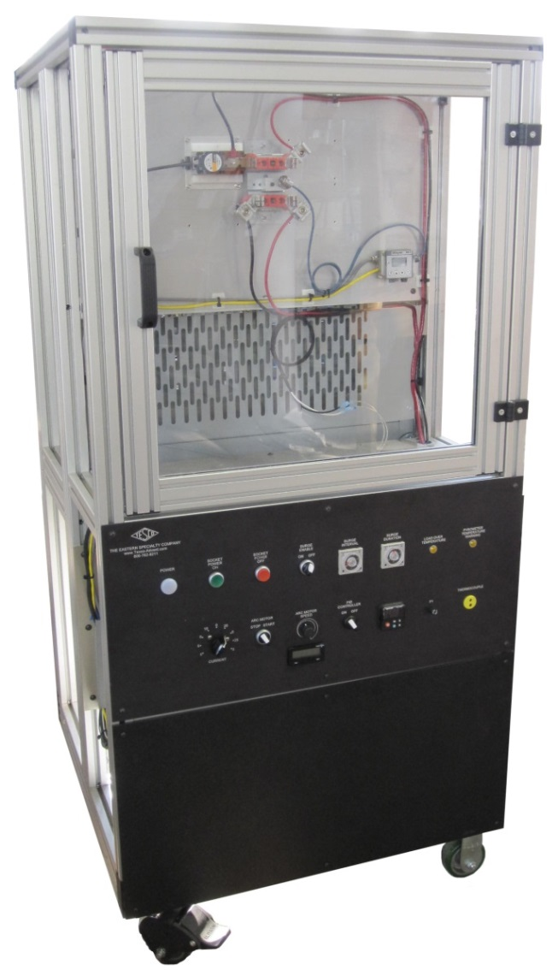
Hot Socket Simulation Fixture

Slide 7
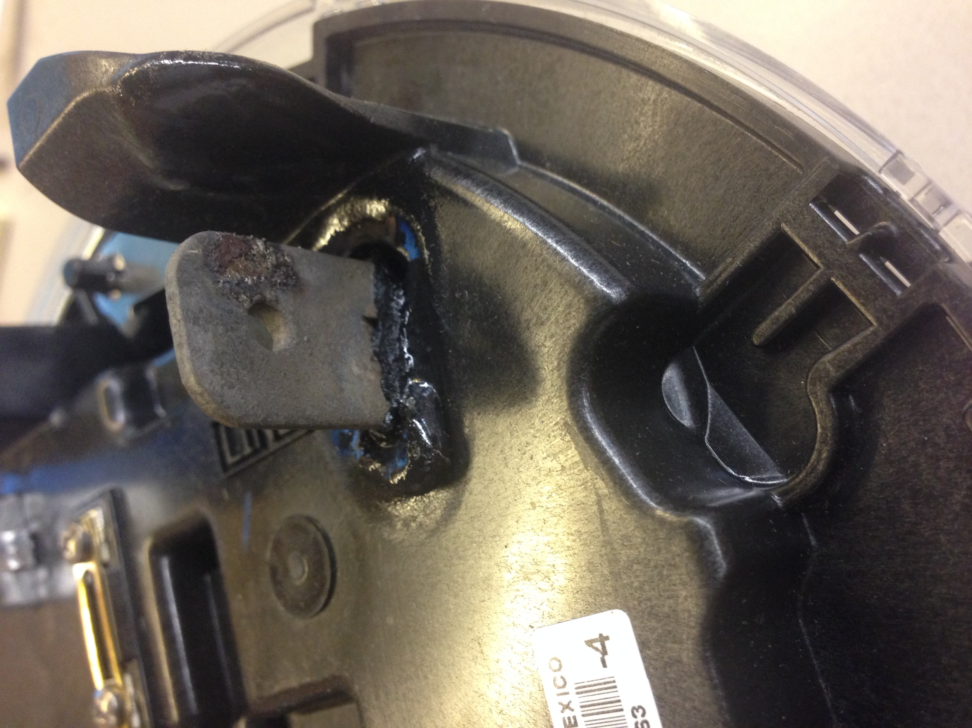
Hot Socket Example

Slide 8
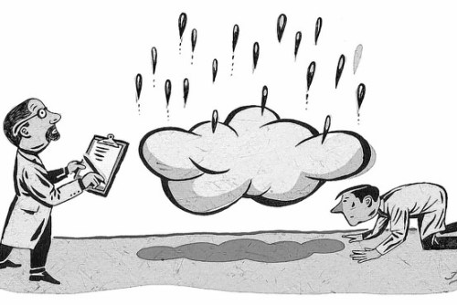
Expected & Unexpected Results
Expected:
Hot Sockets are exactly that – hot sockets. The hot sockets are the source of the problem and not hot meters.
Electromechanical meters withstand hot sockets better than solid state meters
Unexpected:
Current plays only a small role in how quickly a meter will burn up. Meters were burned up nearly as quickly at 3 amps,
30 amps, and 130 amps.
Relatively small amounts of vibration can be the catalyst in the beginning and eventual catastrophic failure of a hot socket. Note: Other catalysts include but are not limited to power surges, debris, humidity, and salt water.
Contact resistance plays no role in creating a hot socket.
And some newer solid state meters are better than electromechanical meters.

Slide 9
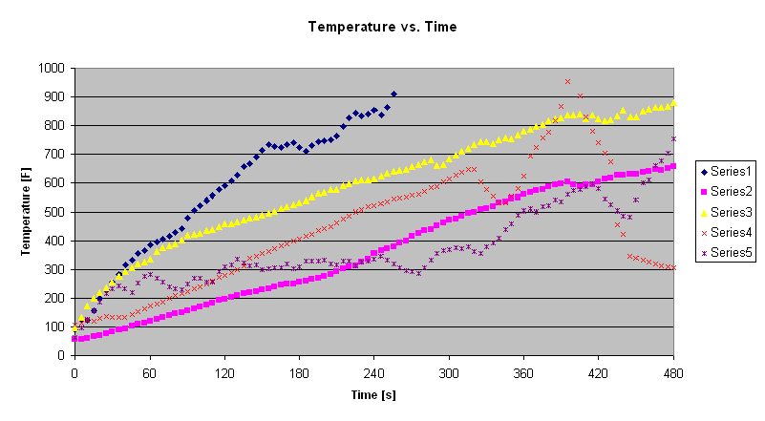
Temperature Rise Data

Slide 10
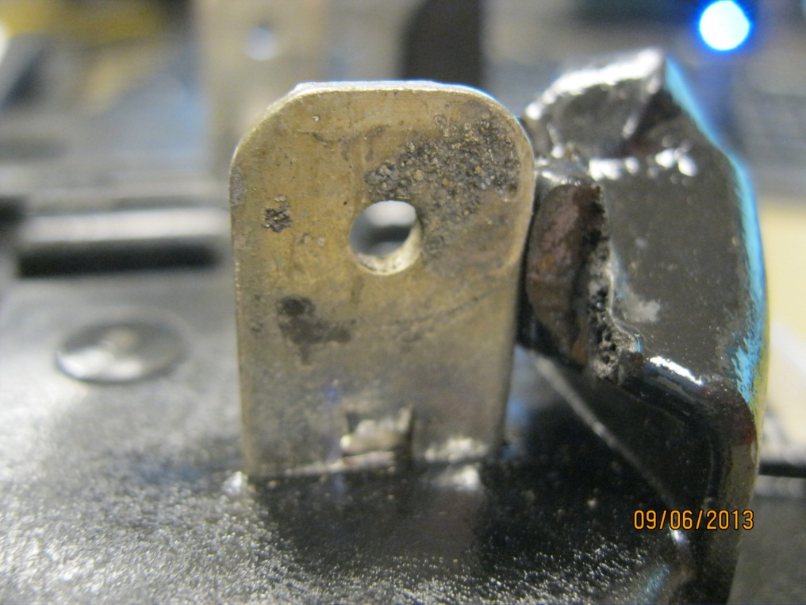
Jaw to Blade Arcing
Jaws with intermittent connections will arc to the meter blade resulting in pitting on the blade.
Blade shows early signs of arcing.
Tin melts at 232ºC which is lower than the 350ºC base plate plastic.

Slide 11
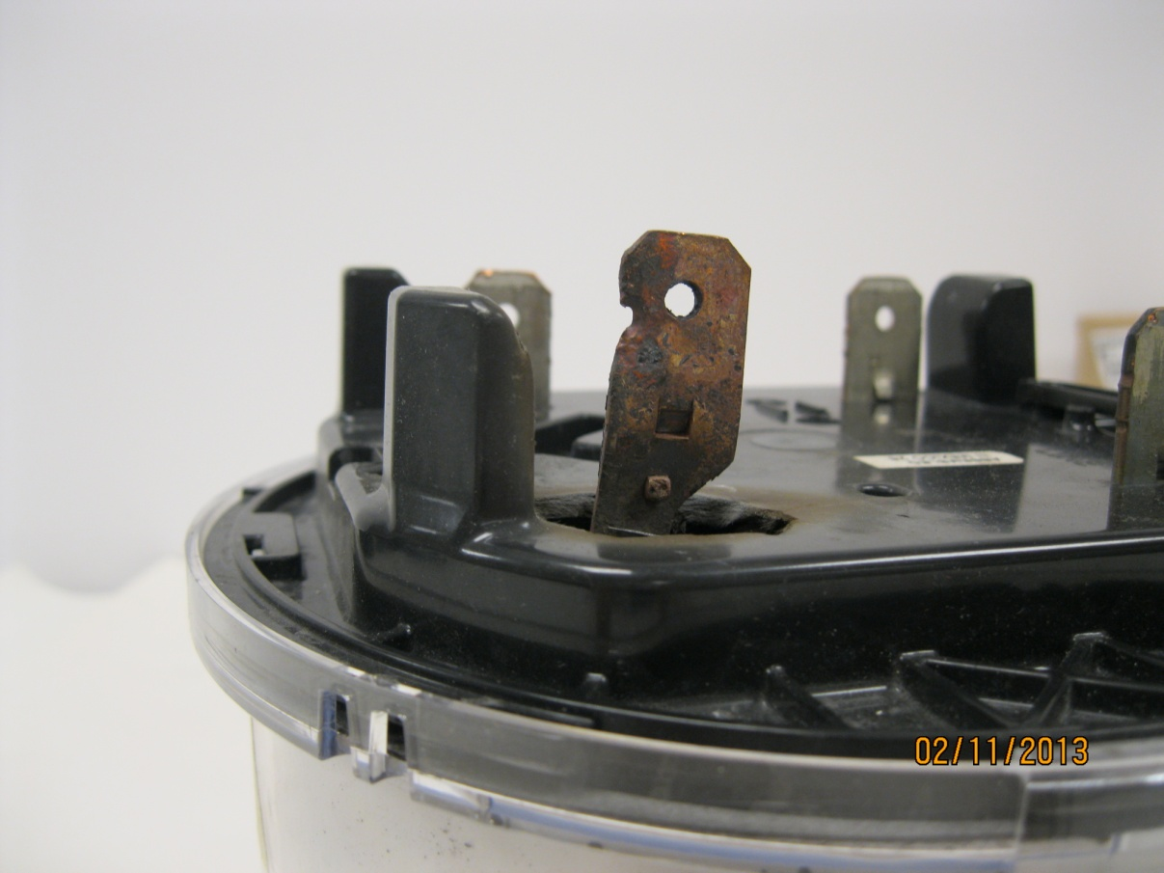
Severe Arcing Jaw to Blade
Tin burned off
Blade hole due to arcing to jaw – Copper melts at 1040ºC (1900ºF)
AX-SD base thermoset plastic melts at 960ºC (1760ºF)

Slide 12
What are the Necessary Ingredients for a Hot Socket?
There are three necessary ingredients to create a hot socket (Note: We are not suggesting that we have simulated or even understand all causes for all hot sockets and meter related fires, but rather that we have simulated and understand the causes behind most hot sockets and meter related fires):
Loss of jaw tension in at least one of the socket jaws
Vibration (or other catalyst
to initiate arcing)
Minimal load present

Slide 13
Reviewing the Data and Learning From the Data
Repeated meter insertions degrades the tension in the socket jaws (see graph), but not to dangerous levels
Exposure to elevated temperatures rapidly degrades the socket jaw tension to dangerous levels (see graph)
Visual inspection will catch some but not all dangerous socket jaws
Arcing creates the heat
Exposure to elevated temperatures has a cumulative effect on the meter socket jaw
Relatively small vibration can initiate arcing

Slide 14
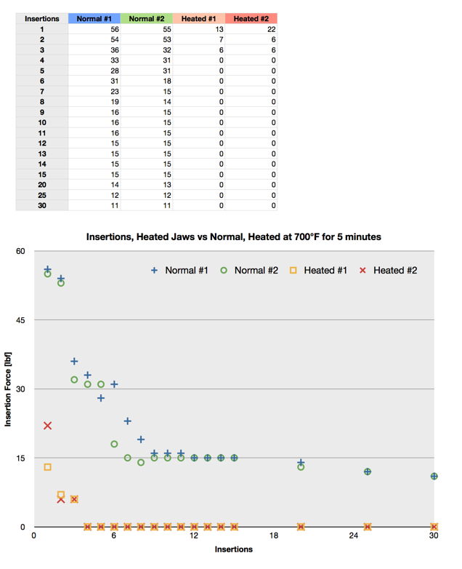

Slide 15
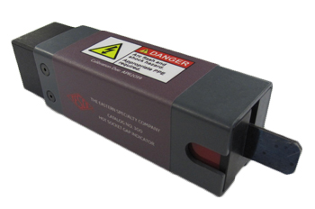
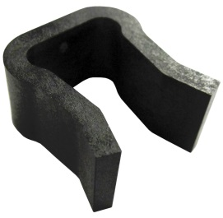
Field Inspection of Sockets Best Practices
Example field check list:
Gaps in meter socket jaws
Discoloration of one jaw vs. the other three
Signs of melted or deformed plastic on meter base
Pitting of either meter blade or socket jaw
Loss of tension in meter socket jaws
Check condition of wire insulation and connections to meter jaws
Check the overall condition of the box, socket, meter, and how they attach to each other and the building.
Look for signs of tampering
Look for signs of water or debris inside of the meter can

Slide 16
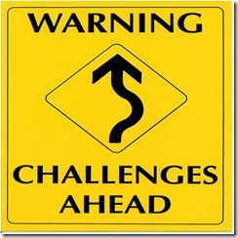
Who Sees Hot Sockets?
Most AMI deployments utilize third-party contractors to handle residential and some self contained non-2S services.
After to or prior to AMI deployments, Utility personnel typically see these sockets
Transformer rated meters typically are handled by the meter service department of the utility.
Hot socket concerns with lever by-pass sockets used on 3-phase meters are extremely rare.

Slide 17
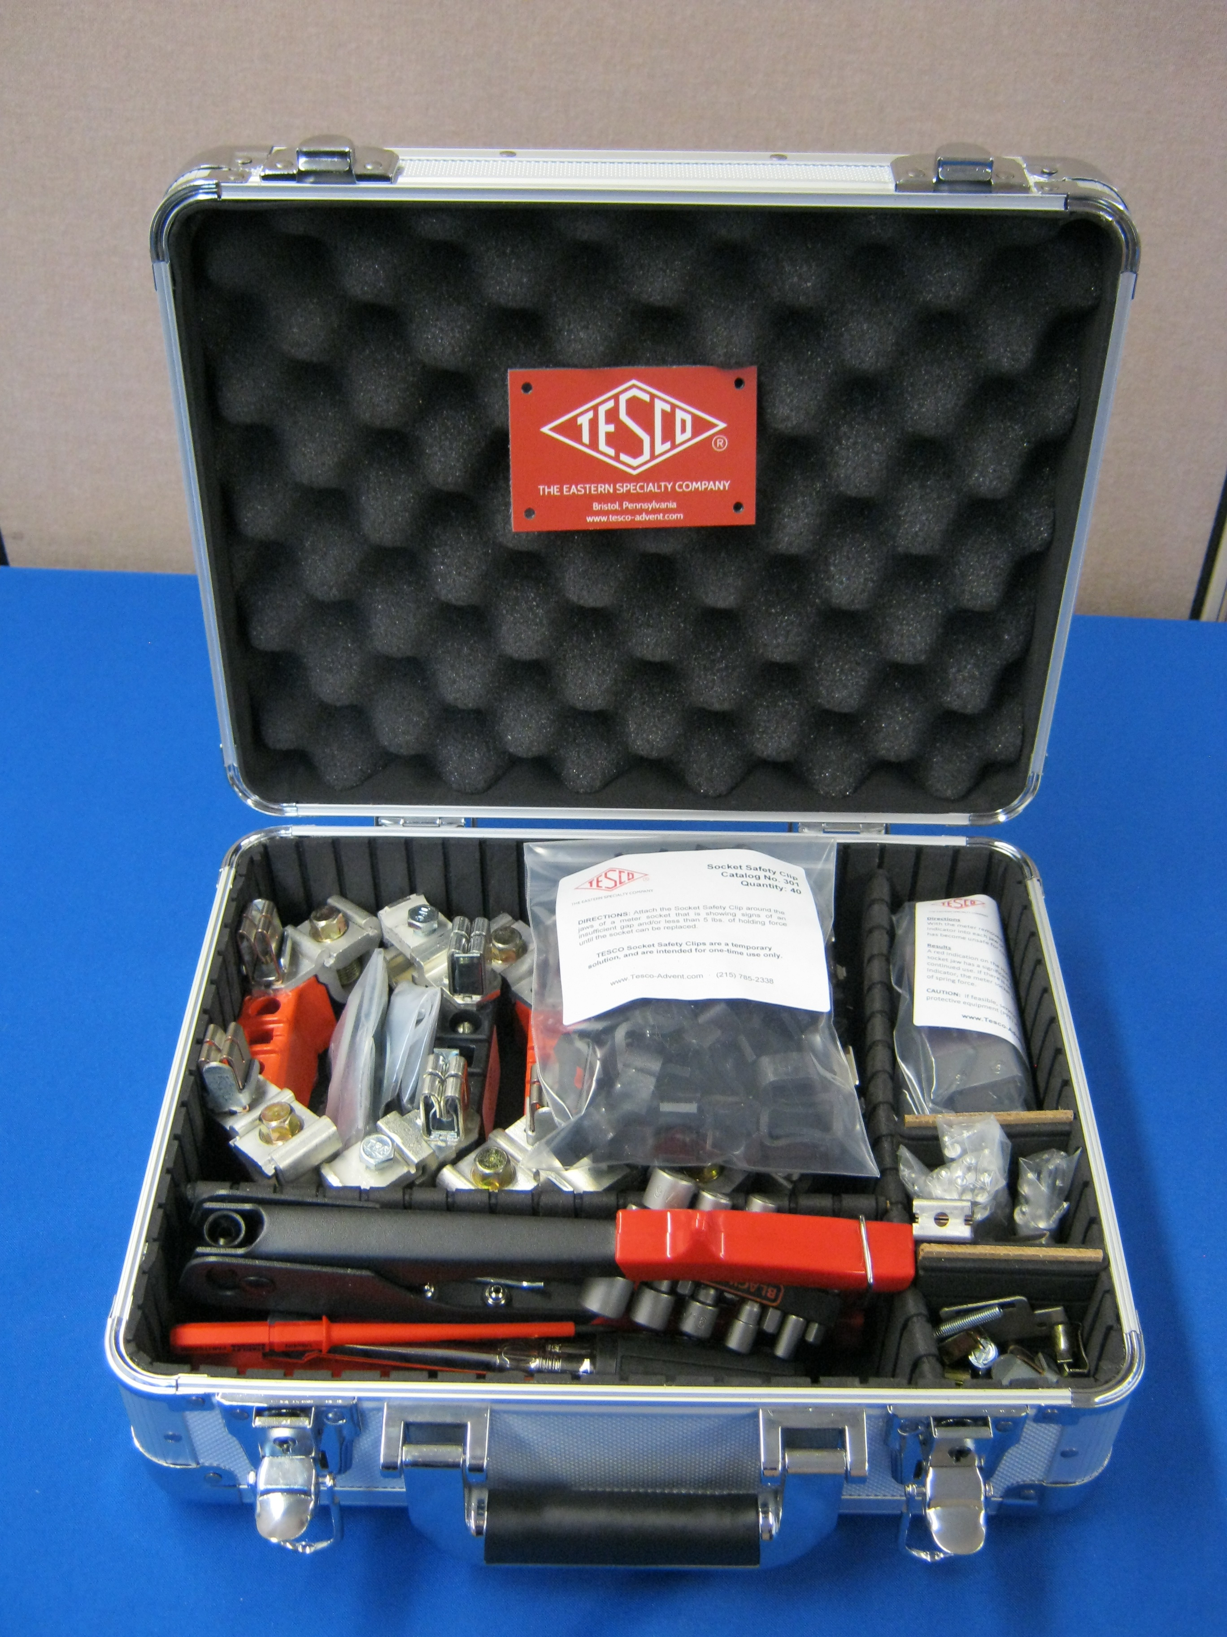
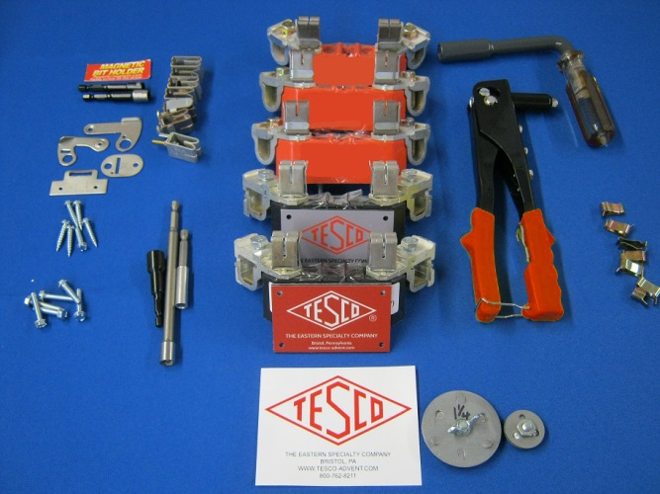
What Can Be Done Once a Hot Socket is Identified?
Easiest resolution is to replace the damaged jaw.
Never try and repair a damaged jaw. The tension in the damaged jaw will not return simply by taking a pair of pliers and closing the jaw tighter.
Either the entire box should be replaced or the damaged socket block and jaw replaced (assuming the wiring and other jaws are deemed safe through the rest of the inspection.)

Slide 18
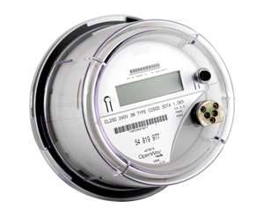
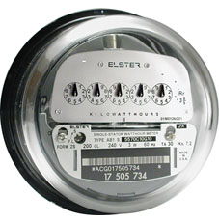
Base Line Data Electro Mechanical Meters vs. Solid State vs. the Latest Generation of Meters Designed with Hot Sockets in Mind
At the start of our laboratory investigation the oldest electro mechanical meters withstood hot sockets the best
The latest vintage solid state meters withstood hot sockets the least
Over the course of the past twenty four months virtually every meter manufacturer has begun to release 2S meters designed to withstand hot sockets.

Slide 19
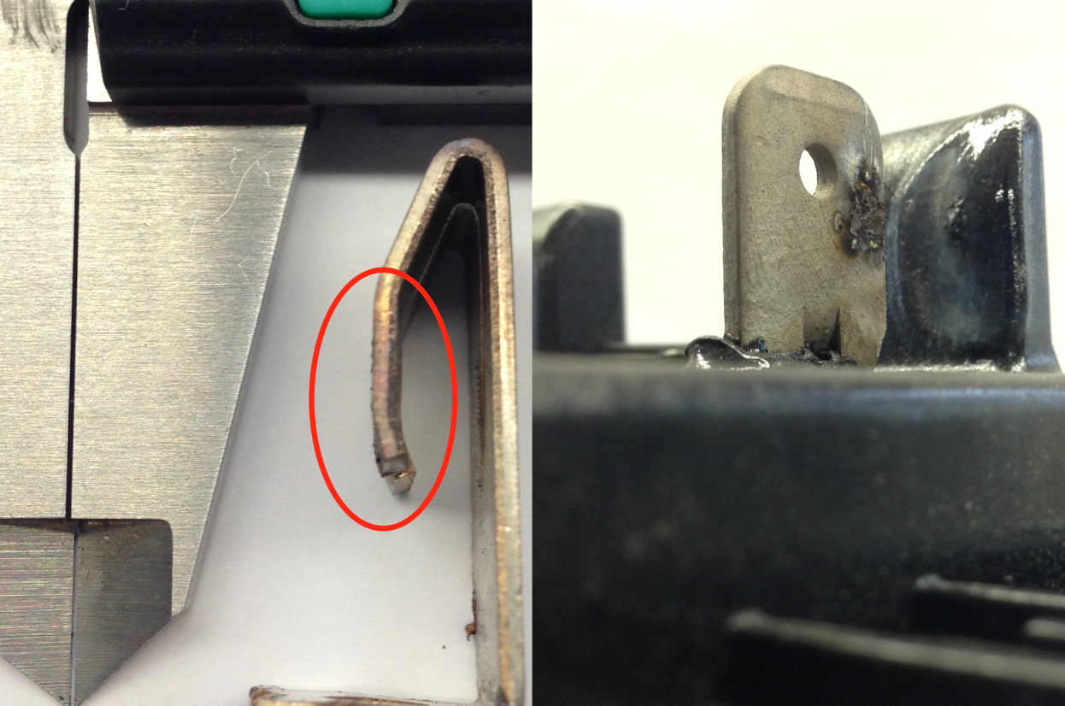
Service Degradation
Calipers show a .01” gap, with that size gap between jaws and stabs we were able to heat meter stabs over 1,000 degrees Fahrenheit in a few minutes.
The rough spots you see on the post-test jaw next to the calipers are over .005” high. This surface degradation appears on the stab as well.
Between the two surfaces you can have large gaps, along with insulating by-product of the arcing, that can sustain heavy arcing in a solid state.

Slide 20
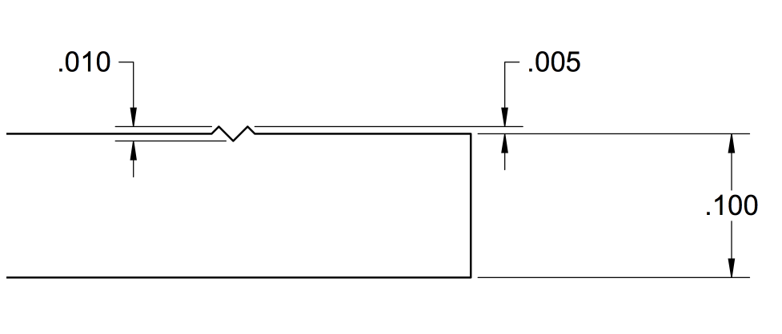
Service Degradation
In a representative side view of a .1” thick standard meter stab, you can see how small these distortions appear relative to the thickness of the stab, while creating an air gap large enough for significant arcing.

Slide 21
Summary of the Problem
Hot sockets start with a loss of tension in at least one of the meter socket jaws. This loss of tension can be from a variety of sources that start as early as improper installation or even “tight sockets.”
Loss of tension is necessary to create the initial micro-arcing conditions.
Sockets with repeated meter exchanges observed to have higher incidence of hot socket issues and “booting” a meter may spring jaws even more.
Vibration appears to be the most common catalyst to the micro-arcing that creates the initial heat in a “hot socket.”
The meter must have some power, but current is not a significant factor in how quickly or dramatically a hot socket occurs.
The effects of vibration and weakened jaw are cumulative.
Meter manufacturers have all been working on the design of their meters to better withstand a hot socket. These new meters have better baseline performance than even the older electro mechanical meters, but a hot socket will eventually burn up even the most robust meter.

Slide 22
Summary of the Potential Solutions
Meter Manufacturers have all been working on the design of their meters to better withstand a hot socket. These new meters have better baseline performance than even the older electro mechanical meters, but a hot socket will eventually burn up even the most robust meter.
Thorough visual inspections of all services when replacing a meter whether for AMI or not
Mechanical, non-invasive way to check that the minimum safe holding force or greater is present in all socket jaws – e.g. Hot Socket Indicator Tool
Repair or replace the damaged socket or use a temporary clip to restore holding force to the socket until a repair can be performed. The Meter Tech should always do everything possible to leave the service as safe or safer than they found the service.
Use all alarms provided by the Meter Manufacturer and attempt to filter out the false positives by type so that future alarms are more indicative of an issue. Sensus and the other meter manufacturers continue to pioneer new and better ways to do this so that eventually they can raise the alarm before the compromised jaws can damage the meter and long before they become dangerous to the rate payer or tenant.

Slide 23
Tom Lawton
TESCO – The Eastern Specialty Company
tom.lawton@tescometering.com
215-688-0298 (mobile)
215-785-2338 (office)

