Slide 1
ArcSense® Study
PSEG Long Island, TESCO, L+G

Slide 2
Project Background
PSEG LI
1.2 million connected customers (electric)
Fully AMI deployed, L+G Gridstream
Deployment commenced: 2018
Deployment completed: Spring 2022
TESCO
Developed ArcSense® technology in-house
Worked with L+G to provide as a formal offering
PSEG LI offered to run a pilot program of ~4,500 meters
Pilot launched in Fall 2021
L+G
Provided platform and access to load profile data for arc reads
Incorporating the technology into their next gen, Revelo® meter

Slide 3
ArcSense® Pilot
Collaboration between PSEG Long Island, TESCO, and Landis + Gyr
Pilot project included a total of ~4,500 meters in the field at various locations
New technology developed by TESCO is integrated into an L+G Focus Meter
The board detects the RF signature of a micro-arc
Micro-arc data is captured and relayed within the load-profile data
Load-profile reporting was an open channel to provide the additional micro-arc data for reporting analysis

Slide 4
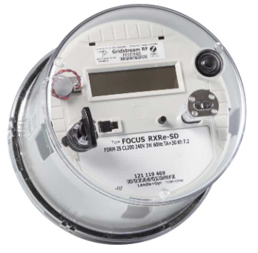
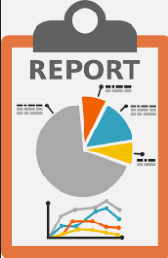
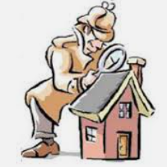
Additional Load Profile Data in Daily Report
L+G Head End System
Automated Report
Analysts / Engineers
Field Investigation
Meter with LP Data
Max arc count
Sum of arc count
Maximum temperature and timestamp
Estimated blade temperature

Slide 5
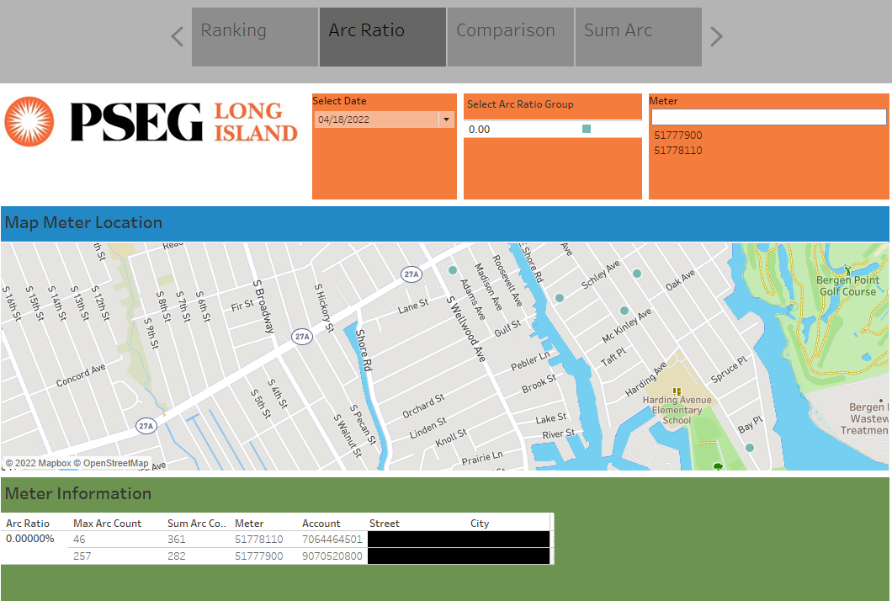
Tableau Data

Slide 6
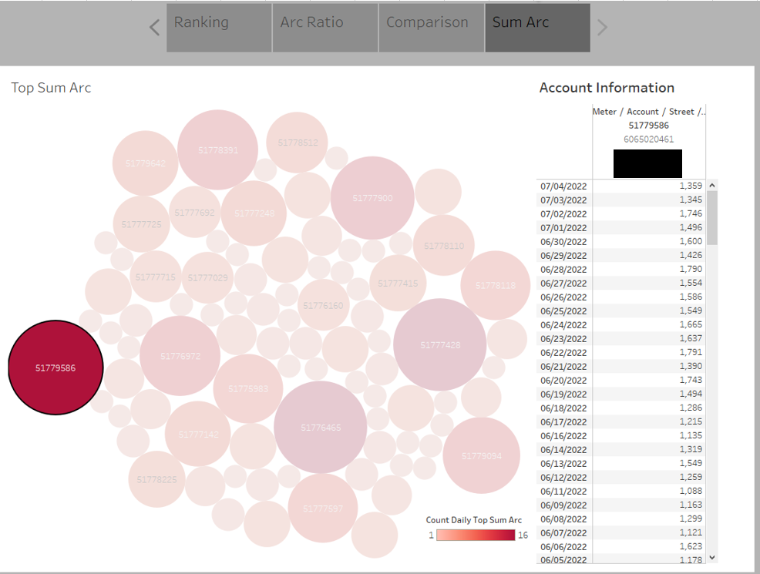
Tableau Data

Slide 7
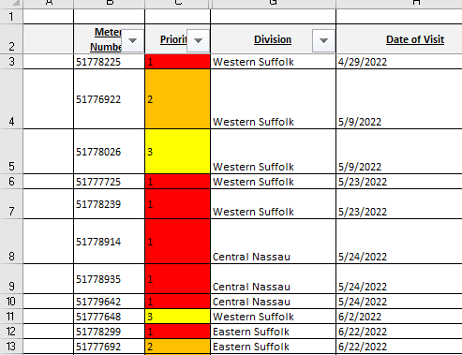
Arc Sense Priority List
Meters were selected based on below criteria:
High arc count: >100 arcs
Days of high arc: >=14 days
Meters prioritized by number of days they appeared on Arc Sense Report
Priority 1 = 40-95 days of high arc
Priority 2 = 20-39 days of high arc
Priority 3 = 14-19 days of high arc
Some meters with anomalous data profiles (high average arc counts or abnormal temp readings) were moved up in priority level

Slide 8
Priority Classifications
Priority 1 – 15 sites, 13 investigations showed issues at the site, 7 hot-socket compromised
Priority 2 – 23 sites, 18 investigations showed issues at the site, 5 hot-socket compromised
Priority 3 – 19 sites, 8 investigations showed issues at the site, 2 hot-socket compromised

Slide 9
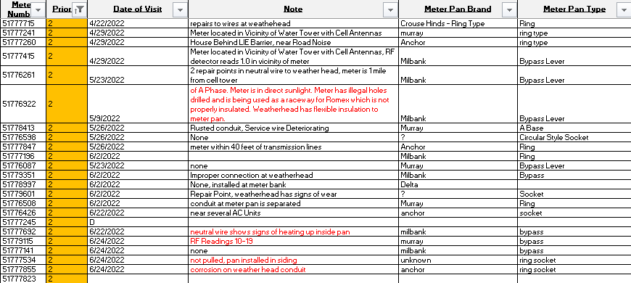
Priority Classifications
Priority 1 – 15 sites, 13 investigations showed issues at the site, 7 hot-socket compromised
Priority 2 – 23 sites, 18 investigations showed issues at the site, 5 hot-socket compromised
Priority 3 – 19 sites, 8 investigations showed issues at the site, 2 hot-socket compromised

Slide 10
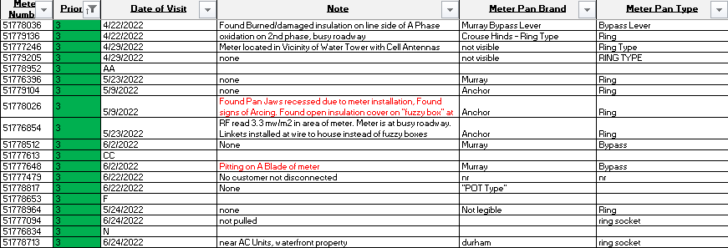
Priority Classifications
Priority 1 – 15 sites, 13 investigations showed issues at the site, 7 hot-socket compromised
Priority 2 – 23 sites, 18 investigations showed issues at the site, 5 hot-socket compromised
Priority 3 – 19 sites, 8 investigations showed issues at the site, 2 hot-socket compromised

Slide 11
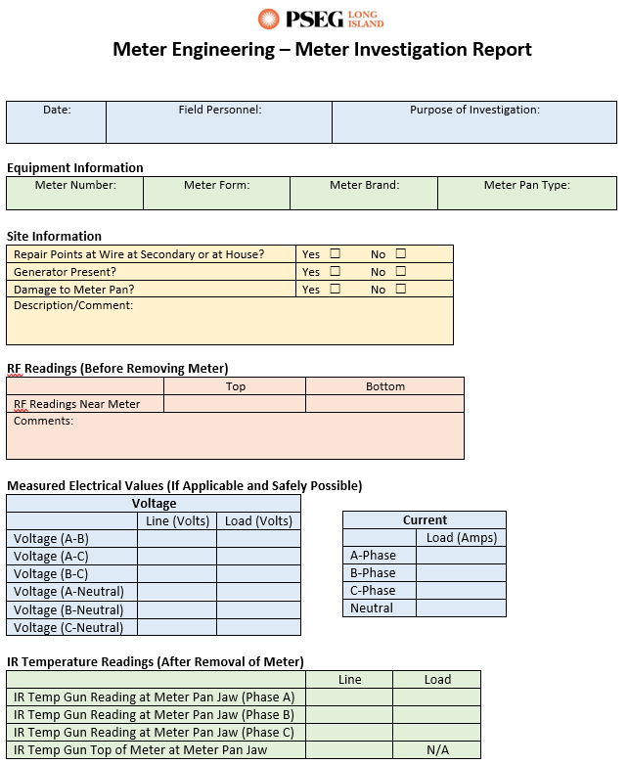
Field Investigations
PSEG Long Island Technicians and Engineers performed site visits
Recorded various site conditions and measurements from each meter:
Condition of meter pan, conduit, weather-head, and secondary wires
Voltage and amperage
IR temperature reading on face of meter and on jaws
RF reading in area of meter
Field Tools:
IR temperature laser
TESCO jaw tester
Multimeter
RF meter

Slide 12
Meter 51****48 – Discoloration on Meter Blade
Days on report with >100 Max Arc Count: 16
Average arc count: 160
Max Arc Count: 320
Arc Sense Priority Level 3
No previous reports of overheating or rise in temperature
Pitting on meter blade
Meter pan did not show any signs of damage or excessive weathering

Slide 13
Meter 51****35 – Discoloration on Meter Blade
Days on report with >100 Max Arc Count: 43
Average arc count: 305
Max Arc Count: 534
Arc Sense Priority Level 1
No previous reports of overheating or rise in temperature

Slide 14
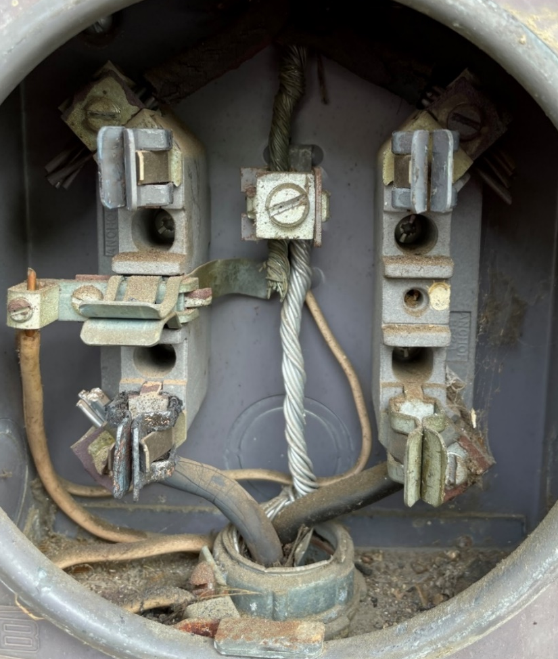
Meter 51****18 – High Temperature Alerts
Originally a non-Arc Sense meter was at property
Meter was reported by Analyst to indicate high temperature alerts
Arc Sense meter was installed in Spring 2022 after high temperature alerts
Arc count and temperature readings were high enough to warrant investigation
Found brittle jaws inside meter pan; meter pan was replaced as a result

Slide 15
Meter 51****26 – Meter Pan with Recessed Jaws
Days on report with >100 Max Arc Count: 18
Average arc count: 278
Max Arc Count: 539
Arc Sense Priority Level 3
No previous reports of overheating or rise in temperature
Recessed springs and discoloration on the jaws
Damaged neutral (as if someone tried to fix the jaws and an uninsulated screwdriver made contact between phase/neutral)

Slide 16
Meter 51****14 – Conduit Allowing Water
Days on report with >100 Max Arc Count: 43
Average arc count: 233
Max Arc Count: 473
Arc Sense Priority Level 1
No previous reports of overheating or rise in temperature
Conduit allowed water to enter into the meter pan
Screw terminal at C-phase load side was rusted and deteriorating
Meter produced arcs when reinstalled

Slide 17
Meter 51****55 – Weather-head Conduit Damage
Days on report with >100 Max Arc Count: 35
Average arc count: 355
Max Arc Count: 1601
Investigation Priority Level: 2*
Moved to priority 1 based on recent top arc counts
No previous reports of overheating or rise in temperature
Meter not removed because customer was not home and it was a non-bypass pan
Technician found damage to weather-head conduit

Slide 18
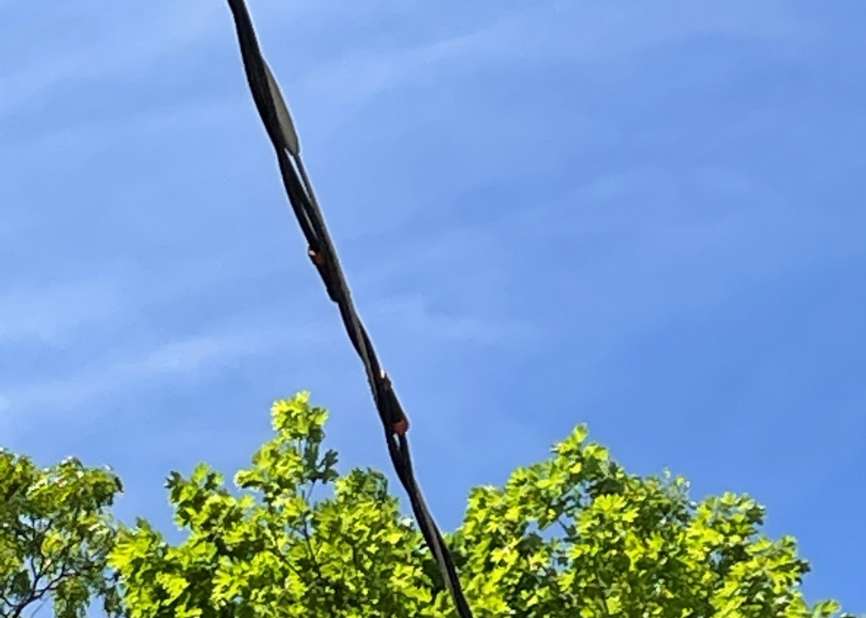
Meter 51****25 – Weather-head + Wire Repair Points
Days on report with >100 Max Arc Count: 56
Average arc count: 247
Max Arc Count: 625
Arc Sense Priority Level 1
No previous reports of overheating or rise in temperature
Damage at weather-head conduit
Found repair points on neutral at triplex to house

Slide 19
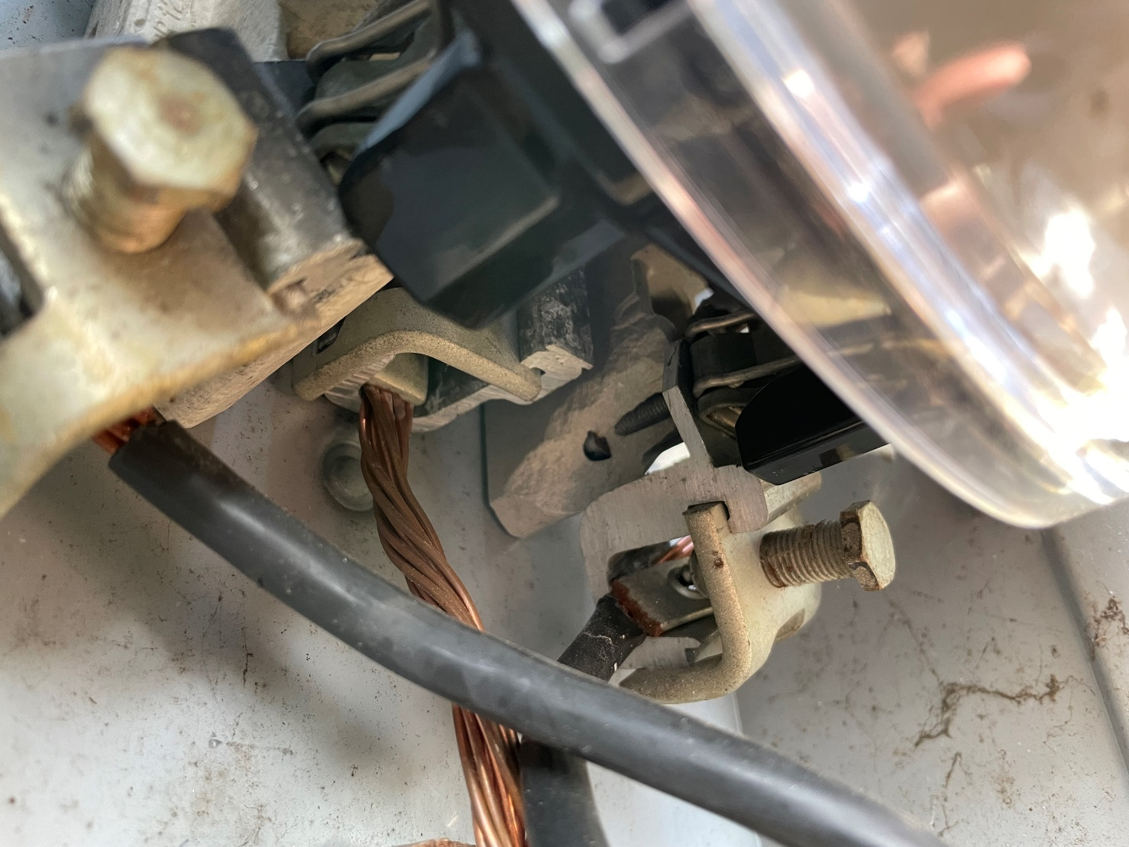
Meter 51****25 – Broken Ceramic Inside Meter Pan
Days on report with >100 Max Arc Count: 93
Average arc count: 236
Max Arc Count: 349
Arc Sense Priority Level 1
No previous reports of overheating or rise in temperature
Technician found broken ceramic on the foundation inside the meter pan

Slide 20
Key Pilot Insights
Value in Arc Detection, Data, and Manpower
Arc Detection: helps to identify meters that may have safety issues
Uses load-profile channel to push as data
Data: allows for analytics to identify trends and identify quality issues
Pushed as daily report via L+G head-end to be interpreted by manpower
Manpower: Analyzes data, informs field force, provides investigation and response to potentially unsafe situations
Specific problems that were identified in this study:
Brittle jaws & recessed jaws
Water damage
Hot socket situations
Current & future
In the short duration of this project, customers have been notified and pan was replaced, thereby avoiding a dangerous situation in the field

Slide 21
Looking Forward
Continuing to evolve
Prioritization Process
Tableau Dashboard
Field Force Checklist
Meter Manager Field Client
Round table results with additional Arc Sense deployments

Slide 22
Comments
Questions

