Slide 1


Hot Rods and Hot Sockets: Maintenance is Key in Preventing Hazards
Prepared by John Greenewald, TESCO
The Eastern Specialty Company
for NWPPA Engineering & Operations Conference
Wednesday, April 10, 2019
3:00 p.m.

Slide 2

Disclaimer – Sensitive Utility Information
This document provides sensitive information concerning a utility’s practices. TESCO and Landis+Gyr provide this document upon request for utilities to facilitate thoughtful internal discussions and to help utilities discuss hot-socket concerns with local fire departments and answering media inquiries.
DO NOT provide this document directly to the public or media to avoid the contents being misused or taken out of context.

Slide 3
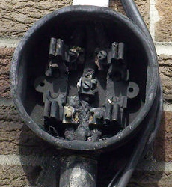
The Issue
Hot Sockets are not a new phenomenon. Virtually every meter man has pulled a meter with a portion of the meter base around a blade melted and virtually every utility has been called to assist in the investigation of a fire at a meter box.
AMI deployments because of the volume of meters involved put a spot light on this issue.
  What causes a hot socket?
  Are the meters ever the cause of a meter box failure?
  What are the things to look for when inspecting an
  existing meter installation?
  What are the best practices for handling potential hot
  sockets?
This presentation will cover the results of our lab
investigation into the sources for hot sockets, the
development of a fixture to simulate hot sockets,
the tests and data gleaned from hot sockets, and
a discussion of “best practices” regarding hot sockets.
We will also cover new technology developed and patented by TESCO and L+G to use the meter to sense a hot socket and forward an alarm in near real time to the head end system.

Slide 4
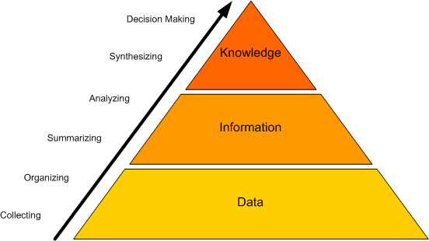
Why do we know anything about hot sockets?
L+G has been investigating hot sockets and how to make their meters withstand hot socket conditions for longer periods of time so the socket has a greater likelihood of being repaired prior to catastrophic failure.
L+G has also been investigating ways to utilize AMI communication to possibly alert head end systems of hot socket incidences.
TESCO has been fortunate enough to be involved in several meter deployments where we supplied full time and part time meter engineers and project managers to our customer’s AMI deployment teams. In this capacity we have been involved in evaluating hot socket issues and helping to determine an appropriate response to actual or potential hot sockets.
TESCO’s meter lab was contracted to develop a laboratory fixture that would simulate the various features common to most hot sockets found in the field. TESCO was also contracted to develop test protocols, gather data and benchmark various conditions and meters.
TESCO has access to a large number of meters which have been exposed to hot sockets both before and after catastrophic failure as well as a limited number of sockets that were hot sockets and did not yet fail catastrophically.

Slide 5
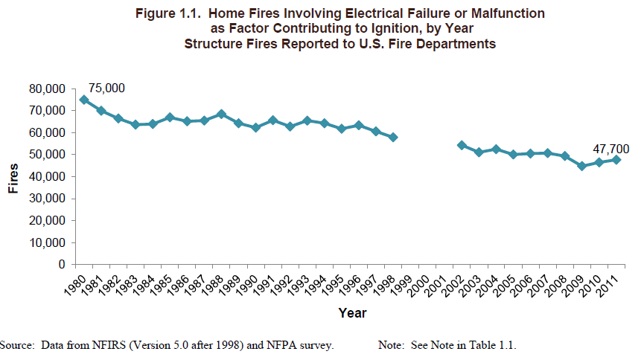
Electrical Fires Generally Decreasing
No NFPA data 1999-2001
National Fire Prevention Association (NFPA) tracks sources of home electrical fires - 2013 report.

Slide 6
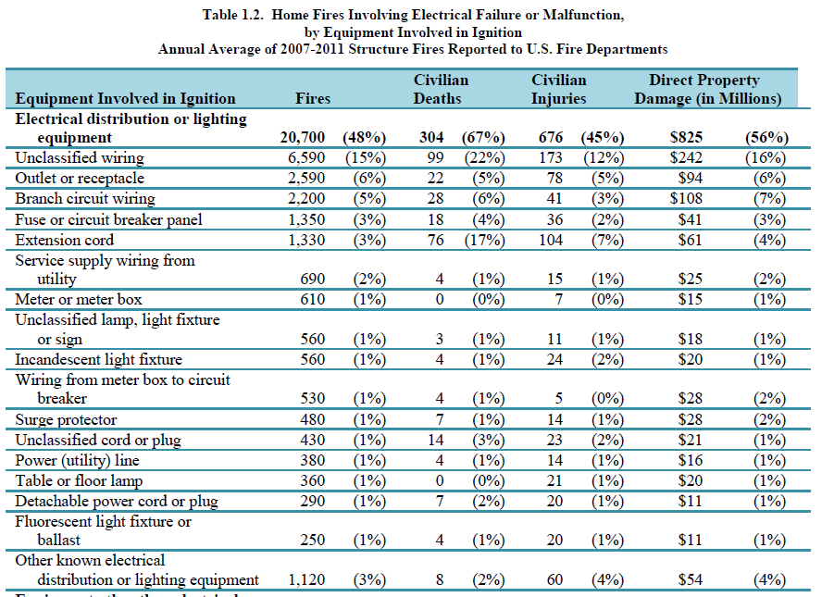
Sources of Electrical Fires
Annualized Rate of Occurrence 2007-2011
610 fires/year in the vicinity of the Meter or Meter Box

Slide 7
Electrical Fires Near the Meter
Annualized Rate of Occurrence 2007-2011
Approximately 141 million connected customers in the United States with approximately 170 Million installed electric meters. Using 610 fires at or near the meter per year yields 3.6 fires per million meters per year without AMI deployments.

Slide 8
Electrical Fires Near the Meter
Annualized Rate of Occurrence 2007-2011
Replacing a meter in an existing meter socket will weaken the socket and if performed enough times this action will create a hazardous condition. AMI deployments will increase the incidence of hot sockets and meter fires unless precautionary steps are taken as part of the meter deployment.

Slide 9
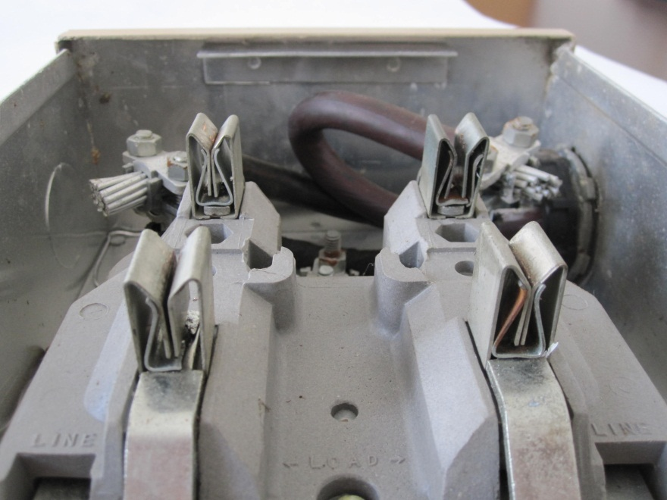
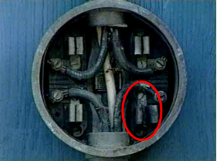
Searching for Hot Socket sources
Common Features and Common Sources of Concern
Pitted and discolored meter blades
Melted plastic around one or more of the meter stabs (typically the plastic around one stab is where the deformation starts)
Pitted and discolored socket jaws
Loss of spring tension in the socket jaws

Slide 10
What are Likely Socket Concerns?
Sprung/damaged jaw
Loose wire termination at line or load side jaw
Meter blade beside and not into socket jaw
Worn line/load wire insulation arcing over to grounded mounting box
Total load exceeding socket capacity – lots of older 100 amp services in the field

Slide 11
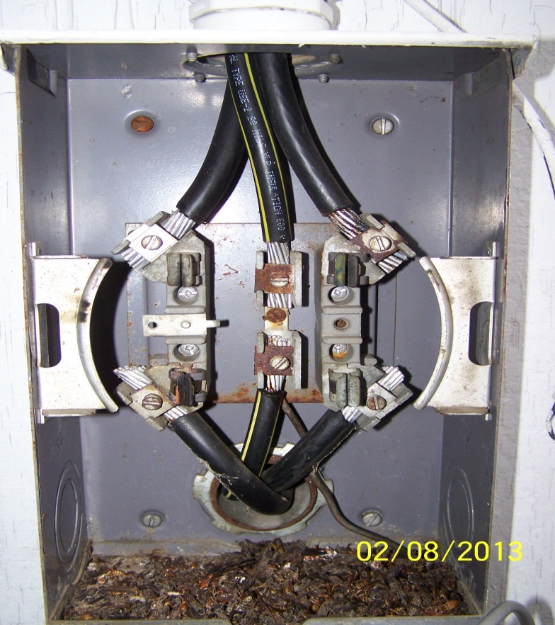

Hot Socket Causes – Sprung Jaws
Tin plating on jaw “cooked”
Heat accelerates oxidation on lug wire
Note: Tin Melts at 232ºC (450ºF)

Slide 12
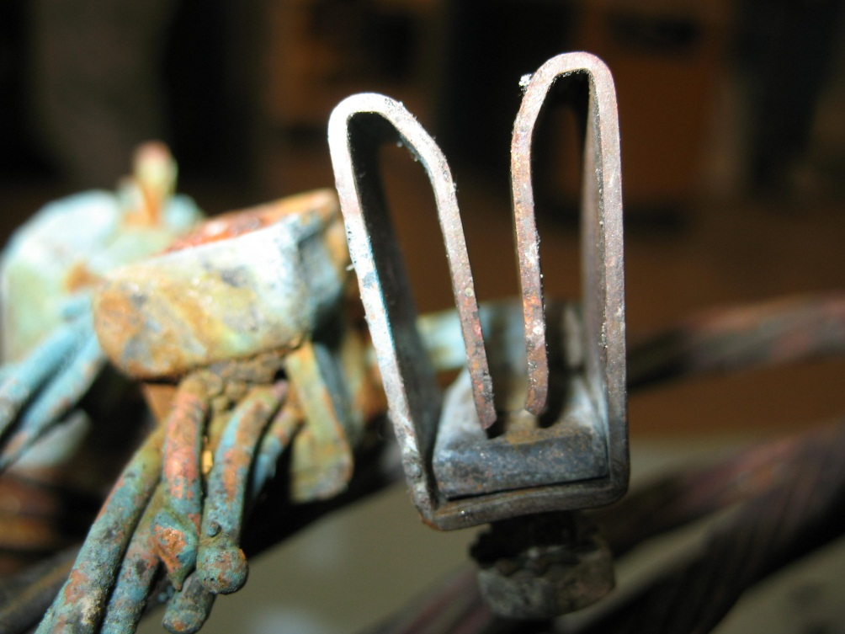
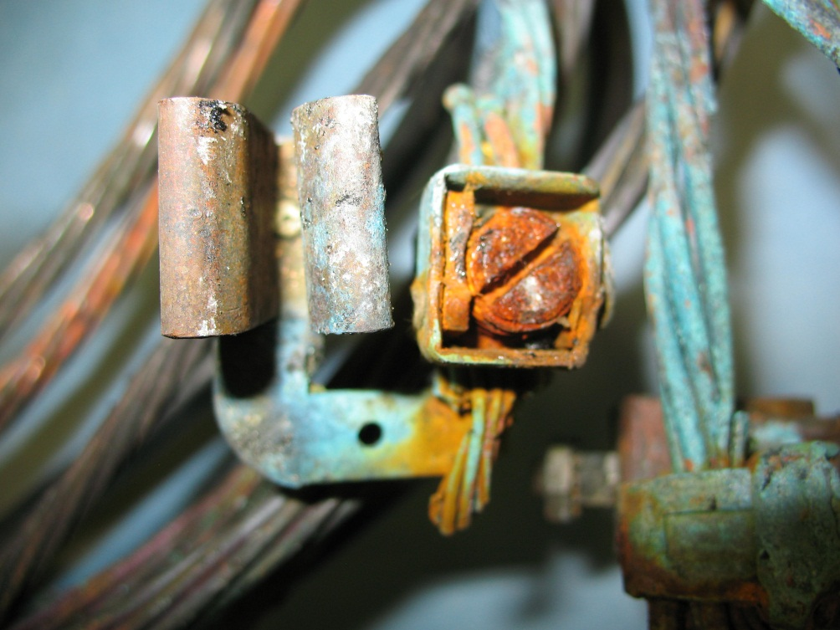
Example – “Sprung Jaw”
Jaw completely separated - large gap resulting in poor connection

Slide 13
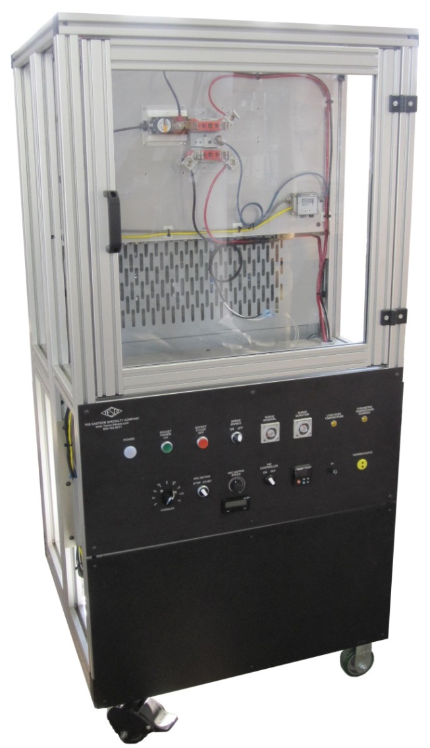

Hot Socket Simulation Fixture
Click to view video

Slide 14
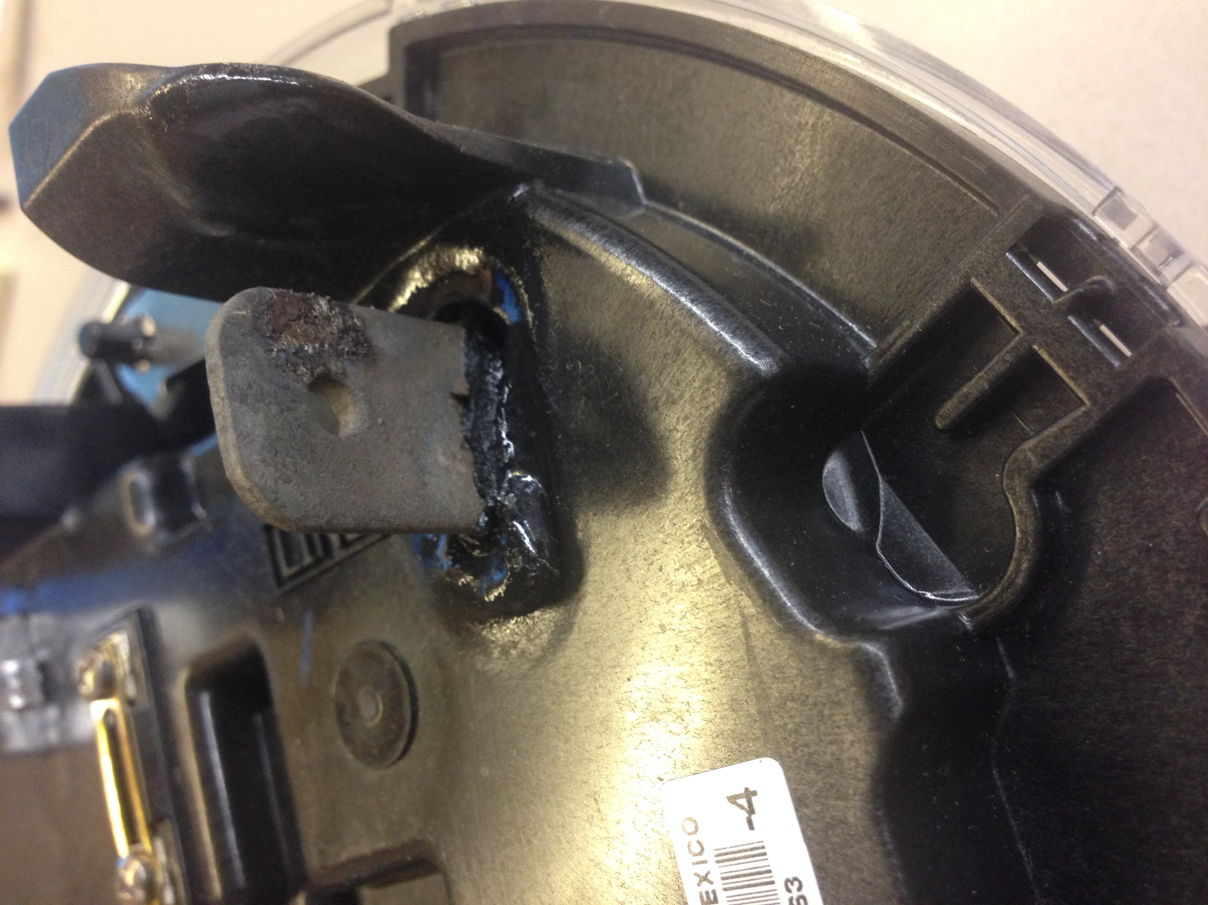

Slide 15
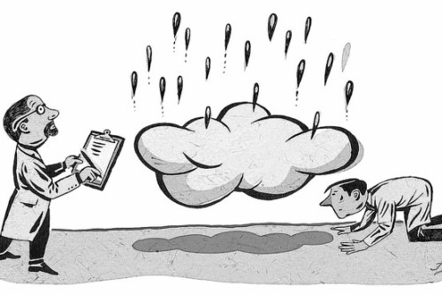
Expected & Unexpected Results
Expected:
Hot Sockets are exactly that – hot sockets. The hot sockets are the source of the problem and not hot meters.
Electromechanical meters withstand hot sockets better than solid state meters
Unexpected:
Current plays only a small role in how quickly a meter will burn up. Meters were burned up nearly as quickly at 3 amps, 30 amps, and 130 amps.
Relatively small amounts of vibration can be the catalyst in the beginning and eventual catastrophic failure of a hot socket. Note: Other catalysts include but are not limited to power surges, debris, humidity, salt water.
Contact resistance plays no role in creating a hot socket
And some newer solid state meters are better than electromechanical meters.
Notes:
15

Slide 16
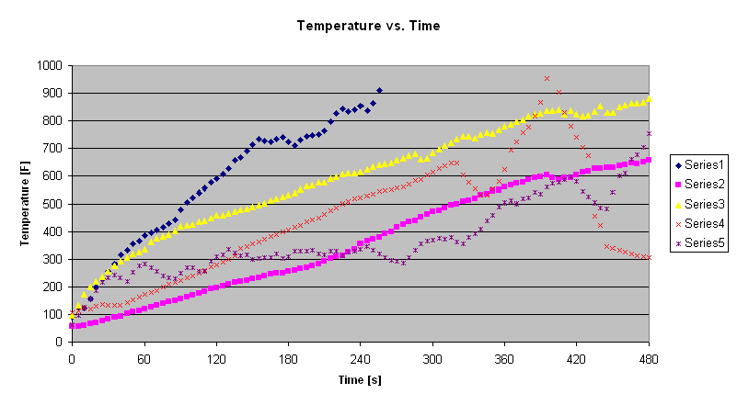
Temperature Rise Data

Slide 17
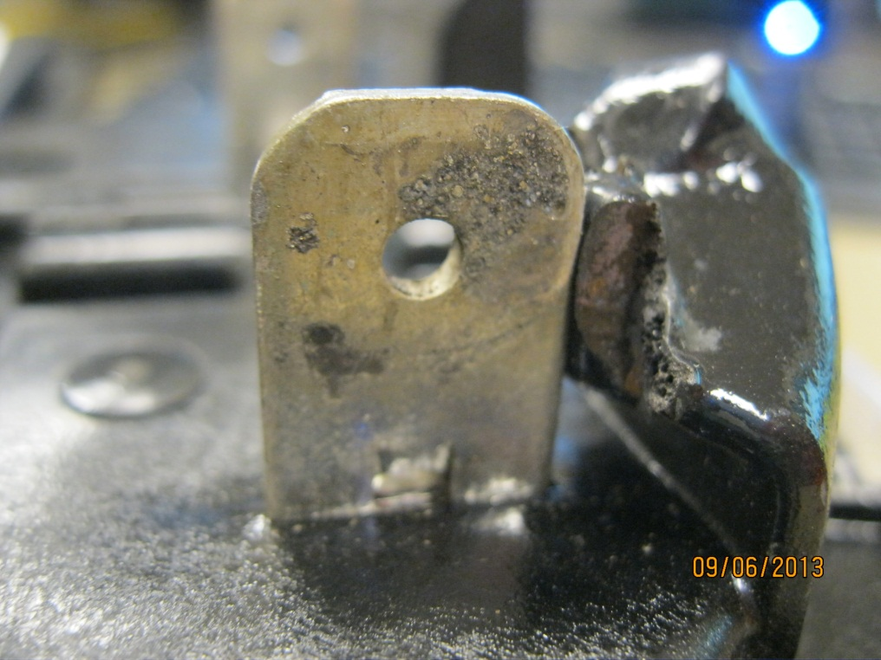
Jaw to Blade Arcing
Jaws with intermittent connections will arc to the meter blade resulting in pitting on the blade.
Blade shows early signs of arcing.
Tin Melts at 232ºC which is lower than the 350ºC base plate plastic.

Slide 18
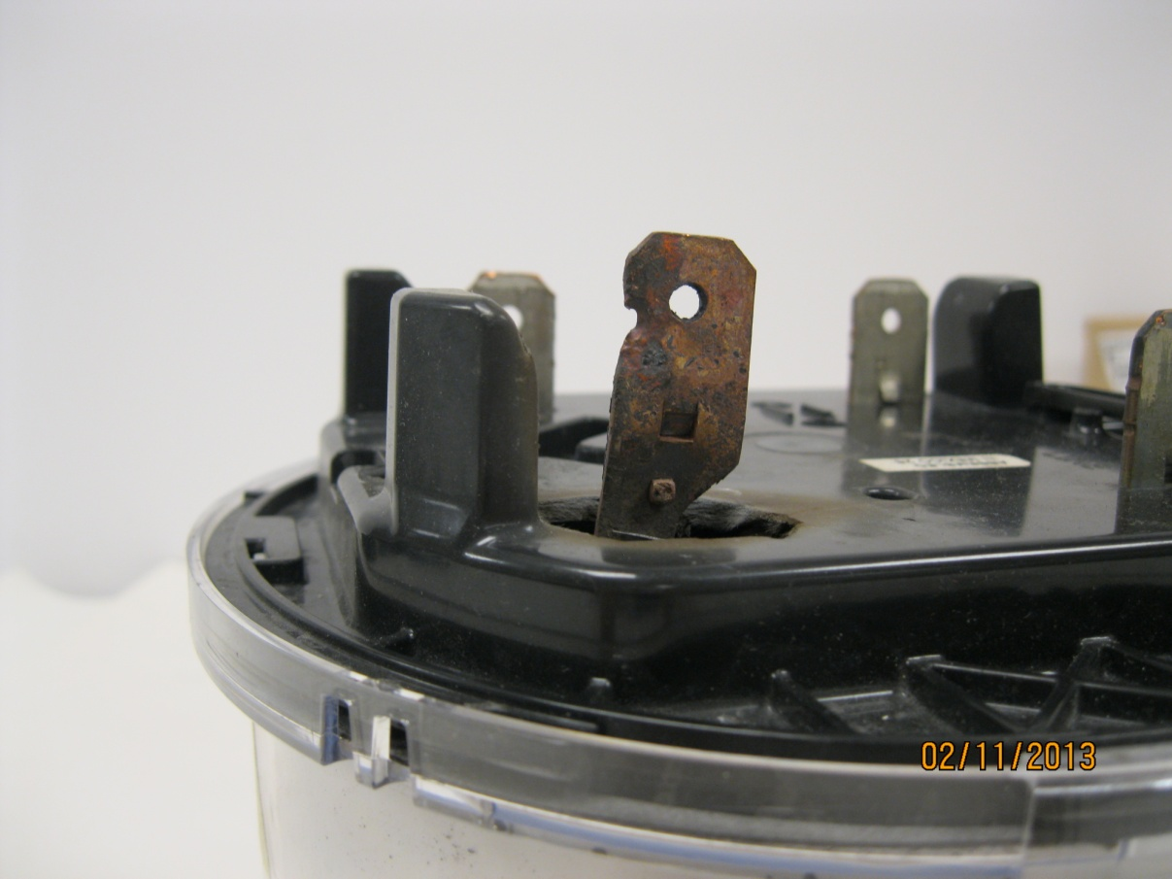
Severe Arcing Jaw to Blade
Tin burned off
Blade hole due to arcing to jaw – Copper melts at 1040ºC (1984ºF)
AX-SD base thermoset plastic melts at 960ºC (1760ºF)
18

Slide 19

What are the necessary ingredients for a hot socket?
There are three necessary ingredients to create a hot socket (Note: We are not suggesting that we have simulated or even understand all causes for all hot sockets and meter related fires, but rather that we have simulated and understand the causes behind most hot sockets and meter related fires);
  Loss of jaw tension in at least
  one of the socket jaws.
  Vibration (or other catalyst
  to initiate arcing)
  Minimal load present

Slide 20

Reviewing the data and learning from the data
Repeated meter insertions degrades the tension in the socket jaws (see graph), but not to dangerous levels
Exposure to elevated temperatures rapidly degrades the socket jaw tension to dangerous levels (see graph)
Visual inspection will catch some but not all dangerous socket jaws
Arcing creates the heat
Exposure to elevated temperatures has a cumulative effect on the meter socket jaw
Relatively small vibration can initiate arcing

Slide 21
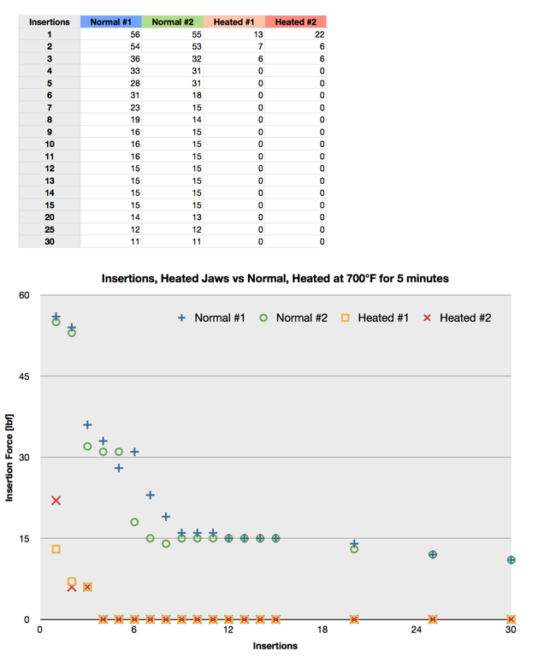

Slide 22

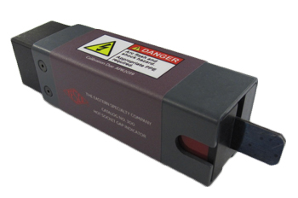
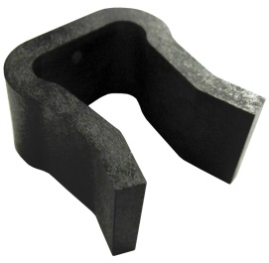
Field Inspection of Sockets
Best Practices
Example field check list
  Gaps in meter socket jaws
  Discoloration of one jaw vs. the other three
  Signs of melted or deformed plastic on meter base
  Pitting of either meter blade or socket jaw
  Loss of tension in meter socket jaws
  Check condition of wire insulation and connections to meter jaws
  Check the overall condition of the box, socket, meter and how they attach to each other and the building.
  Look for signs of tampering
  Look for signs of water or debris inside of the meter can

Slide 23


Who Sees Hot Sockets?
Most AMI deployments utilize third party contractors to handle residential and some self contained non-2S services.
After to or prior to AMI deployments, Utility personnel typically see these sockets
Transformer rated meters typically handled by the meter service department of the utility.
Hot socket concerns with lever by-pass sockets used on 3-phase meters are extremely rare.

Slide 24
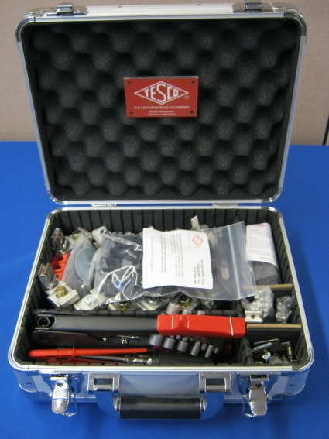
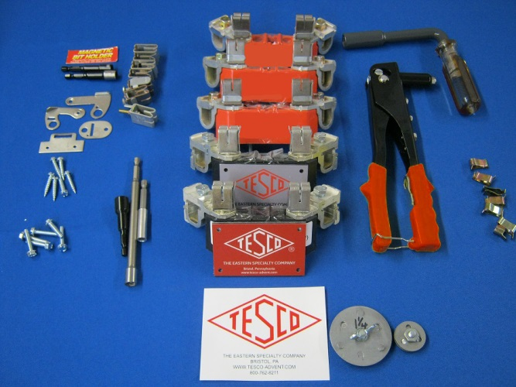
What can be done once a hot socket is identified?
Easiest resolution is to replace the damaged jaw.
Never try and repair a damaged jaw by simply “squeezing” the damaged jaw with a pair of pliers or other tool. The metallurgical properties of the jaw will not magically return and the jaws will simply spread again as soon as a meter is put into the socket.
If the other jaws are deemed to be in good repair, the box and wiring are in good condition and appropriate Socket Blocks are available to effect a repair, then replacing the damaged socket block with a new one is the most expedient and cost effective solution. If any of these conditions do not exist then replacing the box is the best solution.
Notes:
24

Slide 25
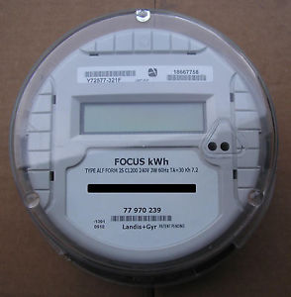
Base Line Data Electro Mechanical meters vs solid state vs the latest generation of meters designed with hot sockets in mind
At the start of our laboratory investigation the oldest electro mechanical meters withstood hot sockets the best
The latest vintage solid state meters withstood hot sockets the least.
Over the course of the past twenty four months virtually every meter manufacturer has begun to release 2S meters designed to withstand hot sockets.

Slide 26

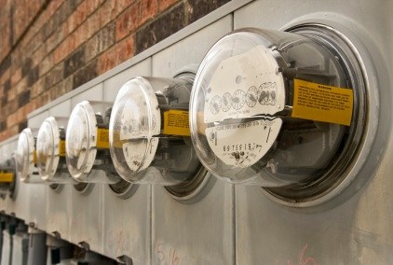
In Search of Hot Sockets
The meter manufacturer’s and various electric utilities have also been looking at a variety of ways to better sense hot sockets.
Utilities who have deployed are looking for a set of alarms that when taken together may give them a better idea that there is a hot socket
Meter Manufacturers have worked on evaluating a variety of temperature levels to send an alarm, disconnecting the meter if there are sustained elevated temperatures, using increased impedance to signify a hot socket, improving the temperature sensors and putting additional temperature sensors on the blades of the meters.

Slide 27
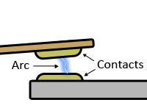
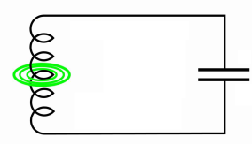
Finding a Hot Socket with a meter – What is known and Keys to these new technologies
Temperature Sensing – sensing the temperature at the metrology board and at the meter stab(s)
Impedance Sensing – detecting a change in impedance in the meter circuit
Detecting the RF signature of a micro Arc with a near field sensor - Arcing emits broadband energy in the form of radio waves. Launching radio waves requires a disturbance in the electric and magnetic fields near where the arc occurs (the near-field space).

Slide 28
Summary of the Problem
Hot sockets start with a loss of tension in at least one of the meter socket jaws. This loss of tension can be from a variety of sources that start as early as improper installation or even “tight sockets”.
Loss of tension is necessary to create the initial micro-arcing conditions.
Sockets with repeated meter exchanges observed to have higher incidence of hot socket issues and “booting” a meter may spring jaws even more.
Vibration appears to be the most common catalyst to the micro-arcing that creates the initial heat in a “hot socket”.
The meter must have some power, but current is not a significant factor in how quickly or dramatically a hot socket occurs
The effects of vibration and weakened jaw are cumulative

Slide 29
Summary of the Potential Solutions
Meter Manufacturers have all been working on the design of their meters to better withstand a hot socket. These new meters have better baseline performance than even the older electro mechanical meters, but a hot socket will eventually burn up even the most robust meter.
Thorough visual inspections of all services when replacing a meter whether for AMI or not
Hot Socket Indicator inspection for all jaws. This is a non-invasive way to check that the minimum safe holding force or greater is present in all socket jaws.
Hot Socket clips. Allows for the meter tech to leave the service as safe or safer than when the problem jaw has been identified.
In Meter circuit for near real time detection and alarm to the head end allows the utility to identify compromised jaws before they damage the meter and before they become dangerous to the rate payer or tenant.

Slide 30
Hot Rod Maintenance Checklist to add to parts of the presentation
Automotive experts often suggest you drive your hot rod at least once a month, if possible. That’ll make sure the battery has enough juice to fire up the engine, and it also gives the parts a chance to move around.
Driving once a month also circulates fluids and helps keep our radiator in better operating condition.
Brake fluid should be changed each year regardless of how often you drive it. When your car sits for long periods of time, the brake fluid can attract moisture from the atmosphere, even if it’s in an enclosed storage space, and that compromises its effectiveness.
Change muscle car oil every three months
It typically takes a solid 30 minutes for an engine to cool down enough for it to be safe to handle.
Exterior: Your car can attract dust while sitting in the garage, and every time you take it out on the road, you’re picking up damaging elements like exhaust from other cars, tar and grime from the road and bugs. All of this can cause deterioration and scratches on your paint. Keeping your car clean can protect and preserve your custom paint job.
Car cover?

Slide 31
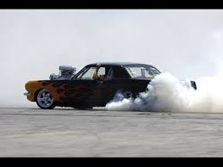
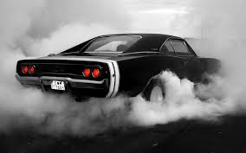
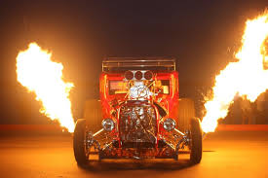
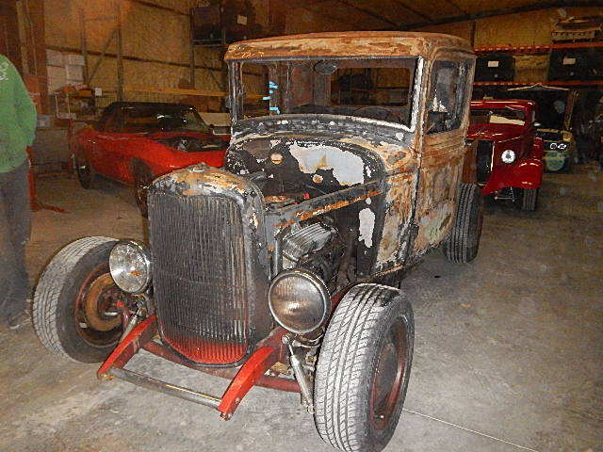
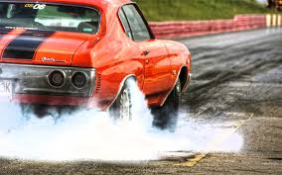
Hot Rod Images for Presentation

Slide 32
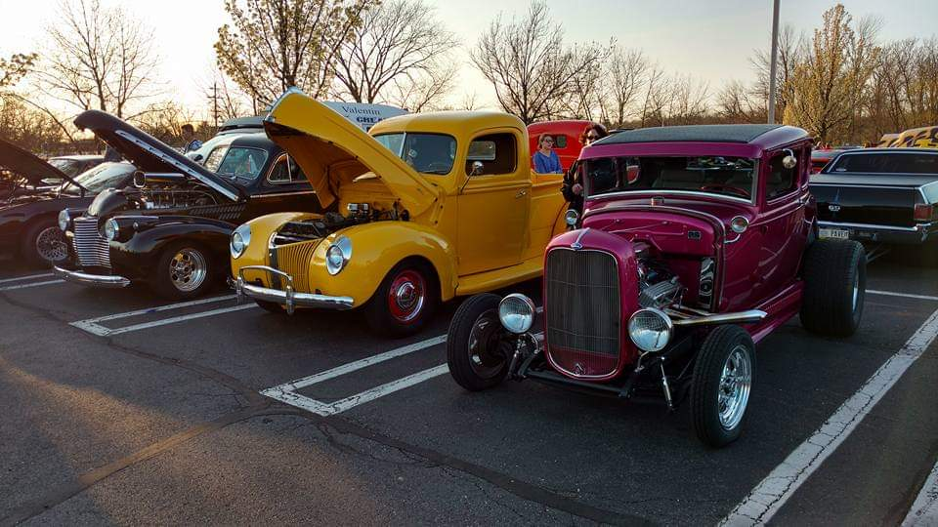
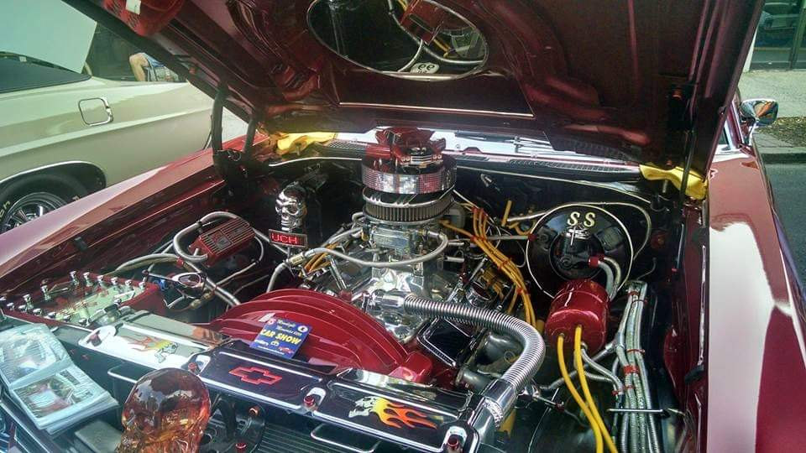
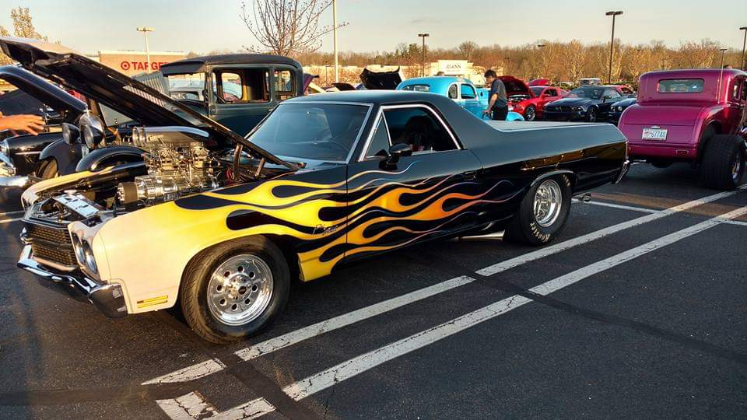
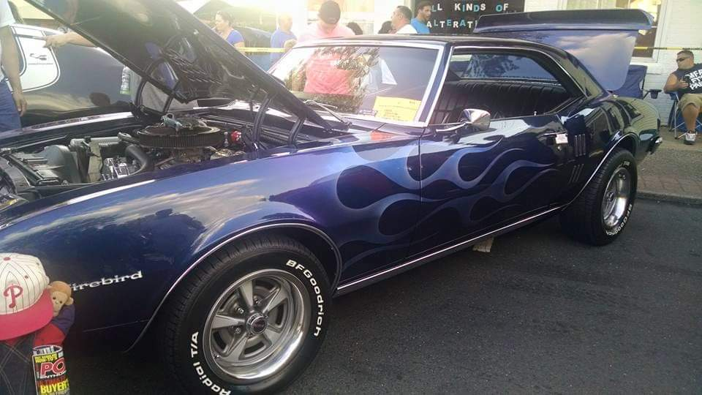
Hot Rod Images for Presentation

Slide 33

Questions and Discussion
Tom Lawton
tom.lawton@tescometering.com
TESCO – The Eastern Specialty Company
Bristol, PA
215-785-2338
This presentation can also be found under Meter Conferences and Schools on the TESCO web site: www.tescometering.com

