Slide 1
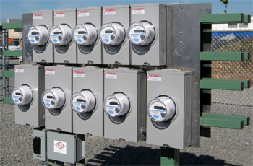
Meter Asset Tracking and the Power of Analytics in an AMI System
Prepared by John Greenwald, TESCO
The Eastern Specialty Company
For AlcaraConnect 2019

Slide 2
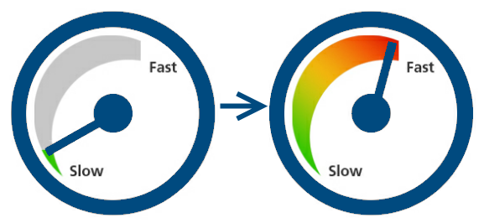
Introduction
Today we will discuss how Asset Tracking for Metering has changed dramatically over the past dozen years and what the term “asset tracking” will mean for meter services in the future. We will also discuss how the data being harvested from our new AMI systems is changing our Operations.
In the past we had corporate asset management systems that originated on the financial side of the business and we had meter record systems that handled all metering test results. Between the two we would have all of our bases covered.

Slide 3
When Taken in Hostile Territory Provide Only Name, Rank, and Serial Number
Traditionally investor-owned utilities have used asset management systems that were created by in-house personnel or purchased in the 1980’s and early 1990’s or were based on Main Frame systems from even earlier years. Most have either have recently converted or are in the process of converting to systems like SAP and Maximo and other enterprise level solutions.
These older systems and the newer generation of enterprise solutions want to track assets in a fairly conventional manner. Name, rank and serial number…..in this case, asset description, location, and serial number.

Slide 4
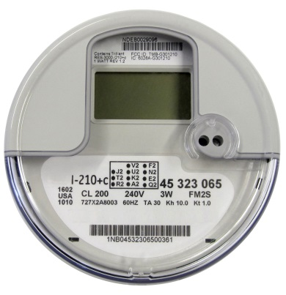
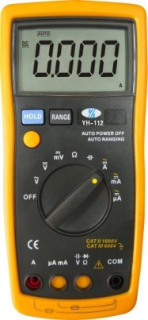
Meter Service Department Territory
Meter Service Departments have typically been tasked with tracking:
The meters on the system
Instrument transformers
Rubber goods
Additional Personal Protective Equipment (PPE)
Instruments (a catch all that mean anything from chainsaws to underground equipment depending on the utility).

Slide 5
Requirements When in This Territory
Meter Services has never been asked to only handle name, rank, and serial number.
For meters we also needed to maintain and provide upon demand test results for all meters from when they were purchased until the day they were retired and then for some indeterminate amount of time after that. We also needed to know the manufacturer and the type of meter and any other pertinent technical information (which was minimal once upon a time).
For Instrument Transformers we needed to maintain similar test information as well as manufacturer, type and ratio. When dual ratio transformers came along we needed a system to report on which ratio was being used.
For Rubber Goods we needed systems that tracked which rubber goods went to which individual or department, when they had to go and when they last were tested. For the safety of our personnel we had to ensure that no one had outdated rubber.
For instruments we typically needed to track calibration dates and service dates.

Slide 6
How We Used to Cope
To do this we had a combination of:
Targeted software solutions from vendors
Excel spreadsheets
Home brewed Access databases
And life was reasonably good!

Slide 7
Moving Into the Future
This is not the situation we find ourselves in today. We still have all of the original responsibilities. And we have more.
In recent years we have had to revisit and answer fundamental questions such as “What is a meter?” Is a meter everything under the cover or is the meter only the energy measurement portion of the device?

Slide 8
AMI and Increased System Features
As an industry we have stayed with the obvious – the meter is everything under the cover. This now includes several disparate components potentially from multiple manufacturers and all serialized by their various manufacturers:
The energy measurement and display component
The communication device
The disconnect device
Additionally both the energy measurement component and the communication device have firmware versions that may need to be tracked.
As utilities prepared for AMI deployments, they quickly realized the traditional asset management systems that had originated on the financial side of the business, as well as the meter record systems that handled all metering test results and the myriad of spreadsheets and offline databases were going to be woefully inadequate to handle the data required for this next generation of metering.

Slide 9
Where Does Traditional Asset Management Fall Short?
Traditional systems fall short in several areas;
Inability to track multiple serialized devices under the cover or a single meter
Inability to swap these same devices or to add additional devices at some later date
Inability to track firmware versions
Inability to track functional test results as well as accuracy results
Inability to track site information for transformer rated sites
Inability to seamlessly handle Rubber Goods, Instrument Transformers, collectors (and their serial numbers and their firmware versions), and other devices now integral to Meter Services.
Inability to continue to grow with the technology as this technology advances.

Slide 10
So Where Does This Leave Us As We Continue To Embrace AMI?
We are approaching 50% AMI deployment in North America and the Northeastern portion of the U.S. is now poised to jump in with both feet. By the time the Northeast is mostly deployed we will be over 80% deployed throughout North America. Some of the early adopters are already looking at the next generation of technology and trying to determine whether they can upgrade or will they have to change their metering technology.
For all of us, an AMI deployment will be the single largest meter related asset purchase ever made by our utility. How we manage and track these assets is critical to the success of every AMI project and for the operation of the meter services department after an AMI deployment project is complete.

Slide 11
Enterprise Solutions
As mentioned earlier many Utilities are adopting enterprise-wide solutions
Typically they are implementing either just before, at the same time, or just after these installations meter-specific solutions that will handle this next generation of requirements
On occasion they are trying to use the enterprise level solution to handle all of their needs
The enterprise solutions never have the ability to handle everything a Meter Services Department requires so they either continue to attempt to use offline spreadsheets and databases or they implement bolt-on solutions

Slide 12
What Is the Industry Using as We Continue to Embrace AMI?
The enterprise solution providers have long recognized this and have done an excellent job of providing the documentation and ability to bolt-on and provide the utility with the extended functionality that they require for today’s meter services operations
The enterprise solution provider typically promotes this as a feature of their solution
Utilities can either provide a third-party solution or an internally prepared solution to meet their needs now and in the future

Slide 13
Bolt-On Capability – An Insurance Policy for the Future
This will hopefully mean that the Enterprise Solution provided will be able to serve the Utility for the indefinite future.

Slide 14
What Do We Need to Make This a Reality From a Meter Services Perspective?
Start by examining our process and go from there. Throw out what we used to do and used to know and start thinking about interoperability of different systems.
The meter manufacturers should be able to automatically interface and send their accuracy data, firmware levels, alarm settings, and other pertinent data to the utility.
The utility should be able to automatically send operational data to the meter manufacturer or other manufacturer regarding equipment shortcomings or failures.

Slide 15
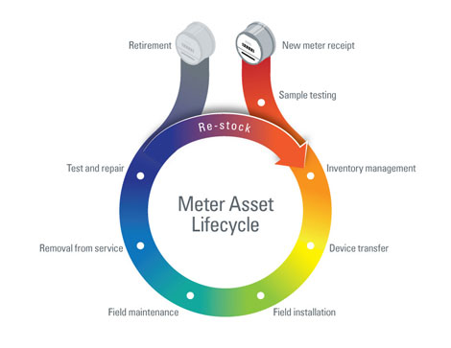
Typical Meter Life Cycle
New Meter Purchase
Purchase Order
Vendor File
Meter Receiving
Acceptance Testing
Device Creation in Customer System of Record
Device Release to Stock
Used Meter Processing
Meter Check-in
Meter Testing
Device Restocking

Slide 16
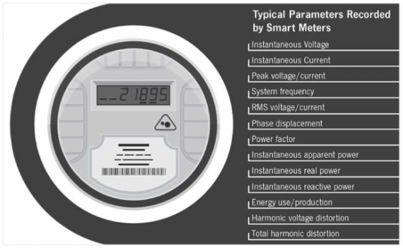
Typical Meter Life Cycle (Continued)
Asset Tracking
Track Inventory within shops / warehouses / storerooms, down to the container and/or shelf
Track Inventory to the person or truck
Meters are assigned to the person / truck
As meters are set, they are removed from inventory
Used meters are tracked from removal to meter shop
Physical inventory counts may be performed at any time
Quality management
Detailed analysis of meter performance
In-service random sample and periodic test plans
Full RMA tracking

Slide 17
Asset Tracking Summary
Use the Enterprise Solutions to manage the Utility and provide the backbone for all operational groups.
Use bolt-ons to handle new AMI related requirements.
Continue to look at bolt-on solutions as new AMI and post-AMI features are introduced to handle the new requirements that result from them.
Look at your Enterprise solution as the backbone of a complete and seamless solution for the entire utility. Your bolt-on becomes part of the whole.
Work with vendors to provide better interfaces that are more similar than different from other ones you are already using in your Corporate systems.
Make sure that all of the systems work together and transfer data seamlessly – even the Enterprise Solution providers have a hard time with that at times.
Make sure that all of your hardware can interface into these systems seamlessly.
This is one area that no Enterprise provider is good at
This is where your bolt-ons will excel and will allow your Enterprise solution to last indefinitely.

Slide 18
The Promise of AMI - Data
The introduction ten years ago and the continued development of an Advanced Meter Infrastructure (AMI) system promised more effective and more efficient Meter Service Operations.
This was to be accomplished in a variety of ways starting with:
No need to read meters (if AMR had not previously been deployed)
No need to roll a truck to perform a disconnect or a reconnect
Better ability to detect and respond to outages
Better ability to detect theft
Better ability to detect (and eventually capture) unbilled energy
Better understand customer usage and make better energy buying decisions
And with all of this came a promise of “Additional Capabilities and Additional Operating Data.”

Slide 19
A Flood of Data: The Promise and Curse of AMI
And so the data started coming in.
Once the investment in gathering this data was made the problem quickly moved from the collection of this data to developing the tools and infrastructure to analyze this voluminous data.
There was far more data than could be analyzed or even utilized at first.

Slide 20
Moving Into the Future
Utilities now collect hundreds of millions of events and readings every day from sources such as the following:
Meters (status, manufacturer, purchase date, events such as reprogramming notifications and tamper alerts)
Transformers (ID, circuit section, circuit ID)
Service points
Customer accounts (type, status, billing cycle)

Slide 21
What Data Are We Getting and How Are We Using It?
Meter quality assurance: Focusing on meter reading performance enables utilities to ensure AMI reliability. For instance, when meter readings are expected but not delivered, the system takes note, and calculates overall performance statistics for the AMI system. Utilities are made privy to problems they never would have been able to identify in the past.
Good Start

Slide 22
The Basics
Outage event analysis and prevention: Integration enables real-time, accurate, and complete outage event analysis that helps identify nested outages and optimize field crew dispatch – all to support efficient response and restoration.
We can often determine the exact piece of equipment causing a problem, along with the customers directly impacted by it.
We can use outage information that is delivered along with meter readings to identify and track outages.
These outage event reports help us to understand the overall impact of outages, then drill down to find the problem areas in the distribution network.
We can then isolate areas of high impact and work to understand how to address them.

Slide 23
And Of Course…Report!
We can filter planned outages and momentary from this data for reporting purposes and provide meaningful customer satisfaction and performance measures and trends
Average interruption durations
Number of interruptions
Number of customers impacted
These system performance indexes and information can be shared with management, regulators, customers, media, and other stakeholders.

Slide 24
What Else?
Gain a better understanding of events, as well as what they mean. For instance, we can correlate power outage events or voltage alarms with the transformers involved to identify faulty or aging infrastructure. And we can roll trucks between 8 AM and 4 PM, Monday to Friday on non-storm days.
Generate new customer insights
Size distribution assets
Implement preventive maintenance techniques
Forecast and build predictive models for demand program planning
Develop new rate plans and services for customers
Address Line Loss in a meaningful and impactful way

Slide 25
Line Loss
Network energy inventory balancing – You can accurately compare feeder energy to aggregated meter data to track down unbilled energy. Some may be energy theft. Some is not but is still actionable once the root cause can be determined.
Meter events and usage information can help paint an overall picture of what’s happening with a customer’s energy usage over time as well as the usage from an entire sub station. This unified view can help detect energy theft, meter tampering or a host of equipment problems that may be affecting service levels.
Some typical filters for theft: Customers can be identified who have active accounts but no recorded usage, or the converse – energy usage but no active account. Customers with gas usage but no electrical usage over months or even years, indicate a very likely candidate for investigation, voltage issues for one customer and not others on the same transformer.

Slide 26
What Else?
Potentially bad metering
Non metering of certain usage
Failing equipment and bad connections
Bad GIS integration and information. To make any of this work we need an up to date and integrated geographic information system (GIS) geodatabase. We need to be able to link our meters accurately to the rest of the system along with every other piece of equipment between the sub station and the meter. The initial investigative work will uncover not system errors but GIS errors and holes. Once corrected this work will begin to uncover correctible losses.

Slide 27
Longer Term Planning
Load profiling – You have accurate and highly granular transformer load profiles, especially significant for effective distribution planning when electric vehicle (EV) charging and distributed generation are involved. What will the impact on your system be as isolated pockets of users influence each other and purchase electric vehicles; adopt home level energy storage and renewable energy solutions.
Pricing analysis – Perform ‘what if’ rate and load shift analysis. Compare current tariffs with alternative pricing scenarios. Estimate energy costs for a new rate at different load levels.

Slide 28
What Are Some of the Challenges in Analyzing this “Flood of Data?”
The first issue is that currently data required for complete meter data analytics solution does not reside in the same database. While there is tremendous real time data being collected the information required to complete many types of analysis may reside in other data bases (e.g. system mapping data).
Another challenge is that while the MDM is configured as a “Fast Write” data base, since it needs to quickly record large volumes of real-time meter information, a useful analytics tool needs to be normalized for “Fast Reads,” since it needs to provide fast access to data for users looking for real-time insights.

Slide 29
Additional Challenges?
No impact on billing: Making sure that you can analyze the data in the MDM system (the “system of truth”) without impacting basic billing operations in any way. As important as meter data analytics is, this capability cannot interrupt billing and other operational systems in terms of performance, data corruption or functionality. Bottom line: The analytics capability cannot threaten the utility’s ability to collect revenues.
Near real-time: Lastly, in order to retain its value to executives, engineers and operational staff, data analytics need to be performed in as near real-time as possible.
The ultimate goal: To establish a repeatable data analytics discipline and infrastructure to reduce the time, cost and complexity of each incremental capability, and with the lowest risk possible to the existing MDM functionality.

Slide 30
New Skill Sets
Utilities also need new skill sets to be able to perform this analysis. To use this data we need:
Data base experts
Metering and operations experts
Business analysts
In a perfect world all of these characteristics are rolled up into one. In a less perfect world into two. And is an even less perfect world – three individual groups or people. But too many utilities are missing one or more of these groups or people even after completing their AMI deployment.

Slide 31
New Tools
Advanced visualization tools – Built-in tools provide an alternative to cumbersome data tables and provide enhanced visibility of your smart meters, AMI network, and distribution network
AMI system health dashboards – A custom definable user interface enabling a visualization of real-time events and trending

Slide 32
Summary for Analytics
We are finding new uses for the data we are receiving as we continue to use these systems.
This data is enabling us to roll fewer trucks for emergencies
This data is allowing us to identify weak spots in our infrastructure and correct them between 8 AM and 4 PM Monday to Friday on non-storm days.
The data is allowing us to perform long term planning and perform far better rate analysis for proposed new tariffs and to even help create new tariffs.
The data allows us to better evaluate performance of hardware on our infrastructure.
The data gives us the tools for the first time to measure, identify, and go after “system loss” in a meaningful and actionable way.
Meter data analytics will enable utilities to tackle the biggest problems we face today, including failing transformers, unbalanced energy generation based on imprecise forecasts, operational inefficiencies and even addressing and reducing line loss.
To do this we an analytics platform to allow us to provide the infrastructure to perform this work, dedicated personnel with both new and old skill sets and new tools for them to use.

Slide 33
Questions and Discussion
John Greenewald
John.Greenewald@tescometering.com
TESCO – The Eastern Specialty Company
Bristol, PA
215-785-2338
This presentation can also be found under Meter Conferences and Schools on the TESCO web site: www.tescometering.com

