Slide 1
AMI & Transformers
Using AMI Data to Appropriately Size Instrument Transformers and Improve Billing Accuracy
Prepared by Tom Lawton, TESCO
The Eastern Specialty Company
For EEI
April 16, 2024
1:00 PM
Notes:
1

Slide 2
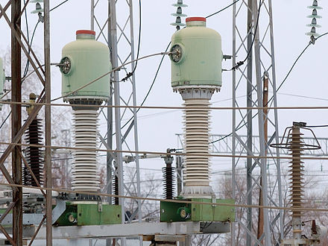
Standard Practice that has caused an issue across all of our systems
Standard practice in our industry is to set Instrument Transformers when there is a new application for service;
Either new construction
Upgraded service
Once set based on these applications the services are left in place regardless of changes to the use of the space by the owner or tenant and without regard to changes in ownership or tenants.
This Photo is licensed under CC BY-SA

Slide 3
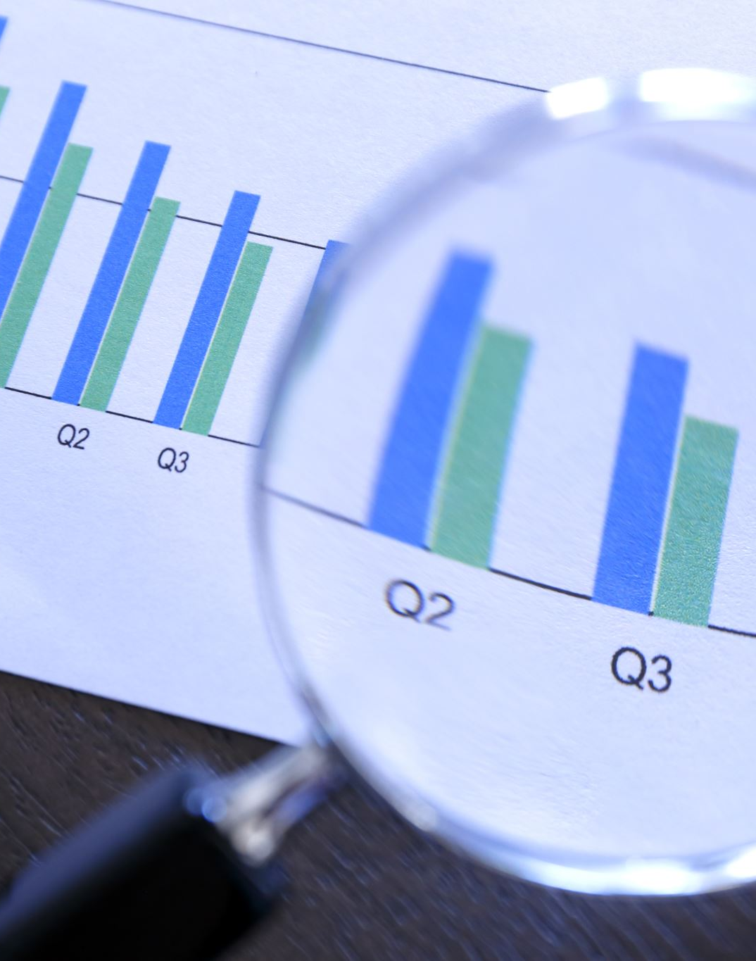
Resulting Issue
Over sized instrument transformers providing inaccurate and incomplete bills that do not reflect the actual usage by the customer resulting in under billing of significant revenue leading to problems for both the utility and the customer.

Slide 4
Why are they always oversized?
If the service was inadequate for the new customer use a new service application would be submitted and the utility would have the opportunity to review the usage and install properly sized instrument transformers. No resulting problem.
If the service is oversized for the new usage the customer has no issues and does not need to submit any new usage application.

Slide 5
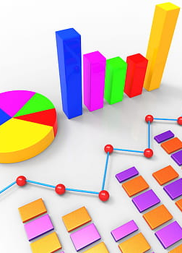
What is the problem with these oversized services and why should we not leave them in place?
The trend across the country over the past seventy years is for manufacturers to either move out of a facility for a larger facility or a facility in a different region of the country or to move offshore. These are typically the larger users with the larger services.
They are historically replaced with new tenants or operations using significantly less power. At times single digit percentages of what was once used. Even when the owner does not change manufacturing space is one region may be changed over to a warehousing operation for the same company or the building sold to a light manufacturing operation or a storage operation for industrial or residential goods. In all of these scenarios the usage is dramatically less.

Slide 6
What is the problem with these oversized services and why should we not leave them in place?
If the trend reverses and a new manufacturing operation is moved in the service may still be oversized by a factor or two or three, the operation may only operate on one shift and not four or the operation is well suited for the service, or the services needs to be increased. If increased the problem is solved. If adequate for the new operation that is nothing but dumb luck – rarely a good business plan, and if over sized still the problem has been lessened but not eliminated.
This Photo is licensed under CC BY-SA-NC

Slide 7
New Technology and better practices allow for significantly better solutions
The first and best opportunity to apply new technology are extended range transformers. The ability for these transformers to reach down to less than 5% of the rating with Thermal rating factors of 2 and 4 give the utility the ability to appropriately size a transformers for even a one or two shift heavy industrial facility without fear of losing any significant revenue.

Slide 8
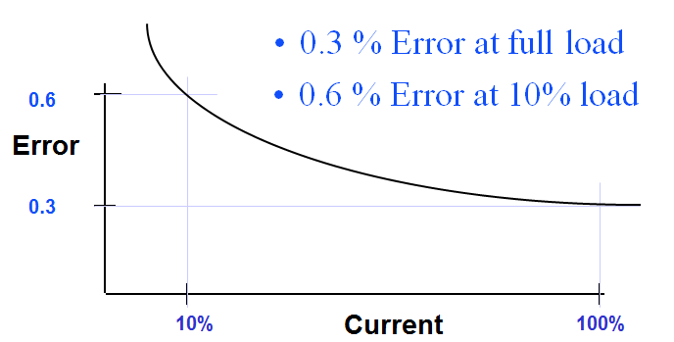
How much revenue can be lost?
In addition to burden (secondary load), a CT’s accuracy is affected by the Metered Load (primary current).
The limit of permissible error in a current transformer for a given accuracy class has one value at 100% rated current and twice that amount of error at 10% rated current.
Below 10 % rated current, error may be as much as 5 – 10 % and continues to increase as the load drops..

Slide 9
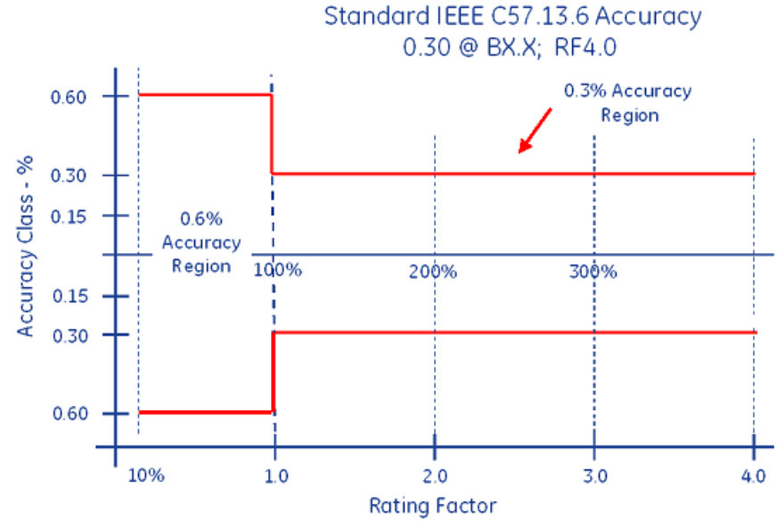
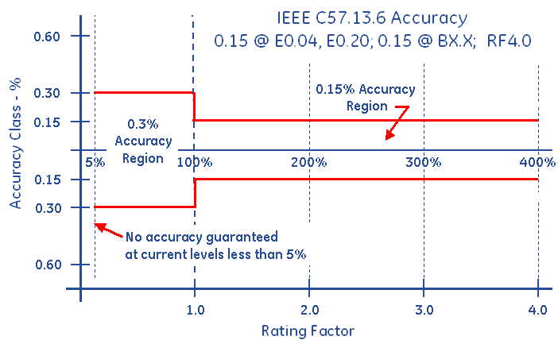
How much revenue can be lost?

Slide 10
How much revenue can be lost?
Assume we have 800:5 standard Transformers where the service never reaches 80amps of draw on a 480v service and on nights and weekends is often below 20 amps.
This single service could be underbilled by $2,000 to $4,000 per month or $24,000 to $48,000 per year.

Slide 11
How do we find them and what do we do?
The what we do is clear.
We remove the old transformers and replace them with appropriately sized extended range transformers.
The site gets a complete refresh and ensures that any other safety or site errors are corrected at the same time
Billing errors go away and the customer is correctly billed
Multipliers can be confirmed between the field and the billing department
Revenue increases paying for the new installation in a matter of months

Slide 12
How do we find them?
Once again, we use the latest technology and tools available to us. We can use our basic AMI 1.0 data to assist and eventually can use our AMI 2.0 systems to allow us to report and respond even faster to these opportunities to improve billing accuracy across our systems.
Image used courtesy of Adobe Stock

Slide 13
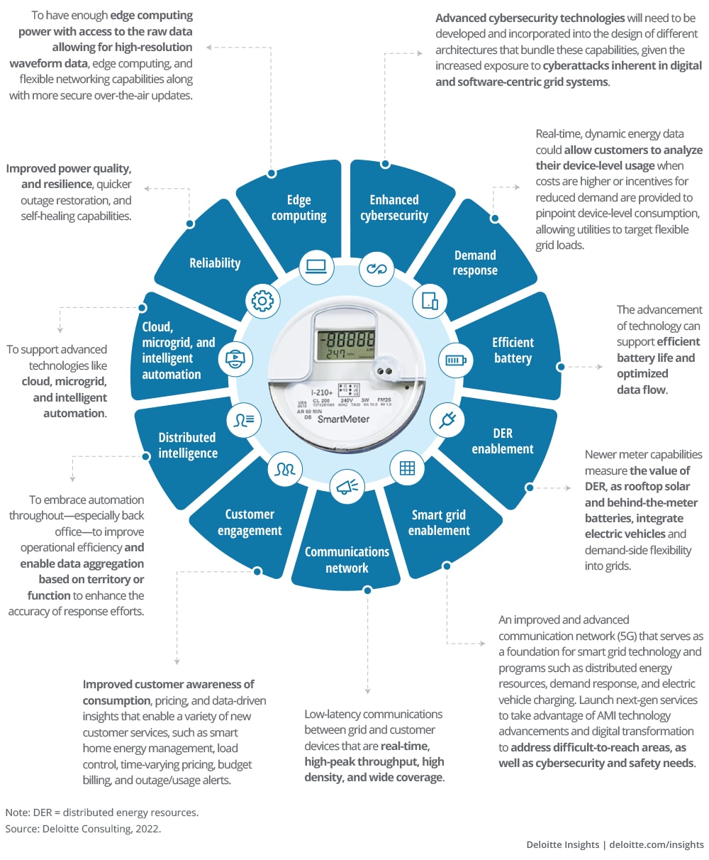
AMI 2.0
AMI 2.0 uses edge-computing devices with advanced capabilities that enable a better understanding of how electricity is used or generated—in real time.

Slide 14
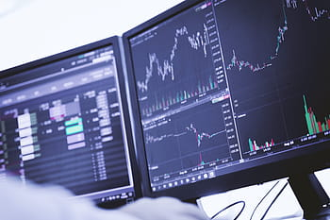
How do we use these tools to provide actionable work orders for our Meter Service teams?
Data that we have or can get with some level of effort;
Customer usage
By whatever interval we are gathering this data at and for whatever period of time we want to analyse
We can see usage on nights and weekends
We can see typical peak usage by amount as well as time of day and week
We can see historical peaks
Installation details including
Size of transformers
Type of transformers
When last visited
Pictures of the installation
Location of the installation
Distribution to the installation

Slide 15
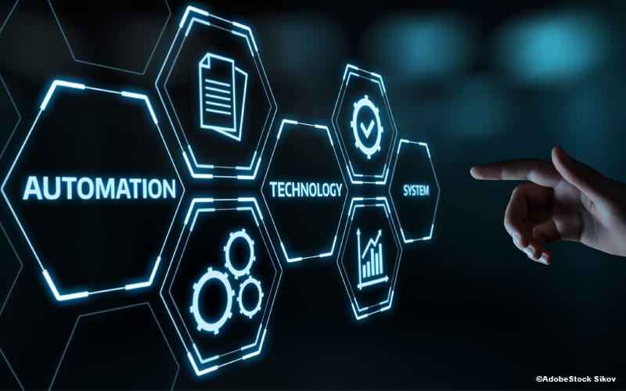
Now what?
Once again, we go with the obvious answer.
As we move into AMI 2.0 we can, in real time and in an automated fashion
generate near real time reports on current usage vs the installation
Identify usage that is too low for the installed transformers
Analyze historic usage to see if this is an anomaly or the norm
Analyze if this service has changed in usage patterns for as far back as we have data
Calculate potential revenue losses
Determine the most appropriate service for this customer based on this data
Make a business decision based on standardized costs to refresh a service
Issue a work order and install the appropriate equipment
This Photo is licensed under CC BY-NC-ND

Slide 16
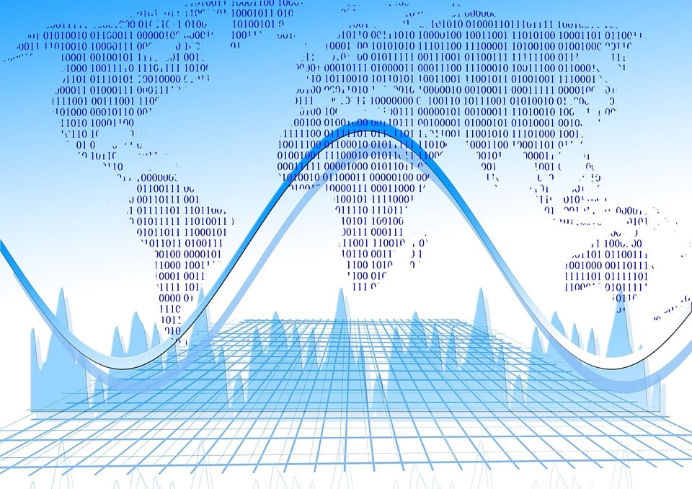
And before AMI 2.0?
We do the same thing but in a more manual fashion. We may not have all of the data in real time, but we have enough data to find the most egregious issues.
We have usage data available to us
We have installation information available (or can get this information)
We cross reference these two pieces of information and can set flags for 10%, 5% and less usage time periods
Analyze historic usage to see if this is an anomaly or the norm
Analyze if this service has changed in usage patterns for as far back as we have data
Calculate potential revenue losses
Determine the most appropriate service for this customer based on this data
Make a business decision based on standardized costs to refresh a service
Issue a work order and install the appropriate equipment

Slide 17
Case Study
Current state:
AMI 1.0 installation that will be upgraded to AMI 2.0 later this decade.
Meter Manager data that includes installation specifics such as transformer ratings, manufacturer, test data, location, typically pictures
An interface between Meter Manager and the usage and billing data

Slide 18
Case Study
System implemented:
A monthly report is run identifying the largest usage mismatches between usage and the transformers installed
We cross reference and set flags for 10%, 5% and less usage time periods
We identify when these usage time periods exceed 10% for a billing cycle
Report is generated
Manual analysis is performed by the customer analysts and engineers
Work orders are generated when the business case is clearly identified
Customer messaging is prepared, reviewed and carried out
Services are refreshed
Appropriate billing is realized
Recovery of previously unbilled usage is tracked and compared to “refresh” costs and the business savings tracked

Slide 19
AMI 2.0
Can we use our existing infrastructure?
Do we have to rip out and replace with a new infrastructure?
Cyber Security?
Reporting and analysis tools? AI?
Notes:
Waveform generation

Slide 20
AMI 2.0 Infrastructure
Second Generation AMI and potentially new communication paradigms as LTL data becomes less and less expensive and reaches larger and larger areas – without new infrastructure
Research in Power Line Carrier Technology may provide expanded bandwidth to allow for greater data transfer more frequently without as much new infrastructure
Mesh networks continue to improve and AMI 2.0 is anticipating leveraging the infrastructure installed in AMI 1.0

Slide 21
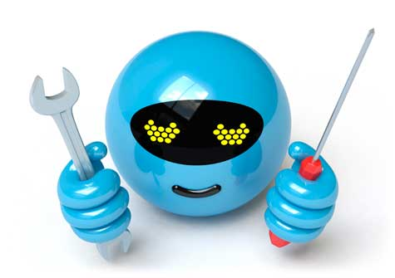
New Tools
Advanced visualization tools – Built-in tools provide an alternative to cumbersome data tables and provide enhanced visibility of your smart meters, AMI network, and distribution network
AMI system health dashboards – A custom definable user interface enabling a visualization of real-time events and trending
The use of AI to further improve our ability to identify potential issues and determine appropriate paths forward in the near real time.

Slide 22
Questions and Discussion
Tom Lawton
President
tom.lawton@tescometering.com
TESCO – The Eastern Specialty Company
Bristol, PA
215.228.0500
This presentation can also be found under Meter Conferences and Schools on the TESCO website: tescometering.com
ISO 9001:2015 Certified Quality Company
ISO 17025:2017 Accredited Laboratory

