Slide 1
Tesco Meeting Supply & Demand
Vertical Integration & New Product Development
Monday April 17th, 2023
4:00 PM
Tom Lawton, President
TESCO – The Eastern Specialty Company

Slide 2
Tesco has made significant Vertical Integration Strategies to help with manufacturing lead times

Slide 3
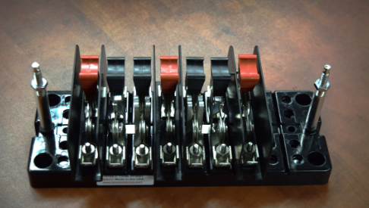
TESCO’s Vertical Integration
Over the past three years TESCO has acquired several of our suppliers including a precision machine shop as well as a sheet metal fabricator.
We have also leveraged our new knowledge base that came with the great work forces from each of these acquisitions to add additional equipment and additional capabilities. In the past three years we have added;
Milling Centers
Turning Centers
Metal Stamping
Box Connector fabrication
Powder Coating
Additional 3-D Printing Capabilities for both manufacturing and prototyping purposes

Slide 4
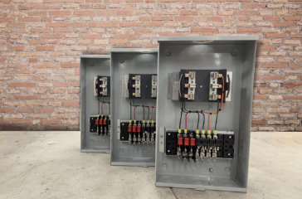
TESCO’s Vertical Integration
Later this year and over the course of 2024 we are planning to;
Add additional equipment of the same types and expand our facility to increase our through out
Add additional PCB Assembly & Population Capabilities
Add injection moling
Add abrasive waterjet cutting
Vertical integration allows TESCO to lead the industry in delivery times. TESCO continues to bring manufacturing resources in-house to address black holes in the supply chain during this period. This means TESCO has the resources and materials to build your test switches and pre-wired boxes

Slide 5
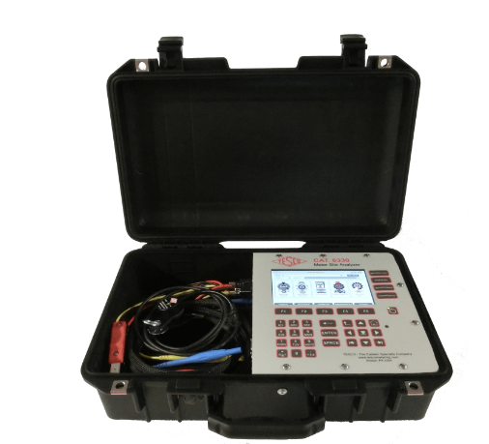
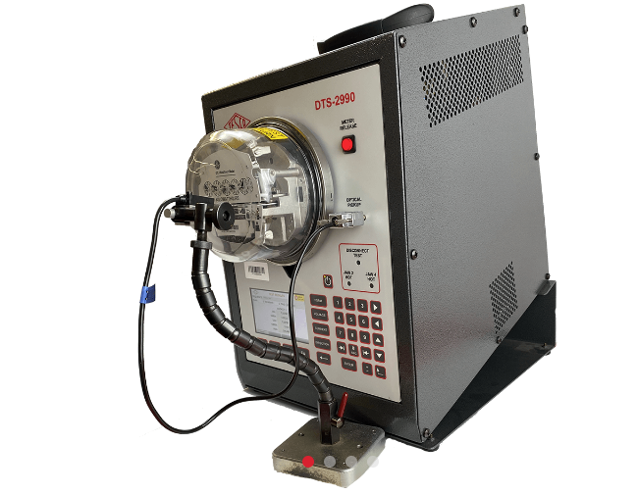
Tesco Leads in Delivery Times
This vertical integration and additional tooling has allowed us to work around a myriad of material and supplier shortages.
We have now created a third engineering team in addition to our New Product development team and our Make-To-Order team. This is our Manufacturing and sustaining engineering team who work on a steady stream of alternate source and alternate part projets. They are also constantly working with our UL inspectors and our ISO 9001 inspectors to ensure that as we bring new parts and suppliers into our supply chain we are doing so in a way that makes our products more reliable and more robust.
This team is also involved in working on new tooling with new suppliers or new tooling for our internal equipment to allow us to bring more and more parts in house. At TESCO we are great believers in internal manufacturing and local manufacturing.

Slide 6
TESCO’s Expansion
The expansion of TESCO continued with the purchase of our building in late 2022. The building has 310,000 sq.ft. and we had less than 200,000 sq.ft. We have been renovating spaces and adding more to our manufacturing footprint every month since the purchase ad expect this trend to continue for the foreseeable future.
Two of our four additional manufacturing sites also doubled in size over the past year to accommodate customer demands.
We are also developing an educational space that we will begin using at our own meter school as part of our User’s group in 2023. We will be hosting TESCOOL as part of our USERS Group in July 2023.

Slide 7
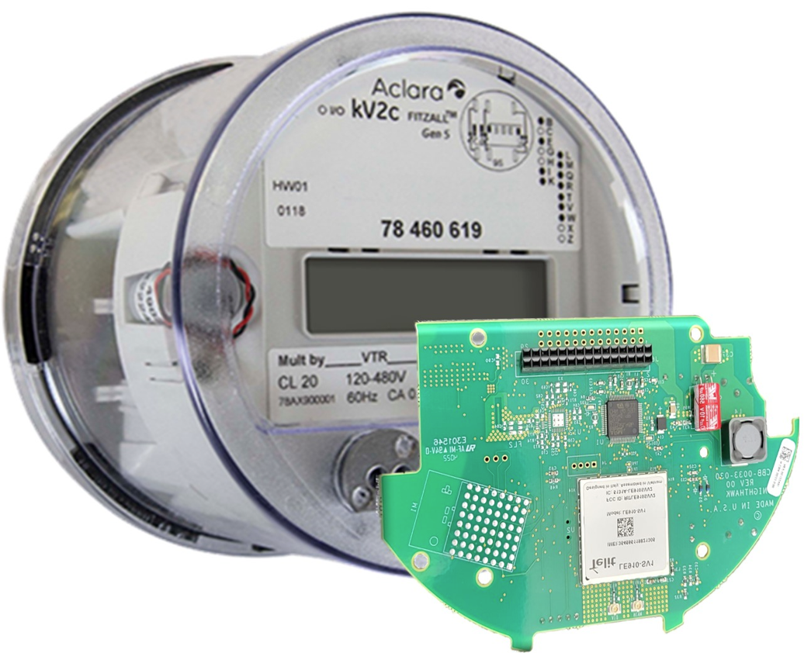
New Product Development
TESCO continues with a string of New Product Development (NPD) efforts. The NPD Team is working on everything from adding new features for our 6330’s and 2990’s to new products in the electric vehicle charger market and others related to energy measurement as well as products that expand our test switch, pre-wired box and transocket offerings.
Two that we would like to highlight this afternoon are
The Catalog 1160 Signal Strength Analyser for assisting in determing the best location for an antennae for a meter on an RF mesh system or if a nantennae would even help
The second is a new offering from our NightHawk product line to help fill holes for existing MV-90 systems..

Slide 8
Signal Strength Analyzer CAT 1160
For utilities considering or currently involved in AMI implementations, a Signal Strength Analyzer (SSA) will determine the location with the highest quality signal when placing an antenna for a poorly communicating meter.
When a meter is not reporting reliably to the Head-end, or for a new meter, concentrator, or antenna installation, TESCO’s SSA will show you the best location for the equipment.
Head end connection information to home office
Indicating lights
Sunlight readable display
GPS enabled
Rechargeable Battery powered

Slide 9
DirectConnect: Your Solution to MV90™ Voids
Connects directly with Itron MV-90™
Robust, secure, and efficient bidirectional message delivery mechanism
Does not require any middleware – DirectConnect o MV-90™ (or other host). Communicates directly between meter and head end.
Stand alone solution
Uses an Aclara Kv2C meter with a new NightHawk communications module developed specifically for this application.
Presently works with both ATT and Verizon networks.
This solution will help to fill holes as land lines fail over time.

Slide 10
DirectConnect: Your Solution to MV90™ Voids
Aclara kV2c DirectConnect solution
Full data retrieval using Aclara MeterMate
Features such as last gasp, modem configuration and firmware update supported
Can use Aclara MeterMate to update meter firmware and configuration
Itron Polyphase meters will be supported when available
This solution can be modified to fill holes for other AMI network solutions that communicate directly to the meter through commercial or private LTE cellular communications or private fiber.

Slide 11
Our Mission: To be the Primary outside Metering Resource for all of our electric utility customers

