Slide 1
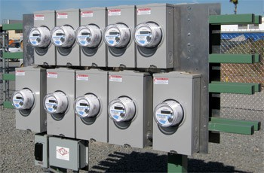
Asset Tracking Systems for Meter Services
Prepared by Tom Lawton,TESCO
The Eastern Specialty Company
For the Spring EEI Transmission, Distribution & Metering Conference 2016
10/02/2012 _{Slide}Slide₁ 1

Slide 2
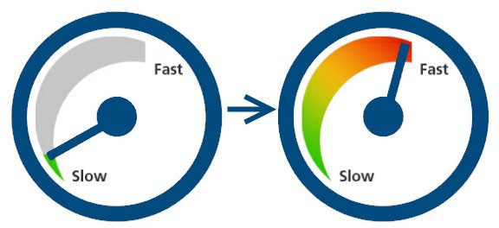
Introduction
This presentation is the second of a series of three examining how data, the collection of this data and the use of this data have dramatically changed and is continuing to change in our industry as a result of AMI.
This morning we discuss how Asset Tracking for Metering has changed dramatically over the past dozen years and what the term “asset tracking” will mean for meter services in the future.

Slide 3
When Taken in Hostile Territory Provide Only Name, Rank and Serial Number
In the past we had Corporate asset management systems that originated on the financial side of the business and we had meter record systems that handled all metering test results. Between the two we would have all of our bases covered.
Traditionally Investor Owned Utilities have used asset management systems that were created by in-house personnel or purchased in the 1980’s and early 1990’s or were based on Main Frame systems from even earlier years. Most have either have recently converted or are in the process of converting to systems like SAP and Maximo and other enterprise level solutions.
These older systems and the newer generation of enterprise solutions want to track assets in a fairly conventional manner. Name, rank and serial number…..in this case, asset description, location and serial number.

Slide 4
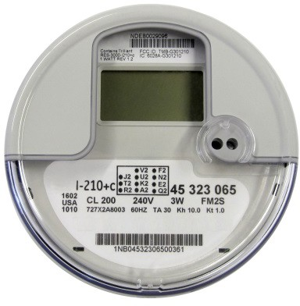
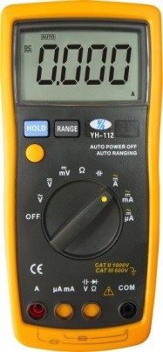
Meter Service Department Territory
Meter Service Departments have typically been tasked with tracking
The meters on the system
Instrument transformers
Rubber goods
Additional Personal Protective Equipment (PPE)
Instruments (a catch all that mean anything from chainsaws to underground equipment depending on the utility).

Slide 5
Requirements When in this Territory
Meter Services has never been asked to only handle name, rank and serial number.
For meters we also needed to maintain and provide upon demand test results for all meters from when they were purchased until the day they were retired and then for some indeterminate amount of time after that. We also needed to know the manufacturer and the type of meter and any other pertinent technical information (which was minimal once upon a time).
For Instrument Transformers we needed to maintain similar test information as well as manufacturer, type and ratio. When dual ratio transformers came along we needed a system to report on which ratio was being used.
For Rubber Goods we needed systems that tracked which rubber goods went to which individual or department, when they had to go and when they last were tested. For the safety of our personnel we had to ensure that no one had outdated rubber.
For instruments we typically needed to track calibration dates and service dates.

Slide 6
How We Used to Cope
To do this we had a combination of;
Targeted software solutions from vendors
Excel spreadsheets
Home brewed Access databases.
And life was reasonably good!

Slide 7
Moving Into The Future
This is not the situation we find ourselves in today. We still have all of the original responsibilities. And we have more.
As we know from our ANSI meetings the very definition of a meter came into question in recent meetings. Is a meter everything under the cover or is the meter only the energy measurement portion of the device?

Slide 8
AMI and Increased System Features
As an industry we have stayed with the obvious – the meter is everything under the cover. This now includes several disparate components potentially from multiple manufacturers and all serialized by their various manufacturers;
The energy measurement and display component
The communication device
The disconnect device
Additionally both the energy measurement component and the communication device have firmware versions that may need to be tracked.
As Utilities have prepared for AMI deployments they have quickly realized that the traditional asset management systems which had originated on the financial side of the business and the meter record systems that handled all metering test results and the myriad of spreadsheets and off line data bases were going to be woefully inadequate to handle the data required for this next generation of metering.

Slide 9
Where Does Traditional Asset Management Fall Short?
Traditional systems fall short in several areas;
Inability to track multiple serialized devices under the cover or a single meter
– Inability to swap these same devices or to add additional devices at some later date
Inability to track firmware versions
Inability to track functional test results as well as accuracy results
Inability to track site information for transformer rated sites
Inability to seamlessly handle Rubber Goods, Instrument Transformers, collectors (and their serial numbers and their firmware versions), and other devices now integral to Meter Services.
Inability to continue to grow with the technology as this technology advances.

Slide 10
So Where Does This Leave Us As We Continue To Embrace AMI?
We are approaching 40% AMI deployment in North America and the Northeastern portion of the US is now poised to jump in with both feet as one of Con Ed’s operating companies in NY State has received approval to move ahead. Surrounding utilities are preparing their plans and surrounding states are watching and starting to move ahead. This region alone will move us closer to 60% deployment in North America, by which time some of the early adopters may be looking at the next generation of technology and trying to determine whether they can upgrade or will they have to change their metering technology.
And at the heart of this will be how we manage our assets.

Slide 11
Enterprise Solutions
As mentioned earlier many Utilities are adopting SAP and other enterprise wide solutions
Typically they are implementing either just before, at the same time, or just after these installations, meter specific solutions that will handle this next generation of requirements
On occasion they are trying to use the enterprise level solution to handle all of their needs
The enterprise solutions never have the ability to handle everything a Meter Services Department requires so they either continue to attempt to use off line spreadsheets and databases or they implement bolt-on solutions

Slide 12
What Is The Industry Using As We Continue To Embrace AMI?
The enterprise solution providers have long recognized this and have done an excellent job of providing the documentation and ability to bolt-on and provide the utility with the extended functionality that they require for today’s meter services operations.
The enterprise solution provider typically promotes this as a feature of their solution
Utilities can either provide a third party solution or an internally prepared solution to meet their needs now and in the future.

Slide 13
Bolt-On Capability –
An Insurance Policy For The Future
This will hopefully mean that the Enterprise Solution provided will be able to serve the Utility for the indefinite future.

Slide 14
What Do We Need to Make This a Reality From a Meter Services Perspective?
Start by examining our process and go from there. Throw out what we used to do and used to know and start thinking about interoperability of different systems.
The meter manufacturers should be able to automatically interface and send their accuracy data, firmware levels, alarm settings and other pertinent data to the utility.
The utility should be able to automatically send operational data to the meter manufacturer or other manufacturer regarding equipment shortcomings or failures.

Slide 15
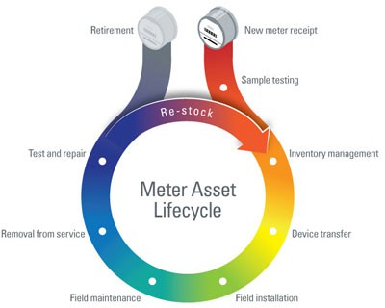
Typical Meter Life Cycle
New Meter Purchase
Purchase Order
Vendor File
Meter Receiving
Acceptance Testing
Device Creation in Customer System of Record
Device Release to Stock
Used Meter Processing
Meter Check-in
Meter Testing
Device Restocking

Slide 16
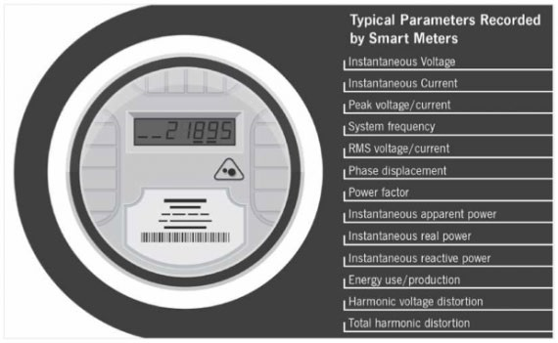
Typical Meter Life Cycle (Continued)
Asset Tracking
Track Inventory within shops / warehouses / storerooms, down to the container and/or shelf
Track Inventory to the person or truck
Meters are assigned to the person / truck
As meters are set, they are removed from inventory
Used meters are tracked from removal to meter shop
Physical inventory counts may be performed at any time
Quality management
Detailed analysis of meter performance
In-service random sample and periodic test plans
– Full RMA tracking
Slide 16

Slide 17
Summary
Use the Enterprise Solutions to manage the Utility and provide the backbone for all operational groups
Use bolt-ons to handle new AMI related requirements
Continue to look at bolt-on solutions as new AMI and post-AMI features are introduced to handle the new requirements that result from them.
Look at your Enterprise solution as the back bone of a complete and seamless solution for the entire utility. Your bolt on becomes part of the whole.
Work with vendors to provide better interfaces that are more similar than different from other ones you are already using in your Corporate systems.
Make sure that all of the systems work together and transfer data seamlessly – even the Enterprise Solution providers have a hard time with that at times.
Make sure that all of your hardware can interface into these systems seamlessly
This is one area that no Enterprise provider is good at
This is where your bolt-ons will excel and will allow your Enterprise solution to last indefinitely.

Slide 18
Tom Lawton
Questions and Discussion
TESCO – The Eastern Specialty Company
Bristol, PA
1-800-762-8211
This presentation can also be found under Meter Conferences and Schools on the TESCO web site: www.tesco-advent.com

