Slide 1
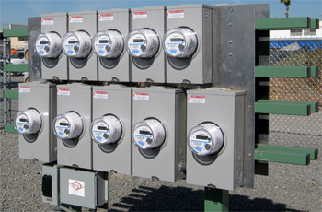
NEW Meter & Transformer Equipment for the Shop and Field
Prepared by Tom Lawton
For EEI Transmission, Distribution, Metering and Mutual Assistance Conference
Manufacturers Technology Forum
Monday, October 1, 2018
3:45 p.m. to 4:00 p.m.
10/02/2012
Slide 1
Notes:
1

Slide 2
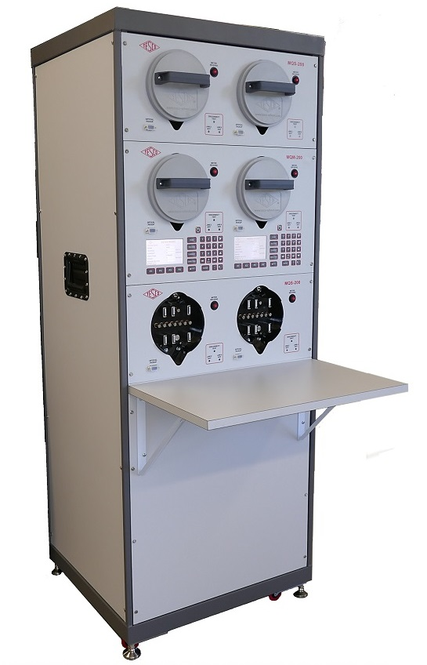
New Meter Testing Equipment
Multi-Position Qualification Boards
Meter Engineering Boards
Single and Multi-Position Test Boards

Slide 3
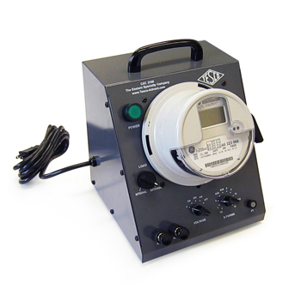
2100 Desktop Meter Station
METER FORMS: FORM SELECTABLE 1, 2, 3, 4, 5/45, 6/36, 8, 9, 12, 14, 15, 16
VOLTAGES: VOLTAGE SELECTABLE 120/208/240/277 VA; 480 VA (OPTIONAL)
DIMENSIONS: 12" X 11" X 10" (STANDARD MODEL); 12" X 13" X 10" (DISCONNECT & BUILT-IN LOAD MODELS) (W X D X H)
TILT CHASSIS (CATALOG NO. 2100-T): TILTS TO VERTICAL FOR ELECTROMECHANICAL METERS
INTERNAL LOAD (CATALOG NO. 2100-I): 0.5 AMP PHANTOM LOAD
EXTERNAL LOAD (CATALOG NO. 2100-E): UP TO 50 AMPS
BUILT-IN LOAD (CATALOG NO. 2100-L): 0, 5 AND 30 AMPS (CUSTOM LOADS AVAILABLE)
DISCONNECT OPERATION (CATALOG NO. 2100-D)
LOAD RECEPTACLE (CATALOG NO. 2100-R): 120 VAC RECEPTACLE
SPECIAL REQUEST (CATALOG NO. 2100-S): CONTACT TESCO TO SPEAK WITH A PRODUCT SPECIALIST
CUSTOM FORMS (CATALOG NO. 2100-F): CONTACT TESCO TO SPEAK WITH A PRODUCT SPECIALIST
480 VAC METER TESTING (CATALOG NO. 2100-V)

Slide 4
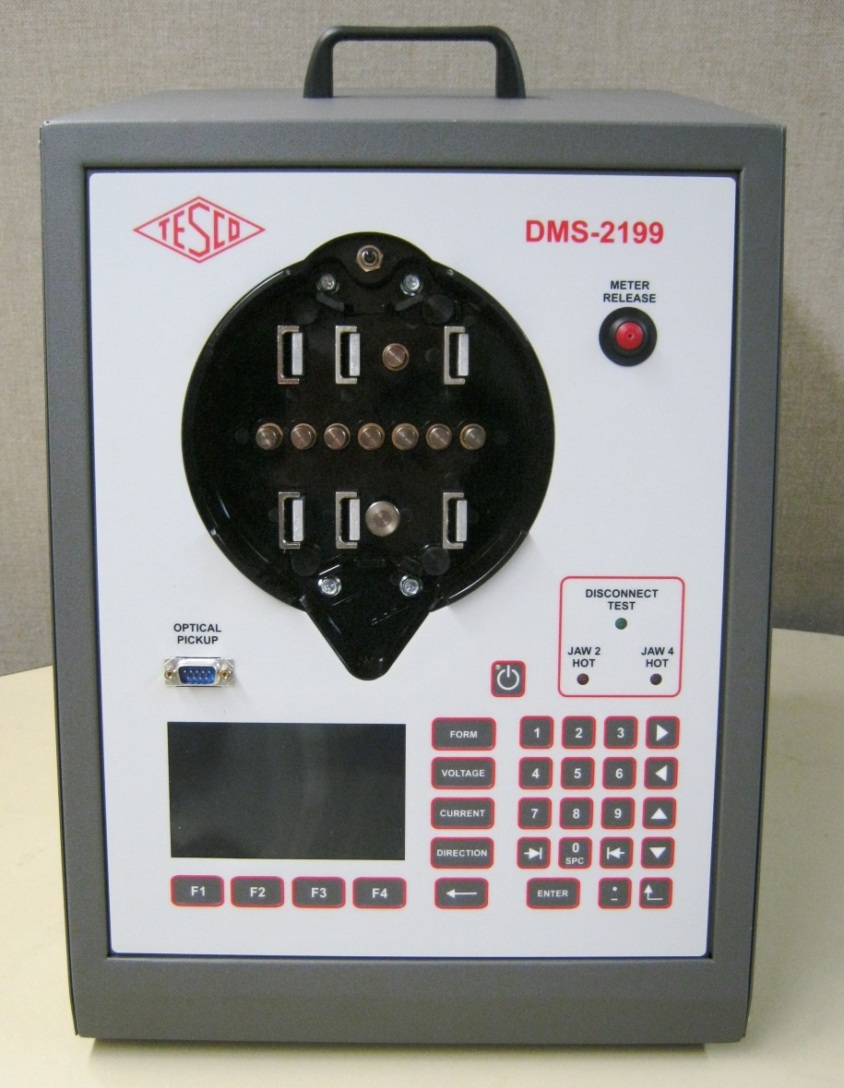
2199 Desktop MQB
2199 Desktop Meter Qualification Board Catalog No. 2199
Providing complete capabilities for
evaluating meters and communications performance
The 2199 provides every option possible on TESCO's 2100 Desktop Meter Station plus much more including:
generate any voltage and load conditions the meter may encounter in the field
Apply non-sinusoidal voltages with complex load waveforms
Perform disconnect tests and reconnect tests without having to worry about being able to drive the meter's switches
Voltages that are completely programmable from 30-350 volts phase to neutral.
Loads that are completely programmable from 0-50 amps
Standard disconnect/reconnect testing
A zero insertion force socket (electrically operated)
The most lightweight and portable desktop meter station available

Slide 5
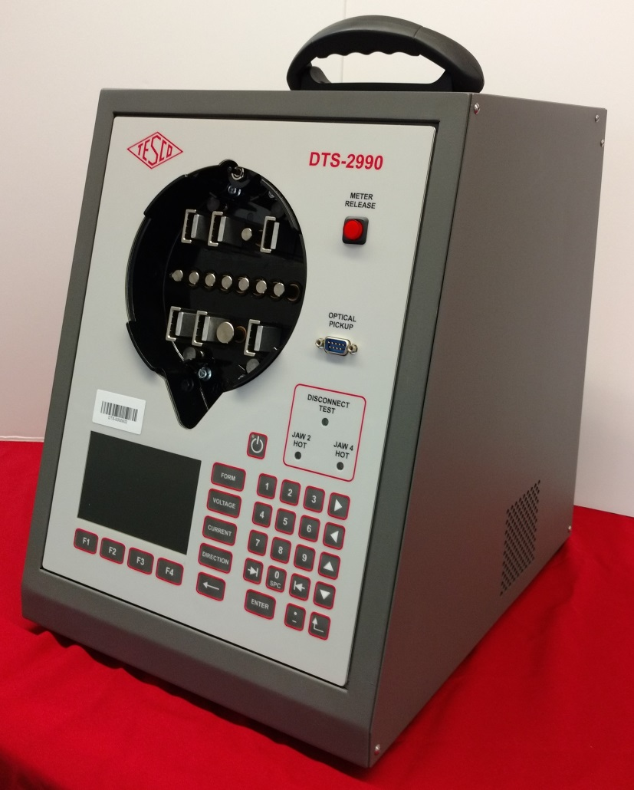
2990 Desktop Meter Test Station
2990 Desktop Meter Test Station Catalog No. 2990
TESCO introduces a state-of-the-art meter accuracy testing in an affordable desktop configuration!
The 2990 revolutionizes meter testing by providing full series parallel meter testing in a small, budget-friendly desktop package.
A fully ANSI compliant test board, the 2990 offers complete testing of all meters under the widest range of test conditions.
The new waveform generator has all waveforms called out in ANSI C12.20-2015 (pub. 4/2017).
All common electromechanical and solid state meters up to 50 amps can be tested with the 2990
0.04% TESCO Standard Traceable through NIST

Slide 6
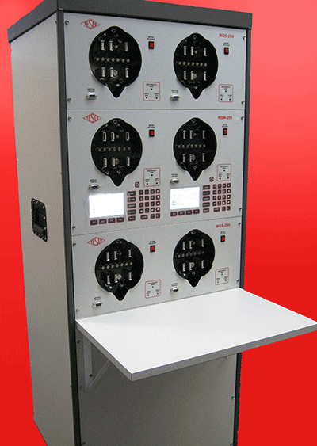
Meter Qualification Board
Next Generation Meter Qualification Board
Three Flavors to fit a variety of budgets and functional needs:
Three Voltages and one current
True Series Parallel
True Three Phase
Stock configurations of Master and slave modules to allow for faster delivery for those difficult to meet year end budgets
These boards can be banked together to provide any number of sockets required. Disconnect testing is standard on all TESCO MQBs and each socket position is designed to accommodate any meter form requested.
Power up and apply load to electric watt-hour meters for functionality testing with TESCO's multi-position Meter Qualification Boards (MQBs). These boards assist with AMI Meter Certification process and AMI meter qualification and communication testing.
The new waveform generator has all waveforms called out in ANSI C12.20-2015 (pub. 4/2017).

Slide 7
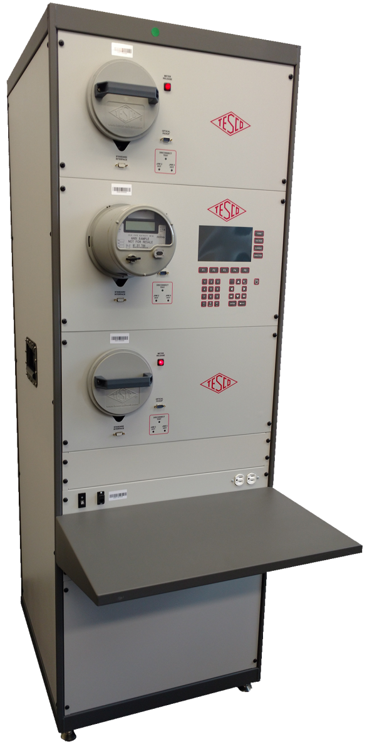
MQB3
Three Phase Meter Qualification Board
Apply true three phase voltage and current to electric meters, enabling them to be tested under all possible conditions that may be encountered in the field with TESCO’s MQB3.
The MQB3 facilitates the following meter shop functions in high volume:
New AMI/AMR meters settings check-out
Meter program updates
Software revision checking for both the meter and the communications module
Communications module troubleshooting
Checking of problem meters for open/shorted elements
With the MQB3, the user has the ability to check meter response to:
Varying loads over long periods of time to simulate brown out and surge conditions
Harmonic waveforms (can download custom harmonic waveforms through PC interface)
Meter power on/off cycling
Phasor distortion

Slide 8
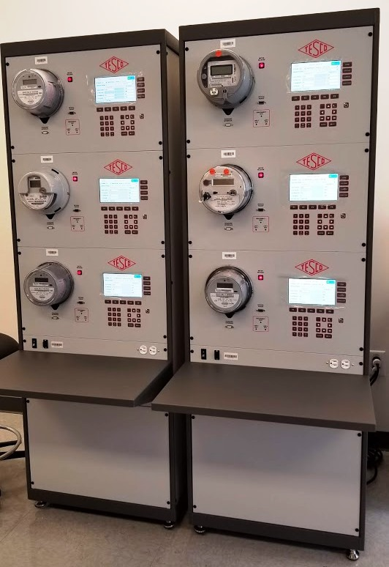
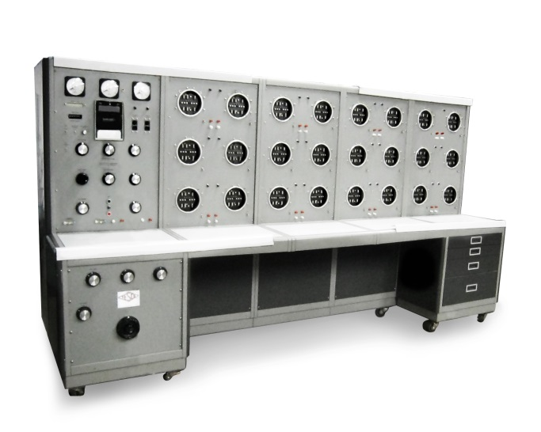
MEB
Meter Engineering Board (MEB)
The Latest Generation of TESCO Demand and Time Run Boards with a lot more under the hood
All of the functionality of the Meter Qualification Boards (MQB’s) including the new automated meter socket design, disconnect testing, communication testing, and advanced functional tests with TESCO’s Meter Engineer Board plus the ability to run Demand and Time Run tests. These boards have basic metrology of 0.1% accuracy traceable back through NIST. There is a Series Parallel version and a True Three Phase version.
TESCO’s MEB can help with:
Meter evaluating testing and certification
Communications performance
Power Line Communications testing
Software and firmware verification
Meter setting verification
Meter functional testing
Demand testing for Utility Commission compliance and meter certification testing
Time-run Testing
Extended use testing
Meter disconnect switch testing

Slide 9
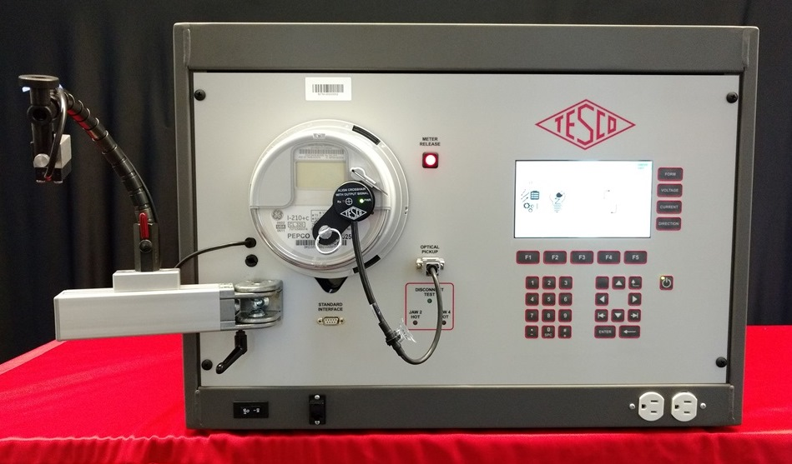
MTS-3050
Three Phase Meter Test Board (MTS-3050)
An innovative meter ACCURACY test system offering unsurpassed functionality and ease of use. All of the features you will need to test meters today and tomorrow are standard.
Run standard meter accuracy tests and complex meter accuracy tests under widely varying loading conditions with TESCO’s MTS-3050.
Features include:
THREE PHASE ACCURACY TEST BOARD
0.04% accuracy
Current Drive: Single range 0.01 to 50A(rms), 70A (peak)
with options to go up to 200 amps
30 to 350v phase to neutral and 50 to 600v phase to phase
Ability to check meter response to:
Varying loads over long periods of time to simulate brownout and surge conditions
Harmonic waveforms (can download custom harmonic waveforms through PC interface)
Meter power on/off cycling
Phasor Distortion
The MTS facilitates these meter shop functions:
Full functional testing capability for all AMI/AMR meters
Meter program updates
Software revision checking for both the meter and the communications module
Communications module troubleshooting
Checking of problem meters for open/shorted elements

Slide 10
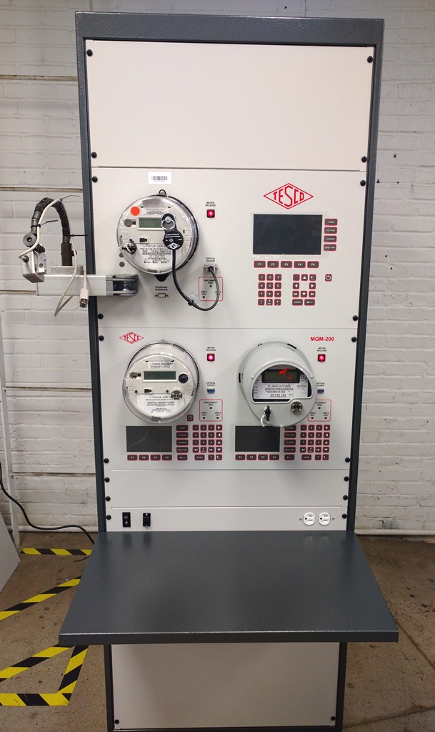
Multi-Position Meter Test Boards and MQB-MTS Hybrid Boards
Three Phase Meter Test Board
Of course we can take this three phase test board and can make a multi-position of up to three sockets per cabinet which allows us to stock these modules and provide these test boards in just a few weeks once again allowing us to meet difficult end of year budget cycles.
But we can also mix and match our MTB’s (Meter Test Boards) with our MQB’s to better match testing time and better meet your budgeting requirements.
We can provide better cost per test socket and provide more of the lower cost sockets for tests that take longer to run and provide only one or two of the Three Phase Accuracy test sockets (standard 0.04% accuracy) allowing a far greater bang for your buck.

Slide 11
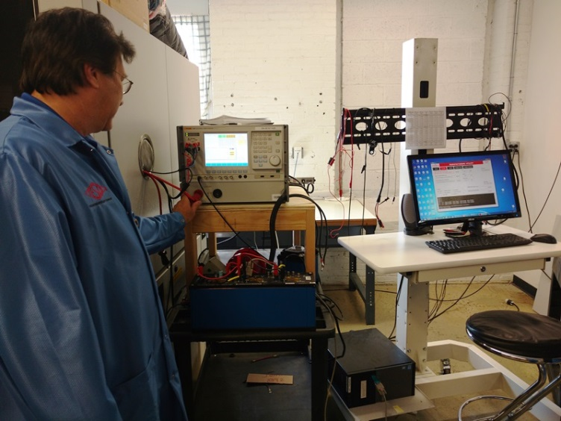
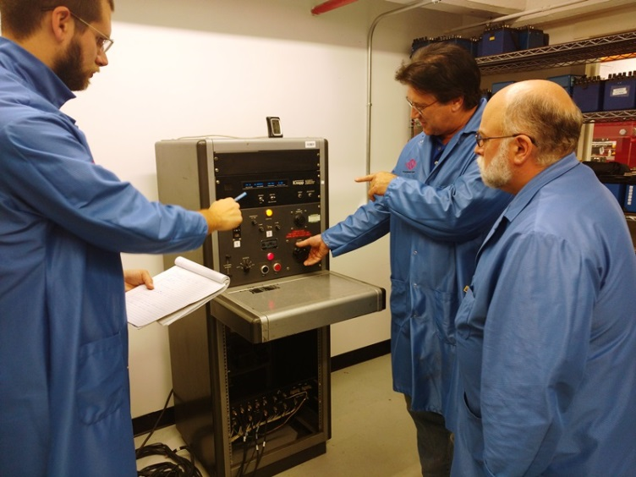
ISO 17025 Lab
TESCO has been working throughout 2018 on our ISO 17025 Accreditation for our Calibration Lab in Bristol. We believe that this accreditation will provide additional confidence and rigor to our standards calibration and measurement capabilities for ourselves in our continual development environment as well as for our customers who rely on us to calibrate TESCO and other energy measurement equipment.
We are also working hard to obtain the same accreditation for our west coast lab at our Knopp facility where we both manufacture and provide calibration services for our transformer testing customers. Both our Bristol PA and our Emeryville CA facilities will have the same capability for testing and providing traceability to an international standard for Transformers and Transformer testing equipment but also for meters and meter testing equipment. This is providing us with both redundancy as well as more options for our customers.

Slide 12
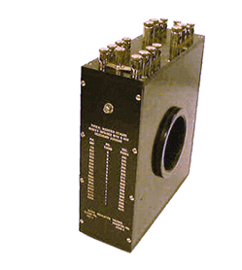
Precision Multirange Current Transformer
P-5000 (and P-12000)
The P-5000 and P-12000 Precision transformers are laboratory standards. These unit's excellent accuracy and the Knopp One-to-One calibrating feature make these precision transformer well-suited as a standard for calibration work. These transformer Standards can provide a very accurate determination of the ratio and phase angle characteristics of current instrument transformers having ratios from 5 to 5,000 amperes for the P-5000 and up to 12,000 amps for the P-12000. These transformers can also accurately extend the range of a 5 ampere ammeter or wattmeter to cover all current values up to 5,000 and 12,000 amps respectfully.
The P-500 provides eight self-contained primary ranges from 5 to 100 amperes. These ranges are brought out to binding posts on the top of the transformer. A 240 turn secondary is provided for use with these primary taps; other secondary taps are provided for other ranges. Ranges above 100 amperes are obtained by passing a primary conductor through the transformer window. Various primary ranges are obtainable by varying the number of through-turns and choosing from among the available secondary taps. The P-12000 operates in a similar fashion and all are traceable back through NIST.

Slide 13
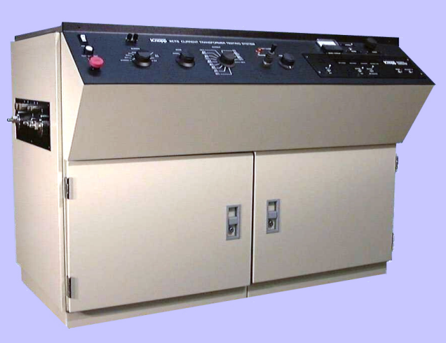
Current Transformer Testing System
KCTS-8000
The Knopp Current Transformer Testing System (Type KCTS-8000) is designed to measure the accuracy of instrument transformers having 1 or 5 ampere secondaries and primaries of up to 8000 amperes. The system uses a high accuracy multi-range current transformer as a reference standard. All ANSI standard burdens are included. The phase angle and ratio errors of the transformer-under-test (TUT) are measured by the built-in Knopp Automatic Transformer Comparator.

Slide 14
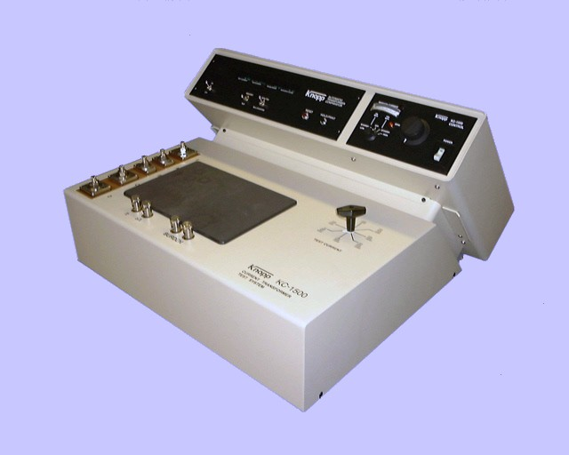
Current Transformer Testing System
KC-1500
The Knopp Type KC-1500 Current Transformer Testing System is designed to measure the accuracy of instrument transformers having 1 and 5 ampere secondaries and primaries of up to 1500 amperes. The KC-1500 is capable of testing transformers with 1 or 5 ampere secondaries. The system uses a high accuracy multi-range current transformer as a reference standard.
The system is well suited for utilities whose current transformer testing needs include primary currents up to and including 1500 amperes. The phase angle and ratio errors of the transformer-under-test (TUT) are measured by the built-in Knopp Automatic Transformer Comparator.

Slide 15
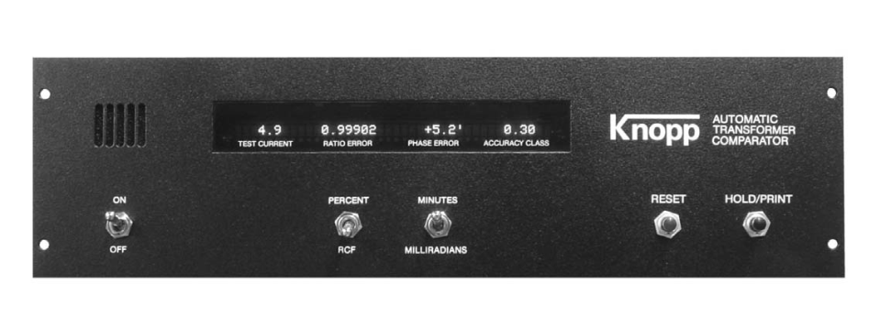
Automatic Transformer Comparators
The Knopp KATC Automatic Transformer Comparators (KATC series) provide the most convenient means available to measure instrument transformer ratio and phase angle errors. Some of the comparator features are:
Reduced testing time - test results are typically available within three seconds
Automatic operation (no manual "nulling" or adjustments required)
Microprocessor control
Auto ranging capability
Digital display
Calculation and display of ANSI accuracy class
Fully protected circuitry
RS-232C output
Interchangeable with other Knopp comparators
KATC-C
KATC-C1
The KATC-C1 Automatic Transformer Comparator is an enhanced version of the popular KATC-C Comparator.
Features of the KATC-C1 include:
The ability to test transformers with 1 or 5 ampere secondaries
Automatic sensing of 50 or 60 Hertz current
Improved data handling capabilities including the ability to be controlled by a remote computer
Improved resistance to damage from excessive test current

Slide 16
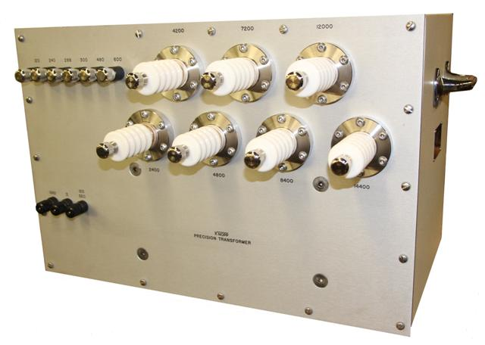
Precision Multirange Voltage Transformer
This Type WP-14000 Transformer is primarily a laboratory standard. Its excellent accuracy and the Knopp one-to-one calibrating feature make it well-suited as a standard for precision calibrating work. This transformer makes possible very accurate determination of the ratio and phase angle characteristics of voltage instrument transformers having ratings from 120 to 14,400 volts. This transformer also makes it possible to accurately extend the range of a 120 volt voltmeter or wattmeter to cover all voltage values up to 14,400 volts.
The WP-1400 Transformer, like other Knopp Precision Multirange Transformers, has excellent ratio and phase angle characteristics with respect to both inter-range accuracy and overall accuracy. This is made possible through a properly engineered design and through exclusive, highly perfected compensating and winding methods.

Slide 17
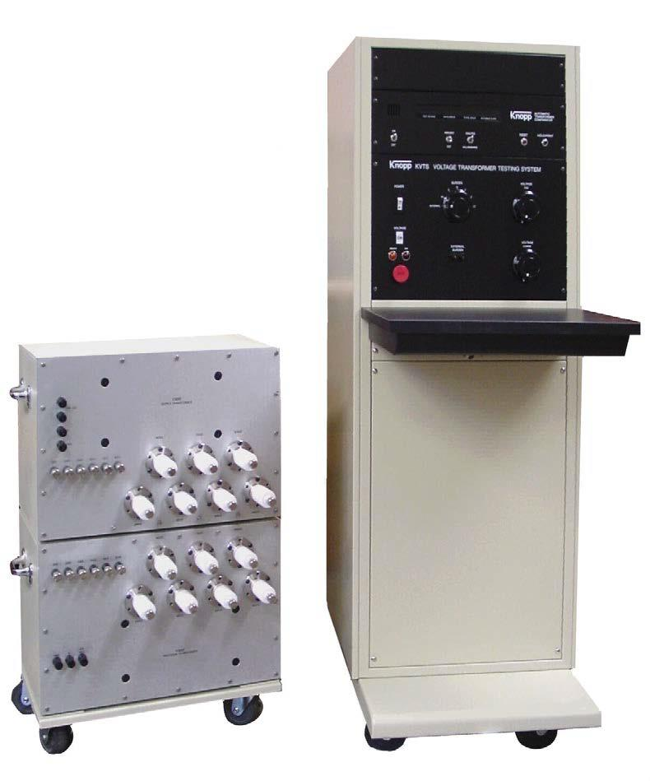
Voltage Transformer Testing System
KVTS
The Knopp Voltage Transformer Testing System is designed to measure the accuracy of instrument transformers having 120 volt secondaries and up to 14,400 volt primaries (special order for up to 36,000 volt primaries is available). The system includes a control console which contains the control circuitry, ANSI standard burdens, and the Knopp Automatic Transformer Comparator. The Knopp precision and loading transformer set is also included (as pictured) and is connected to the console via a special cable.

Slide 18
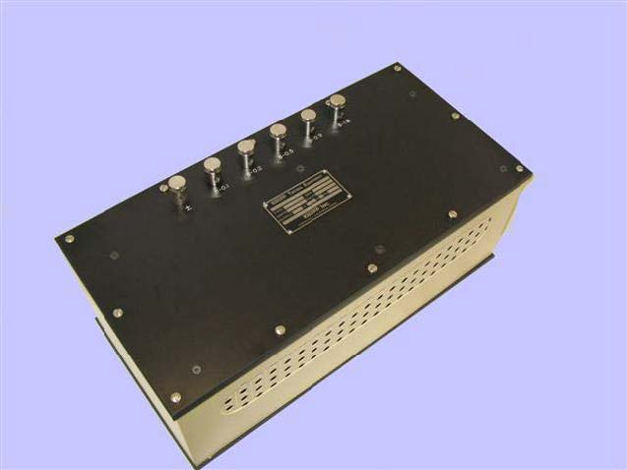
ANSI Standard Burden Sets
Testing and calibrating instrument transformers often requires standard burdens of reliable accuracy and stability, and burdens that are immune to stray fields and harmonics. The burden sets Knopp offers have been carefully designed to meet these requirements. They provide the standard burdens required for the testing of current and voltage transformers for metering service, and for the testing (within the current rating provided by the sets) of current transformers for relaying applications, all as called for by ANSI/IEEE C57.13-2016.
All the current burden sets are designed to be used with external leads consisting of a 5-foot pair of #8 copper conductors. This becomes very significant at the lower burden values, since the external leads constitute a significant part of the total burden.
ANSI Standard Burden Sets
Voltage and Current

Slide 19
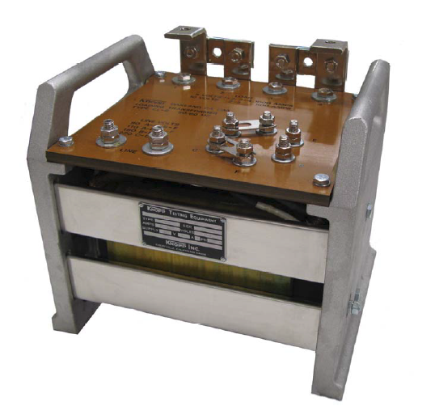
Loading Transformer: CL-6
This readily portable Knopp Loading Transformer weighs only 60 pounds and measures 12" long, 9" wide, and 10" high. Its sturdy enclosure provides protection and adequate ventilation. Two convenient carrying handles are provided.
The insulating terminal panel is rigidly secured to the transformer frame, and heavy-current, bus-bar-type terminals are securely bolted to the panel. The two output terminals each have two connection surfaces, one on a vertical plane and one on a horizontal plane, for maximum convenience in connecting the heavy current leads and in changing, when necessary, the series-parallel links. The links and the output connections cannot interfere with each other. All terminals and connection links are plated
Both the primary and the secondary are insulated for a 4,000 volt, 60 cycle, one-minute test. A grounding stud is provided on the enclosure.

Slide 20
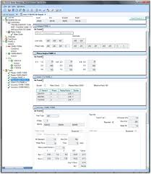
Meter Manager Software
Over the past four years we have added over 25 million meters managed along with CT’s, PT’s, AMI hardware, rubber goods, tools as well as user defined materials
Our team has been built out along with the product and over the past three years we have performed two 5 Million plus end point installations with both meeting every milestone and both going on time and on budget
Meter Manager is considered a “Best of Breed” and is being used as a bolt on to SAP, Maximo, and Oracle CC&B
Meter Manager is a Scalable Enterprise Ready system that has High Availability, Load Balancing, and seamless Fail Over
Larger users have nearly a thousand active users
One application replaced a deeply embedded system that had been installed for over 30 years and had over 70 interfaces. This utility paid an independent party over six figures to perform a sophisticated security penetration analysis. After completing the testing, hacking and analysis a single recommendation was made and implemented for what was defined as a “small vulnerability”.

Slide 21
Meter Manager Software
New Ways in Which Meter Manager is being used;
Meter Manager will be used on tablets to manage an AMI Field Deployment starting in the first quarter of 2019. This will be the largest utilization to date of the Site Verification module.
Meter Manager is being used as the system of record for CT and VT site information for a multi-million meter utility. Their MDM queries Meter Manager for transformer information to check on billing. Unusual wiring parameters for specific sites are stored in meter manager along with all CT and PT ratios so billing multipliers can be calculated and periodically checked as a system against the billing system to ensure that clerical errors do not lead to billing errors.

Slide 22
Meter Manager Software
Basic Modules of Meter Manager
Meter Shop
Meter Inventory
Meter Records
Random Testing
In-Service Testing
PPE Inventory and testing
Tool Inventory and Testing
Field Verification Module
Total life cycle asset management for everything metering

Slide 23
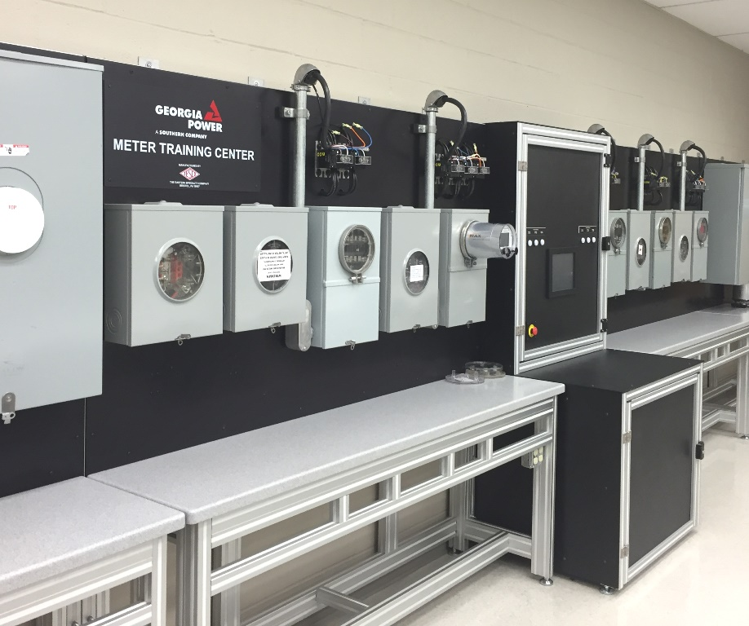
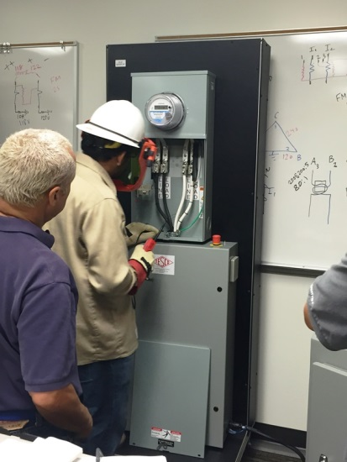
Training Room
TESCO is the leader in Meter Training Boards and Meter Training Rooms.
Instructors can set errors in a safe and consistent manner.
Equipment can be used for new training or refresher training.

Slide 24
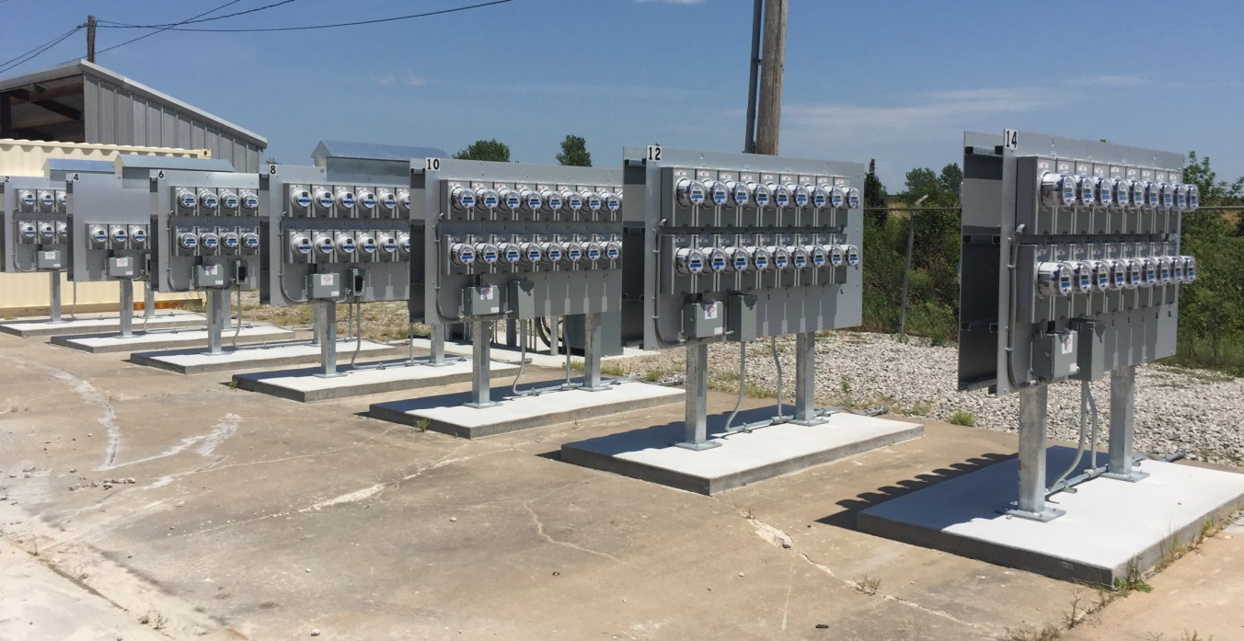
Meter Farms
TESCO has been building Meter Farms since early in this first cycle of AMI deployments.
Over the years we have refined and improved the boards and in true TESCO fashion have been providing an increasing array of features to these meter farm panels so every installation is truly a custom design to the customer’s specifications.
We have more meter farm sockets out than anyone in the industry although we recently toured a Meter Manufacturer’s Meter Farm that is just slightly older than ours and has over 18,000 sockets. However, adding up all of our meter farm installations across North America – we eclipse even this number – in total, but not at any one location.

Slide 25
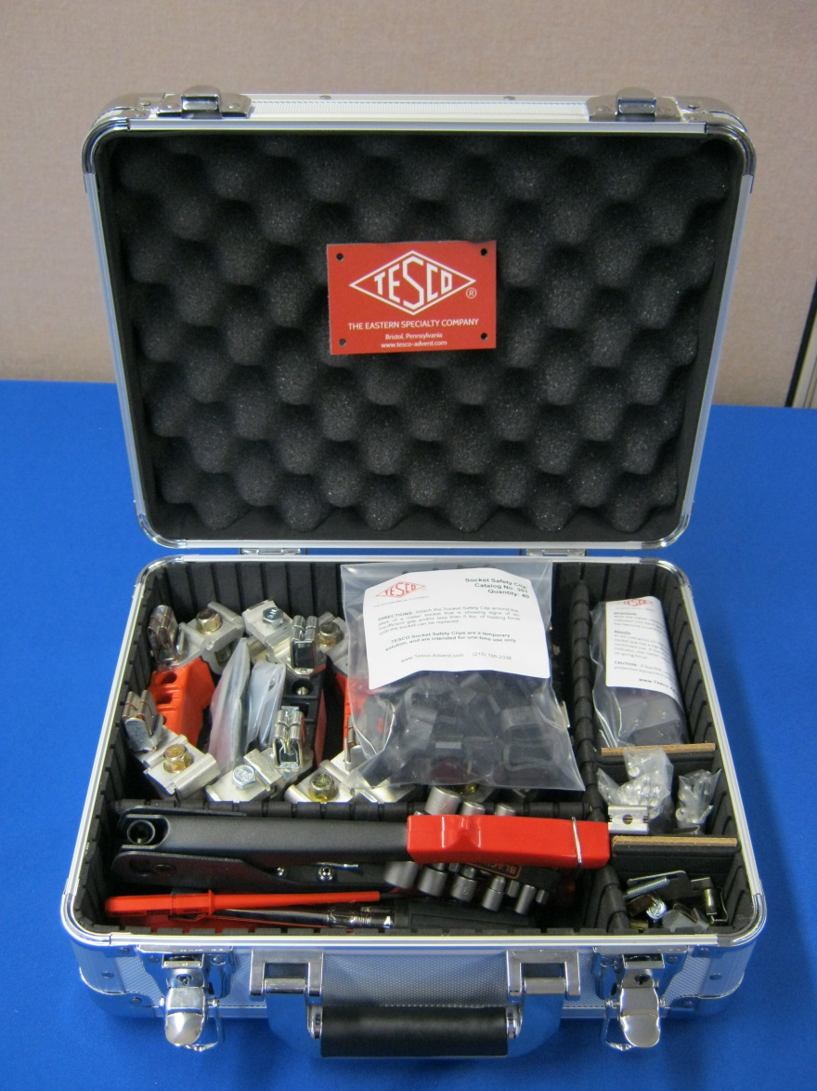
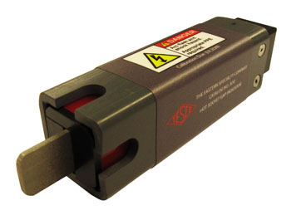
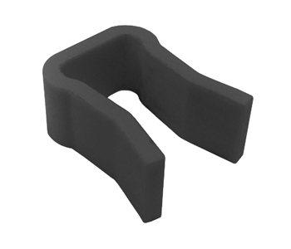
Hot Socket Repair Kit

Slide 26
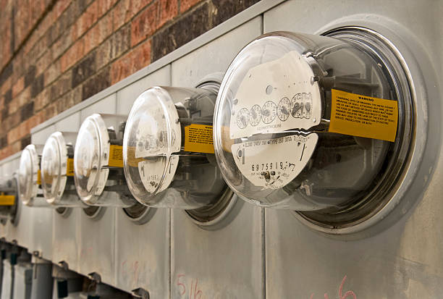
Field Testing Equipment
Field Test Kits
Load Boxes
2200 Series
CT Burden Testers
Phase Sequence Indicators
Phase Angle Meters
IR Optical Pickup
Click Switch
“Duckbill” Plugs
Test Switch Isolators
Hot Socket Gap Indicator
Safety Clips

Slide 27
Consumables
Seals (Padlock, Demand, and Cable Types)
Disconnect Sleeves
Socket Jumper Covers
Socket Blank-out Covers
Test Switch Protectors
Jumpers:
Load-to-Line
H-jumpers
Horn Bypass
A-base and Potential
Fused Potential
Safety Test Switches
Pre-wired Meter Enclosures
Transockets

Slide 28
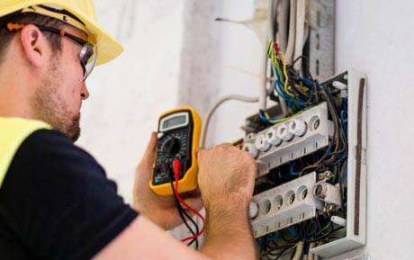
Services
Accuracy Testing
Acceptance Testing
Disconnect Testing
Retirement Testing
Certification Testing
Re-Flashing/Re-Programming
AMI Support
Meter Engineering Support

Slide 29
Voltage Tester: K-60
FOR AC AND DC 120 TO 600 VOLTS
CAT III RATED UL 61010-1
K-60 KNOPP VOLTAGE TESTER for AC and DC with polarity indicator. Double safety indication is by solenoid and by neon lamp.
Knopp Voltage Testers offer portability and ease of use with full protection. These exceptionally versatile and useful tools are backed by a reputation for quality in the design and manufacture of electrical test equipment
Knopp Voltage Testers are designed and built with safety, the key criteria! Dual voltage indication is provided by solenoid and neon lamp, operating independently. The lamp gives a bright warning signal. Voltages are shown by a positive, easy-to-read, moving indicator. There is a signal by hum and vibration; and the user is protected by high-grade, properly applied insulation, and by separation of incoming leads (the do not cross over each other within the housing). Interior separation of the circuit is a basic design feature of the case.
Nylon insulation covers prod tips to within 9/16" of end to prevent shorts across tips. The K-60 has no exposed metal parts. The scale and plate are both of insulating material.
Each K-60 order includes the K-60 voltage tester, Cordura carrying case, and leads.

Slide 30
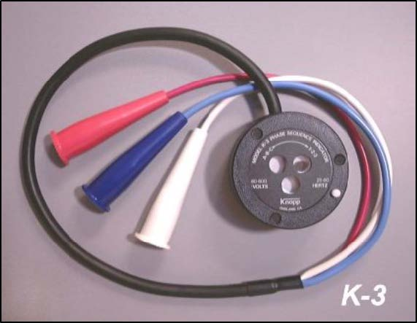
Phase Sequence Indicator
ROTARY TYPE • NO LAMPS • RELIABLE • RUGGED • VERSATILE • TIME SAVING
POSITIVE, STRAIGHTFORWARD SEQUENCE INDICATION IS PROVIDED over a wide variety of voltage and frequency by direction of rotor rotation. No need for range switching or terminal charging. Also indicates an open phase.
MODEL K-3: 60-600 volts, 25-60 Hz
MODEL K-6: 24-480 volts, 400 Hz
Use of the Knopp Phase Sequence Indicator saves man-hours and protects valuable equipment against damage. It pays for itself in a short time.

Slide 31
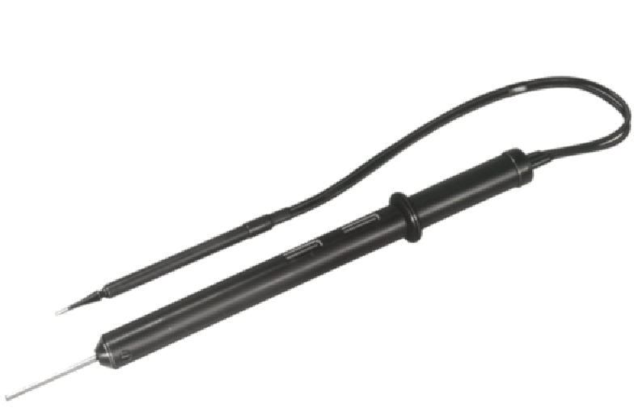
Third Rail Tester: 4E2-1
The Knopp 4E2-1 Voltage Tester is designed to detect electrical potential (voltage) between the third rail and ground on high voltage electrified transit systems. Two, redundant neon bulbs are used to indicate the presence of voltage.
Features of the 4E2-1 include:
Can be used on AC or DC
Can be used up to 1,500 volts
Can span a distance of up to four (4) feet
Uses a dual neon lamp principle for double safety protection

Slide 32
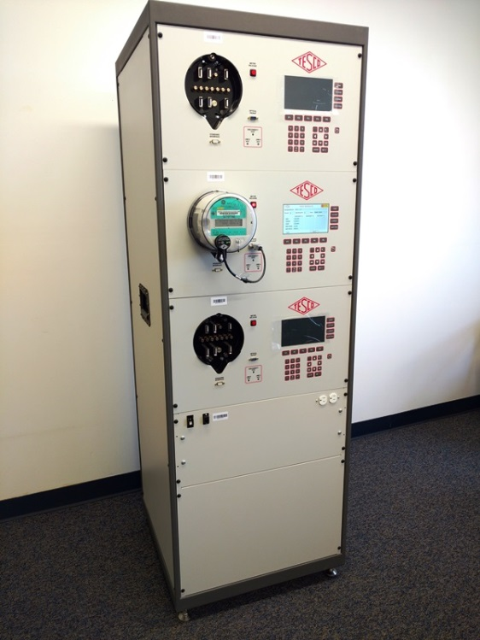
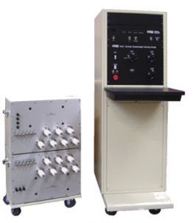
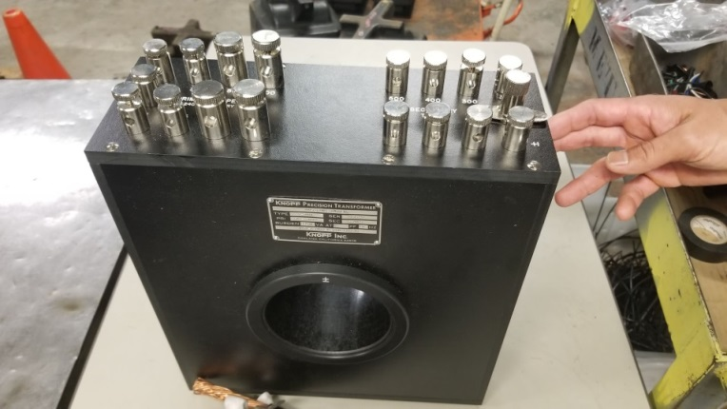
Questions? Orders?
Tom Lawton
TESCO – The Eastern Specialty Company
Bristol, PA
Tom.Lawton@tescometering.com
Cell: 215-688-0298

