Slide 1
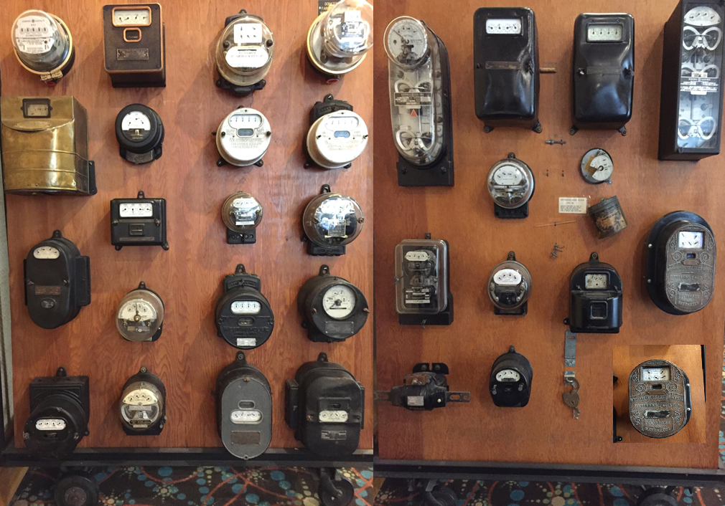
Asset Management &
Inventory Tracking Systems
for Metering Services
Prepared by Paul Fratellone, TESCO The Eastern Specialty Company
for the Manufacturer’s Forum at EEI
Monday, October 2, 2017 at 3 p.m.

Slide 2
Agenda
Asset & Inventory Overview
Benefits & Return on Investment
Owners & Perspectives
Build vs. Buy
Project Methodology
Getting Started
The Portfolio Landscape
Meter Shop & Field Operations
Challenges in AMI
Meter Life-Cycle
Out-of-the-Box
Paradigm Shift
Advancing Business Process Optimization

Slide 3
Asset Management & Inventory Tracking
Asset Management
Asset management refers to tracking unique items of value. They are often called physical assets or fixed assets.
Inventory Tracking
Inventory tracking refers to tracking non-unique items of value. These are often called stock or consumable items that track quantity, disposition, location…
Organizations strive to gain greater control and efficiencies when managing their assets
Notes:
In the past we had Corporate asset management systems that originated on the financial side of the business and we had meter record systems that handled all metering test results. Between the two we would have all of our bases covered.
As organizations bring inventory into their warehouses they are concerned with where product is stored, how it is distributed to locations and customers, how to track units sold, and when to replenish inventory

Slide 4
Benefits & Considerations
Business Drivers
Cost Reduction
Increased Revenue
Improved Efficiencies
Increased Traceability
The system should provide the necessary knowledge both for the warehouse worker to perform daily tasks and management to have product and financial insight.
Notes:
Cost Reduction—Optimize inventory, reduce shrinkage, and lower labor costs
Increased Revenue—Reduce out-of-stock SKUs, better monitor sales trends to optimize sales revenue
Improved Efficiencies—Increased accuracy, reduction of data entry errors, and automated data collection to provide real-time monitoring
Increased Traceability —Gain greater insight into key aspects of your organization
Identify your organization’s objectives—What do you want to track? How do you want it managed? What systems should be integrated into your solution?
Develop a site survey and technology plan—Understand that asset and inventory data will need to be collected and analyzed in order to determine the right solution.
Create a pilot program—If asset management and inventory tracking technology is new to your organization, it is often recommended to pilot your solution in a small area of your organization. Piloting will help you to refine requirements and better understand the components needed

Slide 5
Owners Perspectives, Needs & Wants
Owners
Meter Shop
Field Operations
Revenue Protection
Administration
Technology
Each owner will have their own perspective and objectives for the asset/inventory management system.
Ensure a 360 degree view of your organizations is represented

Slide 6
Build vs. Buy
You must consider:
Creating a weighted decision matrix to qualify & quantify vendors
Ensure ALL business owners are included
Always remember It’s business FIRST, technology SECOND
BUILD
Speed to market
Quality
Maintenance & TCO
Trade-offs
BUY
Vendor’s domain knowledge & experience?
Does the solution meet ALL requirements? (Gas, Electric & Water)
Track record & success stories
Total Cost of Ownership
SaaS
On-Premise

Slide 7
Project Methodology
Your vendor should realize that there is no “one-size-fits-all” that works for all business types, sizes or industries.
The vendor should be ready to assist and guide you through every phase of the initiative
Notes:
Choose the methodology that will deliver the most value, with the least impact on those delivering it. We will evaluate organizational goals, the constraints and dependencies, risks involved, the project size, cost, and of course, the complexity of the project.

Slide 8
Getting Started
Their approach should include:
An initial discovery session to understand your goals, requirements, timeline and budget
An assessment review of your existing environment, definition of project requirements, and success criteria
Defining which systems will be the “system of record”
Offer recommendations for business process improvements
Data conversion, cleansing and migration
Interfacing with other systems
Configuration, and deployment of the final
solution
Product lifecycle support

Slide 9
The Portfolio Landscape
Meter Data Management
Head-End
Test Boards
Accounting
3rd Party Vendors & Manufacturers
Work Management
Billing
Customer Service

Slide 10
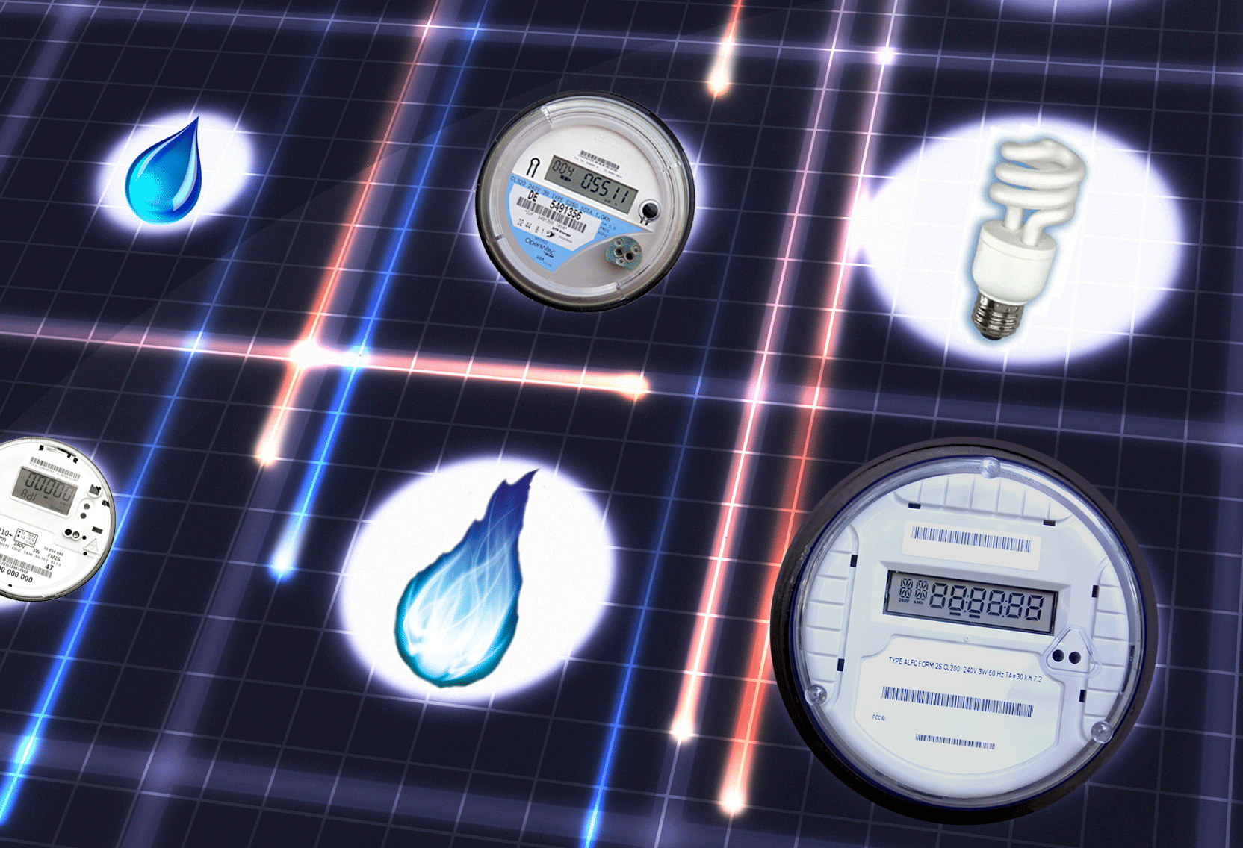
Utility 2.0 – Asset/Inventory Mgmt. Systems for Metering Services
I will use the previous slides as a backdrop to go into details about the MM functions and highlight and emphasize the AMI impacts

Slide 11
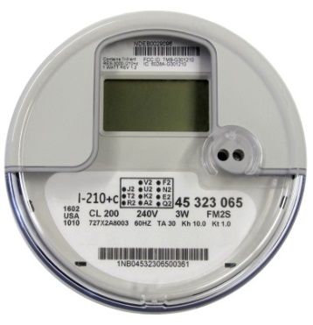
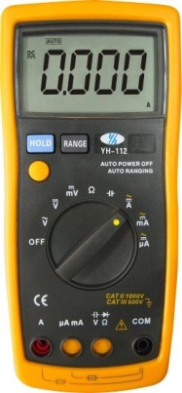
Meter Shop & Field Operations
Traditionally Meter Service Departments have typically been tasked with tracking:
Meters on the system (inventory and installed)
Meter test records (accuracy)
AQL Sample
PSC/PUC Random and Periodic Sample
Instrument transformers
Site Verification
Personal Protective Equipment (PPE)
Tools & Instruments

Slide 12
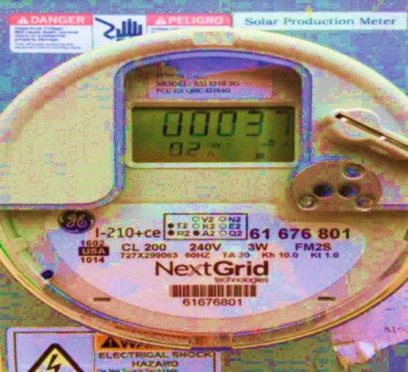
Challenges Introduced by AMI
Track multiple serialized devices under the cover of a single meter
Swap out and/or add additional devices at some later date to an installation
Track and update Program ID
Track both the hardware and firmware version for the meter and AMI Modules
Tracking network devices (bridges, relays, extenders…)
Ability to track functional test results as well as accuracy/demand results
Track complete site information for transformer rated customers
Seamlessly handle PPE i.e. rubber goods, tools and instruments
Deployments require robust RMA processing & tracking

Slide 13
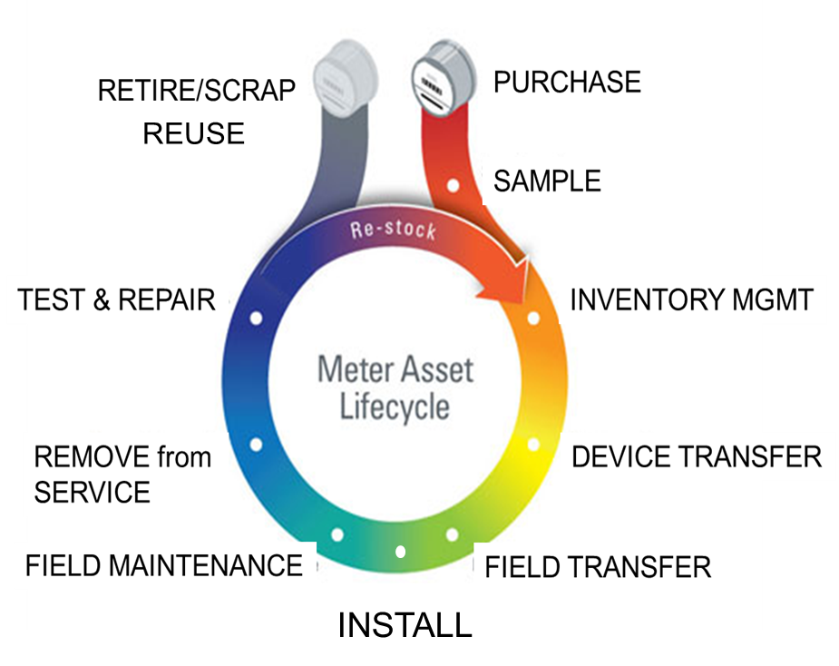
Typical Meter Life-Cycle
New Meter Purchase
First Article
Purchase Order
Vendor File (device creation)
Meter Receiving
Acceptance Testing
Device Release to Stock
Used Meter Processing
Meter Check-in
Meter Testing
Device Restocking
Retirement

Slide 14
Typical Meter Life-Cycle (cont’d)
Inventory Tracking
Track Inventory within shops, warehouses, storerooms, down to the container and/or shelf
Track Inventory to the person or truck
Meters are assigned to the person / truck
As meters are set, they are removed from inventory
Used meters are tracked from removal to meter shop
Physical inventory counts may be performed at any time
Quality management
Detailed analysis of meter performance
In-service, random sample, and periodic test plans
Full RMA tracking
Notes:
Level to which we can track inventory… What level… Shop, employee, vehicle…

Slide 15
Configurable & Customizable – Out of the Box
The software must be able to turn features on/off, based on security but also ensure the workflows are aligned with how your organization operates.
Reference Tables
Operating Areas
Inventory Locations
Meter shops
Container types
Test Boards
Scanners
Operational Tables
Item Models
Device Types
Failure Reasons
Test Types (work-orders)
Retirement Reasons
Test Sequences & Limits
Warranty
Security & Users
People
Users
Roles
Modules
The software must support user defined fields and customizable workflows. These are essential to minimizing disruption to existing systems
Notes:
Purpose built platforms continuously get enhanced/improved from usage and needs. Subsequent installations… One need becomes a core module.
User defined tasks and fields.

Slide 16
Paradigm Shift – Meter Testing
AMI has fundamentally changed what is tested, recorded and tracked. Accuracy Testing is only one component
FUNCTIONAL TESTING – Need to Verify
Display and program ID
Seals
Soft switches
AMI module hardware & firmware
Meter hardware & firmware
Master reset
Communications Check
Disconnect switch (if applicable)
Security Check

Slide 17
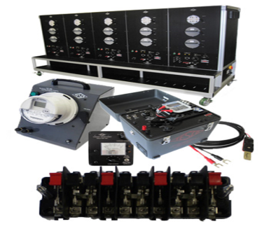
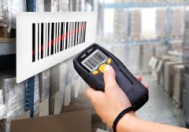
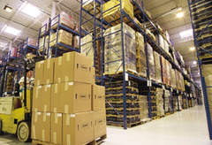
Advancing Business Process Optimization
AMI Inventory & Asset Management
Bridges, Range Extenders
Warranty & Battery Replacement
Integration with Test Boards
WECO, RFL, KNOPP, TESCO, GAS PROVERS
Kiosk workstation to accelerate meter shop & stores operations
Automated Meter Manufacturing File processing
Barcode scanning for managing shipments and inventory movements
Configurable Workflows
Test Sequences, Tasks & Limits
Work orders & test types
Role based security
Inventory Forecasting & Procurements
Regulatory Compliance
Reporting
Notes:
Measurement Systems,

Slide 18
The Promise of AMI
The introduction ten years ago and the continued development of an Advanced Meter Infrastructure (AMI) system promised more effective and more efficient Meter Service Operations.
This was to be accomplished in a variety of ways starting with:
No need to read meters (if AMR had not previously been deployed)
No need to roll a truck to perform a disconnect or a reconnect
Better ability to detect and respond to outages
Better ability to detect theft
Better ability to detect (and eventually capture) unbilled energy
Better understand customer usage and make better energy buying decisions

Slide 19
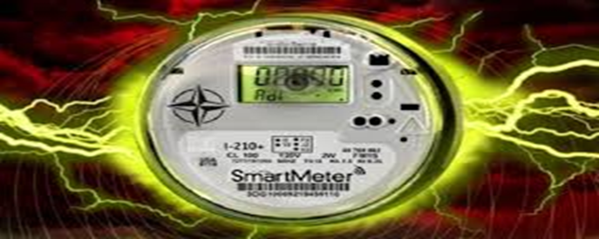
What Data Are We Getting and How Are We Using It?
Meter Quality Assurance:
Focusing on meter reading performance enables utilities to ensure AMI reliability. For instance, when meter readings are expected but not delivered, the system takes note, and calculates overall performance statistics for the AMI system. Utilities are made privy to problems they never would have been able to identify in the past.

Slide 20
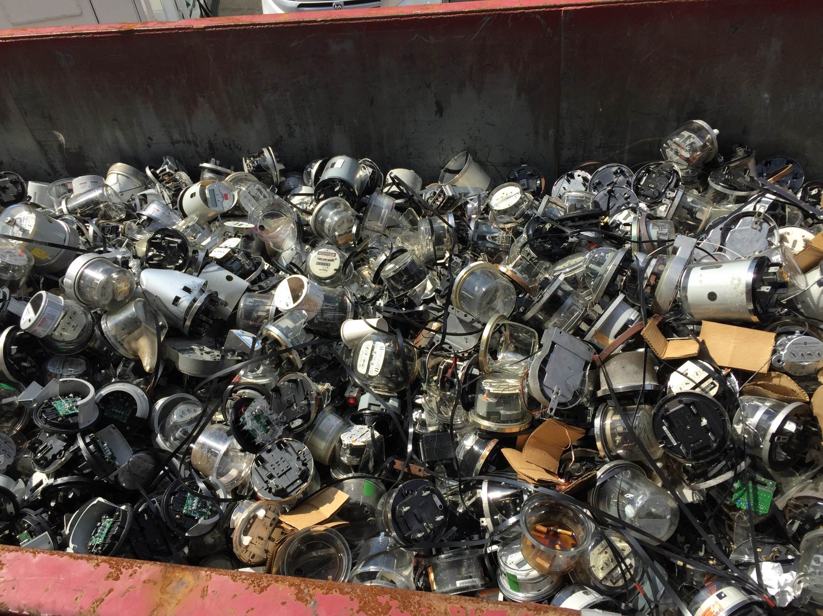
AMI will end a century of metering

Slide 21
Questions and Discussion
Paul Fratellone
Quality Assurance
TESCO – The Eastern Specialty Company
Bristol, PA 19007
email: paul.fratellone@tescometering.com
Mobile: 267-588-1418
This presentation can also be found on the TESCO website:
www.tesco-advent.com

