Slide 1
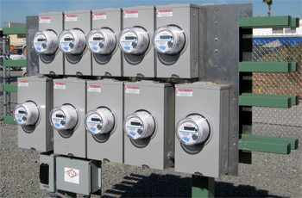
ANSI STANDARDS UPDATE
FALL 2020
Prepared by William H. Hardy, Ph.D.
for the EEI Virtual Conference
October 6, 2020.

Slide 2
OVERVIEW
2020 has been a strange year for the world, but a productive one for C12 standards
With so many people working from home we seem to have found more time for working in small groups where rapid progress can be made
This presentation is a quick review on the main achievements for the year.

Slide 3
C12.1 AND C12.20
C12.1 and C12.20 are the most fundamental of the ANSI metering standards. They provide all of the performance and accuracy requirements for meters.
C12.20 has been merged into C12.1 to create a single meter performance standard.
The merged standard is ready to be balloted.

Slide 4
C12.29 Field Testing of Electricity Meters
This is a technical paper which provides guidance on testing meters in the field
Historically many utilities have used a 2% threshold for fields testing of all meters
C12.29 establishes tolerances based on the accuracy class of the meter and a broad set of operational conditions.

Slide 5
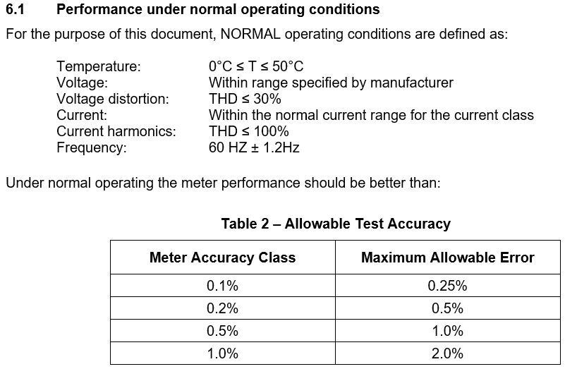
C12.29 Field Testing of Electricity Meters

Slide 6
C12.30 Service Disconnect Switches
A standard for testing of service disconnect switches is in progress
Establishes safety and reliability tests
Proposes a series of tests to assure that the disconnect switch does not reclose when any type of load is present
This will probably be added to C12.1

Slide 7
C12.31 VA Measurement Standard
Standard for the measurement of VA under harmonic
Ready for publication pending the resolution of the issue of including “Source VA” as proposed by John Voisine of Landis+Gyr

Slide 8
C12.32 DC Metering
The DC equivalent of C12.1 in the format of C12.46
Generated in less than 12 months through the tireless efforts of Charlie Ploeger, David Lawrence and super-editor Andrew Dudding and their small band of merry men.
Establishes a full range of performance specifications for DC meters.

Slide 9
C12.32 DC Metering
Accuracy Classes
Environmental Classes

Slide 10
C12.32 DC Metering
Accuracy Classes
Environmental Classes

Slide 11
C12.46 AC Metering Standard
C12.46 has been under development for a long time. It is intended to be a comprehensive replacement for C12.1(C12.20) in a form consistent with OIML R46.
Close to completion

Slide 12
Questions and Discussion
William H. Hardy, Ph.D.
CTO
Bill.Hardy@tescometering.com
TESCO – The Eastern Specialty Company
Bristol, PA
215-228-0500
This presentation can also be found under Meter Conferences and Schools on the TESCO website: www.tescometering.com
ISO 9001:2015 Certified Quality Company
ISO 17025:2017 Accredited Laboratory

