Slide 1
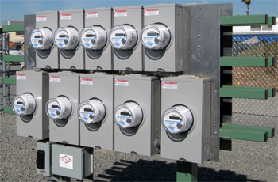
Streetlight Metering
Prepared by Tom Lawton, TESCO
The Eastern Specialty Company
For ECNE Spring E&O Conference
Thursday, March 21, 2019
2:00 p.m. – 3:00 p.m.

Slide 2
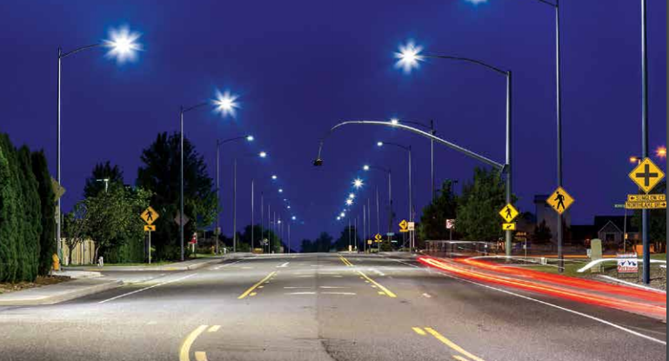
Introduction
This presentation will discuss the current usages and challenges for streetlight metering and the latest in testing/qualification of streetlight meters.
Photos: Acuity Brands Lighting

Slide 3
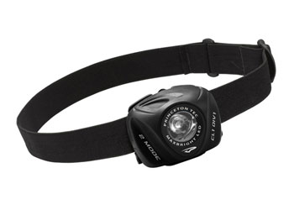
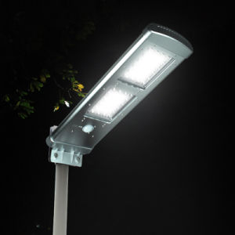
Streetlight Metering—Why change?
LED’s
LED’s have swept through one industry after another over the past twenty five years. Once LED’s are developed for a particular application they take over that industry in just a few years

Slide 4
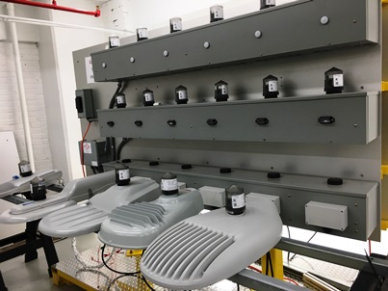
LED’s start to take over
A Better Solution
Better lighting of the pavement surface
Light is better directed so there is less light pollution
Less maintenance
Longer Life
Less energy consumed
Ability to control the lighting load by individual light or bank for
more suitable use given the location and time of day
emergency situations

Slide 5
Streetlight Metering—Intelligent Lighting
Streetlight controls:
Standard photocell operation
Advanced controls for holiday lighting, billboards, etc.
Remote mesh network communications
Scheduling and dimming (LED Lighting)
Graphic: GE lighting

Slide 6
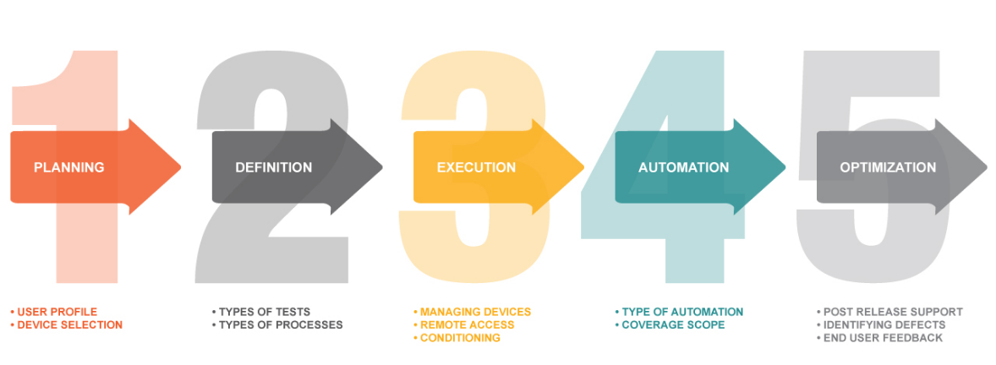
Streetlight Metering—Intelligent Lighting
Integration of metrology into streetlighting…
Graphic: 360Logica.com

Slide 7
Streetlight Metering—Intelligent Lighting
Integration of metrology into streetlighting
Metrology (metering function) integration into “nodes”
Combining metrology with remote access gives utilities access to information that they may never have had before.
Read voltage, current and power factor from each node.
Determine changes in lighting element faults and poor operation.
This information can be used to determine lighting outages (and dispatch a service truck automatically).
Can be used to monitor general outages like
residential meters are now.

Slide 8
Streetlight Metering—Intelligent Lighting
Energy metering today:
.5%, 1%, and 2% metering capabilities are now being quoted
Qualification and validation documentation very sparse.
No complete ANSI regulation to guide qualification testing, though a committee has formed and a spec is being developed (C136.50)

Slide 9
Streetlight Metering—Intelligent Lighting
Energy metering today:
Without the type of qualification testing that metering groups are used to doing prior to rollout of new vendor equipment or technology, billing usage for these nodes has been rare.

Slide 10
Streetlight Metering—Intelligent Lighting
Using metrology to do energy metering
A utility may want to test the accuracy of the nodes and work with local municipalities to determine whether the variance in billing due to metering accuracy could still provide better consistency and more accurate billing than current fixed billing algorithms can provide.

Slide 11
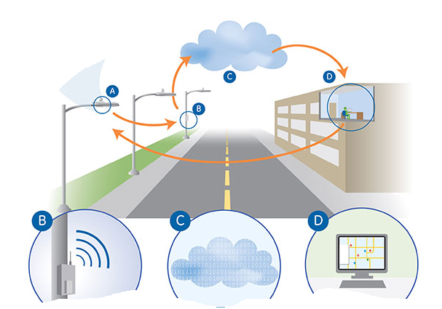
Streetlight Metering—Applications
Applications
Single streetlight meter
Group of single streetlight meters
Meter for a group of streetlights
Meter for any pole mounted device

Slide 12
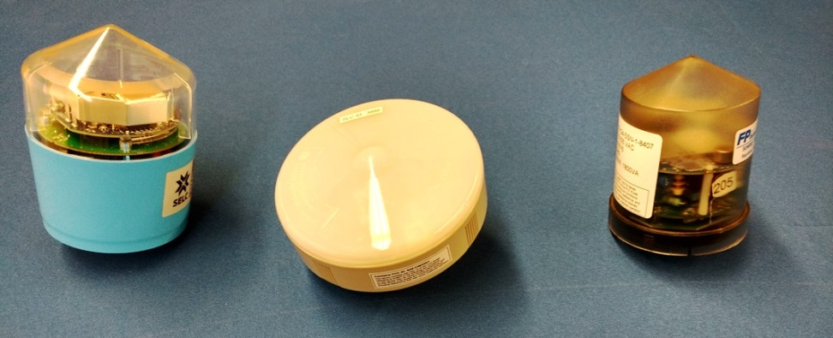
Streetlight Metering—Challenges
Testing Challenges
Meter test pulse
Without this pulse, most nodes only report whole watthours through their communications radios. Testing requires 10,000 Wh (in order to get 5 significant digits – 100.00%). 10,000 Wh at 120V and .25A (typical Light Load value) would take 320 hours
C136.50 is now requiring a pulse for every street light “meter”. Testing can now be done in “conventional” time periods.

Slide 13
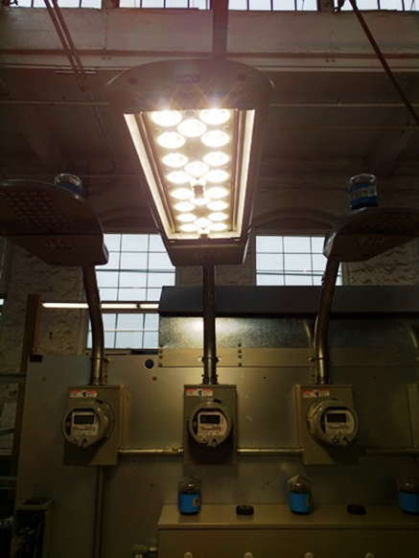
Streetlight Metering—Challenges
Testing Challenges
Meter setups
The setup on each node must be checked to make sure that it is not setup to do any scheduled dimming, or scheduled on/off control, so that the output relay remains on during the testing.
After testing is complete, the setups should be returned to the factory settings before releasing the node.
Working to introduce to C136.50 the concept of test modes for street light meters.

Slide 14
Streetlight Metering—Challenges
Testing Challenges
Functional / Communication testing
This testing is going to be quite similar to standard revenue meters, as the communications networks used are either the same, or similar to what you are used to.
One difference would be that if the utility is using scheduled on/off/dimming, that program will have to be setup or downloaded to the node before releasing for installation.

Slide 15
Streetlight Metering—Challenges
Testing Challenges
Conclusions
A Test Mode will make testing of streetlight meters easier and more consistent to perform in a meter shop environment.
The testing will all be more equitable for all manufacturers and users once the ANSI specification is released.
Relevant testing both for accuracy and functionality can still be done in light of the above; it will just take longer and could be somewhat subjective

Slide 16
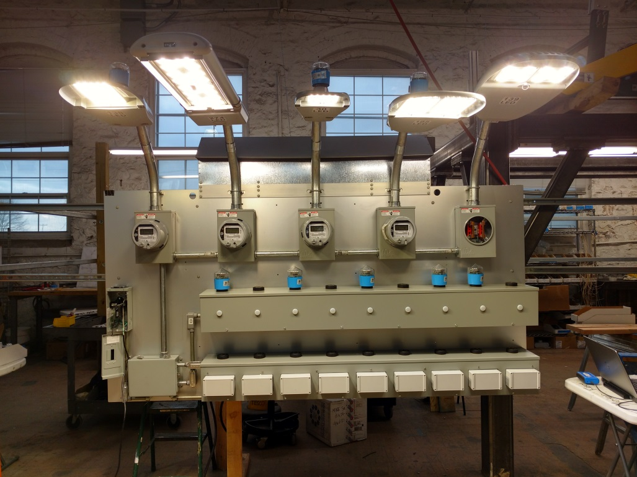
Streetlight Metering—Tests Required
Tests:
Manufacturer product
evaluation testing
Accuracy testing
Functional testing
Qualification testing

Slide 17
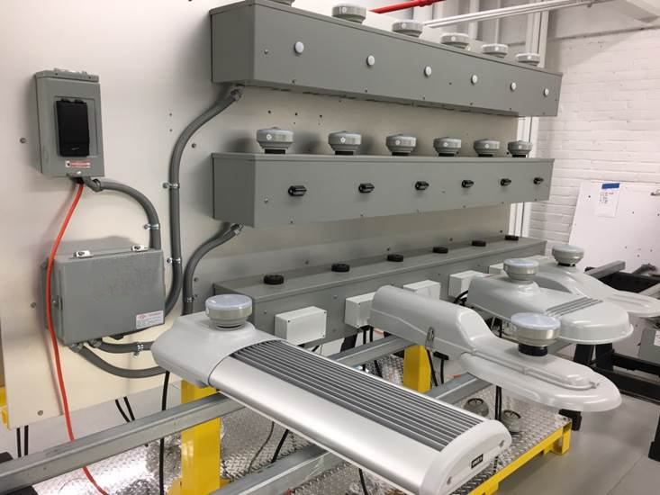
Streetlight Metering in the Meter Shop
Equipment Needed:
Test Boards
Mounting sockets
Transformer Rated applications
Field Test Equipment
Meter Farms
Meter Socket Adapters

Slide 18
Negative Business Case or Business Opportunity?
A large investment by Electric Utilities for less revenue
When the market place wants something there is no wisdom in trying to hold back the flood gates. Embrace and figure out how to not only survive but to thrive.
Smart Poles
Additional Lighting
Controls for the Lighting
Potential new products for Industrial Customers
Potential new products for residential customers
…..but also an investment in future Business Opportunities

Slide 19
Questions and Discussion
Tom Lawton
tom.lawton@tescometering.com
TESCO – The Eastern Specialty Company
Bristol, PA
215-785-2338
This presentation can also be found under Meter Conferences and Schools on the TESCO web site: www.tescometering.com

