Slide 1



Challenges for Meter Operations of the Future
Notes from the Field
Bill Hardy & Tom Lawton, TESCO
for the 2016 ECNE Conference

Slide 2
Abstract
As many utilities have elected to deploy advanced metering systems and millions of new solid-state, microprocessor based end-points with communications under glass, a dramatic shift has begun regarding where metering resources are being deployed and what they are doing.
This presentation will highlight the new value proposition for metering personnel at their respective utility companies in a post-AMI World.
Examples of issues which have arisen or been identified over the course of various deployments and in the immediate aftermath of an AMI deployment.

Slide 3
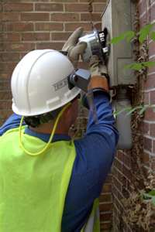
Ongoing Issues
Common Features and Common Sources of Concern
Fewer meter techs in the field and in the shop than there were 25 years ago
Acute shortage of experienced techs growing as industry experiences a wave of retirements
Fewer Field checks and site verifications due to lack of personnel, lack of experience and lack of expertise
More features under glass in the meters even before AMI deployed
Significantly more features under glass in every AMR and AMI system being considered or being deployed

Slide 4

The Pendulum Starts to Move
Meter Operations. Prior to deployment many larger utilities take an attitude of “this is only metering – how hard can that be?”. Over the course of deployment Meter Operations gains a stature and a respect from the rest of the organization that was not previously accorded them – even if this is only begrudging respect.
New tests for AMI meters (e.g. communication, disconnect) are identified
The complexity and issues around high revenue metering are at least acknowledged by the rest of the organization
Tests which have not been performed in years are suddenly back in vogue

Slide 5
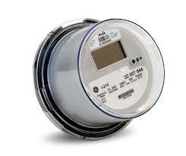
The New Realities
Electro-Mechanical Meters typically lasted 30 years and more. Electronic AMI meters are typically envisioned to have a life span of fifteen
Obsolescence more likely to be driven by technological change than devices wearing out.
This means entire systems are envisioned to be exchanged every fifteen years or so. In the interim the meter population and communication network inherent in the infrastructure for each utility must be maintained.
Meter communication and meter data management are becoming as important to metering operations as meter accuracy.
Firmware upgrades, firmware stability and cyber security are becoming increasingly important to metering departments

Slide 6

Expected & Unexpected Trends at the
End of Deployment
Expected:
The AMI deployment team will declare victory at some point and move on. Clean-up will be left for the meter service department
Change Management continues to be a tremendous challenge for every vendor through every deployment
Meter Acceptance testing including far more than accuracy testing for every deployment
Firmware upgrades must be checked and tested before mass deployment
Unexpected:
Not all forms are available by the end of deployment and must be installed as part of normal operations by the meter service department
Meter Certification Testing never slowed down over the course of any of the deployments
Notes:
6

Slide 7

Why do AMI meters fail?
Looking back at various deployments – what are the chief
causes to reject meter shipments?
Meter functional test failures including but not limited to;
Incorrect firmware
Bad settings
Alarms and errors that do not clear
Communication test failures
Bad tables
Failed disconnect switches

Slide 8
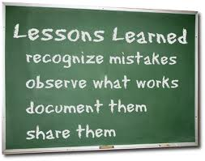
Lessons for the Future?
Are these infant mortality issues or are these issues to be concerned about going forward?
What is almost NEVER the reason for rejecting a shipment – meter accuracy.
Which are the most difficult meters for every deployment – the transformer rated meters. Often these forms are not available until very late in the deployment and sometimes not until the deployment has officially ended.

Slide 9

Commercial and Industrial Metering Challenges
Most AMI deployments utilize third party contractors to handle the residential and some self contained non-2S services. The balance are typically handled by the meter service department of the utility.
No AMI deployment has used the AMI communication network to handle the communication with the largest customer meters. The risk from even a short term interruption of communication or loss of data far outweighs the benefit of meters which are already being communicated with daily or even several times a day.
As these services are evaluated for new metering technology issues are being found at some accounts. These issues represent revenue losses due to inappropriate metering schemes or partially failed metering components (e.g. transformers, electronic components).

Slide 10
How are these new realities starting to affect metering operations?
Metering is becoming more about IT. Some metering departments have been reorganized after AMI as part of the IT department.
Metering emphasis will shift strongly toward C&I customers and further and further away from residential meters
Metering resources are being refocused on C&I accounts.
There are fewer levels of meter tech. Every meter tech needs to be at the higher level as there is not enough lower level work to warrant full time employees
More pressure is being put on the Utility to perform more testing in their own labs and at third party labs. We need to once again be the experts in all things metering.
Now that many AMR/AMI systems have been deployed, questions of payback are being asked.

Slide 11
New or expanded roles for metering departments of all sizes
Responsible for either reviewing ANSI Tests or even performing some of these ANSI Tests
Perform Meter Functionality testing on new and returned AMI meters
Register and communication module energy measurement comparison
Disconnect/Reconnect Functionality
Outage Performance
Meter Communications Performance
Consumer safety and combating real and perceived issues
Near continuous research into the “next” technology and the next deployment

Slide 12
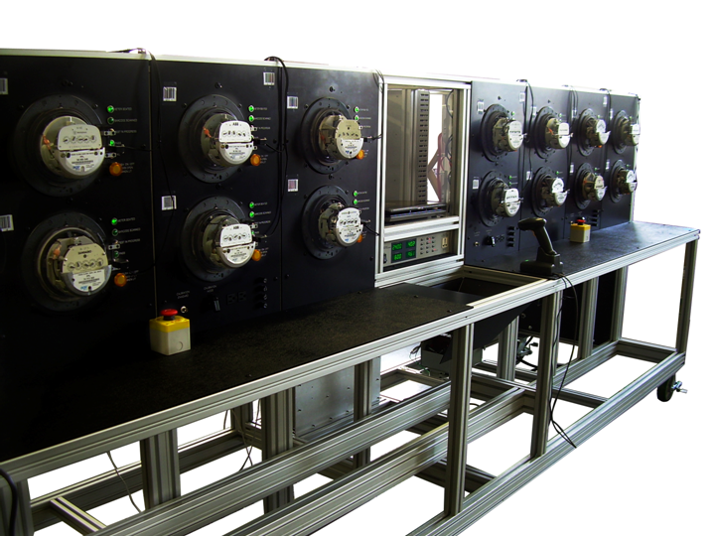
Shop Testing
Accuracy testing
Meter Communications Performance
Software and firmware verification
Setting verification
Functional testing
Disconnect/reconnect Functionality
and as left setting

Slide 13
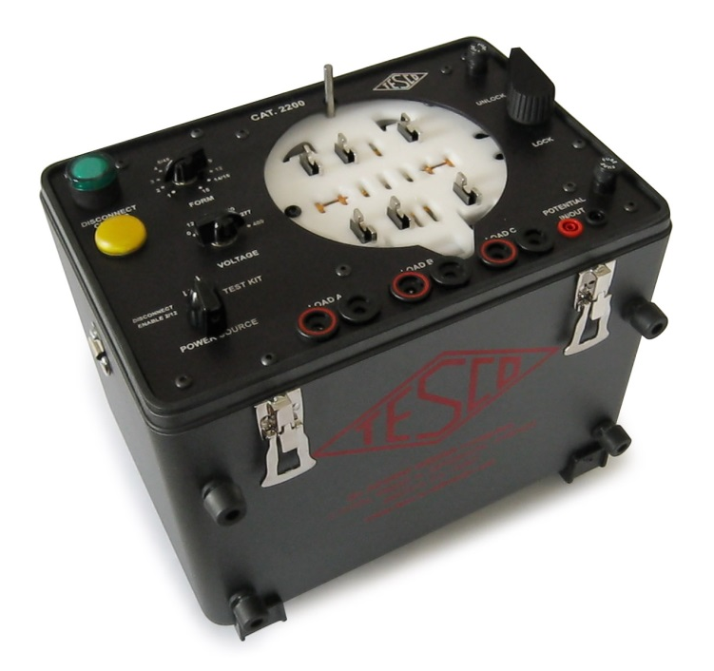
Field Testing
Accuracy Testing
Meter Communications Performance
Software & Firmware Verification
Setting Verification
Functional Testing
Disconnect/Reconnect Functionality
and as left setting
Tamper Verification
Site Audits appropriate to the type
of meter

Slide 14
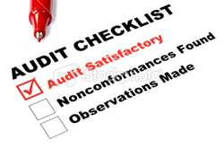
RMA’s, Root Cause Analysis and
In Service Testing
No one knows the actual life of their AMI meter. To do this we must learn as much as we can from the failures and the performance of the meters we have deployed.
Opportunities to Learn:
Meters returned from the field as bad or flagged on incoming inspection. These RMA’s need to be tracked not only for warranty purposes but more importantly to understand the root cause of the issues.
In Service Test programs need to be utilized to understand the overall performance of AMI meters and as failures are identified these meters need to be dissected and the failure mode understood. If necessary, once the failure mode is understood the meter population may need to also be dissected to identify sub-groups of meter that may be similarly affected. This could be a group of meters…
  from the same shipment.
  that were deployed in the same geographic area.
  that saw the same type of usage or environment.

Slide 15
Post-Deployment Needs
Once deployment is complete the certification and acceptance testing does not stop.
Everyone understands the importance of acceptance testing, but future generations of a smart meter also require certification testing.
New software and firmware needs to be tested and compared against the performance of older generations.
New hardware must be tested and compared to older generations.
Firmware upgrades need to be checked
New head end systems or IT protocols need to be tested against a large
group of meters before going live.

Slide 16
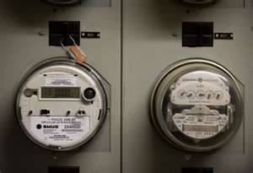
Real Life Examples of Change
Management in Action
Issues in the system not the components – what is the definition of a meter and when did the meter change?
  Meter and communication device interface
Feature Creep – every manufacturer wants to differentiate themselves – sometimes this works in unanticipated ways
  Recovery from power outages
  Short and long demand periods
But we only changed….lessons we
should have learned from Microsoft
  Over the air upgrades
Thank Goodness for test plans – right?
  Half closed disconnect devices
  Disconnect devices of unknown state
  Meters with incorrect firmware
  Hot Sockets and Meter failures during and after deployment

Slide 17
Change from Another Direction
ANSI C12 Moving to Completely Overhaul Standards
New C12.20 just approved
  Adds 0.1 accuracy class
  Implements testing for harmonic effects
  Requires moving to true polyphase testing for polyphase meters
New C12.10 coming soon
  Aligns C12.10 with UL2735 – Will this lead to UL listing requirements for meters?
Coming Soon – C12.31 Formal definitions for P, VA and VAR
  Step one formal definition of VA – only one correct answer - 2017
  Step two formal definition of VAR –only one correct answer – 2018
  Time varying definitions replace steady state definitions

Slide 18
Change from Another Direction
ANSI C12 Moving to Completely Overhaul Standards
Coming Soon – C12.29 Field Testing Standard
  Finally an easy to apply standard which defines what level of accuracy you should expect in the field under real world conditions

Slide 19
Change from Another Direction
ANSI C12 Moving to Completely Overhaul Standards
C12.46 Standard for Electricity Metering
  Replaces C12.1 and C12.20
  Defines accuracy requirements under ALL metering conditions
    Sinusoidal, harmonic, time varying
    Defines performance for Active Energy, Apparent Energy and Reactive Energy
    Moves toward Active energy and Apparent Energy as being the quantities on which billing is based
  Defines the meter as everything “under glass”. So performance testing has to be done “as configured” in the field with all functions “fully operational”.

Slide 20
Summary
Metering is getting much more complicated
  Accuracy is not just sinusoidal in the lab
  Communications are complex and rapidly evolving
At a time when meter operations are suffering from experience drain they need
  Increased expertise in communications technologies
  Ability to analyze complex data available from AMI/AMR systems
  Ability to deal with changing Standards which are much more

Slide 21
Summary
At a time when meter operations are suffering from experience drain and budget tightening they need
  Increased expertise in communications technologies
  Ability to analyze complex data available from AMI/AMR systems
  Ability to deal with changing Standards which are much more complex because they are “real world oriented”
How will metering operations meet these new challenges
  Expand staff? Bring in experts? Use outside services?
  Communications are complex and rapidly evolving

Slide 22
Summary
Change the approach to what they do
  Targeted field testing using statistical analysis of AMR/AMI data, not random sampling
  Large scale functionality testing prior to deployment
  More automation in all aspects of testing
    Consider the “cable guy”
Find ways to leverage outside services and support

Slide 23
Summary
There are fewer “routine jobs” in the field and many of the standard tasks are no longer required. This will lead to fewer classifications of meter techs going forward and the need for a more highly trained tech.
Each Utility must take a far more active role as part of checking, certifying, and rechecking the functionality of their meters.
Metering will be in a near constant cycle of looking for the next technology, evaluating those technologies, planning for deploying these technologies, and cleaning up the aftermath of the deployment of
these technologies.

Slide 24

Questions and Discussion
Bill Hardy
TESCO – The Eastern Specialty Company
Bristol, PA
1-800-762-8211
This presentation can also be found under Meter Conferences and Schools on the TESCO web site: www.tesco-advent.com

