Slide 1
Update to ANSI Standards 2014

Slide 2
Update to ANSI Standards.
Several new releases to various ANSI standards will soon be issued.
The purpose of this discussion is to highlight the upcoming changes to:
ANSI C12.1 – American National Standard for Electricity Meters -Code for Electricity Metering
ANSI C12.20 – American National Standard for Electricity Meters -0.1, 0.2, and 0.5 Accuracy Class

Slide 3
But First ……
2
Things to keep in mind when
discussing ANSI Standards

Slide 4
But First ……
1
State Regulations trump
ANSI Standards !!

Slide 5
But First ……
AND
Understand how each Standard is
Organized and where it’s applicable

Slide 6
ANSI – Application and organization
ANSI C12.1
Applies to all meters that are not cover under a separate standard i.e. ANSI C12.20.
Section 1 –Scope and References
Section 2 - Definitions
Section 3 - Standards and standardizing equipment
Section 4 - Performance requirements
Note: Section 4 only applies to Type Testing
Type Testing is only performed when qualifying a new meter type.
Section 5 -Standards for new and in-service performance
Appendixes are ALL INFORMATIVE
ANSI C12.20
Applies to all AC 01,0.2, and 0.5 meters that MEET BLONDEL’S THEOREM.
Any requirement not explicitly stated in C12.20, falls back onto C12.1.
Requirements for any meter type that does not meet BLONDEL’s Theorem falls back onto C12.1

Slide 7
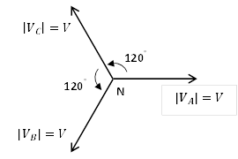
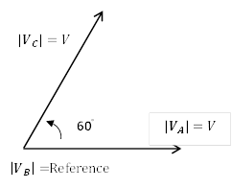
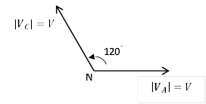
Changes – ANSI C12.1
Section 2– Definition Changes
• Added definitions for balanced voltages along with diagrams:
3 Phase, 4 wire wye – Equal line to neutral magnitudes, 120º relative phase angles
3 Phase, 3 wire delta – Equal line to line magnitudes, 60º relative phase angles
1 Phase, 3 wire – Equal line to neutral magnitudes, 180º relative phase angle
3 wire network – Equal line to neutral magnitudes, 120º relative phase angle

Slide 8
Changes – ANSI C12.1
Section 2– Definition Changes
• Added definitions for balanced voltages along with diagrams:
3 Phase 4 wire delta – Two equal line to neutral magnitudes, 180º relative phase angle.
Third line to neutral voltage; 3 times greater magnitude, 90º relative phase angle.
$$\left|V_{C}\right|=\sqrt{3}×V$$
90°
90°
$$\left|V_{B}\right|=V$$
N
$$\left|V_{A}\right|=V$$

Slide 9
Changes – ANSI C12.1
Section 2– Definition Changes
• Added definitions for the following:
2.9 cover: a lid or equipment covering used to protect the measurement components of a meter from external elements while allowing the viewing of the dials and nameplate information. A cover may contain other components which may be required for resetting demand and electronically reading the meter
2.41 Instrument transformer: A transformer that reproduces in its secondary circuit a definite and known proportion of the voltage or current of its primary circuit with the phase relation substantially preserved.
2.44 meter: A device that measures and records the consumption or usage of the product/service. In this standard, the term “meter” refers to a type of metering device.
2.105 watthour meter – instrument transformer rated: A meter in which the terminals are arranged for connection to the circuit being measured using external instrument transformers.

Slide 10
Changes – ANSI C12.1
Section 3 -Standards and standardizing equipment
Section 3.3 Traceability paths to NIST:
Removed the NIST Traceability Path diagram. It still appears in Appendix B, under B.4 Establishing a Local Reference Standard of Energy
Section 3.10.2.2.2 Performance requirements
Tightened the % errors for portable and reference standards at reference conditions including a specific voltage and current.
At these reference points, the error, after the application of the calibration values of the portable and reference standards, shall not exceed the values in Table 1a.
Table 1a – Portable and Reference Standards Percent Errors
Standards | Percent Error
 | @ 1.00 PF | @ 0.5 PF
Portable Standard (Section3.8) | 0.05 % | 0.05 %
Reference Standard (Section3.6) | 0.02% | 0.02%

Slide 11
Changes – ANSI C12.1
Section 3– Standards and standardizing equipment
3. Section 3.10.2.2.3 Variation for reference condition
Gave additional percent errors for Portable and Reference Maximum Percent
Errors @ 23°C over the designed range of voltage and current
Additionally, at the reference temperature the error of the standard shall not exceed the values in Table 1b
over the design range of voltage and current.
Table 1b – Portable and Reference Maximum Percent Errors @ 23ºC
Standards | Percent Error
 | @ 1.00 PF | @ 0.5 PF
Portable Standard | 0.07 % | 0.07 %
Reference Standard | 0.04% | 0.04%

Slide 12
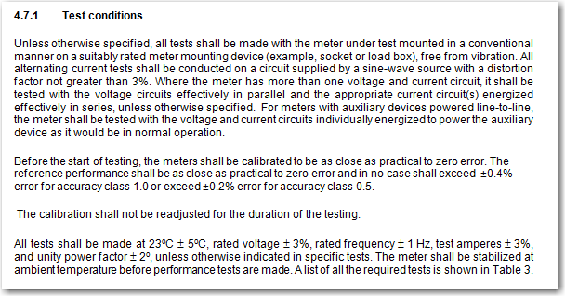
Changes – ANSI C12.1
Section 4– Acceptable performance of new types of Electricity meters and associated equipment
Section 4.7.1 Test conditions under Performance Requirements
Addition of some clarity for the calibration level of meters prior to testing and
highlighted that no adjustments are to be made during the test.

Slide 13
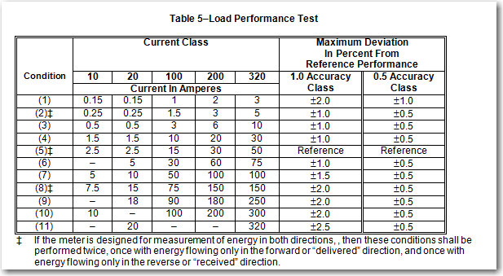
Changes – ANSI C12.1
Section 4– Acceptable performance …..
Section 4.7.2 Accuracy Tests – Internal Influences
Added 0.5% Accuracy Class Limits for applicable tests #s 2 → 7, 11, 19, 20, and 21
Added conditions for meters that measure in both delivered and received directions for
test #2 –Starting Load, test # 3- Load Performance and test #4 – Effect of Variation of Power Factor .

Slide 14
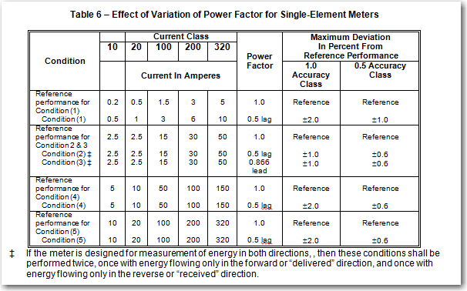
Changes – ANSI C12.1
Section 4– Acceptable performance …..
Section 4.7.2.4 Test No. 4: Effect of variation of power factor
Added a test amps point for reference for conditions 2 and 3
Added the lead and lag reference for conditions 2 and 3
Added the 0.5 accuracy class performance limits.
Added conditions for meters that measure in both delivered and received directions.
Note that Table 6 provides
performance limits for
SINGLE Phase Meters.
While Table 7, 8, and 9
provides for various types
of polyphase meters.
Table 8 added 320A column.

Slide 15
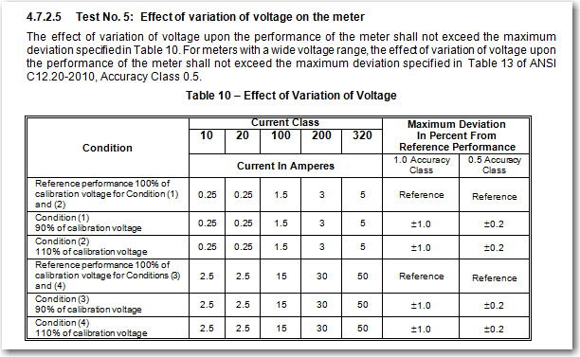
Changes – ANSI C12.1
Section 4– Acceptable performance …..
Section 4.7.2.5 Test No. 5: Effect of variation of voltage on the meter
1. Added a reference to wide voltage range meters in order to evaluate deviations from
Table 13 of ANSI C12.20.

Slide 16
Changes – ANSI C12.1
Section 4– Acceptable performance …..
Section 4.7.2.8 Test No. 8: Meter Losses
Added for clarity that the loss in each current circuit of a meter will be
measured at the reference test amps

Slide 17
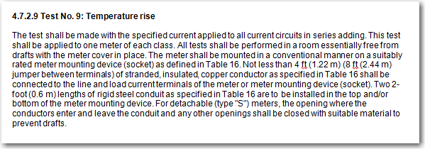
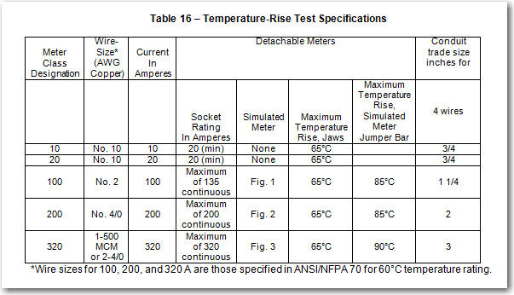
Changes – ANSI C12.1
Section 4– Acceptable performance …..
Section 4.7.2.9 Test No. 9: Temperature Rise
Clarified the test methodology i.e. how the test is to be performed, including the wire size and length.
Added performance conditions which are not to be exceeded in table 16

Slide 18
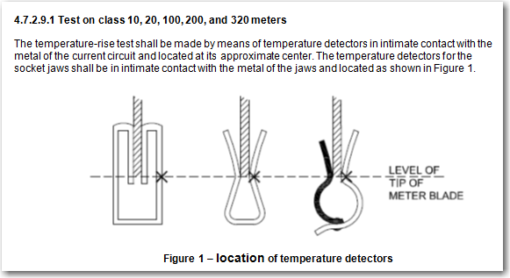
Changes – ANSI C12.1
Section 4– Acceptable performance …..
Section 4.7.2.9 .1 Test No. 9: Temperature Rise (Con’t)
Further clarification of the test methodology i.e. location of temperature detectors
Description of use of the “simulated” meter
Also clarified that an accuracy test shall be performed after the temperature rise test.

Slide 19
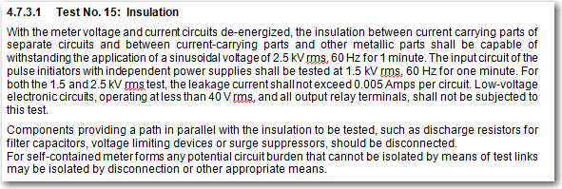
Changes – ANSI C12.1
Section 4– Acceptable performance …..
Section 4.7.2.14 Test No. 14: Independence of Elements
Identified test conditions for Accuracy Class 0.5 meters – aligning with ANSI C12.20
Section 4.7.3.1 Test No. 15: Insulation
Added details specifying that specific components within solid state meters should be disconnected
Also noting that the potential circuit may be isolated by any means if the meter does not have a test link.
Removed the accuracy performance check after an insulation test

Slide 20
Changes – ANSI C12.1
Section 4– Acceptable performance …..
Section 4.7.3.3 Test No. 17: Effect of high voltage line surges
Added clarification on when the accuracy check may be performed for the 100kHz ring wave test.
Section 4.7.3.16 Test No. 30: Effect of operating temperature
Changed the ramp time from 6 hours to 5 hours
Clarified that the current during the test should be between Light Load and Test Amps.
Clarified that it is acceptable to perform the accuracy test after Test 31 – Relative Humidity Test

Slide 21
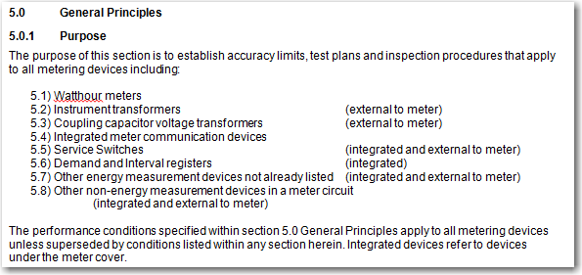
Changes – ANSI C12.1
Section 5– Standards for new and in-service performance
Overall changes
Explicitly covers various metering devices as outlined in the general purposes.
Clarifies the use of ANSI Z1.4/Z1.9 as an acceptable sampling plan along with acceptable AQL levels
if Z1.4 or Z1.9 is used.
Identifies corrective actions if a sampled group does not meet the acceptance criteria.
Changes to the Variable-Interval Plan allowing for random selection of in-service solid-state meters
The informational table regarding the Variable-Interval Plan was moved to the appendix.

Slide 22
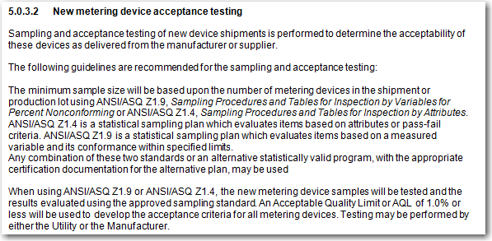
Changes – ANSI C12.1
Section 5– Standards for new and in-service performance
Section 5.0.3.2 New metering device acceptance testing
Here’s our
out !!

Slide 23
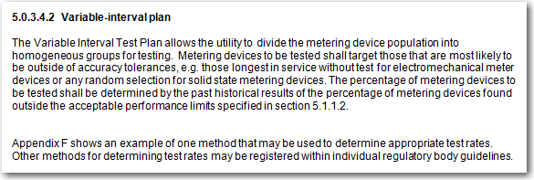
Changes – ANSI C12.1
Section 5– Standards for new and in-service performance
Section 5.0.3.4 Test Plans

Slide 24
Changes – ANSI C12.1
Section 5– Standards for new and in-service performance
Section 5.0.3.4.4 Corrective Action

Slide 25
Changes – ANSI C12.1
Section 5– Standards for new and in-service performance
Section 5.2 Instrument transformers

Slide 26
Changes – ANSI C12.1
Section 5– Standards for new and in-service performance
Section 5.5 Service Switches
Focus is on testing NEW devices; making in-service testing optional.
Can be used for In Service testing of service switches
if the Utility chooses to do so!!

Slide 27
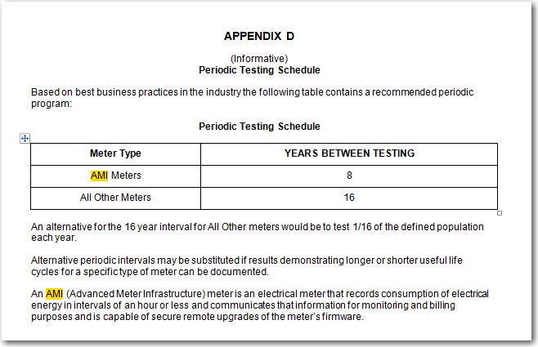
Changes – ANSI C12.1
Other Sections
Appendix D – Periodic Testing Schedules
The Appendix contains informational items only – no requirements.
Cleaned up the old table, placed a reference to AMI meters with an attempt at a definition, below.

Slide 28
Changes – ANSI C12.20
Outline of changes
Scope change – Now includes 0.1 Accuracy Class meters
General focus is on TYPE TESTING
Defers to ANSI C12.1 for in service testing.
Clarifies which meter forms meet Blondel’s Theorem and are therefore covered under ANSI C12.20. Also list those meter forms that are NOT covered.
Moving away from Series-Parallel loading toward true polyphase loading.
Identifies Typical and Alternative loading methods for applicable meter forms
Test 3 (load performance),4 ( Power Factor),5 (voltage variation) and 14 (polyphase loading) must be performed with both the Typical and Alternative loading methods.
Added Harmonic Influence tests with 6 specific non-sinusoidal waveforms

Slide 29
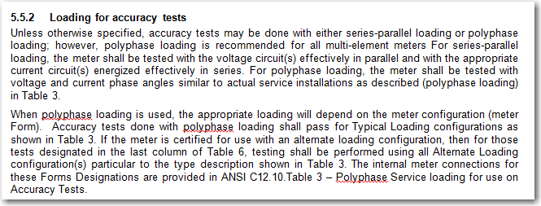
Changes – ANSI C12.20
Section 5.5.2 – Loading for accuracy Tests

Slide 30
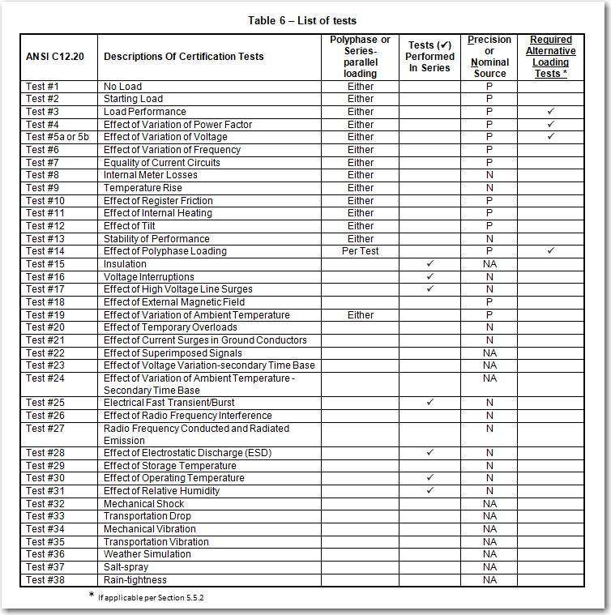
Changes – ANSI C12.20
Section 5.5.2 – Loading for accuracy Tests
Polyphase or
Series-parallel
loading
Required
Alternative
Loading
Tests *

Slide 31
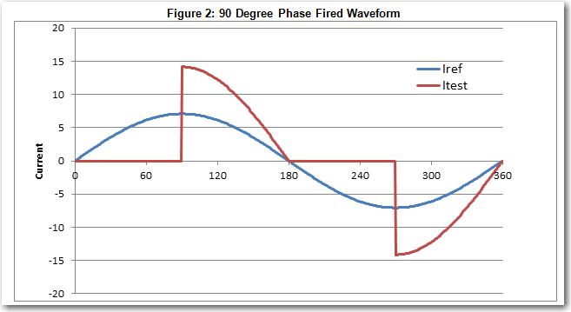
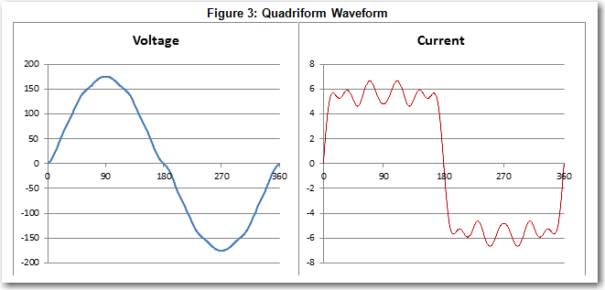
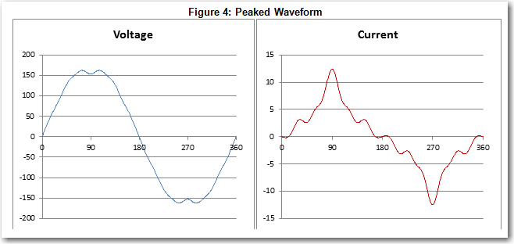
Changes – ANSI C12.20
Waveforms

Slide 32
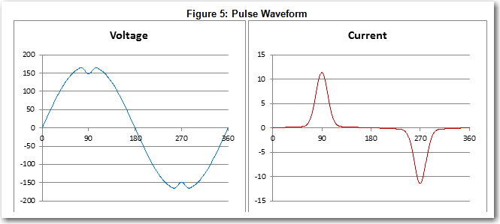
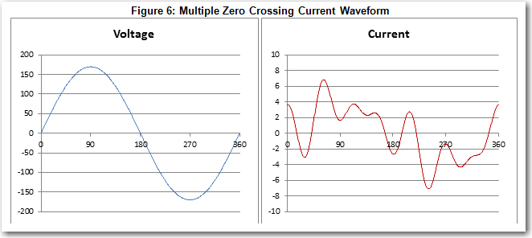
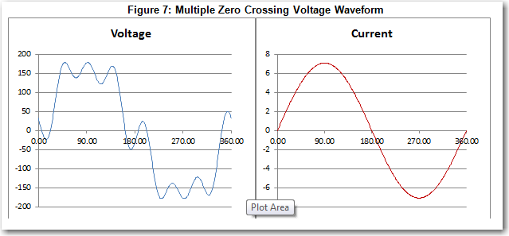
Changes – ANSI C12.20
Waveforms

Slide 33
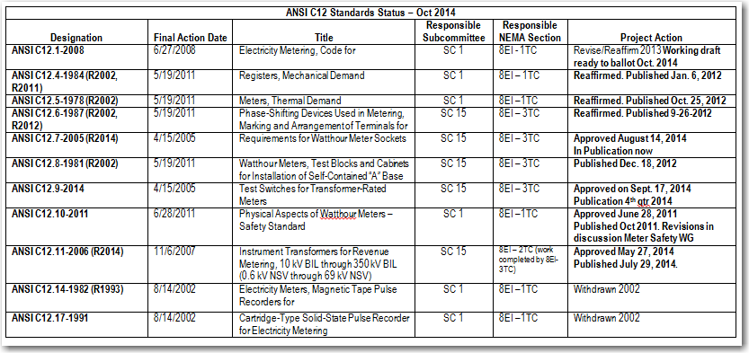
Status of Current ANSI work

Slide 34
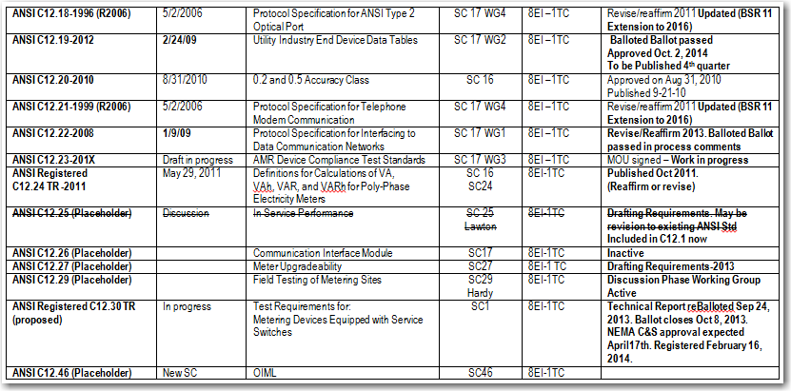
Status of Current ANSI work

Slide 35
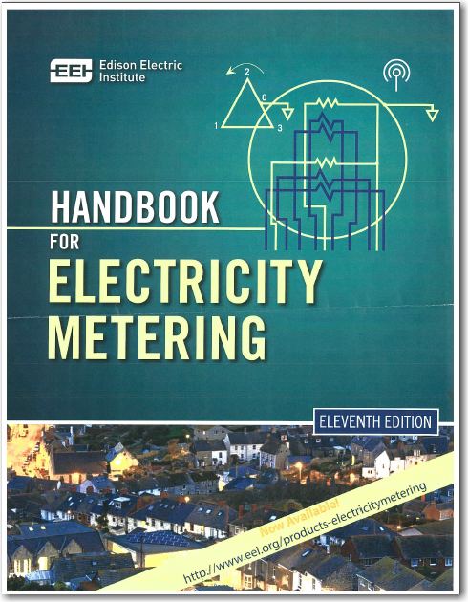
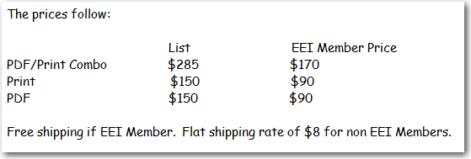
New Metering Handbook is available
To order contact EEI at
http://wwweei.org/products-electricitymetering

Slide 36
Metering Handbook – Chapter 21 STANDARDS
ANSI C12.1 – Code for Electricity Metering - This standard establishes acceptable performance criteria for new types of ac watt-hour meters, demand registers, pulse devices, and auxiliary devices. It also describes acceptable in-service performance levels for meters and devices used in revenue metering.
ANSI C12.7 – Requirements for Watt-hour Meter Sockets - General requirements and pertinent dimensions applicable to watt-hour meter sockets rated up to and including 600V, and up to and including 320 A continuous duty per socket opening.
ANSI C12.9 – Test Switches for Transformer-Rated Meters - Covers the dimensions and functions of meter test switches used with transformer-rated watt-hour meters in conjunction with instrument transformers.
ANSI C12.10 - Physical Aspect of Electricity Meters – Safety Standard - This standard covers the physical aspects of both detachable and bottom-connected watt-hour meters and associated registers. It also includes ratings, internal wiring arrangements, pertinent dimensions, markings, and other general specifications.

Slide 37
Metering Handbook – Chapter 21 STANDARDS
ANSI C12.11 – Instrument Transformers for Revenue Metering, 10kV BIL through 350kV BIL (0.6kV NSV through 69kV NSV) - This standard covers the general requirements, revenue grade accuracy, thermal ratings, and dimensions applicable to current and inductively coupled voltage transformers for revenue metering.
ANSI C12.18 - Protocol Specification for ANSI Type 2 Optical Port - This document details the criteria required for communications with an electricity metering device by another device via an optical port. This document provides details for a complete implementation of an OSI 7-layer model.
ANSI C12.19 - Utility Industry End Device Data Tables - This standard defines a table structure for utility application data to be passed between an End Device and any other device. It, however, neither defines device design criteria nor specifies the language or protocol used to transport that data.

Slide 38
Metering Handbook – Chapter 21 STANDARDS
ANSI C12.20 - 0.2 and 0.5 Accuracy Classes for Electricity Meters - This standard establishes the physical aspects and acceptable performance criteria for 0.2 and 0.5 accuracy class electricity meters meeting Blondel’s Theorem. Where differences exist between the requirements of this Standard and C12.1 and C12.10, the requirements of this Standard shall prevail. Conversely, requirements NOT specifically addressed within this standard, defer to ANSI C12.1.
ANSI C12.21– Protocol Specification for Telephone Modem Communication - This document details the criteria required for communications between an electric power metering device and a utility host via a modem connected to the switched telephone network.
ANSI C12.22 – Protocol Specification for Interfacing to Data Communication Networks - This standard extends the concepts of the ANSI C12.18, C12.19 and C12.21 standards to allow transport of table data over any reliable networking communications system.

Slide 39
Metering Handbook – Chapter 21 STANDARDS

Slide 40
Metering Handbook – Chapter 21 STANDARDS

Slide 41
Metering Handbook – Chapter 21 STANDARDS

Slide 42
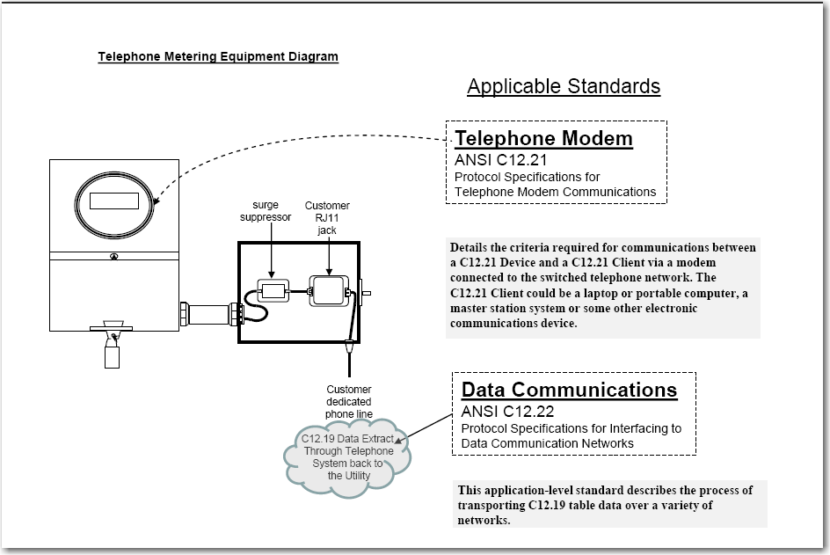
Metering Handbook – Chapter 21 STANDARDS

Slide 43
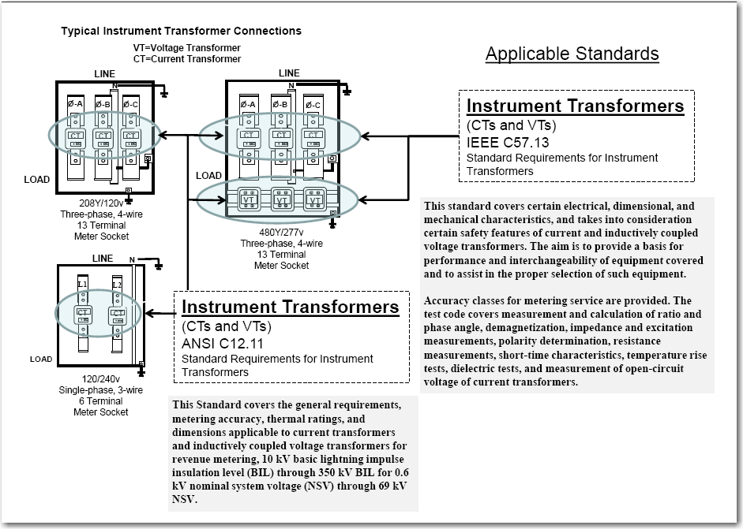
Metering Handbook – Chapter 21 STANDARDS

Slide 44
Metering Handbook – Chapter 21 STANDARDS

Slide 45
Questions?
Thank you!

