Slide 1


DC Metering and Traceability
Prepared by Tom Lawton and
William H. Hardy, Ph.D.
for the AEIC Measurement Technologies Working Group
EEI Metering Track – Virtual Fall Conference
7 October 2020

Slide 2
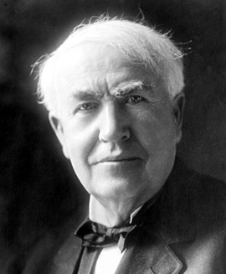
DC – EDISON MAY WIN IN THE END
Edison thought DC was the winning form of electricity.
Maybe in the end he will be right.
Today almost everything we use could, WITHOUT MODIFICATION, be run from DC

Slide 3

DC – EDISON MAY WIN IN THE END
Who would have imagined 10 years ago the cars powered by DC electricity would be the future of transportation.

Slide 4
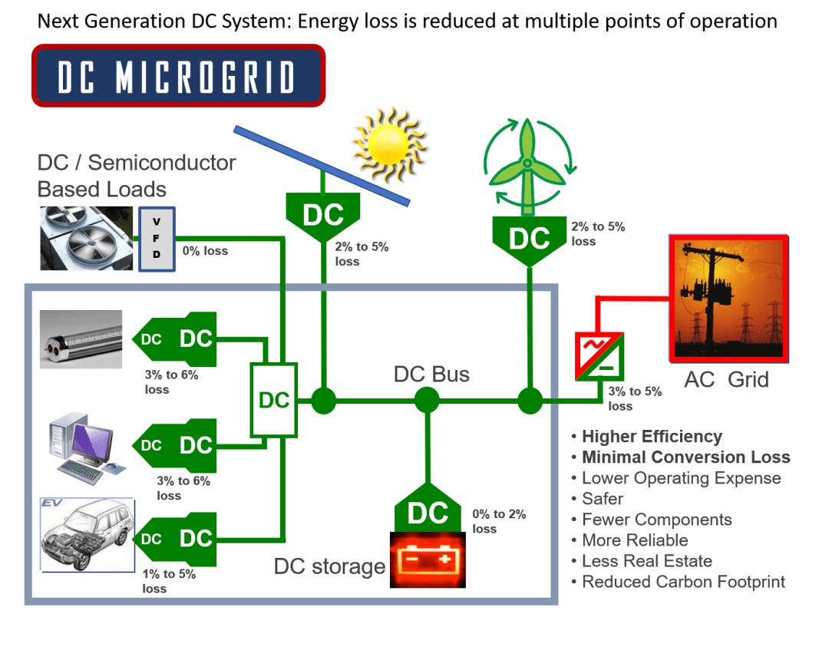
DC – EDISON MAY WIN IN THE END
DC micro-grids prove effective for shared cogeneration and storage

Slide 5
DC METERS – TOMORROW’s CASH REGISTERS
If you are going to sell it, you have to measure it.
Real needs are driving the urgency for DC metering
California has passed legislation requiring DC metering standards by December 1, 2020
Yesterday ANSI SC32 voted out a DC Metering Standard

Slide 6
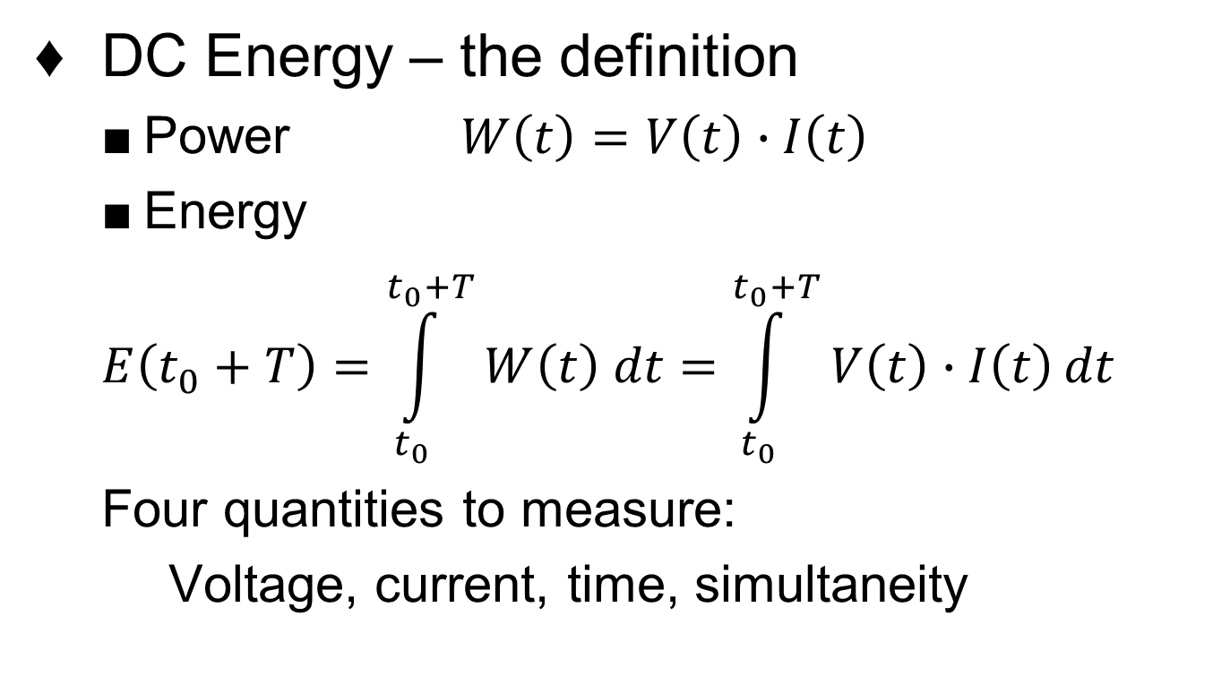
BACKGROUND
DC Energy – the definition
  Power $W\left(t\right)=V\left(t\right)∙I\left(t\right)$
  Energy
  $$E\left(t_{0}+T\right)=\int_{t_{0}}^{t_{0}+T}{W\left(t\right) dt}=\int_{t_{0}}^{t_{0}+T}{V\left(t\right)∙I\left(t\right)dt}$$
  Four quantities to measure:
  Voltage, current, time, simultaneity

Slide 7
CHALLENGES
  Same definition as AC energy
  Voltage
    For DC voltages we are limited to resistive dividers to get from system voltages to ADC levels
      Generally this is not an issue.
  Current
    DC meters may use shunts, Hall effect sensors, or more sophisticated devices such as zero flux transducers
    Both high current and low current applications present issues at high accuracy

Slide 8
CHALLENGES
  Time Interval
    Neither measurement nor accuracy is an issue
  Simultaneity
    Modern sampling ADCs make true simultaneity easy
  So why is DC metering considered so difficult?
    EVSE manufacturers demanded a relaxation of accuracy requirements to 5% and a delay of up to a decade to comply.

Slide 9
CHALLENGES
  DC may not really be DC
  There may be 10% of AC ripple on top of the voltage at frequencies in the 60Hz to 360Hz range
  There may be high frequency saw-tooth waves in the 20kHz to 250kHz range
  Loads may vary rapidly including large instantaneous steps

Slide 10

DEVIL IS IN THE DETAILS
  Modern AC meters use a variety of signal processing techniques to enhance accuracy.
    Any DC content of the signals is removed
    Algorithms such as FFTs and digital transforms make use of the AC nature of the signals to improve accuracy
    For AC, small, inexpensive CTs are available with inherent accuracies of ±0.02 percent

Slide 11
DC CURRENT MEASUREMENT
  SHUNTS
    For high currents shunts are generally large and produce very low signal levels
    A 1mΩ shunt in a 100A meter produces 10W with only a 0.1V signal
    At 1.5 amps the signal is only 0.0015 volts
    DC offsets can easily be larger than the signal and there is no simple signal processing trick to eliminate them
    Shunts generally have fairly high temperature coefficients

Slide 12
CURRENT MEASUREMENT
  Hall effect sensors
    Hall effect sensors are generally in the 1% to 5% accuracy range
    Closed loop sensors may be better than 1%
    Cost is generally high compared to shunts
    Temperature dependence may be an issue

Slide 13
CURRENT MEASUREMENT
  Zero flux transformers/flux gates
    Can be very accurate <0.1% over a wide temperature range
    Measure AC and DC
    Are VERY expensive compared to all other techniques
    Few sources, large in size

Slide 14
ESTABLISHING TRACEABILITY
  Normally one starts by sending a measurement device to NIST for calibration as a primary reference standard
  Unfortunately, NIST has no primary DC Energy Standard and does not offer that service
  So if you want a traceable measurement you have to start from basic measurements and qualify your own primary standard

Slide 15
ESTABLISHING TRACEABILITY
  The Validation Process
    A primary reference standard candidate is constructed using multiple current sensors with AC/DC measurement capabilities
      Precision zero flux transformer for high current 10 – 1000A
      Precision shunt 0.1 ohm, 1 ppm TC with integrated PT100 temperature sensor

Slide 16
ESTABLISHING TRACEABILITY
  Current Measurement is validated in multiple ways
    AC accuracy is validated against a Fluke 6105A with basic uncertainty of <50ppm
    DC accuracy is validated against the Fluke 6105A up to 10A
    Above 10A a pair of precision shunts are used
      An 0.100 Ohm shunt for 0.01 to 21 amps
      A 100uOhm shunt for 10 to 1000A

Slide 17
ESTABLISHING TRACEABILITY
  Voltage Measurement is validated directly with the Fluke 6105A in both AC and DC modes
    The Fluke 6105A has a basic uncertainty of <50ppm
  Because the system is fully calibrated in AC and DC modes it is also capable of mixed signal measurement of any kind
    AC validation resolves any issues of timing and simultaneity

Slide 18
TESTING DC METERS
  TESCO is currently testing a production meter for compliance with ANSI C12.32 (Draft of 10/6/2020
  TESCO is currently testing a production meter for compliance with ANSI C12.32 Draft of 10/6/2020
    DC 120V-250V
    80A Self-contained
    Accuracy class 1%

Slide 19
EXAMPLE RESULTS
  Accuracy testing

Slide 20
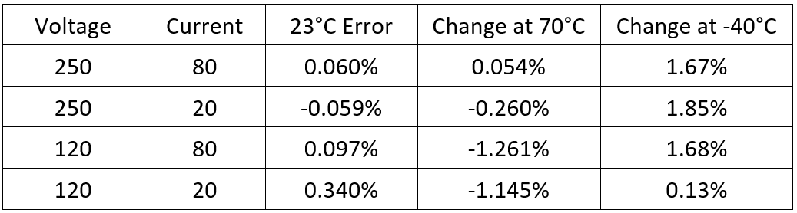
EXAMPLE RESULTS
  Temperature Testing
  Results well within the requirements for an AC or DC meter of Accuracy Class 1%

Slide 21
CONCLUSION
  DC Metering is here today
  Today’s technology can deliver cost effective DC metering with accuracies and environmental performance similar to AC meters.
Edison is smiling today!!!!

Slide 22

Questions and Discussion
William H. Hardy, Ph.D.
CTO
Bill.Hardy@tescometering.com
TESCO – The Eastern Specialty Company
Bristol, PA
215-228-0500
This presentation can also be found under Meter Conferences and Schools on the TESCO website: www.tescometering.com
ISO 9001:2015 Certified Quality Company
ISO 17025:2017 Accredited Laboratory

