Slide 1

DC Energy Traceability/EV Charging Station Accuracy Tracing
EDA Niagara
Metering Exhibition and Workshop
April 4, 2024, 9:00 – 9:45 AM
Perry Lawton, TESCO

Slide 2
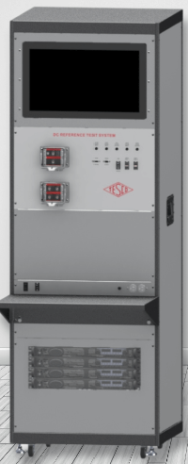
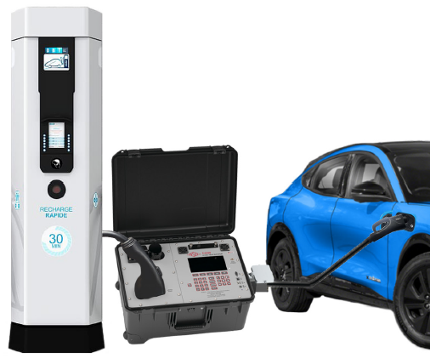
Topics Overview
DC Energy Traceability and ISO 17025 Accreditation
EV Charging Station Accuracy Testing

Slide 3
DC Energy Traceability and ISO 17025 Accreditation
EDA Niagara
Metering Exhibition and Workshop
April 4, 2024, 9:00 – 9:45 AM
Perry Lawton, TESCO

Slide 4
TESCO EVSE History
TESCO: Metering since 1904; energy measurement is what we do
~10 years ago we saw that EV chargers, since they would be selling energy, would need to be calibrated and tested similar to revenue grade utility meters
2015: TESCO’s first patents for AC/DC calibration of EVSE

Slide 5
TESCO EVSE History: AC vs DC
Developed AC calibration capability first
  Familiarity with AC measurement in shop and field test units for utility space was helpful here
DC was not so easy….
  First electric meter standards developed in 1910… a few years after DC meters were obsolete
  There was never a recognized standard in NA for DC metering
  TESCO worked to develop the methodology and process for DC metrology
  Created equipment, took data, reviewed data, adjusted equipment, more data…
    Fast-forward several years.. TESCO’s lab received expansion of scope for ISO 17025:2017 accreditation to include DC Energy Measurement

Slide 6

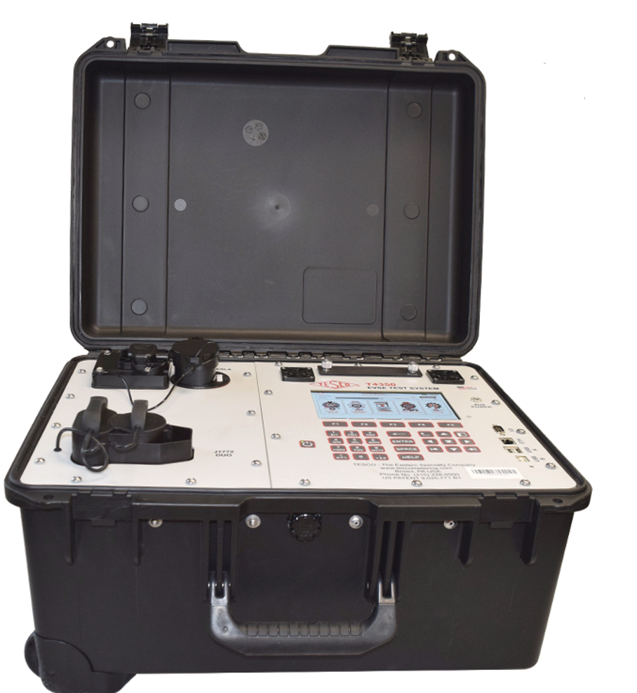
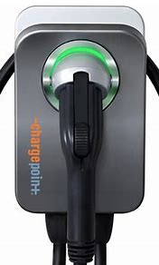

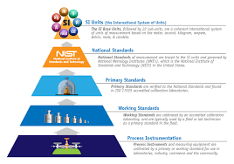
EVSE Tracing
Level 1, 2, 3 EVSE Charger
TESCO Catalog #T4350
TESCO ISO 17025:2017
Accreditation
TESCO DCT

Slide 7
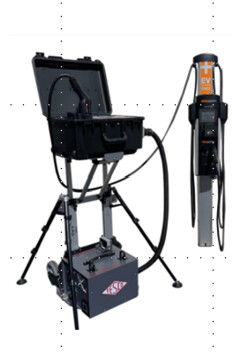
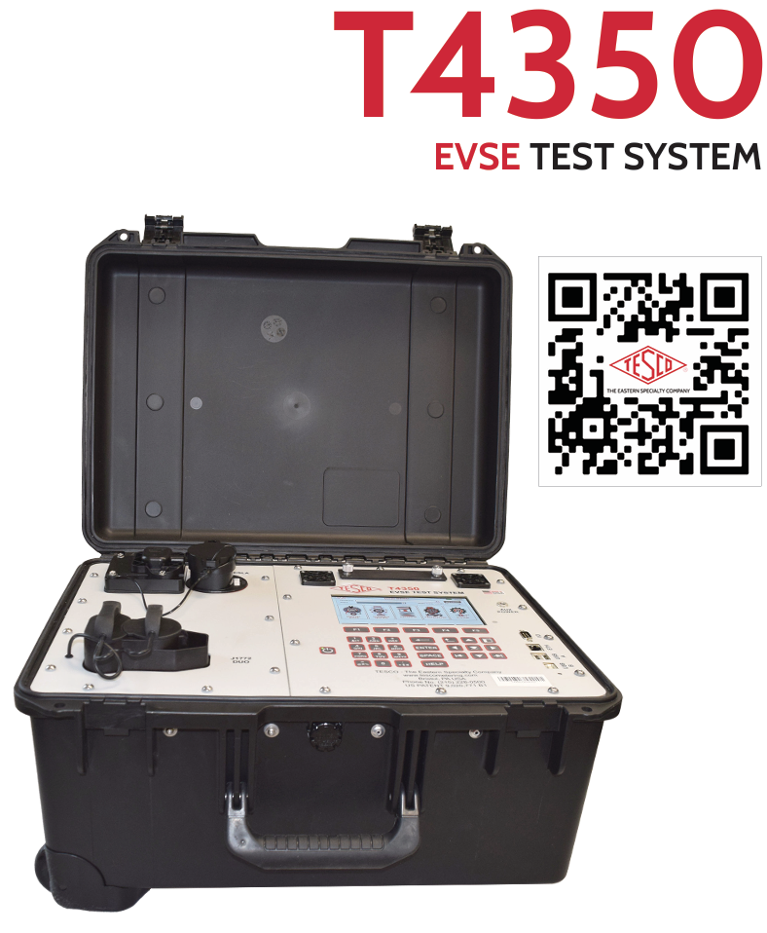
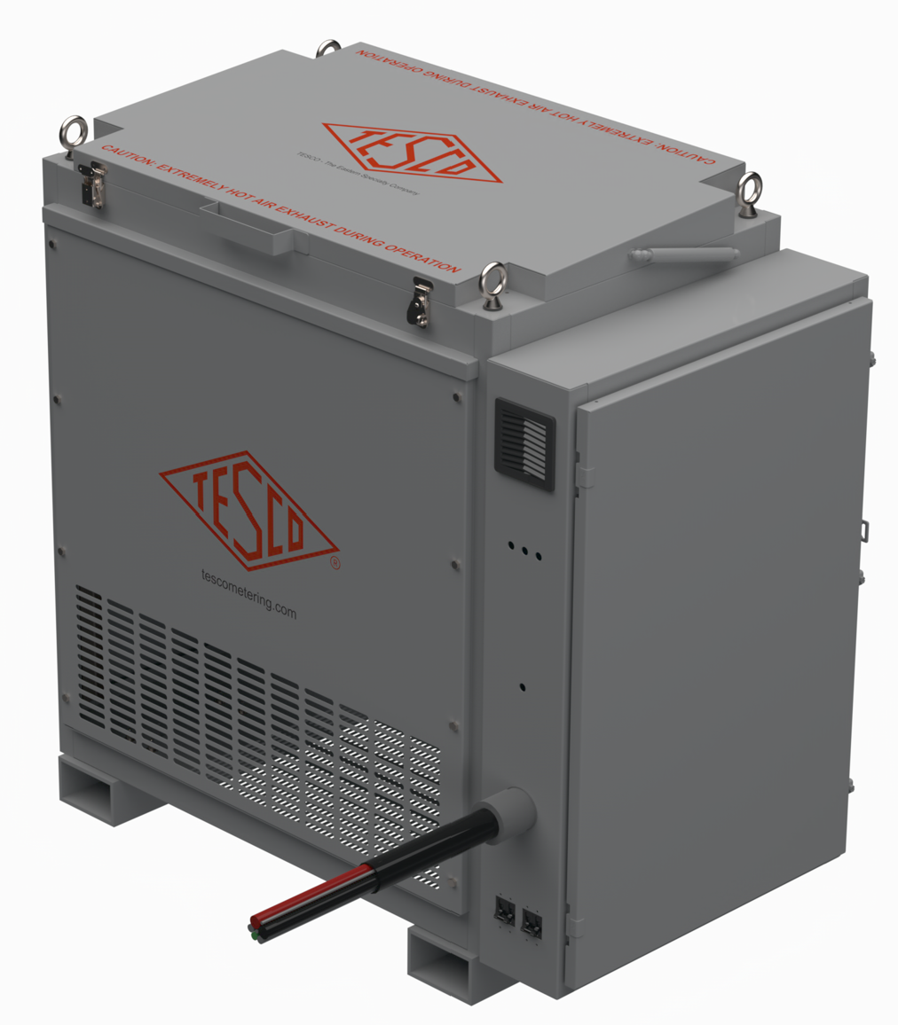
EVSE Tracing
AC Calibration
DC Calibration

Slide 8
Attaining DC Energy Measurement Accreditation
EDA Niagara
Metering Exhibition and Workshop
April 4, 2024, 9:00 – 9:45 AM
Perry Lawton, TESCO

Slide 9
DC Energy Traceability
TESCO Expansion of Scope of ISO17025 Accreditation for DC measurement (2022)
  Standards: ANSI/IS0 9001: 2015, ISO/IEC 17025: 2017
    Past and other standards
  Testing
  Known Process
  Traceability
  Uncertainty
  Audit and Accreditation

Slide 10
Standards
  ISO9001: 2015 – Quality Management Systems
  “ISO 9001 Certified” means an organization has met the requirements in ISO 9001, which defines an ISO 9001 Quality Management System (QMS). ISO 9001 evaluates whether your Quality Management System is appropriate and effective, while forcing you to identify and implement improvements.
  QMS, QM
  Process based approach
  Continuous Improvement

Slide 11
Standards
MIL-STD 45662(A)
  US Military Standard
  First Issued as a Mil-C in early 1960’s
  Requirements for establishing and running a Calibration “System”
  Rescinded 1995, replaced by ANSI/NCSL Z540-1
ANSI/NCSL z540-1
  A U.S. National Standard
  First Issued 1994
  Requirements for operating a Calibration Laboratory
  Compliance of suppliers to customers requirements
  Withdrawn 2007, replaced by IS0/IEC 17025 and ANSI/NCSL Z540.3

Slide 12
Standards
ISO/IEC 17025
  An Inter-national Standard
  First Issued 1999 (1990 as a guide)
  Requirements for the competence of a Testing or Calibration Laboratory
  Includes quality system requirements of IS09001
  Current version is 2017
  Contained three main pillars in establishing competence-
    Metrological Traceability, specifically to the SI unit
    Measurement Uncertainty, the “accuracy of a calibration”
    Assuring the validity of results, all accredited labs must do proficiency testing, usually in the form of inter-laboratory testing to validate their processes
ANSI/NCSL z540.3
  A U.S. national standard
  First Issued 2006
  Requirements for establishing the technical requirements of a Calibration Lab
  Withdrawn as an active standard October 2020 and superseded by IS0/IEC 17025:2017

Slide 13
Standards – Terms
TAR-TEST ACCURACY RATIO
  MIL-STD-45562A, beginning of z540.1
  Required uncertainties to be “sufficiently small”
    4:1
    If 4:1 not achieved, it must then be stated
TUR – TEST UNCERTAINTY RATIO
  Latter part of z540.1, z540.3
  Thought of added error from calibration process
  4:1

Slide 14
Standards – Terms
Mu – Measurement Uncertainty
  ISO/IEC 17025
  Shifted the focus from a test ratio to understanding a calibration process and the contributors to the uncertainty or inaccuracies of the calibration
  Mu must be reported for each calibration test point
  The concept was that by knowing the Mu the lab established more confidence in their measurements
  Left the customer the responsibility to understand uncertainties and what it meant for their tests

Slide 15
IS0/IEC 17025: 2017
General requirements for the competence of testing and calibration laboratories
Measurement Uncertainty
ISO9001
SI Traceability
Inter-national
Proficiency Testing
Accreditation – Different than certification

Slide 16
IS0/IEC 17025: 2017
Certification - Certification is used for verifying that personnel have adequate credentials to practice certain disciplines, as well as for verifying that products meet certain requirements.
Accreditation - Accreditation is used to verify that laboratories have an appropriate quality management system and can properly perform certain test methods (e.g., ANSI, ASTM, and ISO test methods) and calibration parameters according to their scopes of accreditation.

Slide 17
Traceability
NRC/NIST Traceable?
SI – BIPM
Metre convention – Paris May 20 1875
NMIs – NRC, NRC PTB
Units Traceable?
  NO
  Measurements
Unbroken Chain
Notes:
Bureau Internasionale de Poids et Mesures

Slide 18
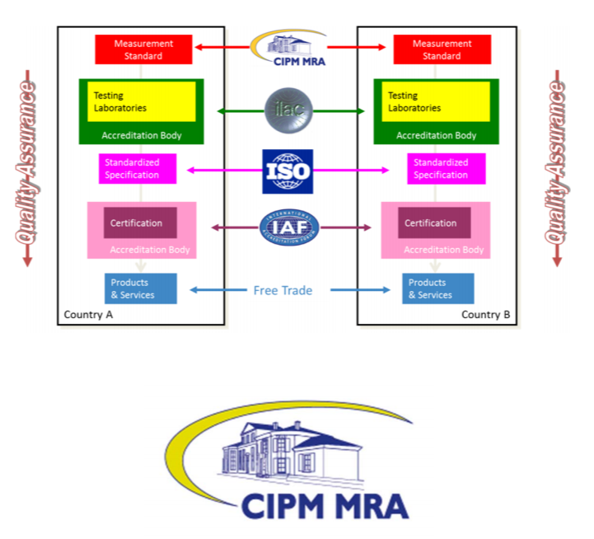
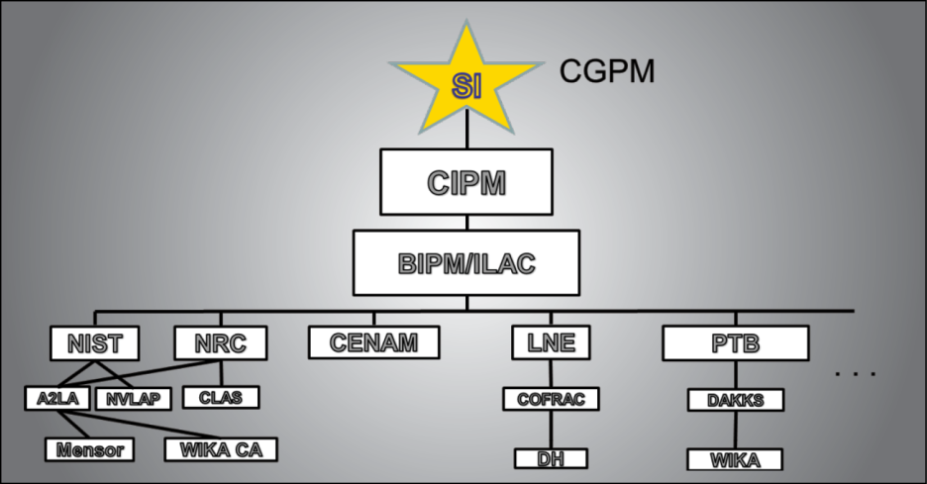
Traceability
CIPM - The CIPM Mutual Recognition Arrangement (CIPM MRA) is the framework through which National Metrology Institutes demonstrate the international equivalence of their measurement standards and the calibration and measurement certificates they issue.
ILAC – International Laboratory Accreditation counsel
ISO - International Organization for Standardization
IAF - International Accreditation Forum
  PJLA, A2LA
Notes:
CGPM – General Conference on Weights and Measures; CIPM – Conference Internasionale de Poids et Mesures; made up of 18 members of different countries

Slide 19
Calibration and Testing
Calibrate DCT
Rigorous Testing
Repeatability
Reproducibility
Best Measurement, best measurement practices
Ensure traceability with calibrated Measuring and Testing Equipment
  What does it mean to calibrate?
  What is the Specifications for calibration?
  What determines calibration lifecyle?

Slide 20
Known Process
Document process
ISO9001
Repeatable process
Work Instruction, SOP
QMS
Training
Continuous Improvement

Slide 21
EV Charging Station Tracing

Slide 22
EV Charging Station Tracing
What are we doing?
Why are we doing it?
How are we doing it?

Slide 23
What are we doing? EVSE Testing CA
Testing Electric Vehicle Supply Equipment (EVSE) as per Scope identified in S-E-EVSE-01, issued under the authority of Section 12 of the Electricity and Gas Regulations
Level 1+2 to start; Temporary dispensation for Level 3+ electric vehicle supply equipment (canada.ca)
  Level 3 placed in service prior to July, 2024
Source: S-E-EVSE-01—Specifications for approval of type of electric vehicle supply equipment (canada.ca)

Slide 24
What are we doing? EVSE Testing CA
B) Level 3+ EVSE put into service between July 1, 2024, and December 31, 2029
  No later than December 31, 2029, eligible owners, or an authorized individual designated by the owner as acting on their behalf, wishing to take advantage of the dispensation shall:
    Meet all the requirements for Level 3+ EVSE in service prior to July 1, 2024, listed above in section (A);
    Supply electricity to the purchaser within an acceptable limit of error of ±3%;
    Provide evidence that the EVSE is dispensing electricity within the acceptable limit of error, either by submitting:
    test results for their meters, using a method and testing standard acceptable to Measurement Canada; or
    a letter, report or other similar document from the meter manufacturer, attesting to the accuracy of the EVSE, as established through the manufacturer's recognized evaluation program; and
  Ensure that every eligible EVSE identified in (A)(1)(b) is equipped with:
    a metering system capable of measuring the delivered energy; and
    a means to display the software and firmware version.
Source: Temporary dispensation for Level 3+ electric vehicle supply equipment (canada.ca)

Slide 25
What are we doing? EVSE Testing CA
Testing of EVSE is done using the same transactional process as is used in the normal operation of the EVSE and consists of at least the following steps:
Initiating a charging session using the standard handshake exchange between the EVSE and a vehicle. A vehicle may be replaced by a simulated vehicle, as long as it conforms to the standard protocols for handshake exchange.
Charging at a specified power level for a specified quantity of energy (must be greater than the MMQ).
Terminating the delivery of energy as would occur when terminating normal charging of an electric vehicle.
Comparing the energy delivered as measured by the EVSE with that measured by the test equipment.
Comparing the energy received (if applicable) as measured by the EVSE with that measured by the test equipment.
Note: For DC EVSE the energy delivered should be sufficient so that the amount of energy delivered during ramp up and ramp down are less than 10 percent of the energy delivered at the test power.
Note 2: The tests can be performed either with real load or with phantom load.
Source: S-E-EVSE-01—Specifications for approval of type of electric vehicle supply equipment (canada.ca)

Slide 26
What are we doing?
Table 2: Maximum permissible errors
Current range | Power factor | Maximum permissible error
I_{st} ≤ I < I_{min} | >0.9 | ±15%
I_{min} ≤ I < I_{tr} | >0.9 | ±1.5%
I_{tr} ≤ I ≤ I_{max} | >0.9 | ±1.0%
S-E-EVSE-01—Specifications for approval of type of electric vehicle supply equipment (canada.ca) Section 7.6 Table 2

Slide 27
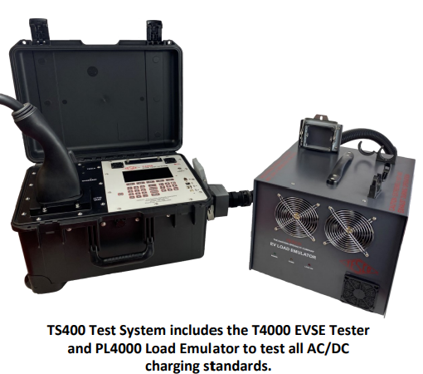
How are we doing it?
Test Methods
  Simulation
    Use of a load emulator, “Phantom Load”
  Man-in-the-middle (MITM)
    Use of an electric vehicle, “Customer Load”
SIMULATION
  MAN-IN-THE-MIDDLE

Slide 28
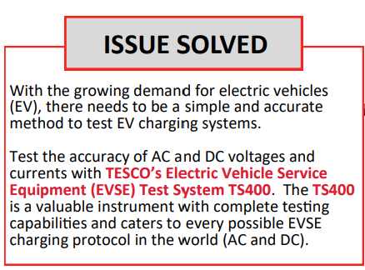
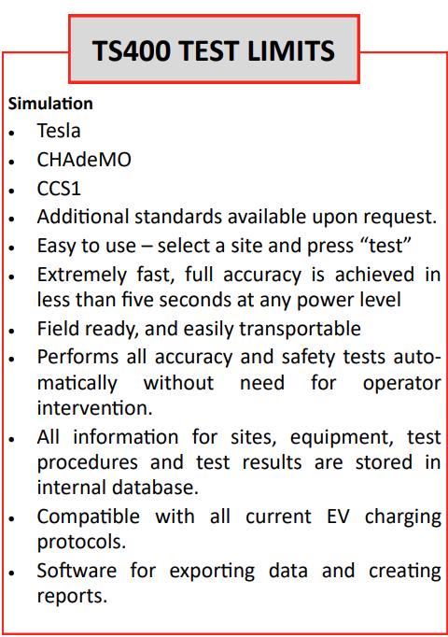
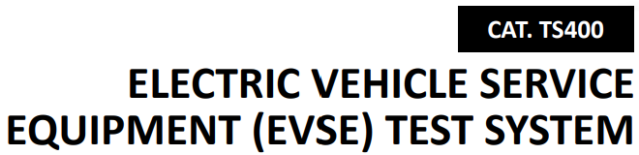
TS400 Overview: Hardware

Slide 29
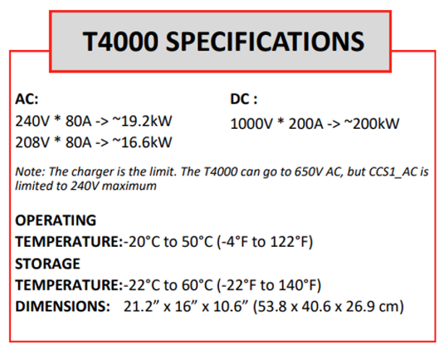
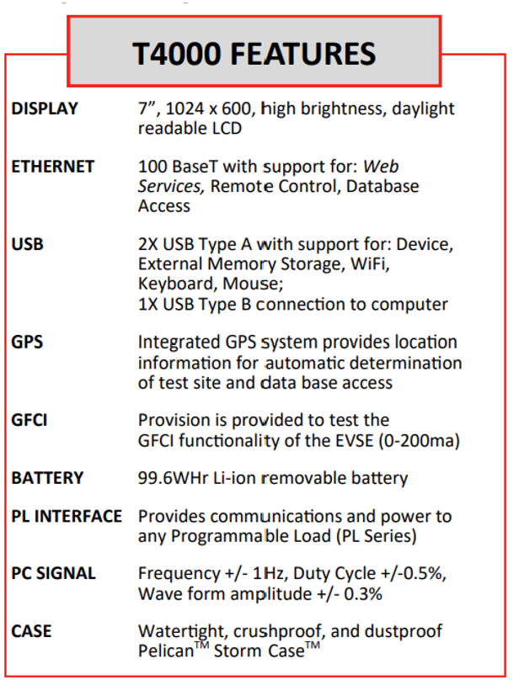
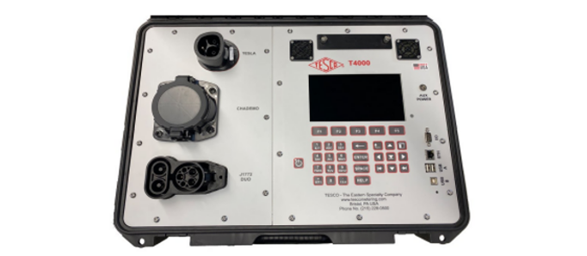
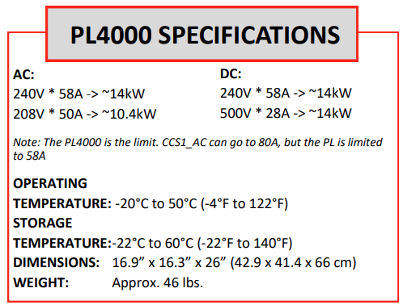
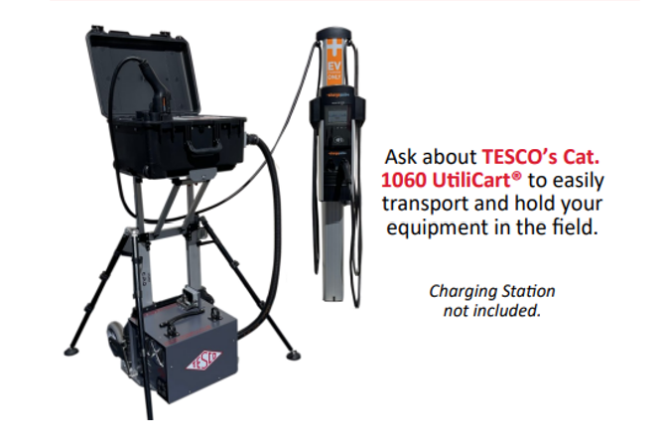
TS400 Overview: Hardware

Slide 30
T4350 vs T4000
T4350 – what’s in a name?
  “T”: Tester
  “4”: 4th generation
  “350”: rated for 350A continuous load
What’s changed?
  The T4350 is capable of higher power testing and supports the full spectrum of charger types across AC/DC
 | T4000 |  | T4350
Continuous Load | 200A |  | 350A
Max Load | 400A |  | 650A

Slide 31
PL4150 vs. PL4000
PL4150 – what’s in a name?
  “PL”: Phantom Load
  “4”: 4th generation
  150: 150 kW Capable
PL4150 is an AC/DC, 150kW capable dissipative load-box
What’s Changed?
  The PL4000 was only capable of ~14kW and thus was only relevant for AC Load dissipation in a regulatory capacity; the PL4150 can handle up 150 kW @ 100% FL

Slide 32
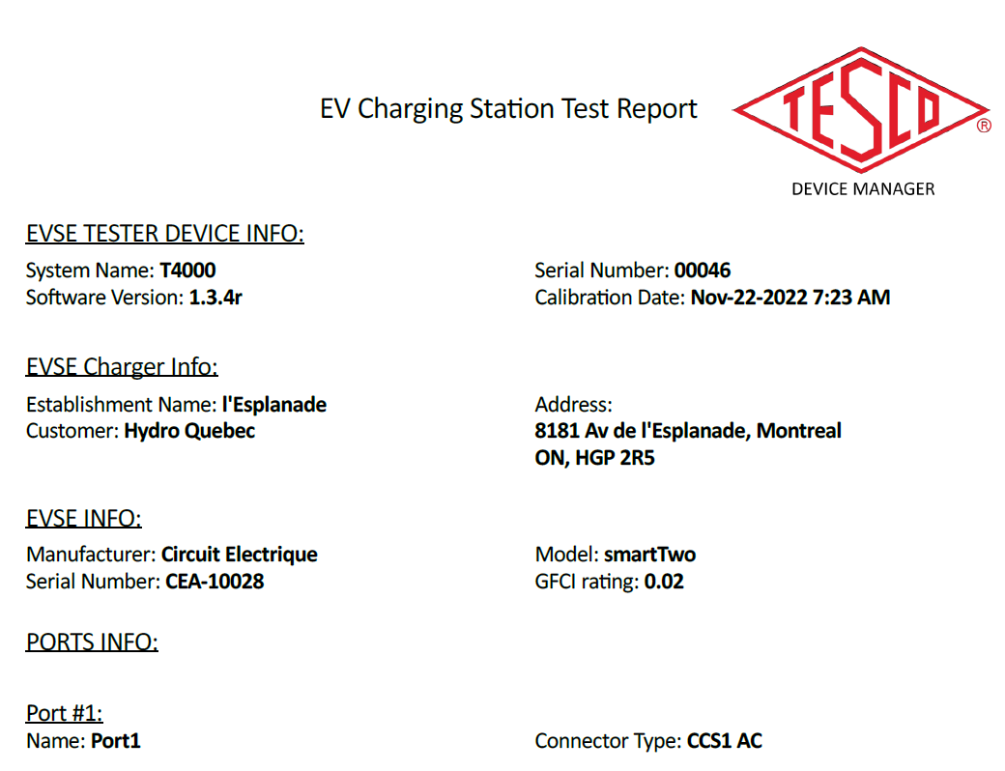
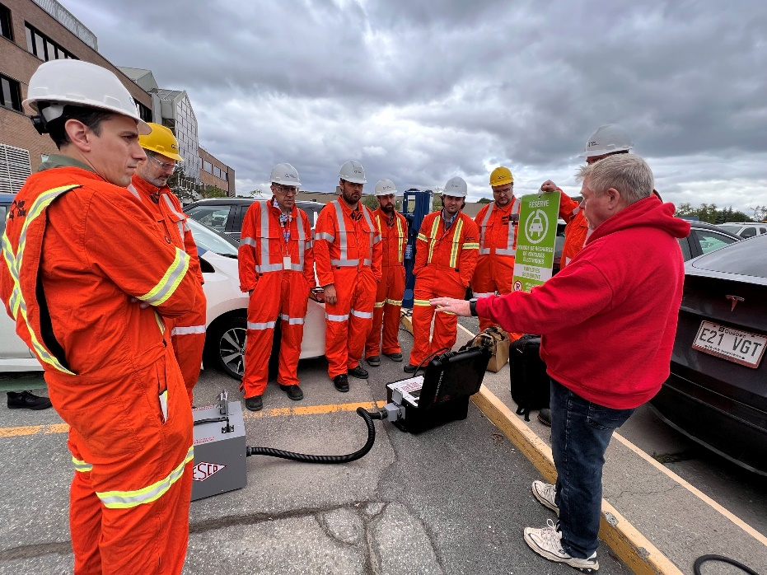
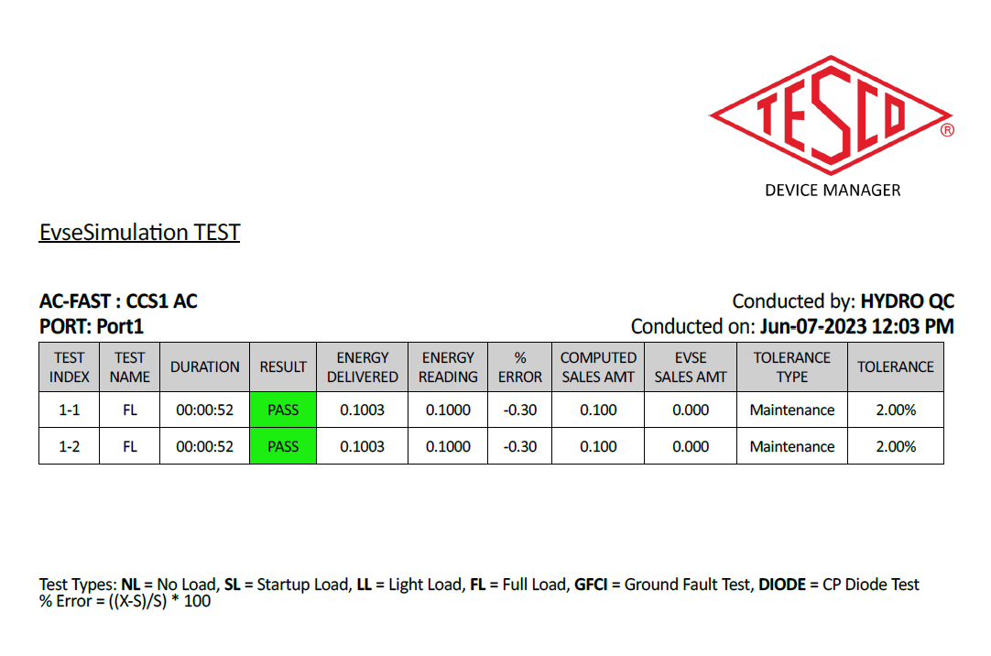
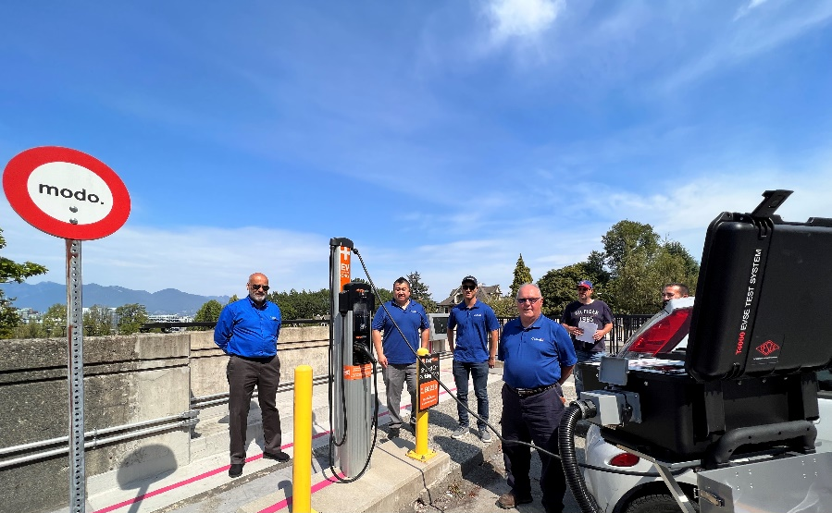
TESCO EVSE Testing

Slide 33

Review of Key Points
DC Energy Measurement is possible with certified, SI traceable equipment from TESCO’s 17025:2017 accredited lab
Canada has released guidance fortype approval, field testing, and temporary dispensation for Level 1, 2, and 3+ EVSE
Level 1, 2, 3+ EVSE can be tested using available, traceable equipment on the market today; TESCO offers several options of test equipment that are currently being used across the US and in Canada today

Slide 34

Questions and Discussion
Perry Lawton
Northeastern Regional Sales Manager
perry.lawton@tescometering.com
TESCO – The Eastern Specialty Company
Bristol, PA
215.228.0500
This presentation can also be found under Meter Conferences and Schools on the TESCO website: tescometering.com
ISO 9001:2015 Certified Quality Company
ISO 17025:2017 Accredited Laboratory

