Slide 1
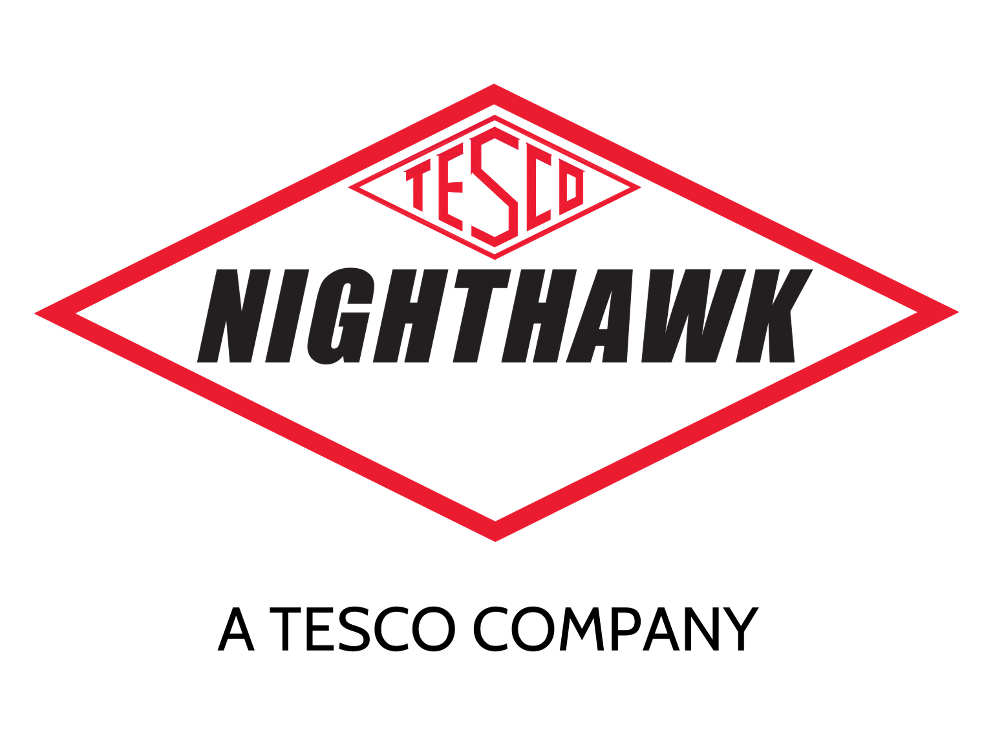
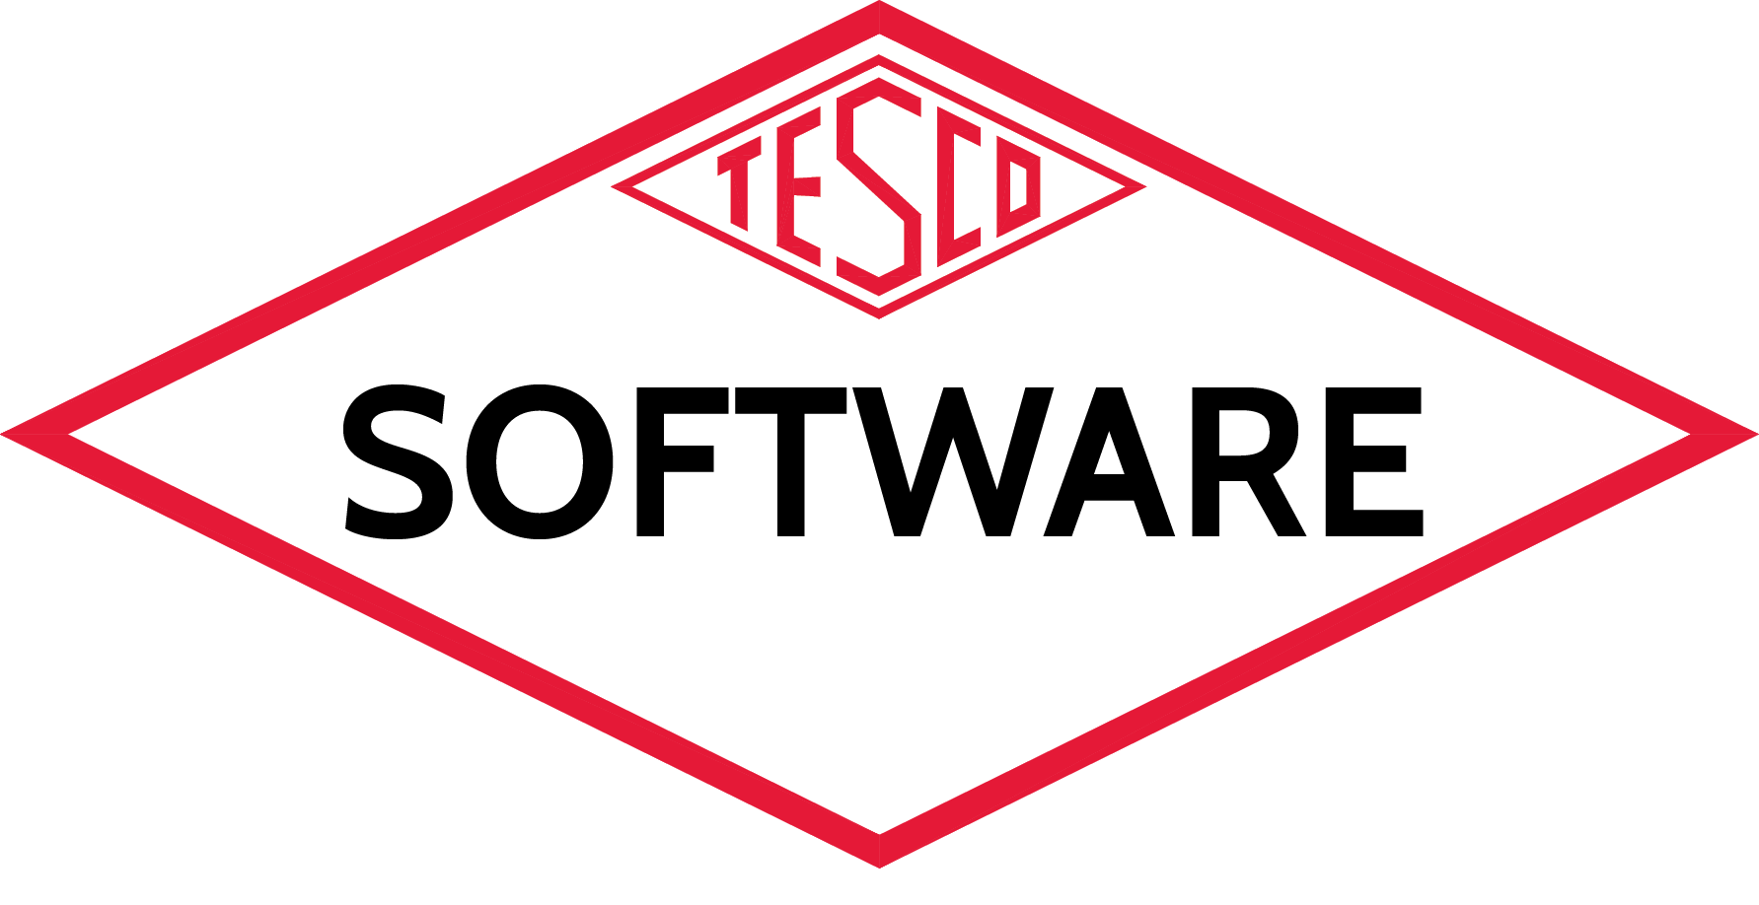
Building a Better Software Base for Meter Services
Monday, October 2, 2023
11:00 am
Presented by Tom Lawton
TESCO – The Eastern Specialty Company

Slide 2
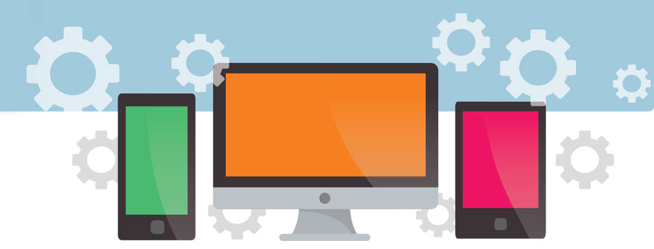
Software as a Tool
Software is no different than any other tool or process we have at our disposal, but it has the power to provide exponential returns be leveraging the data we know best. The more we know about how these tools help us, the better we can bring them to bear on existing problems and issues and future problems and issues. At Tesco, we’re doubling down on software.

Slide 3
TESCO’s vision
A series of platforms that have all of the information we need to make the best-informed decisions for operations and infrastructure development.

Slide 4
TESCO’s vision
Having access to and analyzing data from
Assets
Customer Usage
Testing
AMI non-billing site data
Creating routine work tickets to correct and improve the distribution system

Slide 5
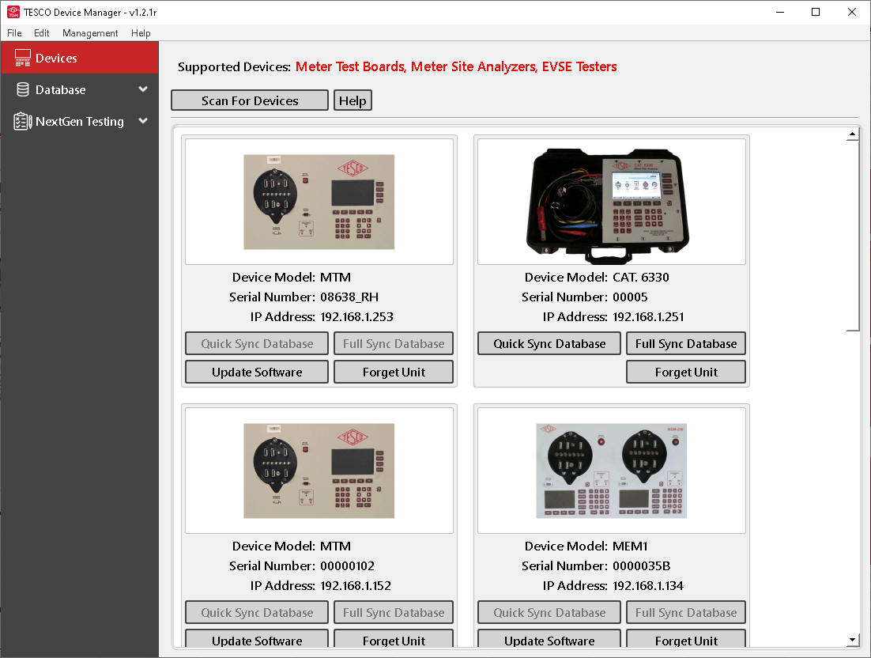
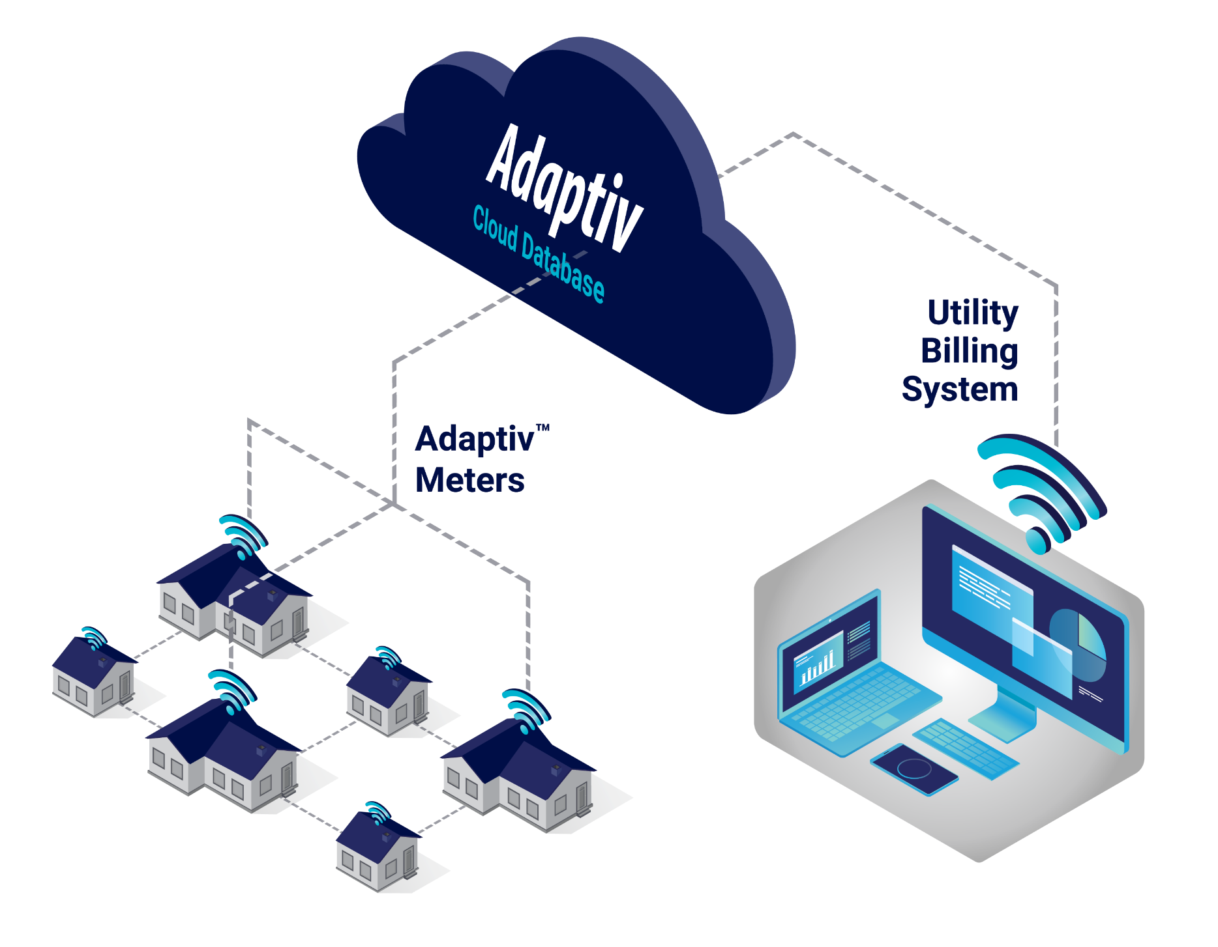
Using this model for ourselves
Site Asset Data from your Inventory,
Asset Management, ERP systems
Testing Data via TESCO Device Manager (TDM)
Unified Digital Platform
For Analytics, Automation and AI
Usage Data from your AMI system

Slide 6
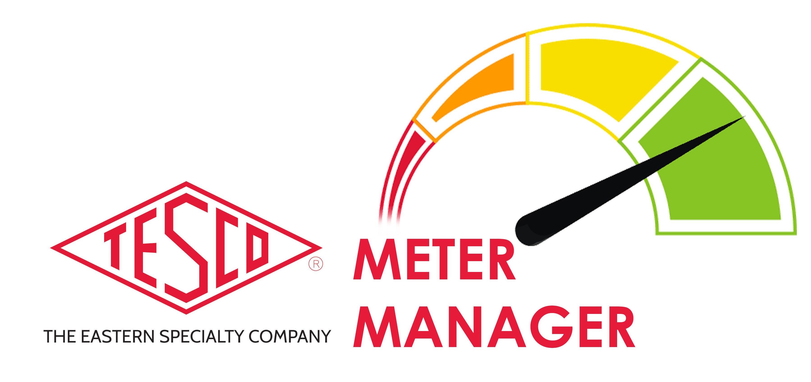
Meter Manager

Slide 7
Add Value Throughout the AMI Portfolio
Architected with touchpoints to efficiently process core information

Slide 8
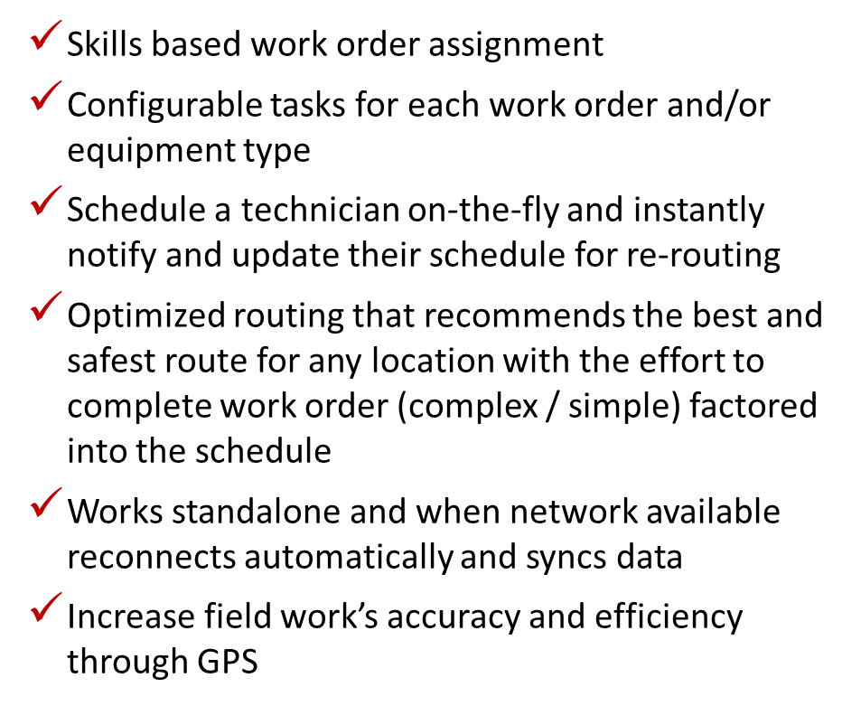
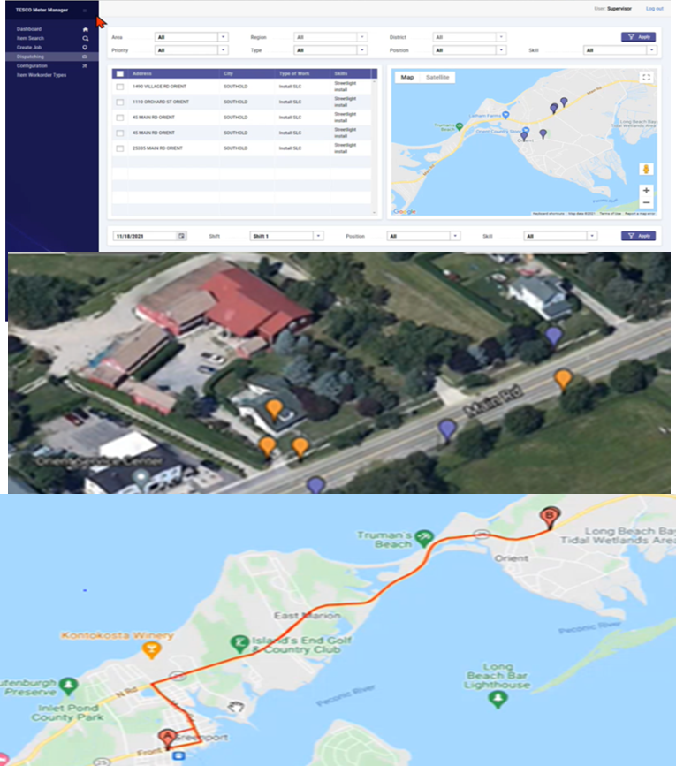
Metering-Centric Field Service Management

Slide 9
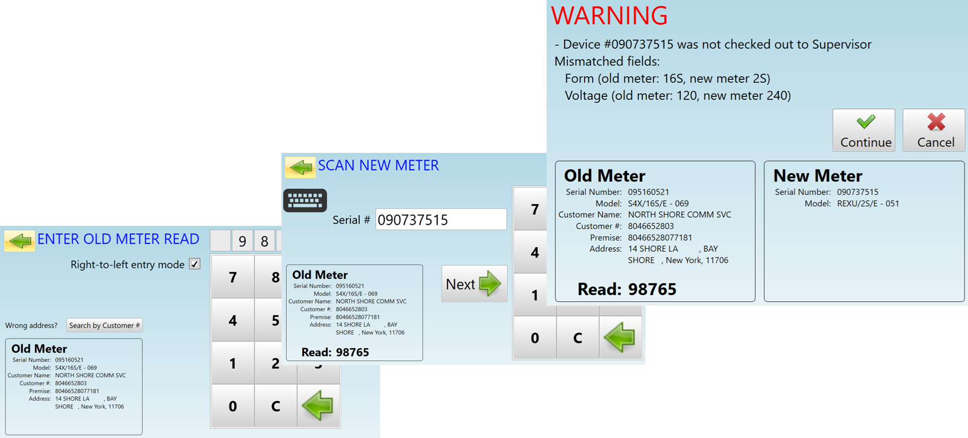
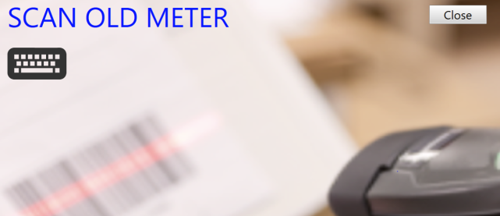
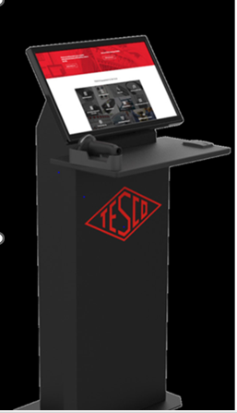
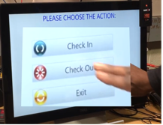
Built in Intelligence with Real-time Information

Slide 10
TESCO Device Manager - TDM

Slide 11
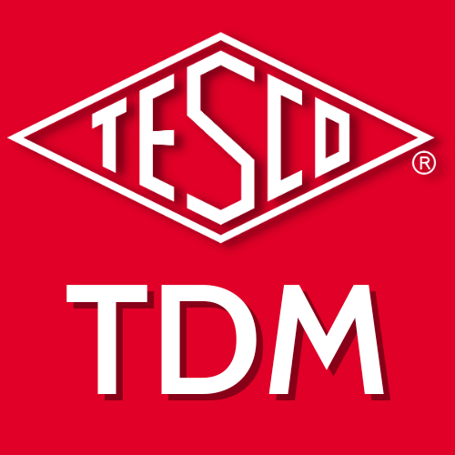
TESCO Device Manager (TDM) linking to the hardware
Software is a tool. This tool needs to be easy to use and intuitive to understand. All Microsoft products have a look and a feel that tells you they are Microsoft products. If you can navigate in one you can generally navigate in another.
We are working hard at TESCO to do the same across all of our platforms. TDM has been developed to bring efficiency to the meter shop by using the same platform to control all TESCO lab equipment, shop equipment and field equipment.
Features include:
Direct to PDF reporting
Report customization with company logo
CSV data exporting
Ability to simultaneously extract data from multiple units
Ability to import data from any test equipment into any other software tool for analysis
Ability to simultaneously update multiple units

Slide 12
TESCO TDM with Meter Manager

Slide 13
Using TDM to automate and streamline
TDM can create test sequences to automate tasks and reduce wasted effort;
For Standard As Found and As Left Tests
Create sequences for standard forms
Link with Meter Manager to automatically set up for any individual meter or other device being accuracy or functionally tested
Do the same for Instrument transformers or anything else that you are using TDM to test
For First Article Testing
Create a sequence for every functional and accuracy test you want to run and ensure that every new type of meter or iteration of a new type of meter are tested in a consistent manner with far less manual intervention.
For Sample Testing
Create an automated sequence for sample testing of any meter and soon for any instrument transformer or even electric vehicle charger
Being able to create these sequences allows the meter engineer or the meter tech the ability to ensure consistent testing while also removing a significant amount of unnecessary labor

Slide 14
NightHawk

Slide 15
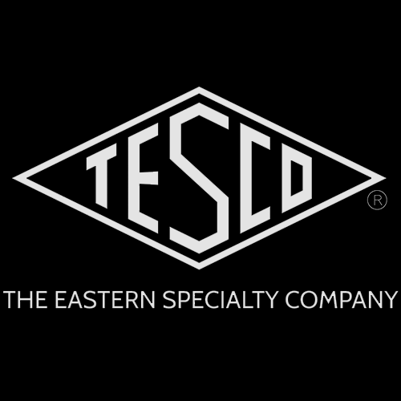
NightHawk
About Nighthawk
Nearly 30 years of utility experience
100+ utilities served
Nighthawk is a TESCO company.
TESCO (The Eastern Specialty Company) is a manufacturer and service provider to the meter industry owned by, run by, and staffed by engineers.
Headquartered in Bristol, PA
Founded in 1904
Uniquely qualified to support MUB
About Adaptiv™
Unique zero-infrastructure network
Cellular + Mesh Communications
Verizon LTE
AT&T
Ideal for either incremental or rapid deployment
Lowest total cost of ownership in the industry

Slide 16
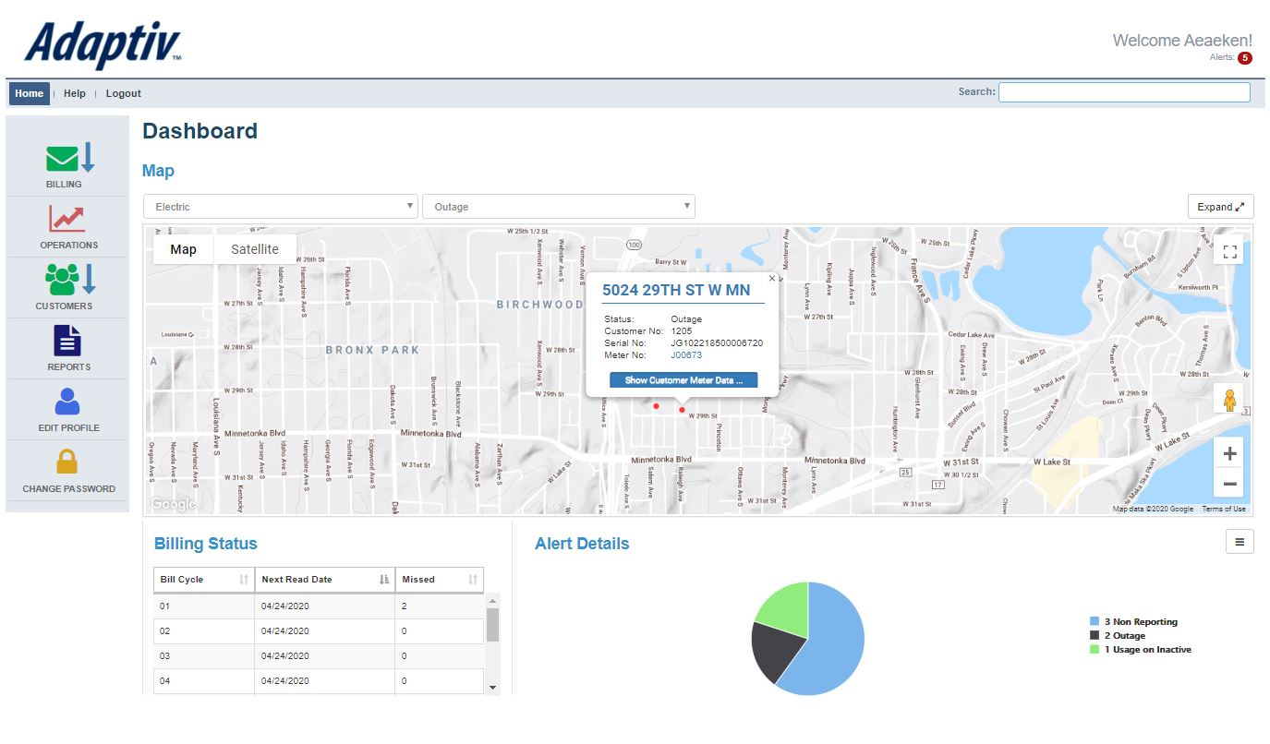
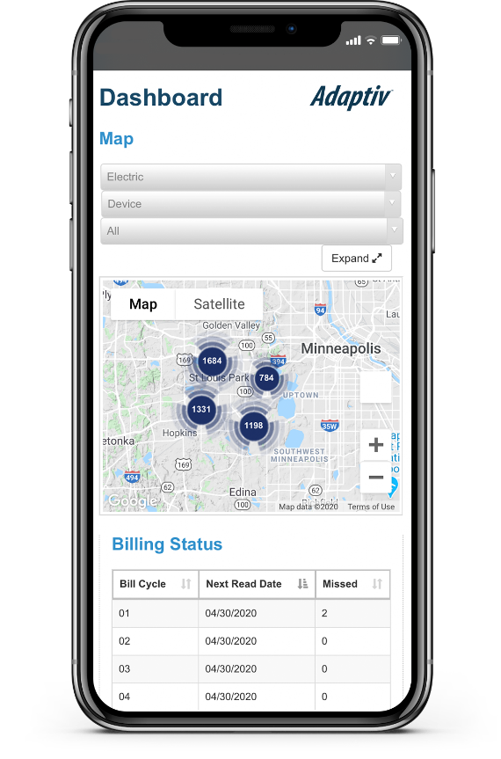
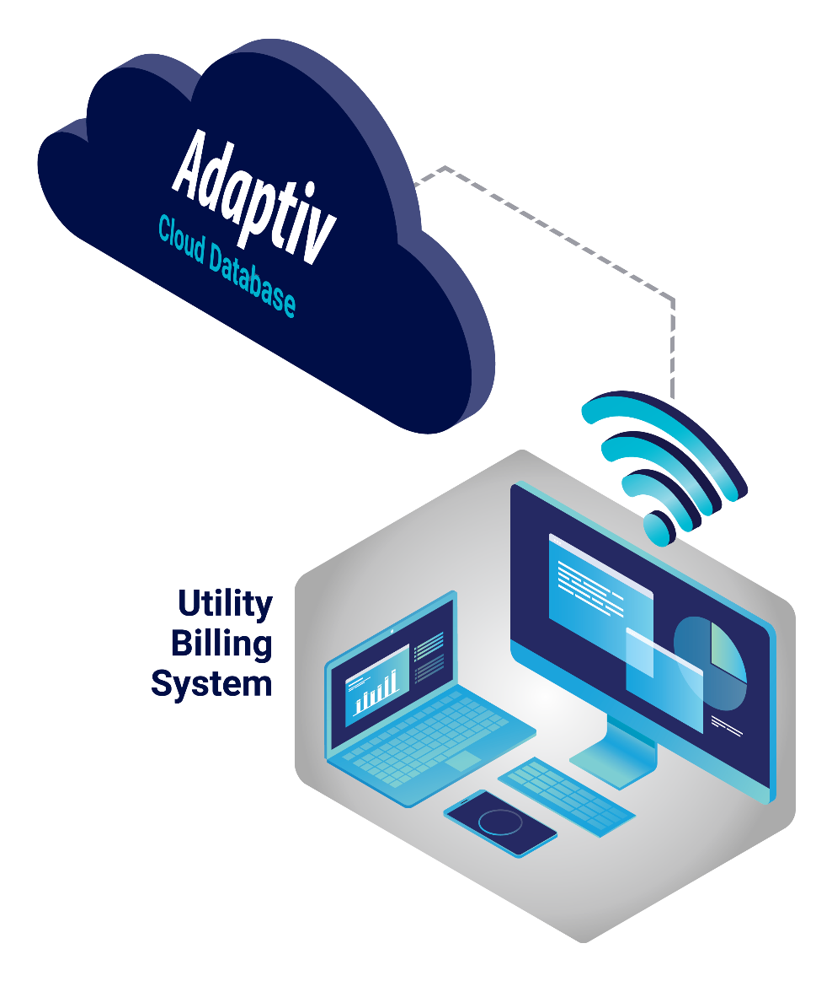
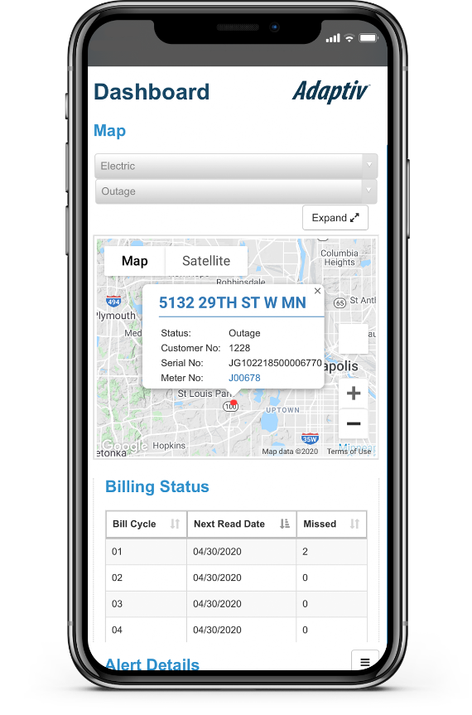
NightHawk
Smart billing integration with secure mobile access
Screenshots TBD
Over-the-air configuration and upgrades on all Adaptiv™ units

Slide 17
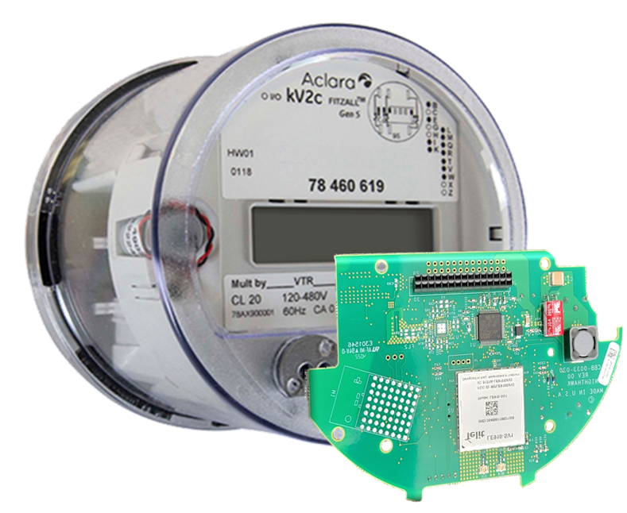
Communication Network and Cyber Security
DirectConnect
Compatible with all data acquisition software
that supports TCP/IP connections

Slide 18
Unified Digital Platform
AI
Analytics
Tesco Digital Platform
Automation
Notes:
This Photo by Unknown Author is licensed under CC BY-SA
This Photo by Unknown Author is licensed under CC BY-SA
This Photo by Unknown Author is licensed under CC BY-SA-NC

Slide 19
Tesco Analytics
Notes:
This Photo by Unknown Author is licensed under CC BY-SA
This Photo by Unknown Author is licensed under CC BY-SA
This Photo by Unknown Author is licensed under CC BY-SA-NC

Slide 20
History and Statistics
Average, mean, mode, median
Do this a lot = long run frequency
We do this in Real Time using “Big Data” from all of our sources
Notes:
This Photo by Unknown Author is licensed under CC BY-SA

Slide 21
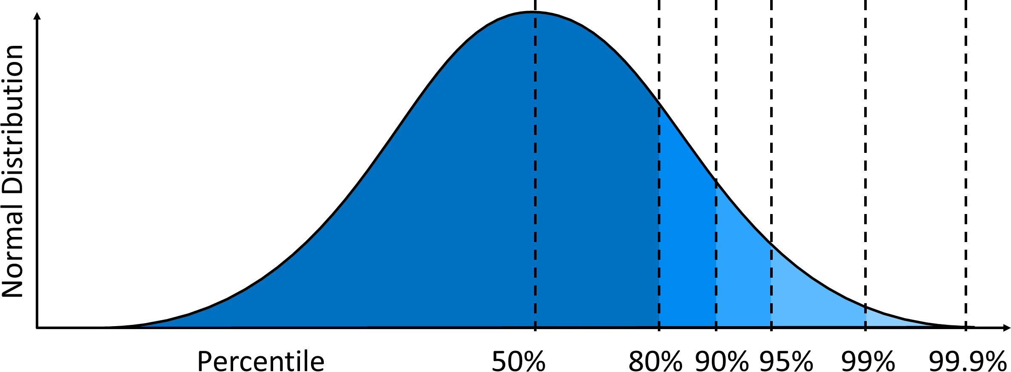
Significance and Testing
Now let’s look at a few examples of how we use this data to Operational Advantage
Notes:
This Photo by Unknown Author is licensed under CC BY-SA

Slide 22
A few case studies on how to use data across platforms
Oversized Transformer Reporting
Platforms used:
Meter Manager – has all physical assets at every location including the instrument transformers
Consumption information from the head end – in this case a Silver Spring/Open Way head end

Slide 23
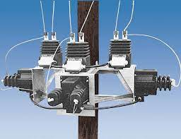
A few case studies on how to use data across platforms
Oversized Transformer Reporting
Output:
A monthly report of the most egregiously over-sized transformer installations with usage going back over the past two years to demonstrate and estimate lost revenue
Use:
Field services receives monthly work orders to replace the instrument transformers with appropriately sized transformers. Extended range transformers further improve the effectiveness of the monthly billing

Slide 24
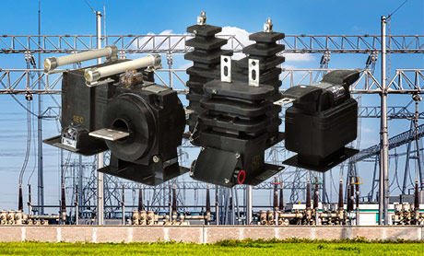
A few case studies on how to use data across platforms
Oversized Transformer Reporting
Results:
A steady increase in monthly revenue gains on every Commercial/Industrial account addressed. Payback for the work is under three months in every case as there are so many oversized accounts.

Slide 25
A few case studies on how to use data across platforms
Oversized transformer reporting
Results:
Safety hazards found in the field were initially anticipated to be only failed socket jaw (hot socket) events, but this proved to be only a fraction of what was found. Some of the various safety related issues discovered in the field include;
Failed meter socket jaw
Frayed and breaking weather head connections
Arcing on a customer circuit on the customer side of the service panel in the home
Arcing at the connection to the Distribution transformers closest to the house
Arcing in the manual disconnect mechanism of the meter box
Frayed and failing wires between the socket and the service panel in the home

Slide 26
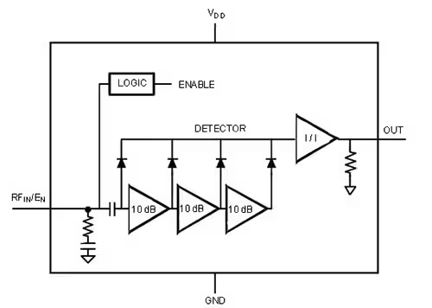
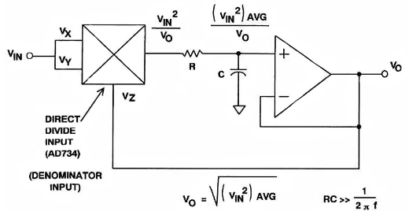
A few case studies on how to use data across platforms
RF Detection Alarms
Platforms used:
Itron Open Way head-end and L+G Gridstream head-end – receive alarm data on the RF signature of electrical arcs in or around the service
TESCO Analytic software – over-arching customized analysis software to work across a variety of platforms

Slide 27
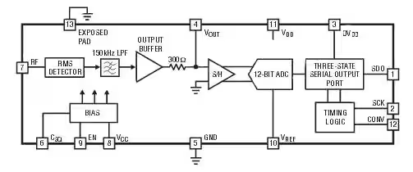
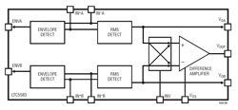
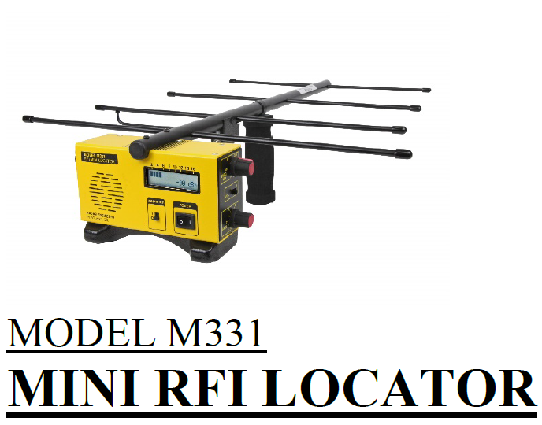
A few case studies on how to use data across platforms
RF Detection Alarms
Output:
A weekly report identifying sites with RF detect (micro arc) alarms that fit an identified pattern
Use:
Field services receives a weekly report of sites to check for safety related issues. Inspection involves a visual detection as well as the use of RF detection equipment to pinpoint the source of the problem.
RADAR ENGINEERS

Slide 28
Next Generation Analytics
Consumption Analysis: Combine data from Tesco Meter Manager and Nighthawk AMI to analyze consumption patterns of utility services such as water, gas, or electricity. Utilities can identify high consumption areas, detect anomalies, and offer energy-saving recommendations to customers.
Demand Forecasting: Use historical consumption data from Nighthawk AMI and Tesco Meter Manager to predict future demand patterns. Accurate demand forecasting helps utilities plan their resources more efficiently, avoiding overcapacity or shortages.
Leak Detection: By analyzing data from both systems, utilities can detect water or gas leaks in the distribution network. Early detection of leaks allows utilities to reduce water waste, prevent potential accidents, and minimize repair costs.
Asset Performance Management: Combine asset data from Tesco Meter Manager with usage data from Nighthawk AMI to assess the health and performance of utility assets. This analysis can aid in predictive maintenance, reducing downtime, and extending the lifespan of infrastructure.
Customer Segmentation: Analyze customer data from Tesco Meter Manager and usage patterns from Nighthawk AMI to segment customers based on consumption behavior. Utilities can tailor their services and marketing strategies to specific customer segments.
Load Profiling: Create load profiles by analyzing data from Nighthawk AMI and Tesco Meter Manager. Load profiling helps utilities understand peak demand periods, plan capacity, and optimize energy distribution.
Revenue Assurance: Integrate billing data from Tesco Meter Manager and usage data from Nighthawk AMI to identify discrepancies and reduce revenue losses due to metering errors or inaccurate billing.
Operational Efficiency Analysis: Analyze data from both systems to evaluate the efficiency of utility operations. Identify areas where processes can be streamlined, resources optimized, and costs reduced.
Outage Management: By combining data from Tesco Meter Manager and Nighthawk AMI, utilities can improve outage detection and management. They can quickly identify affected areas, estimate restoration times, and communicate more effectively with customers during outages.
Environmental Impact Assessment: Analyze consumption data from Nighthawk AMI and Tesco Meter Manager to assess the environmental impact of utility services. Utilities can monitor their carbon footprint, set sustainability goals, and implement initiatives to reduce environmental impact

Slide 29
Artificial Intelligence

Slide 30
Artificial Intelligence
AI provides the ability to make informed decisions automatically. By using big data in real time, we can augment and make the right decision, better, faster and cheaper, e.g. which alarms become actionable which data become actionable.

Slide 31
Data Engineering and Data Science
Data Engineering
Structure, semi-structure, unstructured data
Integration, consolidation, cleansing, transformation
Operational and analytical data, streaming data, live data
Data pipelines, data lakes, data warehouses

Slide 32
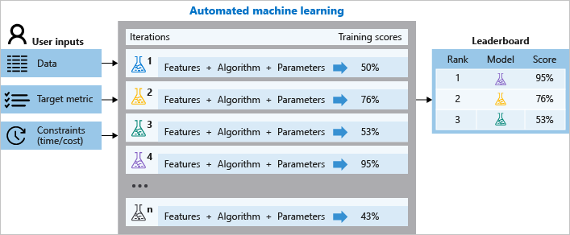
Automated Machine Learning

Slide 33
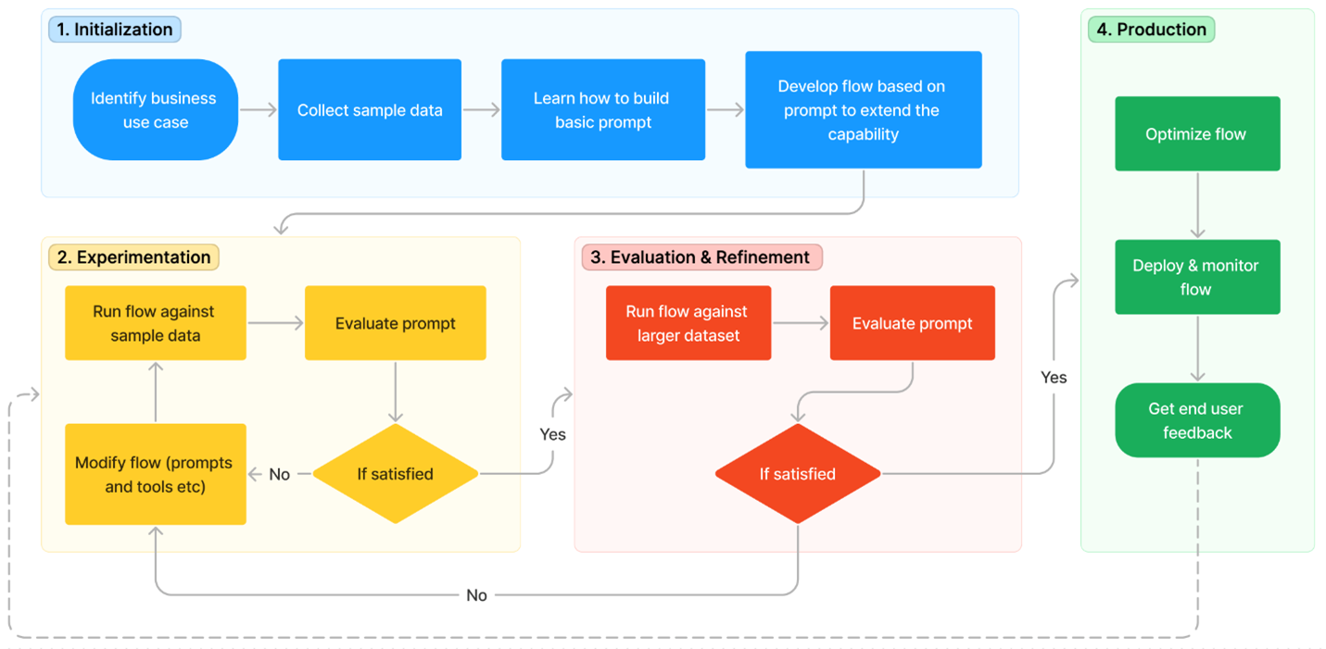
Representative Machine learning Process Map
Notes:
Cancer
Microsoft

Slide 34
Automation

Slide 35
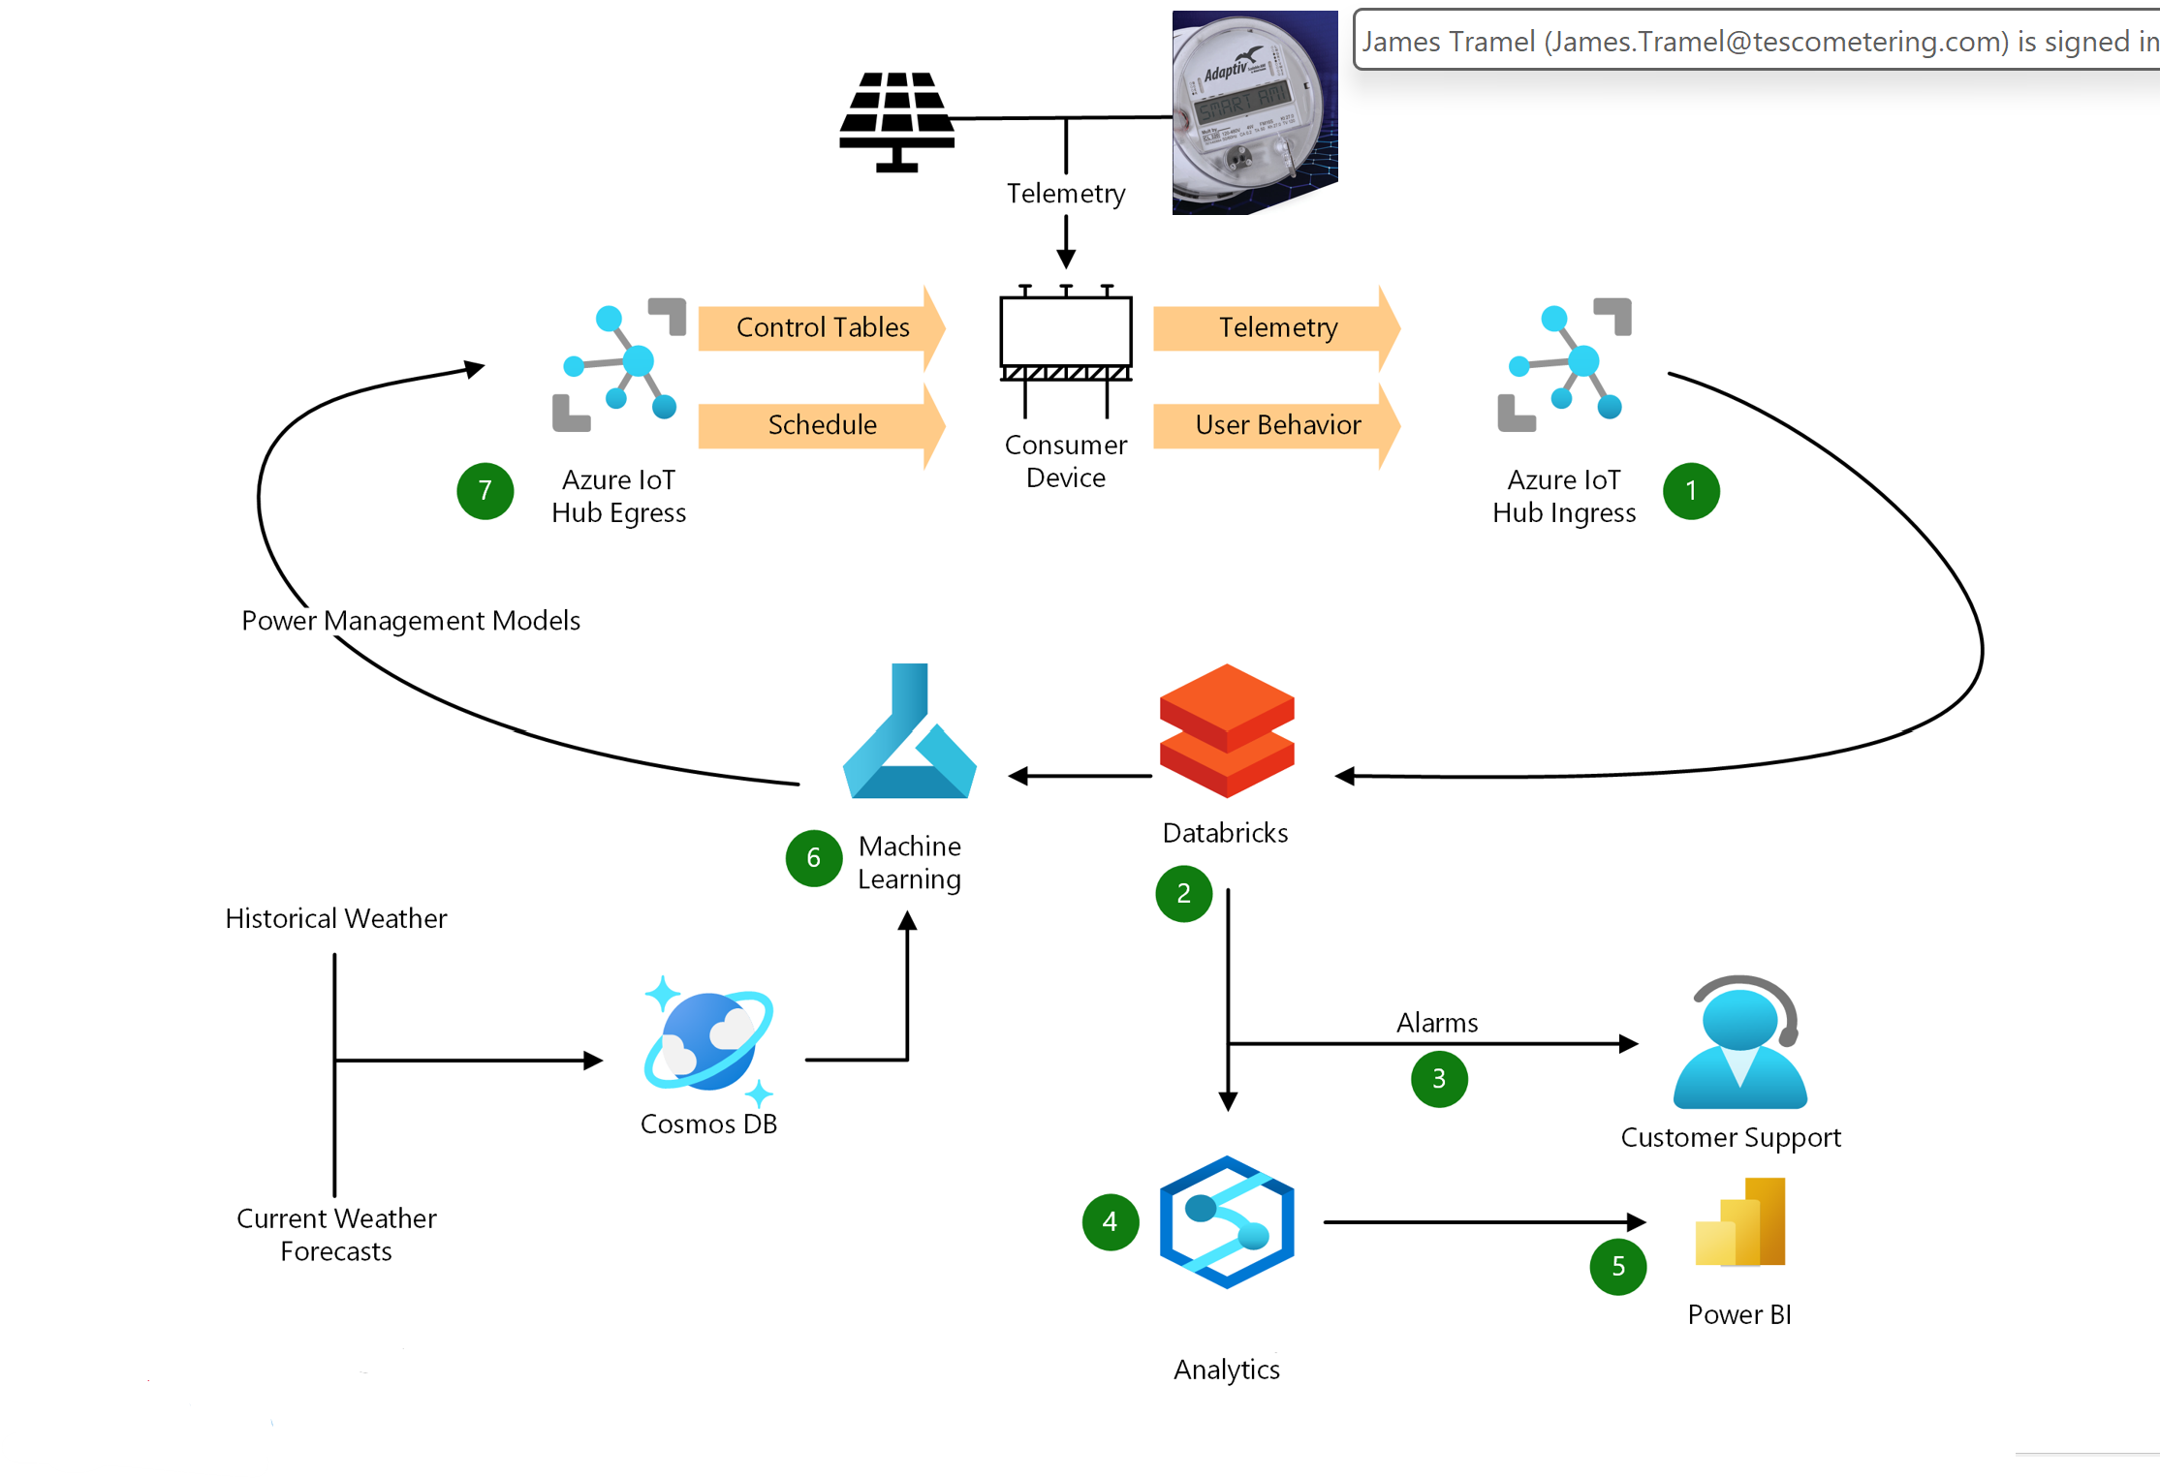
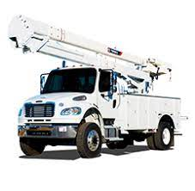
AI & automation Example - Predictive Maintenance
Notes:
This Photo by Unknown Author is licensed under CC BY-SA

Slide 36
Tesco Digital Platform
AI
NightHawk
AI
Meter Manager
Analytics
Automation
TDM
Tesco Digital Platform
Notes:
This Photo by Unknown Author is licensed under CC BY-SA
This Photo by Unknown Author is licensed under CC BY-SA
This Photo by Unknown Author is licensed under CC BY-SA-NC

Slide 37
Tesco Digital
Meter Manager + TDM + NightHawk
Meter manager
System of record, inventory, ERP
Adaptiv/ Nighthawk
Transactional, always on service
TDM
State based, on demand service
Bring your own systems to integrate with all or part of the platform
Integrate what you need, when you need it
Get the insights you need, when you need it

Slide 38
Q&A/Contact Us
Tom Lawton
Cell: 215-688-0298
Email: Tom.Lawton@tescometering.com
John Greenewald
Cell: 609-894-3358
Email: John.Greenewald@tescometering.com
James Tramel
Cell: 703-981-5030
Email: James.Tramel@tescometering.com

