Slide 1
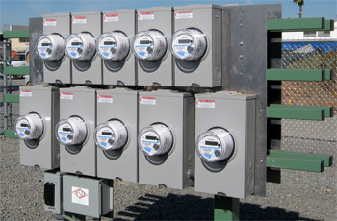
Meter Management Application with TECO AMI System
Presented by Tom Lawton, TESCO
The Eastern Specialty Company
Mark Tanner, TECO
Tampa Electric Company
Wes Caldwell (retired), TECO
Tampa Electric Company
For Southeastern Meter School
Wednesday, August 18, 2021 at 9:15 a.m.

Slide 2
Tampa Electric Company AMI Deployment
TECO, Tampa Electric Company, serves about 2,000 square miles in West Central Florida, including Hillsborough County (Tampa Florida) and part of Polk, Pasco and Pinellas Counties, serving just over one million residential and commercial customers.
The company began in 1899 by servicing the electric trolley system for the new city of Tampa and was purchased in 2016 by Emera Energy out of Halifax, Canada which also owns Nova Scotia Power and several Caribbean Utility Companies.
The company began deploying an Itron Open Way AMI system in 2018 and has just completed deployment. One of the first tools identified as being needed during the planning for deployment was a way to track all the new assets and even more importantly manage the information required to use these new assets effectively.

Slide 3
Investment and Returns
TECO had invested in a new SAP system to provide a solid foundation for the entire company to work from.
This system was designed to be the system of record, but the metering team quickly found that as good as this system was, the SAP system treated all metering devices as “non-inventory” and struggled to track anything as fundamental as test records, much less firmware versions, program profiles, NIC serial numbers, disconnect serial numbers, collectors or any of the other myriad of accessories that TECO was installing to provide the infrastructure needed for their AMI system to operate.

Slide 4
Using SAP with TESCO’s Meter Manager
Initially, TECO upper management considered the purchase of a separate Meter Asset Management tool to be competitive with their company-wide SAP investment. The meter service department and the SAP team convinced upper management that the TESCO Meter Management system was a complementary tool that was necessary in both the planning stages of a new AMI deployment, would be critical during the deployment and would then be in place to help manage, operate and eventually upgrade the AMI system after deployment.
This presentation will cover some of the needs filled by this system that could not be filled directly by the larger, Corporate wide system.

Slide 5
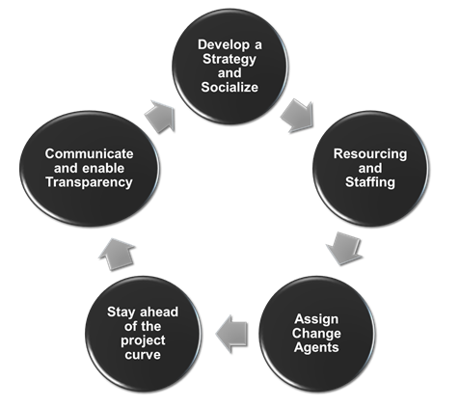
Planning Stages
SAP was the backbone but basic items like Meter Attributes could not be readily stored, accessed and most importantly provided to the Work Order Management System for the deployment team.
Meter Manager was purchased a little late in the process due to the initial thoughts by upper management that SAP would handle everything without a bolt on piece of third-party software specifically designed for this application.
What did this mean? Initially, a tremendous amount of data could not be readily shared and had to be manually entered into multiple systems. This included
Meter Information
Test Results
Transformer information
Other meter site asset and installation information

Slide 6
Getting Everything in Sync
One of the greatest benefits of the Meter Management tool was the ability to interface all the disparate systems and allow the easy transfer of information between them.
Information seamlessly moves between the meter manufacturer, SAP asset management, SAP billing, Meter Services, the third-party Work Order Management system, the TECO internal work order management system and the ITRON Open Way Collection Manager. These systems do not need to see all the same information, but they all need or have some of the information needed to run the entire system. Meter Manager has become the clearing house for much of this information by providing the interfaces to each of them.

Slide 7
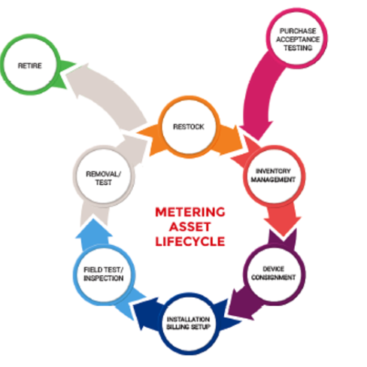
What is Meter Manager, and Why Was This the Right Tool for TECO?
Meter Manager is an asset management tool built around the operations of a Meter Services Department.
This can sometimes be confusing to people and managers outside of meter services. When TECO’s upper management heard that Meter Manager would provide asset lifecycle management and basic Inventory management capabilities for meter services as they took on the operation and management of this new AMI system, they dismissed the need as they were investing in this incredibly expensive and sophisticated SAP system to do exactly that.
But SAP did not do “exactly that.” During the early planning sessions, the need for a bolt on system that would handle everything needed to manage the assets and information being purchased and deployed for this new AMI system was quickly acknowledged by the SAP team and the TECO AMI Meter Service Teams.

Slide 8
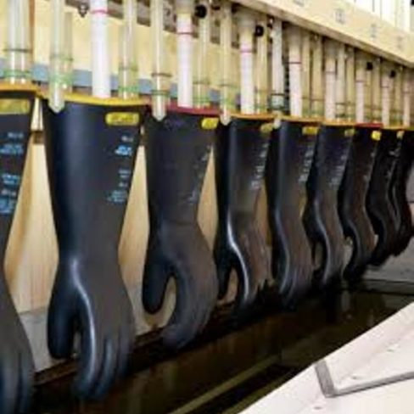
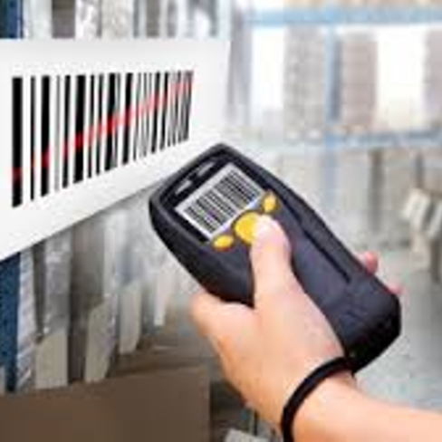
Transformer Testing? Lightning Arrestors? Rubber Goods Tracking? What are those?
Some of the first areas recognized as “gaps” during the initial AMI planning with TECO and SAP were things as mundane as collecting instrument transformer test data and interfacing to the equipment that TECO used. Then came things like tracking lightning arrestors. And what was SAP going to do with scheduling and tracking rubber goods to the individual operator on a specific team and make sure to never miss a test cycle even as he or she transferred between teams?
And these were just the tip of the iceberg. SAP is meant to be a Corporate wide system able to handle all the needs of the Utility as a whole. Very wide but very shallow. To take maximum advantage of SAP third party solutions that go in depth in particular operating areas are needed to “bolt on” to SAP, provide the data SAP needs but be the primary tool used by the Operating group which needs the far more in-depth system.
Meter Manager has provided this tool for TECO’s Meter Services Department to effectively manage and operate their AMI system while also providing all the information necessary to SAP so the Corporate system has all the reporting information they require.

Slide 9
Expanding the reporting and access of the Meter Manager System. A Work in Progress.
As the system continues to mature departments outside of metering have requested and gained access to the Meter Manager system for their own operational and reporting needs.
These include
AMI Operations
Billing team
Lighting department
Network Operations for CGR’s
and the list is expected to expand as more devices and information are incorporated into the system.

Slide 10
Next Steps…………..
Inventory in the warehouse – by location. Initially SAP was going to perform this function. Being transitioned into Meter Manager.
Adding Lighting Equipment
Read Only access for outside departments
Adding Internet Cellular modems – serial numbers, IP addresses and physical locations, instead of using a spreadsheet

Slide 11
Meter Manager Modules Used and Interfaces Between Systems
By the end of deployment TECO was successfully using the following Meter Manager Modules and interfacing seamlessly with their work order management system, Itron, and their Corporate SAP system;
Meter Shop Module
PPE (Rubber Goods) module
Test Records module
Operations Management module
Parts of the new Site Verification and Field Exchange modules
Inventory management including stock room locations, in transit locations, and warehousing kiosks
The system also became the interface to twelve different internal TECO systems including SAP. This is a nominal number of interfaces indicating a high degree of consolidation by TECO on the operational side. TESCO has had over 90 interfaces to disparate internal systems at other electric and gas utilities. Regardless of 12 or 90 interfaces, Meter Manager is the clearing house for these systems allowing information and data to move between each of them and to be reported on and analyzed so the utility's operating group can make the most informed decisions possible on a real time basis.

Slide 12
Questions and Discussion
Tom Lawton, TESCO
tom.lawton@tescometering.com
Mark Tanner, TECO
mmtanner@tecoenergy.com
Wes Caldwell (retired), TECO
TESCO – The Eastern Specialty Company
Bristol, PA
215-228-0500
This presentation can also be found under Meter Conferences and Schools on the TESCO website: www.tescometering.com
ISO 9001:2015 Certified Quality Company
ISO 17025:2017 Accredited Laboratory

