Slide 1
Micro-Arc Detection as Part of Your AMI System
Southeastern Meter School Module 400
Wednesday March 20 3:00 PM – 3:45 PM
Tom Lawton

Slide 2
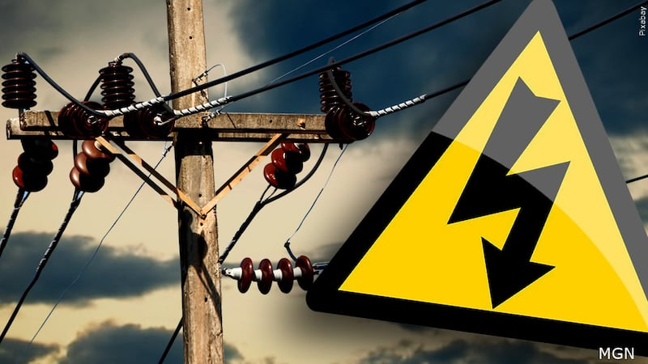
What is the point of more flags?
Why should we pay attention to new features in our meters?
We already have too much data and too many flags to investigate.
Answer: Safety, Reduced Operational Costs and better power delivery to our customers with fewer power interruptions

Slide 3
Agenda
What we will Cover today
What is Micro-Arc Detection?
Location and Purpose of Arc Sense in Meter Base
Description of Operation
Block Diagram
Circuit Diagram
Important Parameters and Take Aways
Your Data & You
How is Micro-Arc Data Captured
How do I make use of it?
Micro-Arc Detection in the Wild
PSEG LI Micro-Arc Case Study
AvanGrid Case Study Preliminary Findings

Slide 4
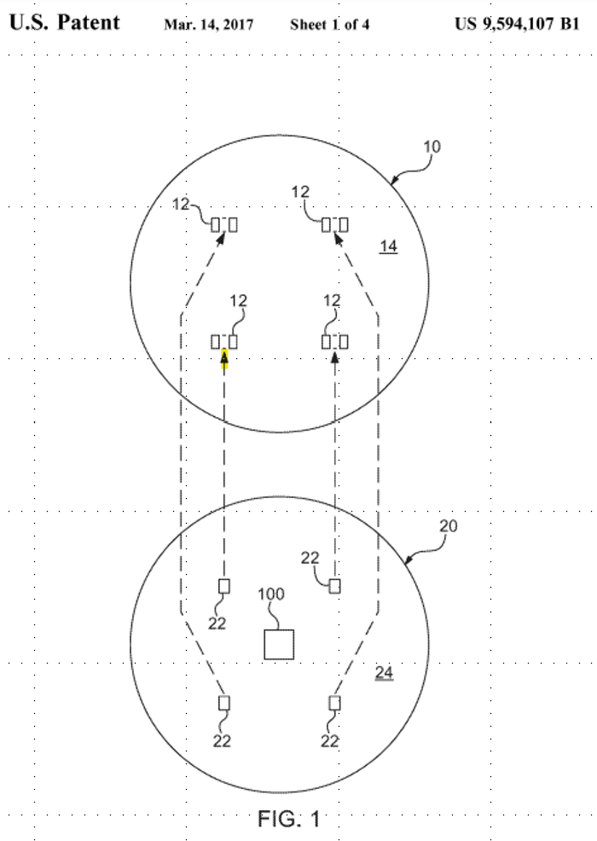
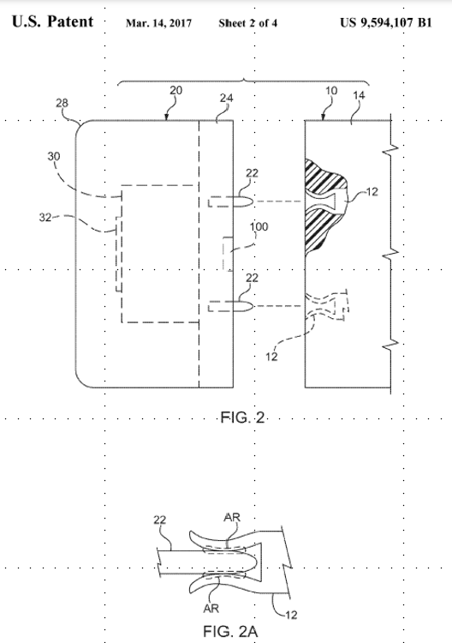
Location and Purpose of Detector

Slide 5
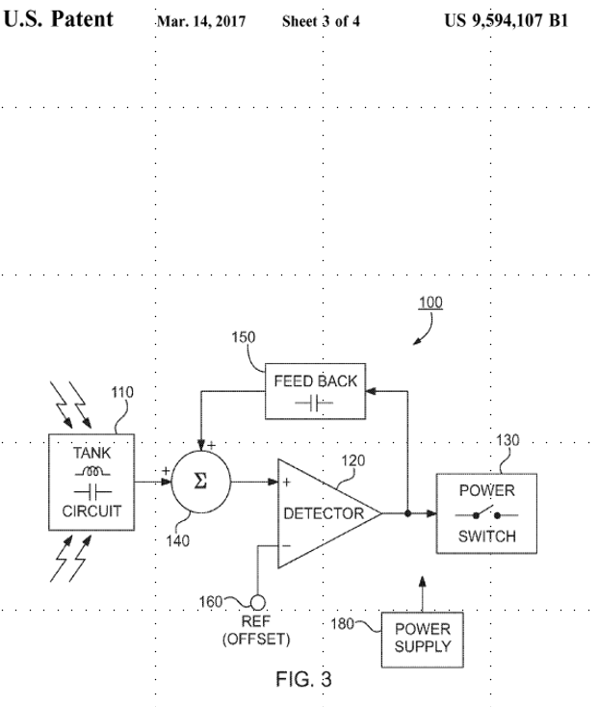
Block Diagram

Slide 6
Theory of Operation Take Aways
Sensor (100) embedded in meter base (24) within 4 inches of Stabs (22)
FIG 2A. Arc will occur when Contact Surface Area (22,12) Compromised
AND Vibration Occurs to Stimulate Arcing
Arcing Produces EMF (~ 500 kHz) (low energy – UHF high frequency)
Arc Detector (110): Tank Circuit (110) De-Tuned Resonant R,L,C Circuit*
Electric Detector(120): Latches Occurrence High (~ one second )
Arc Count = One Second Resolution ( f(RC Time Constant) (150) )
Output (130) Logic High for One Second

Slide 7
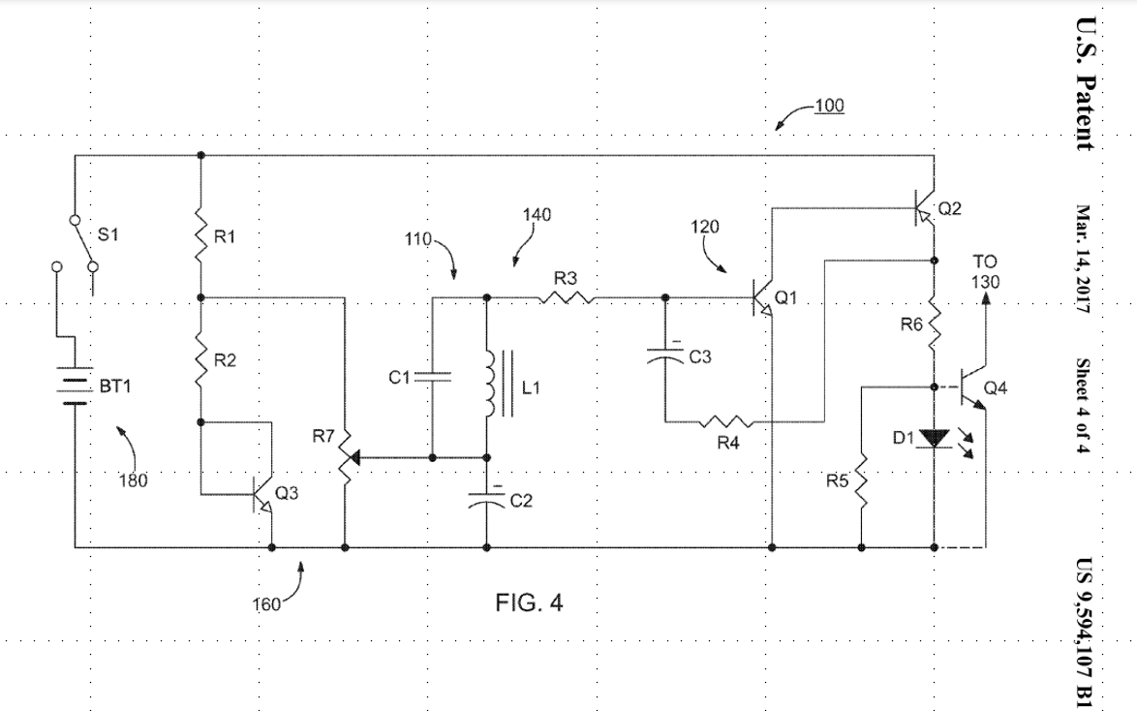
Circuit Diagram

Slide 8
Arc Properties: Type One and Two
Type One:
“Jittering” type “intermittent” arcing (lower energy “heat” content)
Incipient Information… Contact Area Compromise Early Stages
Type Two:
“Welding” type “longer duration” arcing (high energy “heat” content)
Significant Compromise of Contact Area and High Impedance
Later Stages, Thermal Runaway Condition

Slide 9
Your Data & You
Micro-Arc Detection as Part of Your AMI System

Slide 10
Your Data & You
Reporting and data is the lifeblood of a healthy Micro-arc detection ecosystem
Alarms are good, but not enough
High temp and vibration alarms
These are good alarms but are typically indicators of other issues (e.g. rusted sockets, site specific issues) or a late arriving flag for a failed socket.
What should my settings be?

Slide 11
Your Data & You: Your Settings
What should my settings be?
Depends on the utility
Each utility will have their own sweet spot when it comes to their problem sets; this can take a bit of time to dial in
Variables like:
Age of meter population
Type of meter sockets (lever bypass vs ring etc)
Climate (inland vs coastal)
Depends on the meter manufacturer
Itron and L+G implemented different data capture methods and provide disparate reporting formats and granularity of data capture

Slide 12
Your Data & You: L+G Settings
L+G Settings
Captures raw arcs in Load Profile
Can capture 4-5 arcs/second
Can capture “highest rise”, “temp”, and other important co-variables
Basic set-up is easy: select the number of arcs/day required to trigger an Arc Alarm*
*Currently tied to High Temp alarm

Slide 13
PSEG Long Island Case Study
PSEG Long Island, TESCO, L+G

Slide 14
Project Background
PSEG LI
1.2 million connected customers (electric)
Fully AMI deployed, L+G Gridstream
Deployment commenced: 2018
Deployment completed: Spring 2022
TESCO
Developed ArcSense® technology in-house
Worked with L+G to provide as a formal offering
PSEG LI offered to run a pilot program of ~4,500 meters
Pilot launched in Fall 2021
L+G
Provided platform and access to load profile data for arc reads
Incorporating the technology into their next gen, Revelo® meter

Slide 15
ArcSense® Pilot
Collaboration between PSEG Long Island, TESCO, and Landis + Gyr
Pilot project included a total of ~4,500 meters in the field at various locations
New technology developed by TESCO is integrated into an L+G Focus Meter
The board detects the RF signature of a micro-arc
Micro-arc data is captured and relayed within the load-profile data
Load-profile reporting was an open channel to provide the additional micro-arc data for reporting analysis

Slide 16
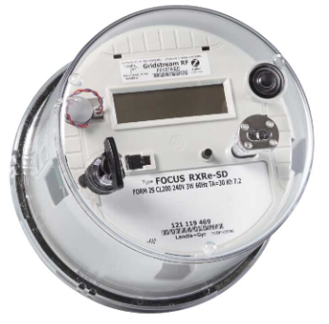
Additional Load Profile Data in Daily Report
Max arc count
Sum of arc count
Maximum temperature and timestamp
Estimated blade temperature
L+G Head End System
Automated Report
Analysts / Engineers
Field Investigation
Meter with LP Data

Slide 17
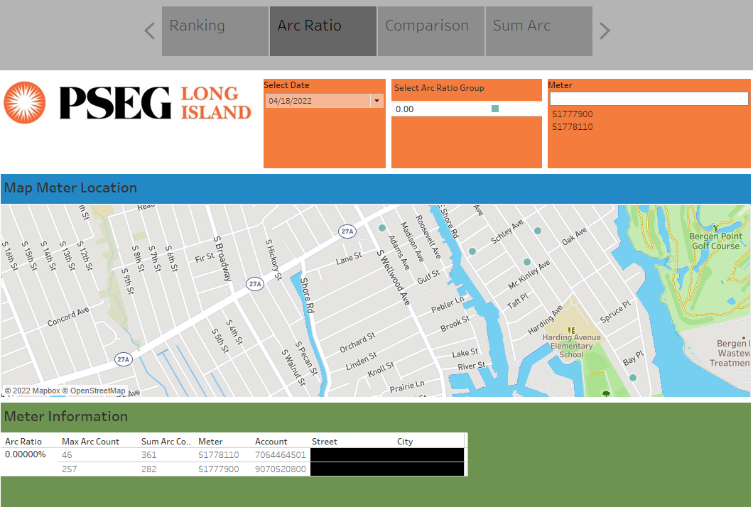
Tableau Data

Slide 18
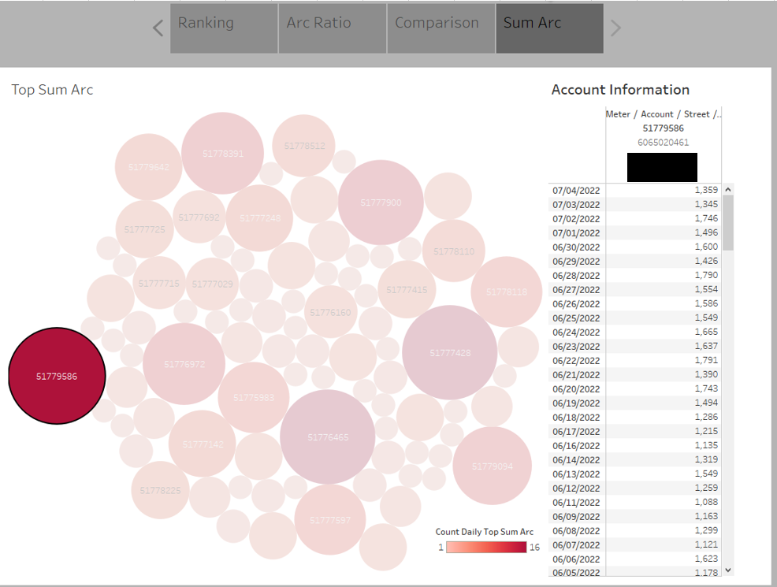
Tableau Data

Slide 19
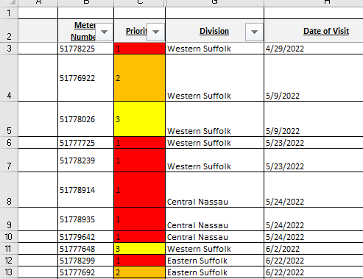
ArcSense Priority List
Meters were selected based on below criteria:
High arc count: >100 arcs
Days of high arc: >=14 days
Meters prioritized by number of days they appeared on Arc Sense Report
Priority 1 = 40-95 days of high arc
Priority 2 = 20-39 days of high arc
Priority 3 = 14-19 days of high arc
Some meters with anomalous data profiles (high average arc counts or abnormal temp readings) were moved up in priority level
tescometering.com

Slide 20
Priority Classifications
Priority 1 – 15 sites, 13 investigations showed issues at the site, 7 hot-socket compromised
Priority 2 – 23 sites, 18 investigations showed issues at the site, 5 hot-socket compromised
Priority 3 – 19 sites, 8 investigations showed issues at the site, 2 hot-socket compromised
tescometering.com

Slide 21
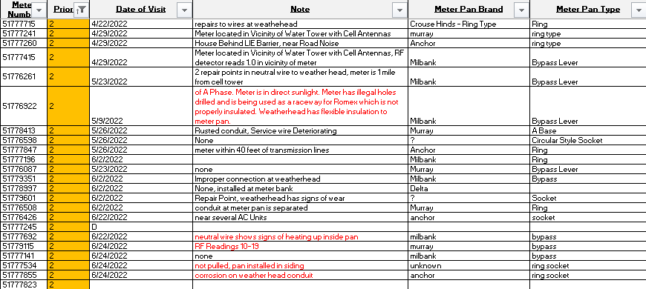
Priority Classifications
Priority 1 – 15 sites, 13 investigations showed issues at the site, 7 hot-socket compromised
Priority 2 – 23 sites, 18 investigations showed issues at the site, 5 hot-socket compromised
Priority 3 – 19 sites, 8 investigations showed issues at the site, 2 hot-socket compromised

Slide 22
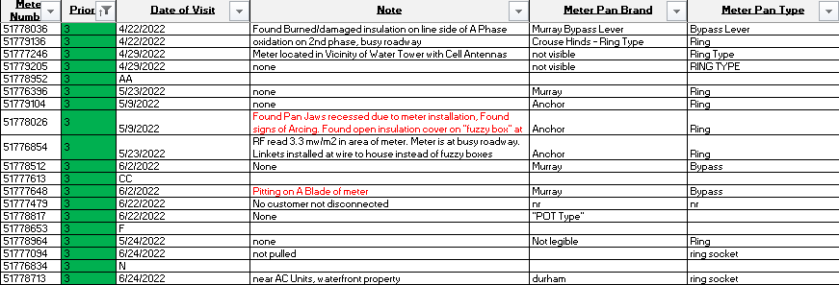
Priority Classifications
Priority 1 – 15 sites, 13 investigations showed issues at the site, 7 hot-socket compromised
Priority 2 – 23 sites, 18 investigations showed issues at the site, 5 hot-socket compromised
Priority 3 – 19 sites, 8 investigations showed issues at the site, 2 hot-socket compromised
tescometering.com

Slide 23
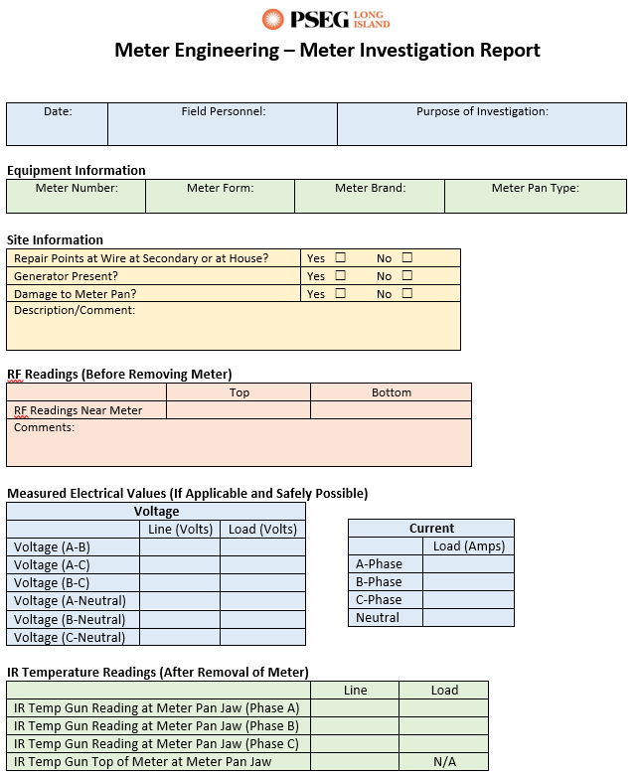
Field Investigations
PSEG Long Island Technicians and Engineers performed site visits
Recorded various site conditions and measurements from each meter:
Condition of meter pan, conduit, weather-head, and secondary wires
Voltage and amperage
IR temperature reading on face of meter and on jaws
RF reading in area of meter
Field Tools:
IR temperature laser
TESCO jaw tester
Multimeter
RF meter
tescometering.com

Slide 24
Meter 51****48 – Discoloration on Meter Blade
Days on report with >100 Max Arc Count: 16
Average arc count: 160
Max Arc Count: 320
Arc Sense Priority Level 3
No previous reports of overheating or rise in temperature
Pitting on meter blade
Meter pan did not show any signs of damage or excessive weathering

Slide 25
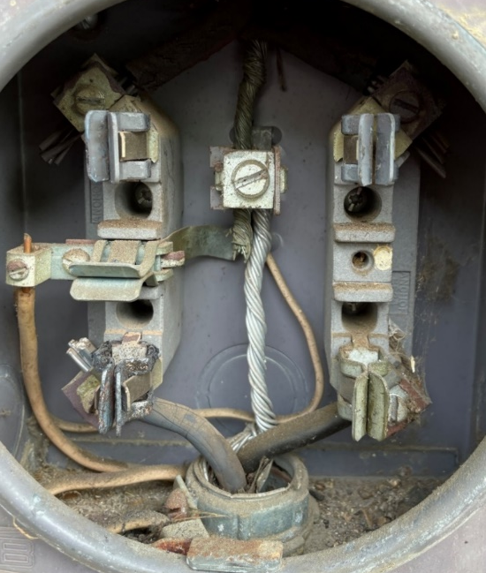
Meter 51****18 – High Temperature Alerts
Originally a non-Arc Sense meter was at property
Meter was reported by Analyst to indicate high temperature alerts
Arc Sense meter was installed in Spring 2022 after high temperature alerts
Arc count and temperature readings were high enough to warrant investigation
Found brittle jaws inside meter pan; meter pan was replaced as a result

Slide 26
Meter 51****26 – Meter Pan with Recessed Jaws
Days on report with >100 Max Arc Count: 18
Average arc count: 278
Max Arc Count: 539
Arc Sense Priority Level 3
No previous reports of overheating or rise in temperature
Recessed springs and discoloration on the jaws
Damaged neutral (as if someone tried to fix the jaws and an uninsulated screwdriver made contact between phase/neutral)

Slide 27
Meter 51****14 – Conduit Allowing Water
Days on report with >100 Max Arc Count: 43
Average arc count: 233
Max Arc Count: 473
Arc Sense Priority Level 1
No previous reports of overheating or rise in temperature
Conduit allowed water to enter into the meter pan
Screw terminal at C-phase load side was rusted and deteriorating
Meter produced arcs when reinstalled

Slide 28
Meter 51****55 – Weather-head Conduit Damage
Days on report with >100 Max Arc Count: 35
Average arc count: 355
Max Arc Count: 1601
Investigation Priority Level: 2*
Moved to priority 1 based on recent top arc counts
No previous reports of overheating or rise in temperature
Meter not removed because customer was not home and it was a non-bypass pan
Technician found damage to weather-head conduit

Slide 29
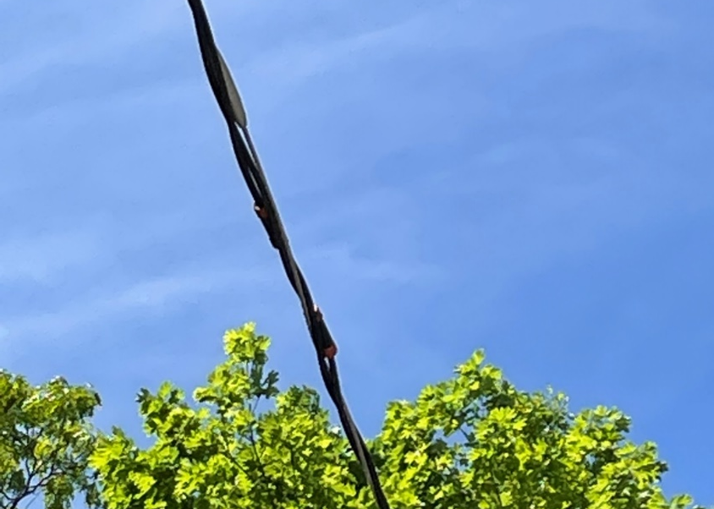
Meter 51****25 – Weather-head + Wire Repair Points
Days on report with >100 Max Arc Count: 56
Average arc count: 247
Max Arc Count: 625
Arc Sense Priority Level 1
No previous reports of overheating or rise in temperature
Damage at weather-head conduit
Found repair points on neutral at triplex to house

Slide 30
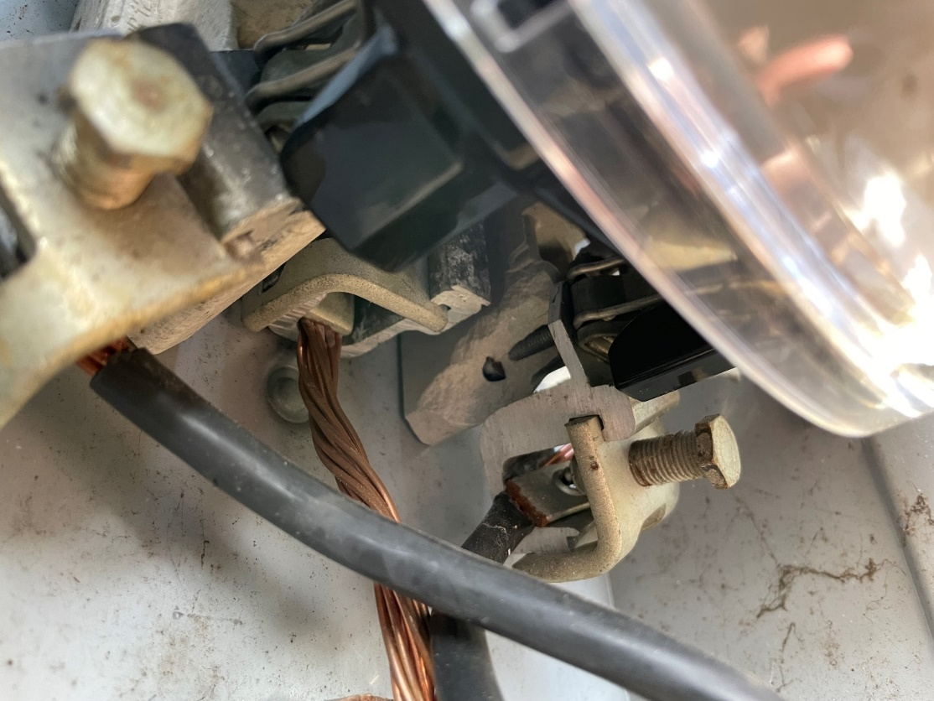
Meter 51****25 – Broken Ceramic Inside Meter Pan
Days on report with >100 Max Arc Count: 93
Average arc count: 236
Max Arc Count: 349
Arc Sense Priority Level 1
No previous reports of overheating or rise in temperature
Technician found broken ceramic on the foundation inside the meter pan

Slide 31
Key Pilot Insights
Value in Arc Detection, Data, and Manpower
Arc Detection: helps to identify meters that may have safety issues
Uses load-profile channel to push as data
Data: allows for analytics to identify trends and identify quality issues
Pushed as daily report via L+G head-end to be interpreted by manpower
Manpower: Analyzes data, informs field force, provides investigation and response to potentially unsafe situations
Specific problems that were identified in this study:
Brittle jaws & recessed jaws
Water damage
Hot socket situations
Current & future
In the short duration of this project, customers were notified and pan was replaced, thereby avoiding a dangerous situation in the field
tescometering.com

Slide 32
Looking Forward
Continuing to evolve
Prioritization Process
Tableau Dashboard
Field Force Checklist
Meter Manager Field Client
Round table results with additional Arc Sense deployments
tescometering.com

Slide 33
Itron Methodology – Overview
Itron application TESCO micro arc detection tracks arcs as they occur over periods of time, rather than individual arcs
Users establish how much of a given time period they need to witness arcs occurring, in order to trigger am Arc Recognition flag
Users establish how many consecutive Arc Recognition flags they need to trigger an alarm
In this example, a meter must experience 5 consecutive periods of arcs experienced for 30 seconds within a 60 second period
tescometering.com
Notes:
First, let’s talk about REGISTER FIRMWARE. From the perspective of the register, it is simply looking for a bit to be set by the Arc Detection circuitry which is passed through via the blurt message. The blurt is the “board to board” message that is sent from the meter metrology to the register which contains various power measurement and status data. It arrives 1/second on the G5R. So, the register FW is basically observing and counting these status bits as they arrive, and as noted, you are already aware of how the counters work with respect to the various fields defined in the meter configuration for ARC DETECTION.
Now moving down a level to the physical circuitry. I don’t have a detailed engineering description of how the circuit works, and it would probably be proprietary if I did, but I’ll talk in general terms about how things are being set and passed from the circuit. The analog portion of the arc detect ckt produces a small pulse when it detects an arc. This is about 15ms longand is sent to the metrology board. The metrology sets the status bit (let’s call it “arc present”) any time it receives this pulse within the blurt period. Note that the metrology requires that the incoming pulse from the arc detect ckt be a minimum of 4.9ms in length, which is one way it avoids triggering on random noise.
So finally, let’s go back to your original question – what if we have a long sustaining arc within a 60 second block that lasts for 30+ seconds? The arc detection circuit will go positive as soon as it detects the start of this long arc and for sake of argument, let’s assume it stays positive for 30 seconds. My question is, under this last scenario will the “Single Blocks Exceeded Count” counter advance from 0 to 1 (i.e. will the meter see this 30 second long arc as a count of 30 arcs) or will the meter count the 30 second long arc as an arc count of 1. In this scenario, whether the blurt receives a continuous input or multiple oscillations of high/low due to a ‘reset’ of time constant really does not make a lot of difference because the reset will be much faster than the blurt period (1/second). So, we would expect that the blurt will be triggered constantly for each blurt therefore each time the message is sent to the register, the “arc present” bit is set, meaning that a 30 second continuous arc would be interpreted by the register as a series of 30 consecutive arcs, indicated by the bit being set in each incoming blurt message.

Slide 34
AVANGRID – Itron Deployment
Avangrid is currently deploying Itron Gen 5 meters for their AMI transition.
Installation started in November 2022, There are close to half a million meters in the field. The first two examples were from the first 30,000 or so deployed.
Base settings triggered no alarms
Queried database for any arc hits; data showed 8 meters with arc counts and single blocks exceeding criteria
Investigated two of the meters that showed the greatest number of SingleBlocksExceeded (meters 1 and 3)
tescometering.com

Slide 35
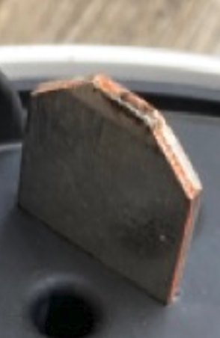
AVANGRID – Meter 1 Field Findings
The meter technician confirmed the presence of small burn marks and slight discoloration on the meter blade (picture below).
He confirmed all service terminations were tight and he tested socket jaw tension using the Tesco Hot Socket Gap Indicator tool.
Jaw tension was good.
Based on photo, it appeared meter was misaligned; after field visit and reinsertion of the meter, report showed zero incremental arc counts, on all six counters.
tescometering.com
Notes:
The meter technician confirmed the presence of small burn marks and slight discoloration on the meter blade (picture below). He confirmed all service terminations were tight and he tested socket jaw tension using the Tesco Hot Socket Gap Indicator tool. Jaw tension was good.
Tom, your analysis on the two meters that were inspected last week seems to be spot on. Meter 301 that appeared to be misaligned shows zero incremental counts on all 6 counters from last week to this week. I spoke to the meter technician this morning and he admitted there’s a chance the supply side blades on this meter were misaligned with the socket jaws but can’t be 100% certain. At any rate, there’s zero incremental arc counts in roughly one week on this meter.

Slide 36
AVANGRID – Meter 2 Field Findings
A-Base to socket adapter
The adapter is new and was installed when the new AMI meter was set
The meter technician said he used a magnifying glass to inspect the meter blades but didn’t see any pit marks.
He checked all external service connections and everything seemed to be OK (i.e. no loose connections, etc.).
He used the TESCO Hot Socket Gap Indicator tool on the adapter and jaw tension looked good.
Expected arcing occurring in older connection base to new socket adapter; arc passing through meter channel.
Additional inspection discovered a failing weather head where broken strands were creating arcs.
tescometering.com
Notes:
A-Base to socket adapter (picture below). The adapter is new and was installed when the new AMI meter was set. The meter technician said he used a magnifying glass to inspect the meter blades but didn’t see any pit marks. He checked all external service connections and everything seemed to be OK (i.e. no lose connections, etc.). He used the TESCO Hot Socket Gap Indicator tool on the adapter and jaw tension looked good.
The other meter with the A-Base to Socket adapter continued to arc. The delta on “Total Arc Counts” in roughly a week is 13,594 and the delta in “Single Blocks Exceeded Count” is 2 (see the attached spreadsheet). Our AMI Ops group created a work order for a meter technician to visit this site again for further inspection. There wasn’t that much activity on the other meters.

Slide 37
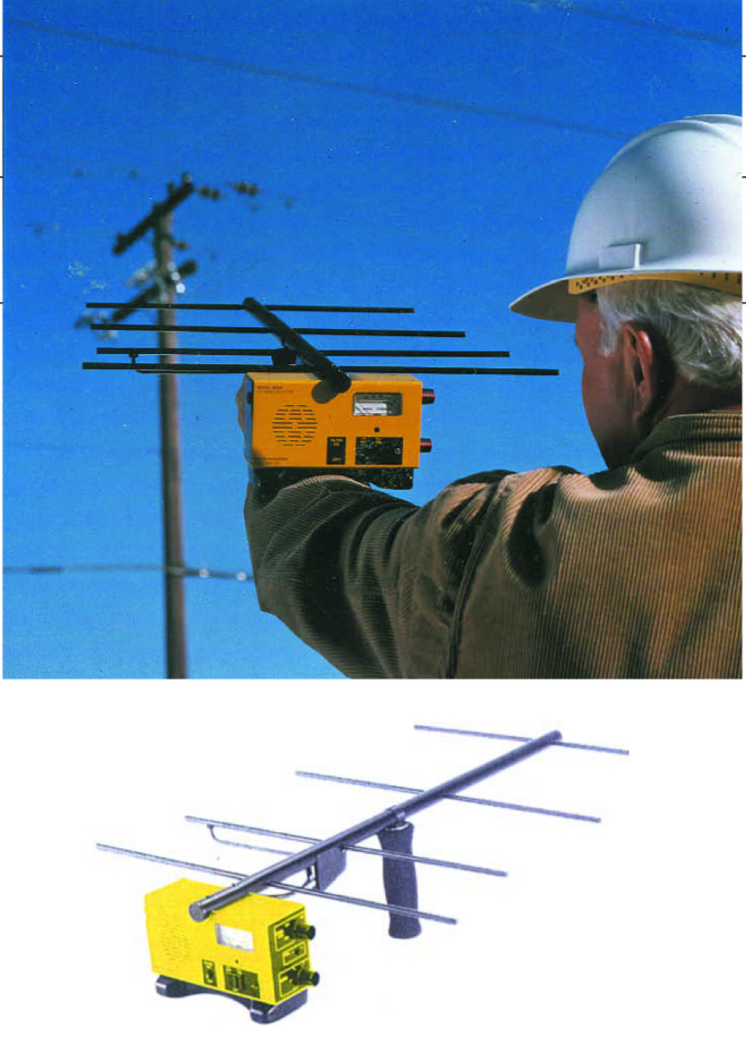
AVANGRID – Unexpected Findings
What was unexpected was the ability to the detection circuit to pick other safety or operational (or both) issues that could be addressed prior to leading to a catastrophic failure.
Failing distribution transformer
Broken strands at weather head – near separation of weather head
Failing equipment on the customer side of the Main service box in the house
The adapter is new and was installed when the new AMI meter was set
These are just three of several examples. The common theme was arcing on the line and a direct line into the meter that was relatively close to the meter. These issues were only ever reported by one meter and not a series of neighboring meters.
Finding these issues required the use of additional RF detection equipment by the field technician.
New protocols and checklists were recommended for field investigations of significant arc reports from the field
tescometering.com
Notes:
A-Base to socket adapter (picture below). The adapter is new and was installed when the new AMI meter was set. The meter technician said he used a magnifying glass to inspect the meter blades but didn’t see any pit marks. He checked all external service connections and everything seemed to be OK (i.e. no lose connections, etc.). He used the TESCO Hot Socket Gap Indicator tool on the adapter and jaw tension looked good.
The other meter with the A-Base to Socket adapter continued to arc. The delta on “Total Arc Counts” in roughly a week is 13,594 and the delta in “Single Blocks Exceeded Count” is 2 (see the attached spreadsheet). Our AMI Ops group created a work order for a meter technician to visit this site again for further inspection. There wasn’t that much activity on the other meters.

Slide 38
Summary
What is Micro-Arc Detection?
Location and Purpose of Arc Sense in Meter Base
Description of Operation
Block Diagram
Circuit Diagram
Important Parameters and Take Aways
Your Data & You
How is Micro-Arc Data Captured
How do I make use of it?

Slide 39
Summary
Why we need to pay attention to the flags and alarms we are receiving?
Answer:
Safety
Reduced Operational Costs
Better power delivery to our customers with fewer power interruptions

Slide 40
Questions and Discussion
Tom Lawton
President
tom.lawton@tescometering.com
TESCO – The Eastern Specialty Company
Bristol, PA
215.228.0500
This presentation can also be found under Meter Conferences and Schools on the TESCO website: tescometering.com
ISO 9001:2015 Certified Quality Company
ISO 17025:2017 Accredited Laboratory

