Slide 1


Site Testing with
TESCO’s 6330
Kevin Farrell, TESCO
Texas Sales Manager
The Eastern Specialty Company
SWEMA

Slide 2
Meter Site Analyzer Cat. 6330
Southern California Edison
True 3 phase Portable Field CT & Meter Tester.
Battery Operation. Lithium Ion. Lightweight 17.8lbs
Customer Load and Phantom Load Testing
Demagnetization & Admittance Testing

Slide 3
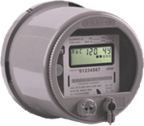

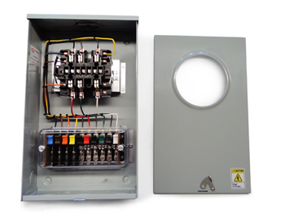
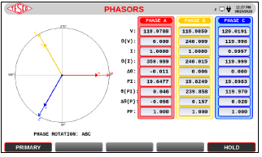
TESCO/Georgia Power 2017 Caribbean Meter School
Fundamentals of Polyphase Field Meter Testing and Site Verification
Meter Accuracy Testing
Customer Load
Customer Load
Customer Billing
Customer Conditions
Meter Accuracy Testing
Phantom Load
Full Load
Light Load
Power Factor

Slide 4
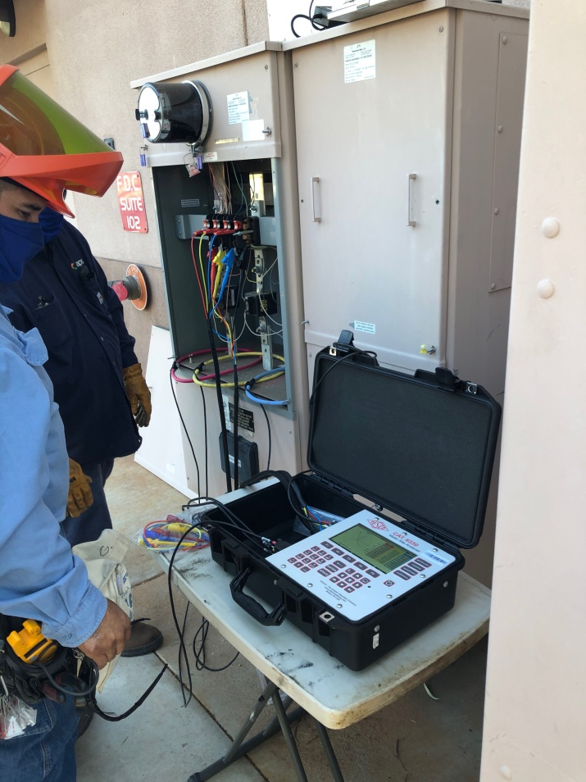
Testing at Transformer Rated Sites
Meter Accuracy
Customer Load
Full Load
Light Load
Power Factor
CT Health
Burden Testing
Ratio Testing
Demagnetization
Admittance Testing
Harmonics Assessment
Site Verification

Slide 5
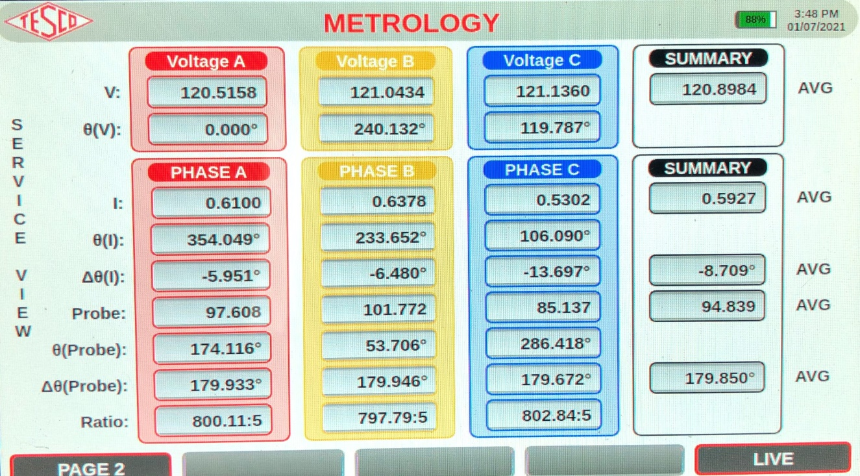
Metrology
Primary and Secondary
Instant LIVE Data
3 Phases with Average Summary

Slide 6
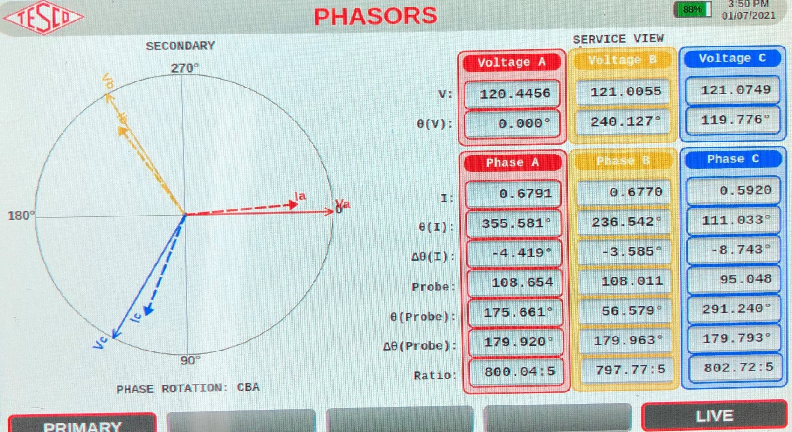
3 Phase Vectors

Slide 7
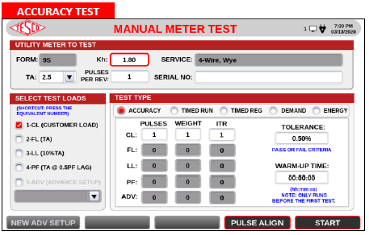
Meter Accuracy Testing
Meter Accuracy Test using IR Pulse Detection
Make connections from Field Tester to Meter Form
Connect IR Pulse Detector to meter output
Check pulse indictor
Pulse Align if necessary

Slide 8
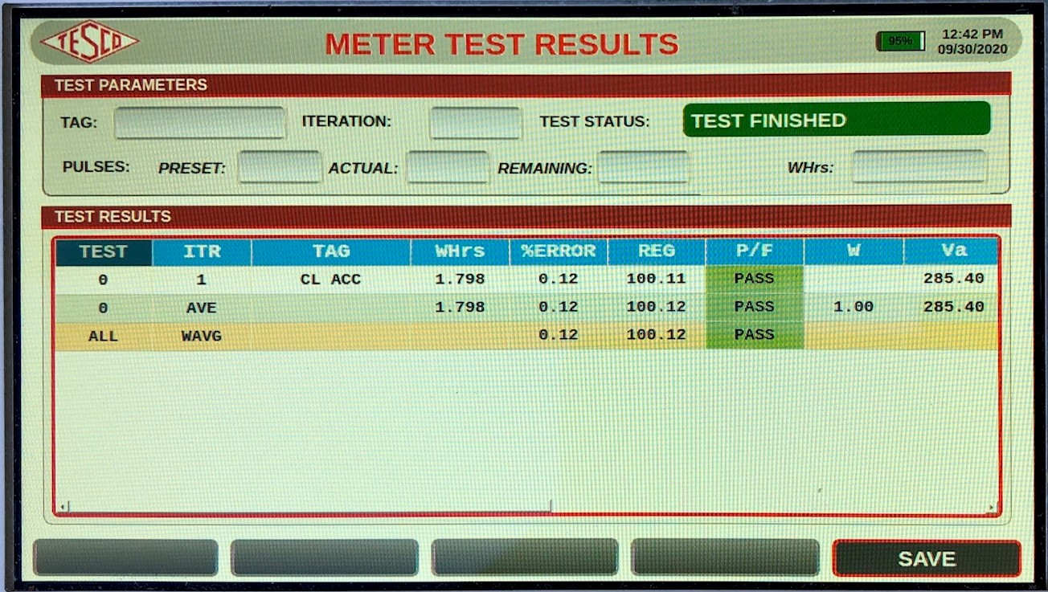
Meter Accuracy Testing
Meter Accuracy Test using IR Pulse Detection
Make connections from Field Tester to Meter Form
Connect IR Pulse Detector to meter output
Check pulse indictor
Pulse Align if necessary

Slide 9
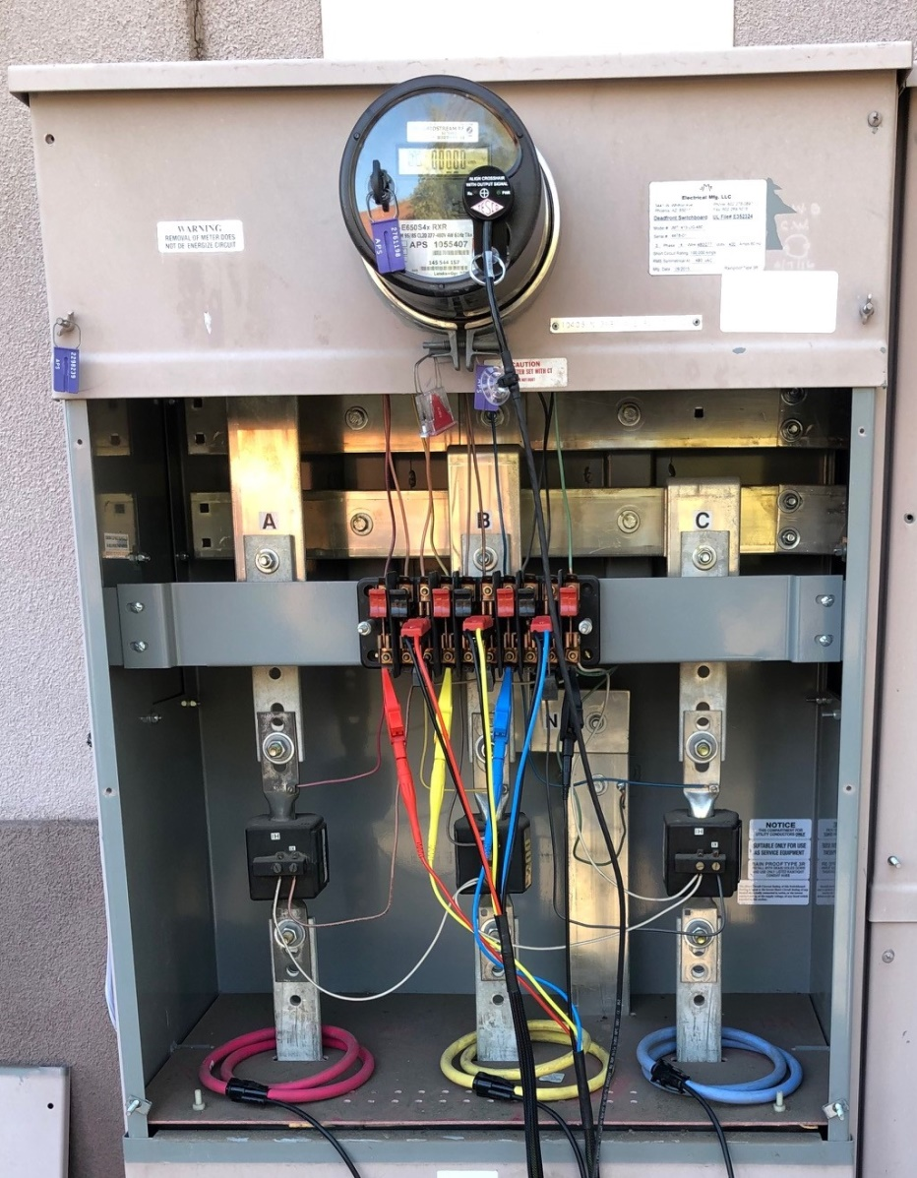
Customer CT Ratio Test with Burden
Make Connections from Field Tester to Primary current phases
Make connections from Field Tester to Secondary test switch
Connect IR Pulse Detector to meter output
Courtesy of APS

Slide 10
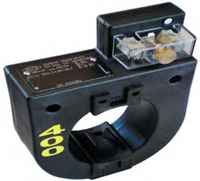
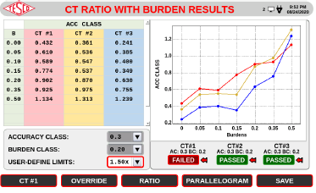
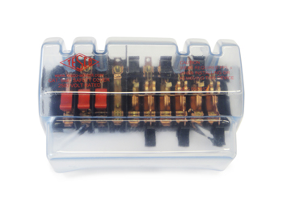
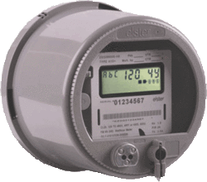
Fundamentals of Polyphase Field Meter Testing and Site Verification
Functionality with Burden Present on the Secondary Loop
PHASE A
Some burden will always be present – junctions, meter coils, test switches, cables, etc.
CT’s must be able to maintain an accurate ratio with burden on the secondary.

Slide 11
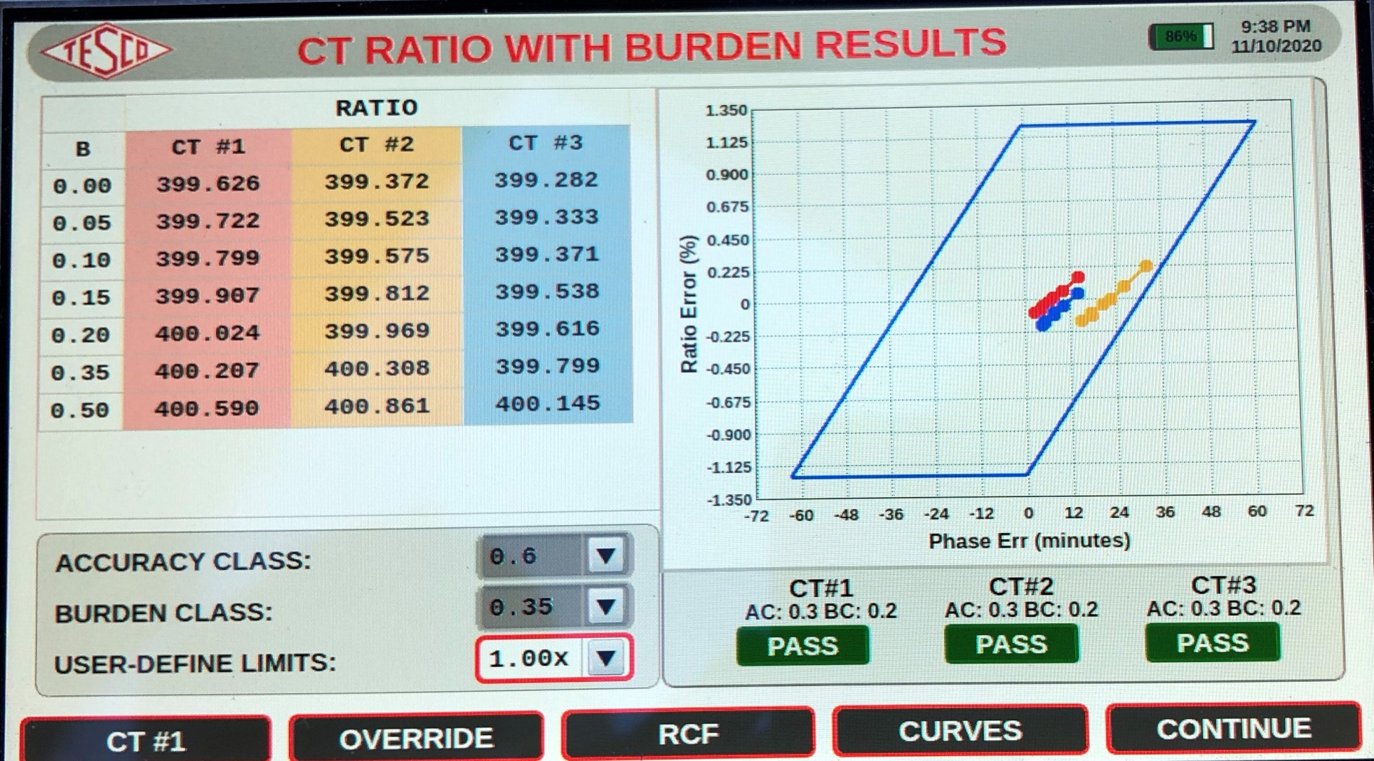
CT Ratio Testing with Burden Added

Slide 12
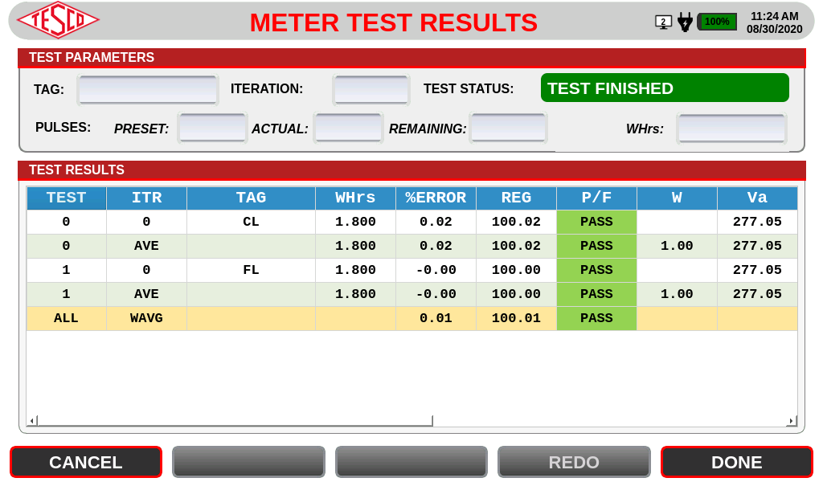
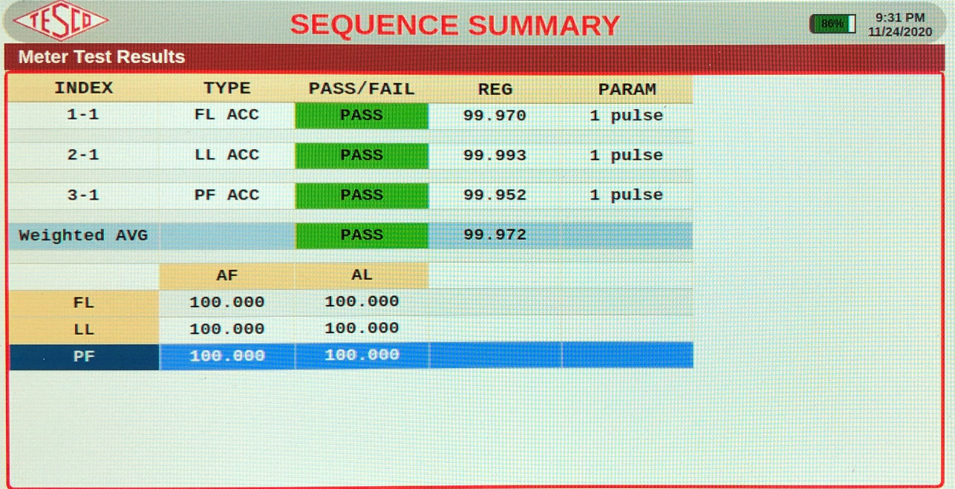
Phantom Load Testing

Slide 13
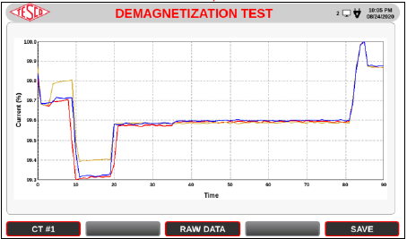
Demagnetization Testing
Current transformers (CTs) show large errors when they are magnetized by dc current. This error can be reduced after proper demagnetization.
One of the methods to demagnetize the CT is to increase the core flux by increasing its burden. This method enables to restore the nominal precision of the heavily magnetized CT from 2.5% back to 0.2% without interruption of the CT operation.

Slide 14
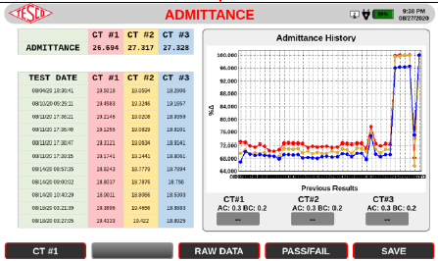
Admittance Testing
admittance is a measure of how easily a circuit or device will allow a current to flow. It is defined as the reciprocal of impedance.
The SI Unit of admittance is the (symbol S)

Slide 15
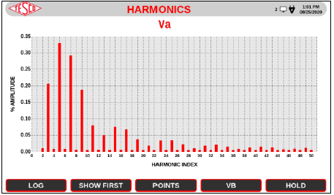
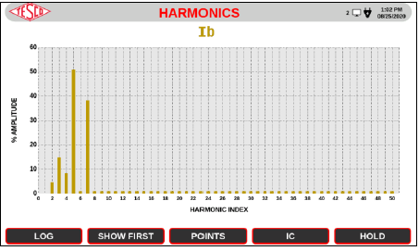
Harmonics Testing
Harmonics are integer frequencies often found with nonlinear loads.
THD=Total Harmonic Distortion
Vthd <5%

Slide 16
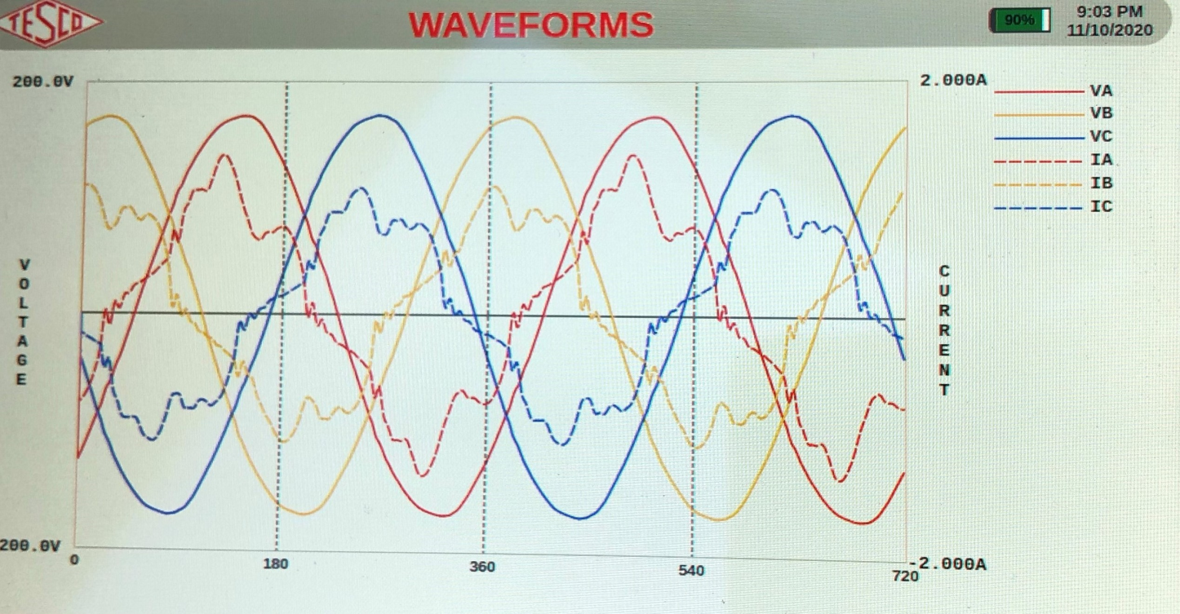
Harmonics Testing-Waveforms
Harmonics are generated as a voltage or current at an integer frequency of the system, produced by the action of non-linear loads such as rectifiers, discharge lighting, or switch mode power supplies.
Harmonic frequencies in the power grid are a frequent cause of power quality problems.

Slide 17

Questions and Discussion
Thank you for Attending.
Kevin Farrell
Texas Sales Manager
Kevin.Farrell@tescometering.com
TESCO – The Eastern Specialty Company
267-799-9075

