Slide 1
Test Switch Operation & Accessories
Prepared by Dan Hollow Rocky Mountain Regional Sales Manager, TESCO – The Eastern Specialty Company
for Rocky Mountain Meter School
March 16, 2022
10:30AM-11:30 AM

Slide 2
Introduction / Biography
Dan has worked for TESCO since 2015, and was originally hired to sell the Meter Manager Meter Asset Management Software and then was given the Rocky Mountain Region Sales Territory in late 2016. He now sells the TESCO products in 4 states (CO, WY, UT, MT, ID, AZ, and the western half of KS, NE, SD, and ND). Dan has been working in the utility industry since 1988 and began his career in the utility industry as the Test Department Supervisor for Aptech. In 1992 he accepted an outside sales position with Aptech and has been in outside sales ever since. Dan has worked for companies such as UTS/Itron, Datamatic, SmartSynch, Metrum Technologies/Aclara, and TESCO. Primary background is in Electronics.
Dan has worked in the technology industry since 1980 and has worked in other industries such as Banking Equipment, Industrial CNC Controls, Process Controls and Flight Simulation Equipment prior to working in the utility industry.

Slide 3
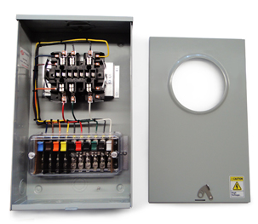
Purpose:
To acquaint the attendees with the use and purpose of Meter Test Switches
Course Breakdown of Topics:
Using Test Switches
Meter Test Switch Specifications
Meter Test Switch Configurations
Meter Test Switch Accessories
Pre-Wired Transformer Rated Enclosures

Slide 4
Typical Self Contained Service
Typically found in residential metering
Meters are capable of handling the direct incoming amperage
Meter is connected directly to the load being measured
Meter is part of the circuit
When the meter is removed from the socket, power to the customer is interrupted

Slide 5
Transformer Rated Service
Meter measures scaled down representation of the load.
Scaling is accomplished by the use of external current transformers (CTs) and sometimes voltage transformers or PTs).
The meter is NOT part of the circuit
When the meter is removed from the socket, power to the customer is not effected.

Slide 6
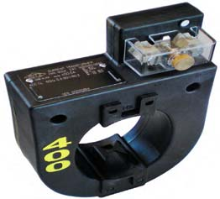
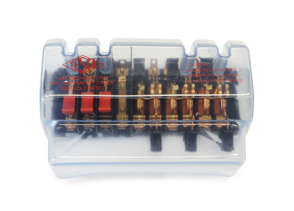
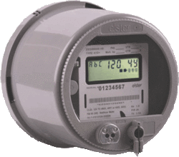
Transformer Rated Service
9S Meter Installation with 400:5 CT’s
SOURCE
PHASE A
400A
PHASE B
400A
LOAD
PHASE C
400A
5A
5A
5A
5A
5A
5A

Slide 7
Safety
Testing current transformers while they are in service can be a dangerous operation if certain safety procedures are not followed. The secondary loop of a current transformer must NEVER BE OPENED when service current is present in the primary. When there is current in the primary, and the secondary of a current transformer is open circuited, the voltage across the secondary can rise to hundreds and even thousands of volts, creating an extremely dangerous situation. The open CT secondary voltage magnitude varies with CT design and primary
current flow. The high voltage that is present on the open secondary of an energized current transformer generates two great hazards. The first hazard is ELECTRICAL SHOCK TO TESTING PERSONNEL. The second hazard is THE BREAKDOWN OF THE CURRENT TRANSFORMER INSULATION. Both hazards can be avoided provided that the secondary of the current transformer is never opened. The safest current transformer installations for testing are those that have a Test Switch as part of the secondary loop. A Test Switch is a device that will facilitate inserting instrumentation in the current transformer secondary loop without the danger of opening the circuit.

Slide 8
Typical Connections for Common Meter Forms

Slide 9
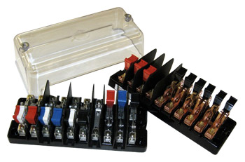
Test Switch Specifications
ANSI C12 Definitions
Test Switch Materials
Plating
Barriers
Wiring Connections
What to look for
Covers

Slide 10
ANSI C12.9 Test Switch Definitions

Slide 11
ANSI C12.9 Test Switches

Slide 12
ANSI C12.9 General Test Switch Specifications

Slide 13
Test Switch Configurations
Layout
Handle Colors
Reversed vs. Normal Potentials
Current Links
Base Sizing
Barrier Locations

Slide 14
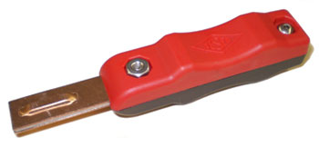
Test Switch Accessories
Test Plugs
Safety Covers
Test Switch Isolators
On installations that contain Test Switches, test leads terminated with a test switch safety test probe (test plug) should be used for CT testing. This provides a “make-before-break” connection to prevent accidental opening of the current transformer secondary loop.

Slide 15
ANSI C12.9 Test Jack Specifications

Slide 16
ANSI C12.9 Test Plug Specifications

Slide 17
For Utilities not Currently Using Test Switches

Slide 18
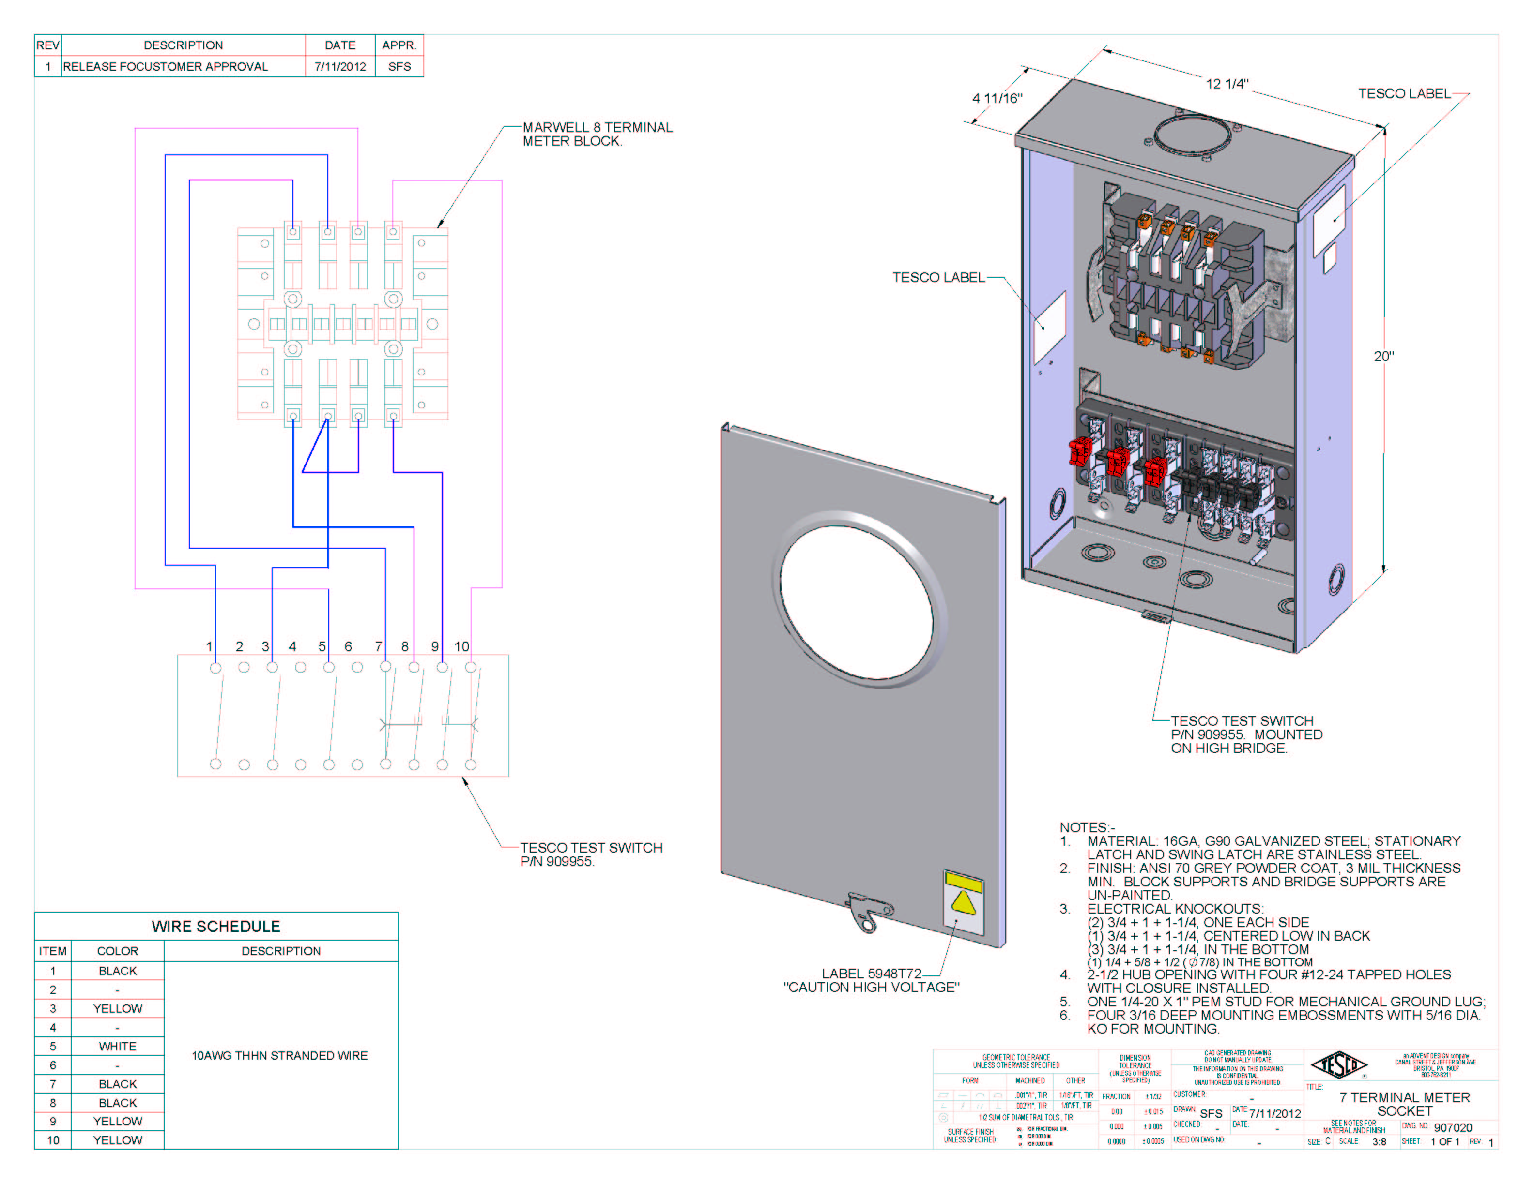
Pre-Wired Transformer Rated Enclosures
Cover Types
Wiring
Sockets

Slide 19
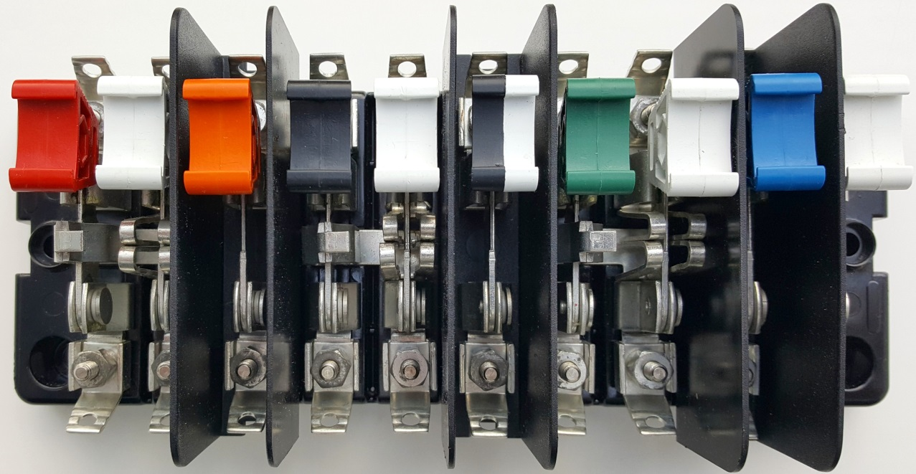
Questions?

Slide 20
3 Quiz Questions Multiple Choice
1. Which type of metering service typically has a test switch?
Self Contained
Transformer Rated
Gas
2. Why would you want to reverse the potentials on test switch?
Aesthetics
To use multiple voltages
To de-energize the potential blades when open for safety
3. What is the purpose of a current link on a test switch?
To enable connection of the test jack and shunt in the current pair to complete the current loop.
To connect the current pairs to the potentials
To eliminate the need for barriers between the poles

Slide 21
More Questions and Discussion
Dan Hollow
Rocky Mountain Regional Sales Manager
dan.hollow@tescometering.com
TESCO – The Eastern Specialty Company
Bristol, PA
303.810.6528
This presentation can also be found under Meter Conferences and Schools on the TESCO website: tescometering.com
ISO 9001:2015 Certified Quality Company
ISO 17025:2017 Accredited Laboratory

