Slide 1
Intro to Transformer Rated Metering
PREA
March 5, 2024
Rob Reese, TESCO

Slide 2
Self-Contained vs. Transformer-Rated
14S
39S
17S
1S
2S
3S
12S
35S
4S
25S
10S
76S
46S
45S
66S
11S
32S
5S
26S
6S
16S
9S
15S
56S
24S
13S

Slide 3
Self-Contained vs. Transformer-Rated
SELF-CONTAINED
TRANSFORMER RATED
1S
39S
7S
14S
36S
3S
2S
12S
29S
76S
5S
35S
25S
46S
4S
8S
16S
11S
26S
17S
66S
6S
45S
9S
13S
10S
15S
32S
56S
24S

Slide 4
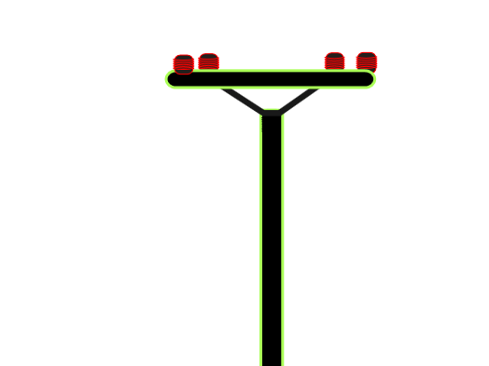
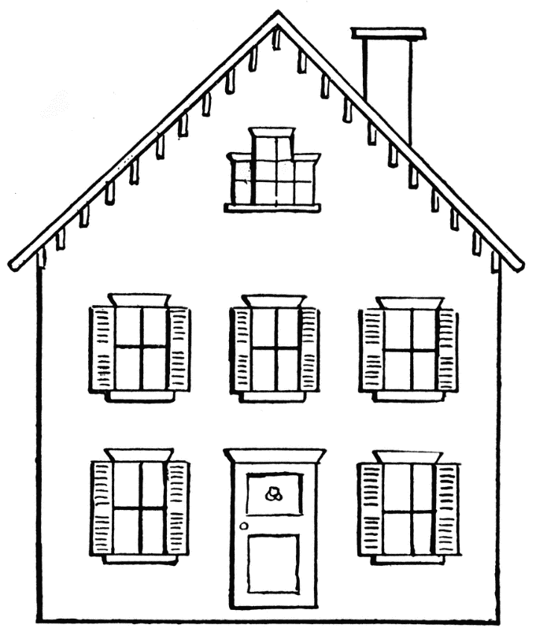
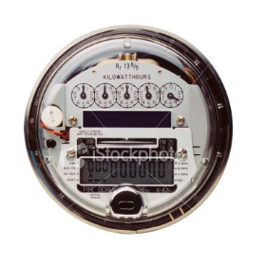
Self-Contained Metering
Primarily Residential
(1S, 2S, 12S)
Relatively Low Current
Example: 100A

Slide 5
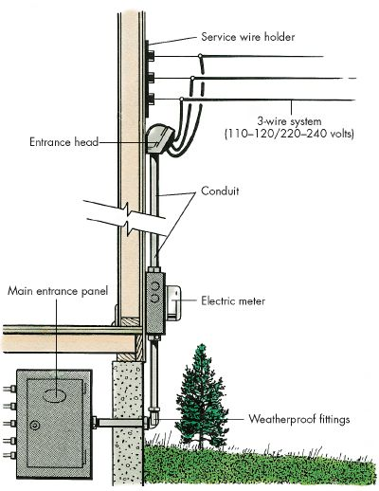
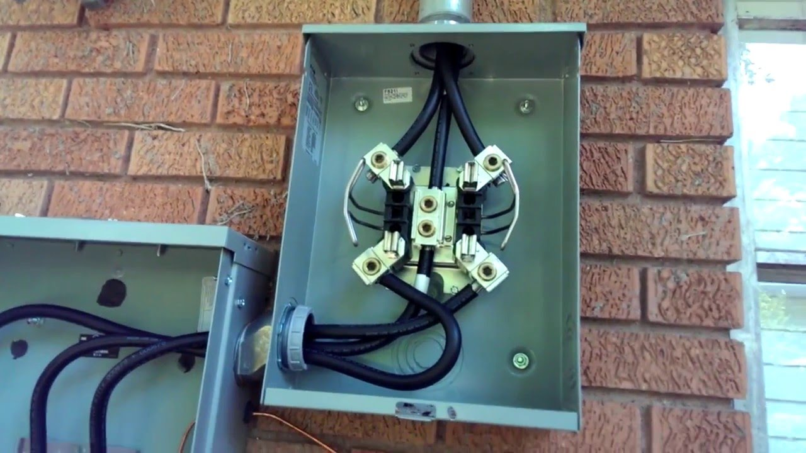
Self-Contained Metering
Primarily Residential
(1S, 2S, 12S)

Slide 6
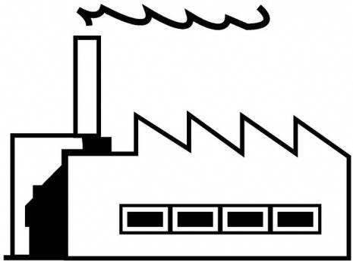
Transformer-Rated Metering
Primarily Commercial/Industrial
(9S)
Relatively High Current
Example: 2000A

Slide 7
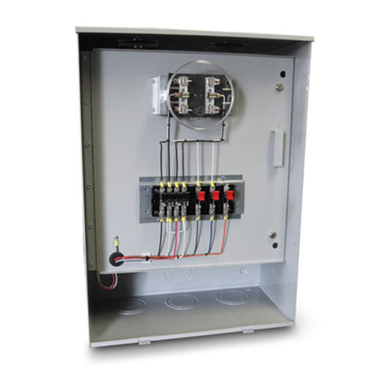
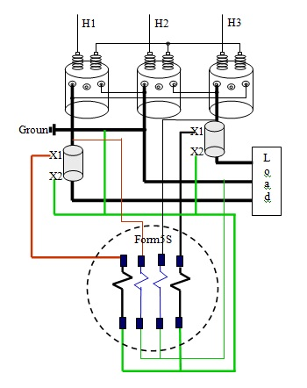
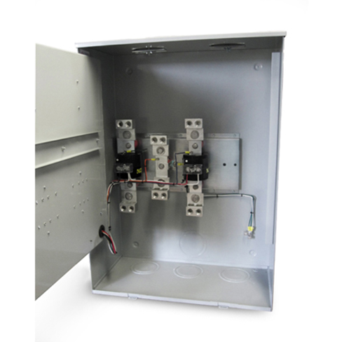
Transformer-Rated Metering
Primarily Commercial/Industrial
(9S)

Slide 8
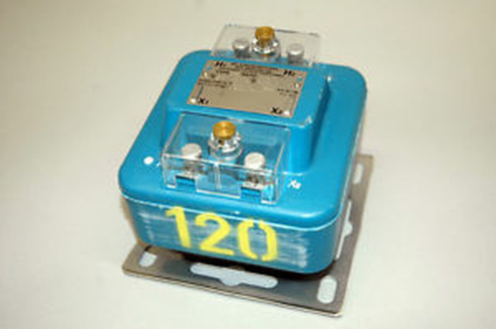
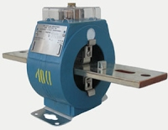
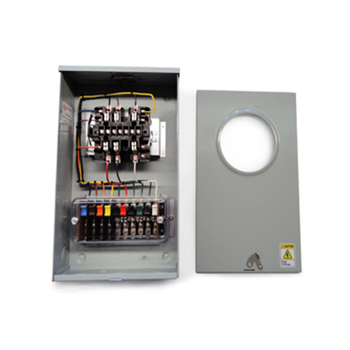
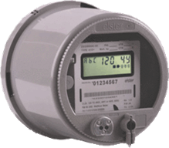
Transformer-Rated Metering
Typical Components of an Installation

Slide 9
Transformer-Rated Metering
Meter

Slide 10
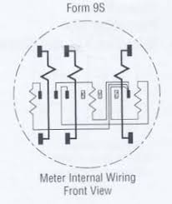
Transformer-Rated Metering
Meter

Slide 11
Transformer-Rated Metering
Enclosure, Socket, Test Switch

Slide 12
Transformer-Rated Metering
Enclosure, Socket, Test Switch
Enclosure
Painted Steel or Aluminum
One or Two Piece Lid
Many, Many Configurations

Slide 13
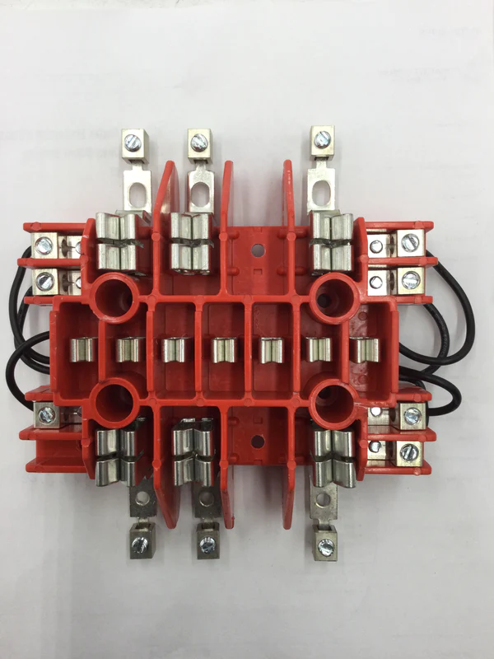
Transformer-Rated Metering
Enclosure, Socket, Test Switch
Socket
Configured for Specific Form

Slide 14
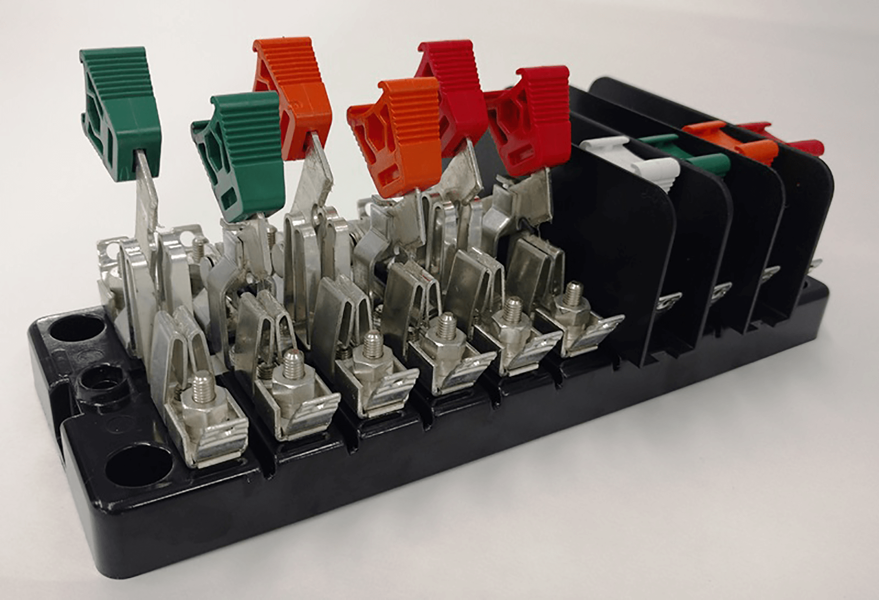
Transformer-Rated Metering
Enclosure, Socket, Test Switch
Test Switch
Upmost Safety
Shuts the CT
Isolates the Meter from the Service During Testing

Slide 15
Transformer-Rated Metering
PT/VT –Voltage Transformer

Slide 16
Transformer-Rated Metering
PT/VT –Voltage Transformer
PT/VT
Scales Down the Voltage
4:1
480V:120V

Slide 17
Transformer-Rated Metering
CT – Current Transformer

Slide 18
Transformer-Rated Metering
CT – Current Transformer
CT
Scales Down the Current
400:5
800A:10A

Slide 19
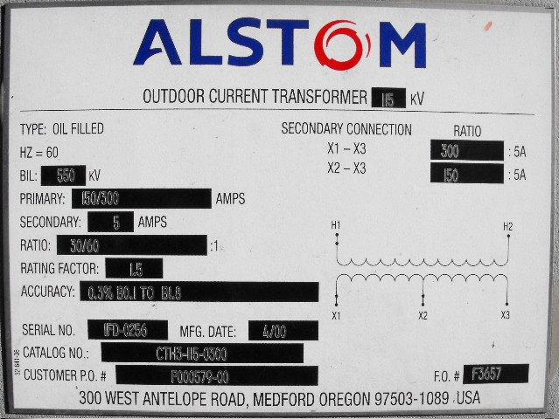
Faceplate Specifications

Slide 20
Faceplate Specifications
Ratio

Slide 21
Faceplate Specifications
Thermal factor

Slide 22
CT’s – Functions and Terminology
Thermal Rating factor
A value representing the amount by which the primary current can be increased without exceeding the allowable temperature rise.
For instance, a RF of 4.0 at 30° ambient on a 400:5 ratio CT would allow for a primary current up to 1600A.

Slide 23
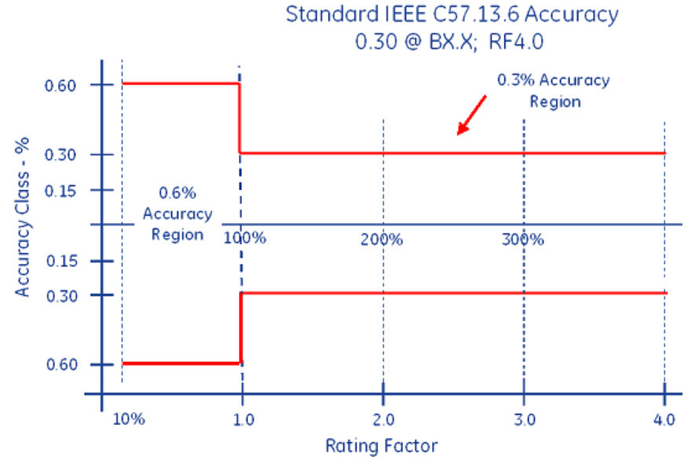
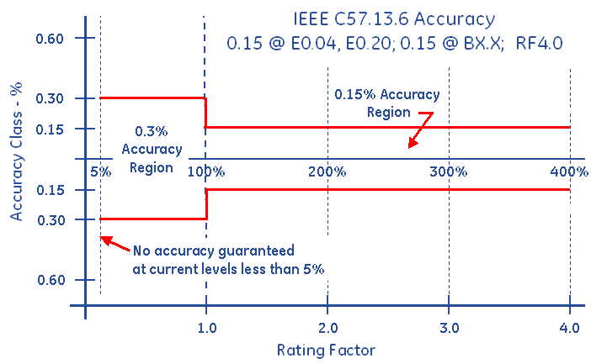
Faceplate Specifications
Accuracy Classifications
All CT’s fall within an accuracy class.
IEEE Standards have defined accuracy classes.

Slide 24
Faceplate Specifications
BurdenRating

Slide 25
Burden Rating
.3@B0.1,B0.2
The burden range, present in the secondary circuit, that the manufacturer will guarantee their CT’s will still accurately function, in regards to the ratio specification.

Slide 26
Questions and Discussion
Rob Reese
Midwest Regional Sales Manager
rob.reese@tescometering.com
TESCO – The Eastern Specialty Company
Bristol, PA
215.310.8809
This presentation can also be found under Meter Conferences and Schools on the TESCO website: tescometering.com
ISO 9001:2015 Certified Quality Company
ISO 17025:2017 Accredited Laboratory

