Slide 1
Intro to Self-Contained Metering
PREA
March 5, 2024 8:15 AM – 9:30 AM
Perry Lawton, TESCO
Michael Mayer, CB Associates

Slide 2
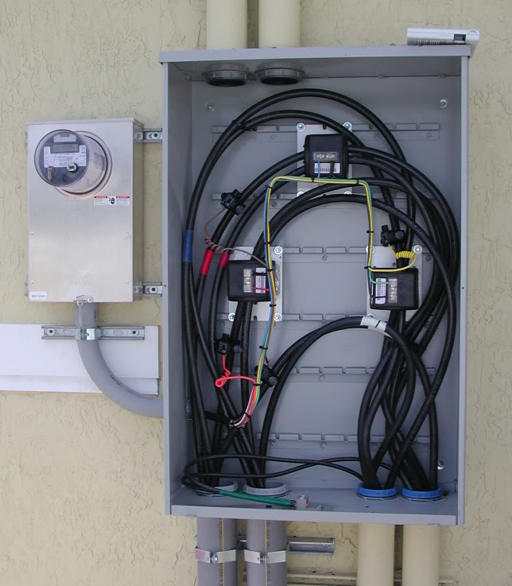
Topics we will be covering
The Basics- Differences Between Self Contained and Transformer or Instrument Rated Meter Sites
Transformer Rated Meter Forms
Test Switches and CT’s
Blondel’s Theorem and why this matters to us in metering
Meter Accuracy Testing in the Field
Checking the Health of your CT’s and PT’s
Site Verification and not just meter testing

Slide 3
Self Contained Metering
Typically found in residential metering
Meters are capable of handling the direct incoming amperage
Meter is connected directly to the load being measured
Meter is part of the circuit
When the meter is removed from the socket, power to the customer is interrupted

Slide 4
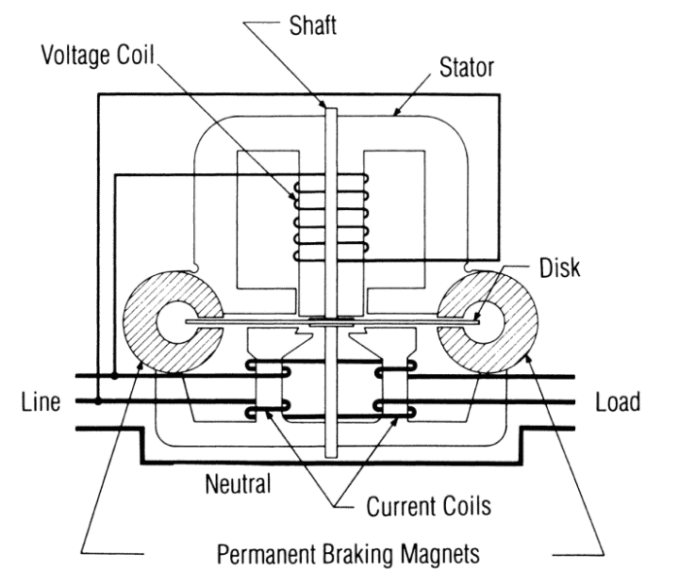
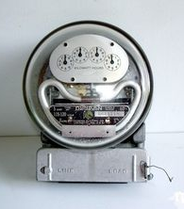
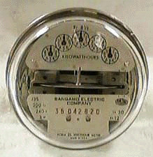
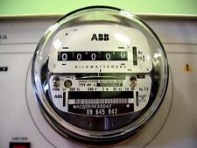
Meters Through the Years
Induction Meter
Duncan Meter
Meter from 1960’s
Meter from 80’s and 90’s
2000 to Present

Slide 5
Back to Basics: Electrical Laws
Ohms Law
Voltage = Current times Resistance
V = I X R
THE MOST USEFUL AND THE MOST FUNDAMENTAL OF THE ELECTRICAL LAWS

Slide 6
Basic Concepts: Electricity and Water
Comparing Electricity to Water flowing from a hose
Voltage is the equivalent of the pressure in the hose
Current is water flowing through a hose (coulombs/sec vs gal/sec). The water in a system is the “charge” (coulombs)
Impedance(Resistance) is the size of the hose. The nozzle would provide a change in resistance.
Power is how fast water flows from a pipe (gallons per minute vs kilowatts). Power is a rate of energy consumption

Slide 7
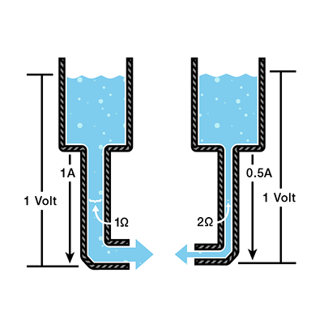
Basic Concepts: Electricity and Water

Slide 8
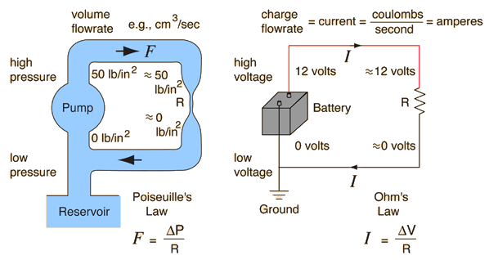
Practical Electricity

Slide 9
Basic Electrical Laws
Ohms Law Examples
If V = 20 volts and I = 5 amperes what is the resistance?
R = V / I = 20 / 5 = 4 ohms
If R = 20 ohms and V = 120 volts what is the current?
I = V / R = 120 / 20 = 6 amps
If I = 10 amperes and R = 24 ohms what is the voltage?
V = I x R = 10 x 24 = 240 volts
Problem: If V = 240 volts and R = 6 ohms what is the current?
I = V / R = 240 / 6 = 40 amps

Slide 10
Basic Electrical Laws

Slide 11
Basic Electrical Laws
Power = Voltage x Current = V x I = I²R = V^{2/}R
If V = 20 volts and I = 8 amperes what is the power?
P = V x I = 20 x 8 = 160 watts
If R = 5 ohms and V = 120 volts what is the power?
P = V^{2/}R = 120 x 120 / 5 = 2880 watts
If I = 10 amperes and R = 20 ohms what is the power?
P = I²R = 10 x 10 x 20 = 2000 watts
1 kilowatt (kW) = 1,000 watts
1 megawatt (MW) = 1,000,000 watts

Slide 12
Basic AC Theory What is VA?
Power was measured in Watts. Power does useful work. The power that does useful work is referred to as
“Active Power.”
VA is measured in Volt-Amperes. It is the capacity required to deliver the Power. It is also referred to as the “Apparent Power.”
Power Factor = Active Power / Apparent Power
VA = E x I
PF = W/VA

Slide 13
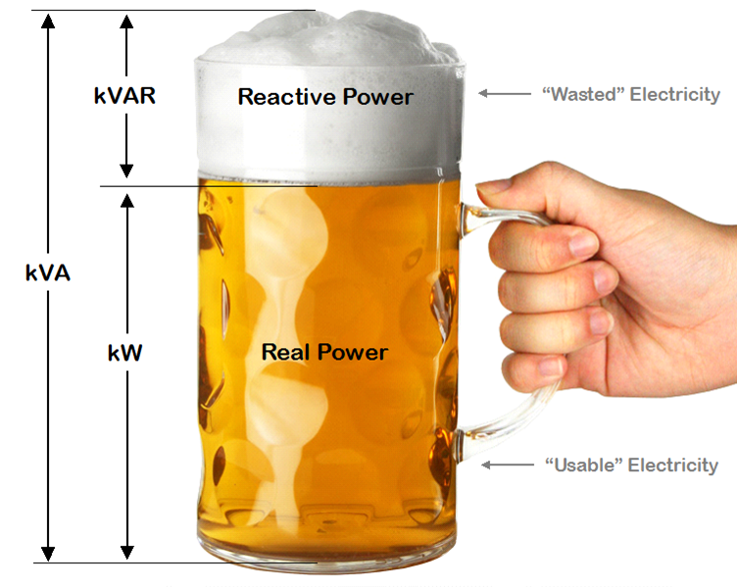
Basic AC Theory What is VA?
VA = E x I
PF = W/VA

Slide 14
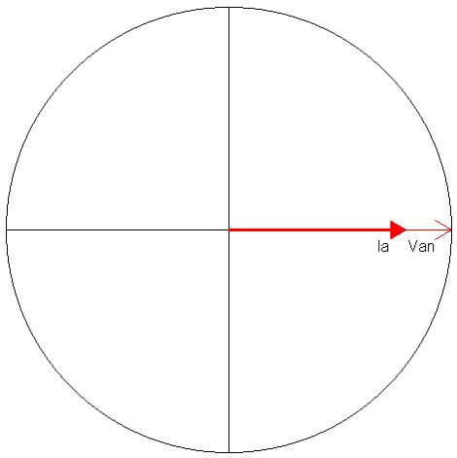
Basic Meter Math Power – VA
For a 120 Volt service drawing 60 Amps at 1.00 PF
How much power is being drawn?
Power = 120 x 60 x 1.00 = 7,200 Watts
How many VA are being drawn?
VA = 120 x 60 = 7,200 Volt Amperes

Slide 15
Basic AC Theory Power – The Simple View
E = Voltage (rms)
I = Current (rms)
PF = Power Factor
Power = Watts = E x I x PF
Power is sometimes
referred to as Demand
Sinusoidal
Waveforms
Only
NO
Harmonics
For a 120 Volt service drawing
13 Amps at Unity (1.0) PF,
how much power is being drawn?
Power = 120 x 13 x 1.0 = 1560 Watts

Slide 16
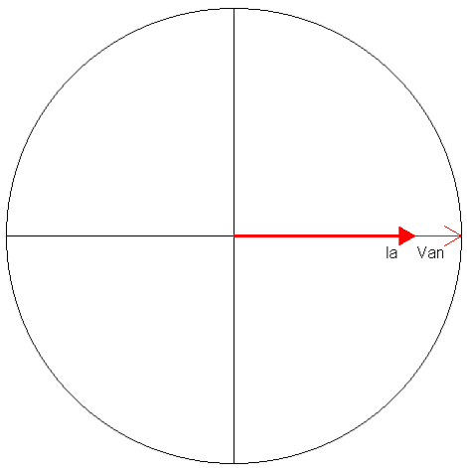
Basic AC Theory Power Factor = 1.0

Slide 17
Basic Meter Math Power – The Simple View
For a 120 Volt service drawing
13 Amps at 0.866 PF,
how much power is being drawn?
Power = 120 x 13 x 0.866 = 1351 Watts
For a 480 Volt service drawing
156 Amps at 0.712 PF,
how much power is being drawn?
Power = 480 x 156 x 0.712 = 53,315 Watts

Slide 18
Basic AC Theory Power – The Simple View
In the previous example we had:
Power = 480 x 156 x 0.712 = 53,315 Watts
Normally we don’t talk about Watts, we speak in Kilowatts
1000 Watts = 1 Kilowatt = 1 kW
Watts / 1000 = Kilowatts
For a 480 Volt service drawing
156 Amps at Unity (0.712) PF,
how many Kilowatts are being drawn?
Power = 480 x 156 x 0.712 / 1000 = 53.315 kW

Slide 19
Basic AC Theory Energy – What We Sell
If power is how fast water flows from a pipe,
then energy is how much water we have in a bucket
after the water has been flowing for a specified time.
Energy = Power x Time
1 kW for 1 Hour = 1 Kilowatt-Hour = 1 kWh
Energy (Wh) = E x I x PF x T
where T = time in hours
Energy (kW) = (E x I x PF / 1000) x T

Slide 20
Basic Meter Math Energy – What We Sell
For a 120 Volt service drawing 45 Amps at a Power Factor of 0.9 for 1 day,
how much Energy (kWh) has been used?
Energy = (120 x 45 x 0.9 / 1000) x 24 = 116.64 kWh
For a 240 Volt service drawing 60 Amps at a Power Factor of 1.0 for 5.5 hours,
how much Energy (kWh) has been used?
Energy = (240 x 60 x 1.0 / 1000) x 5.5 = 79.2 kWh

Slide 21
Basic Meter Math Energy – What We Sell
For a 120 Volt service drawing 20 Amps at a Power Factor of 0.8 from 8:00AM to 6:00PM,
and 1 Amp at PF=1.0 from 6:00PM to 8:00AM
how much Energy (kWh) has been used?
8:00AM to 6:00PM = 10 hours
6:00PM to 8:00AM = 14 hours
Energy = (120 x 20 x 0.8 / 1000) x 10 = 19.2 kWh
Energy = (120 x 1 x 1 / 1000) x 14 = 1.68 kWh
Energy = 19.2 kWh + 1.68 kWh = 20.88 kWh

Slide 22
Basic Energy Formula
The essential specification of a watthour meter’s measurement is given by the value K_{h} [ Watthours per disk revolution ]
The watthour meter formula is as follows:

Slide 23
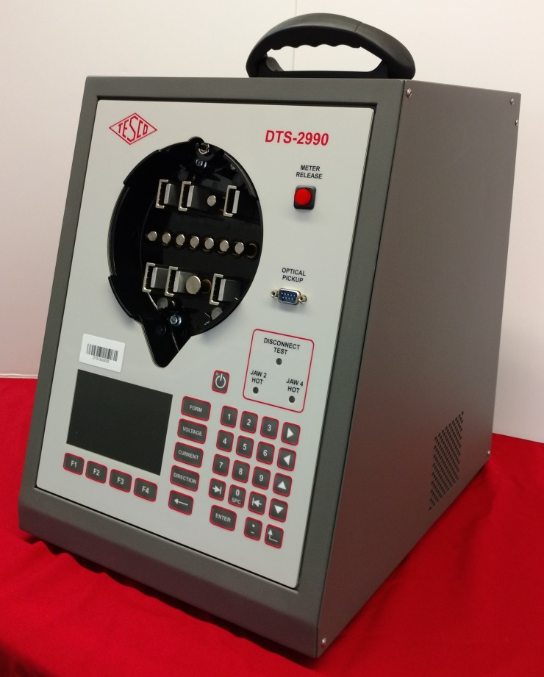
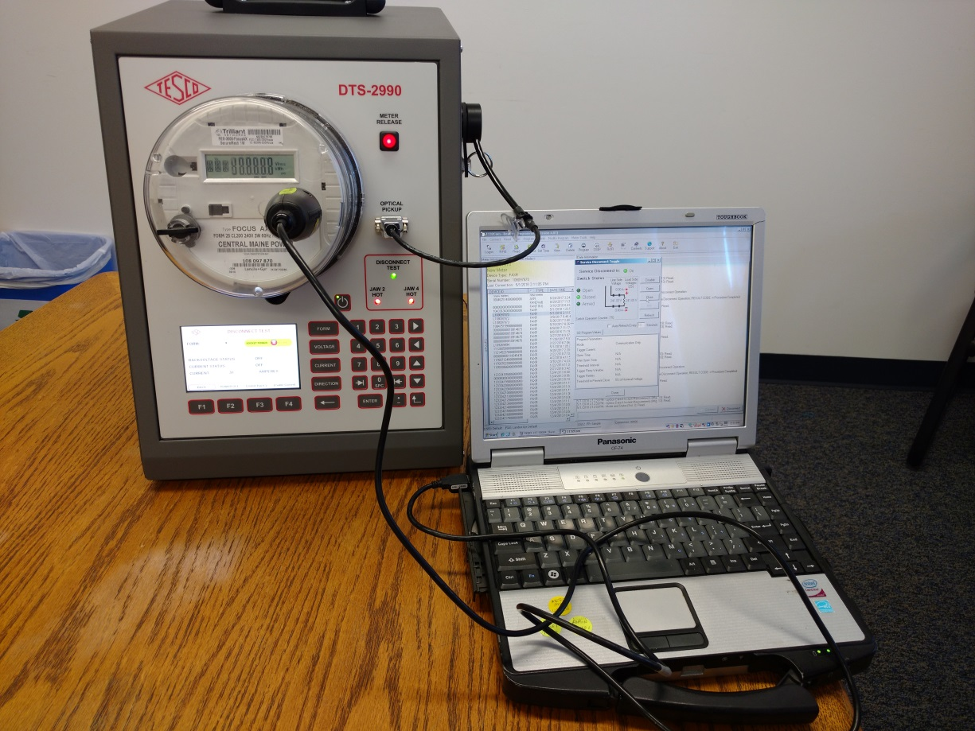
Meter Shop Accuracy Test Demo

Slide 24
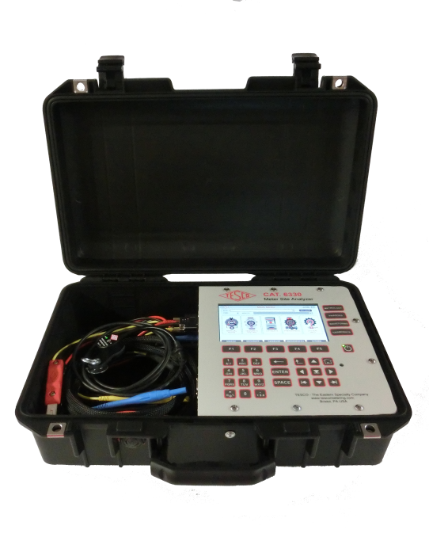
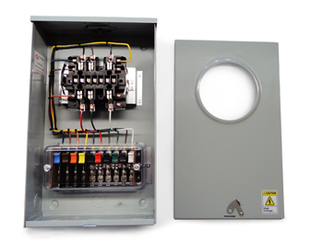
Meter Accuracy Testing
Meter Accuracy Testing in a Nutshell
Full Load
Light Load
Power Factor

Slide 25
Questions and Discussion
Perry Lawton
Northeast Regional Sales Manager
perry.lawton@tescometering.com
Michael Mayer
Owner, CB Associates
michaelM@cb-associates.com
TESCO – The Eastern Specialty Company
Bristol, PA
215.228.0500
This presentation can also be found under Meter Conferences and Schools on the TESCO website: tescometering.com
ISO 9001:2015 Certified Quality Company
ISO 17025:2017 Accredited Laboratory

