Slide 1
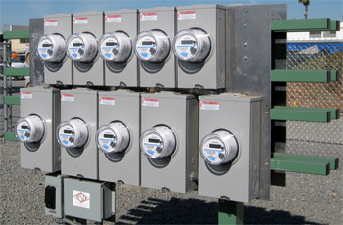
Meter Testing 101
Prepared by Tom Lawton, TESCO
The Eastern Specialty Company
For North Carolina Electric Meter School
Single Phase
Tuesday, June 26, 2018 at 8:00 a.m.
10/02/2012
Slide 1
Notes:
1

Slide 2
Questions to Answer
Why do we test?
How do we test?
What types of meter tests are there?
How do utility tests differ from customer request tests?
What is In-Service Testing?
How do we know meter tests are good?
What do we do with the test data?

Slide 3
Why Do We Test?
Our regulatory commissions typically require us to test meters for accuracy. Regulatory commissions typically take their lead from ANSI C12.1 American National Standard for electricity Metering.
State regulatory commissions focus on accuracy because they want electric utilities to ensure that no customer is being billed unfairly and that no subset of customers is being unfairly subsidized by the rest of the rate payers. Some states mandate only accuracy tests and others require demand and time of use accuracy tests.
Any tests beyond accuracy tests are tests that are simply good business practice.

Slide 4
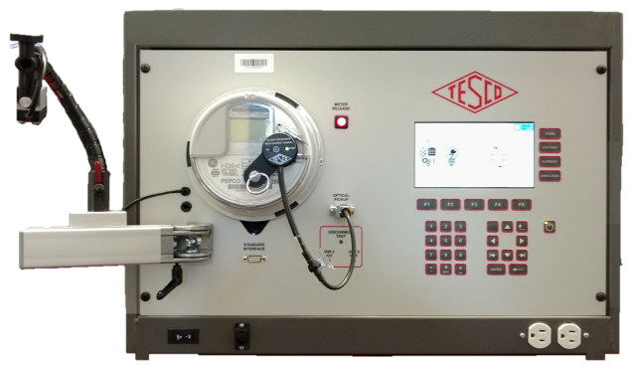
Field Testing
Any testing performed in the field
Can be performed
without removing the meter
through the use of an adapter
or by removing the meter and testing in a piece of field equipment or van mounted equipment with a meter socket for testing where the meter can be tested and returned to the customers socket in a minimum amount of time and without ever leaving the premises other than to return to the utility van.

Slide 5
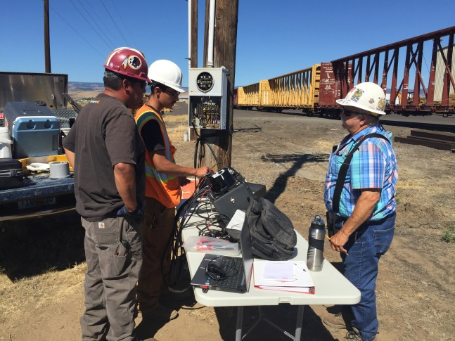
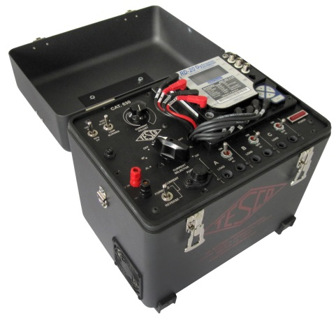
Complaint Testing
Customers always have the right to request a meter test. This is a type of field testing.
Some utilities and some jurisdictions allow for testing at the customer site, others require a test in a laboratory environment.
Some allow the customer to witness the test and others require the utility commission to witness the test.
Utilities must show that the meter tests well and must demonstrate that they have a test program in place to ensure the meters in service are performing well.

Slide 6
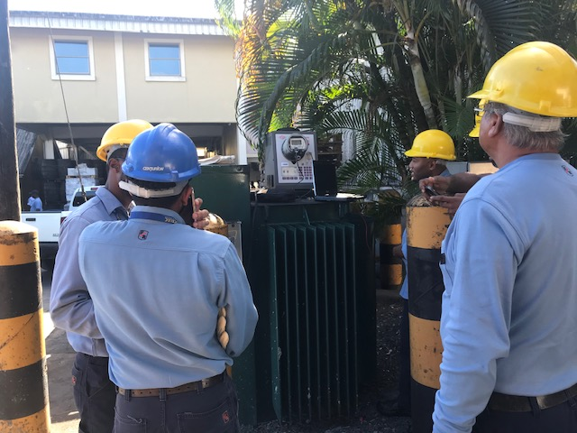
General Meter Testing Requirements
New Meters
Manufacturers tests
In-house tests on new shipments
Return to Service Testing
In-Service Meters
Periodic Tests
Selective, random, or statistical testing
Retirement tests
Testing of related metering equipment

Slide 7
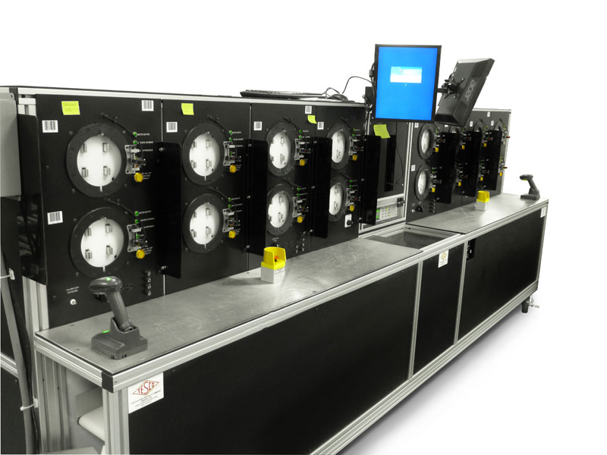
New Meter Testing Programs
Accept the Manufacturer’s Test results
Perform a Statistical Test of an incoming shipment
Perform a 100% test of an incoming shipment

Slide 8
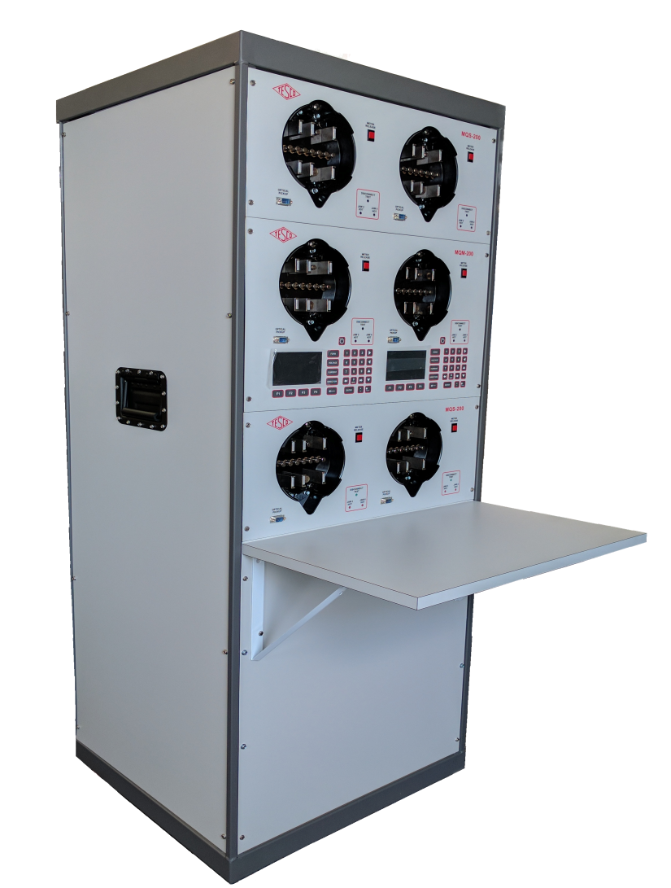
Return to Service Testing
Meters to be returned to service must always (virtually every utility commission requires this) be accuracy tested before being returned to service.
Best business practices also require that the meter is functionally tested as well.

Slide 9
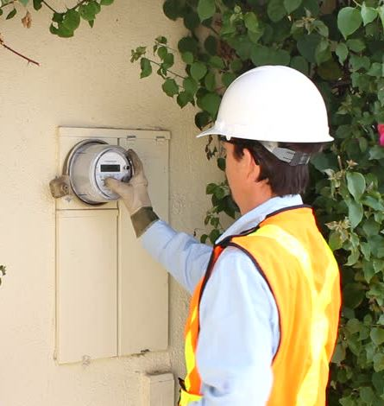
In Service Testing
Meter Testing for new and in-service meters is specified in ANSI C12.1-2015, American National Standard for Electric Meters, Code for Electricity Metering. Most utility commissions use this Standard a reference or the basis for their meter testing requirements.

Slide 10
Test Plans for Meters
Four test plan options available:
Periodic
Statistical
Notes:
UMPIRE is a
Universal Meter Programming and Reading System
It reads all meters and recorders
It can control all manufactures software

Slide 11
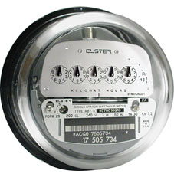
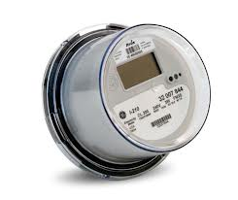
Periodic Test Plans
Periodic
Varies by State
Example provided by ANSI C12.1:
Each Electro Mechanical meter is tested once every 8 years
All other Meters are tested every 16 years
Appendix D provides details for other meters & devices
No guidance for AMI meters
Generally, average of 12.5% of population tested per year
8 Years
16 Years

Slide 12
Statistical Test Plans The Best Approach
ANSI C12.1-2001 Code for Electricity Metering Guidance
Paragraph 5.1.4.3.3 Statistical sampling plan
“The statistical sampling plan used shall conform to accepted principles of statistical sampling based on either variables or attributes methods. Meters shall be divided into homogeneous groups, such as manufacturer and manufacturer’s type. The groups may be further divided into subdivision within the manufacturer’s type by major design modifications.”
NOTE - Examples of statistical sampling plans can be found in ANSI/ASQC Z1.9, the ANSI version of MIL-STD-414 and ANSI/ASQC Z1.4, the ANSI version of MIL-STD-105.

Slide 13
Why Use a Statistical Testing Plan?
Focuses testing on the proper meters
Minimizes number of meters to be tested; usually requires less than 30% of what a periodic testing plan requires
Provides data and analysis tools for use in
understanding what is happening with installed meters
or for use in the purchasing of new meters

Slide 14
Homogeneous Population(s)
The groups or populations being sampled and tested
are made up of the same or similar items, items
which operate in the same way and were made in the
same manner.
For electric meters, this has traditionally been
interpreted as being meters of a specific meter
type from a manufacturer (i.e. AB1, J5S, MX, etc.).
AMR & AMI programs have helped to make the
overall populations more homogenous. This makes a
utility with AMR & AMI meters better prepared to
take advantage of a statistical sampling plan.

Slide 15
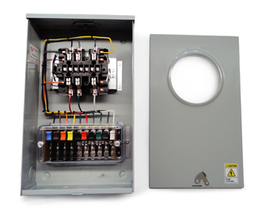
Testing of a Meter vs Testing a Site
Test an installation and system and not just a meter!
Test programs may need to involve testing and checking the meter performance as well as checking and testing the installation. This more extensive test check list needs to be done especially for the higher revenue C&I customers.

Slide 16
Meter Testing Traceability
Test equipment to NIST standards
Tracking number of meters to be tested per State Commission requirements
Tracking meter test data
Meter Records
Meter Data Management System (MDMS)

Slide 17
Meter Testing Traceability
Traceability is defined as ability to link the results of the calibration and measurement to related standard and/or reference (preferably national or international standard) through an unbroken chain of comparisons.
Calibration is typically performed by measuring a test unit against a known standard or reference.
Master standard (i.e. gages) are kept by National Measurement Institute (NMI) of each country.
Notes:
17

Slide 18
Meter Testing Traceability
National Institute of Standards and Technology (NIST) provides internal tracking numbers, which are often used as evidence of traceability.
WARNING! NIST does not certify or guarantee that calibration and measurements are correct, nor does it provide any kind of certification of accuracy and calibration. NIST only provides certifications for the work performed by them.
Notes:
18

Slide 19
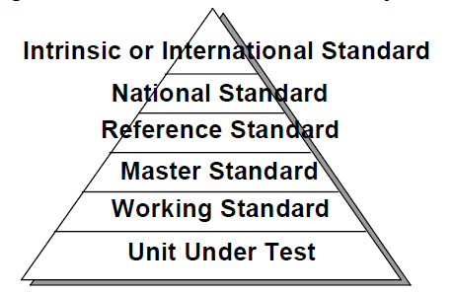
Meter Testing Traceability - Standards
Notes:
19

Slide 20
Meter Testing Traceability - Standards
National Standard
In the US, this is maintained by NIST, in Canada by NRC. Not all countries have a National Standards group and even the US does not have a group for every item of interest to an electric utility (e.g. voltage transformers)
Reference/Master Standard
Item of highest metrological quality located at a site where calibration is being conducted.
Transfer Standard
Lower level of Reference Standard and used for calibration of lower level calibration requirements measuring devices.
Working Standard
Lower level of Reference Standard and used for calibration of lower level calibration requirements measuring devices. Should be compared to Master Standard or Reference Standard on regular basis; used for daily checks comparisons of the calibrated devices.
Notes:
20

Slide 21
Test Equipment Calibration
Primary Requirement: Traceable to NIST Standards
Meter Test Boards, Field Test Kits calibrated to a known master standard maintained at Meter Shop.
Some periodicity such as monthly or quarterly
Reference or Master standard calibrated by outside vendor traceable to NIST or directly by NIST.
Usually annually

Slide 22
Tracking Meter Records
AMI programs help to update and overhaul meter record systems.
Having the records for the entire meter population updated allows for a better chance that test data is available to answer questions and that any meter may be selected as part of the sample for testing.

Slide 23
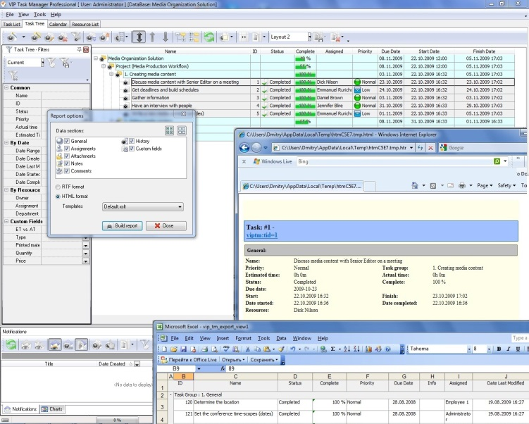
Meter Test Data Tracking
Test data should be tracked throughout meter life
Certification testing, first article, acceptance testing, in-service (field & shop), retirement
Meter test data should be linked to meter record data such as meter form, amps, voltage, display type, etc.
Best time to start to develop the program is before the meters are being installed.
Accuracy test data is usually collected automatically as new meters are tested in meter shops or cross docks.

Slide 24
Meter Test Data Tracking
Need to consider tracking non-accuracy functional testing (meter software configuration, service disconnect testing, voltage, etc.)
Use installation reports to determine if there is any initial concerns about the meters being installed.
Typical reports that should be available:
Failed Meter Report, Project to Date
Electric Meters on Network Report

Slide 25
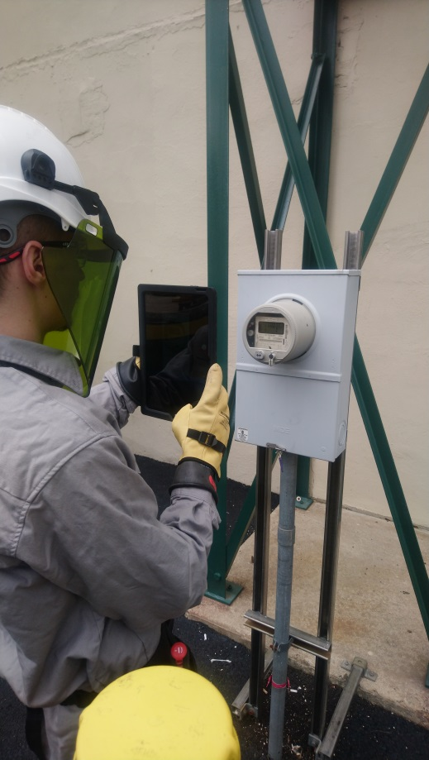
Meter Test Data Tracking System
System should track meter test results for ease of future reference or for response to public or Utility Commission inquiries.
Maybe part of Meter Data Management System (MDMS) or a separate Meter Records system.
Requires discipline in collecting & entering data, especially field tests.

Slide 26
Questions to Answer
Why do we test?
How do we test?
What types of meter tests are there?
How do utility tests differ from customer request tests?
What is In-Service Testing?
How do we know meter tests are good?
What do we do with the test data?

Slide 27
Questions?
Tom Lawton
TESCO – The Eastern Specialty Company
Bristol, PA
215-785-2338
This presentation can also be found under Meter Conferences and Schools on the TESCO website: www.tescometering.com

