Slide 1
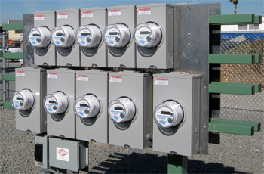
Fundamentals of AMI Testing
Prepared by Tom Lawton
For North Carolina Meter School
Advanced
Tuesday, June 25, 2019 at 1:00 p.m.

Slide 2
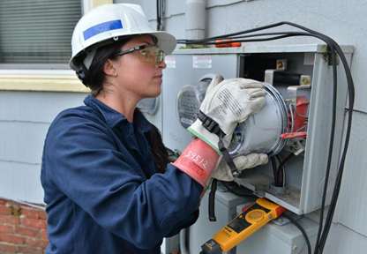
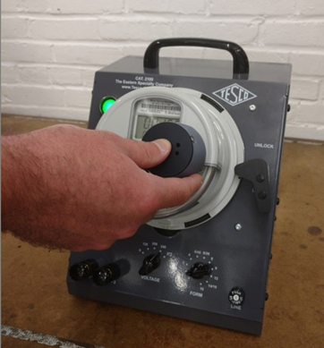
What We Will Cover
We will discuss:
testing protocols
pitfalls
and other solutions developed by various utilities who have gone through these various stages
We will also talk about the equipment and systems used to handle these types of testing.

Slide 3
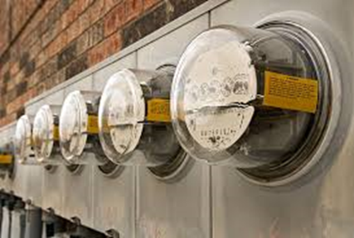
Why Develop Protocols?
The first Question is really
Why do we Test?
Because things fail.
Why do we develop protocols?
So we can capture all of the ways that meters have failed in the past and make sure we are rigorously checking them going forward.

Slide 4
Before – Preparing for AMI
Certification Testing – This is not the most detailed testing we will perform on a meter. The goal of this testing is to determine that the meter has the features that the utility is looking for, that the manufacturer says the meter has and that the communication system is working as advertised.
Note: And what are the back up plans? How well does the meter under consideration handle other communication protocols should the primary protocol fail? Can an antennae be added? Cellular solution added? PLC potential?
First Article Testing – This is the most detailed testing that the utility will perform on the meter. What most people do not realize is that the meter manufacturers will be delivering them a series of “First Articles” as the production meter being delivered will change over the course of the AMI deployment.
Pilot Test – This will allow the utility to test the entire system and begin to identify and fill some of the process holes identified.
Do your internal systems need to be upgraded or augmented to allow the system the ability to handle the stress of an AMI deployment?
Acceptance testing – this will be a part of the pilot test
Accuracy testing – the shorter part of the acceptance test
Functional testing – the longer part of the acceptance test
Equipment Used in this phase – Functional Test boards (Meter Qualification Boards), Accuracy Test Boards, Meter Engineering/Demand Boards, Meter Farms, Meter Asset Management and Meter Record System upgrades/replacement

Slide 5
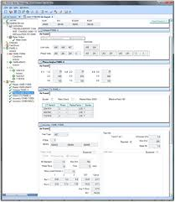
Data to Keep
So what type of data will we be interested in for these various types of tests?
Guidelines: Record everything and make everything as automated as possible. Add to your protocol every time you encounter an issue.

Slide 6
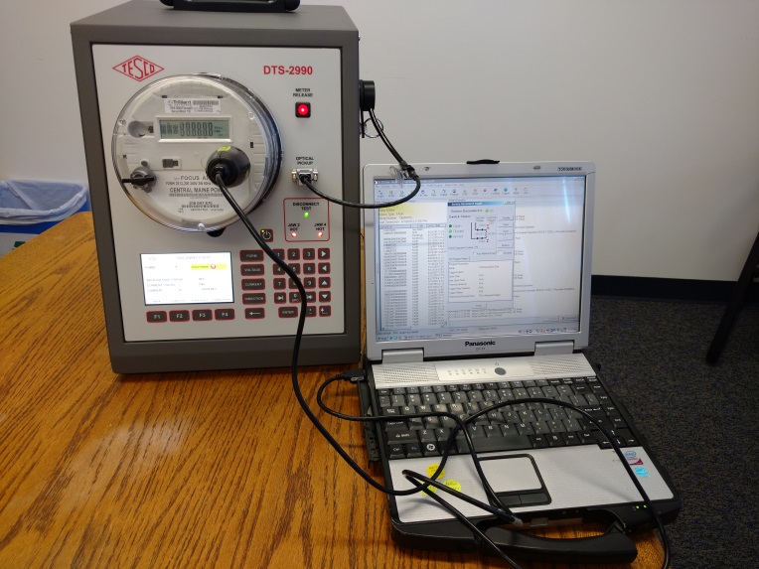
First Article Testing
For FAT we are looking at everything.
Start with the ANSI tests and even the ANSI folder from the Manufacturer.
Take nothing for granted from accuracy at Test Amps to accuracy at light loads and rated loads. Check for performance with sags and swells, disconnect under load and reconnect, ability to detect and not reconnect with back feed, introduce the new ANSI waveforms and monitor performance. Check everything.
Similar tests can and should be developed for the collectors and every other device used to get information from the meter to the head end.

Slide 7
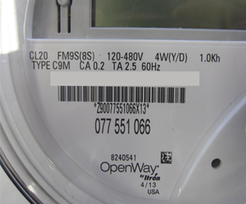
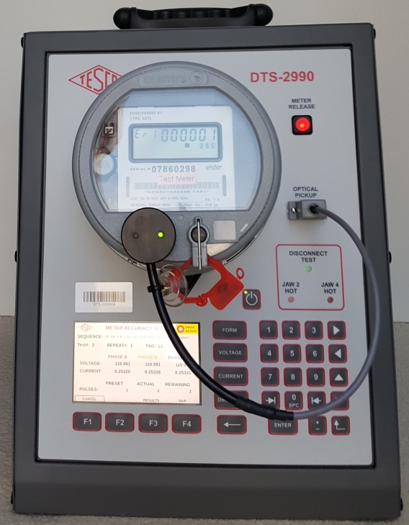
Pilot and Acceptance Testing Protocols
Examples of things to check (i.e. have gone wrong)
The Meter Box label: Company header, meter attributes listed, part # listed, meter model listed
The PO: Line items and descriptions and ID’s all matching between the Manufacturer's system and the utilities system. Barcodes include, start and stop on a pallet correct, all bar codes scanable, # of meters on a pallet
Meter Nameplate: Correct format for SN, bar code, part number
Meter File: PO match between manufacturer and utility (down to and including individual line numbers), text file format correct, file format processes in Utility CIS and meter record systems, file can flow to inventory and be released for work management system
Physical Inspection: Pot clips, cover, T seal, hardware version – part number
Power up inspection: Meter connects to network, display works, correct firmware on meter and on communications module; correct settings in meter; energy accumulation working; reverse power working; correct date and time displayed; correct company name displayed; all screens displayed as specified; Validate interval data; DST time change; Simulate time adjustment; validate interval data against meter register; clear billing, interval and event data
Accuracy Test
Voltage Profile
Service Switch: Disconnect with load, reconnect with load; attempt reconnect with back feed; switch status displayed on meter

Slide 8
Pitfalls and Protocols
Discussion of problems encountered.
Not all features advertised were present
Data issues and reporting issues
Problems identified in internal systems to receive and deploy meters. This is potentially the most serious, the most time consuming and the most costly to address
Do we have the personnel and the training capabilities needed before deployment begins? Will we need more of both after deployment ends?

Slide 9
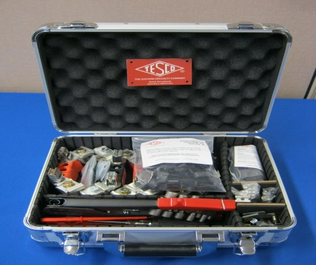
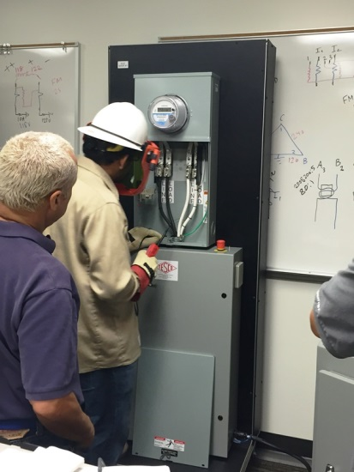
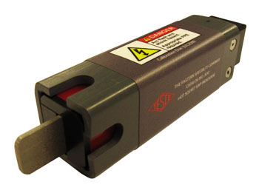
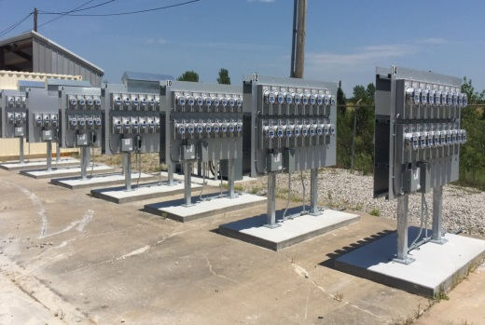
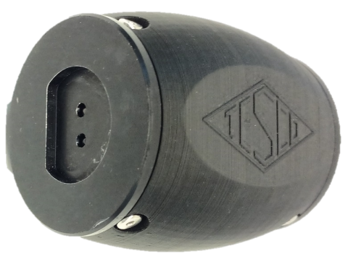
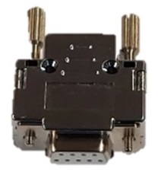
Things Often Forgotten About
Consumables
Socket Repairs
Training Facilities
KYZ cables and testing
Useful tools and protocols not envisioned or necessary prior to AMI deployments (e.g. Safety disconnect to repair kits to meter farms)

Slide 10
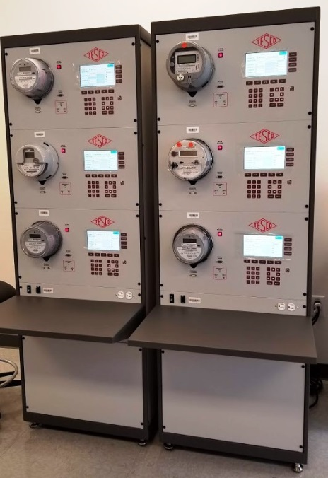
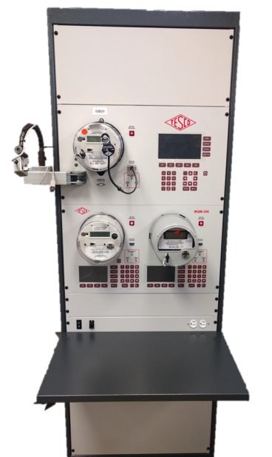
During AMI Deployment
Acceptance Testing: Who is doing this, the utility or the third party deployment vendor? How will test results be transferred if the latter.
Functional Testing
Accuracy testing
Field Audits: Are they needed? Who is responsible?
Continued Certification/First Article Testing: Does this ever end?
System Testing: Does this ever end?
What are we looking for/hoping for: Nothing
Equipment Used in this phase: Functional Test boards (Meter Qualification Boards), Accuracy Test Boards, Meter Engineering/Demand Boards, Meter Farms

Slide 11
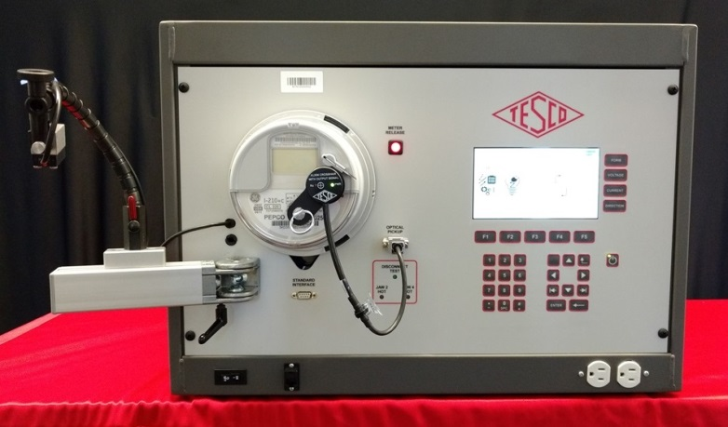
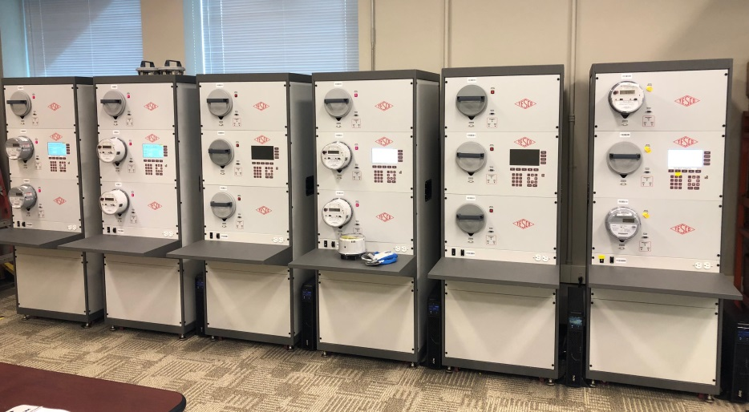
After AMI Deployment
Acceptance Testing: This is now the Utility’s responsibility regardless of who performed this function during deployment
Functional Testing
Accuracy testing
System monitoring and population management: This become essential and hopefully, very low key. But always in the background
What are we looking for/hoping for: Nothing again
Equipment Used in this phase: Functional Test boards (Meter Qualification Boards), Accuracy Test Boards, Meter Engineering/Demand Boards, Meter Farms

Slide 12
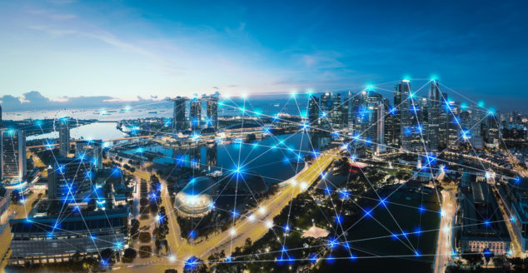
AMI 2.0
Can we use our existing infrastructure?
Do we have to rip out and replace with a new infrastructure?
What about LTL back haul or a Private Network?
What about Power Line Carrier? Is there life there for my most remote service areas?
And what do we have to do this testing? Does the testing ever end? Will this be meter accuracy testing? Meter Functional Testing? Communication Testing?

Slide 13
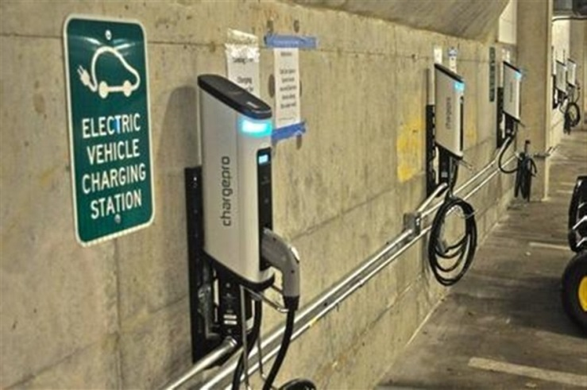
The shape of metering to come 2020 and beyond
The Shape of Metering to Come –
2020 and Beyond
Meters that do not look like meters as we know them, will become a part of our world.
Street lights
Smart Poles
Electric vehicle chargers
Sub meters – which may now become our meters

Slide 14
Summary
Test but verify has never been more true than as you
Prepare for AMI
During AMI deployment
After AMI deployment
When working properly AMI is a tremendous boon to Electric Utility Operations reducing ongoing Operational costs and improving the system performance for the customer. However, one issue getting past the meter Service department and into the field is quickly multiplied during an AMI deployment and both costs and delays can quickly spin out of control.
We need to embrace change as we have never had to embrace change before but at the same time we have to enhance our in- house testing capabilities (personnel and equipment) to carry out this testing in a difficult and fast paced environment

Slide 15
Questions and Discussion
Tom Lawton
TESCO – The Eastern Specialty Company
Bristol, PA
1-215-785-2338
This presentation can also be found under Meter Conferences and Schools on the TESCO website: www.tescometering.com

