Slide 1


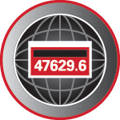
Electric Vehicle Chargers: Trends in the Marketplace and What They Mean for Utilities
Prepared by Bill Hardy, TESCO
The Eastern Specialty Company
For North Carolina Meter School
Emerging Technologies
Tuesday, June 25, 2019 at 1:45 p.m.

Slide 2
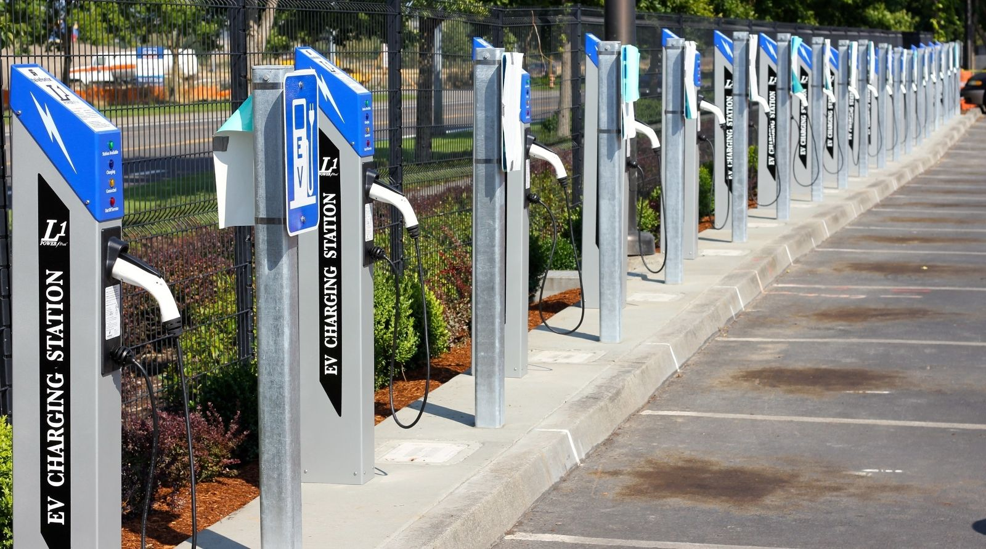
EVSE
Electric Vehicle Service Equipment
What is it all about?

Slide 3
INTRODUCTION
Types of EVSE’s
Market growth
Regulatory environment
Type approval & testing

Slide 4
AC EVSE STANDARDS
AC Standards are well established and stable
J1772 AC Level 1
  Primarily for home installation
  120 Volts at up to 16 Amps ( 1.92 kW )
  Typical time to charge
    Pluggable Hybrid ( 3 – 5 hours, 0% to 90%)
    EV 80 Mile Range (8 – 20 hours, 20% to 90%)
    EV200 Mile Range ( 15 – 40 hours, 20% to 90%)
  5.6 miles per hour of charge
  If you drive <40mi/day you can recharge overnight.

Slide 5
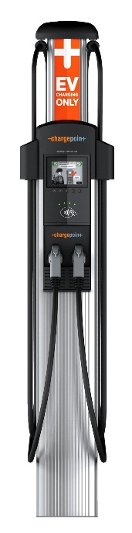
AC EVSE STANDARDS
J1772 AC Level 2
  Home and Commercial Installation
  240 Volts at up to 80 Amps (30A and 50A most common)
    Home 30A, Commercial 30A, 50A, 75A
  Maximum Power Delivery ( 19.2 kW )
  Typical time to charge
    Pluggable Hybrid ( 0.5 – 1.5 hours, 0% to 90%)
    EV 80 Mile Range (1.5 – 4 hours, 20% to 90%)
    EV200 Mile Range ( 3.2 – 10 hours, 20% to 90%)
  21 miles per hour of charge @ 30A
  If you drive <160mi/day you can recharge overnight.

Slide 6
AC EVSE STANDARDS
J1772 AC Level 2
  Over 85% of commercial EVSEs are AC Level 2
  All current EV/PEV in US can use this type though some need adapters
  Stations cost $400 to $8,000

Slide 7
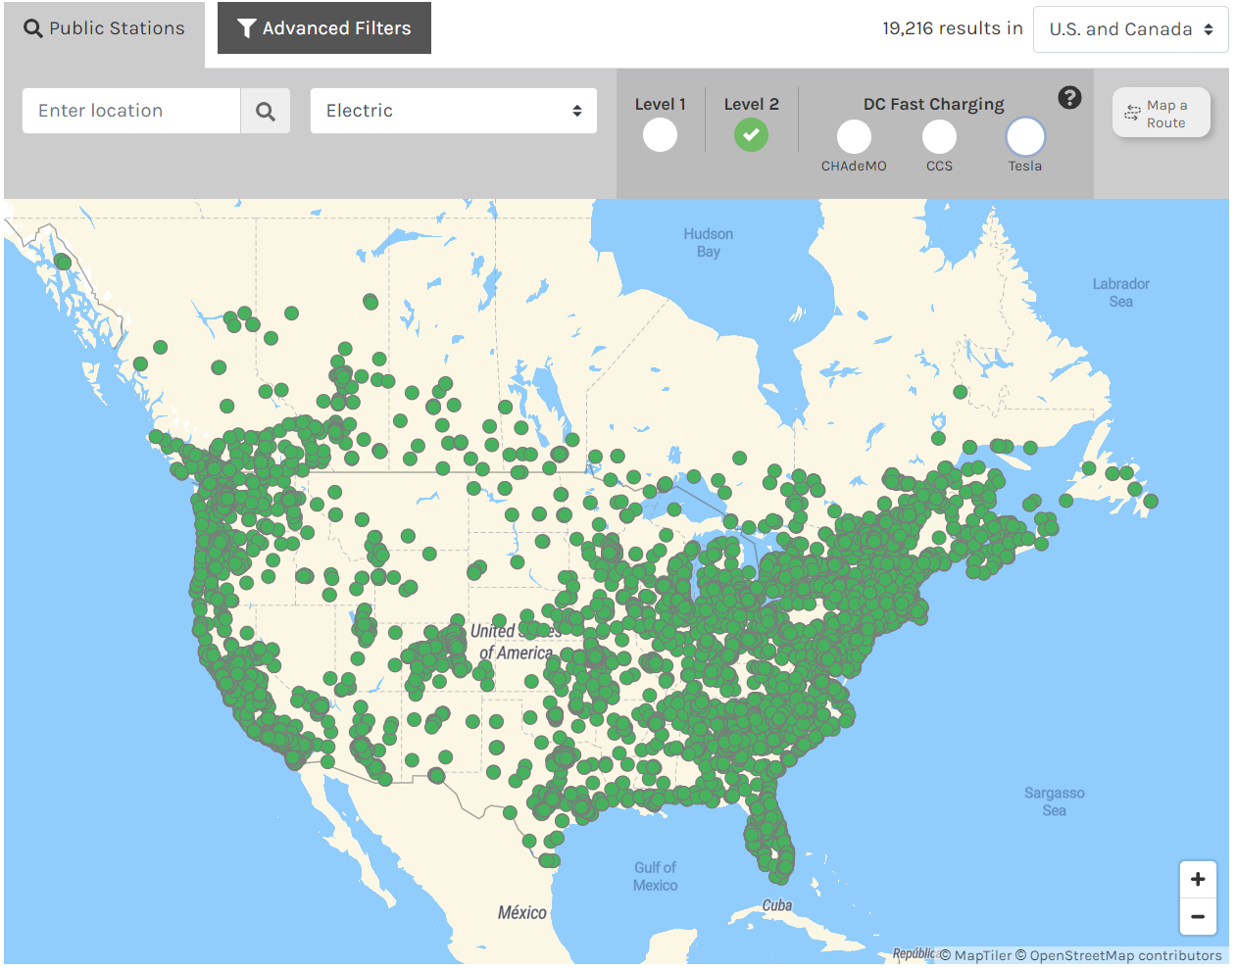
J1772 AC Level 2 Public Stations
Heads:
58,077
Sites:
19,216
June 2017

Slide 8
DC EVSE STANDARDS
Standards evolving rapidly
  Combined Charging System
    CCS1 SAE J1772 North America
    CCS2 Europe
  CHadeMO
  Tesla V1
  Tesla V2 (New in 2019)
  CHadeMO – BG/T (China-Japan-India) (New)
  Now 100kW is considered “high end”
  First US 350kW units installed Dec 10, 2018

Slide 9
DC EVSE STANDARDS
Deployment is growing rapidly in US
But slowly compared to Europe, China and Japan
Total PUBLIC chargers installed (70,212/25,246)
  AC Level 1 1180
  AC Level 2 58,077 heads /19,216 locations
  DC Rapid 10,955
    Tesla 5,871 heads / 644 locations
    CHadeMO 2,348 locations
    J1772 2,042 locations

Slide 10
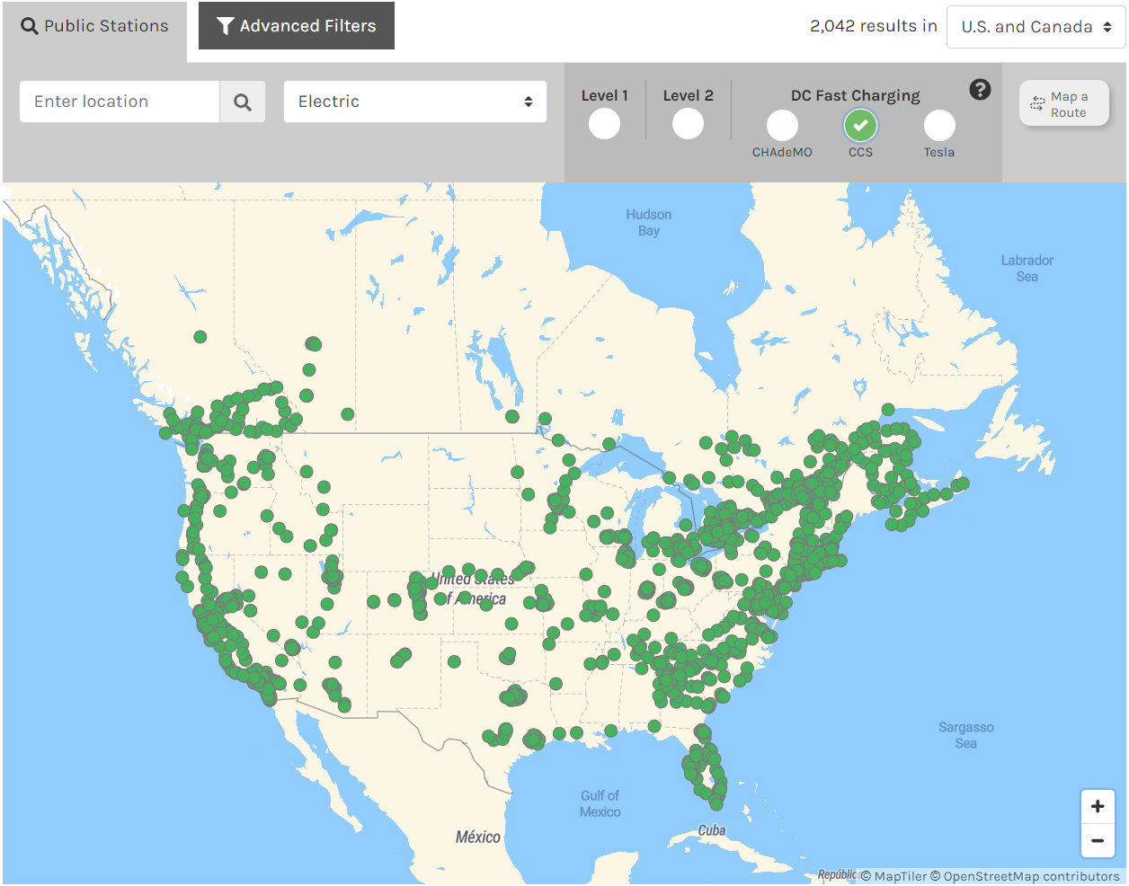
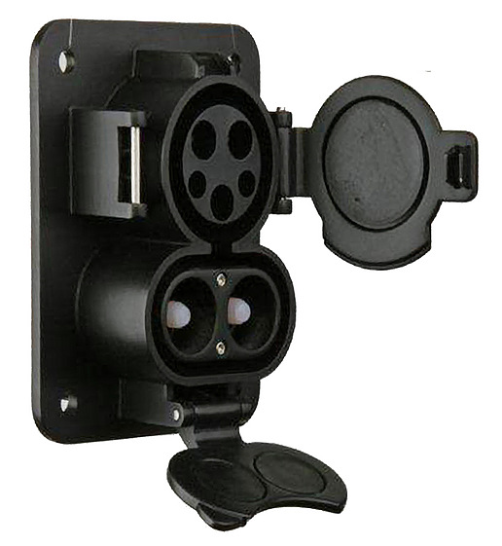
J1772 DC Public Stations
Sites:
2,042
June 2017

Slide 11
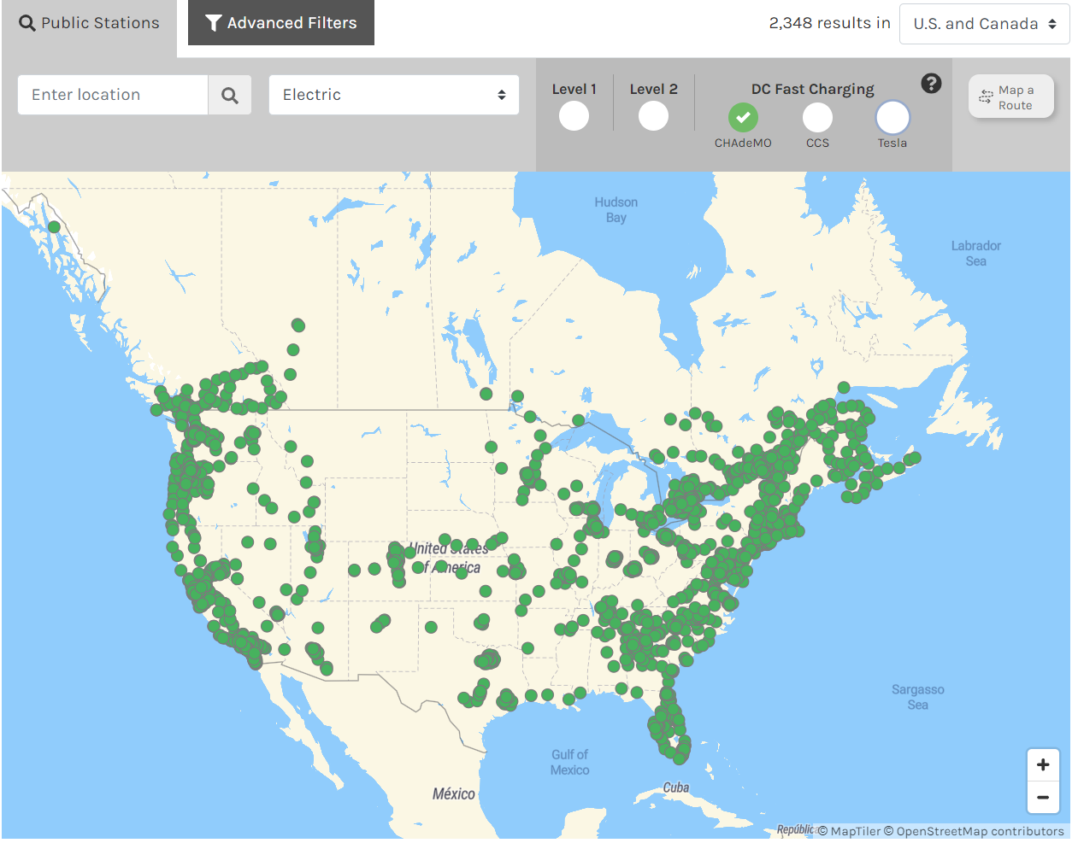
CHadeMO DC Public Stations
Sites:
2,348
June 2017

Slide 12
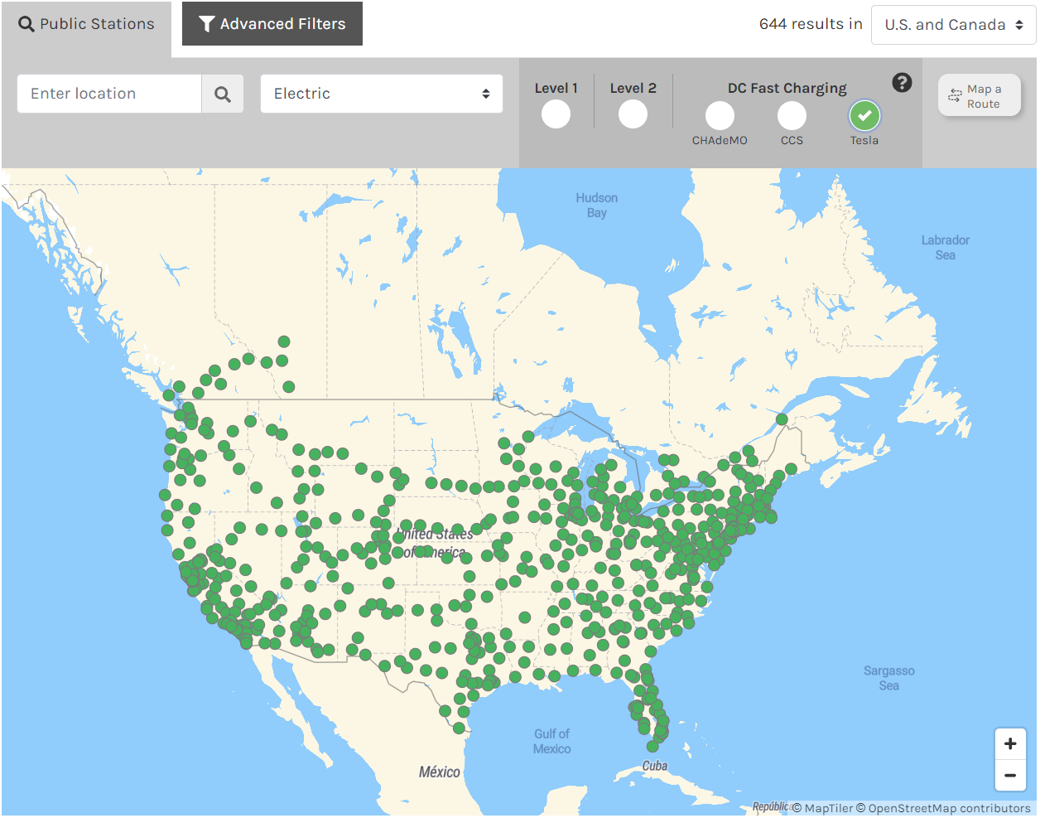
Tesla DC Public Stations
June 2017

Slide 13
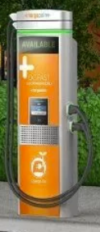
DC EVSE STANDARDS
Market Direction
  Higher current, higher voltage
    Typical J1772 or CHadeMO 50kW or 100kW
    Tesla SuperCharger 90kW or 120kW
  Tesla just announced V2 SuperCharger
    145kW charge rate
  First ABB 350kW chargers installed Dec 2018 as part of VW backed network
  ChargePoint has announced a 500kW DC system

Slide 14
THE EVSE MARKET
Charge Times (hours)

Slide 15
THE EVSE MARKET
Fill the Tank Costs

Slide 16
The EV MarketT
2015 - 11 PHEV and 14 EVs
ONE HAS 200+ MILE RANGE, most < 100
  ALL have AC Level 1 and 2 Capability
    maximum Charging Rate is 7.2 kW, many only 1.92kW
  Three Offer DC Rapid Charge
2018/19 – 43 PHEV and 44 EVs
  EVs have >100 mile range
  All EVs have DC Rapid Charge

Slide 17
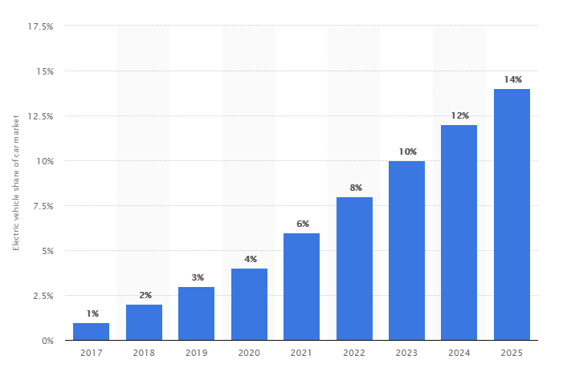
The EV MarketT
EV sales grew 89% in 2018 but future unclear.

Slide 18
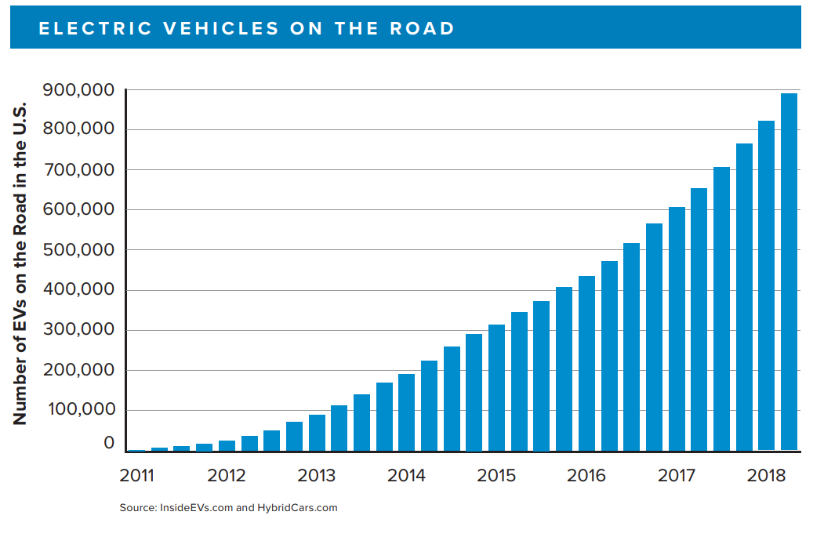
The EV MarketT
EV sales grew 89% in 2018 but future unclear.

Slide 19
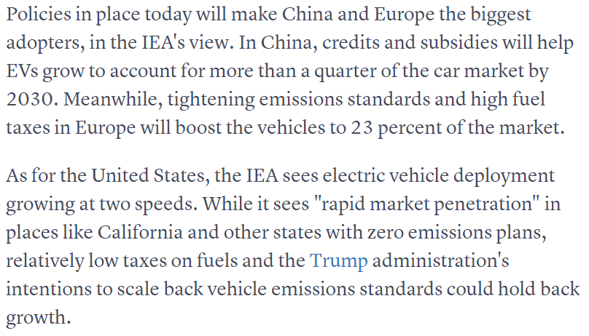
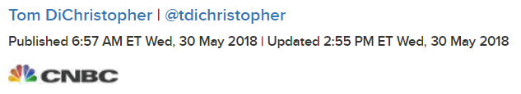
The EV MarketT

Slide 20
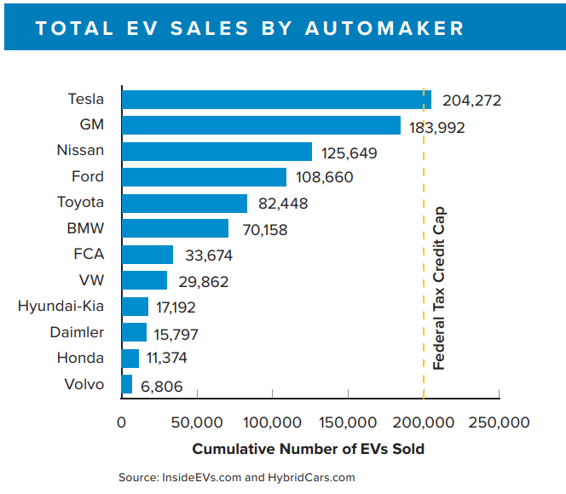
The EV MarketT

Slide 21
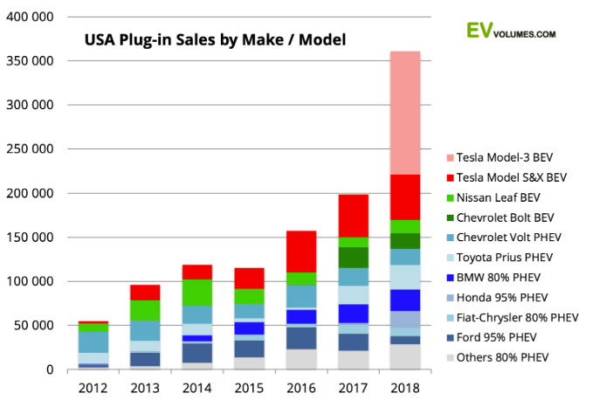
The EV MarketT

Slide 22
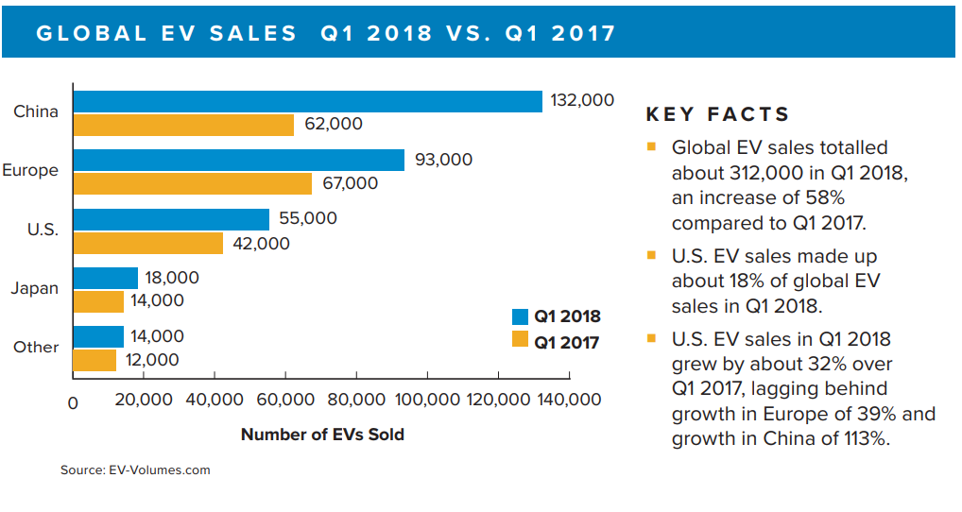
The EV MarketT

Slide 23
REGULATORY BACKGROUND
New Provisional National Standard Approved in July 2015 Effective Jan 1, 2016
  HB44 Section 1.10 General Code
    Several changes relevant to EVSE
  HB44 Section 3.4 – Electric Vehicle Fueling Systems – Tentative Code
  HB44 Section 5.5 – Timing Devices
    Several changes relevant to EVSE

Slide 24
REGULATORY BACKGROUND
Additional New Standards
NIST Handbook 130 Examination Procedure for Retail Electric Vehicle Fueling Systems
    Procedure approved and published
  NTEP PB14 Working Group
    Checklist approved and published

Slide 25
HB44 APPLICABILITY
A.1. General. – This code applies to devices, accessories, and systems used for the measurement of electricity dispensed in vehicle fuel applications wherein a quantity determination or statement of measure is used wholly or partially as a basis for sale or upon which a charge for service is based.

Slide 26
HB44 APPLICABILITY
Exceptions-This code does not apply to:
  The use of any measure or measuring device owned, maintained, and used by a public utility or municipality only in connection with measuring electricity subject to the authority having jurisdiction such as the Public Utilities Commission.
  Electric Vehicle Supply Equipmentused solely for dispensing electrical energy in connection with operations in which the amount dispensed does not affect customer charges or compensation.
  The wholesale delivery of electricity.

Slide 27
HB44 APPLICABILITY
Use Cases – NOT COVERED
  A store provides a free EVSE in its parking lot
  A paid parking lot provides EVSEs for which there is no charge based on the amount of energy delivered
  Tesla provides free charging services for owners
  An organization charges a monthly fee for unlimited use of its network of EVSEs.

Slide 28
HB44 APPLICABILITY
Use Cases –COVERED
  ANY transaction which is based on the amount of energy delivered
  Examples
    An network of charge stations charges a monthly fee to belong AND a fee based on the amount of energy used
    A EVSE charges for the amount of energy delivered
    A parking lot charges for parking and EVSEs located in it also charge for the amount of energy delivered if used

Slide 29
Implementation Status
Federal Codes are still provisional
California will go fully compliant for AC EVSE systems January 1, 2020
California will go fully compliant for DC EVSE systems January 1, 2021
NTEP should start approving AC EVSE’s by late summer 2019.

Slide 30
CA - CHANGES
EVSE Value of Smallest Unit. – The value of the smallest unit of indicated delivery by an EVSE, and recorded delivery, if the EVSE is equipped to record, shall be 0.0005 MJ or 0.0001 kWh.
Minimum Measured Quantity. –
Measuring systems shall have a minimum measured quantity not exceeding 2.5 MJ or 0.5 kWh.
  Specified by Manufacturer, encouraged to be much lower

Slide 31
HB44 - REQUIREMENTS
Temperature Range for System Components. – EVSEs shall be accurate and correct over the temperature range of – 40 °C to + 85 °C (− 40 °F to 185 °F). If the system or any measuring system components are not capable of meeting these requirements, the temperature range over which the system is capable shall be stated on the NTEP CC, marked on the EVSE, and installations shall be limited to the narrower temperature limits.

Slide 32
HB44 – TESTING REQUIREMENTS
N.1. No Load Test. – A no load test may be conducted on an EVSE measuring system by applying rated voltage to the system under test and no load applied.
WHH – How long to run test not specified.
N.2. Starting Load Test. – A system starting load test may be conducted by applying rated voltage and 0.5‑ampere load.
WHH – Is there any level of accuracy required?

Slide 33
HB44 – TESTING REQUIREMENTS
N.3. Minimum Test Draft (Size). – Full and light load tests shall require test of the EVSE System for a delivery of the minimum measured quantity as declared by the manufacturer.

Slide 34
HB44 – TESTING REQUIREMENTS
Accuracy Testing – AC Systems
(1) Accuracy test of the EVSE system at a load of not less than 85 % of the maximum deliverable current (MDA) as determined from the pilot signal for a total energy delivered of at least twice the minimum measured quantity (MMQ). If the MDA would result in maximum deliverable power of greater than 7.2 kW, then the test may be performed at 7.2 kW.
(2) Accuracy test of the EVSE system at a load of not greater than 10 % of the maximum deliverable current (MDA) as determined from the pilot signal for a total energy delivered of at least the minimum measured quantity (MMQ).

Slide 35
HB44 – TESTING REQUIREMENTS
Accuracy Testing – DC Systems
Accuracy test of the EVSE system at a load of not less than 85 % of the maximum deliverable current (MDA) as determined from the pilot signal for a total energy delivered of at least twice the minimum measured quantity (MMQ).
WHH – The following was omitted from the final version of the standard.
If the MDA would result in maximum deliverable power of greater than 7.2 kW, then the test may be performed at 7.2 kW.

Slide 36
HB44 – TESTING REQUIREMENTS
Accuracy Testing – DC Systems
(2) Accuracy test of the EVSE system at a load of not greater than 10 % of the maximum deliverable current (MDA) as determined from the pilot signal for a total energy delivered of at least the minimum measured quantity (MMQ).
Note: For DC systems it is anticipated that an electric vehicle may be used as the test load. Under that circumstance testing at the load presented by the vehicle shall be sufficient.

Slide 37
HB44 – TESTING REQUIREMENTS
Repeatibility Testing – DC Systems
Tests for repeatability should include a minimum of three consecutive tests at the same load, similar time period, etc., and be conducted under conditions where variations in factors are reduced to minimize the effect on the results obtained.

Slide 38
HB44 – TESTING TOLERANCES
GENERAL
The tolerances apply equally to errors of underregistration and errors of overregistration.
The tolerances apply to all deliveries measured at any load within the rated measuring range of the EVSE.
Where instrument transformers or other components are used, the provisions of this section shall apply to all system components.

Slide 39
HB44 – TESTING TOLERANCES
TEST TOLERANCES
The tolerances for EVSE load tests are Acceptance Tolerance: 1.0 % and Maintenance Tolerance: 2.0 %.
Repeatability. – When multiple load tests are conducted at the same load condition, the range of the load test results shall not exceed 25 % of the absolute value of the maintenance tolerance and the results of each test shall be within the applicable tolerance.

Slide 40
HB44 – TESTING TOLERANCES
TEST TOLERANCES
No Load Test. – An EVSE measuring system shall not register when no load is applied.
Starting Load. – An EVSE measuring system shall register starting load test at a 0.5 ampere (A) load.

Slide 41
HB44 – TESTING TOLERANCES
TYPE EVALUATION
For type evaluation examinations, the acceptance tolerance values shall apply under the following conditions:
  at any temperature, voltage, load, and power factor within the operating range of the EVSE, and
  regardless of the influence factors in effect at the time of the conduct of the examination, and
  for all quantities greater than the minimum measured quantity.

Slide 42
EPO 30 – FIELD TEST
Process in EARLY stage of development
  Verify EVSE labeling meets requirements
  Record all site information
  Power on test equipment with load connected
  Start test process on test equipment
  Connect EVSE to test equipment
  Determine maximum deliverable current (MDA) from CP signal
  Set load to <=10% of MDA and perform the light load test

Slide 43
EPO 30 – FIELD TEST
Process in EARLY stage of development
  Perform the light load test
    (a) This requires doing a charging cycle and at the conclusion of energy delivery comparing the total energy and price registered on the EVSE with that measured by the test equipment.
  Record the test results
    (a) Repeat 8 & 9 multiple times for reproducibility test
  Set load to >85% of MDA and perform the full load test
    (a) This requires doing a charging cycle and at the conclusion of energy delivery comparing the total energy and price registered on the EVSE with that measured by the test equipment.
  Record the test results
    Repeat 10 & 11 multiple times for reproducibility test

Slide 44
EPO 30 – FIELD TEST
Process in EARLY stage of development
  Verify that after the final test that the display on the EVSE remains visible for at least 15 seconds
  No Load Test (optional)
    Test system must initiate a valid charging sequence without placing a load on the EVSE. No energy should be registered.
    Not yet defined what “No” means or for how long the test should be performed

Slide 45
EPO 30 – FIELD TEST
Process in EARLY stage of development
  Starting Load Test (optional)
    Test system must initiate a valid charging sequence with a load of 0.5 amps.
    Energy must be registered, not clear at this point what the accuracy requirement is, if any if 0.5 amps is less than 10% of MDA.

Slide 46
EPO 30 – FIELD TEST
Process in EARLY stage of development
  Time Test (tbd)
  RFI/EMI Test (tbd)
  Zero-Setback Test
    On equipment activated with a single remote controller, activate one EVFS and check all others operated by the same controller to make certain they will not operate without activating the individual EVFS starting mechanism.

Slide 47
EPO 30 – FIELD TEST
Process in EARLY stage of development
  Power Loss Test
    Power loss results in termination of transaction or transaction continues without additional authorization with indication of the event on the receipt
    EVFS memory or supporting network retains quantity of time and sales price totals during power loss

Slide 48
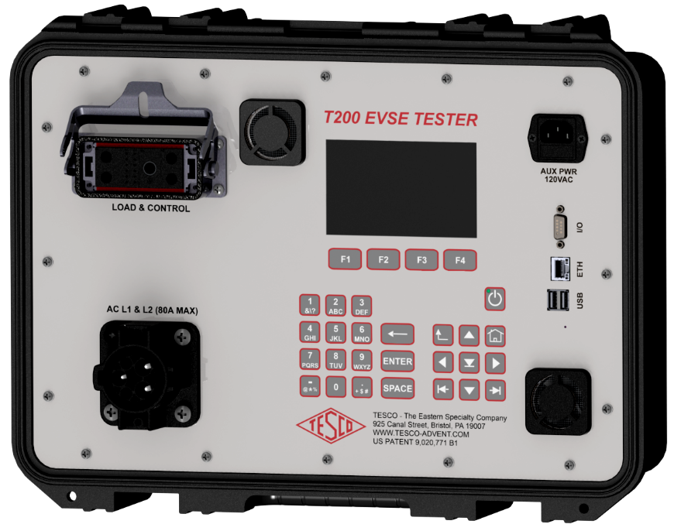
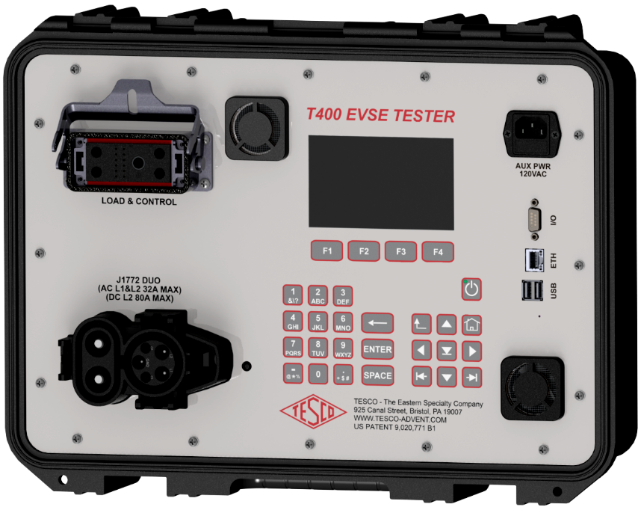
OUR TEST SOLUTIONS
T400
AC Level 1 & 2 to 64 Amps
DC Level 2 to 75 Amps
T200 AC Level 1 & 2 to 64Amps

Slide 49
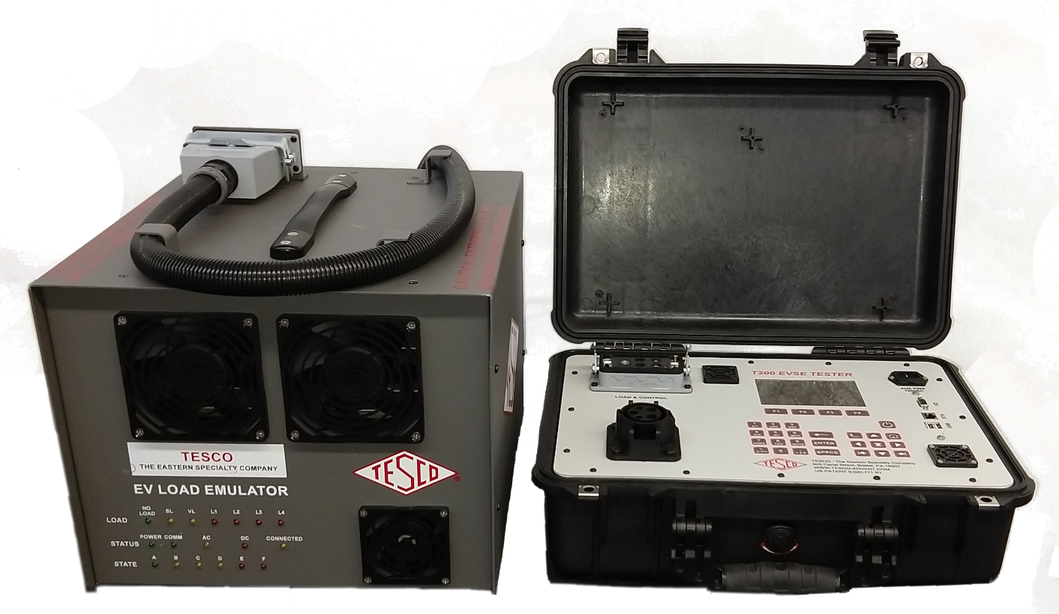
OUR TEST SOLUTIONS
PL200 200 AC Level 1 & 2 to 64 Amps
PL400 AC Level 1 & 2 to 64 Amps, DC Level 2 to 32 Amps

Slide 50
OUR TEST SOLUTIONS
T200/T400 EVSE TESTERS
  Fully Self Contained
    AC or AC/DC Models
    Rugged Pelican Case
    Run from internal battery, AUX AC or L1-L2 of EVSE
    High Res Color display
    Ethernet, USB, Serial
    Built in GPS

Slide 51
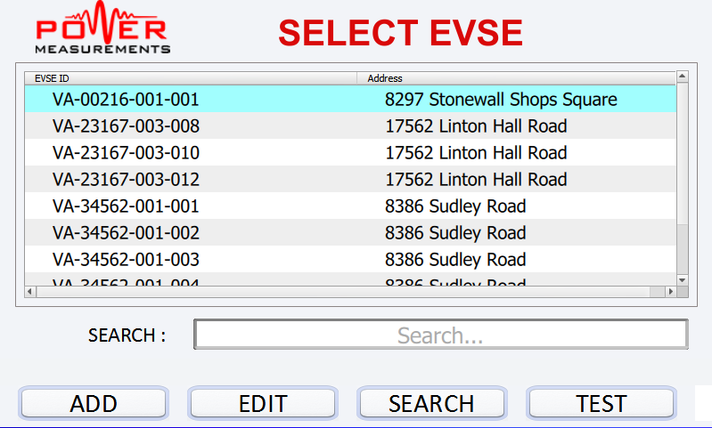
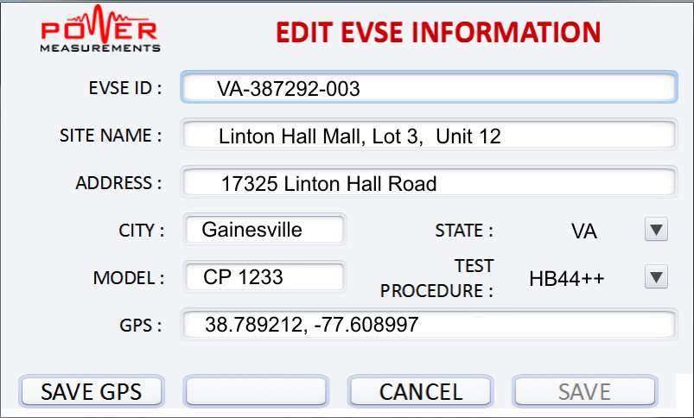
OUR TEST SOLUTIONS
T200/400 EVSE TESTERS
  Database driven
    Select a site and test
    Download all of your site data from your PC
    Locate site by GPS , ID or any other field

Slide 52
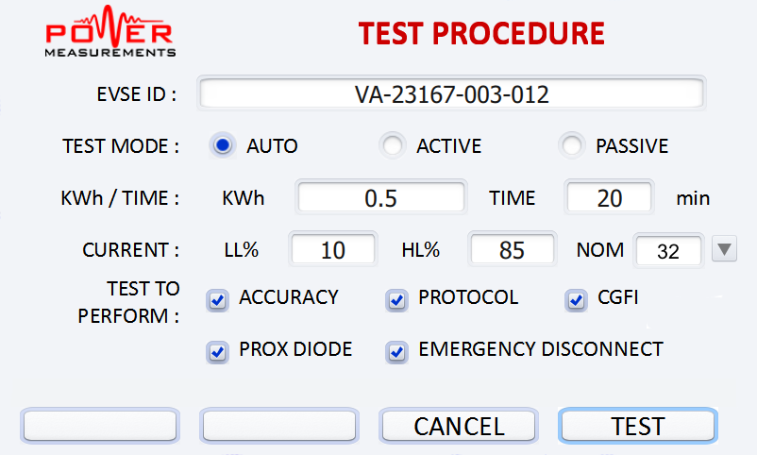
OUR TEST SOLUTIONS
T200/400 EVSE TESTERS
  Automated Operation
    Create Test sequences which completely automate process
    Testing is then a simple one click process

Slide 53
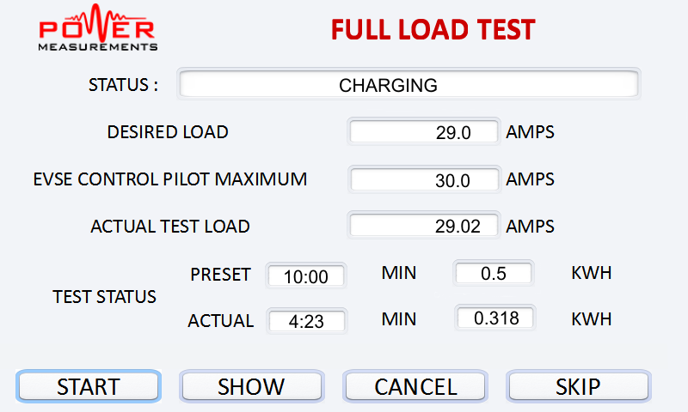
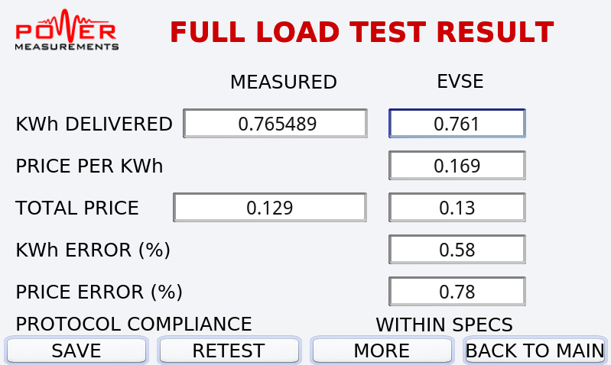
OUR SOLUTION
T200/400 EVSE TESTERS
  Simple Results
    Process and Status During Testing
    Easy entry of EVSE Displayed Results

Slide 54
BREAKING NEWS
NTEP/CTEP will conduct first dry run type approval testing this month
California issues final regulations

Slide 55

QUESTIONS & DISCUSSION
Bill Hardy, CTO
TESCO – The Eastern Specialty Company
Bristol, PA
215-785-2338
This presentation can also be found under Meter Conferences and Schools on the TESCO web site: www.tescometering.com

