Slide 1
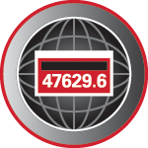
Complete Site testing
Prepared by Tom Lawton, TESCO
The Eastern Specialty Company
For North Carolina Electric Meter School
Advanced
XXXXXXXXXXXXXXX
Notes:
1

Slide 2
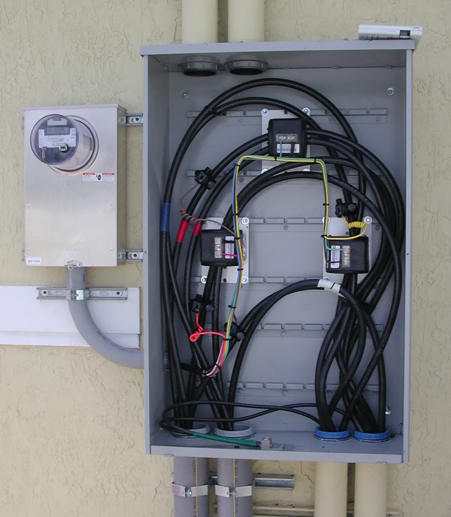
Topics we will be covering
Transformer Rated Meter Forms
Test Switches and CT’s
Site Inspection and Safety Checks
Meter Accuracy Testing in the Field
Checking the Health of your CT’s and PT’s
Site Verification and not just meter testing
Admittance Testing
Harmonics determination and effects

Slide 3
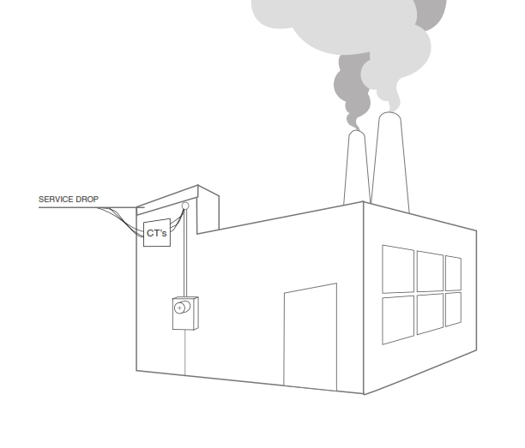
Transformer Rated Metering
Meter measures scaled down representation of the load.
Scaling is accomplished by the use of external current transformers (CTs) and sometimes voltage transformers or PTs).
The meter is NOT part of the circuit
When the meter is removed from the socket, power to the customer is not effected.

Slide 4
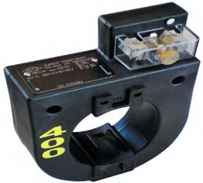
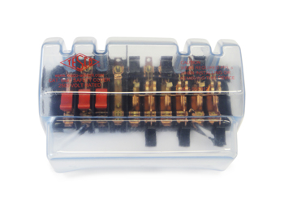
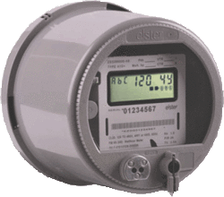
The Basic Components
9S Meter Installation with 400:5 CT’s
SOURCE
400A
LOAD
PHASE A
PHASE B
400A
PHASE C
400A
5A
5A
5A

Slide 5
Typical Meter Connections
Typical Connections for 3 Phase Common Transformer (Instrument) Rated Meter Forms
Examples :
Form 5s Class 20
Form 6S Class 20
Form 9s Class 20

Slide 6
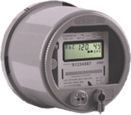

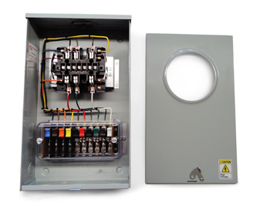
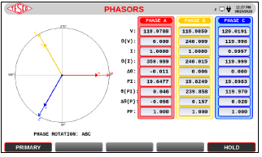
Meter Accuracy Testing
Meter Accuracy Testing
Customer Load
Customer Load
Customer Billing
Customer Conditions
Meter Accuracy Testing
Phantom Load
Full Load
Light Load
Power Factor

Slide 7
The Importance of CT Testing in the Field
One transformer in three wired backwards will give the customer a bill of 1/3rd the actual bill.
One broken wire to a single transformer will give the customer a bill of 2/3rd the actual bill
One dual ratio transformer inappropriately marked in the billing system as 400:5 instead of 800:5 provides a bill that is ½ of the actual bill. And the inverse will give a bill double of what should have been sent. Both are lose-lose situations for the utility.

Slide 8
The Importance of CT Testing in the Field (cont.)
Cross Phasing (wiring errors)
Loose or Corroded Connections
CT Mounted Backwards
CT’s with Shorted Turns
Wrong Selection of Dual Ratio CT
Detect Magnetized CT’s
Burden Failure in Secondary Circuit
Open or Shorted Secondary
Mislabeled CT’s
Ensures all Shorting Blocks have been Removed

Slide 9
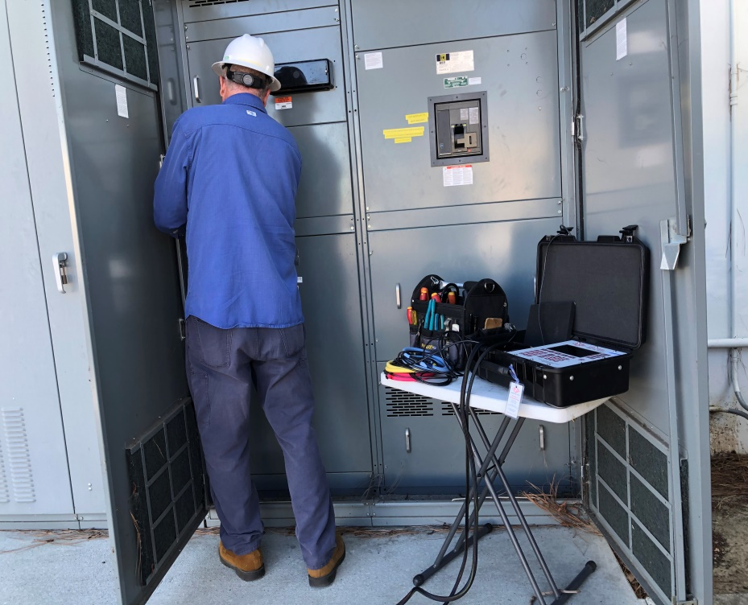
Testing at Transformer Rated Sites
Safety walk around site
Check PPE
Check test switch
Tighten any loose connections
Check primary cabinet
Check connections
Thermal scan
Connect field tester

Slide 10
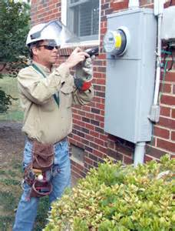
Testing at Transformer Rated Sites
Meter Accuracy
Customer Load
Full Load
Light Load
Power Factor
CT Health
Burden Testing
Ratio Testing
Demagnetization
Admittance Testing
Harmonics Assessment
Site Verification

Slide 11
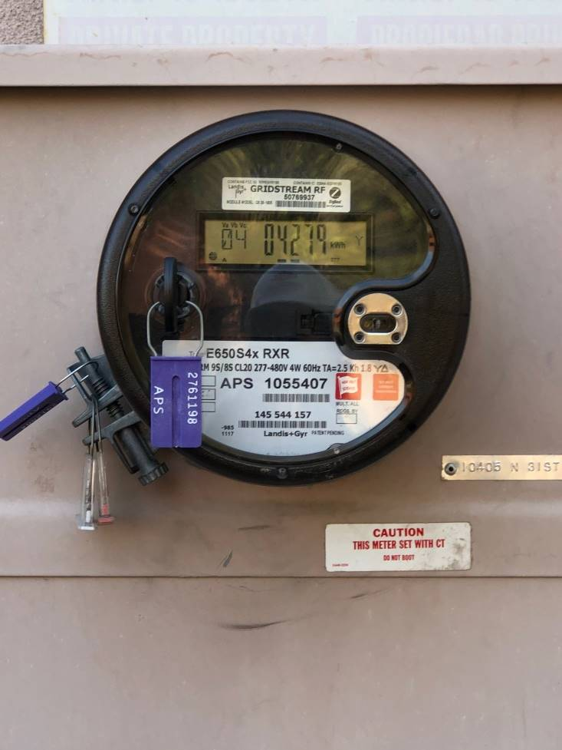
Meter Accuracy Testing
Meter Accuracy Test using IR Pulse Detection
Make connections from Field Tester to Meter Form
Connect IR Pulse Detector to meter output
Check pulse indictor
Pulse Align if necessary

Slide 12
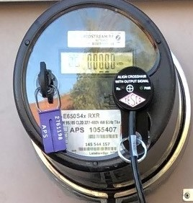
Meter Accuracy Testing
Meter Accuracy Test using IR Pulse Detection
Make connections from Field Tester to Meter Form
Connect IR Pulse Detector to meter output
Check pulse indictor
Pulse Align if necessary

Slide 13
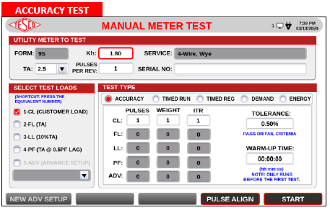
Meter Accuracy Testing
Meter Accuracy Test using IR Pulse Detection
Make connections from Field Tester to Meter Form
Connect IR Pulse Detector to meter output
Check pulse indictor
Pulse Align if necessary

Slide 14
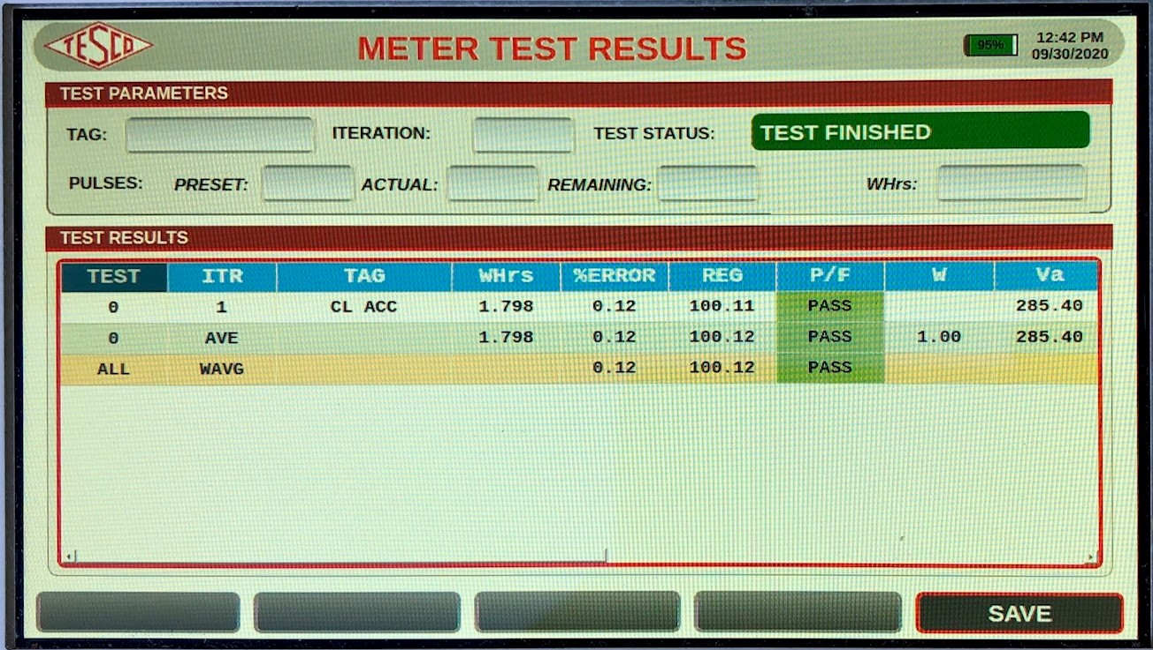
Meter Accuracy Testing
Meter Accuracy Test using IR Pulse Detection
Make connections from Field Tester to Meter Form
Connect IR Pulse Detector to meter output
Check pulse indictor
Pulse Align if necessary

Slide 15
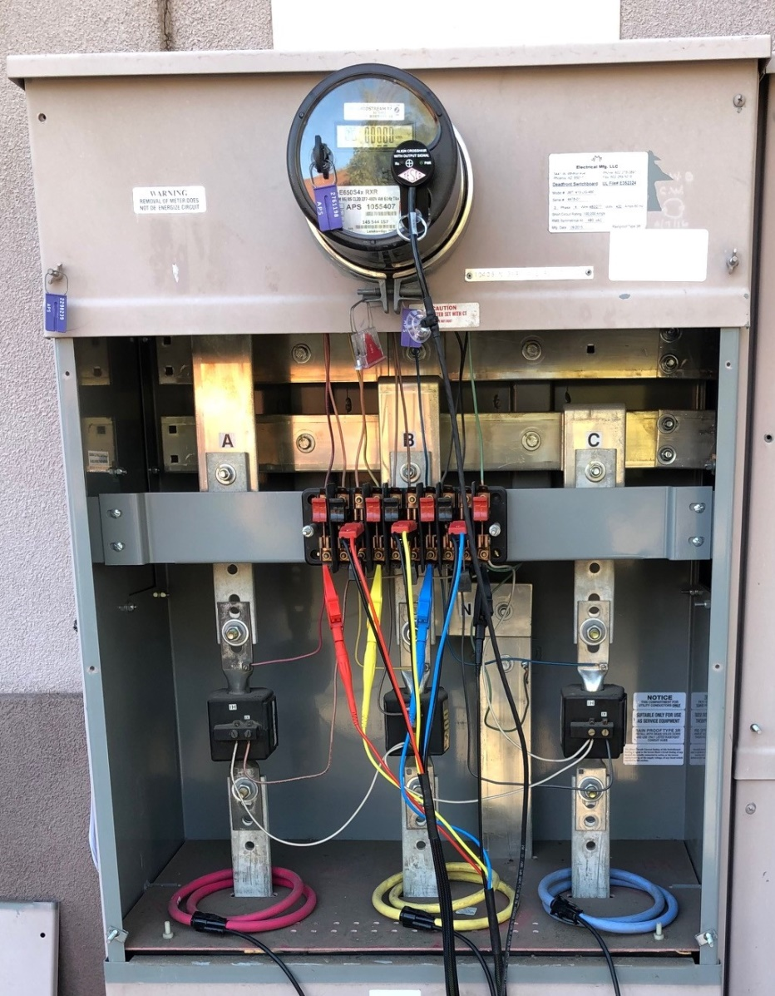
Customer CT Ratio Test with Burden
Make Connections from Field Tester to Primary current phases
Make connections from Field Tester to Secondary test switch
Connect IR Pulse Detector to meter output

Slide 16
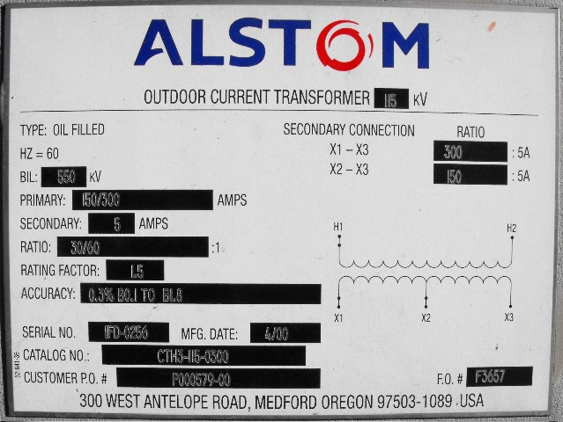
Fundamentals of Polyphase Field Meter Testing and Site Verification
Functionality with Burden Present on the Secondary Loop
Example Burden Spec:
0.3% @ B0.1, B0.2, B0.5
or
There should be less than the 0.3% change in secondary current from initial (“0” burden) reading, when up to 0.5 Ohms of burden is applied

Slide 17
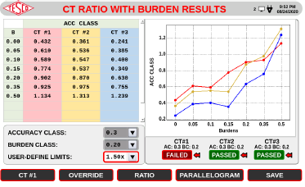
Fundamentals of Polyphase Field Meter Testing and Site Verification
Functionality with Burden Present on the Secondary Loop
PHASE A
Some burden will always be present – junctions, meter coils, test switches, cables, etc.
CT’s must be able to maintain an accurate ratio with burden on the secondary.

Slide 18
Fundamentals of Polyphase Field Meter Testing and Site Verification
Functionality with Burden Present on the Secondary Loop
Initial Reading = 5Amps
0.3% x 5A = 0.015A
5A – 0.015 = 4.985A
0.3% @ B0.1, B0.2, B0.5
Burden | Reading
0 | 5.0000
0.1 | 4.9999
0.2 | 4.9950
0.5 | 4.9900
1 | 4.9800
2 | 4.9500
4 | 4.0000
8 | 0.8000

Slide 19
Fundamentals of Polyphase Field Meter Testing and Site Verification
Ratio of Primary Current to Secondary Current
SOURCE
LOAD
PHASE A
400A
400A
400A
Calculate Ratio
80:1
5A
5A

Slide 20
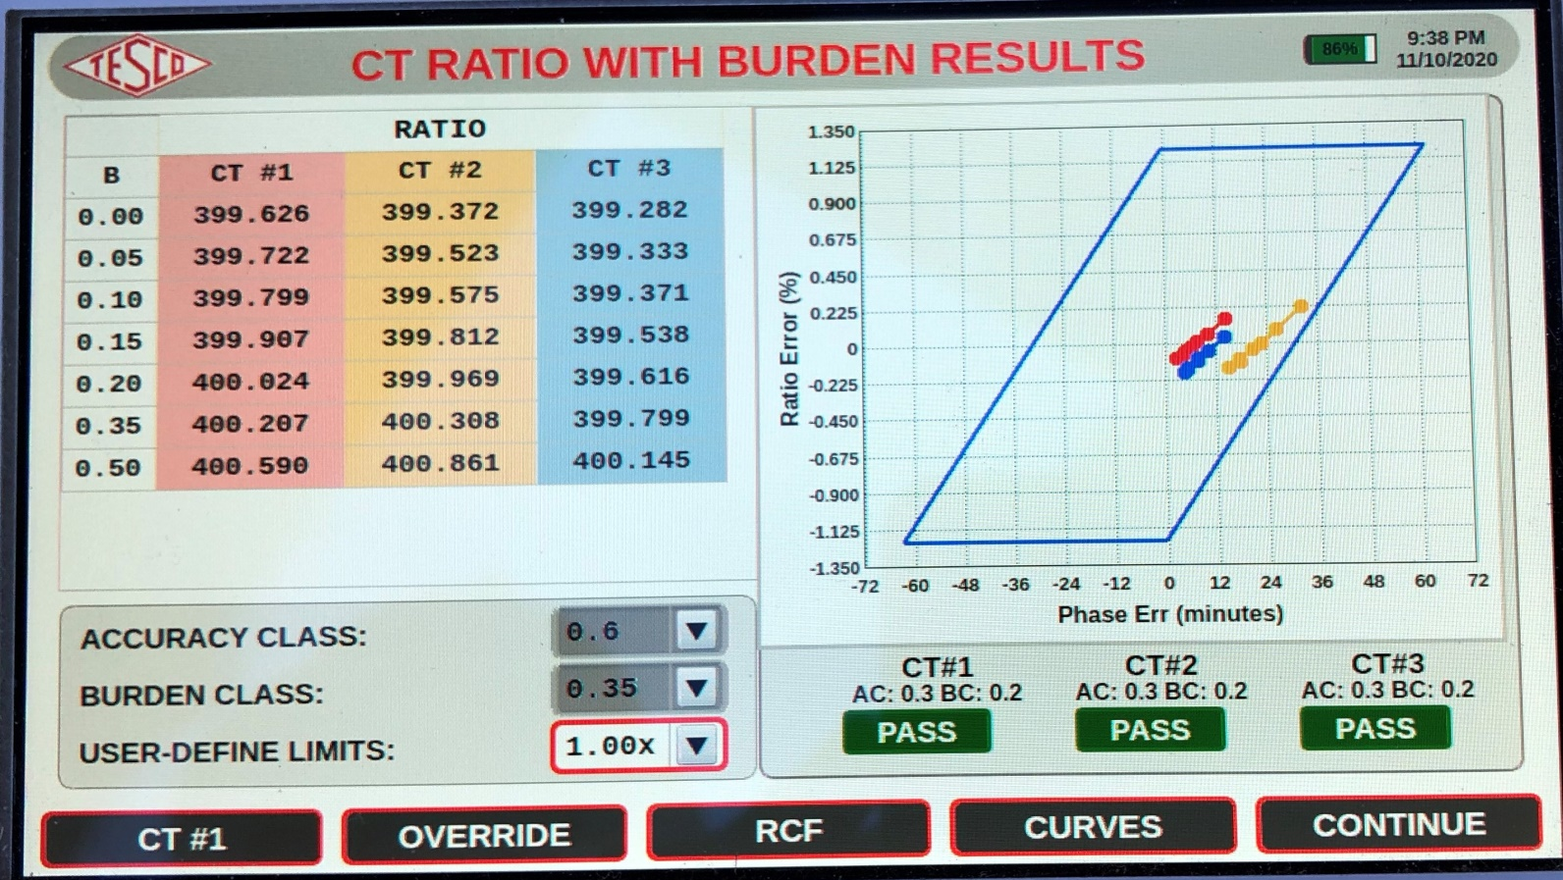
CT Ratio Testing with Burden Added
Meter Accuracy Test using IR Pulse Detection
Make connections from Field Tester to Meter Form
Connect IR Pulse Detector to meter output
Check pulse indictor
Pulse Align if necessary

Slide 21
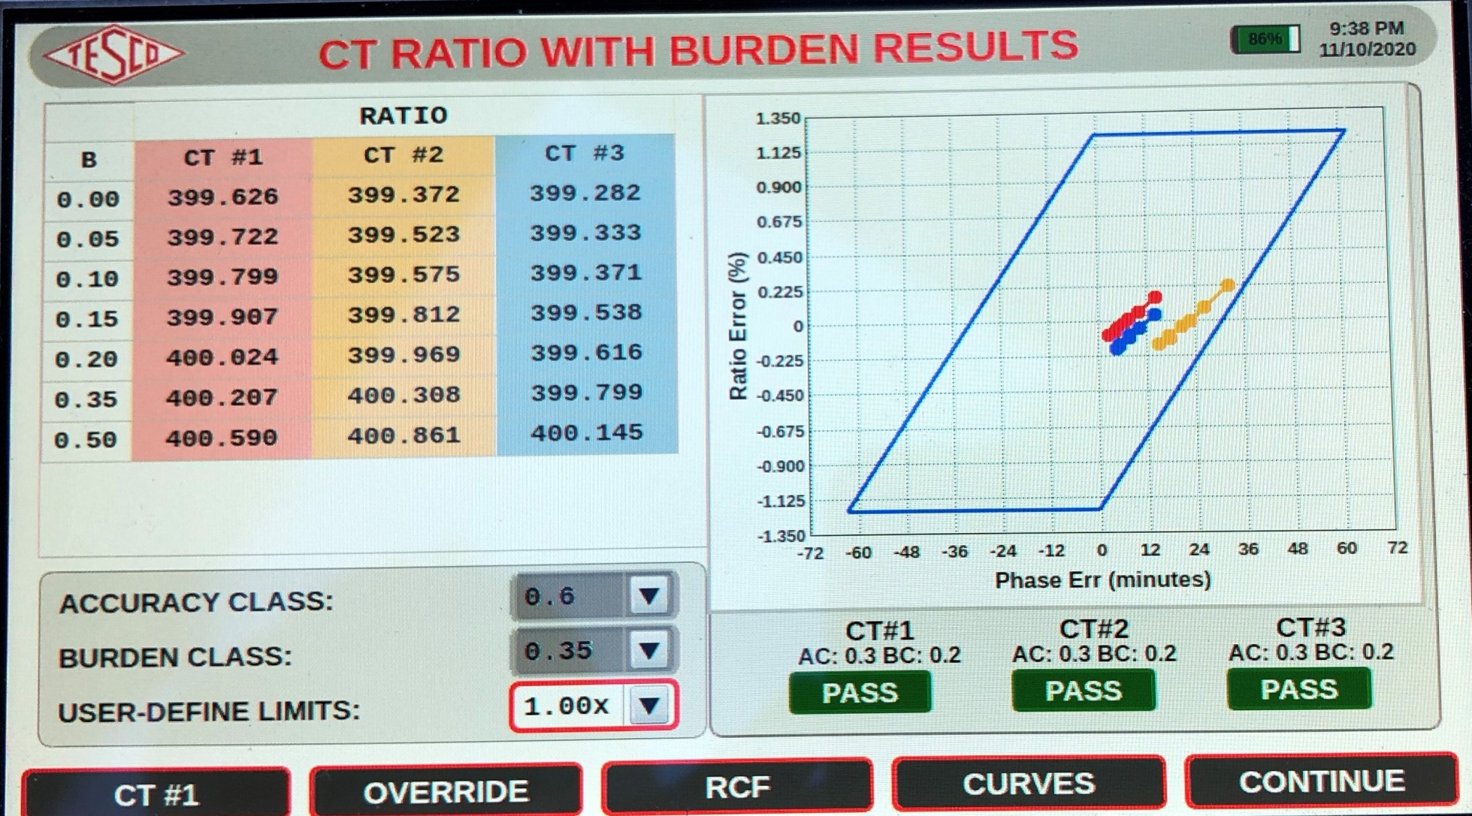
CT Ratio Testing with Burden Added

Slide 22
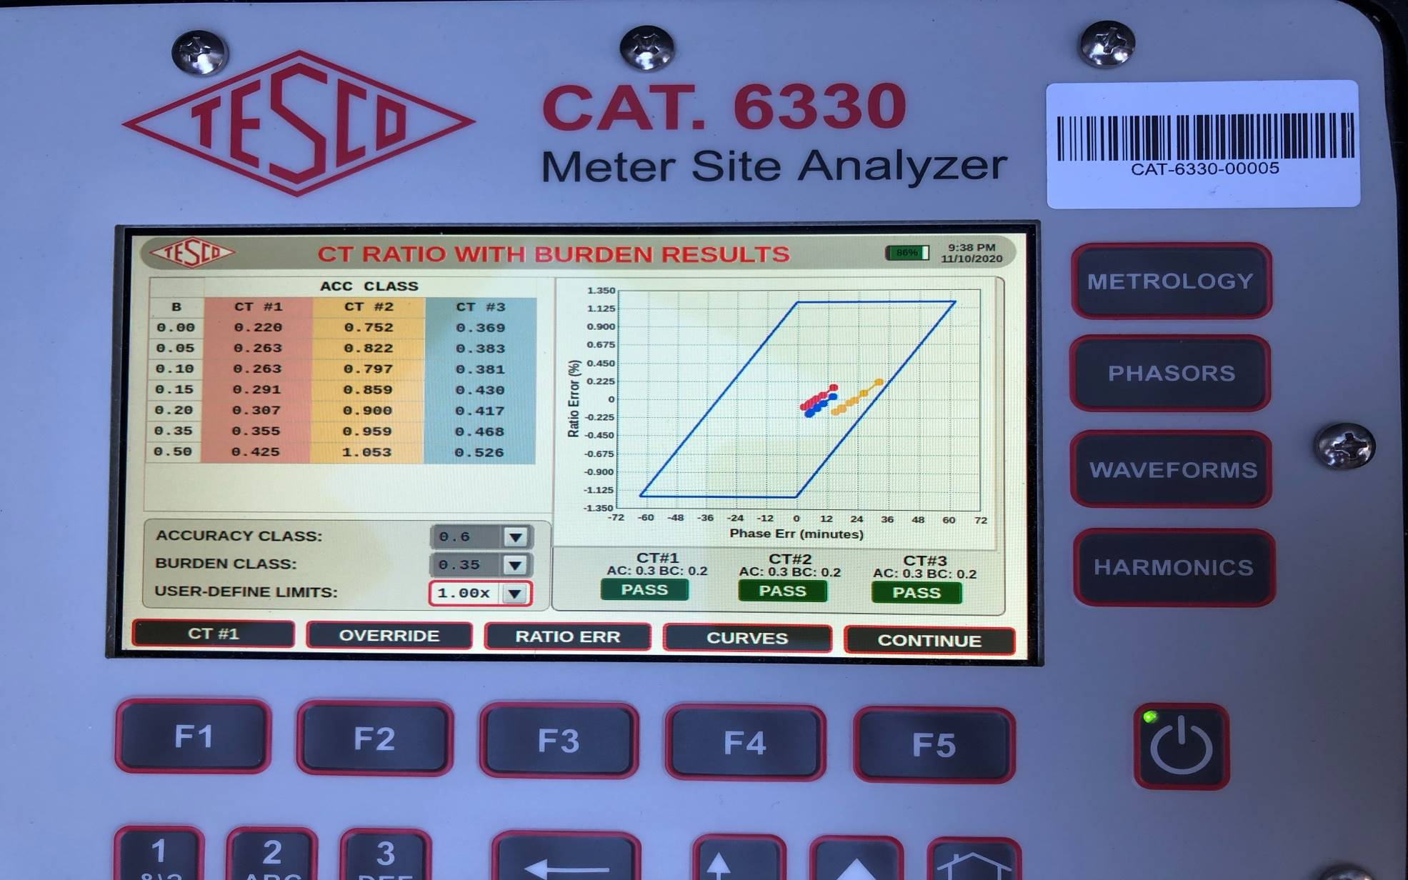
CT Ratio Testing with Burden Added

Slide 23
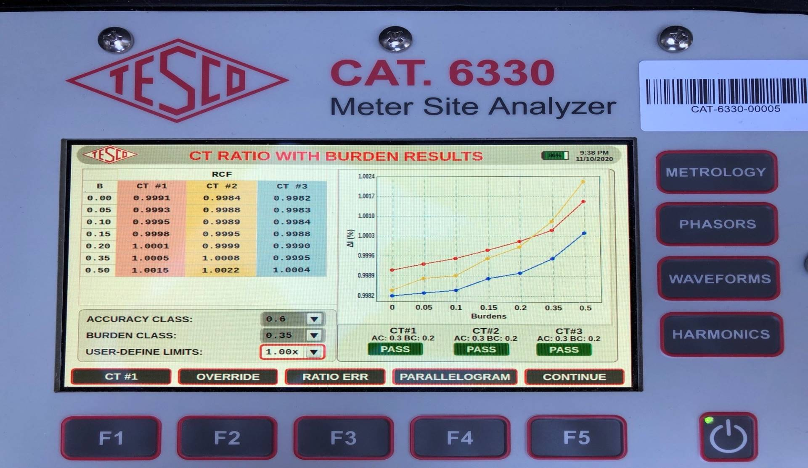
CT Ratio Testing with Burden Added
& Ratio Correction Factor

Slide 24
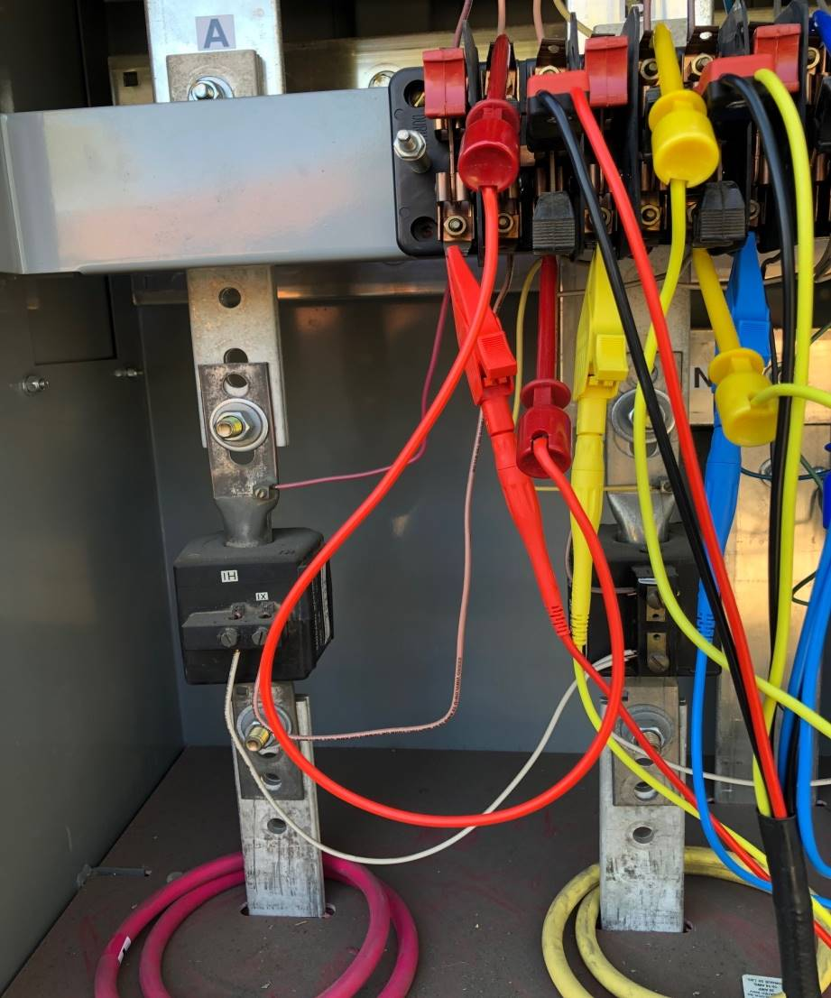
Phantom Load Testing
Determine the TA ( Test Amps) from Meter Faceplate
Ensure Safety shorting switch and test jack have been disengaged
Make connections from Field Tester to Meter Form using jumper EZ Clips.
Connect IR Pulse Detector to meter output
Check pulse indictor
Pulse Align if necessary

Slide 25
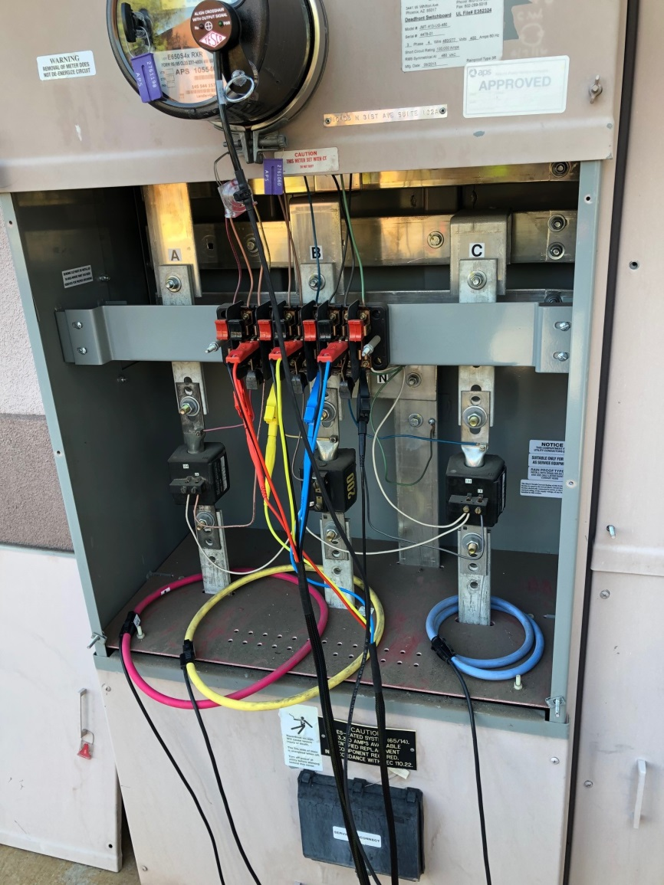
Phantom Load Testing
Determine the TA ( Test Amps) from Meter Faceplate
Ensure Safety shorting switch and test jack have been disengaged
Make connections from Field Tester to Meter Form using jumper EZ Clips.
Connect IR Pulse Detector to meter output
Check pulse indictor
Pulse Align if necessary

Slide 26
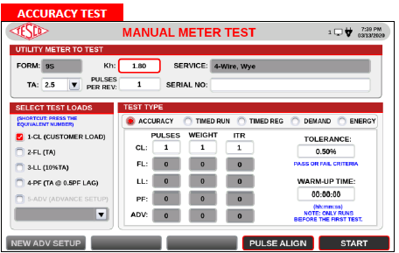
Phantom Load Testing
Determine the TA ( Test Amps) from Meter Faceplate
Ensure Safety shorting switch and test jack have been disengaged
Make connections from Field Tester to Meter Form using jumper EZ Clips.
Connect IR Pulse Detector to meter output
Check pulse indictor
Pulse Align if necessary

Slide 27
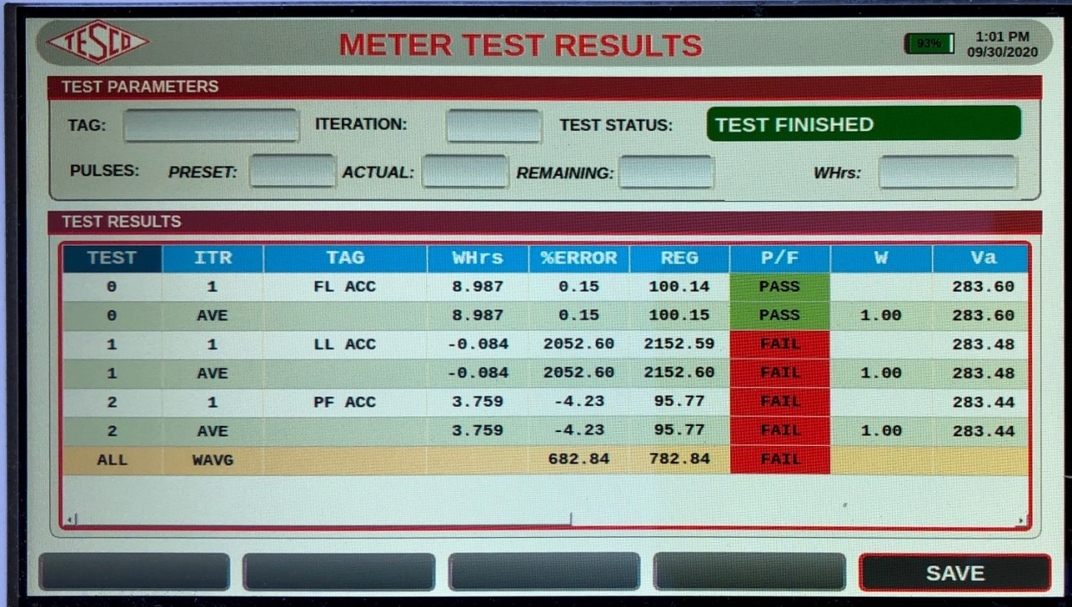
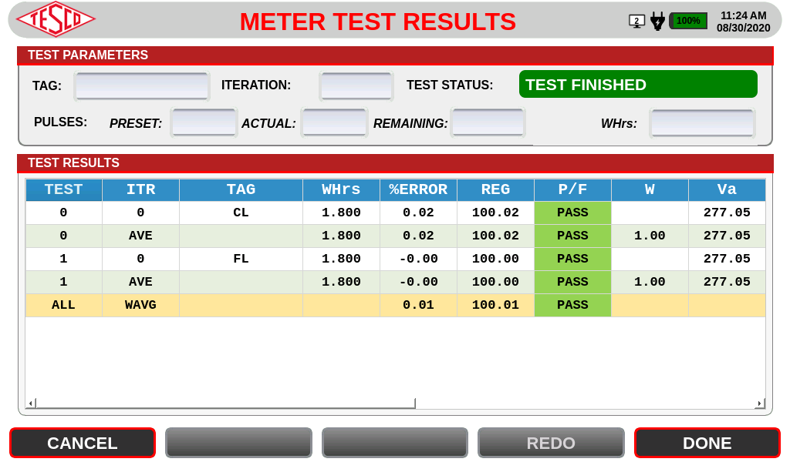
Phantom Load Testing

Slide 28
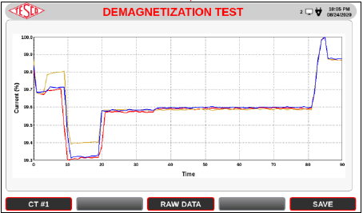
Demagnetization Testing
Current transformers (CTs) show large errors when they are magnetized by dc current. This error can be reduced after proper demagnetization.
One of the methods to demagnetize the CT is to increase the core flux by increasing its burden. This method enables to restore the nominal precision of the heavily magnetized CT from 2.5% back to 0.2% without interruption of the CT operation.

Slide 29
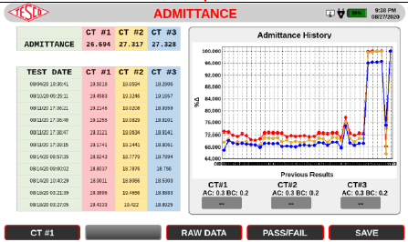
Admittance Testing
admittance is a measure of how easily a circuit or device will allow a current to flow. It is defined as the reciprocal of impedance.
The SI Unit of admittance is the (symbol S)

Slide 30
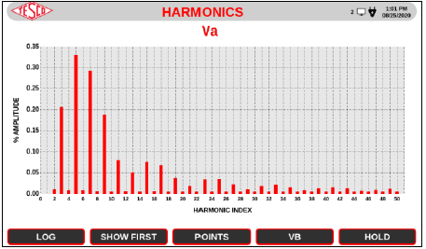
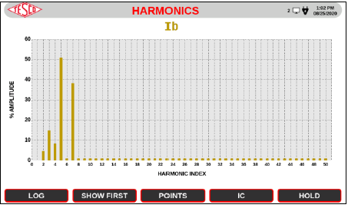
Harmonics Testing
Harmonics are integer frequencies often found with non linear loads.
THD=Total Harmonic Distortion
Vthd <5%

Slide 31
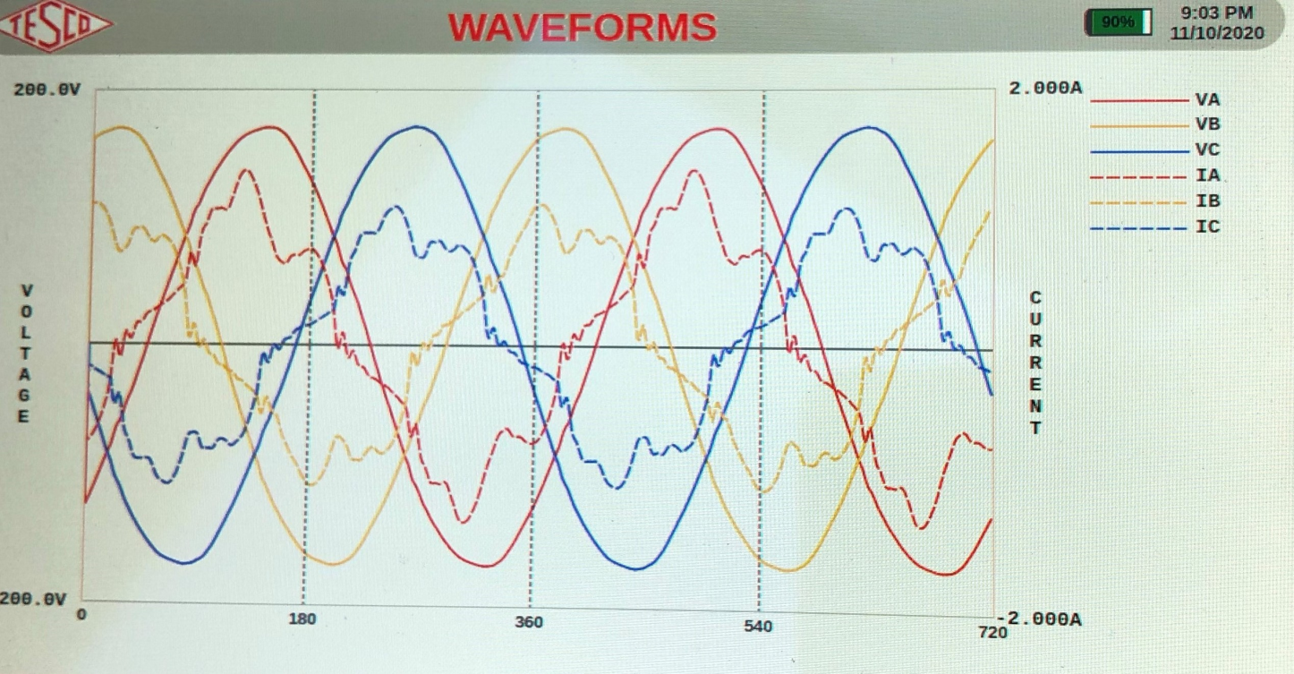
Harmonics Testing-Waveforms
Harmonics are generated as a voltage or current at an integer frequency of the system, produced by the action of non-linear loads such as rectifiers, discharge lighting, or switch mode power supplies.
Harmonic frequencies in the power grid are a frequent cause of power quality problems.

Slide 32
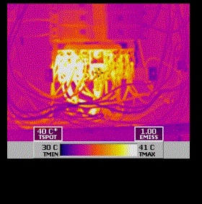
Harmonics Testing-Waveforms
What is the problem with Harmonics?
HEAT.
Can cause significant damage
Safety Hazard
Poor Power Factor
AMI Mesh Interference
Transformer Overheating
Loss of service
Image courtesy of irinfo.org

Slide 33
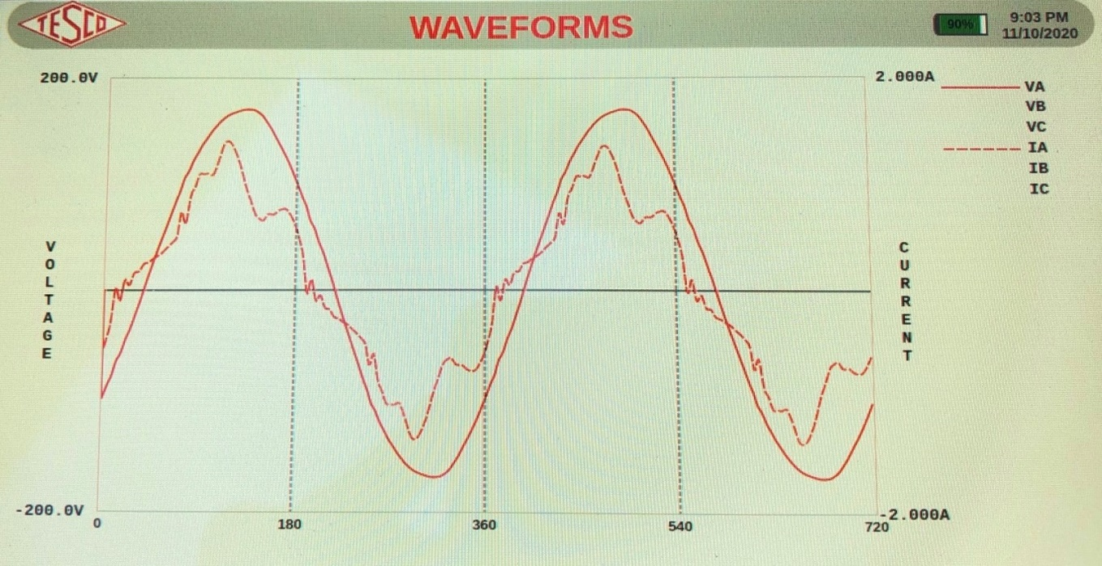
Harmonics Testing-Waveforms
Can we reduce or eliminate Harmonics?
Perhaps not eliminate. But we can reduce their impact.
We live in non linear world of power where harmonics are generated.
PWM conversion and AC Frequency Drive Motors and Pumps.
Many thousands of todays electrical products have SWPS devices.

Slide 34

Harmonics Testing-Waveforms
How can we reduce the impact of harmonics ?
Measure and determine major harmonic condition under customer load.
Assess most significant even & odd harmonics.
Active Harmonic Filtering can reduce most significant index.
Power Factor Correction Capacitor.

Slide 35
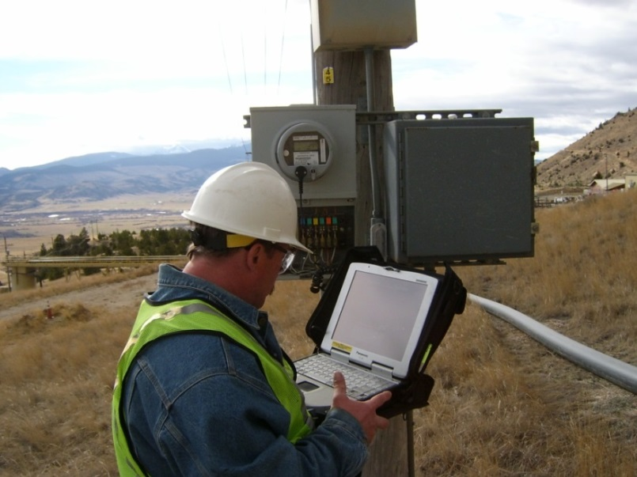
Periodic Site Inspections…..
….Can Discover or Prevent:
Billing Errors
Bad Metering set-up
Detect Current Diversion
Identify Potential Safety Issues
Metering Issues (issues not
related to meter accuracy)
AMR/AMI Communications Issues
The need for Unscheduled Truck Rolls due to Undetected Field Related Issues
Discrepancies between what is believed to be at a given site versus the actual setup and equipment at the site

Slide 36

Questions and Discussion
Tom Lawton
President
tom.lawton@tescometering.com
TESCO – The Eastern Specialty Company
Bristol, PA
215-228-0500
This presentation can also be found under Meter Conferences and Schools on the TESCO website: www.tescometering.com
ISO 9001:2015 Certified Quality Company
ISO 17025:2017 Accredited Laboratory

