Slide 1
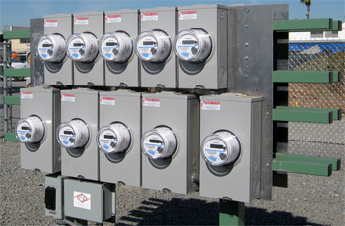
Communicating to Your Meters
Prepared by Tom Lawton, TESCO
The Eastern Specialty Company
For North Carolina Electric Meter School
Advanced Session
Wednesday June 16, 2021 at 2:45 p.m.
10/02/2012
Slide 1
Notes:
1

Slide 2
Introduction
Today we are going to review different methods of communicating to your meters, the reasons for them, and some of the testing and challenges related to each.
We will discuss the following:
Optical port communications
PLC communications, applications and testing
AMI/AMR programs and radio mesh networks
Other devices and methods to help with hard to reach meters
…but first, a little bit about why we need to talk to meters

Slide 3
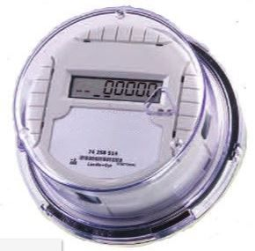
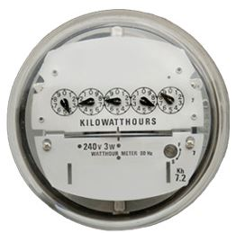
Why Do We Need to Communicate to Meters?
Prior to Electronic Meters, Electro-Mechanical meters served just one purpose, and that was to measure and display the amount of energy consumed by the premises to which they were mounted. In order to be read, someone will have to go to the meter and read the dials, and compare the current readings to the previous ones.
Electronic meters are capable of much more, and have the ability to communicate all of their information back to a computer system in order to be acted upon or analyzed much more quickly.

Slide 4
Why Do We Need to Communicate to Meters?
There are two main reasons to communicate to electronic meters:
To locally check the settings, firmware revisions and operation of the meter and communication module
To remotely obtain all of the information that the meter has collected for the purposes of billing, load management, and service
Communications can also be used to update the firmware in the meter, disconnect residential service for non-payment or emergency. Local communication can be used to do the software updates, and to test the service disconnect function.

Slide 5
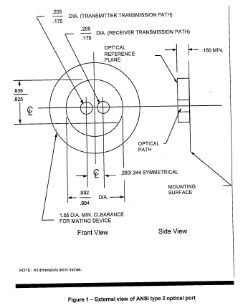
Local Communications
OPTICAL PORT
Local communications is achieved through the optical port, typically located on the front face of the meter.
This port is made up of two Infrared (IR) light conduits that are referenced to a mechanical feature as defined in Figure 1, taken from ANSI Standard C12.10. The leftmost IR conduit is dedicated for transmitting and the other for receiving.

Slide 6
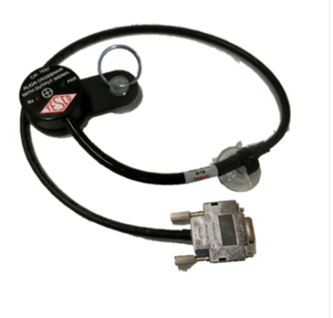
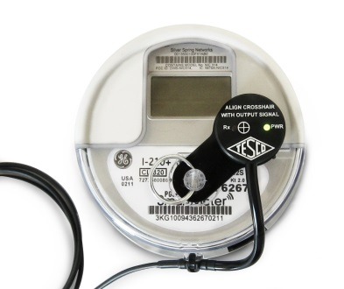
Local Communications
Optical Port Readers:
Pickups:
This term refers to a device that mates to the optical port feature on the front of the meter and simply translates the IR pulses from the meter into electrical pulses that can be read by meter test board electronics. (TESCO Cat.1037).
This type of device is only used to read distinct pulses from the meter to be used as the reference for meter testing.

Slide 7
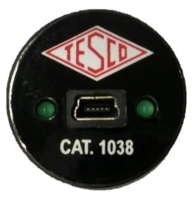
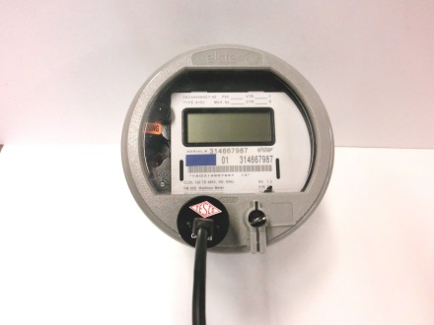
Local Communications
Optical Port Readers:
Probe:
This term refers to a device that mates to the optical port feature on the front of the meter and translates the IR pulses from the meter into electrical pulses corresponding to serial communications that can be read by a computer. This type of device is also a transmitter, converting electrical pulses from a computer serial output (USB or RS232) to IR pulses that are able to be read by the meter. (TESCO Cat. 1038).
This type of device is only used to communicate from a computer to the meter.

Slide 8
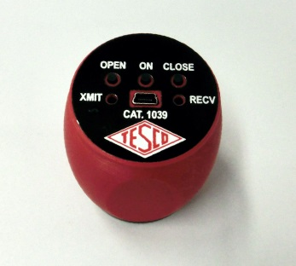
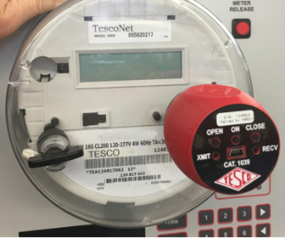
Local Communications
Optical Port Readers:
Wireless Probe:
This device performs the same tasks as the previous one, but instead of being hardwired to the computer through a USB or serial cable, it communicates wirelessly to the computer (Bluetooth or wireless radio). (TESCO Cat. 1039-WP)
This type of device is only used to communicate from a computer to the meter, but is easier to use in the field, particularly during inclement weather.

Slide 9
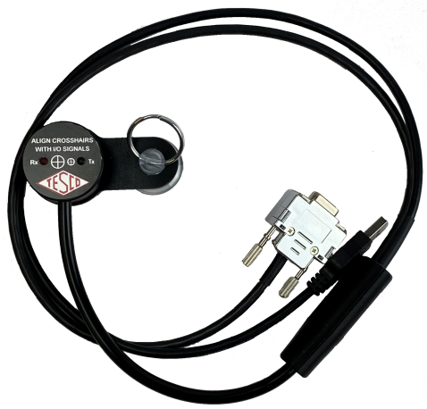
Local Communications
Optical Port Readers:
Pickup/Probe Combination Device:
This device performs the same tasks as the pick and the probe, with two outputs – the first being the uni-directional pickup output that can be wired into the test board, and the second being the bi-directional serial signal. (TESCO Cat. 1035)
This type of device is used in complex testing environments, where the utility is doing both accuracy and functional testing in one location. The combination device keeps the tester from having to switch devices while performing the tests.

Slide 10
Local Communications
Optical Port Uses:
In the lab
Serial communication to meter (probe)
Perform “functional testing” of the meter prior to deployment
Checking meter firmware version
Checking setup and ratios
Checking the operation of service disconnect
Metering pulse output (pickup)
Used for meter accuracy testing
Combination probe/pickup can be used to better facilitate both functional and accuracy testing without having to change devices.

Slide 11
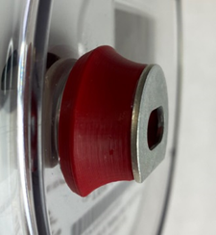
Local Communications
In the field
Serial communication to meter (probe) to do meter readings if radio comms are not working.
Opening or closing service disconnects – removing meters, emergencies
Things to consider when using or testing with the optical port
USB or wireless connection to probe
Magnetic and non-magnetic coupling
Ambient light intrusion in the field
Damage, scratching, or fogging of plastic meter cover.
Non-traditional locations for the optical port
No convenient coupling for the probe

Slide 12
Power Line Carrier (PLC) Communications
The first form of remote communications that we are going to talk about is PLC, or power line carrier. This mode of communication uses the existing wiring and infrastructure to talk to the meters.
The basic technology is to add a higher frequency communications signal on top of the standard 60Hz power signal. Inside the meter, a special transceiver separates the communications signal from the power signal.
Though this type of communication has a number of benefits, there are a number of difficulties in testing this type of communications in a lab environment…

Slide 13
Power Line Carrier (PLC) Communications
Benefits:
Like local communications, PLC is a bidirectional protocol, allowing for complex data exchanges to occur.
The utility can collect information from the meter, along with being able to control the meter’s service disconnect.
The technology uses existing wiring, making this method very attractive in reaching remote, hard to reach meters.

Slide 14
Power Line Carrier (PLC) Communications
Challenges in testing:
PLC testing is simplest for the utilities when the meters can be reached directly through the powerline in the meter shop using either the existing infrastructure (i.e. the transmitters already on the powerlines) or through a signal simulator plugged into the shop’s power lines.
Testing PLC using standard MQB and Test board technology requires that the test equipment be able to not only do the job that it was intended to do, but also be able to allow the passage of the PLC signals through to the meter.
Typical modern test boards do not have a single pathway from the power line to the meter socket. They use the incoming power from the wall socket to energize their electronics and digital power circuits that are used to re-create metered services.

Slide 15
Power Line Carrier (PLC) Communications
Challenges in testing:
The nature of the PLC signal makes it nearly impossible to transmit through standard isolation transformers found in meter test equipment.
Because of this difficulty, the test equipment needs to make a completely separate, non-isolated connection between the wall outlet and the meter socket.
Since PLC communications can be used on a number of single phase and polyphase meter forms, some amount of voltage translation is necessary. Normally, this is done through step-up isolation transformer. For PLC testing, autotransformers have to be applied so that there is a direct line from the meter transponder to the PLC communications equipment.

Slide 16
Power Line Carrier (PLC) Communications
Challenges in testing:
PLC signals can draw upwards of 50A through the line during communication transactions.
Though these high currents are typically of short duration, the wiring and circuit protection on the test equipment have to take this current draw into consideration, while ensuring that the equipment is adequately protected during normal operations.
Test equipment is designed to test all meter forms from all manufacturers. Depending on the meter form and manufacturer, the PLC transceivers may be wired between different points on the meter.
Utilities order their meters with PLC capability and can choose, at times, different configurations. Typically, the transceivers can be wired either line to line or line to neutral. The option of where to connect the power line to the meter socket by the test equipment has to take this option into account.

Slide 17
Remote Communications – Radio (RF)
The next form of remote communications that we are going to talk about is Radio, or wireless network communications. This mode of communication uses high frequency radio waves to talk to the meters.
This method is by far the most popular of the AMI communications methods and provides the ability to talk to large numbers of energy meters at the same time.
The basic technology involved in this method is to communicate from a head-end computer system to various distributed multichannel transceivers, known as collectors, which then communicate over the air to a group of meters.

Slide 18
Remote Communications – Radio (RF)
There are two main types of radio networking employed. The first is called Point to Multipoint (P2MP) and the second is a mesh network.
P2MP employs a central antenna or antenna array that broadcasts to several receiving antennas in the meters. This method is typically employed in fairly dense areas. They are also much less susceptible to RF noise, since they reside in licensed frequency bands.
In Mesh networking, the communication to and from the meters is done through the construction of a mesh, which allows for multiple pathways and redundancies for each meter or group of meters to communicate back to the collectors and the head end system. Mesh networks operate in unlicensed frequency bands
Though this type of communication has a number of benefits, there are a number of difficulties in implementing this type of communications in the field…

Slide 19
Remote Communications – Radio (RF)
Benefits:
Radio communication can be done without the addition of communications wiring to each meter.
Mesh networks build in a great deal of redundancy if designed and planned properly.
Communication platforms have become quite stable and have expanded into devices other than just meters. This allows the utilities not only to talk to other devices and systems (Smart Cities), but to enhance and expand the meshes themselves.

Slide 20
Remote Communications – Radio (RF)
Challenges:
With any AMI implementation, one of the main priorities (and challenges) is to maximize the number of meters reached by the system.
The mesh type network employs somewhat low power radio communications and is reliant on multiple nodes within “earshot” to be able to not only reach remote locations, but have redundant pathways.
It is imperative for the planners and installers of mesh networks to have the proper test equipment in order to properly place the meters and other devices in areas where they can reach other nodes.

Slide 21
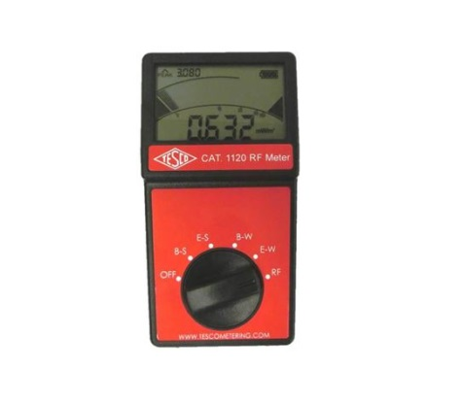
Remote Communications – Radio (RF)
Challenges:
At a minimum, a signal strength meter can be used to read the concentration and strength of a given frequency band in which the mesh network resides.
Though this type of device is a good start, it becomes challenging when you are in an area where other devices and systems that have nothing to do with the meter network exist, but reside in the same RF band.

Slide 22
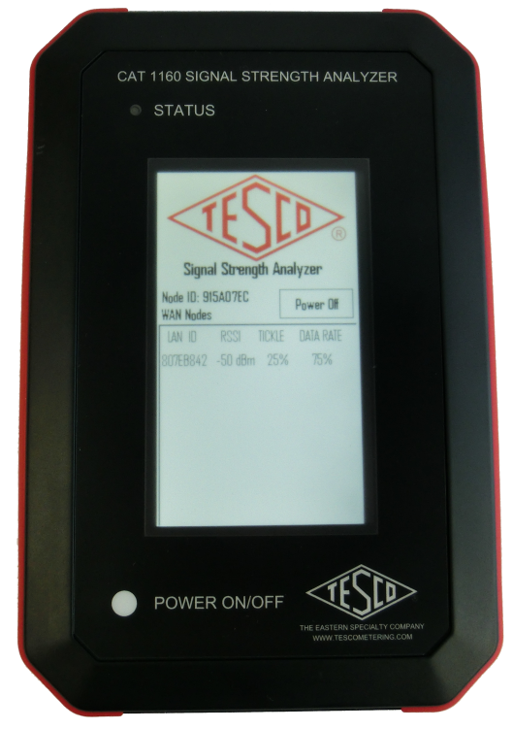
Remote Communications – Radio (RF)
Tools and methods:
A signal strength analyzer of some sort is always helpful in deciding if a remote antennae will help or not and if so, where the remote antennae should go. The fall back is to simply take your best guess and put in an antennae. In a true mesh, meters are sometimes installed simply to act as a “repeater”.

Slide 23
Remote Communications – Radio (RF)
Challenges:
If a meter is just too remotely located, or there are other impediments to getting the signal to or from the meter, other methods may have to be used.
As we discussed earlier, PLC communications can be used to reach hard to reach meters.
Meters can have antennas connected to them and mounted remotely from the meter.
Meters can be fitted with other communication technologies, such as cellular, ethernet, or even satellite.
Adding any additional communications technologies to the meters is going to burden the utility with either having to track more SKU’s in their system, or the bigger cost of fitting all of the meters with multiple communications technology.

Slide 24
Remote Communications – Radio (RF)
Challenges:
As mentioned earlier, with the expansion of different protocols into other devices, those devices can be used to enlarge the area covered by the mesh. An example of this would be NLCs (Networked Lighting Controllers). These devices replace standard photocells on LED street lighting and have the radio NICs and protocols on board that allow the device to become part of the mesh.

Slide 25
Cellular Communications and the future
Radio Frequency (RF)
Power Line Carrier (PLC)
Cellular Communications

Slide 26
Questions and Discussion
Tom Lawton
President
tom.lawton@tescometering.com
TESCO – The Eastern Specialty Company
Bristol, PA
215-228-0500
This presentation can also be found under Meter Conferences and Schools on the TESCO website: www.tescometering.com
ISO 9001:2015 Certified Quality Company
ISO 17025:2017 Accredited Laboratory

