Slide 1
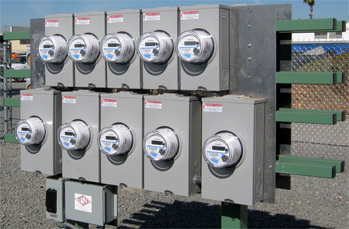
Challenges for Meter Shop Operations of the Future
Prepared by Tom Lawton,TESCO
The Eastern Specialty Company
For North Carolina Electric Meter School
Management
Tuesday, June 25, 2019 at 10:30 a.m.

Slide 2
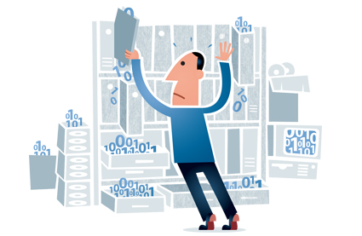
Introduction
This presentation examines how AMI data has dramatically changed and is continuing to change metering operations and the challenges this is presenting.

Slide 3
The Promise of AMI
The introduction ten years ago and the continued development of an Advanced Meter Infrastructure (AMI) system promised more effective and more efficient Meter Service Operations.
This was to be accomplished in a variety of ways starting with:
No need to read meters (if AMR had not previously been deployed)
No need to roll a truck to perform a disconnect or a reconnect
Better ability to detect and respond to outages
Better ability to detect theft
Better ability to detect (and eventually capture) unbilled energy
Better understand customer usage and make better energy buying decisions
And with all of this came a promise of “Additional Capabilities and additional Operating data.”

Slide 4
A Flood of Data: The Promise and the Curse of AMI
And so the data started coming in.
Once the investment in gathering this data was made the problem quickly moved from the collection of this data to developing the tools and infrastructure to analyze this voluminous data.
There was far more data than could be analyzed or even utilized at first.

Slide 5
Moving Into The Future
Utilities now collect hundreds of millions of events and readings every day from sources such as the following:
Meters (status, manufacturer, purchase date, events such as reprogramming notifications and tamper alerts)
Transformers (ID, circuit section, circuit ID)
Service points
Customer accounts (type, status, billing cycle)

Slide 6
What Data Are We Getting & How Are We Using It?
Meter quality assurance: Focusing on meter reading performance enables utilities to ensure AMI reliability. For instance, when meter readings are expected but not delivered, the system takes note, and calculates overall performance statistics for the AMI system. Utilities are made privy to problems they never would have been able to identify in the past.
Good Start

Slide 7
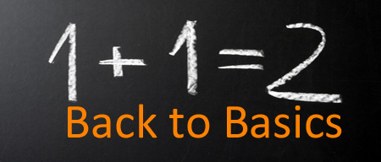
The Basics
Outage event analysis and prevention: Integration enables real-time, accurate, and complete outage event analysis that helps identify nested outages and optimize field crew dispatch – all to support efficient response and restoration.
We can often determine the exact piece of equipment causing a problem, along with the customers directly impacted by it.
We can use outage information that is delivered along with meter readings to identify and track outages.
These outage event reports help us to understand the overall impact of outages, then drill down to find the problem areas in the distribution network.
We can then isolate areas of high impact and work to understand how to address them.

Slide 8
And of Course…Report!
We can filter planned outages and momentary from this data for reporting purposes and provide meaningful customer satisfaction and performance measures and trends
Average interruption durations
Number of interruptions
Number of customers impacted
These system performance indexes and information can be shared with management, regulators, customers, media, and other stakeholders.

Slide 9
What Else?
Gain a better understanding of events, as well as what they mean. For instance, we can correlate power outage events or voltage alarms with the transformers involved to identify faulty or aging infrastructure. And we can roll trucks between 8 AM and 4 PM, Monday to Friday on non-storm days.
Generate new customer insights
Size distribution assets
Implement preventive maintenance techniques
Forecast and build predictive models for demand program planning
Develop new rate plans and services for customers
Address Line Loss in a meaningful and impactful way

Slide 10
Line Loss
Network energy inventory balancing – You can accurately compare feeder energy to aggregated meter data to track down unbilled energy. Some may be energy theft. Some is not but is still actionable once the root cause can be determined.
Meter events and usage information can help paint an overall picture of what’s happening with a customer’s energy usage over time as well as the usage from an entire sub station. This unified view can help detect energy theft, meter tampering or a host of equipment problems that may be affecting service levels.
Some typical filters for theft: Customers can be identified who have active accounts but no recorded usage, or the converse – energy usage but no active account. Customers with gas usage but no electrical usage over months or even years, indicate a very likely candidate for investigation, voltage issues for one customer and not others on the same transformer.

Slide 11
What Else?
Potentially bad metering
Non metering of certain usage
Failing equipment and bad connections
Bad GIS integration and information. To make any of this work we need an up to date and integrated geographic information system (GIS) geodatabase. We need to be able to link our meters accurately to the rest of the system along with every other piece of equipment between the sub station and the meter. The initial investigative work will uncover not system errors but GIS errors and holes. Once corrected this work will begin to uncover correctible losses.

Slide 12
Longer Term Planning
Load profiling – You have accurate and highly granular transformer load profiles, especially significant for effective distribution planning when electric vehicle (EV) charging and distributed generation are involved. What will the impact on your system be as isolated pockets of users influence each other and purchase electric vehicles; adopt home level energy storage and renewable energy solutions.
Pricing analysis – Perform ‘what if’ rate and load shift analysis. Compare current tariffs with alternative pricing scenarios. Estimate energy costs for a new rate at different load levels.

Slide 13
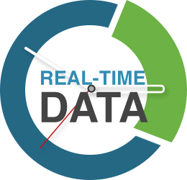
What are Some of the Challenges in Analyzing this “Flood of Data?”
The first issue is that currently data required for complete meter data analytics solution does not all reside in the same place. While there is tremendous real time data being collected the information required to complete many types of analysis may reside in different systems that may or may not talk to one another (e.g. system mapping data).
Another challenge is that while the MDM is configured as a “Fast Write” data base, since it needs to quickly record large volumes of real-time meter information, a useful analytics tool needs to be normalized for “Fast Reads,” since it needs to provide fast access to data for users looking for real-time insights.

Slide 14
Additional Challenges?
No impact on billing: Making sure that you can analyze the data in the MDM system (the “system of truth”) without impacting basic billing operations in any way. As important as meter data analytics is, this capability cannot interrupt billing and other operational systems in terms of performance, data corruption or functionality. Bottom line: The analytics capability cannot threaten the utility’s ability to collect revenues.
Near real-time: Lastly, in order to retain its value to executives, engineers and operational staff, data analytics need to be performed in as near real-time as possible.
The ultimate goal: To establish a repeatable data analytics discipline and infrastructure to reduce the time, cost and complexity of each incremental capability, and with the lowest risk possible to the existing MDM functionality.

Slide 15
How Should an “Analytics” Database Be Set-Up?
The analytics database should use a different design that classifies the attributes of an event into “facts,” which would include the data itself, and “dimensions” that can give the facts context such as meters, transformers, service points, customer accounts, register reads, billing values, interval readings, register readings, missed reads, data quality information and meter events.
Using a “Fast Read” design, the analytics database correlates measured data (“facts”) along many “dimensions” (e.g., location, by transformer, etc.) and stages them so that the data can be analyzed in many ways.
This enables users to gain more understanding of events, as well as what they mean. For instance, analysts can correlate power outage events or voltage alarms (“fact”) with the transformers (“dimension”) to identify faulty or aging infrastructure with a single simple calculation.

Slide 16
New Skill Sets
Utilities also need new skill sets to be able to perform this analysis. To use this data we need
Data base experts
Metering and operations experts
Business analysts
In a perfect world all of these characteristics are rolled up into one. In a less perfect world into two. And is an even less perfect world – three individual groups or people. But too many utilities are missing one or more of these groups or people even after completing their AMI deployment.

Slide 17
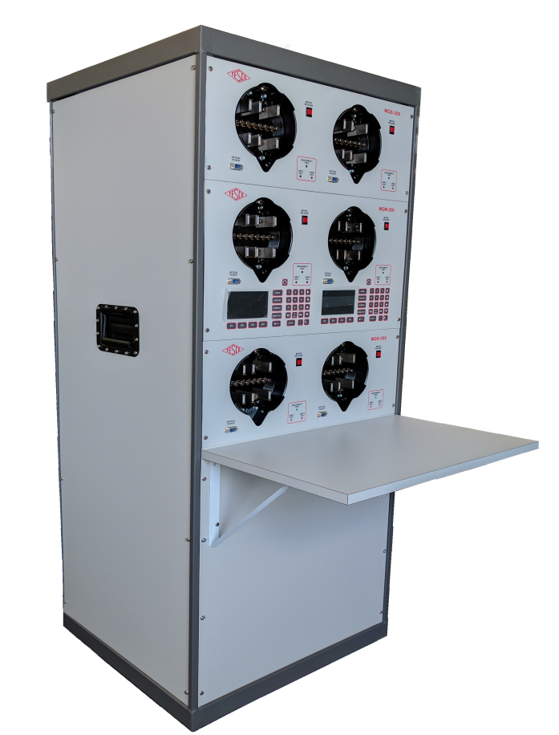
New Tools for the Meter Shop and the Field
Advanced functional test boards
Automated firmware and setting comparison tools
Site Verification equipment, procedures and data
…….and data
…….and data
…….and data

Slide 18
New Tools
Advanced visualization tools – Built-in tools provide an alternative to cumbersome data tables and provide enhanced visibility of your smart meters, AMI network, and distribution network
AMI system health dashboards – A custom definable user interface enabling a visualization of real-time events and trending

Slide 19
Summary
We are finding new uses for the data we are receiving as we continue to use these systems.
This data is enabling us to roll fewer trucks for emergencies
This data is allowing us to identify weak spots in our infrastructure and correct them between 8 AM and 4 PM Monday to Friday on non-storm days.
The data is allowing us to perform long term planning and perform far better rate analysis for proposed new tariffs and to even help create new tariffs.
The data allows us to better evaluate performance of hardware on our infrastructure.
The data gives us the tools for the first time to measure, identify, and go after “system loss” in a meaningful and actionable way.
Meter data analytics will enable utilities to tackle the biggest problems we face today, including failing transformers, unbalanced energy generation based on imprecise forecasts, operational inefficiencies and even addressing and reducing line loss.
To do this we an analytics platform to allow us to provide the infrastructure to perform this work, dedicated personnel with both new and old skill sets and new tools for them to use.
We need new skill sets in Meter Service Departments
As metering begins to move to the center of operations Meter Services Managers and Directors need to embrace the new role of meter Services within your organization.

Slide 20
Questions and Discussion
Tom Lawton
TESCO – The Eastern Specialty Company
Bristol, PA
1-215-785-2338
This presentation can also be found under Meter Conferences and Schools on the TESCO website: www.tescometering.com

