Slide 1
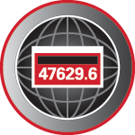
Certifying DC Electric Vehicle Chargers and AC Level Two Chargers
Prepared by Tom Lawton, TESCO
The Eastern Specialty Company
For North Carolina Electric Meter School
Single Phase
Tuesday, June 14, 2022 at 1:00 PM
Notes:
1

Slide 2
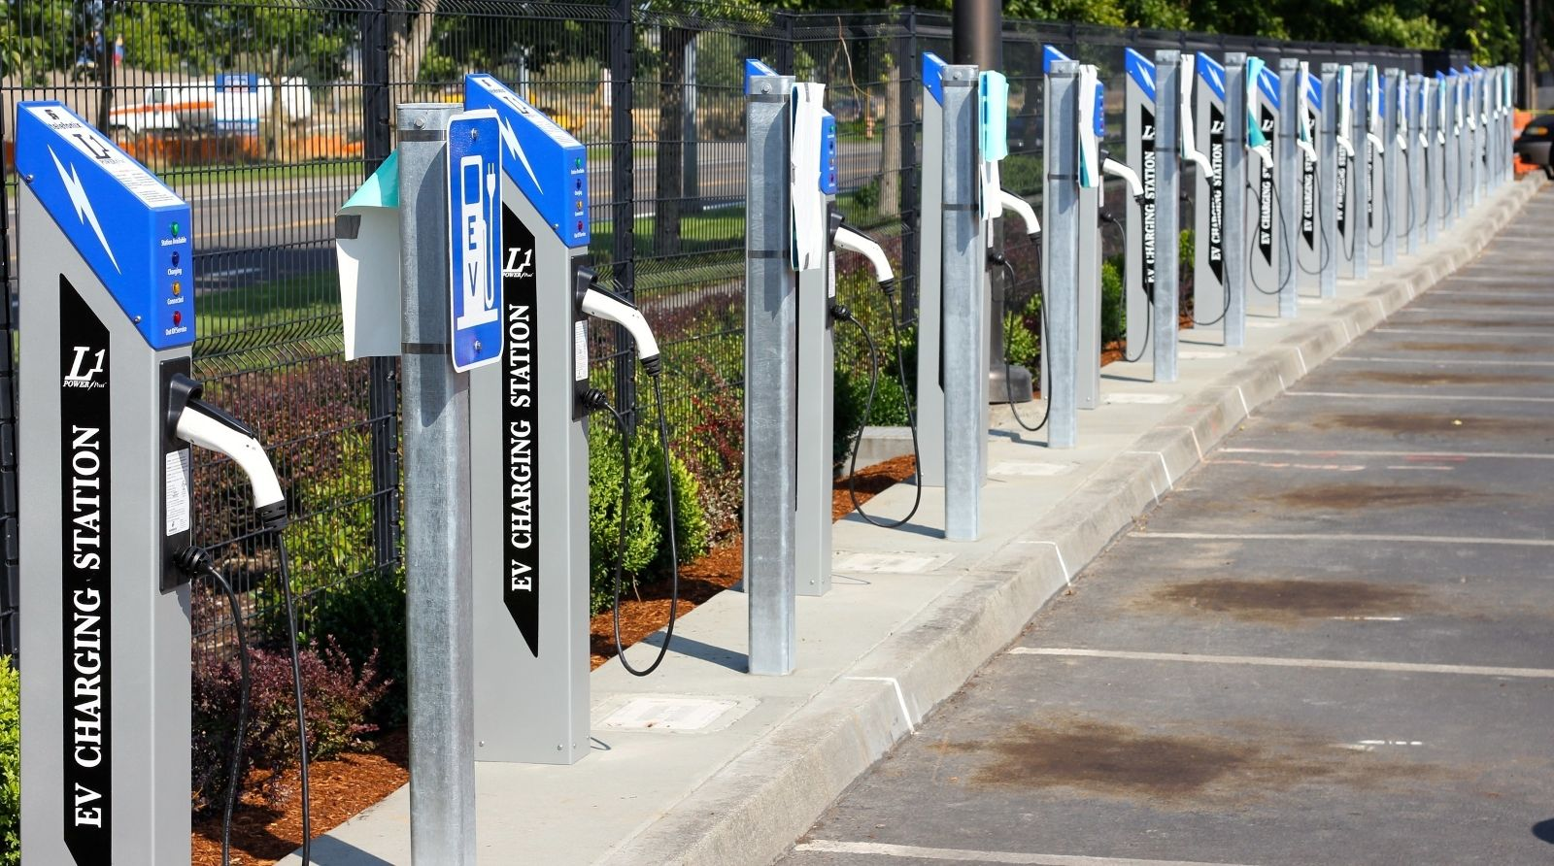
EVSE
Electric Vehicle Service Equipment
What is it all about?

Slide 3
INTRODUCTION
Types of EVSE’s
Market growth
Regulatory environment
Type approval & testing

Slide 4
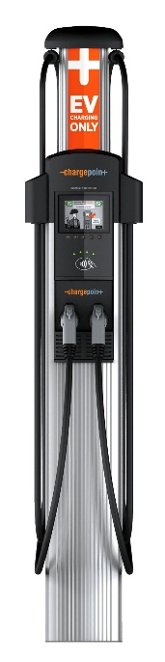
AC EVSE STANDARDS
J1772 AC Level 2
  Home and Commercial Installation
  240 Volts at up to 80 Amps (30A most common)
    Home 30A, Commercial 30A, 50A, 75A
  Maximum Power Delivery ( 19.2 kW )
    Mostly vehicle limited to 7.2kW
  Typical time to charge
    Pluggable Hybrid ( 0.5 – 1.5 hours, 0% to 90%)
    EV 80 Mile Range (1.5 – 4 hours, 20% to 90%)
    EV200 Mile Range ( 3.2 – 10 hours, 20% to 90%)
  21 miles per hour of charge @ 30A
  If you drive <160mi/day you can recharge overnight.

Slide 5
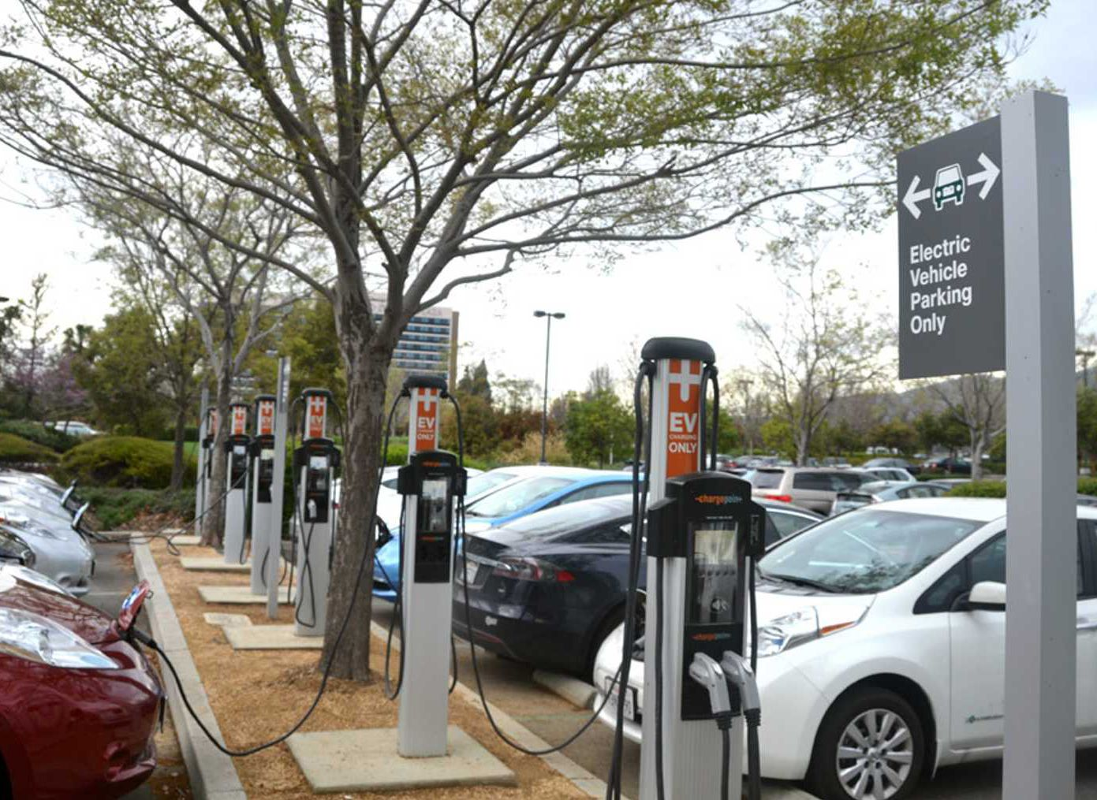
AC EVSE STANDARDS
J1772 AC Level 2
  Over 85% of commercial EVSEs are AC Level 2
  All current EV/PEV in US can use this type though some (Tesla) need adapters
  Stations cost $5K to $8K per port including installation

Slide 6
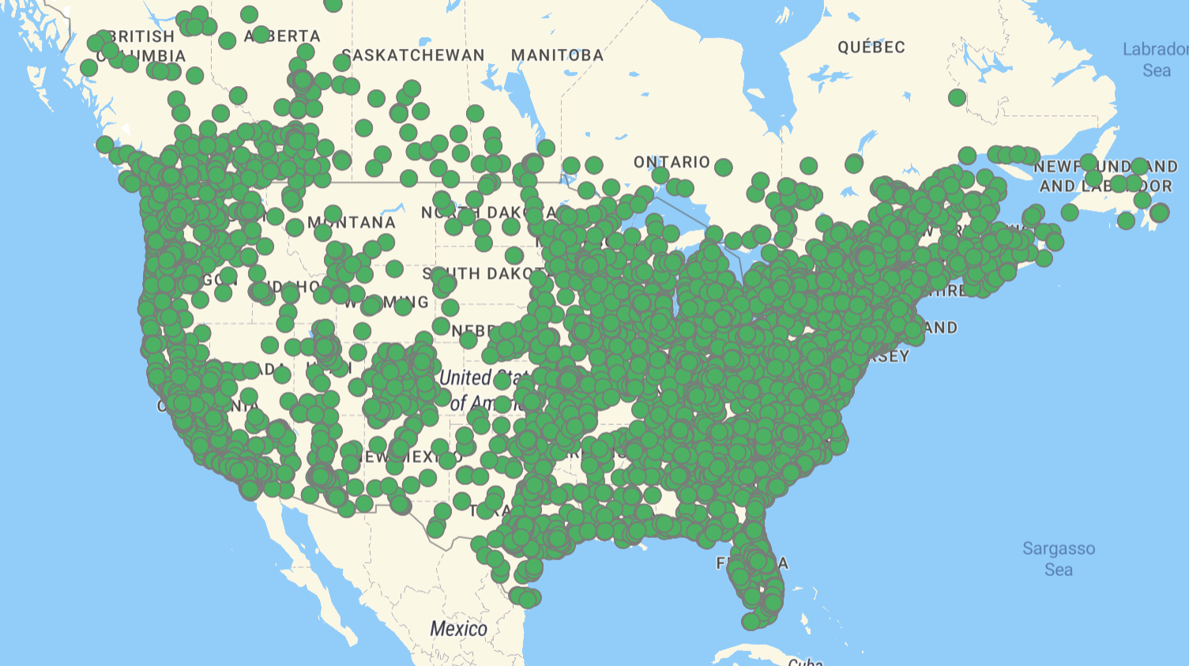
J1772 AC Level 2 Public Stations
2019
Sites:
19,216
2020
Sites:
30,145
4/2021
Sites:
43,132
Number of sites, not ports. A site typically has many ports.

Slide 7
DC EVSE STANDARDS
Standards evolving rapidly
  Combined Charging System
    CCS1 SAE J1772 North America
    CCS2 Europe
  CHadeMO (Only Nissan and Mitsubishi)
  Tesla V1
  Tesla V2/V3 (New in 2019)
  Chaoji (China, Japan, India – successor to CHadeMO and GB/T
  >100kW is considered “high end” (400V Systems)
  First US 350kW units installed Dec 10, 2018 (800V)

Slide 8
DC EVSE STANDARDS
Deployment is growing rapidly in US
  Biden proposes adding 400K stations by 2025
But slowly compared to Europe, China and Japan
Total PUBLIC chargers installed
  AC Level 1 1180
  AC Level 2 43,132 locations
  DC Rapid 6,028 locations
    Tesla 1,126 locations
    CHadeMO 4,390 locations
    J1772 4,333 locations

Slide 9
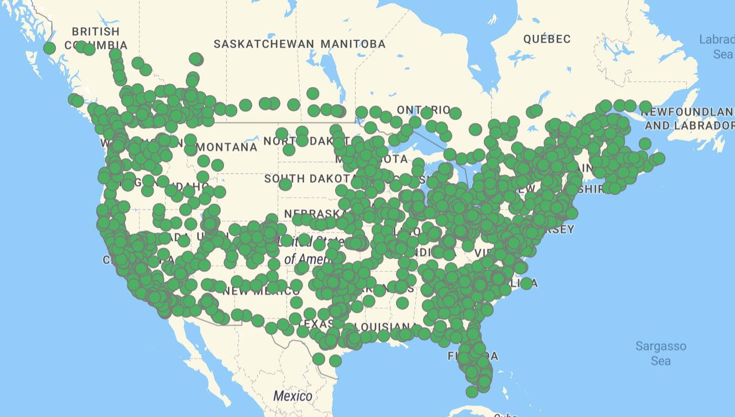
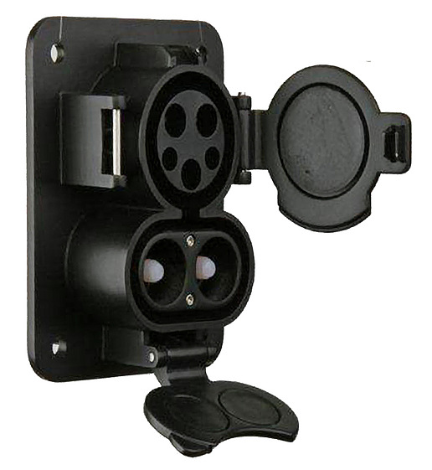
J1772 DC Public Stations
2019
Sites:
2,042
2020
Sites:
3,489
4/2021
Sites:
4,333
Number of sites, not ports. A site typically has many ports.

Slide 10
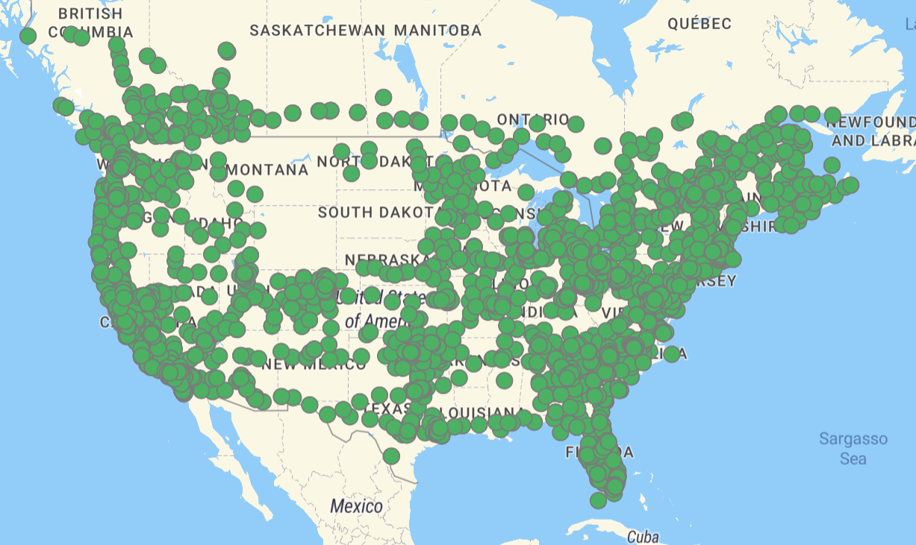
CHadeMO DC Public Stations
2019
Sites:
2,348
2020
Sites:
3,640
4/2021
Sites:
4,390
Number of sites, not ports. A site typically has many ports.

Slide 11
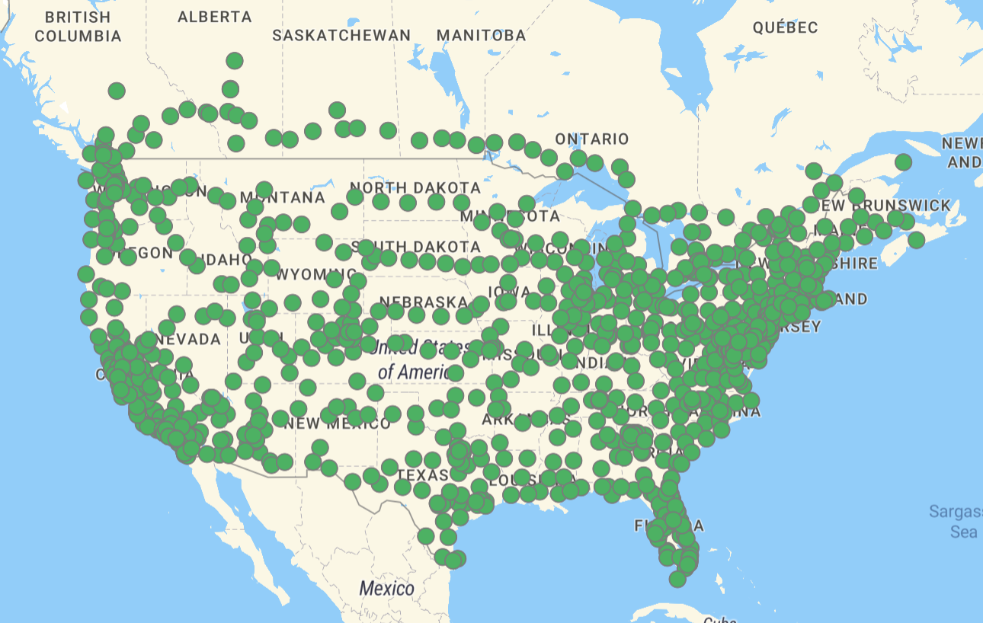
Tesla DC Public Stations
2019
Sites:
644
2020
Sites:
1,039
4/2020
Sites:
1,126
Number of sites, not ports. A site typically has many ports.

Slide 12
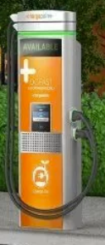
DC EVSE STANDARDS
Market Direction
  DC Generation 1 ( less than 150kW )
    Nominal 400-500 VDC
    Up to 300 A max
    All current EV’s except one
  DC Generation 2 ( up to 400 kW )
    Nominal 800 VDC (1000VDC max)
    Up to 350A typ, 500 A max
    Multiple vehicles announced for 2022
    Expected to be the norm by 2025

Slide 13
The EVSE Market
Charge Times (hours)

Slide 14
The EVSE Market
Fill the Tank Costs
Evgo $0.31/kWh subscriber price (~$0.10/mile)
Compare to gas at $3.00/gal in a 30mi/gal vehicle

Slide 15
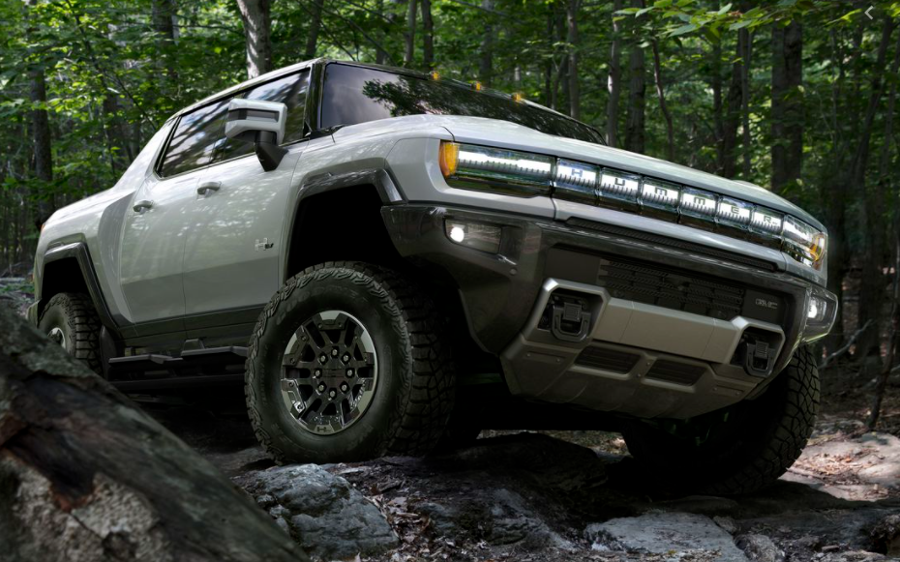
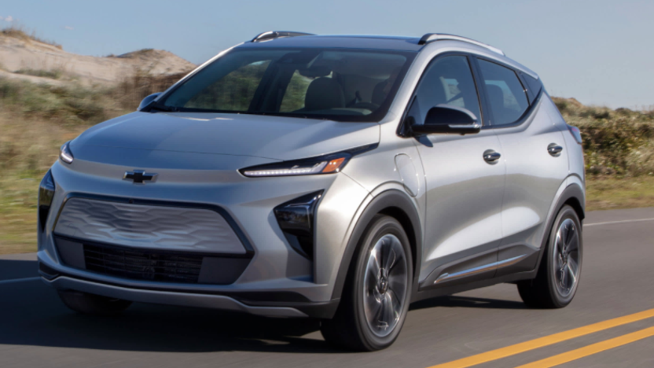
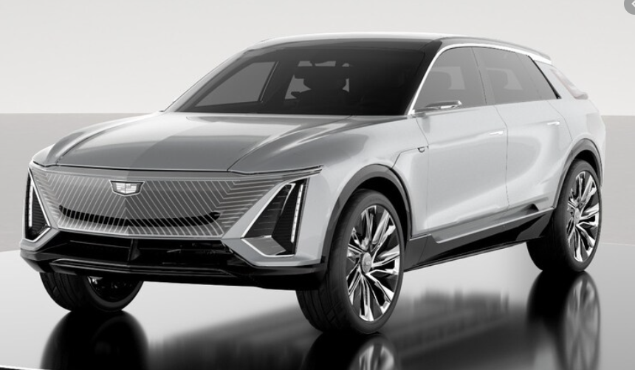
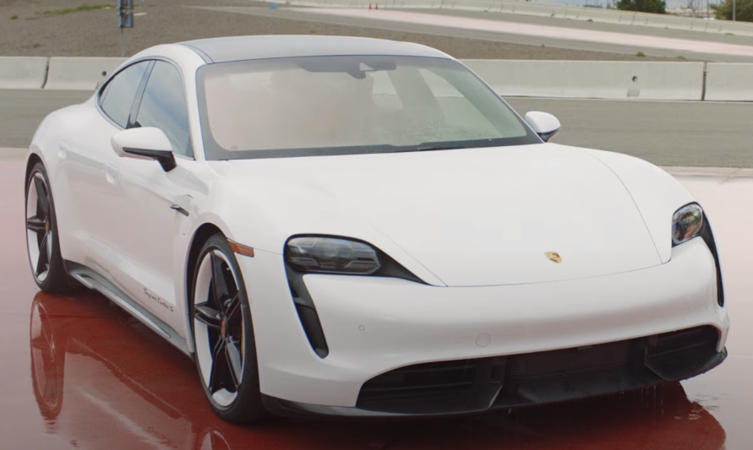
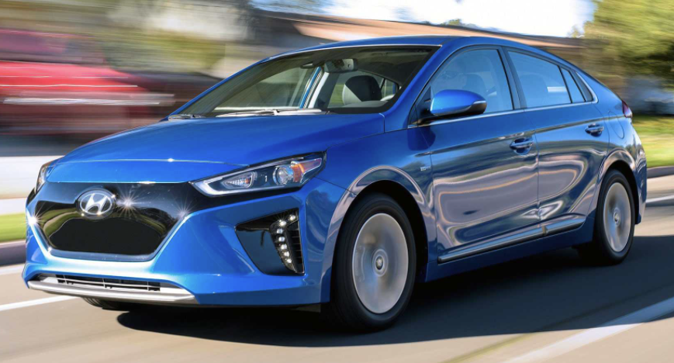
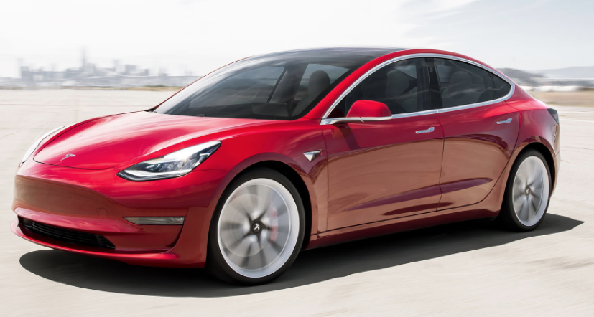
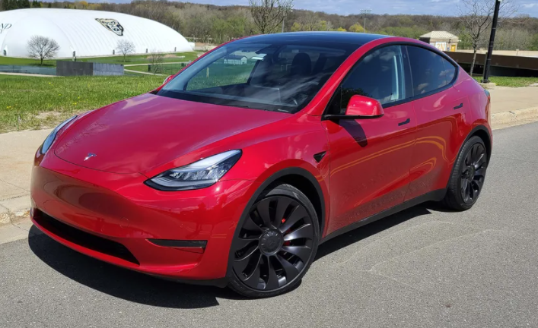
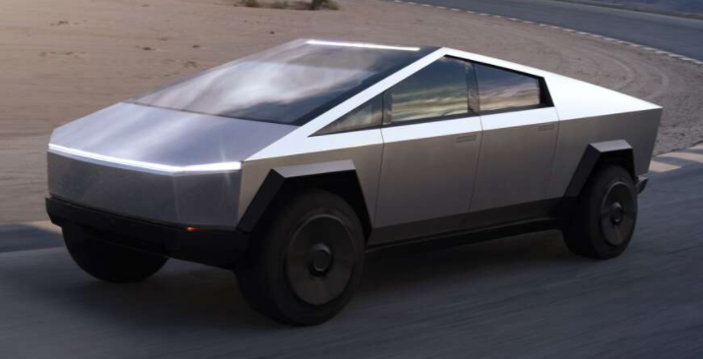
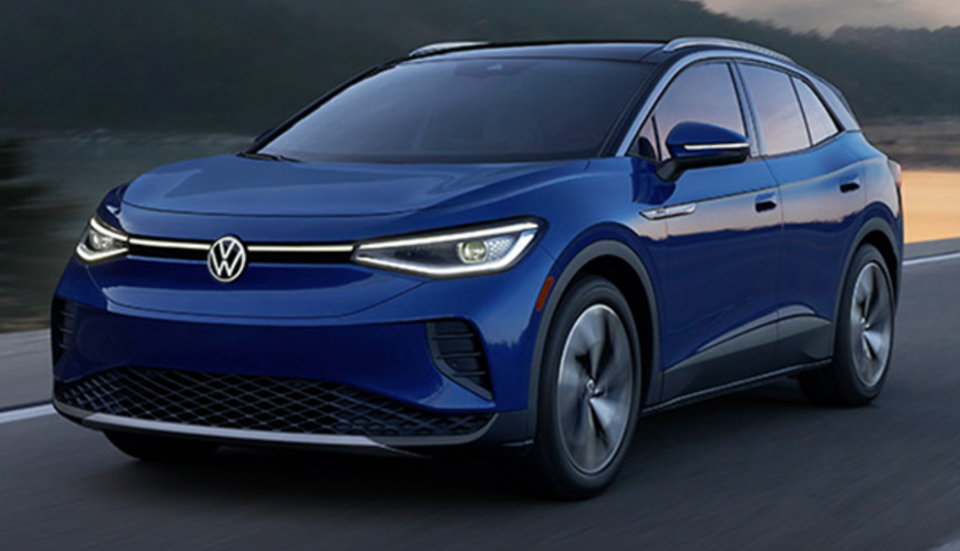
The EV Market
Manufacturers have announced over 100 EV models
to be introduced by 2024.

Slide 16


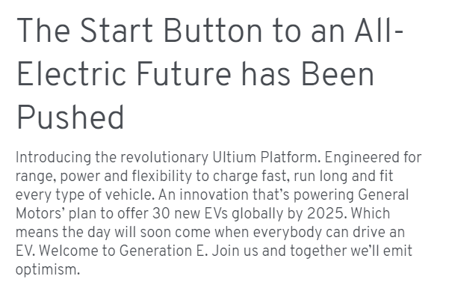
The EV Market
30 by 2025

Slide 17


The EV Market
Ford announced during its fourth-quarter earnings report that it will invest $22 billion in electric vehicles and $7 billion in autonomous vehicles through 2025.

Slide 18
The EV Market
Hyundai Unveils EV Platform, Will Have 23 Global Electric Vehicles by 2025
Toyota Details New EV Models Launching for 2022–2025
BMW raises target for EV sales, plans new electric-focused platform

Slide 19
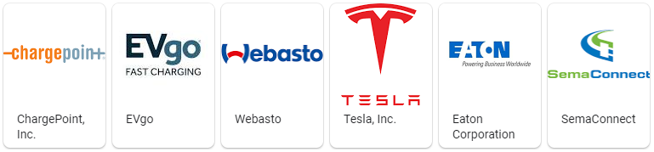
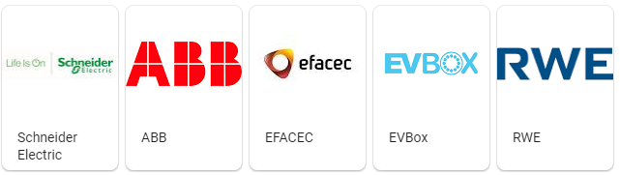
EVSE Manufacturers
Major charging system manufacturers

Slide 20
Charging Networks
Major charging system networks
  Blink
  Chargepoint
  Electrify America
  EvGo
  Tesla
  Volta

Slide 21
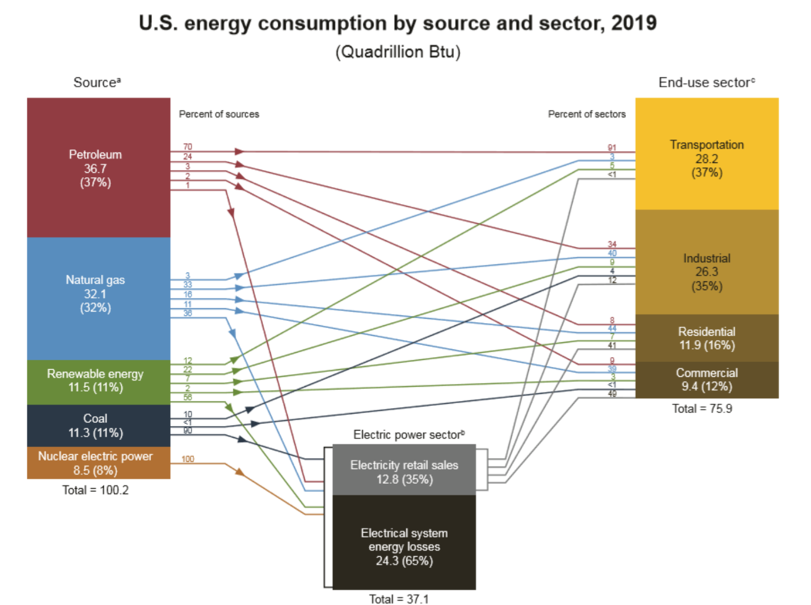
US Total Energy Consumption
8.26E6 GWh
3.75E6 GWh
7.12E6 GWh
10.87E6 GWh

Slide 22
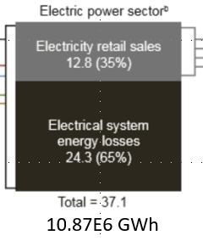
US Electric Energy Consumption
Americans drove 3.23 trillion miles in 2019. If this was all done in electric vehicles getting 3 mi/kWh, then we would need 1.1E6 GWh of energy just to charge cars.
3.75E6 GWh
30% of total US capacity just to charge Cars!!!
Average household uses 10.6 MWh/yr.
Charging their cars would take 8.8 MWh/yr.

Slide 23
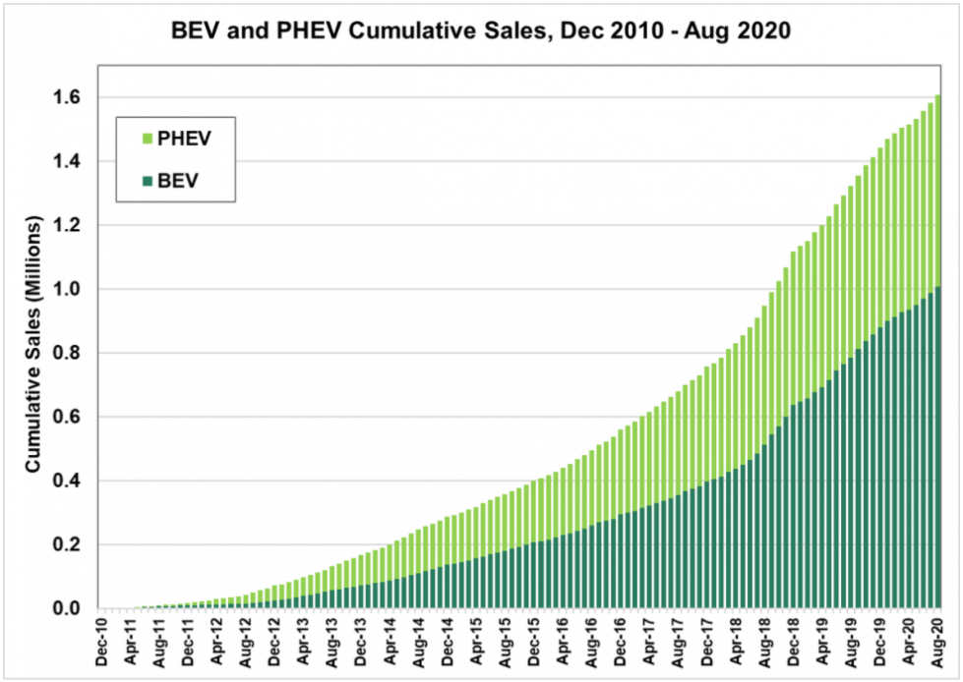
The US EV Market

Slide 24
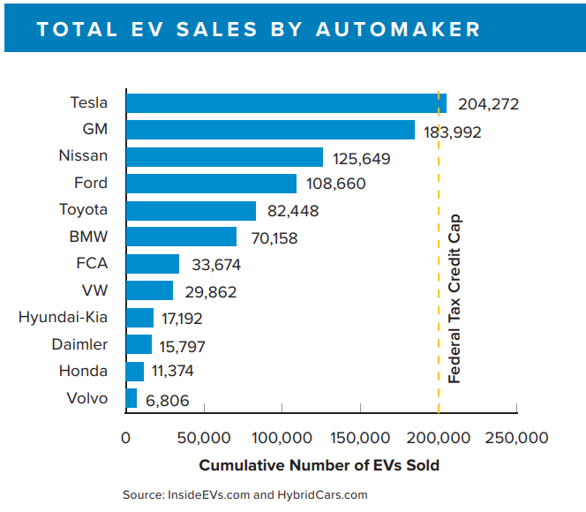
The US EV Market

Slide 25
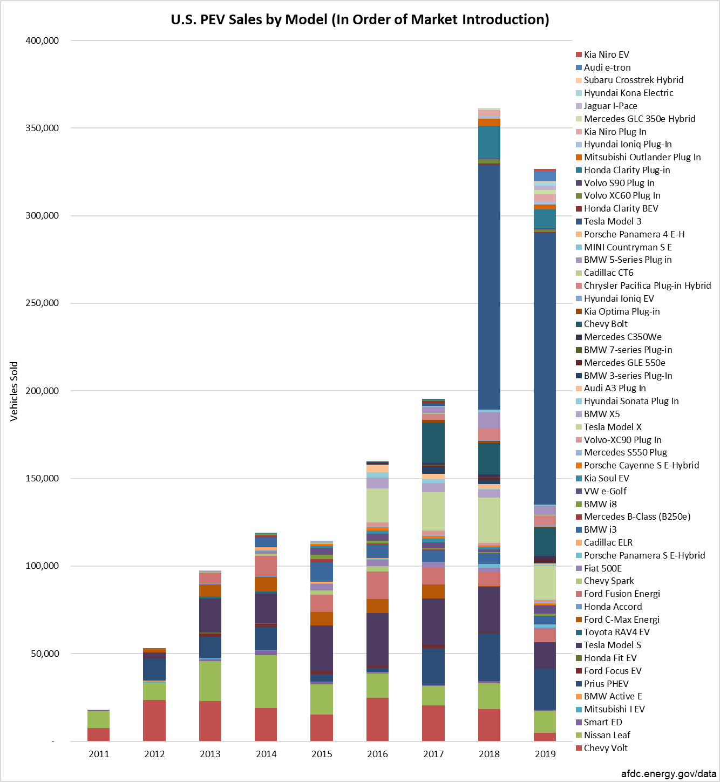
The EV Market
55 EV/PHEV Models were sold in the US in 2019
TESLA Model 3

Slide 26
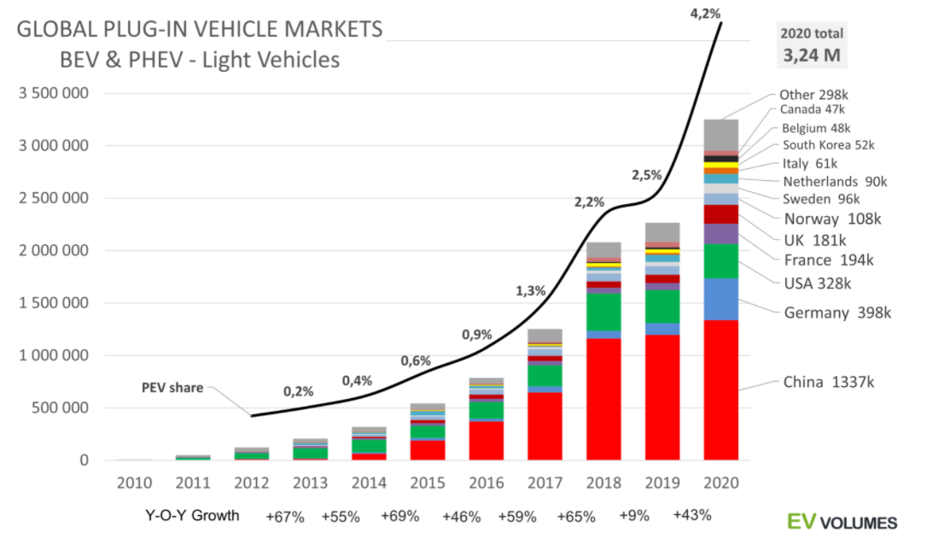
The World EV Market

Slide 27
Regulatory Background
Sales of electricity as a vehicle fuel are regulated by the Department of Commerce
Like all sales of all things based on quantity sold, EVSE sales are regulated by NIST Handbooks 130 and 44.
HB130 establishes that all sales of electricity as a vehicle fuel must be based on the quantity delivered.
HB44 sets performance requirements for devices (Electric Vehicle Service Equipment) used to dispense electricity for sale.

Slide 28
HB44 Applicability
A.1. General
This code applies to devices, accessories, and systems used for the measurement of electricity dispensed in vehicle fuel applications wherein a quantity determination or statement of measure is used wholly or partially as a basis for sale or upon which a charge for service is based.

Slide 29
HB44 Applicability
Exceptions-This code does not apply to:
  The use of any measure or measuring device owned, maintained, and used by a public utility or municipality only in connection with measuring electricity subject to the authority having jurisdiction such as the Public Utilities Commission.
  Electric Vehicle Supply Equipment used solely for dispensing electrical energy in connection with operations in which the amount dispensed does not affect customer charges or compensation.
  The wholesale delivery of electricity.

Slide 30
HB44 Applicability
Use Cases – NOT COVERED
  A store provides a free EVSE in its parking lot
  A paid parking lot provides EVSEs for which there is no charge based on the amount of energy delivered
  Tesla provides free charging services for some owners
  An organization charges a monthly fee for unlimited use of its network of EVSEs.

Slide 31
HB44 Applicability
Use Cases –COVERED
  ANY transaction which is based on the amount of energy delivered
  Examples
    A network of charge stations charges a monthly fee to belong AND a fee based on the amount of energy used
    A EVSE charges for the amount of energy delivered
    A parking lot charges for parking and EVSEs located in it also charge for the amount of energy delivered if used

Slide 32
HB44 Requirements
Type Approval
  All EVSE used in commercial transactions (subject to HB44) must pass type approval by an NTEP testing laboratory.
    NTEP is National Type Evaluation Program which is created by NIST and run by the National Conference of Weights and Measures.
    For EVSE, the NTEP lab is the CTEP lab of the California Department of Weights and Measures
    EVSE type approvals for AC EVSE are being done now.
    Three devices have been approved.

Slide 33
HB44 Requirements
Metrological Requirements of HB44
  S.3.1. Metrological Components. – An EVSE measuring system shall be designed and constructed so that metrological components are adequately protected from environmental conditions likely to be detrimental to accuracy.
  S.3.5. Temperature Range for System Components. – EVSEs shall be accurate and correct over the temperature range of – 40 °C to + 85 °C (− 40 °F to 185 °F).
  S.8. Minimum Measured Quantity (MMQ). – The minimum measured quantity shall satisfy the conditions of use of the measuring system as follows:
    (a) Measuring systems shall have a minimum measured quantity not exceeding 2.5 MJ or 0.5 kWh.

Slide 34
HB44 Requirements
Accuracy Tests
  N.1. No Load Test. – A no load test may be conducted on an EVSE measuring system by applying rated voltage to the system under test and no load applied.
  N.2. Starting Load Test. – A system starting load test maybe conducted by applying rated voltage and 0.5-ampere load.
  N.5.2. Accuracy Testing. – The testing methodology compares the total energy delivered in a transaction and the total cost charged as displayed/reported by the EVSE with that measured by the measurement standard.
    Light Load Test. - ≤ 15% of maximum available charge current
    Full Load Test. - ≥ 85% of maximum available charge current

Slide 35
HB44 Requirements
Commissioning
  All EVSE used in commercial transactions (subject to HB44) must have their performance verified after installation and before any sale can occur.
  EVSE performance must be reverified on a periodic basis as long as they are in service.
  EVSE are treated as fuel dispensers just like a gas pump. They are inspected and “sealed” by state/county Department of Weights and Measures personnel.

Slide 36
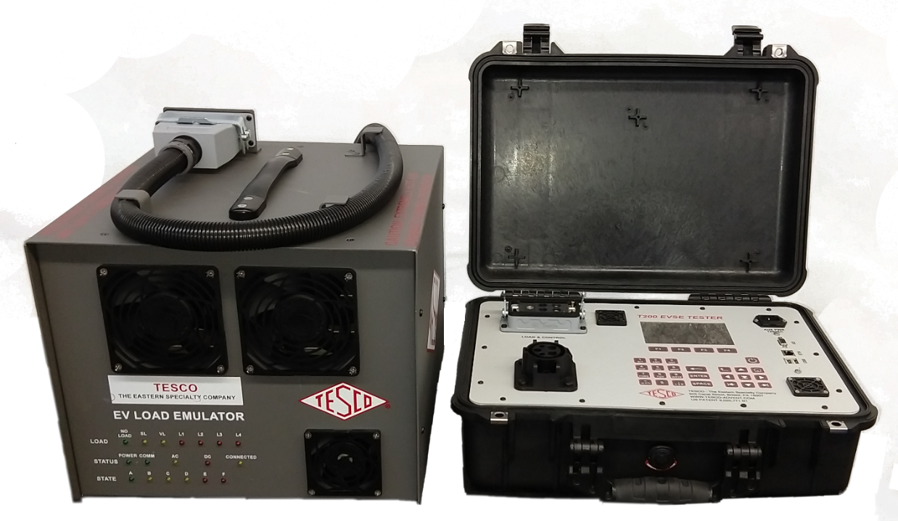
First Generation Test Solutions
PL200 200 AC Level 1 & 2 to 64 Amps
PL400 AC Level 1 & 2 to 64 Amps, DC Level 2 to 32 Amps

Slide 37
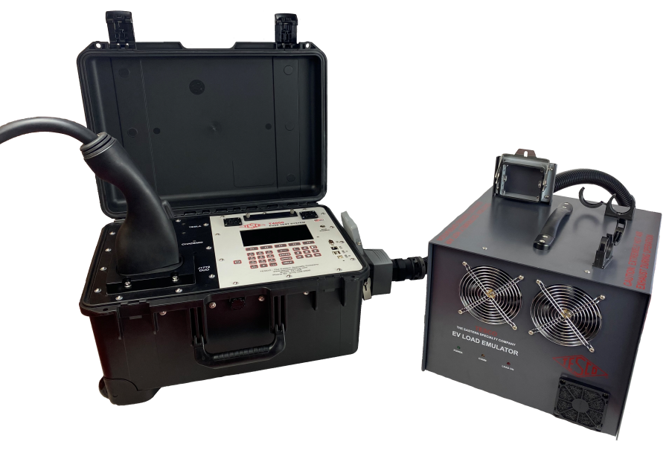
Second Generation EVSE Site Testers

Slide 38
Second Generation EVSE Tester
Universal Testing Capabilities
  AC Single Phase (CCS1, CCS2, GB/T, Tesla)
  AC 3-Phase (CCS2, GB/T)
  DC to 200A at 1000V (Higher when connectors are available)
    CCS1 (J1772 DUO)
    CCS2
    CHadeMO
    GB/T
    Tesla
  Use programmable load to 17kW or EV for higher DC loads

Slide 39
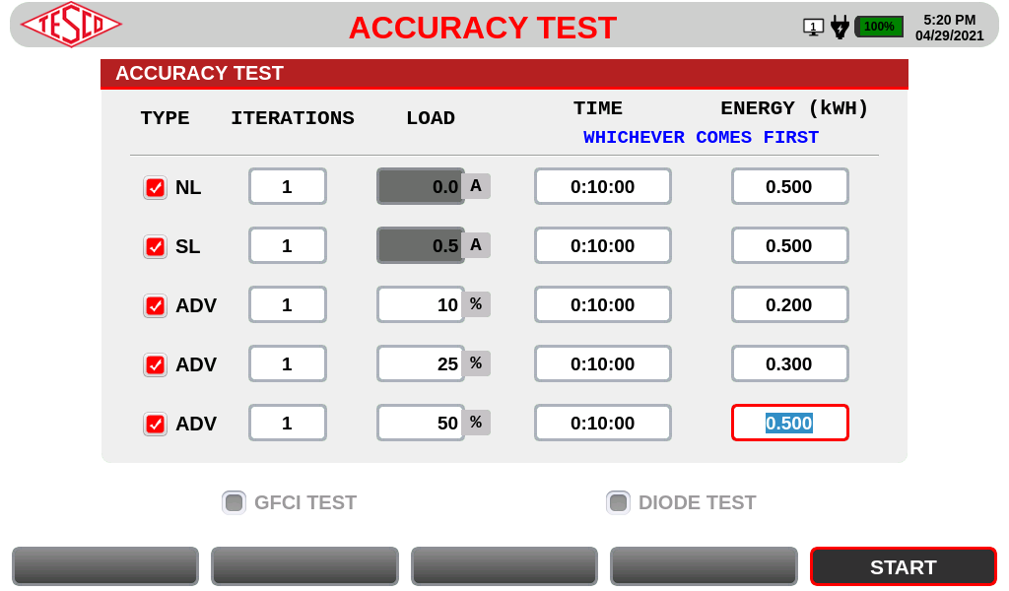
Industry Needs
Automated Operation
  Create Test sequences that completely automate process
  Testing is then a simple one click process
  Why?

Slide 40
Certification and Traceability
None of this means anything if we can not certify and provide traceability for these tests.
Two general approaches – New York approach and California Approach
Traceability through a National Lab to an International Standard
  This requires a DC “Standard”
  Fortunately DC Power = VA
    Need a certifiable voltage source and a certified current source and the ability to measure down to the appropriate levels for both Volts and Amps, then have a National Lab do the same test on the lab equipment
ANSI has also spent a great deal of time creating a new Standard to cover DC Metering – ANSI C12.32 ready for re-balloting this year. This will be the DC version of C12.1 for AC metering.

Slide 41

Questions and Discussion
Tom Lawton
President
tom.lawton@tescometering.com
TESCO – The Eastern Specialty Company
Bristol, PA
215-228-0500
This presentation can also be found under Meter Conferences and Schools on the TESCO website: tescometering.com
ISO 9001:2015 Certified Quality Company
ISO 17025:2017 Accredited Laboratory

