Slide 1

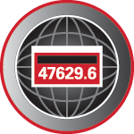

CT Testing:
Theory and Practice
Presented Tom Lawton, TESCO
The Eastern Specialty Company
For North Carolina Electric Meter School
Polyphase
Tuesday, June 15, 2021 at 3:45 p.m.
10/02/2012
Slide 1
Notes:
1

Slide 2
What we will cover
Why do we test CT’s?
Shop testing
How to read and interpret a transformer face plate
Types of field tests
Magnetization effects and demagnetization

Slide 3
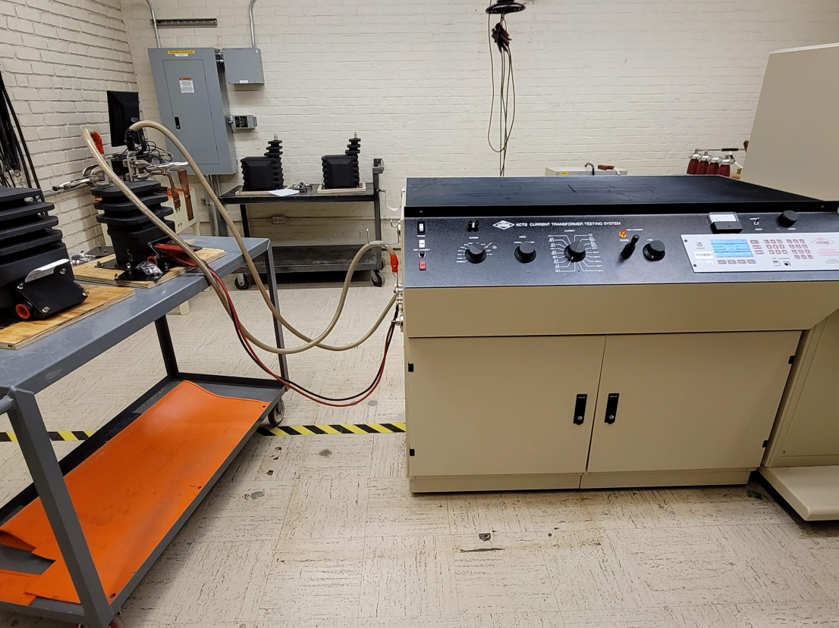
Shop Testing
New Transformers
  Manufacturer’s tests
  Utility tests

Slide 4
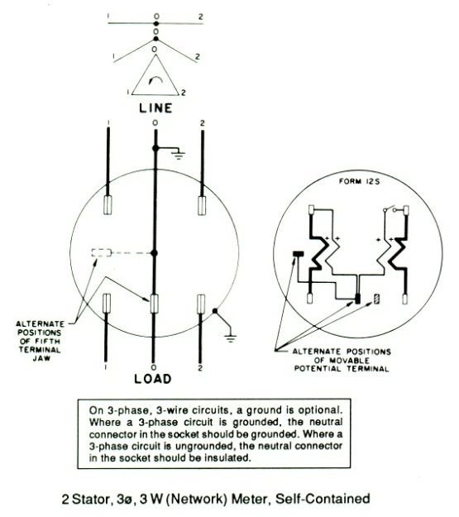

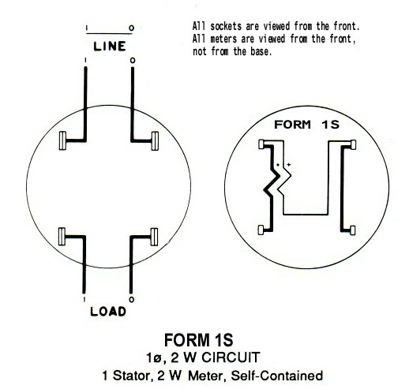
Self-Contained vs. Transformer-Rated
1S, 2S, 3S, 4S, 9S, 12S, 16S, 45S, etc., etc.
What’s the Difference?
Different Forms for Different Services and Applications

Slide 5
Self-Contained vs. Transformer-Rated
Self-Contained
(direct)
Transformer-Rated
(indirect)

Slide 6
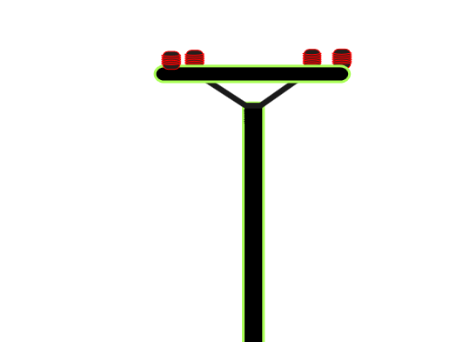
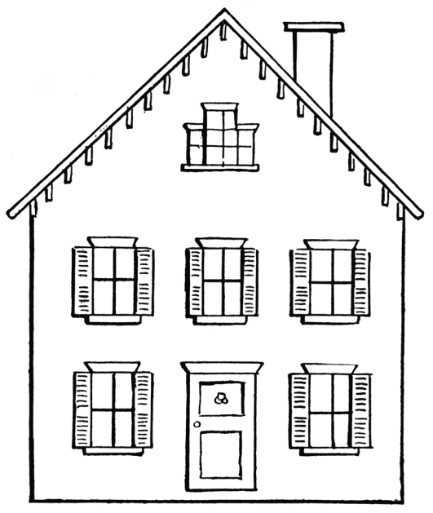
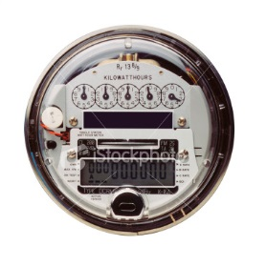
Self-Contained
Primarily Residential
(1S, 2S, 12S)
Relatively Low Current
Example: 100A

Slide 7
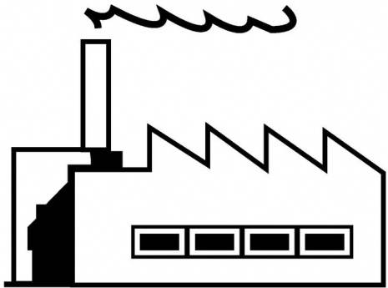
Transformer-Rated
Primarily Commercial/Industrial
(9S, 16S)
Relatively High Current
Example: 400A

Slide 8
What is a CT?
“A current transformer (CT) is used for measurement of alternating electric currents. Current transformers, together with voltage (or potential) transformers (VT or PT), are known as instrument transformers. When current in a circuit is too high to apply directly to measuring instruments, a current transformer produces a reduced current accurately proportional to the current in the circuit, which can be conveniently connected to measuring and recording instruments. A current transformer isolates the measuring instruments from what may be very high voltage in the monitored circuit. Current transformers are commonly used in metering and protective relays in the electrical power industry.” - Wikipedia

Slide 9
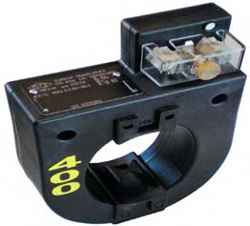
Transformer-Rated
Primarily Commercial/Industrial
(9S, 16S)
Relatively High Current
Example: 400A
400:5
5A

Slide 10
Current Transformers Conceptual Representation
Ideal. No losses
Real, with core losses

Slide 11
CT’s – Functions and Terminology
Ratio
For instance, a CT with a 400:5 ratio will produce
5A on the secondary, when 400A are applied
to the primary.

Slide 12
CT’s – Functions and Terminology
Thermal Rating Factor
A value representing the amount by which the primary current can be increased without exceeding the allowable temperature rise.
For instance, a RF of 4.0 at 30° ambient on a 400:5 ratio CT would allow for a primary current up to 1600A.

Slide 13
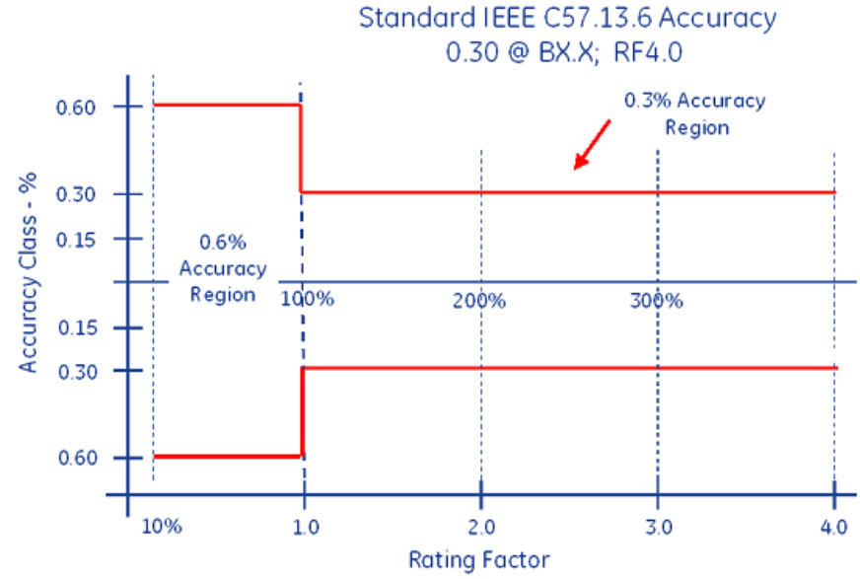
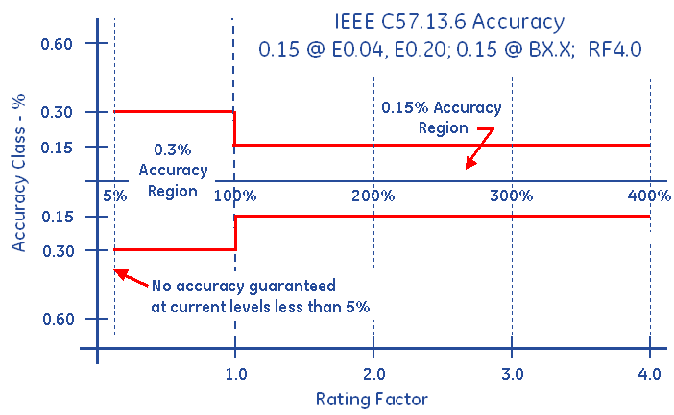
CT’s – Functions and Terminology
Accuracy Classifications and Burden
All CT’s fall within an accuracy class.
IEEE Standards have defined accuracy classes.

Slide 14
CT’s – Functions and Terminology
Accuracy Classifications and Burden
Example: 0.3% @ B0.1, B0.2, B0.5

Slide 15
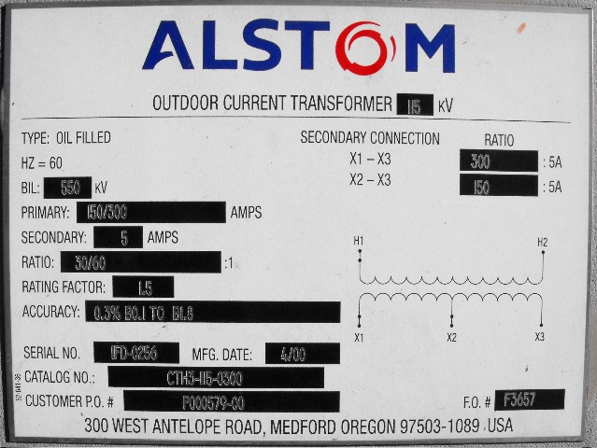
CT’s – Functions and Terminology
Faceplate

Slide 16
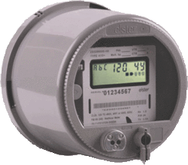
Transformer-Rated
9S Meter Installation
SOURCE
LOAD
PHASE A
400A
PHASE B
400A
PHASE C
400A
5A
5A
5A

Slide 17
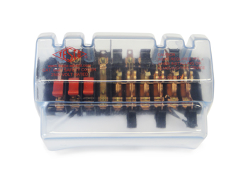
Transformer-Rated
9S Meter Installation
SOURCE
LOAD
PHASE A
400A
PHASE B
400A
PHASE C
400A
5A
5A
5A

Slide 18
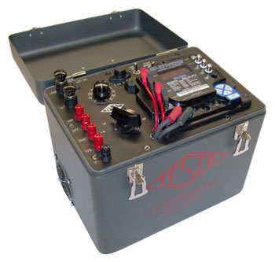
Meter Testing
9S Meter Installation
SOURCE
LOAD
PHASE A
400A
PHASE B
400A
PHASE C
400A
Isolate the Meter
from the Service
5A
5A
5A
P

Slide 19
Meter Testing
9S Meter Installation
SOURCE
LOAD
PHASE A
? ? ?
400A
PHASE B
400A
PHASE C
400A
5A
5A
5A

Slide 20
Meter Testing
9S Meter Installation
SOURCE
LOAD
PHASE A
400A
PHASE B
400A
PHASE C
400A
What if?
355:5
405:5
200:5
Shorted
etc.
5A
5A
5A

Slide 21
CT Testing
CT Testing is Important!
Test for correct ratio
Test for functionality at rated burdens

Slide 22
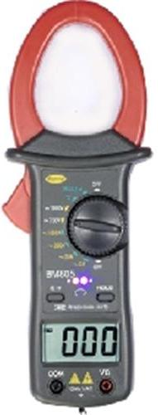
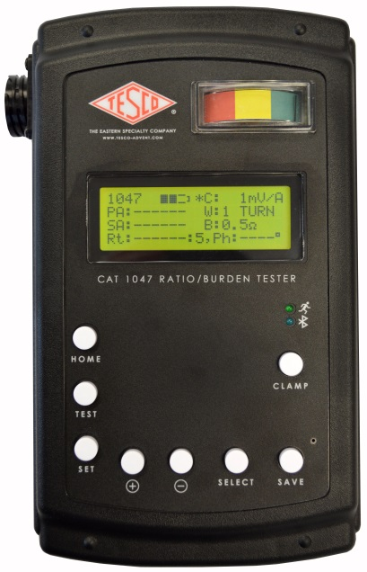
Ratio Testing
Ratio of Primary Current to Secondary Current
SOURCE
LOAD
PHASE A
400A
400A
400A
5A
5A
5A
Calculate Ratio

Slide 23

Burden Testing
Functionality with Burden Present on the Secondary Loop
PHASE A
Some burden will always be present – junctions, meter coils, test switches, cables, etc.
CT’s must be able to maintain an accurate ratio with burden on the secondary.

Slide 24
Burden Testing
Functionality with Burden Present on the Secondary Loop

Slide 25
Burden Testing
Functionality with Burden Present on the Secondary Loop
Example Burden Spec:
0.3% @ B0.1, B0.2, B0.5
or
There should be less than the 0.3% change in secondary current from initial (“0” burden) reading, when up to 0.5Ohms of burden is applied

Slide 26
Burden Testing
Functionality with Burden Present on the Secondary Loop
ANSI Burden Values
0.1 Ohms
0.2 Ohms
0.5 Ohms
1 Ohms
2 Ohms
4 Ohms
8 Ohms

Slide 27
Burden Testing
0.3% @ B0.1, B0.2, B0.5
Initial Reading = 5Amps
0.3% x 5A = 0.015A
5A – 0.015 = 4.985A
Burden | Reading
0 | 5.0000
0.1 | 4.9999
0.2 | 4.9950
0.5 | 4.9900
1 | 4.9800
2 | 4.9500
4 | 4.0000
8 | 0.8000

Slide 28
Burden Testing
0.3% @ B0.1, B0.2, B0.5
Initial Reading = 5Amps
0.3% x 5A = 0.015A
5A – 0.015 = 4.985A
At 0.5Ohms of Burden
the secondary current is still at 4.990A – Less than 0.3% change – Good CT!
Burden | Reading
0 | 5.0000
0.1 | 4.9999
0.2 | 4.9950
0.5 | 4.9900
1 | 4.9800
2 | 4.9500
4 | 4.0000
8 | 0.8000

Slide 29
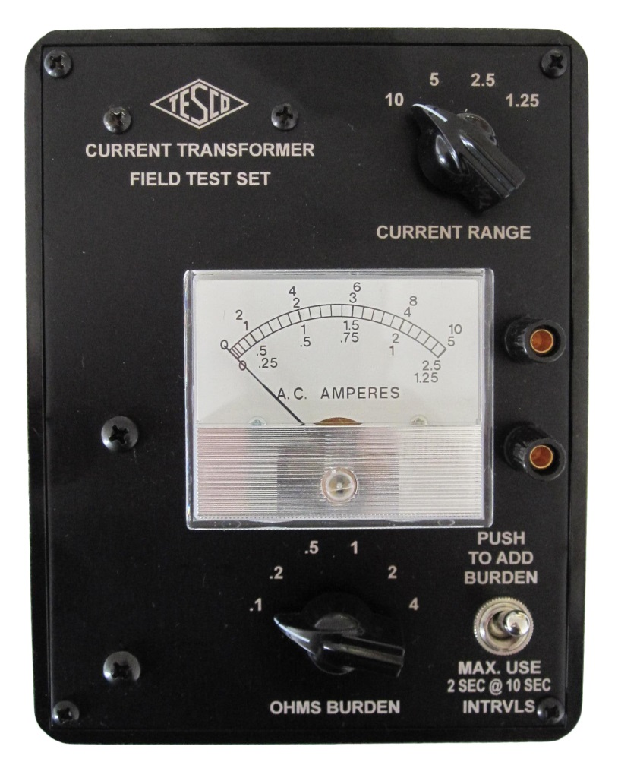
Analog Testing
Application of Burden and Calculation
Manual reading of initial and post-burden secondary currents

Slide 30
Admittance Testing
Admittance test results are not immediately intuitive.
Some analysis and interpretation is need.
What do all these mS values mean?

Slide 31
Admittance Testing
What is Admittance?
Measured in units of MiliSiemens (mS)
Admittance is the inverse of impedance.
Impedance is the opposition to current.
Therefore, admittance testing measures the overall “health” of the secondary loop of the CT.

Slide 32
Admittance Testing
Admittance testing devices inject an audio sine wave signal into the secondary loop of the CT.
The resulting current is measured.
The voltage of the initial signal is known.
From these two parameters, the impedance, and thus the admittance can be calculated.

Slide 33
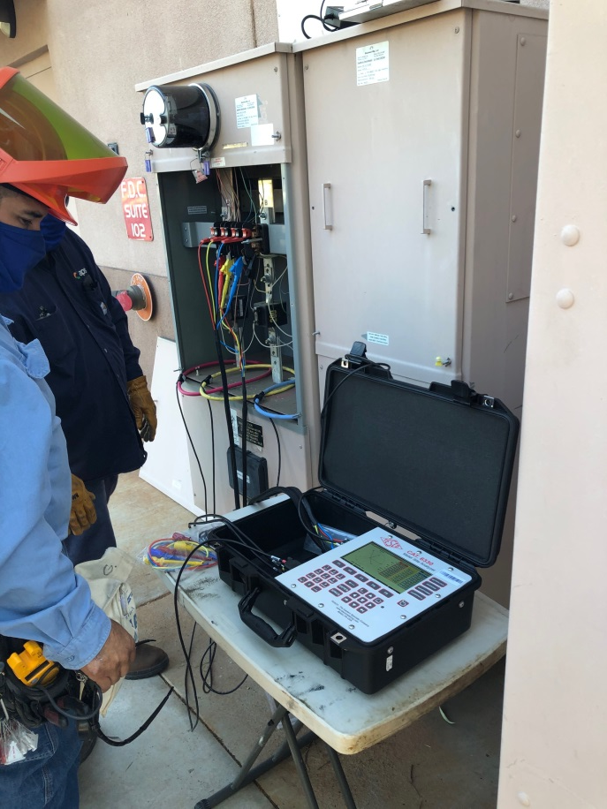
Admittance Testing
Three phase process is recommended.
Test each CT individually
Test the matched sets
Test over time

Slide 34
De-magnetization
CT’s can become magnetized, due to a number of reasons, including leaving the shorting clip open, near lightning strikes, and harmonic content.
CT’s can be demagnetized by slowly and smoothly increasing the secondary resistance until saturation occurs, and then slowly and smoothly decreasing the secondary resistance.
A resistance that will cause a secondary current reduction of 65% to 75% will typically put the CT into saturation.

Slide 35
What we covered
Why do we test CT’s?
Shop testing
How to read and interpret a transformer face plate
Types of field tests
Magnetization effects and demagnetization

Slide 36

Questions and Discussion
Tom Lawton
President
tom.lawton@tescometering.com
TESCO – The Eastern Specialty Company
Bristol, PA
215-228-0500
This presentation can also be found under Meter Conferences and Schools on the TESCO website: www.tescometering.com
ISO 9001:2015 Certified Quality Company
ISO 17025:2017 Accredited Laboratory

