Slide 1
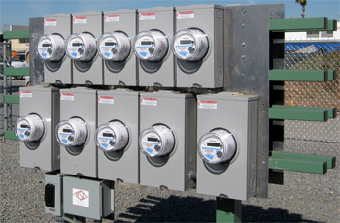
Asset Insights Through Analytics
Prepared by Perry Lawton, TESCO
The Eastern Specialty Company
For North Carolina Electric Meter School
Emerging Technologies
Tuesday, June 15, 2021 at 10:30 a.m.

Slide 2
The Path Forward – Successful AMI Deployment
Organizations that want to grow their business are adopting analytics and business intelligence to increase responsiveness, reduce operational costs and improve asset integrity.
Business intelligence / analytics are crucial to solving key business problems for all organizations. For utilities, it can turn information from smart meter and smart grid projects into meaningful operational insights and understandings about their customer’s behavior.

Slide 3
Investment and Returns
Many companies have been concerned about the high costs and complexity of data. To reduce those concerns, organizations simply need to take a structured approach. This change begins with a realistic review of their analytics maturity levels: where they want to get to, and what they want to achieve.

Slide 4
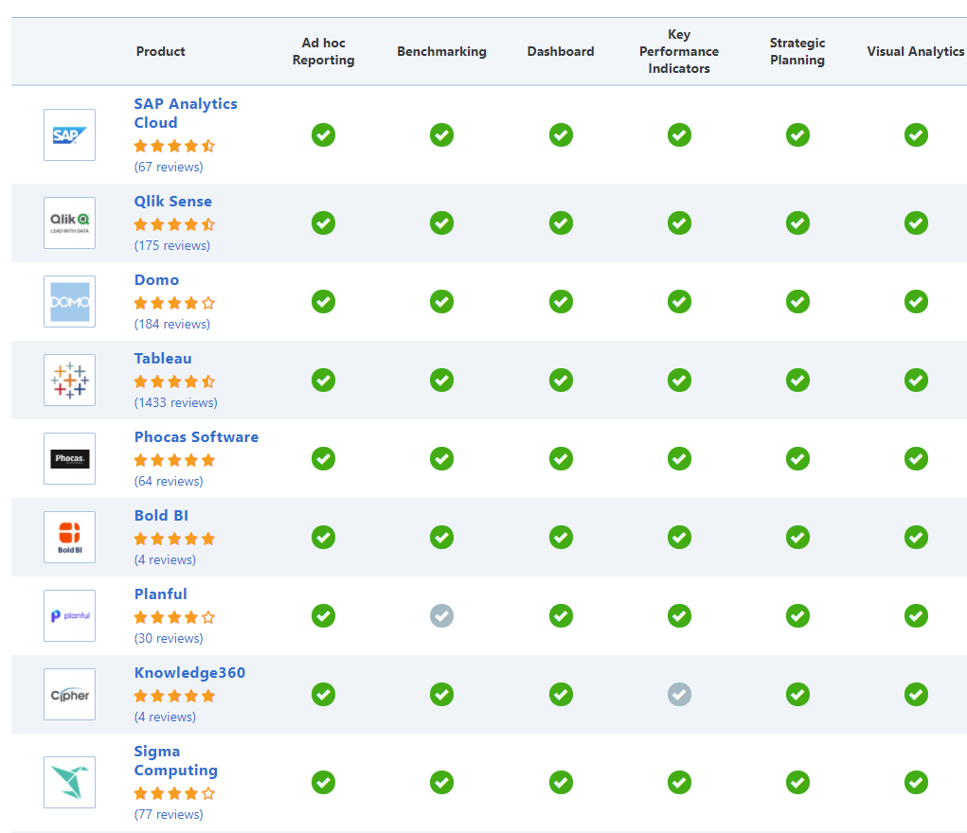
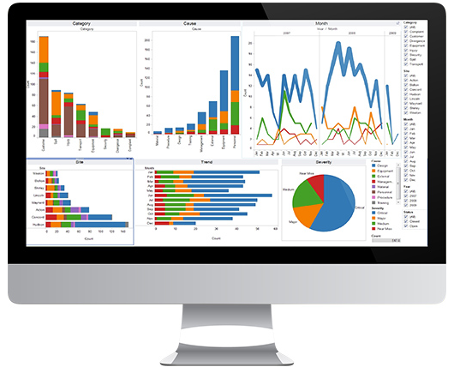
COTS, Niche Providers, OpenSource, Enterprise Software
It is expected by Gartner that by the end of 2020 at least 25% of new monitoring and control systems in the utility sector will use IoT to enhance the algorithmic business capabilities.

Slide 5
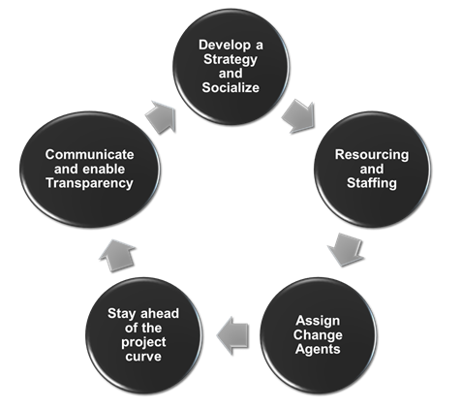
If you Build it, They MAY Come
Start change management early in the project lifecycle
Gain cross-functional consensus with stakeholders
Develop a clear strategy, baseline and define the key performance indicators: (Revenue Protection, Efficiency gains, Compliance Risk, Customer Satisfaction…) and their associated metrics
Staff associates assigned to project should be their only assignment. If part-time, state their dedicated allocation.
Keep change management efforts ahead of the project curve with constant , transparent updates and successes.

Slide 6
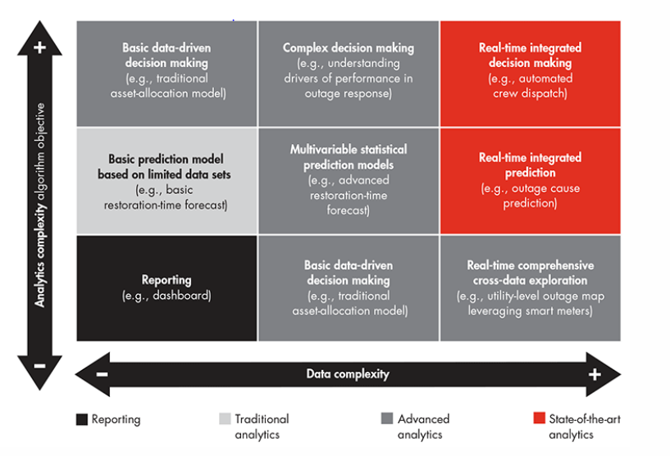
Getting Started

Slide 7
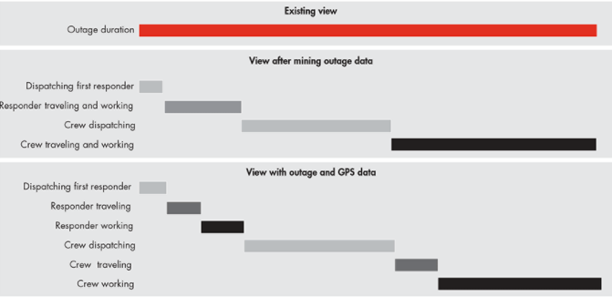
Finding the Value in the Raw Data
Analytics will help utilities shift from traditional and costly time-based asset management, where network repairs are done on schedule regardless of how much useful life is left in an asset, to a more informed reliability-based approach of making repairs when they are actually needed. Moreover a coordinated cross-enterprise vision can help reduce IT costs.

Slide 8
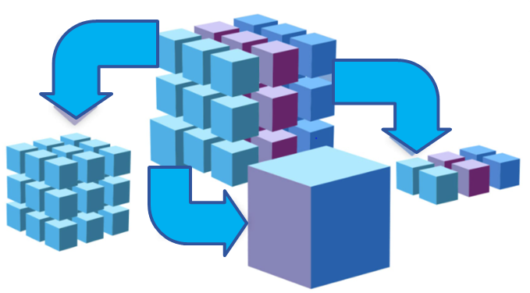
Quantifiable Targets
By using the data already in their possession, utilities can see comprehensive information about each of their assets, from purchase through retirement and define measurable goals and success criteria
This data is enabling us to roll fewer trucks for emergencies.
This data is allowing us to identify weak spots in our infrastructure and correct them between 8 AM and 4 PM Monday to Friday on non-storm days.
The data is allowing us to perform long term planning and perform far better rate analysis for proposed new tariffs and to even help create new tariffs.
The data allows us to better evaluate performance of hardware on our infrastructure.
The data gives us the tools for the first time to measure, identify, and go after “system loss” in a meaningful and actionable way.
Detection of losses due to oversized current transformer.
Data analytics will enable utilities to tackle the biggest problems we face today, including failing transformers, unbalanced energy generation based on imprecise forecasts, operational inefficiencies and even addressing and reducing line loss.

Slide 9
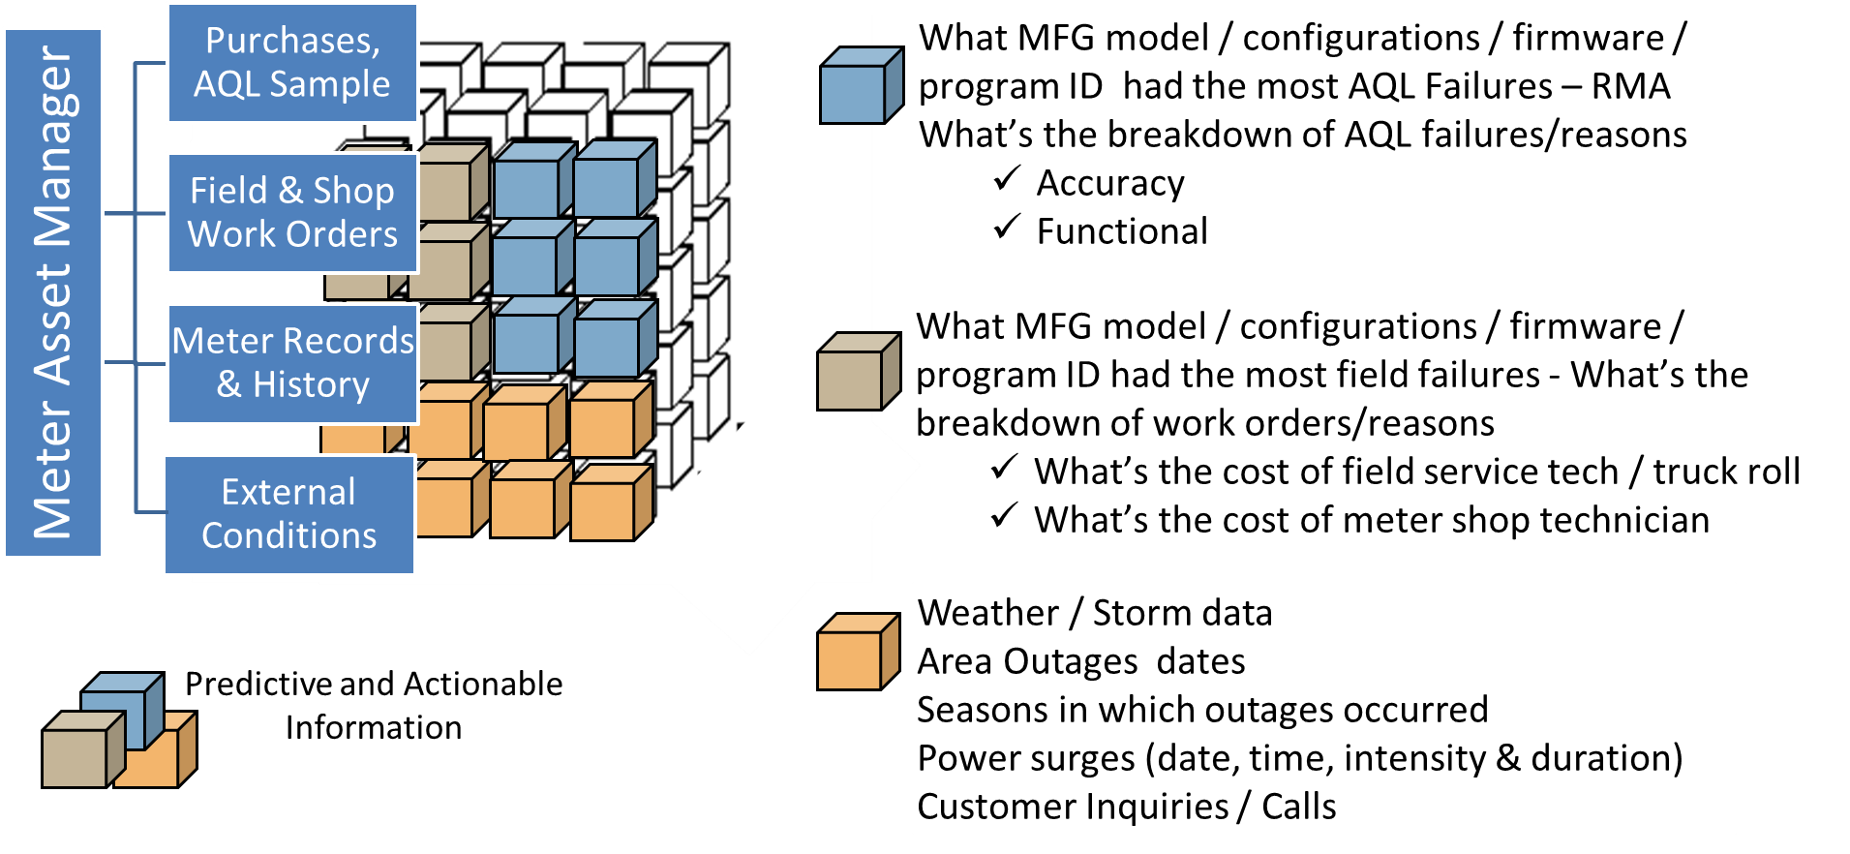
How Can We Use It?

Slide 10
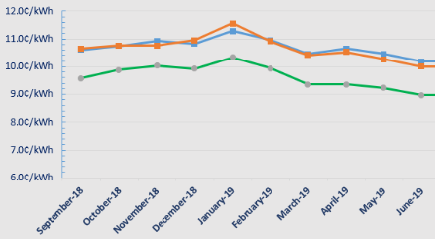
Market the Right Message
Knowledge is Power
Educate the Consumer
Compare & Measure Usage
Enabling customers to better manage and reduce their energy costs
Improved disputes & settlements
Improving system efficiency and resiliency
Improve Outage Detection and Restoration
Improve Industry Standards Compliance
Reduce Carbon Emissions
Increased flexibility in rate design

Slide 11
Questions and Discussion
Perry Lawton
Northeast Regional Sales Manager
perry.lawton@tescometering.com
TESCO – The Eastern Specialty Company
Bristol, PA
215-228-0500
This presentation can also be found under Meter Conferences and Schools on the TESCO website: www.tescometering.com
ISO 9001:2015 Certified Quality Company
ISO 17025:2017 Accredited Laboratory

