Slide 1
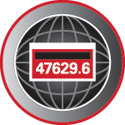
21st Century Power Measurements
Prepared by Tom Lawton, TESCO
The Eastern Specialty Company
For North Carolina Electric Meter School
Advanced/Management/Emerging Technologies Combined Session
Wednesday, June 15, 2022 at 10:30 AM

Slide 2
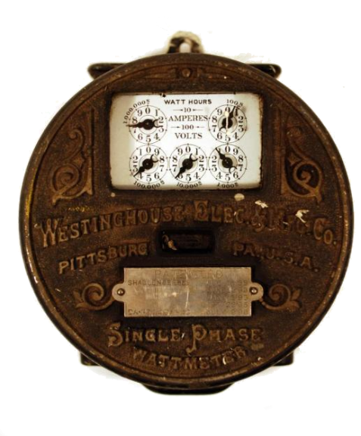
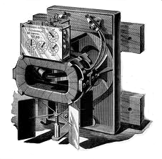
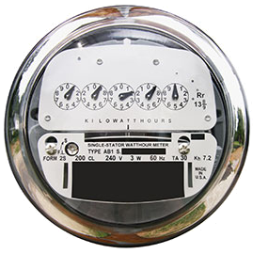
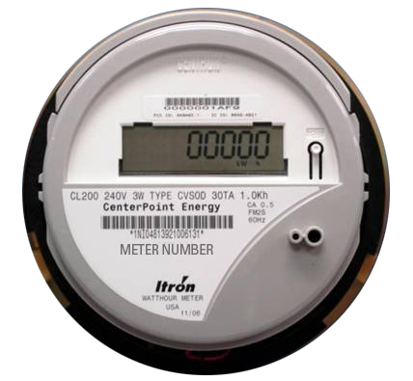
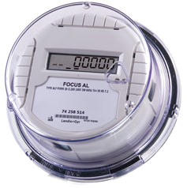
Then – Now – Tomorrow? Meters
First Meters mid-1890s
Westinghouse 1905
2005
2006
2014
2025 ???

Slide 3
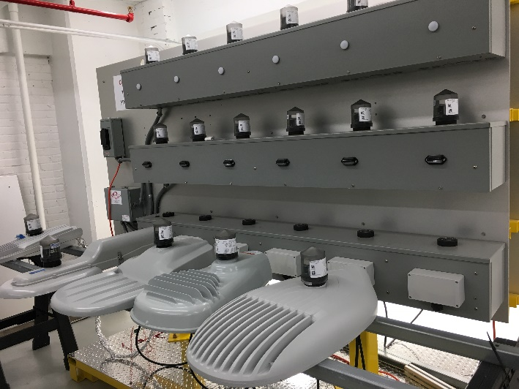
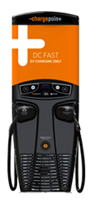
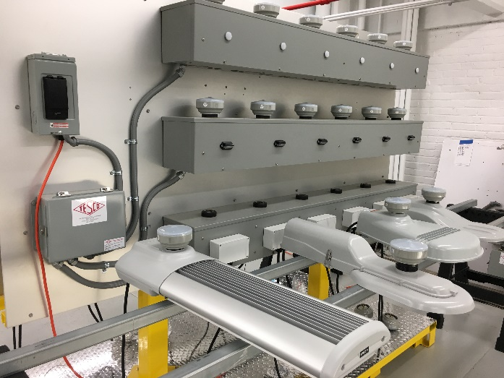
Then – Now – Tomorrow? Meters?

Slide 4
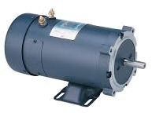
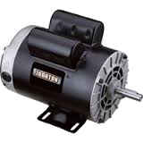
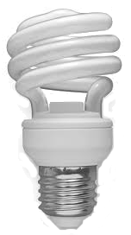
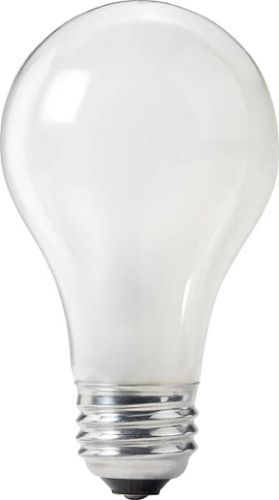
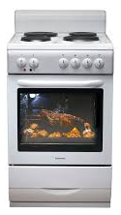
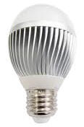
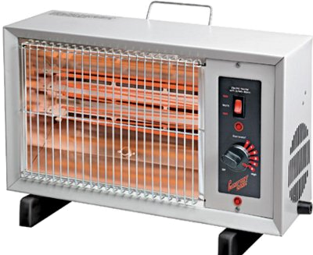
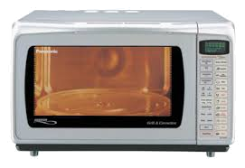
Then – Now – Tomorrow? Loads
TODAY
YESTERDAY

Slide 5
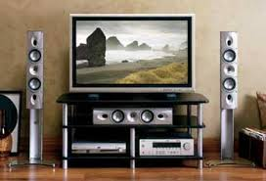
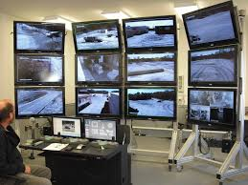
Then – Now – Tomorrow? Loads
TODAY

Slide 6
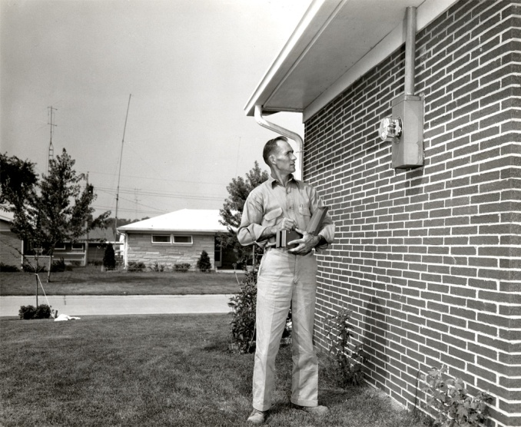
Then – Now – Tomorrow? Communications
THEN
NOW

Slide 7
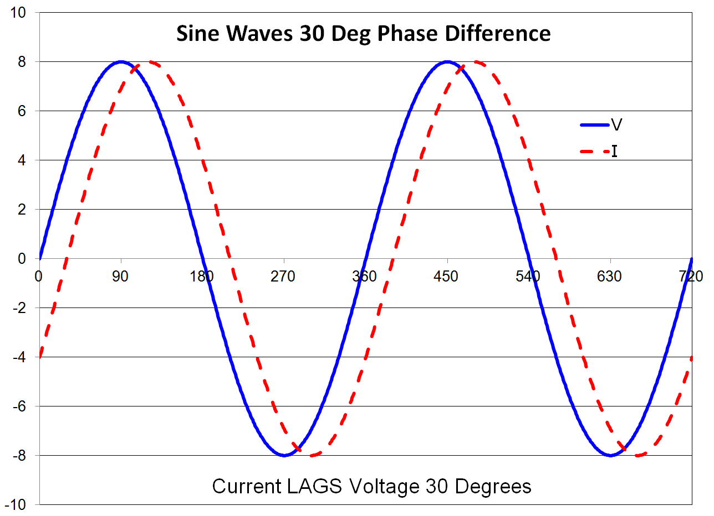
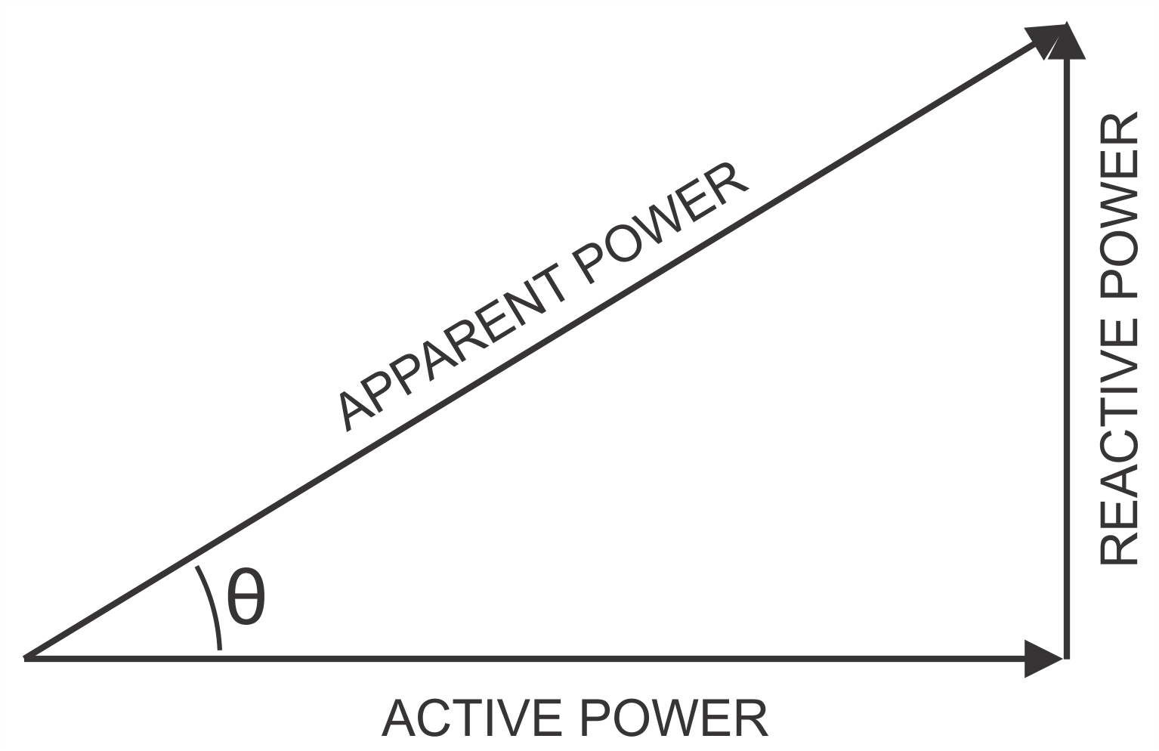
Why do these changes matter?
Changes to our loads have changed the basic computations of metering.
When loads were linear the power triangle was all we needed to know

Slide 8
Why do these changes matter?
Today’s loads look more like these

Slide 9
Why do these changes matter?
Today’s loads look more like these

Slide 10
Why do these changes matter?
Today’s loads look more like these

Slide 11
Standards Changes
C12.1-2021 American National Standard for Electric Meters—Code for Electricity Metering
Combines C12.1 and C12.20 into a single modernized document
Polyphase meters tested using polyphase
Unbalanced load testing required
Full harmonic testing required
Bidirectional energy flow testing required.

Slide 12
Standards Changes
Testing with Auxiliary Communications Devices for accuracy required
Testing for each service type for which the meter is applicable is required
Blondel vs non-Blondel meter forms and applications are called out.
An appendix on inherent non-Blondel errors and the governing assumptions is included.
Many tests were updated to make them more applicable to 21st century applications

Slide 13
Harmonic Load Waveforms
ANSI C12.1/C12.20 now addresses harmonic waveforms

Slide 14
Standards Changes
New Revision of C12.10
Safety tests moved here from C12.1
Much broader safety requirements
Coordinated effort with UL2735
Utilities exempt from UL2735 but only if they own and install the equipment

Slide 15
Standards Changes
Communications Standards
COSEM has been approved for adoption as an ANSI standard

Slide 16
ANSI C12.31
There was no non-sinusoidal definition for VA or VAR or Power Factor
New ANSI Standard C12.31 defines these mathematically so every meter manufacturer can use the same calculations
Addresses the issue of non-sinusoidal waveforms
Addresses the issue of polyphase measurements for VA

Slide 17
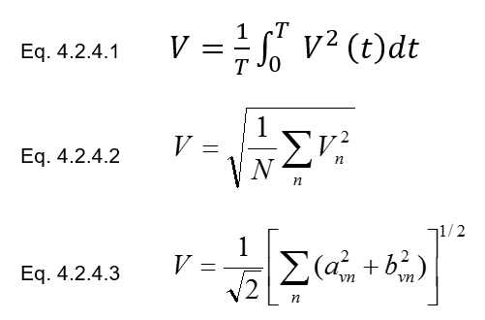
ANSI C12.31
RMS Voltage
Waveform
Basic Definition
Time Domain
Frequency Domain

Slide 18
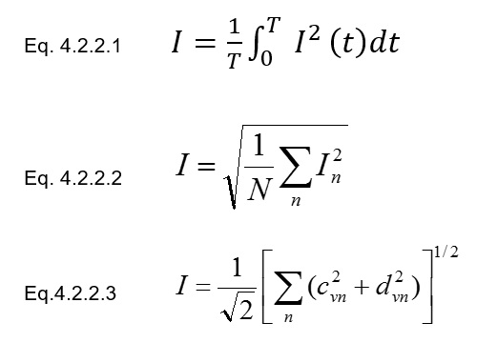
ANSI C12.31
RMS Current
Waveform
Basic Definition
Time Domain
Frequency Domain

Slide 19
ANSI C12.31
Active Power
Basic Definition
Time Domain
Frequency Domain

Slide 20
ANSI C12.31
Apparent Power
Basic Definition
Time Domain
Frequency Domain

Slide 21
ANSI C12.31
OPEN ISSUE – Polyphase VA
New approach suggested by John Voisine (Landis+Gyr)
Tries to better represent VA seen by the transformer
The issue of how to compute polyphase VA is presently unresolved but is being actively worked on
The Issue is the meter can neither know the real load configuration nor the transformer configuration

Slide 22
Next Generation Standards
ANSI C12.46
New standard in development to eventually replace C12.1-2021
Structured to be inline with OIML R-46
New C12.1 has moved much closer to the actual requirements of IR-46.
Applies to ALL energy measurements
Watts, VA and VAR
Uses C12.31 definitions for all quantities

Slide 23
Next Generation Standards
ANSI C12.46
Covers ALL waveform types
sinusoidal, harmonic, time varying
Defines the meter as everything under the cover
If there is auxiliary functions in the meter they must be fully operational during accuracy testing
If an option is added to a meter, the meter must be tested with the option running to remain qualified

Slide 24
Next Generation Standards
OIML TC12 now working on expanded recommendation
Expanding to cover VA and VAR
Adding harmonic performance tests
Adding new (non-utility) applications
Sub-metering
Point of load (Streetlights for example)
Electric vehicle chargers

Slide 25
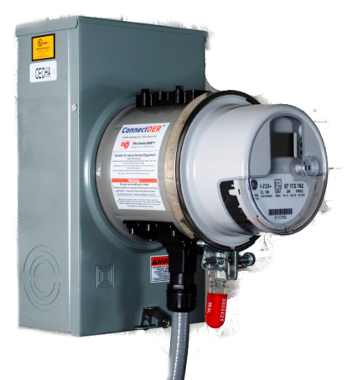
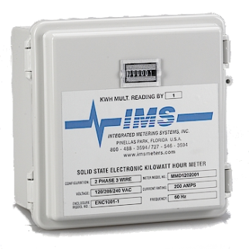
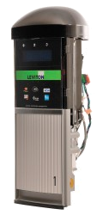
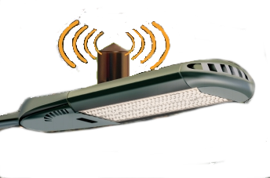
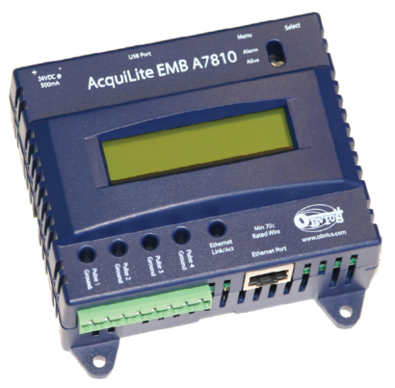
What does the Future Hold?
Traditional meters will have many more integrated features and take on a wider operational role and will become a primary source of system data
Many more devices will have a non-traditional embedded revenue meter
Some will NOT be regulated by the PSC’s

Slide 26
What does the Future Hold?
The Meter Tech of the future will be
dealing with these embedded meters
working with all of these new features
addressing communications issues
working across departments at the Utility to provide information and accomplish wider ranging initiatives (e.g. DER)
Work with a new set of primarily private commercial customers who do not own buildings but own assets piggy backed onto the network

Slide 27
What about DC?
There are still a number of DC meters out on our systems, primarily in the larger, older urban areas such as San Francisco and New York City.
There has been no effective way to test these legacy meters for some time. This is shortcoming was highlighted as new DC metering applications have begun to make an appearance on the grid and are demanding we find a solution (e.g. DC superchargers)
Using labs with traceable Voltage sources and measurement capabilities and traceable Current sources and measurement capabilities we are now starting to do this.

Slide 28
DC Theory?
No need for new definitions. Power is simply VA. If we can measure the fundamental Volt and the fundamental Amp then we can create a Standard to measure against and can effectively test our DC meter.

Slide 29
ANSI C12.32
As always, the theory is only the start. We now need to take this theory and create a practical process. For AC Meters we have been using ANSI C12.1 for many years to guide us on how to move from theory to practice.
We have never had a comparable Standard for DC Metering
ANSI Standard ANSI C12.32 for Electricity Meters for the Measurement of DC Energy has been developed over the past several years and is actively being balloted and is expected to be released in 2022.
This Standard lays out the tests, the definitions, the acceptable performance levels for accuracy as well as functional testing.
Definitions are given and the practical means of type testing as well as acceptance testing are given.

Slide 30
2S to 12S to DC Residential?
Are 2S Meters suitable for the need of the residential customer in 2021?
Should we start the transition to all 12S metering for residential if 2S is no longer applicable or desirable?
Should we consider DC metering at the residence and eliminate all inverters other than between the home and grid.
Should the meter include this inverter?

Slide 31
Questions and Discussion
Tom Lawton
President
tom.lawton@tescometering.com
TESCO – The Eastern Specialty Company
Bristol, PA
215-228-0500
This presentation can also be found under Meter Conferences and Schools on the TESCO website: tescometering.com
ISO 9001:2015 Certified Quality Company
ISO 17025:2017 Accredited Laboratory

