Slide 1
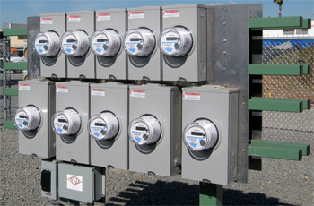
Ratio, Burden, Admittance Testing
Prepared by Tom Lawton, TESCO
The Eastern Specialty Company
For North Carolina Electric Meter School
Advanced Session
Wednesday, June 27, 2018 at 10:30 a.m.
10/02/2012
Slide 1
Notes:
1

Slide 2
Agenda – Advanced Session
What we will not cover!
The Very Basics: meter forms and
self-contained vs. transformer rated
What we will cover
CT Functionality Basics
The Faceplate:
Terminology and Specifications
Ratio Testing
Burden Testing
Admittance Testing
Demag Functions
Roundtable: What you do and why?

Slide 3
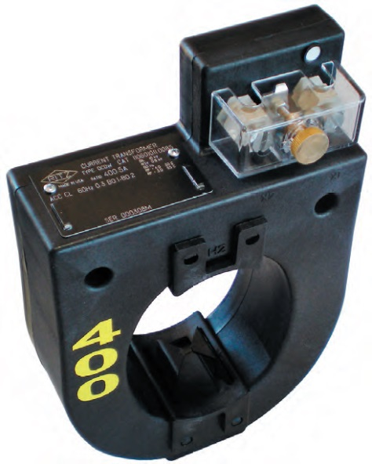
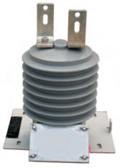
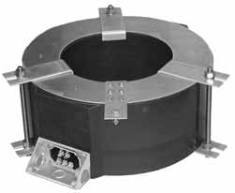
What is a CT? a PT?
“A current transformer (CT) is used for measurement of alternating electric currents. Current transformers, together with voltage (or potential) transformers (VT or PT), are known as instrument transformers. When current in a circuit is too high to apply directly to measuring instruments, a current transformer produces a reduced current accurately proportional to the current in the circuit, which can be conveniently connected to measuring and recording instruments. A current transformer isolates the measuring instruments from what may be very high voltage in the monitored circuit. Current transformers are commonly used in metering and protective relays in the electrical power industry.” - Wikipedia

Slide 4
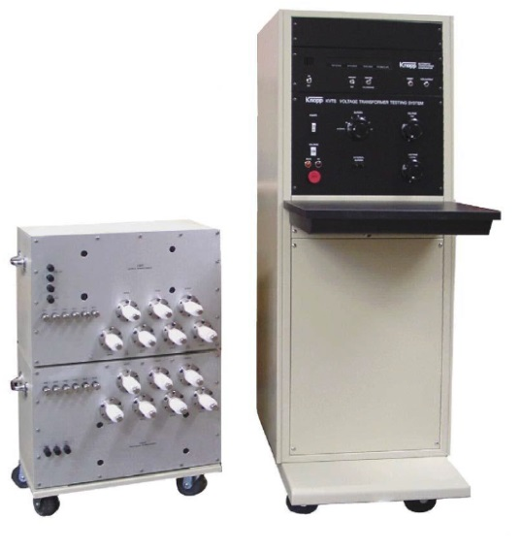
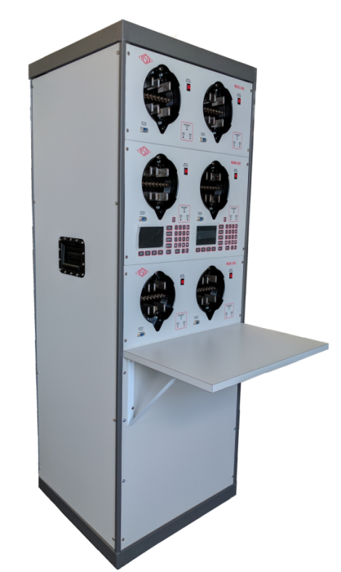
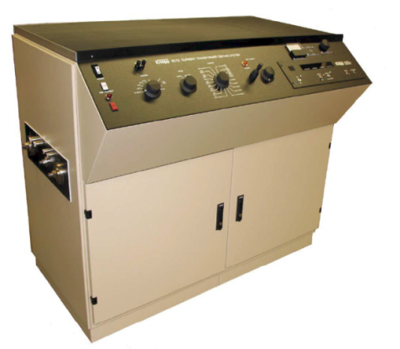
Shop Testing
Accuracy Testing
Meter Communications Performance
Software & Firmware Verification
Setting Verification
Functional Testing
Disconnect/Reconnect Functionality and as left setting
Ratio and accuracy testing
Polarity checking
Accuracy class determination

Slide 5
Shop Testing Programs
100% of all Transformers
If not possible then sample testing of all and 100% of all those over a certain size for CT’s and all VT’s (generally not a large volume)
Transformer testing should include
Ratio and accuracy testing
Polarity checking
Accuracy class determination
100% of all transformer rated meters
If not possible then sample testing of all transformer rated meters and 100% of all those going into a certain size service and over
Meter testing should include
Software & Firmware Verification
Setting Verification
Functional Testing
Disconnect/Reconnect Functionality and as left setting

Slide 6
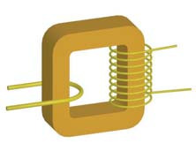
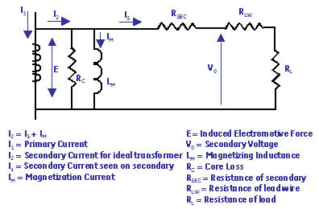
What is a CT?
Conceptual Picture of a CT
Equivalent Circuit w/ losses
As current is applied in the primary, it produces a magnetic flux in the core. This flux flows through the core and induces a current in the secondary windings and circuit that is proportional to the number of turns.

Slide 7
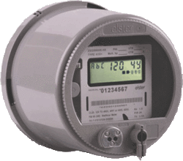
Example Application
SOURCE
LOAD
PHASE A
400A
PHASE B
400A
PHASE C
400A
9S Meter Installation
5A
5A
5A

Slide 8
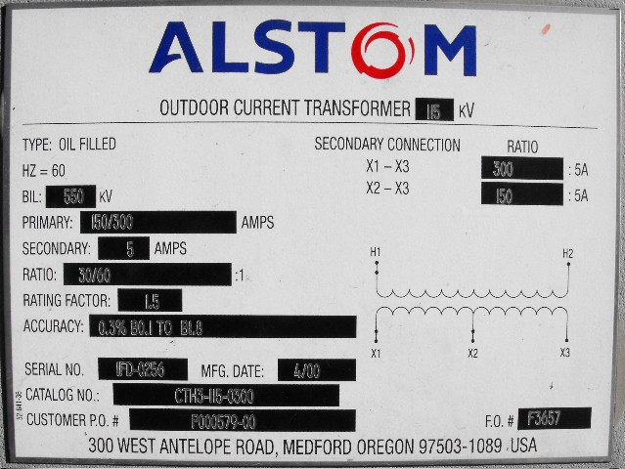
Faceplate Specifications

Slide 9
Faceplate Specifications
Ratio

Slide 10
CT’s Ratio
For instance, a CT with a 400:5 ratio will produce 5A on the secondary, when 400A are applied to the primary.

Slide 11
Faceplate Specifications
Thermalfactor

Slide 12
CT’s – Functions and Terminology
Thermal Rating factor
A value representing the amount by which the primary current can be increased without exceeding the allowable temperature rise.
For instance, a RF of 4.0 at 30° ambient on a 400:5 ratio CT would allow for a primary current up to 1600A.

Slide 13
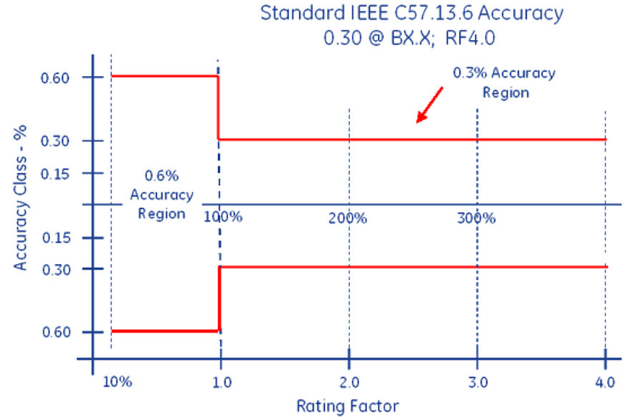
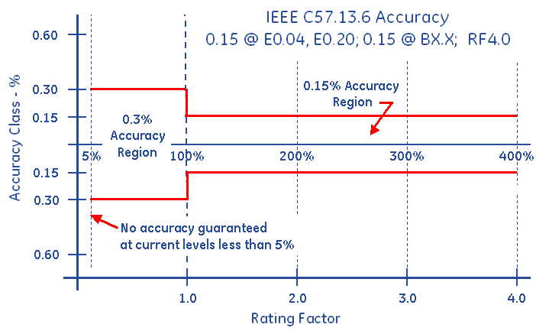
Faceplate Specifications
Accuracy Classifications
All CT’s fall within an accuracy class.
IEEE Standards have defined accuracy classes.

Slide 14
Faceplate Specifications
BurdenRating

Slide 15
Burden Rating
The burden range, present in the secondary circuit, that the manufacturer will guarantee their CT’s will still accurately function, in regards to the ratio specification.

Slide 16
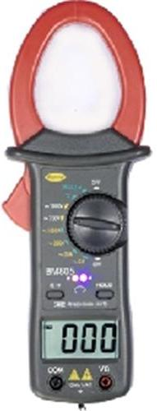
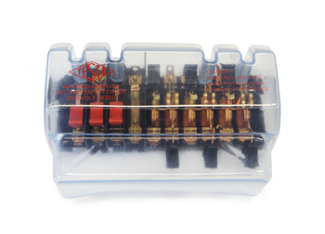
Ratio Testing
Ratio of Primary Current to Secondary Current
SOURCE
LOAD
PHASE A
400A
400A
400A
5A
5A
5A
Calculate Ratio

Slide 17
Burden Testing
Functionality with Burden Present on the Secondary Loop
PHASE A
Some burden will always be present – junctions, meter coils, test switches, cables, etc.
CT’s must be able to maintain an accurate ratio with burden on the secondary.

Slide 18
Burden Testing
Functionality with Burden Present on the Secondary Loop
PHASE A
Some burden will always be present – junctions, meter coils, test switches, cables, etc.
CT’s must be able to maintain an accurate ratio with burden on the secondary.

Slide 19
Burden Testing
Functionality with Burden Present on the Secondary Loop
Example Burden Spec:
0.3% @ B0.1, B0.2, B0.5
or
There should be less than the 0.3% change in secondary current from initial (“0” burden) reading, when up to 0.5Ohms of burden is applied

Slide 20
Burden Testing
Functionality with Burden Present on the Secondary Loop
ANSI Burden Values
0.1 Ohms
0.2 Ohms
0.5 Ohms
1 Ohms
2 Ohms
4 Ohms
8 Ohms

Slide 21
Burden Testing
0.3% @ B0.1, B0.2, B0.5
Initial Reading = 5Amps
0.3% x 5A = 0.015A
5A – 0.015 = 4.985A
Burden | Reading
0 | 5.0000
0.1 | 4.9999
0.2 | 4.9950
0.5 | 4.9900
1 | 4.9800
2 | 4.9500
4 | 4.0000
8 | 0.8000

Slide 22
Burden Testing
0.3% @ B0.1, B0.2, B0.5
Initial Reading = 5Amps
0.3% x 5A = 0.015A
5A – 0.015 = 4.985A
Burden | Reading
0 | 5.0000
0.1 | 4.9999
0.2 | 4.9950
0.5 | 4.9900
1 | 4.9800
2 | 4.9500
4 | 4.0000
8 | 0.8000
At 0.5Ohms of Burden
the secondary current is still at 4.990A – Less than 0.3% change – Good CT!

Slide 23
Admittance Testing
What is Admittance?
Admittance testing measures the overall “health” of the secondary loop of the CT.
Measured in units of MiliSiemens (mS)
Admittance is the inverse of impedance.
Impedance is the opposition to current.
Therefore, admittance testing measures the overall “health” of the secondary loop of the CT.

Slide 24
Admittance Testing
Admittance testing devices inject an audio sine wave signal into the secondary loop of the CT.
The resulting current is measured.
The voltage of the initial signal is known.
From these two parameters, the impedance, and thus the admittance can be calculated.

Slide 25
Admittance Testing
Admittance test results are not immediately intuitive.
Some analysis and interpretation is need.
What do all these mS values mean?

Slide 26
Admittance Testing
Three phase process is recommended.
Test each CT individually
Test the matched sets
Test over time

Slide 27
De-magnitization
CT’s can become magnitized, due to a number of reasons, including leaving the shorting clip open, near lightning strikes, and harmonic content.
CT’s can be demagnitized by slowly and smoothly increasing the secondary resistance until saturation occurs, and then slowly and smoothly decreasing the secondary resistance.
A resistance that will cause a secondary current reduction of 65% to 75% will typically put the CT into saturation.
*Some information has been taken from Radian Research’s Application Note 1109A: Admittance Testing Verifies CT Testing Integrity

Slide 28
Roundtable
What CT testing is executed at your utility?
Do you test CT’s?
Do you choose not to?
What method(s) do you use?
Why?

Slide 29
Questions?
Tom Lawton
TESCO – The Eastern Specialty Company
Bristol, PA
215-785-2338
This presentation can also be found under Meter Conferences and Schools on the TESCO web site: www.tescometering.com

