Slide 1
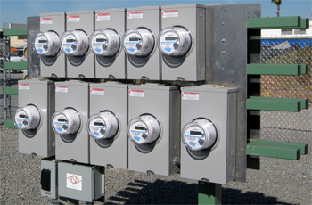
Metering, Operations and Utilities: 2020 and Beyond
Prepared by Tom Lawton, TESCO
The Eastern Specialty Company
For North Carolina Meter School
GENERAL SESSION
Monday, June 25, 2018 from 1:00 p.m. to 2:30 p.m.
10/02/2012
Slide 1
Notes:
1

Slide 2
Topics to Cover as We Look to the Future
How Metering Has Changed from the 1870’s to the 2010’s
Metering Today and the status of our Advanced Metering Infrastructure, Smart Meters and a Smartgrid
Meter Services role in the utility of the future
Big Data and Rolling Trucks
Meters – the shape of the future?
Notes:
Get definitions for each buzzword in bullet two

Slide 3
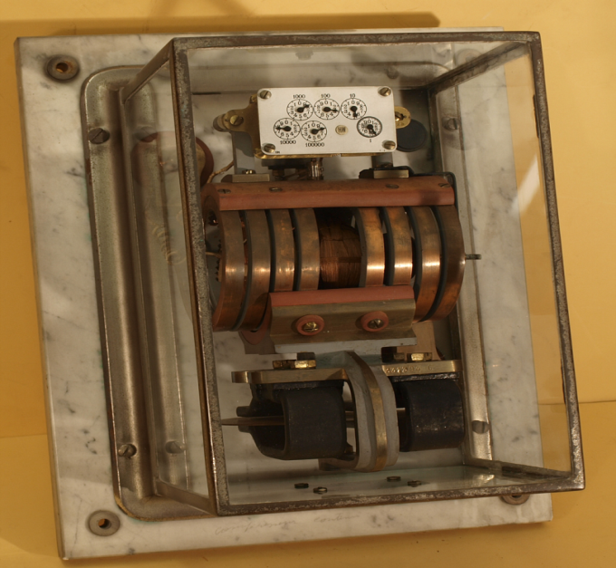
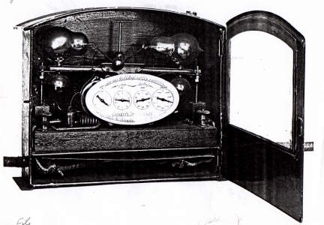
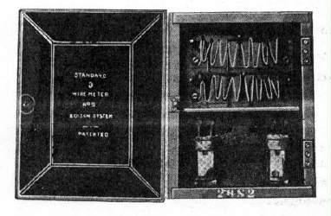
1870’s to 1900
Electric Metering is Invented
After a few interesting “false starts” several inventors and firms developed and began producing induction meters that are still recognizable to us today
Four of the five present meter manufacturer’s were producing meters:
Sangamo (Itron)
GE (Aclara)
Westinghouse (Honeywell)
Duncan (L+G)

Slide 4
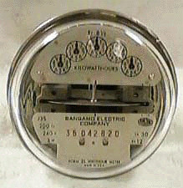
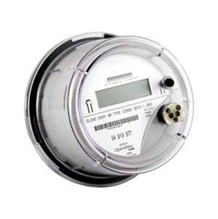
1900 to 2000
Not much changed – we use an induction meter for most of the century and only toward the very end of the century start using electronic meters.
Meters are standardized in the first half of the century
NC Meter School begins 1923 – they had a bell
Socket base meters take over for A-base meters
Electronic meters are introduced
Communications begins to be integrated into higher end metering
Same big four meter manufacturers

Slide 5
2000 to Present
The last electromechanical meters are produced. All new meters produced in North America are electronic
The concept of a Smart Grid is introduced as like our metering infrastructure the grid had not changed much in design since the inception of the grid more than a century ago
The “brains” of a Smart Grid is an Advanced Metering Infrastructure (AMI)
The heart of this Infrastructure is a “Smart” meter as the meter becomes a two way communication device with more features built in than just metrology
A host of new communication vendors enter the market and work with meter manufacturer’s to put their technology under the cover of the meter
Meter Manufacturer’s also develop their own communication technology to put under the cover
Additional features such as Disconnect switches and power quality monitoring become standard accessories to be included under the cover of a new meter
Meters are no longer looked at as simply energy measurement devices
Notes:
Put in history by every decade starting 1870’s

Slide 6
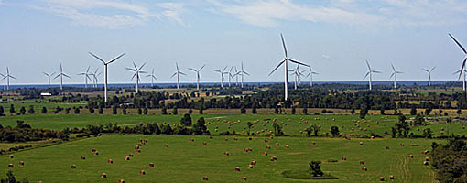
2020 and Beyond
Now What?
Notes:
As our earlier speaker asked…..Now What?

Slide 7
2020 and Beyond
The best way to know the future is to pay attention to the present
Notes:
and if possible look without our prejudices coloring our view of the world around us

Slide 8
Near Term Projections
Notes:
and if possible look without our prejudices coloring our view of the world around us

Slide 9
Near Term Projecttions
Notes:
and if possible look without our prejudices coloring our view of the world around us

Slide 10
2020 and Beyond
The best way to know the future is to pay attention to the present.
Best way to do this is to follow the money;
Not the news.
Notes:
and if possible look without our prejudices coloring our view of the world around us

Slide 11
New Technologies and shifts in Meter Services and Electric Operations
Second Generation AMI
New capabilities under glass
Additional data and additional actionable work orders coming from Meter Services
LTL and Private networks
Street Lights
Smart Poles
Renewables
Battery Storage
Electric Vehicles

Slide 12
New Technologies and shifts in Meter Services and Electric Operations
Folks like Slade Griffen and Contextual Security will be even busier in coming years
Users and Utilities will want more data more easily
Folks like Slade Griffen and Contextual Security will be even busier in coming years
Metering will become enmeshed in distribution and generation and power storage and cyber scurity and data analysis projects – and then they will become part of the every day fabric for Meter Service Departments

Slide 13
2020 and beyond (cont.)
There is only one thing we know for certain about metering in 2020 and beyond;
Metering will not be the same as today and Meter Departments will
New
Different
and ADDITIONAL work

Slide 14
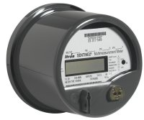
AMI and Next Generation AMI
We are slightly more than 50% deployed in North America and the North East is still just at the front end of rolling out AMI
By 2022 we should be nearly 80% deployed and the early adopters who first started deploying in 2007 are already starting to investigate what they will be doing for AMI 2.0
We are seeing more and more features incorporated inside the meter
Disconnect Devices are essentially standard
Power Quality and circuit sensing devices are working inside the meter and sending operational data back to the utility

Slide 15
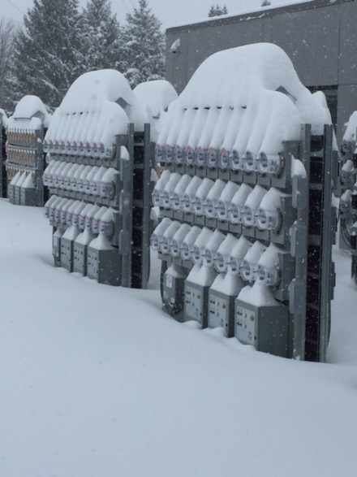
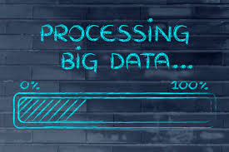
2020 and beyond (cont.) AMI and Next Generation AMI
Metering will move the center of Distribution Operations at most utilities as analytics are developed, embraced and begin to mature at individual utilities.
Knowledge and Information will rule utility operations
AMI will provide this information and big data/analytics teams will help to provide the tools
Metering professionals will provide the knowledge on how best to utilize these tools
Notes:
Talk about Use cases and Big Data – tie into earlier presentation?

Slide 16
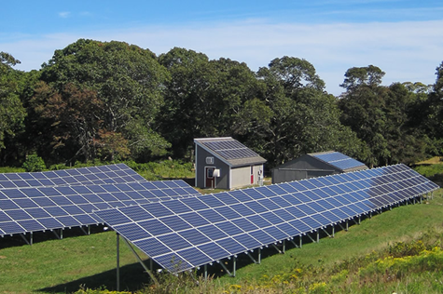
2020 and beyond (cont.)
The tolerance for non-technical losses of any type will become dramatically less.
As the rest of the Utility and the customers begin to understand that we now have the tools to identify, track down and correct these losses they will demand more data and more tools to track down and eliminate these losses
Notes:
Can tie back to theft but also non-malicious losses. Multiplier report.

Slide 17
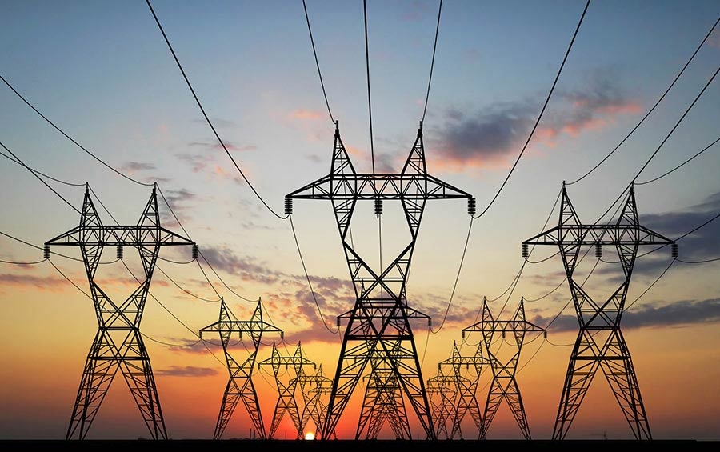
2020 and beyond (cont.)
The tolerance for outages will go down as customers get used to us hardening our infrastructure as well as to identify and correct problems without them even reporting them and before or immediately after they even know there is a problem.

Slide 18
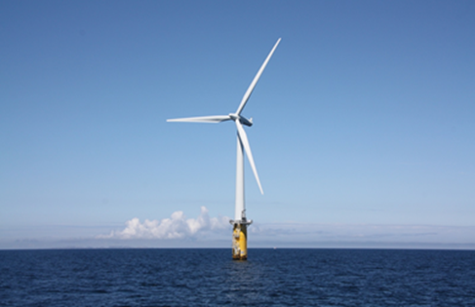
2020 and beyond (cont.)
The tolerance for poor power quality will go down as we improve our power quality and begin to educate customers on the effects of poor power quality, harmonics and distortion on our networks. New tariffs may come into effect or new requirements placed on customers (or utilities) to provide power factor correction at the customer site.
Notes:
Waveform generation

Slide 19
Business Use Cases for this big data
In the earlier presentation we talked about;
Voltage Monitoring (Min, max, average)
Transformer Loading Analysis
Number of customers out of power
Current demand savings from load control (kW)
Outage Index Reporting (SAIDI, SAIFI, MAIFI) at multiple levels
Cumulative outage hours (MTD/YTD)
General line loss analysis
Demand Response (CVR, Peak Reduction, Etc.)
Power quality investigation
Number of blinks, sags, etc. (over time specified)
Peak condition tracking
Power factor by circuit or time of day
Pattern detection (Algorithm to detect patterns in voltage, demand, blinks, etc.)
System efficiency by circuit
Remote Disconnect/Reconnect
Notes:
Waveform generation

Slide 20
Business Use Cases for this big data
Now what can we do with this information? Well….To start;
Isolate and determine where we have voltage issues, correct them and bring an entire line to the same level. This not only works better for our customers but also allows the utility to pursue voltage reduction in a meaningful and controlled way.
Determine what transformers should be used in any location
Determine which transformers to store in which inventory yards
Determine when new loads are present and which transformers are in jeopardy
Locate Bad connections
Locate Undersized lines
For Transformer Rated Services determine which ones are operating for a substantial amount of time below 10% of the rated current
Find and remediate theft
Find and remediate remote outages before the user knows they exist
Find and address Power factor issues
Notes:
Waveform generation

Slide 21
And now we want MORE……
More data
Greater frequency
Whatever bandwidth you thought you needed, now you need more.
Notes:
Waveform generation

Slide 22
AMI 2.0
Can we use our existing infrastructure?
Do we have to rip out and replace with a new infrastructure?
What about LTL back haul or a Private Network?
What about Power Line Carrier? Is there life there for my most remote service areas?
Notes:
Waveform generation

Slide 23
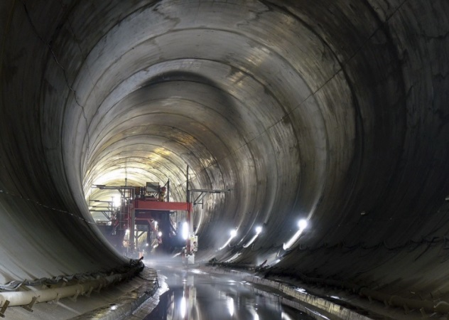
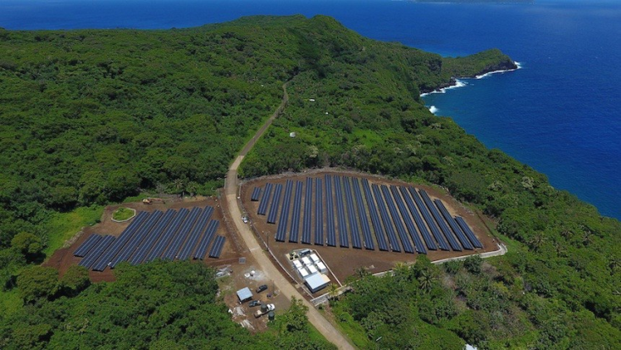
Generation vs Storage
Utility grade energy storage will replace new generation at an increasing pace as some of the largest capital investment projects for utilities.
The great tunnel under Niagara Falls, Ontario $1.6 Billion; 150 megawatts – part of an Ontario plan to shut all of their Coal generation Plants
New generation projects are increasingly becoming renewables
Island communities are already showing us this on larger and larger scales – Ta’u American Samoa; 1.5 megawatts with battery storage for three days
Notes:
The project's new 12.7 meters (42 ft.) diameter, 10.2 kilometers (6.3 mi) long tunnel was officially placed into service on 21 March 2013, helping to increase the generating complex's nameplate capacity by 150 megawatts,^{[1]}
American Samoa

Slide 24
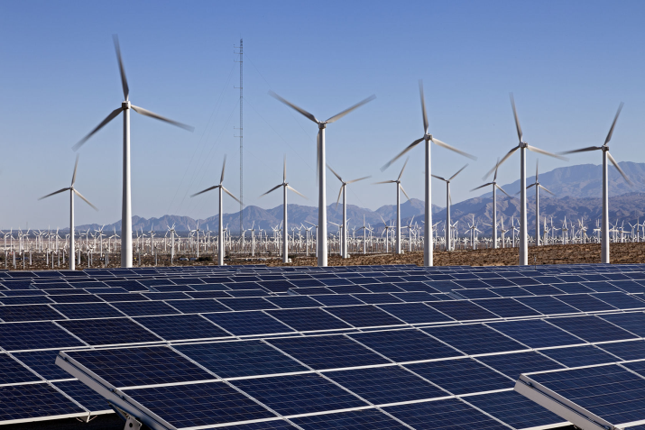
2020 and beyond (cont.)
On the distribution side customers will be encouraged to put in more and more renewable energy and they will also add more and more energy storage
Residential loads will move further and further away from power factors of one and put increasing pressure to move to either a Blondel solution for them, a VA/VAR solution for them, or a correction factor for them as AMI systems begin to report back customer power factor for all metering solutions
12S or 2S?

Slide 25
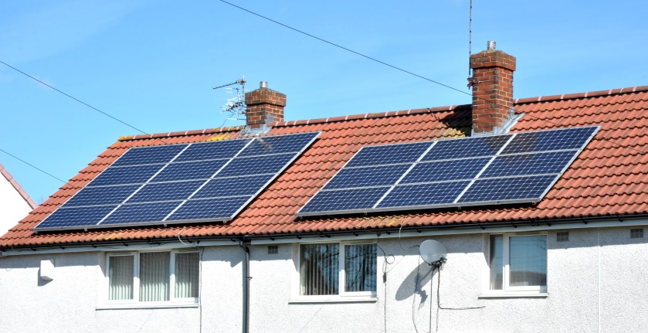
2020 and beyond (cont.)
On the distribution side customers will be encouraged to put in more and more renewable energy and they will also add more and more energy storage
Larger customer based energy production and solutions will lead to expanded micro grids.
Second Generation AMI and potentially new communication paradigms as LTL data becomes less and less expensive and reaches larger and larger areas.

Slide 26
AMI 2.0 Infrastructure
Second Generation AMI and potentially new communication paradigms as LTL data becomes less and less expensive and reaches larger and larger areas – without new infrastructure
Research in Power Line Carrier Technology may provide expanded bandwidth to allow for greater data transfer more frequently without as much new infrastructure
Mesh networks continue to improve and AMI 2.0 is anticipating leveraging the infrastructure installed in AMI 1.0

Slide 27
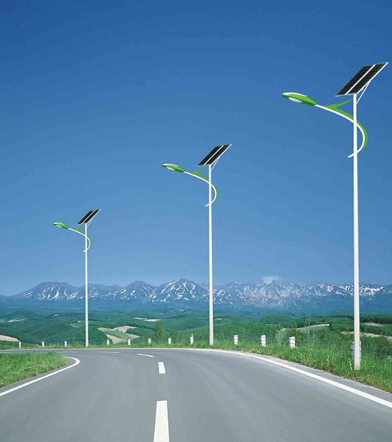
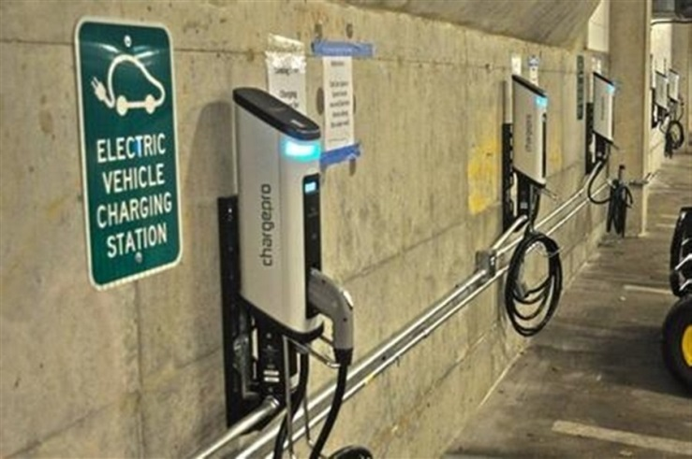
The shape of metering to come 2020 and beyond
Meters that do not look like meters as we know them, will become a part of our world.
Street lights
Smart Poles
Electric vehicle chargers
Sub meters – which may now become our meters

Slide 28
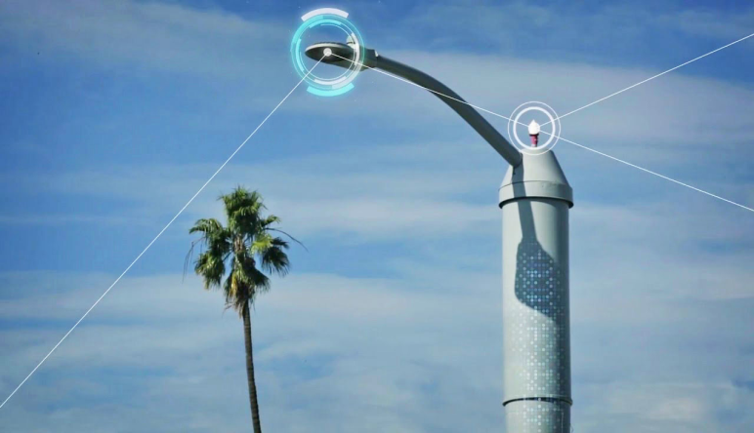
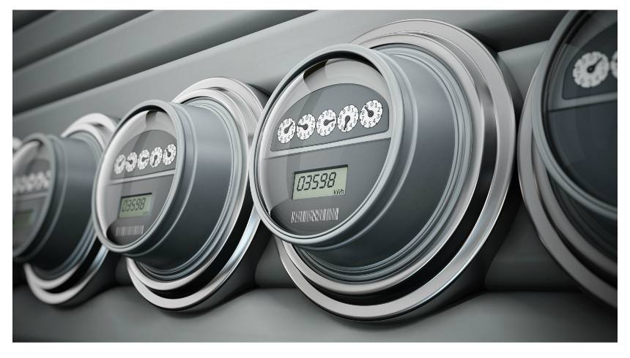
Summary – The Past and the Future
The more things change, the more they will remain the same.
Understanding how to accurately and measure a customers consumption correctly will become an increasingly valuable commodity. This includes a better understanding of the effects on metering of poor power quality and energy distortion.
How to pair an understanding of metering and distribution with big data to provide an increasingly automated set of AMI analytics to monitor and maintain our distribution network and to continue to develop new ones to constantly improve our networks.
Meters may not look like meters in the future but metering will become the center of the Electric Distribution Universe.
There will continue to be NC Meter Schools to help keep you abreast

Slide 29
Questions?
Tom Lawton
TESCO – The Eastern Specialty Company
Bristol, PA
215-785-2338
This presentation can also be found under Meter Conferences and Schools on the TESCO web site: www.tescometering.com

