Slide 1
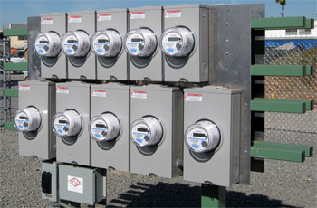
Extending the AMI Network With Intra-Grid Sensors
Prepared by John Kretzschmar, SAMSCO
Spartan Armstrong Metering Supply Company
For North Carolina Electric Meter School
Management Session
Tuesday, June 26, 2018 at 1:00 p.m.
10/02/2012
Slide 1
Notes:
1

Slide 2
US Energy Information Administration:
The Energy Information Administration (EIA) is a government agency formed in 1977. The EIA is responsible for objectively collecting energy data, conducting analysis and making forecasts.

Slide 3
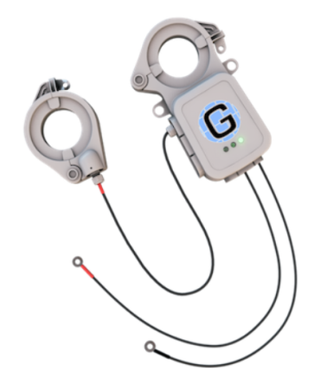
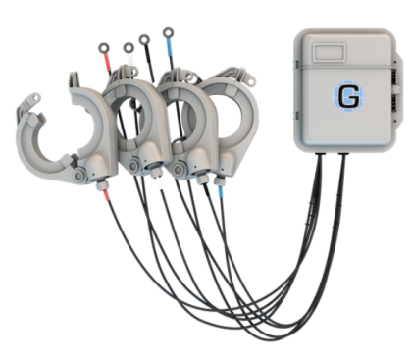
What is an intra-grid sensor?
A sensor used to provide detailed information about conditions that exist between the distribution transformer and the meter.

Slide 4
Why do we need intra-grid sensors?

Slide 5
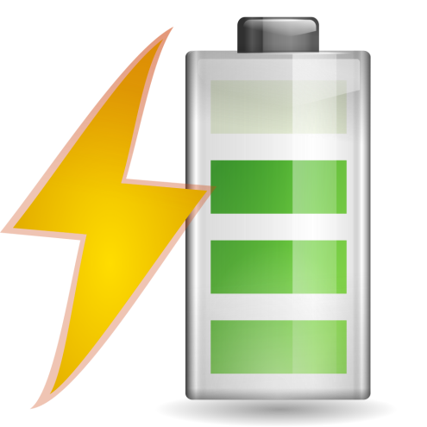
Because times have changed!
We are now stressing grid assets with increased unplanned burden and never previously conceived pressures.
Yet operators are still without comprehensive data that will accurately reveal the intra-grid dynamics created by these changes.

Slide 6
Distributed Energy Resources (DER)
Through solar and wind renewables, we are introducing Reverse Energy onto the distribution grids.
The millions of existing transformers were not designed to handle this impact.
While renewables are beneficial, Reverse Energy can produce unstable, and unsafe grid conditions.

Slide 7
Distributed Energy Resources (DER)
Intra-grid sensors accurately measure and report Reverse Energy, and its impacts on the grid.
Utilities without AMI, or “smart meters” need intra-grid sensors to understand the Reverse Energy impacts inside their grid.
Utilities with AMI need intra-grid sensors to understand Reverse Energy impacts on transformers.

Slide 8
Distributed Energy Resources (DER)
The reality is that AMI generated Reverse Energy data does not accurately indicate impacts on transformers or the resulting grid impacts.
AMI data is typically not accurately aligned to the upstream transformers due to pervasive GIS mapping errors, thus causing aggregated AMI data to be unreliable.

Slide 9
Distributed Energy Resources (DER)
Even though utilities are pre-notified of Distributed Energy Resources installations, operators still remain uncertain of potentially serious and/or dangerous impacts upon upstream assets since AMI intra-grid data is unreliable.

Slide 10
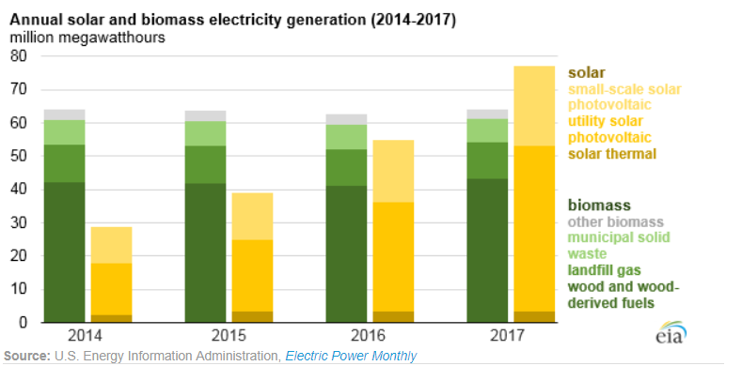
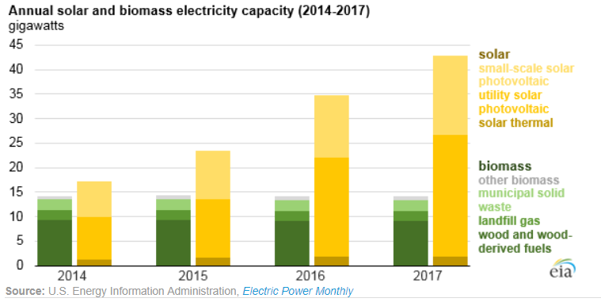
Growth of Solar Energy
Solar generation has shown steady growth while biomass has remained relatively flat.
Solar capacity has grown significantly while biomass has remained flat.

Slide 11
Reverse Energy
Reverse Energy creates new instances of unknown and unplanned voltage fluctuations/conditions. This contributes to potentially unstable and unsafe grid conditions.
Safety for the public at-large is key, but so too is the safety of utility linemen who are increasingly at risk due to the unanticipated voltage levels being created by Distributed Energy Resources (DER).

Slide 12
Reverse Energy
AMI-deployed utilities might think they know Reverse Energy impacts, the truth is they typically do not possess accurate AMI-to-transformer information.
This can leave linemen in a position of not knowing what to expect when they approach DER-active transformers.

Slide 13
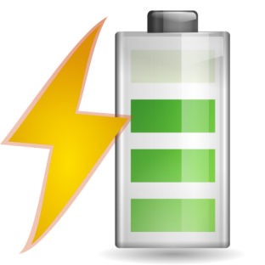
Electric Vehicles
Electric Vehicle charging stations create a new, unplanned load on transformers. Each charging station has the capability of adding up to one additional home worth of power load on a transformer.
This unplanned loading impacts transformers and may actually exceed a transformer’s designed capacity causing major problems.

Slide 14
Illegal Marijuana Production
Illegal marijuana grow houses commonly steal significant levels of power from the grid.
Theft occurs simply by tapping power lines in front of the meters.
No endpoint meter (including AMI smart meters) can effectively detect pre-meter power theft.
This means thieves steal as much power as they want, and they steal it indefinitely without fear of detection.

Slide 15
Legalized Marijuana
When jurisdictions legalize weed, significant unplanned loading hits the respective transformers and the grid.
Legalization permits (and possibly encourages) residents to grow weed using power-intense hydroponic resources. This unanticipated reality then causes additional strain on the existing transformers, and the grid

Slide 16
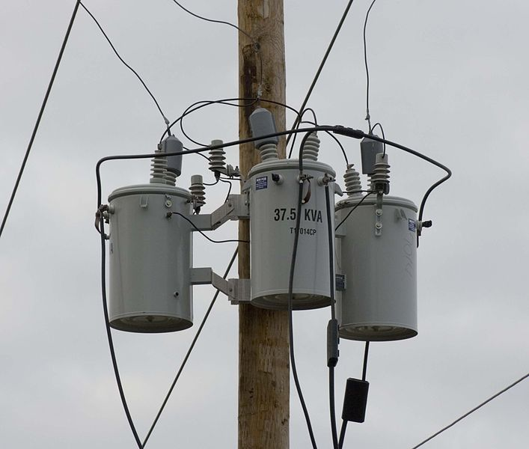
Aging Assets
According to the US Department of Energy, the average age of existing distribution grid transformer is presently in the range of 38-42 years.
The average projected life span of transformers is typically 40 years so many transformers are nearing or have already eclipsed their intended life span, yet we demand more performance, reliability, and various unintended service capabilities.

Slide 17
Aging Assets
Intra-grid sensors proactively reveal over-burdened and failing transformer assets allowing operators to effectively enable preventive maintenance efforts.
This approach enables operators to transition away from costly and disruptive, reactive grid management practices

Slide 18
Power Theft
Despite significant Smart Meter penetration, power theft is a perpetual problem. Industry experts suggest that U.S. power theft is in excess of $6 Billion per year.
The locations of power theft is typically a mystery. If the affected overburdened transformers finally fail, utility operators then learn where the theft is occurring.

Slide 19
Power Theft
Smart Meters claim to lessen power theft but the reality is that power theft has increased.
Thieves have discovered that since utility personnel are no longer coming onto their property, they can tap power lines ahead of the meter and the diversion will go undetected indefinitely.

Slide 20
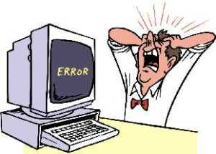
Meter Programming Issues
An incorrectly programmed meter can result in significant errors.
For example: a meter programmed for a 200:5 transformer but actually has a 400:5 transformer will significantly misreport usage.

Slide 21
What are system losses?
Energy generated by Power Station does not match energy distributed to the consumers.
The difference between generated and distributed energy is known as Transmission and Distribution loss; aka system loss.
System loss is the energy that is generated but not paid for by users.

Slide 22
Line Loss:
According to US Energy Information Administration reports, nearly 200 Billion unmetered kWh’s are ‘leaked’ from US distribution grids annually.
This loss represents nearly $21 Billion that was unmetered, but was amortized as electricity cost across US rate payer’s bills.
All of this while our government, utilities, and rate payers have been investing billions of dollars in ‘smart meters’, and other energy efficiency efforts.

Slide 23
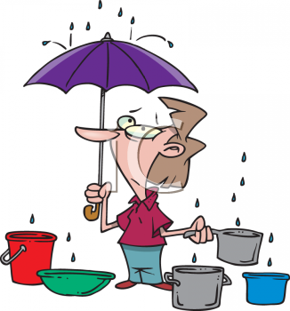
Line Loss:
Electricity is ‘leaking’ heavily from within the US distribution grid in front of the AMI/AMR meters and at costly levels.
To a large extent, electricity providers have been unable to accurately identify where these substantial power leaks have been occurring within the grid(s).
Intra-grid power loss is substantial and is occurring daily.

Slide 24
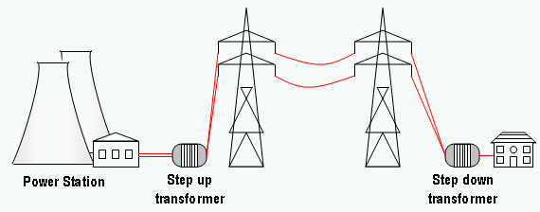
Line Loss:
The electric distribution grid does not have adequate sensor technology and analytic capabilities to allow operators to directly reduce system losses.
As a result, a blind spot exists between the substation SCADA and the AMI meter.
Intra-Grid Sensors can provide visibility into this critical area.

Slide 25
Ontario Hydro - The Problem
A real world example
According to the Ontario Energy Board’s 2015 Yearbook of Electricity Distributors: Over 4.639 Billion kWh of unmetered loss ‘leaked’ from LDC’s distribution grids in 2015.
Using Ontario’s 2015 average retail cost of 11.17₵ per kWh, this loss represents over $518 Million of electricity that was unmetered/unbilled, but was amortized as cost across Ontarian’s hydro bills.

Slide 26
Ontario Hydro - The Challenge
A real world example
The IESO (Independent Electricity System Operator) and LDC’s (Local Distribution Company) within Ontario must strive to achieve 7 Terawatt Hours of Conservation by 2020.

Slide 27
Ontario Hydro - The Opportunity
A real world example
Through the use of intra-grid sensors, Ontario created 2.3 Tera Watt Hours of conservation savings per year via Technical and Non-Technical line loss identification and remediation.
The LDC’c also gained a series of additional grid management benefits to help reduce bills for Ontarians, lessen power outage occurrences and durations and improve energy efficiency.

Slide 28
Ontario Hydro – Net Benefit
A real world example
Facilitate Conservation Voltage Reduction efforts to lessen excessive power consumption costs, b)
Conserve up to 2.3 Tera Watt Hours/Year--- in addition to the current CFF planned efficiency gains.
Reduce Ontario’s Greenhouse Gas Emissions by up to 1.2 Million Metric Tonne per Year.

Slide 29
Ontario Hydro – Net Benefit
A real world example
Prepare the grid for the emerging solar/wind renewables and electric vehicle impacts.
Decreased power outages.
Shrink operating costs of LDC’s in Ontario via fewer unplanned outages, fewer trouble calls, etc.
Produced an estimated Carbon Tax Credits value of over $18.2 Million Per Year for Ontario.

Slide 30
Ontario Hydro – Net Benefit
A real world example
Increase ‘metered’ revenues for LDCs by converting unmetered loss into metered revenue.
Lower capital expense by reducing premature replacement of transformers due to overloading.
A deployment ROI of approximately 3.6 years using a 50% Loss Reduction factor.

Slide 31
SMUD – Power Theft
A real world example
The Revenue Assurance team at SMUD has been leveraging intra-grid sensors to identify power theft within its grid space since 2015.
Although their efforts have been very surgical in nature, the results have been exceptional.

Slide 32
SMUD – Power Theft
A real world example
Within the first 18 months, SMUD’s Revenue Assurance team was able to identify and shut down $376,652.42 of power theft.
When power theft occurs, excessive unplanned loading negatively impacts and can overload the associated transformers beyond its rated performance level.
This can result in premature aging of transformers, and eventual power outages.

Slide 33
Hawaiian Electric – Solar Impact
A real world example
Due to high electricity prices and incentives such us tax credits and net metering, Hawaii boasts record levels of Distributed Energy Resources (DER).
As the Hawaiian Electric Companies have discovered, this is both a remarkable achievement and a serious challenge.

Slide 34
Hawaiian Electric – Solar Impact
A real world example
The rapid growth in rooftop solar has caused some circuits to reach extremely high levels of photovoltaic (PV) penetration.
This often leads to voltages that exceed regulated maximums, or creates additional impacts at the circuit level.

Slide 35
ACME Electric – Line Loss
A real world example
Energy produced/purchased = 1,391,871,000 kWh
Retail sales = 1,303,879,000 kWh
Total energy loses = 87,992,000 kWh
Total loses as a percentage = 6.32%

Slide 36
ACME Electric – Line Loss
A real world example
Total energy loses = 87,992,000 kWh
Assuming 9.33 cents per kWh
Total loses = $8,209,653.60

Slide 37
ACME Electric – Line Loss
A real world example
ROI < 6 Years!

Slide 38
ACME Electric – Carbon Credits
A real world example
Total loses = 87,992,000 kWh
Metric Tons of CO2 generated = 47,076
CER Credit (CO2 x $11.00) = $517,832.92
Total value for 50% CO2 reduction $258,916.46

Slide 39
Why do we need intra-grid sensors?

Slide 40
Summary of Benefits
Line Loss Identification – revealing invisible loss; permitting visible loss to then be remediated.
Increased Metered Revenues – converting unmetered loss into metered revenue.
Conservation Voltage Reduction – providing accurate / timely intra-grid voltage information.
DER/DG Readiness & Monitoring – safely integrating reverse energy, and monitoring voltages.

Slide 41
Summary of Benefits
Unplanned Outages Reduction – proactively identifying failing transformer assets.
Technical Loss Identification–revealing over/under-sized transformers and incorrect tap settings.
Power Theft Identification – revealing the sources of $6+ Billion per year of unconscionable loss.
Electric Vehicle Readiness & Monitoring – identifying unplanned loading due to charging stations.

Slide 42
Summary of Benefits
GIS Mapping & Accuracy Improvements – revealing improper meter-to-transformer association.
AMI Data Errors Reconciliation – identifying bad multipliers, pre-meter tap impacts, GIS errors.
Voltage Imbalance Identification – preventing downstream equipment damage and related costs.
Premature Transformer Failures Avoided – proactive information enabling proactive measures.

Slide 43
Summary of Benefits
Rate Payer Cost Reductions – achieved via reduced OpEx/CapEx, and improved energy efficiency.
CO2 Reductions – remediating line loss lessens generation demand; improves energy efficiency.
CO2 Emissions Reduction Credits (CER) – creating revenue to improve utilities’ financial strength.
Improve SAIDI & SAIFI Ratings – lessening outages and duration via unique/timely intra-grid data

Slide 44
Questions?
John Kretzschmar
SAMSCO
Spartan Armstrong Metering Supply Company
Boiling Springs, SC 29316
john@samscometering.com
864.590.2883
This presentation can also be found under Meter Conferences and Schools on the TESCO web site: www.tescometering.com

