Slide 1



Electric Vehicle Chargers: An Exploding Energy Market
Prepared by Bill Hardy, TESCO
The Eastern Specialty Company
For North Carolina Electric Meter School
Management Session
Thursday, June 28, 2018 at 8:00 a.m.

Slide 2
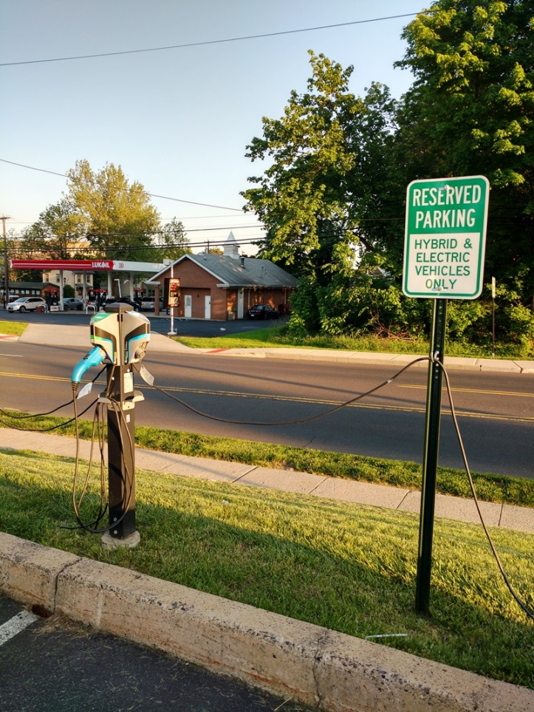
EVSE
Electric Vehicle Service Equipment
What is it all about?

Slide 3
INTRODUCTION
EVSE Basics
HB 44 Requirements
Real World Testing

Slide 4
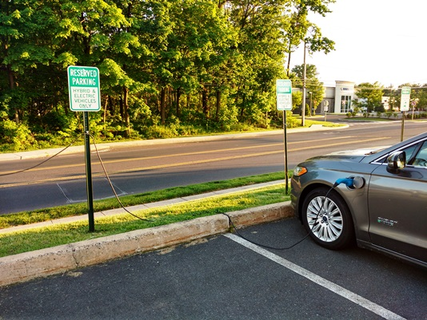
INTRODUCTION
Basic Statistics
  30,221 Commercial Charging Spots
  371 Non-Tesla DC Rapid Charge Locations
  4,359 Tesla SuperChargers at 705 Locations
  >500,000 pluggable electric vehicles in US

Slide 5
The EVSE MarketT
2015 - 15 Electric Vehicles on USGOV List
  ONE HAS 100+ MILE RANGE, most < 50
  ALL have AC Level 1 and 2 Capability
    maximum Charging Rate is 7.2 kW, many only 3.6kW
  Three Offer DC Rapid Charge
2018 – 24 Announced ALL ELECTRIC VEHICLES
  All have 120+ mile range
  All have DC Rapid Charge (Most are J1772 Compatible)
  INFRASTRUCTURE IS ESSENTIAL TO MAKE THESE CARS SELL

Slide 6
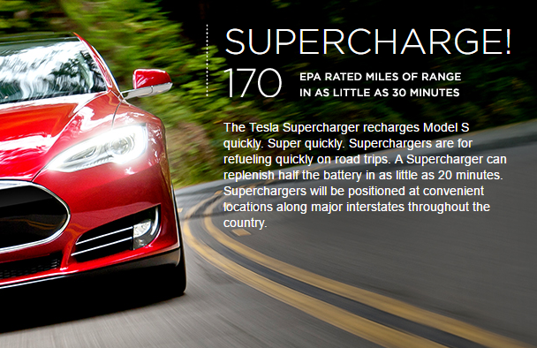
The EVSE MarketT
Over 300,000 Tesla Model X reserved at $1,000 each in first three months.
EVERY major auto manufacturer has multiple models on 2018 introduction plans.

Slide 7
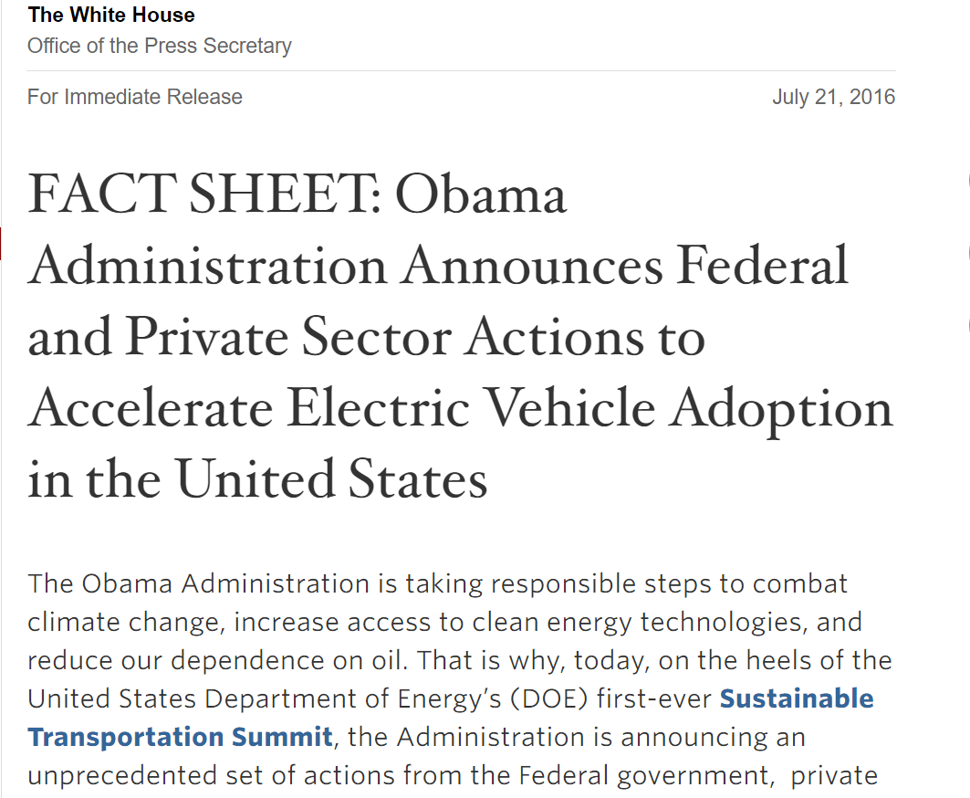
The EVSE MarketT
July 21, 2016

Slide 8
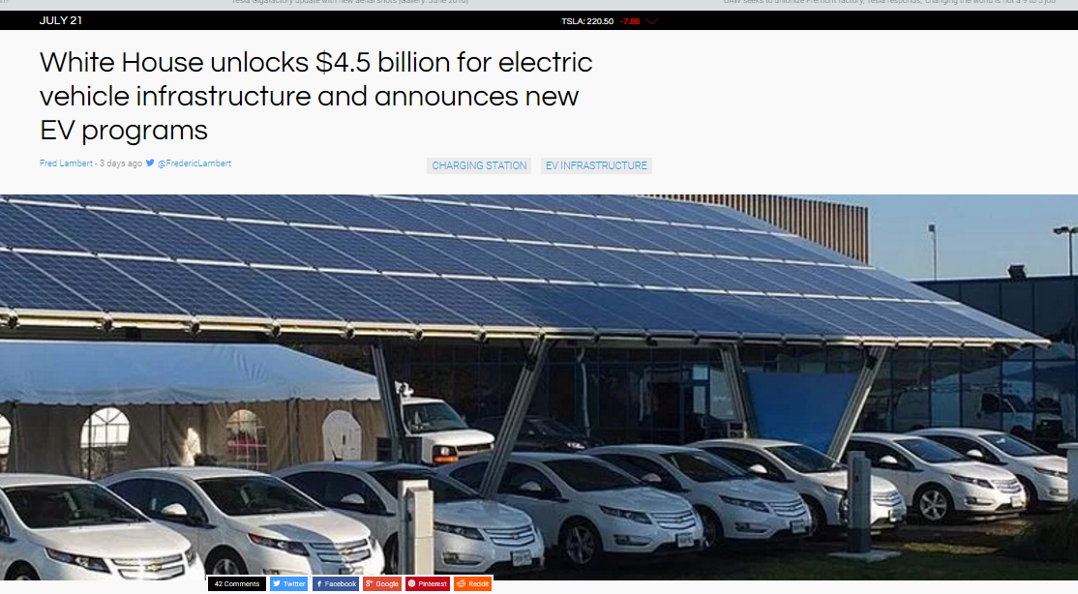
The EVSE MarketT

Slide 9
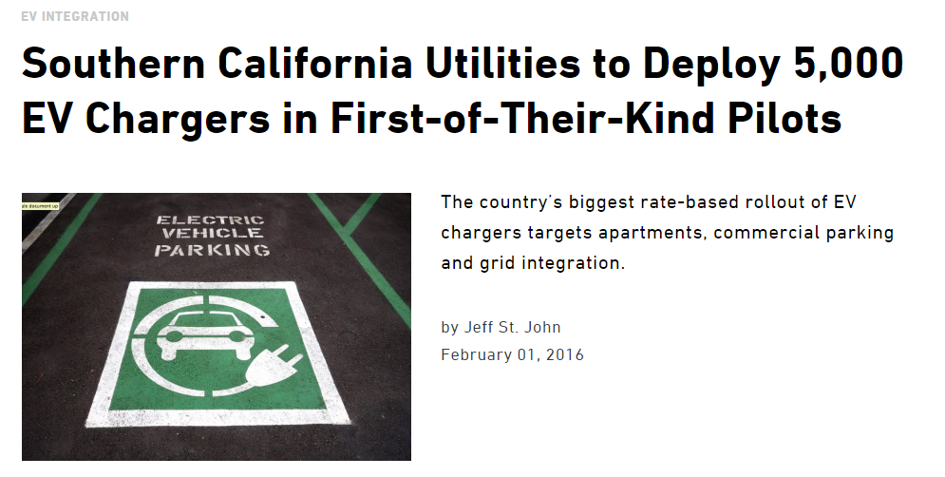
The EVSE MarketT
15,000

Slide 10
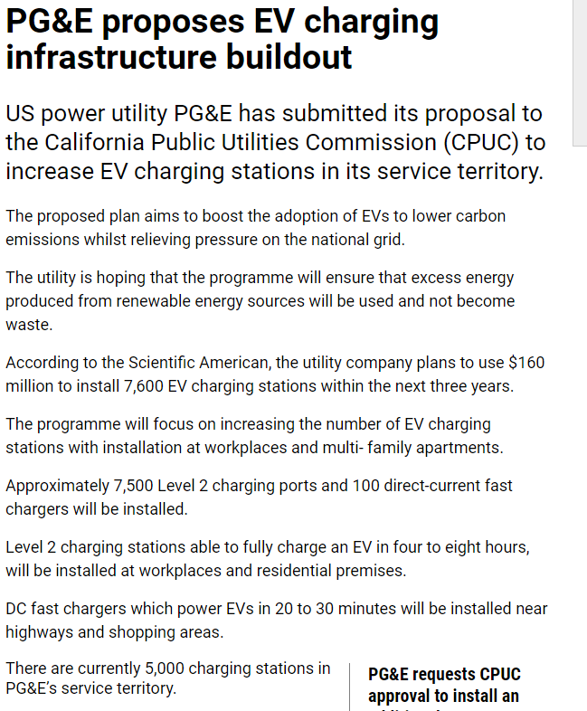
The EVSE Market

Slide 11
The EVSE MarketT
UNIVERSAL DRIVERS
  Auto Companies believe there are two major issues holding back electric vehicles
    Range Anxiety
    Cost to purchase compared to gas vehicles
  Range Anxiety is resolved in several ways
    Car has larger battery to extend range
    Charging gets below 15 minutes per hundred miles
    Wide spread availability of rapid charging stations

Slide 12
THE MARKET
UNIVERSAL DRIVERS
  Vehicle purchase cost
    Major part of vehicle cost is battery
    Battery costs are dropping very rapidly even as the battery capacity grows
    Efforts like the “Giga-Factory” and Chinese efforts promise to drive the price down further
    Giga-Factories just announced in Germany and Asia
    Examples:
      Nissan Leaf was over $40K now under $30k
      TESLA Model 3 is $35,000

Slide 13
THE MARKET
Electric Vehicle Adoption
  Cheap Gas ??
    Gas prices are very low now, but that has not slowed EV manufacturers plans for new model introductions
    Even at these prices EV fuel is 25% the cost of gas
    Certain urban areas may force wide scale adoption
    The probability that gas stays cheap forever is low
  Maintenance Costs
    Electric vehicles have almost no maintenance costs
    Lifetime ownership costs will be very low

Slide 14
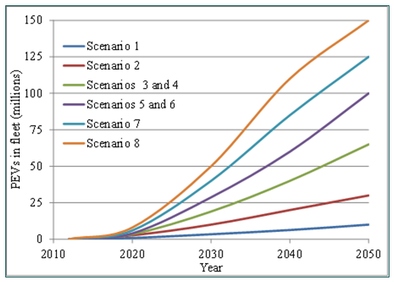
THE MARKET
Electric Vehicle Adoption
  EV Economics overtake gas as lowest total cost to own and operate
  Maintenance Costs
    Electric vehicles have almost no maintenance costs
    Lifetime ownership costs will be very low

Slide 15
THE EVSE MARKET
Vehicles Must Charge Quickly for Wide Scale Adoption
  Typical miles per kWHr is 2.7 to 3.3
    That is not likely to change much with technology improvements
For a 100 mile range you need
  30 kWHr of charge
A Tesla SuperCharger delivers 120 kW and can add 170 miles of range in 30 minutes.

Slide 16
THE EVSE MARKET
Charge Times (hours)

Slide 17
THE EVSE MARKET
Fill the Tank Costs

Slide 18
MULTIPLE STANDARDS IN USE
J1772 AC Level 1
  Primarily for home installation
  120 Volts at up to 16 Amps
  Maximum Power Delivery ( 1.92 kW )
  Typical time to charge
    Pluggable Hybrid ( 3 – 5 hours, 0% to 100%)
    EV 80 Mile Range (8 – 20 hours, 20% to 100%)
    EV200 Mile Range ( 15 – 40 hours, 20% to 100%)
  5.6 miles per hour of charge

Slide 19
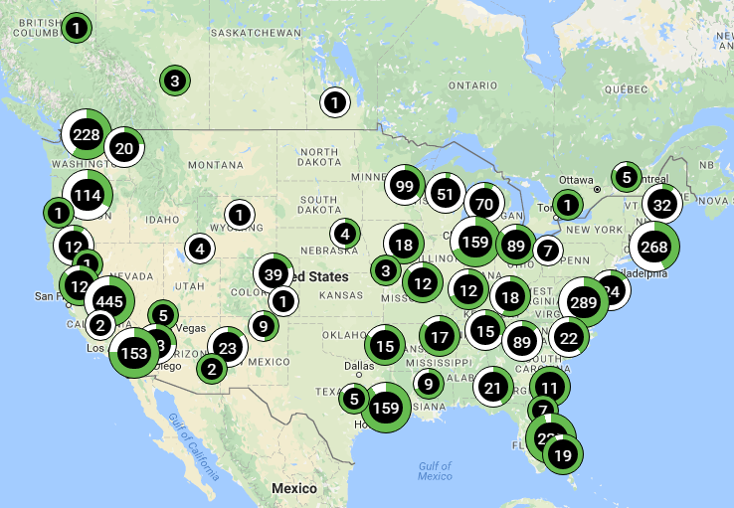
MULTIPLE STANDARDS IN USE
J1772 AC Level 1 – Public Stations

Slide 20
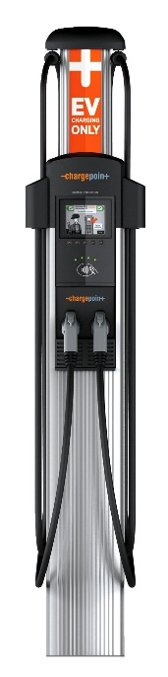
MULTIPLE STANDARDS IN USE
J1772 AC Level 2
  Home and Commercial Installation
  240 Volts at up to 80 Amps (30A and 50A most common)
    Home 30A, Commercial 30A, 50A, 75A
  Maximum Power Delivery ( 19.2 kW )
  Typical time to charge
    Pluggable Hybrid ( 0.5 – 1.5 hours, 0% to 100%)
    EV 80 Mile Range (1.5 – 4 hours, 20% to 100%)
    EV200 Mile Range ( 3.2 – 10 hours, 20% to 100%)

Slide 21
MULTIPLE STANDARDS IN USE
J1772 AC Level 2
    240V at up to 80A (19.2 kW) ( 56 miles per hour of charge)
    Most common is 32A (7.68 kW) ( 23 miles per hour of charge)
  Over 95% of commercial EVSEs are AC Level 2
  All current EV/PEV in US can use this type though some need adapters
  Stations cost $3,000 - $8,000

Slide 22
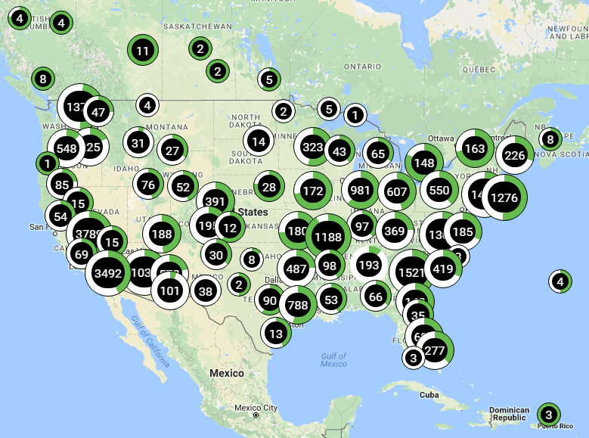
MULTIPLE STANDARDS IN USE
J1772 AC Level 2 - Public Stations

Slide 23
MULTIPLE STANDARDS IN USE
J1772 DC Rapid Charge
  Commercial Installation
  200 to 600 Volts at up to 400 Amps (30A and 50A most common today)
    Commercial 50kW, 100kW
  Maximum Power Delivery ( 240 kW theoretical)
  Typical time to charge
    EV 80 Mile Range (0.3 – 1.5 hours, 10% to 80%)
    EV200 Mile Range ( 0.3 – 1.5 hours, 10% to 80%)
  At 50kW you get 150 miles per hour of charge

Slide 24
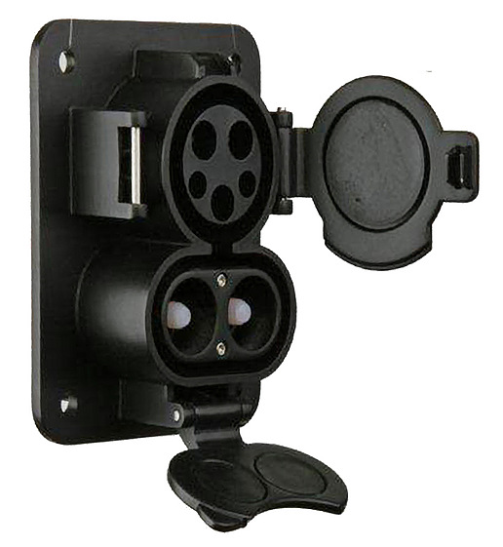
MULTIPLE STANDARDS IN USE
J1772 – 2016 for DC Level 2
  Uses Duo Connector
  Only one connector for AC or DC
  Very few presently installed in US
  Will be standard for US and European manufacturers beginning in 2018 model year.

Slide 25
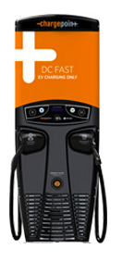
MULTIPLE STANDARDS IN USE
J1772- 2016 DC Level 2
  Being installed at a rate of about 1 per every 100 AC Level 2
  Driving factor – Few current vehicles can use DC Fast Charge
    Mainly Tesla and Nissan Leaf
    These have their own free networks
  OVER 24 2018 models will have rapid charge capability
  Negative – Stations cost $80,000 to $120,000

Slide 26
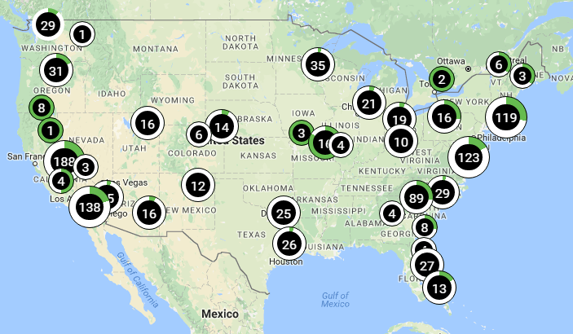
MULTIPLE STANDARDS IN USE
J1772 DC Level 2

Slide 27
EVSE BASICS
CHAdeMO
  Originated in Japan but used World Wide
  First DC Rapid Charging Standard
  Cars which use this for DC need separate J1772 connector for AC
  Most US stations at Nissan dealerships
  Not clear if Japanese manufacturers will switch to new SAE J1772 DUO standard

Slide 28
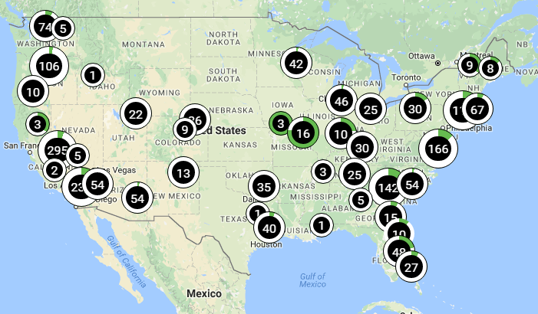
EVSE BASICS
CHAdeMO

Slide 29
EVSE BASICS
Tesla
  Largest US DC Fast Charge Network
  Exclusive to Tesla Owners
  Today it is free, but will not be for Model 3 buyers
  Will it fall under W&M regulations???
  Protocol and hardware are proprietary
  Poses challenge for test equipment vendors

Slide 30
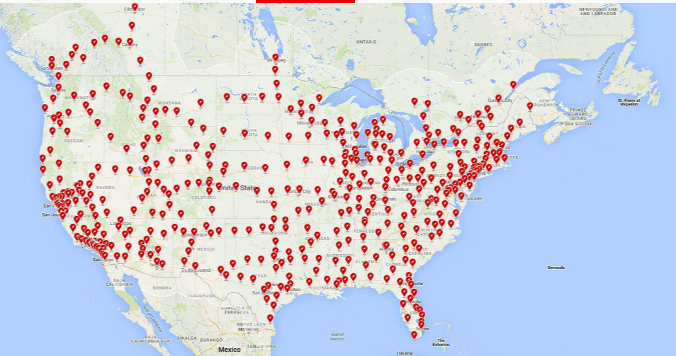
EVSE BASICS
Tesla

Slide 31
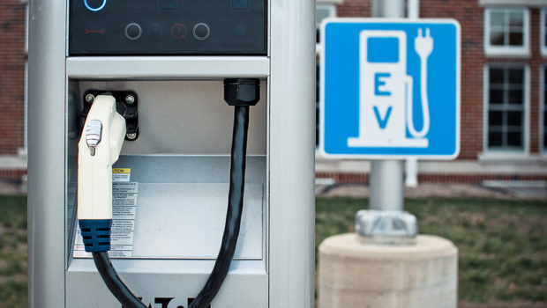
MAJOR CHARGING NETWORKS
Aerovironment (AV)
BLINK
ChargePoint
The Electric Circuit
EVGO
GE Wattstations
GreenLots
SEMAConnect
Tesla

Slide 32
REGULATORY BACKGROUND
U.S. National Work Group - Electric Vehicle Fueling and Submetering
  Formed two years ago to develop HB44 standards for EVSE and submetering applications
  Phase 1: EVSE Standard – Initial work completed July 2015
New Provisional Standard Approved in July 2015 Effective Jan 1, 2016
  HB44 Section 1.10 General Code
    Several changes relevant to EVSE
  HB44 Section 3.4 – Electric Vehicle Fueling Systems – Tentative Code
  HB44 Section 5.5 – Timing Devices
    Several changes relevant to EVSE

Slide 33
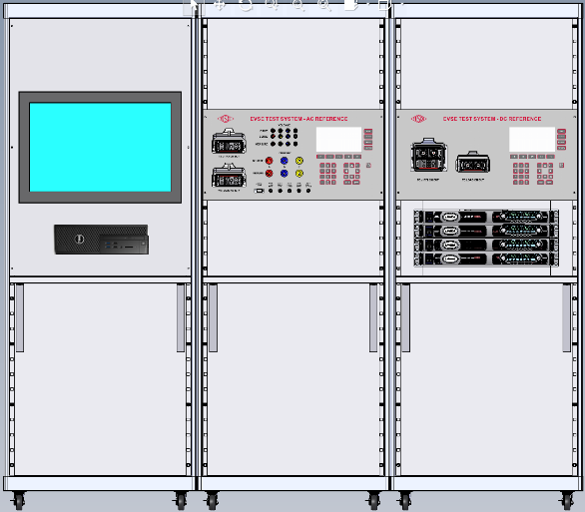
REGULATORY BACKGROUND
Additional New Standards in Process
  NIST Handbook 130 Examination Procedure for Retail Electric Vehicle Fueling Systems
    This procedure is currently in development
    A draft version is available from Juana Williams at NIST
  NTEP PB14 Working Group
    Establishing type test checklist
TESCO wins contract to build Primary Reference Standards and Type Test System for US NTEP Lab.

Slide 34
HB44 APPLICABILITY
A.1. General. – This code applies to devices, accessories, and systems used for the measurement of electricity dispensed in vehicle fuel applications wherein a quantity determination or statement of measure is used wholly or partially as a basis for sale or upon which a charge for service is based.

Slide 35
HB44 APPLICABILITY
Exceptions-This code does not apply to:
  The use of any measure or measuring device owned, maintained, and used by a public utility or municipality only in connection with measuring electricity subject to the authority having jurisdiction such as the Public Utilities Commission.
  Electric Vehicle Supply Equipmentused solely for dispensing electrical energy in connection with operations in which the amount dispensed does not affect customer charges or compensation.
  The wholesale delivery of electricity.

Slide 36
HB44 APPLICABILITY
Use Cases – NOT COVERED
  A store provides a free EVSE in its parking lot
  A paid parking lot provides EVSEs for which there is no charge based on the amount of energy delivered
  Tesla provides free charging services for owners
  An organization charges a monthly fee for unlimited use of its network of EVSEs.

Slide 37
HB44 APPLICABILITY
Use Cases –COVERED
  ANY transaction which is based on the amount of energy delivered
  Examples
    An network of charge stations charges a monthly fee to belong AND a fee based on the amount of energy used
    A EVSE charges for the amount of energy delivered
    A parking lot charges for parking and EVSEs located in it also charge for the amount of energy delivered if used

Slide 38
HB44 - REQUIREMENTS
S.1.1. Electric Vehicle Supply Equipment (EVSE). – An EVSE used to charge electric vehicles shall be of the computing type and shall indicate the electrical energy, the unit price, and the total price of each transaction.
  EVSEs capable of applying multiple unit prices over the course of a single transaction shall also be capable of indicating the start and stop time, the total quantity of energy delivered, the unit price, and the total price for the quantity of energy delivered during each discrete phase corresponding to one of the multiple unit prices.

Slide 39
HB44 - REQUIREMENTS
  EVSEs capable of applying additional fees for time-based and other services shall also be capable of indicating the total time measured; the unit price(s) for the additional time based service(s); the total computed price(s) for the time measured; and the total transaction price, including the total price for the energy and all additional fees.

Slide 40
HB44 - REQUIREMENTS
An EVSE used to charge electric vehicles shall include an indicating element that accumulates continuously and displays, for a minimum of 15 seconds at the activation by the user and at the start and end of the transaction, the correct measurement results relative to quantity and total price. Indications shall be clear, definite, accurate, and easily read under normal conditions of operation of the device. All indications and representations of electricity sold shall be clearly identified and separate from other time-based fees indicated by an EVSE that is used for both the sale of electricity as vehicle fuel and the sale of other separate time-based services (e.g., vehicle parking).

Slide 41
HB44 - REQUIREMENTS
EVSE Value of Smallest Unit. – The value of the smallest unit of indicated delivery by an EVSE, and recorded delivery, if the EVSE is equipped to record, shall be 0.005 MJ or 0.001 kWh.
Equipment Capacity and Type of Voltage. – An EVSE shall be able to conspicuously indicate on each face the maximum rate of energy transfer (i.e., maximum power) type of current associated with each unit price offered (e.g., 7 kW AC, 25 kW DC, etc.).

Slide 42
HB44 - REQUIREMENTS
Money-Value Divisions Digital. – An EVSE with digital indications shall comply with the requirements of paragraph G-S.5.5. Money-Values, Mathematical Agreement, and the total price computation shall be based on quantities not exceeding 0.5 MJ or 0.1 kWh.

Slide 43
HB44 - REQUIREMENTS
EVSE data accumulated and indicated shall be unalterable and accessible.
Values indicated or stored in memory shall not be affected by electrical, mechanical or temperature variations, radio-frequency interference, power failure, or any other environmental influences to the extent that accuracy is impaired. Memory and/or display shall be recallable for a minimum of three years. A replaceable battery shall not be used for this purpose.

Slide 44
HB44 - REQUIREMENTS
Temperature Range for System Components. – EVSEs shall be accurate and correct over the temperature range of – 40 °C to + 85 °C (− 40 °F to 185 °F). If the system or any measuring system components are not capable of meeting these requirements, the temperature range over which the system is capable shall be stated on the NTEP CC, marked on the EVSE, and installations shall be limited to the narrower temperature limits.

Slide 45
HB44 - REQUIREMENTS
Minimum Measured Quantity. –
Measuring systems shall have a minimum measured quantity not exceeding 2.5 MJ or 0.5 kWh.
WHH Comment: This is a large amount of energy for most systems. Drawing this much energy can take five minutes or more on an AC Level 2 system.

Slide 46
HB44 – TESTING REQUIREMENTS
N.1. No Load Test. – A no load test may be conducted on an EVSE measuring system by applying rated voltage to the system under test and no load applied.
WHH – How long to run test not specified.
N.2. Starting Load Test. – A system starting load test may be conducted by applying rated voltage and 0.5‑ampere load.
WHH – Is there any level of accuracy required?

Slide 47
HB44 – TESTING REQUIREMENTS
N.3. Minimum Test Draft (Size). – Full and light load tests shall require test of the EVSE System for a delivery of the minimum measured quantity as declared by the manufacturer.

Slide 48
HB44 – TESTING REQUIREMENTS
Accuracy Testing – AC Systems
(1) Accuracy test of the EVSE system at a load of not less than 85 % of the maximum deliverable current (MDA) as determined from the pilot signal for a total energy delivered of at least twice the minimum measured quantity (MMQ). If the MDA would result in maximum deliverable power of greater than 7.2 kW, then the test may be performed at 7.2 kW.
(2) Accuracy test of the EVSE system at a load of not greater than 10 % of the maximum deliverable current (MDA) as determined from the pilot signal for a total energy delivered of at least the minimum measured quantity (MMQ).

Slide 49
HB44 – TESTING REQUIREMENTS
Accuracy Testing – DC Systems
Accuracy test of the EVSE system at a load of not less than 85 % of the maximum deliverable current (MDA) as determined from the pilot signal for a total energy delivered of at least twice the minimum measured quantity (MMQ).
WHH – The following was omitted from the final version of the standard.
If the MDA would result in maximum deliverable power of greater than 7.2 kW, then the test may be performed at 7.2 kW.

Slide 50
HB44 – TESTING REQUIREMENTS
Accuracy Testing – DC Systems
(2) Accuracy test of the EVSE system at a load of not greater than 10 % of the maximum deliverable current (MDA) as determined from the pilot signal for a total energy delivered of at least the minimum measured quantity (MMQ).
Note: For DC systems it is anticipated that an electric vehicle may be used as the test load. Under that circumstance testing at the load presented by the vehicle shall be sufficient.

Slide 51
HB44 – TESTING REQUIREMENTS
Repeatibility Testing – DC Systems
Tests for repeatability should include a minimum of three consecutive tests at the same load, similar time period, etc., and be conducted under conditions where variations in factors are reduced to minimize the effect on the results obtained.

Slide 52
HB44 – TESTING TOLERANCES
GENERAL
The tolerances apply equally to errors of underregistration and errors of overregistration.
The tolerances apply to all deliveries measured at any load within the rated measuring range of the EVSE.
Where instrument transformers or other components are used, the provisions of this section shall apply to all system components.

Slide 53
HB44 – TESTING TOLERANCES
TEST TOLERANCES
The tolerances for EVSE load tests are Acceptance Tolerance: 1.0 % and Maintenance Tolerance: 2.0 %.
Repeatability. – When multiple load tests are conducted at the same load condition, the range of the load test results shall not exceed 25 % of the absolute value of the maintenance tolerance and the results of each test shall be within the applicable tolerance.

Slide 54
HB44 – TESTING TOLERANCES
TEST TOLERANCES
No Load Test. – An EVSE measuring system shall not register when no load is applied.
Starting Load. – An EVSE measuring system shall register starting load test at a 0.5 ampere (A) load.

Slide 55
HB44 – TESTING TOLERANCES
TYPE EVALUATION
For type evaluation examinations, the acceptance tolerance values shall apply under the following conditions:
  at any temperature, voltage, load, and power factor within the operating range of the EVSE, and
  regardless of the influence factors in effect at the time of the conduct of the examination, and
  for all quantities greater than the minimum measured quantity.

Slide 56
EPO 30 – FIELD TEST
Process in EARLY stage of development
  Verify EVSE labeling meets requirements
  Record all site information
  Power on test equipment with load connected
  Start test process on test equipment
  Connect EVSE to test equipment
  Determine maximum deliverable current (MDA) from CP signal
  Set load to <=10% of MDA and perform the light load test

Slide 57
EPO 30 – FIELD TEST
Process in EARLY stage of development
  Perform the light load test
    (a) This requires doing a charging cycle and at the conclusion of energy delivery comparing the total energy and price registered on the EVSE with that measured by the test equipment.
  Record the test results
    (a) Repeat 8 & 9 multiple times for reproducibility test
  Set load to >85% of MDA and perform the full load test
    (a) This requires doing a charging cycle and at the conclusion of energy delivery comparing the total energy and price registered on the EVSE with that measured by the test equipment.
  Record the test results
    Repeat 10 & 11 multiple times for reproducibility test

Slide 58
EPO 30 – FIELD TEST
Process in EARLY stage of development
  Verify that after the final test that the display on the EVSE remains visible for at least 15 seconds
  No Load Test (optional)
    Test system must initiate a valid charging sequence without placing a load on the EVSE. No energy should be registered.
    Not yet defined what “No” means or for how long the test should be performed

Slide 59
EPO 30 – FIELD TEST
Process in EARLY stage of development
  Starting Load Test (optional)
    Test system must initiate a valid charging sequence with a load of 0.5 amps.
    Energy must be registered, not clear at this point what the accuracy requirement is, if any if 0.5 amps is less than 10% of MDA.

Slide 60
EPO 30 – FIELD TEST
Process in EARLY stage of development
  Time Test (tbd)
  RFI/EMI Test (tbd)
  Zero-Setback Test
    On equipment activated with a single remote controller, activate one EVFS and check all others operated by the same controller to make certain they will not operate without activating the individual EVFS starting mechanism.

Slide 61
EPO 30 – FIELD TEST
Process in EARLY stage of development
  Power Loss Test
    Power loss results in termination of transaction or transaction continues without additional authorization with indication of the event on the receipt
    EVFS memory or supporting network retains quantity of time and sales price totals during power loss

Slide 62
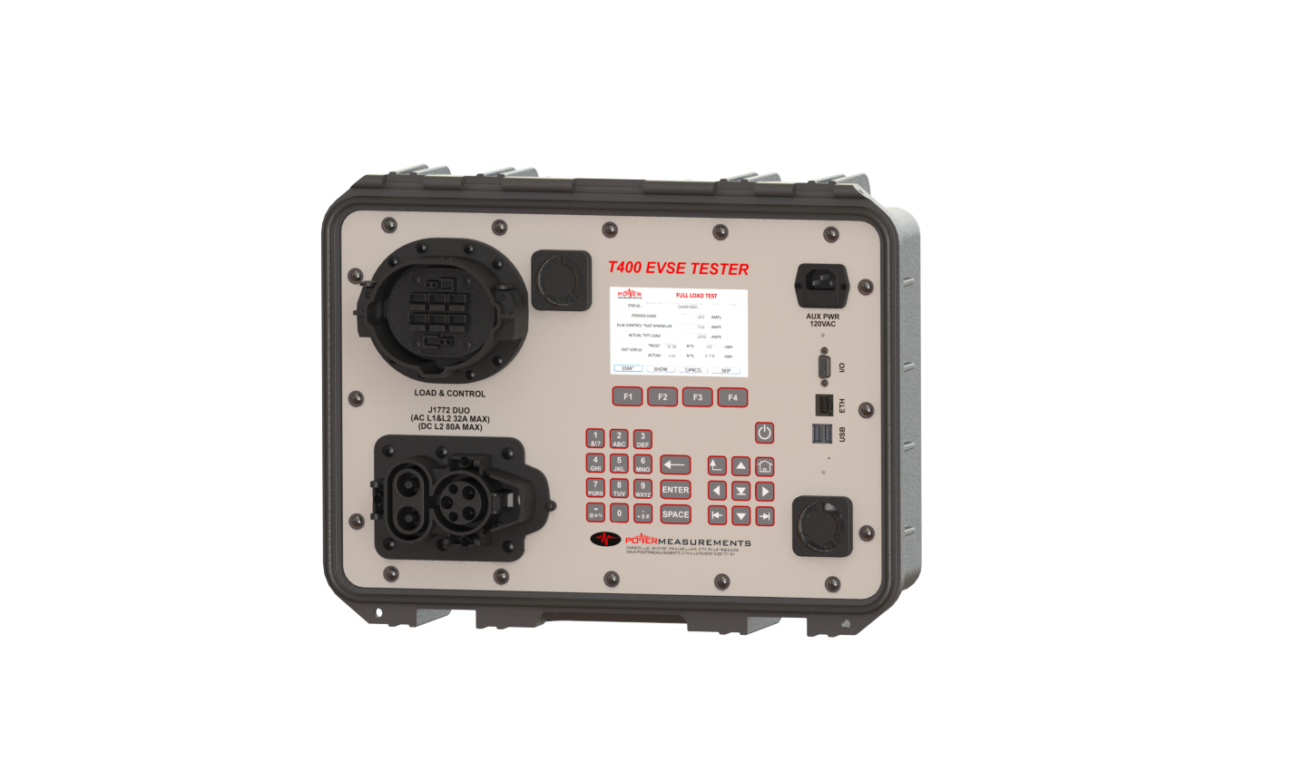
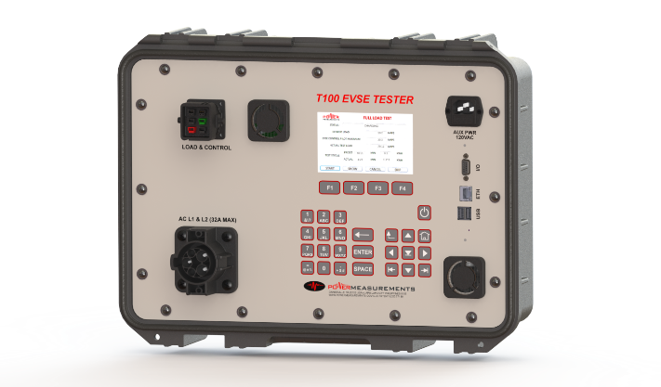
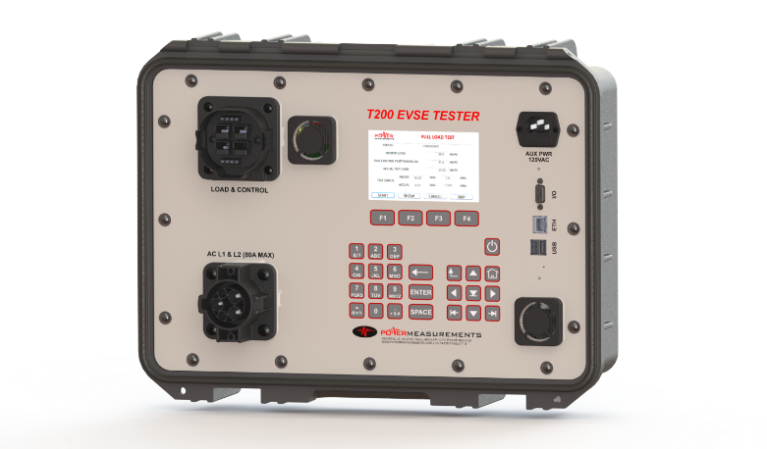
OUR TEST SOLUTIONS
T100 AC Level 1 & 2 to 32 Amps
T200 AC Level 1 & 2 to 75Amps
T400
AC Level 1 & 2 to 75 Amps
DC Level 2 to 75 Amps

Slide 63
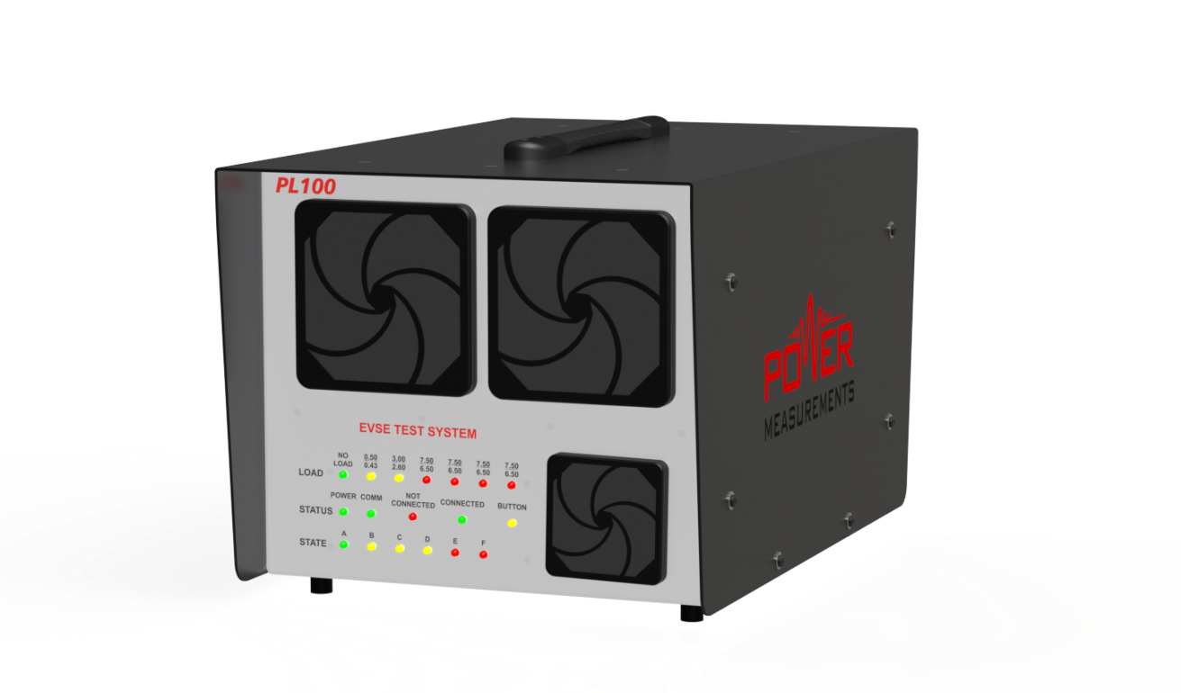
OUR TEST SOLUTIONS
PL100 AC Level 1 & 2 to 32 Amps
PL200 200 AC Level 1 & 2 to 64 Amps
PL400
AC Level 1 & 2 to 64 Amps
DC Level 2 to 32 Amps

Slide 64
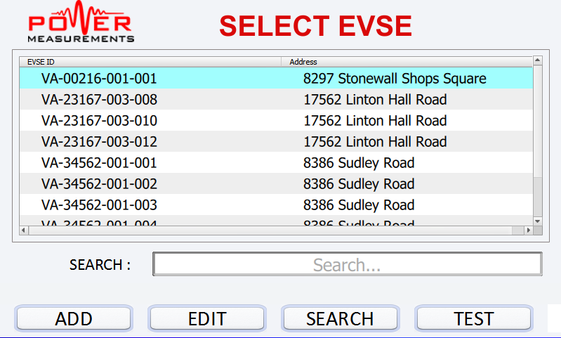
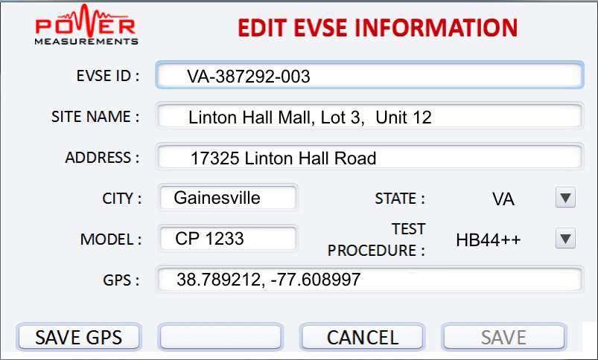
OUR TEST SOLUTIONS
TXXX EVSE TESTER
  Database driven
    Select a site and test
    Download all of your site data from your PC
    Locate site by GPS , ID or any other field

Slide 65
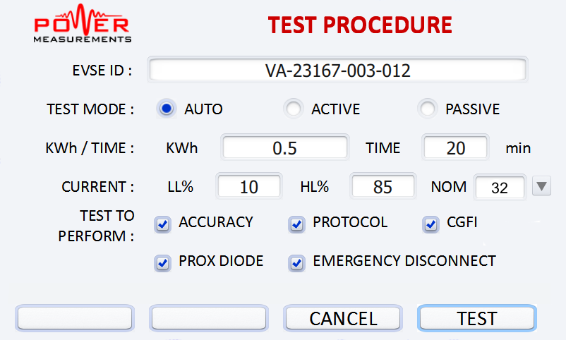
OUR SOLUTION
TXXX EVSE TESTER
  Automated Operation
    Create Test sequences which completely automate process
    Testing is then a simple one click process

Slide 66
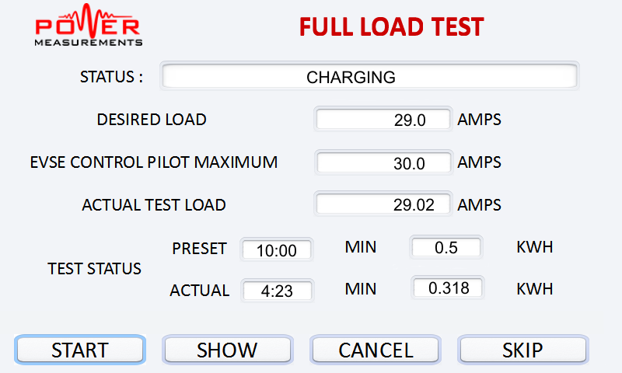
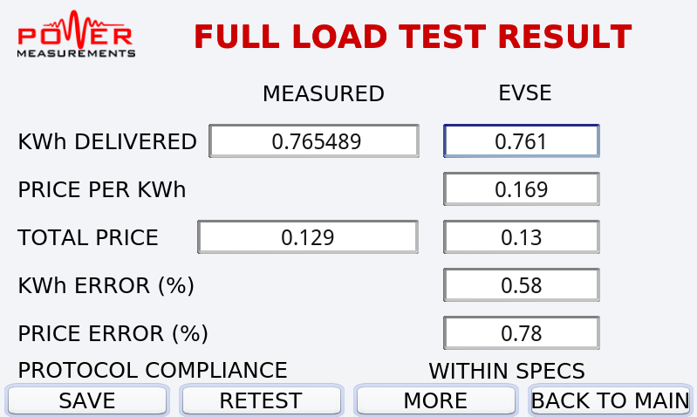
OUR SOLUTION
TXXX EVSE TESTER
  Simple Results
    Process and Status During Testing
    Easy entry of EVSE Displayed Results

Slide 67
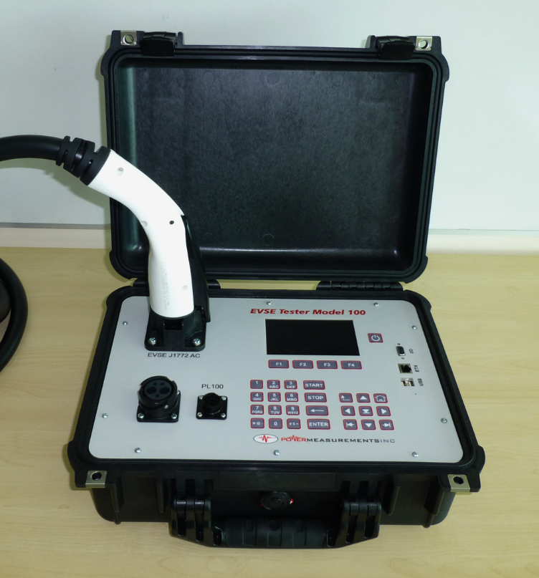
OUR SOLUTION
TXXX EVSE TESTER
  Fully Self Contained
    No PC or Smart Phone
    Rugged Pelican Case
    Run from internal battery, AUX AC or L1-L2 of EVSE
    High Res Color display
    Ethernet, USB, Serial
    Built in GPS

Slide 68
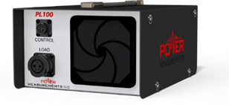


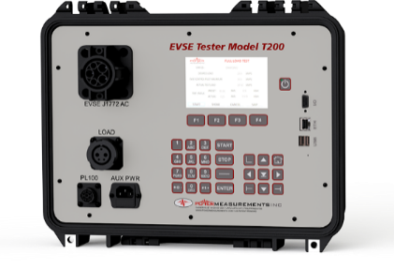


EVSE TEST SYSTEMS
Charging Station
Programmable Load Emulates Vehicle
Can Provide Any Value of Load
Allows Multiple Tests to be Run Automatically
Electric Vehicle

Slide 69
PRACTICAL CHALLENGES
Present Generation VERY difficult to test
  Devices may not display all HB44 parameters
  Devices may require a transaction to start with removing the plug and end by replacing it
  EVSEs require a account to charge, who pays
  HB44 requires 6 to 10 tests, very slow if each requires a plug-unplug cycle.

Slide 70
PRACTICAL CHALLENGES
Industry working on a solution
  We need your help to make sure it works for you
  Issues are:
    Need for universal authorization for inspectors
      Must be secure
      Access achieved through test equipment ????
    Access to special test modes
      Will these be acceptable to W&M
      If these involve higher precision data access is that acceptable
    Since energy can’t be put back, who pays

Slide 71

QUESTIONS & DISCUSSION
Bill Hardy
TESCO – The Eastern Specialty Company
Bristol, PA
215-785-2338
This presentation can also be found under Meter Conferences and Schools on the TESCO web site: www.tescometering.com

