Slide 1
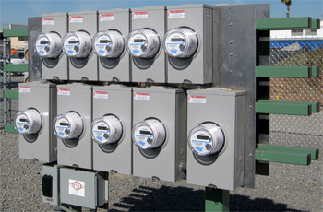
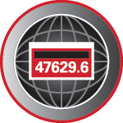
Current Metering Safety Topics
Prepared by Tom Lawton, TESCO
The Eastern Specialty Company
For North Carolina Electric Meter School
Single Phase Session
Thursday, June 28, 2018 at 9:00 a.m.
10/02/2012
Slide 1
Notes:
1

Slide 2
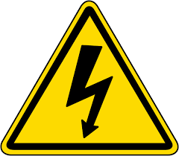
Metering Safety
Fatal Electrical Injuries
The 154 electrical fatalities that occurred during 2016 represent a 15% increase over the 2015 total.
Exposure to electric current increased one place to sixth on the list of occupational exposures leading to fatal on-the-job injury, trading places with aircraft fatalities.
Once again, electrocutions constituted the vast majority of electrical fatalities while electrical burns of all degrees were responsible for four fatalities.

Slide 3
Metering Safety
Fatal Electrical Injuries
The highest rate of fatal electrical injury in 2016 occurred in the Utility industry (0.87/100,000), followed closely by the Construction industry (0.82/100,000).
In 2016, there was one electrical fatality for every 34 fatalities from all causes versus one for every 36 fatalities in 2015. The long-term trend has declined from one electrical fatality for each 23 fatalities from all causes in 2003 to the 2016 level of one in 34.

Slide 4
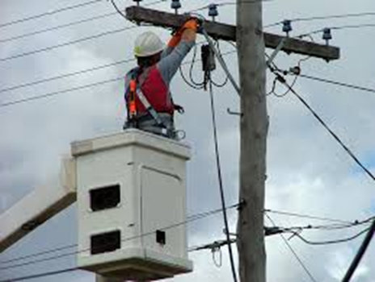
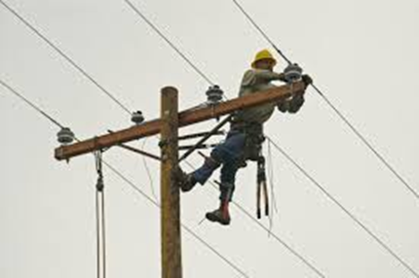
Does Age Matter – Or Experience?
Fatal Electrical Injuries
In 2016, 3% of fatalities from all causes involved electricity. The data show that younger workers experience fatal electrical injury at up to 2.3 times the frequency of more experienced workers.
Workers 16 to 17 years of age experienced electrical fatalities at 2 times the average for all age groups;
18 to 19 years age group - 2.3 times;
20 to 24 years age group - 1.7 times;
25 to 34 years age group - 1.3 times, and;
those 45 years and up are at or below the average frequency of electrical injury.

Slide 5
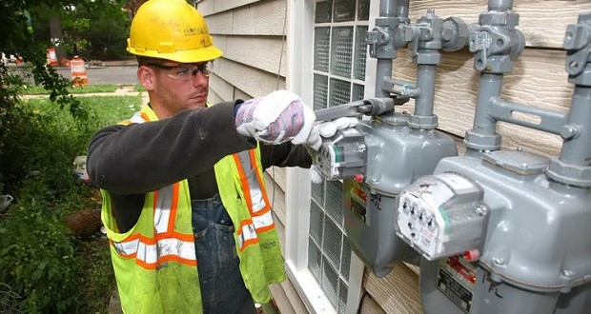
Non-Fatal Electrical Injuries
The median number of days away from work for nonfatal electrical injuries was 5.
More electrical burn injuries (270) than electric shock injuries (150) occurred in the Construction industry in 2016. Numbers of electrical shock injuries for the Utility industry were unavailable for 2016, while 50 electrical burn injuries were recorded.
The Utility industry rate of nonfatal electrical injury involving days away from work (0.9/10,000) surpassed the Construction industry rate (0.7/10,000) in 2016.
The Mining industry had rate of nonfatal electrical burn injury of 1.0/10,000 for 2016, followed by the Utility industry (0.9) followed by the construction industry (0.4). The rate for all of Private industry remained consistent at 0.1.

Slide 6
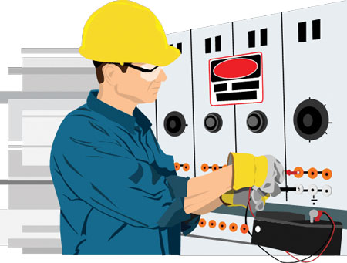
How Dangerous is Metering?
Electricity is Organized Lightning – George Carlin
Any Voltage without current will not kill you, but any voltage with current can kill you.

Slide 7
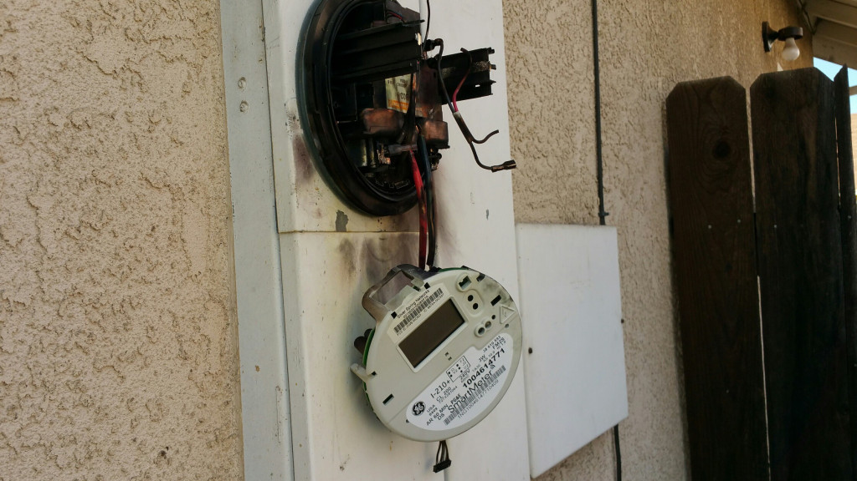
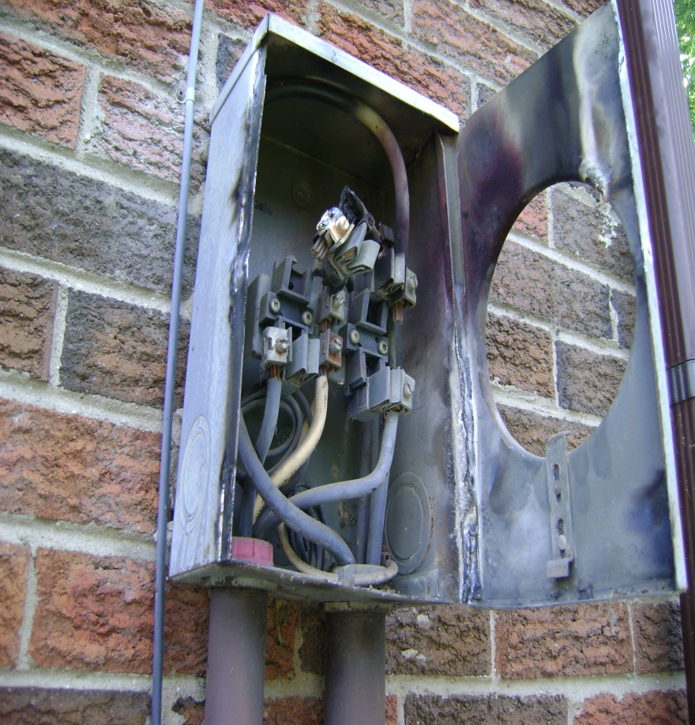
How Dangerous is Metering?

Slide 8
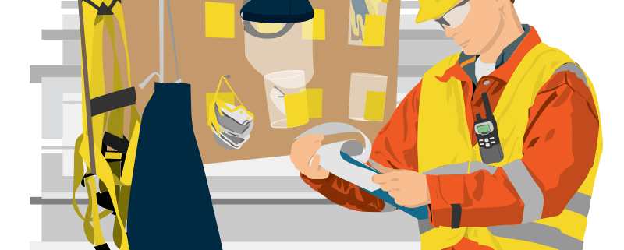
Safety First - PPE
Personal Protective Equipment
Leathers
Rubber Gloves
Face Shield
FR Clothing
Safety Shoes

Slide 9
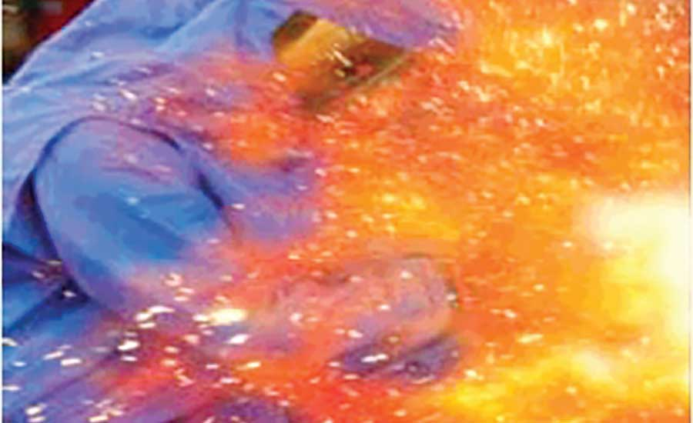
Arc Flash
What is Arc Flash?
While an arc flash is sometimes used interchangeably with “arc fault”, an arc flash is more accurately defined as the light produced during an arc fault. An arc fault is a type of electrical fault that results from the breakdown of an insulating medium between two conductors where the energy is sufficient to sustain an arc across the insulator (often air) and can cause extreme amounts of light (arc flash), immense heat upwards of 19,000 degrees C, and a resulting explosive pressure wave (arc blast). These forces combine to create a hazardous condition that can vaporize metal, destroy equipment, and pose a significant hazard to anyone in the vicinity.

Slide 10
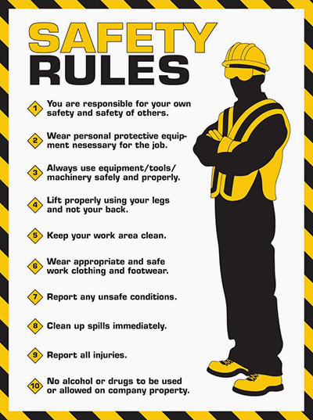
Covering the Basics

Slide 11
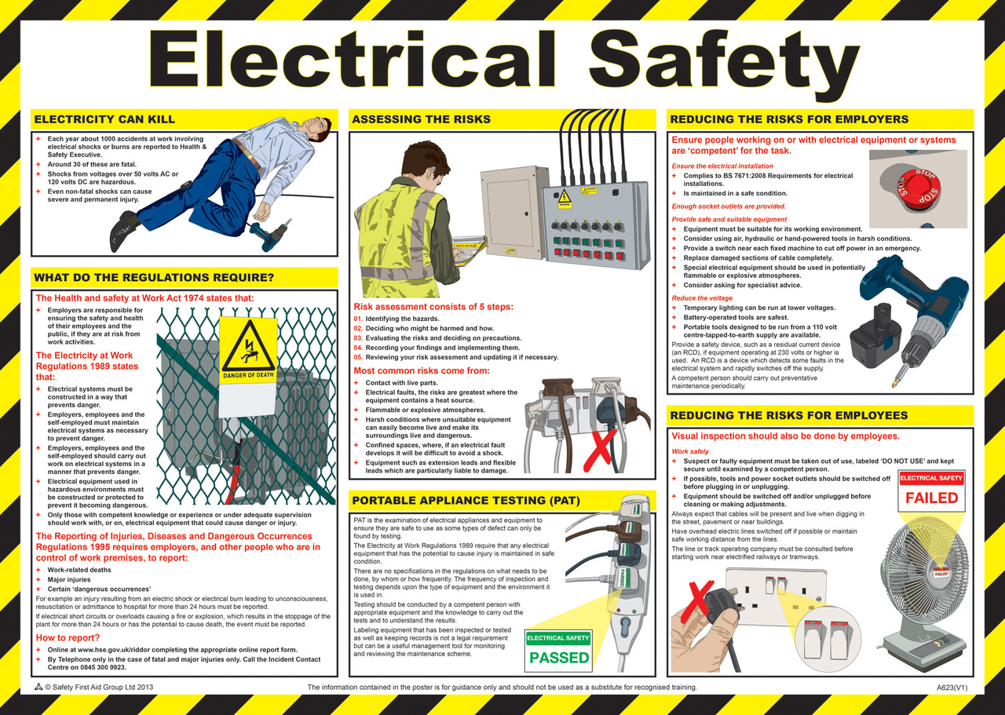
More of the Basics

Slide 12
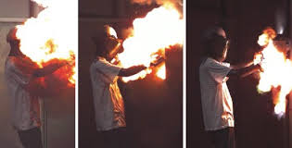
How Bad Can Things Get?
Many thanks to Dominion Power
https://youtu.be/2Xoyb9M5-EA
Rubber Gloves and FR 4:10
Meter enclosure – shorted out 10:48
Thanks to Meter Grabber
https://youtu.be/Azuu8VnM36g

Slide 13
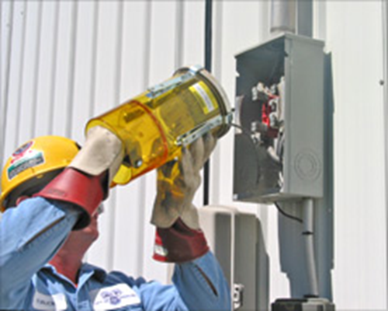
Field Audits, Trouble Shooting and Testing
Always approach an electrical service with caution and while wearing your full PPE. Why?
Never stand directly in front of the meter when removing the meter
Before you even open the box or get the cover off….
Live box
Bees
Other live animals
Broken Seal
Cover dropping off

Slide 14
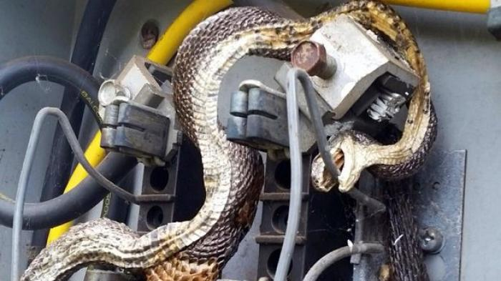
Field Audits, Trouble Shooting and Testing

Slide 15
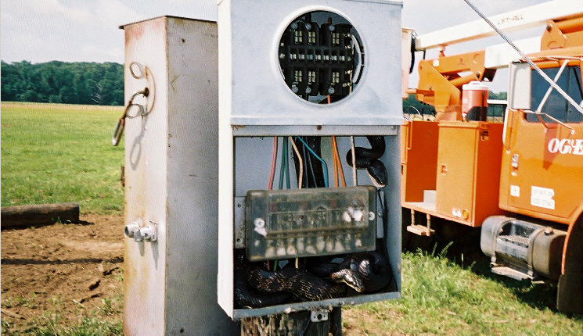
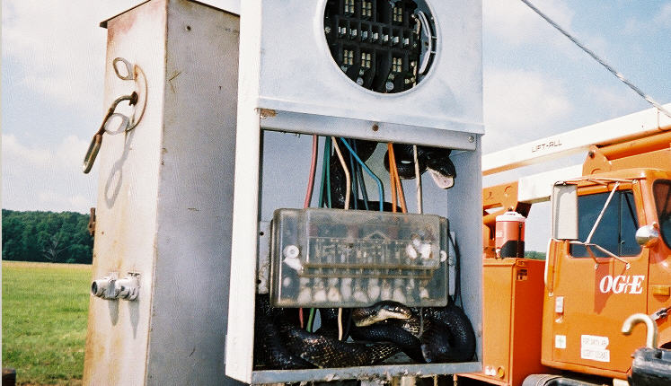
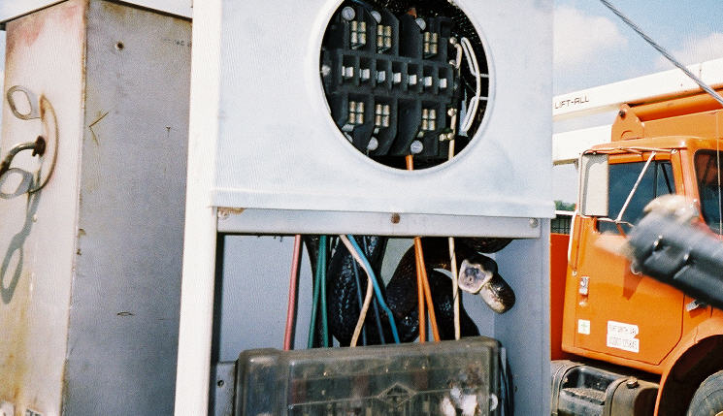
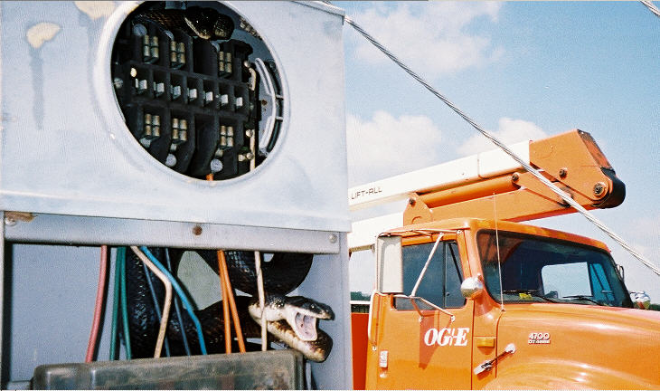
Field Audits, Trouble Shooting and Testing

Slide 16
Once the box is Open Issues to Look For
Open line – open line side connection to the meter socket.
Missing neutral – missing neutral connection to the center lug in the meter socket
Cross phase condition – cross wiring between the test block and the meter socket.
Hidden jumpers line to load – diversion on both legs.
Dead Short - dead short phase to ground on the load side of one leg of the socket.
Partial Short - partial short phase to ground on the load side of one leg of the socket
Notes:
UMPIRE is a
Universal Meter Programming and Reading System
It reads all meters and recorders
It can control all manufactures software

Slide 17
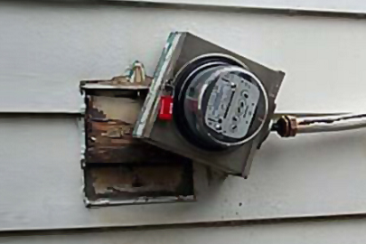
Backfeed, Ground Fault and other Issues to Look For
Back fed meter socket
Ground fault
Phase to phase fault
Pulling a meter jaw with the meter
Notes:
UMPIRE is a
Universal Meter Programming and Reading System
It reads all meters and recorders
It can control all manufactures software

Slide 18
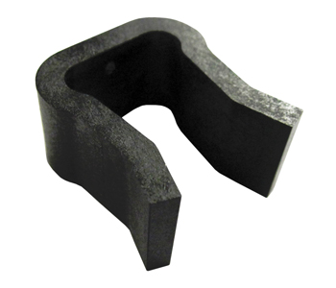
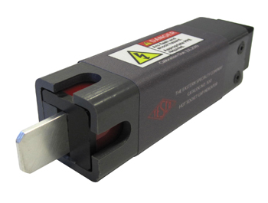
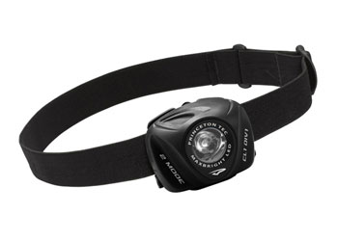
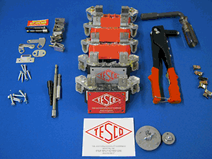
Tools
Socket Pullers
Volt meters
Specialized tools

Slide 19
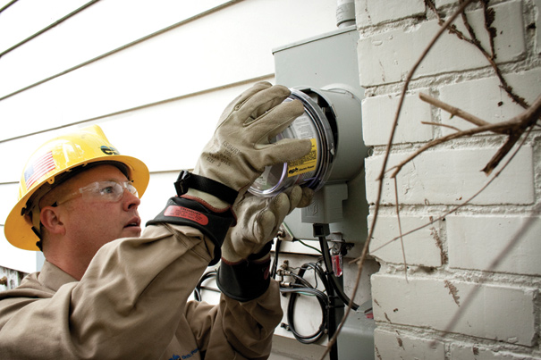
Summary
Be Careful
Assume the box is live
Assume there is something live in the box
Treat electricity with respect
Treat all meter boxes with respect

Slide 20
Questions?
Tom Lawton
TESCO – The Eastern Specialty Company
Bristol, PA
215-785-2338
This presentation can also be found under Meter Conferences and Schools on the TESCO web site: www.tescometering.com

