Slide 1
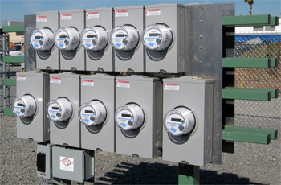
CT Testing:
Theory and Practice
Presented Bill Hardy, TESCO
The Eastern Specialty Company
For North Carolina Electric Meter School
Polyphase Session
Wednesday, June 27, 2018 at 8:00 a.m.
10/02/2012
Slide 1
Notes:
1

Slide 2
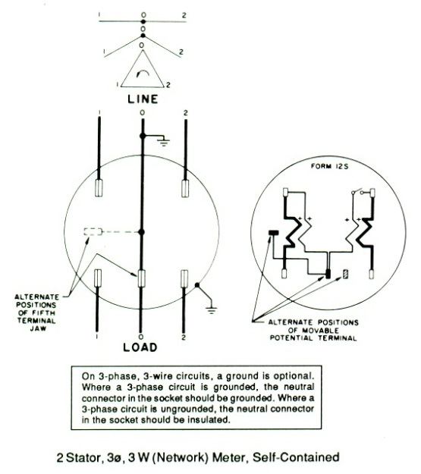
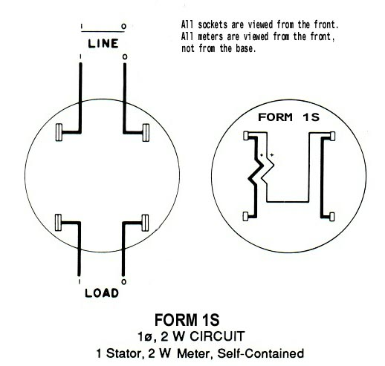
Self Contained vs. Transformer Rated
1S, 2S, 3S, 4S, 9S, 12S, 16S, 45S, etc., etc.
What’s the Difference?
Different Forms for Different Services and Applications

Slide 3
Self Contained vs. Transformer Rated
Self Contained
(direct)
Transformer Rated
(indirect)

Slide 4
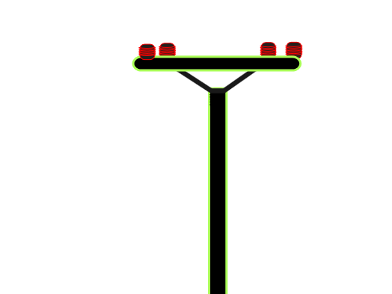
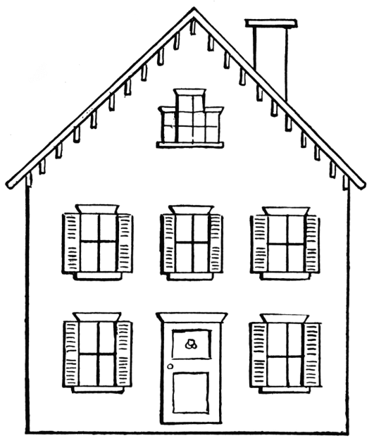
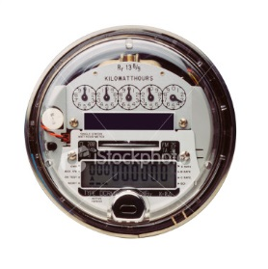
Self Contained
Primarily Residential
(1S, 2S, 12S)
Relatively Low Current
Example: 100A

Slide 5
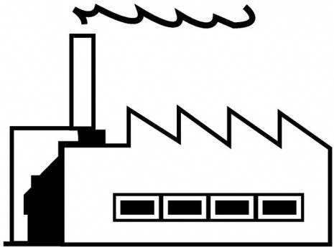
Transformer Rated
Primarily Commercial/Industrial
(9S, 16S)
Relatively High Current
Example: 400A

Slide 6
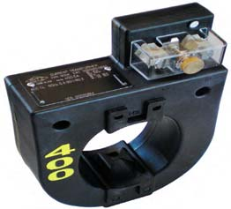
Transformer Rated
Primarily Commercial/Industrial
(9S, 16S)
Relatively High Current
Example: 400A
400:5
5A

Slide 7
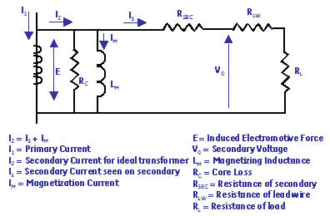
CT’s – Functions and Terminology
Ratio
Conceptual Picture of a CT
Equivalent Circuit w/ losses
As current is applied in the primary, it produces a magnetic flux in the core. This flux flows through the core and induces a current in the secondary windings and circuit that is proportional to the number of turns.

Slide 8
CT’s – Functions and Terminology
Ratio
For instance, a CT with a 400:5 ratio will produce 5A on the secondary, when 400A are applied to the primary.

Slide 9
CT’s – Functions and Terminology
Thermal Rating Factor
A value representing the amount by which the primary current can be increased without exceeding the allowable temperature rise.
For instance, a RF of 4.0 at 30° ambient on a 400:5 ratio CT would allow for a primary current up to 1600A.

Slide 10
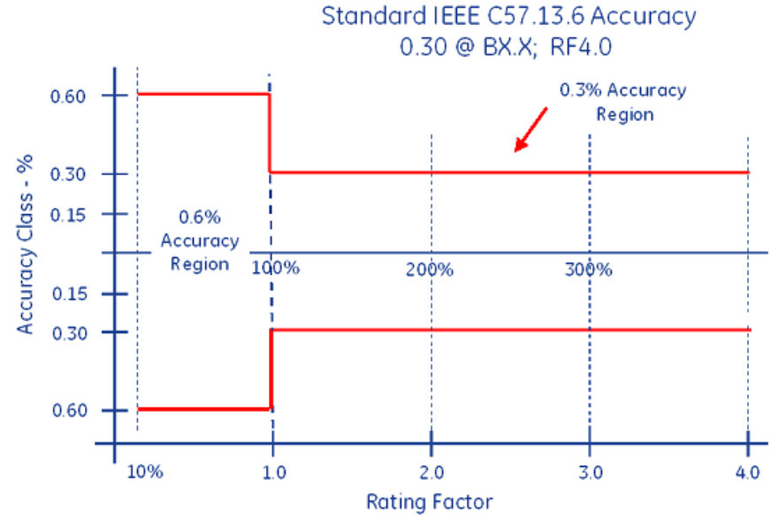
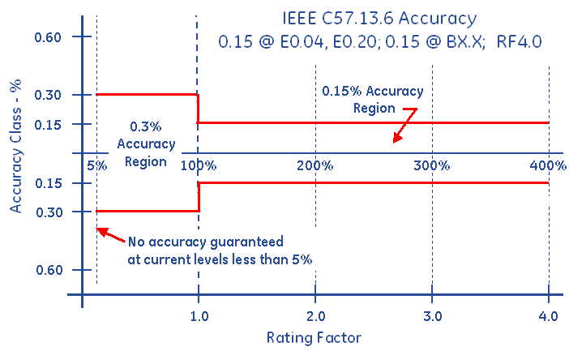
CT’s – Functions and Terminology
Accuracy Classifications and Burden
All CT’s fall within an accuracy class.
IEEE Standards have defined accuracy classes.

Slide 11
CT’s – Functions and Terminology
Accuracy Classifications and Burden
Example: 0.3% @ B0.1, B0.2, B0.5

Slide 12
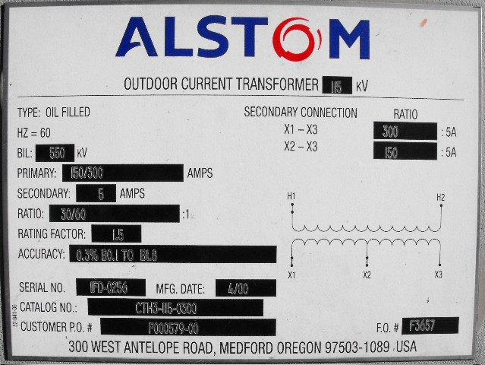
CT’s – Functions and Terminology
Faceplate

Slide 13
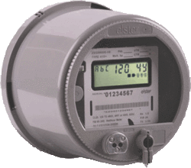
Transformer Rated
9S Meter Installation
SOURCE
LOAD
PHASE A
400A
PHASE B
400A
PHASE C
400A
5A
5A
5A

Slide 14
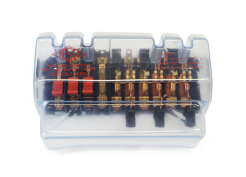
Transformer Rated
9S Meter Installation
SOURCE
LOAD
PHASE A
400A
PHASE B
400A
PHASE C
400A
5A
5A
5A

Slide 15
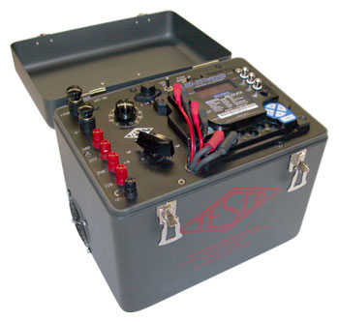
Meter Testing
9S Meter Installation
SOURCE
LOAD
PHASE A
400A
PHASE B
400A
PHASE C
400A
Isolate the Meter
from the Service
5A
5A
5A
P

Slide 16
Meter Testing
9S Meter Installation
SOURCE
LOAD
PHASE A
? ? ?
400A
PHASE B
400A
PHASE C
400A
5A
5A
5A

Slide 17
Meter Testing
9S Meter Installation
SOURCE
LOAD
PHASE A
400A
PHASE B
400A
PHASE C
400A
What if?
355:5
405:5
200:5
Shorted
etc.
5A
5A
5A

Slide 18
CT Testing
CT Testing is Important!
Test for correct ratio
Test for functionality at rated burdens

Slide 19
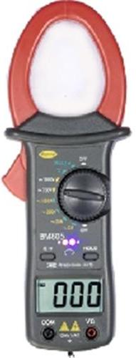
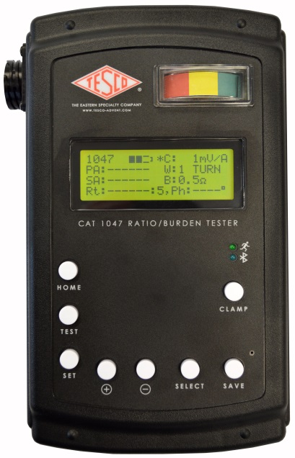
Ratio Testing
Ratio of Primary Current to Secondary Current
SOURCE
LOAD
PHASE A
400A
400A
400A
5A
5A
5A
Calculate Ratio

Slide 20
Burden Testing
Functionality with Burden Present on the Secondary Loop
PHASE A
Some burden will always be present – junctions, meter coils, test switches, cables, etc.
CT’s must be able to maintain an accurate ratio with burden on the secondary.

Slide 21
Burden Testing
Functionality with Burden Present on the Secondary Loop

Slide 22
Burden Testing
Functionality with Burden Present on the Secondary Loop
Example Burden Spec:
0.3% @ B0.1, B0.2, B0.5
or
There should be less than the 0.3% change in secondary current from initial (“0” burden) reading, when up to 0.5Ohms of burden is applied

Slide 23
Burden Testing
Functionality with Burden Present on the Secondary Loop
ANSI Burden Values
0.1 Ohms
0.2 Ohms
0.5 Ohms
1 Ohms
2 Ohms
4 Ohms
8 Ohms

Slide 24
Burden Testing
0.3% @ B0.1, B0.2, B0.5
Initial Reading = 5Amps
0.3% x 5A = 0.015A
5A – 0.015 = 4.985A
Burden | Reading
0 | 5.0000
0.1 | 4.9999
0.2 | 4.9950
0.5 | 4.9900
1 | 4.9800
2 | 4.9500
4 | 4.0000
8 | 0.8000

Slide 25
Burden Testing
0.3% @ B0.1, B0.2, B0.5
Initial Reading = 5Amps
0.3% x 5A = 0.015A
5A – 0.015 = 4.985A
At 0.5Ohms of Burden
the secondary current is still at 4.990A – Less than 0.3% change – Good CT!
Burden | Reading
0 | 5.0000
0.1 | 4.9999
0.2 | 4.9950
0.5 | 4.9900
1 | 4.9800
2 | 4.9500
4 | 4.0000
8 | 0.8000

Slide 26
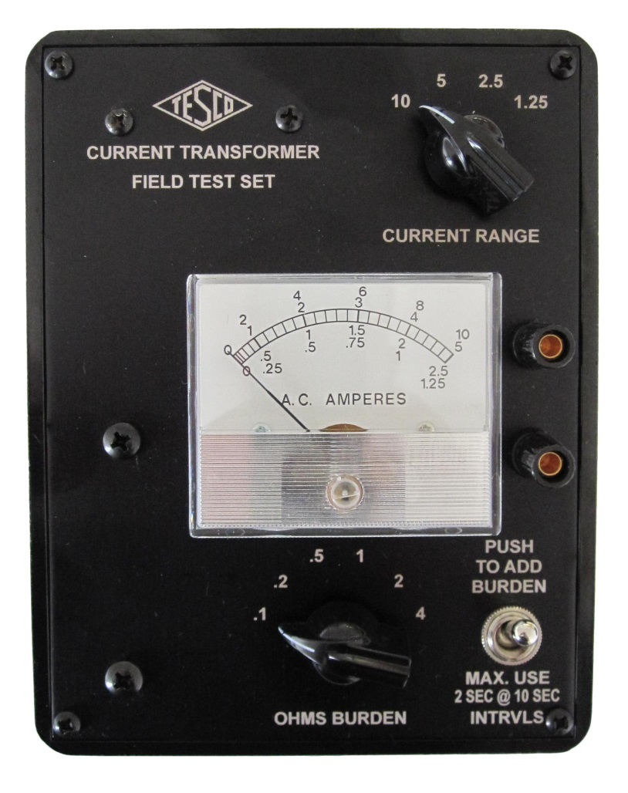
Analog Testing
Application of Burden and Calculation
Manual reading of initial and post-burden secondary currents

Slide 27
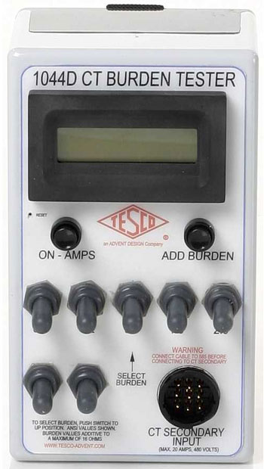
Digital Testing
Application of Burden and Calculation
Reads the initial current immediately prior to applying the selected burden
Applies the selected burden to the secondary
Reads the current immediately following current application
Calculates the percentages change

Slide 28
Questions?
Bill Hardy
TESCO – The Eastern Specialty Company
Bristol, PA
215-785-2338
This presentation can also be found under Meter Conferences and Schools on the TESCO web site: www.tescometering.com

