Slide 1



AMI Meter Certification Before, During & After Deployment
Prepared by Tom Lawton, TESCO
The Eastern Specialty Company
For North Carolina Electric Meter School
Management Session
Tuesday, June 26, 2018 at 8:45 a.m.

Slide 2
Session Objectives
Session Objectives
Managing change and minimizing risk
Session Objectives
Initial Certification testing and First Article Testing
Developing functional testing from initial Certification protocols
The need for continued Certification Testing on a regular basis
Protocols and frequency for certification testing during and after deployment

Slide 3

Types of Meter Testing
Meter Certification
New meters have many tests specified in ANSI C12.1 and C12.20, typically performed by the meter vendors.
These tests only involve what has been traditionally considered “the meter”
With AMI meters all meter functionality must be considered and tested, even where no standard test exists
Each Utility must develop their own Certification Test protocol
  The First Article Test can be a subset of this Certification Test or repeat everything in the Certification Test.

Slide 4
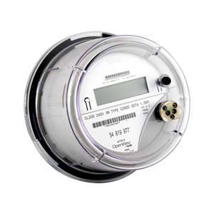
Impact of AMI Devices
Certification vs. First Article Testing
Certification Testing can cover a wide variety of sins. Initially the meter vendor selected provides a 2S meter or another relatively common meter and an entire battery of tests is performed to “Certify” this meter for this application.
First Article Testing (FAT) confirms that the first meter of each type that is delivered meets all requirements quoted in a satisfactory manner.

Slide 5
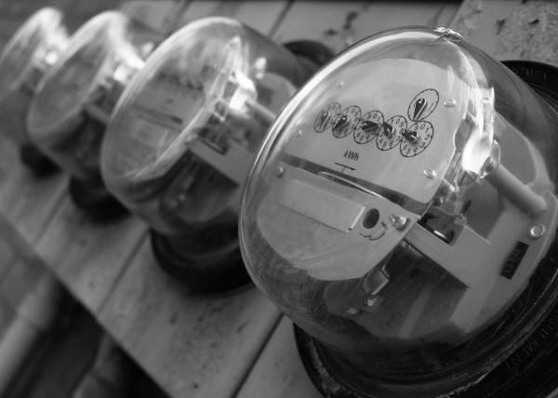
Categories Of Meter Testing
Traditional Categories of Meter Testing
First Article Testing (cont..)
  The FAT protocols may be a subset of the initial Certification testing or may have all of the same protocols.
Certification Testing (cont..)
  Once FAT is completed the Certification testing is not complete. Certification testing begins again with the first change to the meter’s being delivered. The changes could be hardware, software, firmware or even settings. This testing is typically a subset of FAT protocols.

Slide 6
Categories Of Meter Testing
How frequently should Certification testing be repeated?
Whenever we are aware of a significant design change or firmware change to the meter
  What is “significant”? This is up to the user. Significant should be defined as a potential risk. Potential can be defined as something more than an “unlikely or remote possibility”.
On a time based frequency (e.g. once per year) if there is a stream of small changes and no epic changes over a short period of time.
  This is not set in stone but is simply a recommended practice.

Slide 7
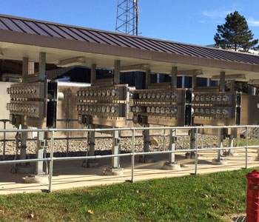
AMI Meter Testing
Inspection
Error Reporting/Clearing
Clear/Reset
Meter Reprogramming
Program Verification
Disconnect Testing
Firmware Updates
Security Updates
Password Updates & Verification
Battery Replacement

Slide 8
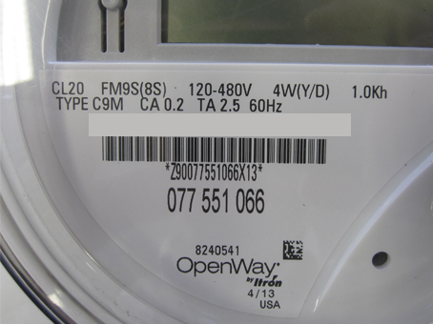
AMI Network Testing
Firmware Updates
Disconnect Testing
Meter Association Confirmation
Network Status Updates
Security Updates
Communication Interval Verification and Configuration
Communication Verification
Real Time Clock synchronization
Alarms (Verification and Programming)
Lat/Long (Verification and Configuration)

Slide 9
Sample Certification and FAT
Tests conducted by the Manufacturer
This testing should be performed and documented by the manufacturer as they have the resources and labs to perform this testing. The option should be given for the customer to witness some or all of this testing.
The following ANSI tests will be conducted by the meter manufacturer in the sequence below using the same number of meters:
a. Insulation ANSI C12.20 Test #15
b. Voltage Interruptions ANSI C12.20 Test #16
c. Effect of High Voltage Line Surges ANSI C12.20 Test #17
d. Effect of Fast Transient/Burst ANSI C12.20 Test #25
e. Effect of Electrostatic Discharge (ESD) ANSI C12.20 Test #28
f. Effect of Operating Temp. ANSI C12.20 Test #30 but Expand range to -40º to +80ºC
g. Effect of Relative Humidity ANSI C12.20 Test #31
h. Surge Withstand (also known as C12.20 #25a) ANSI C37.90.1

Slide 10
Sample Certification and FAT Protocol
(Manufacturer cont..)
The following ANSI tests and other tests will be performed by the meter manufacturer but do not need to be performed in sequence:
i. Temperature Rise of current carrying meter parts ANSI C12.20 Test #9
j. Effect of External Magnetic Field ANSI C12.20 Test #18
k. Ambient Temperature Variance ANSI C12.20 Test #19
l. RF interference and emission tests ANSI C12.20 Tests #26 and
#27
m. Rain Tightness (UL50) (see note below) ANSI C12.20 Test #38
n. Sunlight interference test for meter optical port ANSI C12.1 Section 6.3.6
o. Remote Disconnection and Reconnection of the meter
Note: Rain tightness test only needs to be performed on the basic meter as long as addition of NIC module does not change the physical characteristics of the meter.

Slide 11
Sample Certification and FAT Protocol
Performed by the Utility
Test #1 – Box Label – Compare the box label to the sample carton label from the manufacturer. Make a photocopy of the all the box labels on the FAT meters for record keeping.
Test #2 – Meter Cover – Verify that the meter manufacturer provided the correct meter cover for the meter.
Test #3 – Battery – Verify that the meter either has a battery or does not have a battery per Utility specification.
Test #4 – Physical Inspection – Verify meter & box condition, verify attributes & test continuity.
Test #5 – Faceplate & Barcode – Verify that the meter faceplate matches the sample artwork from the meter manufacturer that was approved by the Utility and the barcode conforms to the Utility’s conventions.
Test #6 – Accuracy Test - Verify the meter meets ANSI specification. Compare to manufacturer test results.

Slide 12
Sample Certification and FAT Protocol
(Utility testing cont..)
Test #7 – Date & Time Set – Prepare meter for optical communication and testing using 1132ComE650.
Test #8 – Normal Meter Display Check – verify that the meter’s normal display correctly scrolls & displays the desired items.
Test #9 – Verify Program – Use meter manufacturer’s software to verify correct program is in the meter and use Program Verify feature to ensure program in meter matches program in the utility's .mdb database
Test #10 – Voltage Check – Set load board to required meter voltage. Communicate with the meter via software and check the voltage reference in the meter. Observe voltage in ALT display.
Test #11 – Confirm Internal Meter ID, Serial Number, HW & FW – Verify the internal meter information matches the information listed on test sheet and faceplate.
Test #12 – Service Disconnect Switch – Operate the meter’s service disconnect switch via the optical port.

Slide 13
Sample Certification and FAT Protocol
(Utility testing cont.)
Test #13 – Network Id – Use the meter manufacturer’s local tool to verify the network id programmed in the meter’s NIC matches the information listed.
Test #14 – Radio Binding Check – Confirm the independent communication device is in sync with the meter and broadcasting the correct data (i.e. meter identification/serial no.). Compare to marriage file from vendor for wrong ID and duplicate numbers. Meter Manufacturer’s local tool
Test #15 – NIC Hardware & Firmware – using the vendor communication tool verify the NIC hardware & firmware versions are as specified. Meter Manufacturer’s local tool
Test #16 – NIC Table 12 Settings – Meter Manufacturer’s local tool
Test #17 – Non-Display Error Check – Use meter manufacturer’s software to check for non-display errors
Test #18 – Master Reset – Perform master reset on meter to set up meter for time run tests.

Slide 14
Sample Certification and FAT Protocol
(Utility testing cont.)
Test #19 – KW Demand Test – Compare the measured KWH register data, Demand displayed and Demand readings to recorded load profile data. Run meters for a full hour (minimum) and verify results Load Profile against known load (Can use demand readings). Compare 15-minute Load Profile data vs.15-minute demand for demand meters.
Test #20 – LP Channels & Configuration Check - Use meter manufacturer’s software to verify that the meter’s recorder channels are configured correctly.
Test #21 – LP Interval Data Read & Data Verification – Read & compare LP data stored in the meter’s recorder channels to meter’s displayed values. For meters programmed for KVAR (h) use LP Channel information.
Test #22 – Configuration Changes – test the meter’s ability to change configuration by modifying register readings and verifying that meter accepts the changes
Test #23 – Capacitor Max Outage Time Check – examine the meter’s internal tables to ensure the capacitor setting will permit the orderly shutdown of the meter’s electronics during an extended outage.

Slide 15
Sample Certification and FAT Protocol
(Utility testing cont.)
Test #24 – Power Monitoring – Read the voltage log, Event Log, and Gear Box with the manufacturer software to observe Power Monitoring functions.
Test #25 –Test Mode Functionality – The test mode usage will only be recorded and displayed in the test display. The normal and alternate displays will not measure or display the test loads.

Slide 16
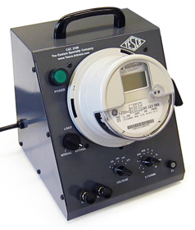
Digging Deeper
Test Procedure #5 – Faceplate & Barcode
Examine the meter faceplate compare to artwork on individual Test Sheet & verify:
  Barcode format
  Form
  Class Amps
  Voltage
  Wire
  KH
  60 Hz
  Meter Type
  Test AMPS
  Utility Name
  Utility logo
Mark Test Sheet Pass or Fail and initial
For any Failures provide written explanation for test record.
Confirm bar code logic as follows:
"aaabbbcddddd" (i.e. 02S200F00001)

Slide 17
Digging Deeper (cont.)
Where:
aaa (reflects the form, i.e. 02S, 04S, 05S, 06S, 09S, 16S, 25N, 25D)
bbb (reflects the meter class, i.e. 20, 200, 320)
c (reflects the meter type, i.e. Focus or S4X)
ddddd (reflects the sequence, as defined below)
Sequence A: 00001 to 49999 (For all single phase meters, non-network, i.e. 2S, 4S) Sequence B: 70001 to 79999 (For all network meters, 25N) Sequence C: 80001 to 89999 (For all 3 phase 3 wire meters, 25D, 5S) Sequence D: 90001 to 99999 (For all 3 phase 4 wire meters, 6S, 9S, 16S)

Slide 18
Using third party labs
Example of tests conducted for a Utility by themselves and by an outside lab – some on multiple forms and some on just two forms and some on just 2S;
Test #1 - No Load - apply voltage for specified time with zero load condition and measuring the power consumption or lack there of using a NIST traceable standard.
Test #2 - Starting Load
Test #3 Load Performance
Test #4 Effect of Variation of Power Factor
Test #5 Effect of Variation of Voltage
Test #6 Effect of Variation of Frequency
Test #7 Internal Meter Losses
Test #8 Effect of Variation of Frequency
Test #9 Temperature Rise
Test #10 Effect of Internal Heating
Test #11 Stability of Performance
Test #12 Independence of Elements (Polyphase Only)
Test #13 Insulation
Test #14 Voltage Interruptions
Weather Simulation
Salt-spray
Rain Tightness

Slide 19
Using internal and third party labs (cont)
Test #15 Effect of Variation of Ambient Temperature
Test #16 Effect of Storage Temperature
Test #17 Effect of Operating Temperature
Test #18 Effect of Relative Humidity
Test #19 Mechanical Shock
Test #20 Transportation Drop
Test #21 Mechanical Vibration
Test #22 Transportation Vibration
Test #23 Weather Simulation
Test #24 Salt-spray
Test #25 Rain Tightness
Test #26 Disconnect and reconnect (back voltage testing)
Test #27 Accuracy under distorted wave forms
Additional Testing: Utility specific concerns

Slide 20
Session Objectives
Summary
Managing change and minimizing risk
Session Objectives
Initial Certification testing and First Article Testing
Developing functional testing from initial Certification protocols
The need for continued Certification Testing on a regular basis
Protocols and frequency for certification testing during and after deployment

Slide 21

Questions and Discussion
Tom Lawton
TESCO – The Eastern Specialty Company
Bristol, PA
Tom.Lawton@tescometering.com
Cell: 215-688-0298
This presentation can also be found under Meter Conferences and Schools on the TESCO web site: www.tescometering.com

