Slide 1
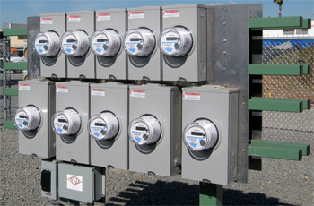
21st Century Power Measurements
Prepared by Bill Hardy, TESCO
The Eastern Specialty Company
For North Carolina Electric Meter School
Advanced Session
Tuesday, June 26, 2018 at 1:45 p.m.

Slide 2
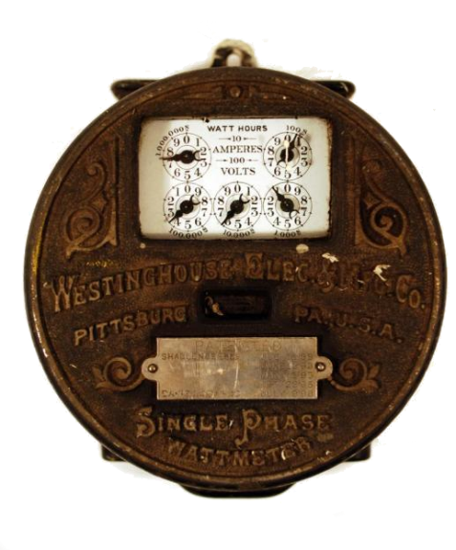
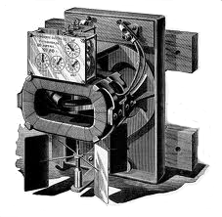
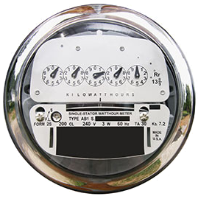
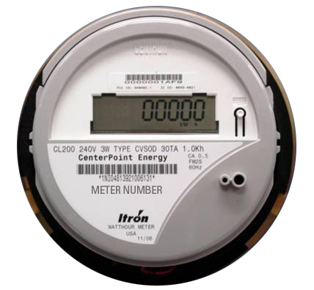
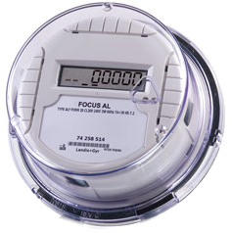
Then – Now – Tomorrow? Meters
First Meters mid-1890s
Westinghouse 1905
2005
2006
2014
2025 ???

Slide 3
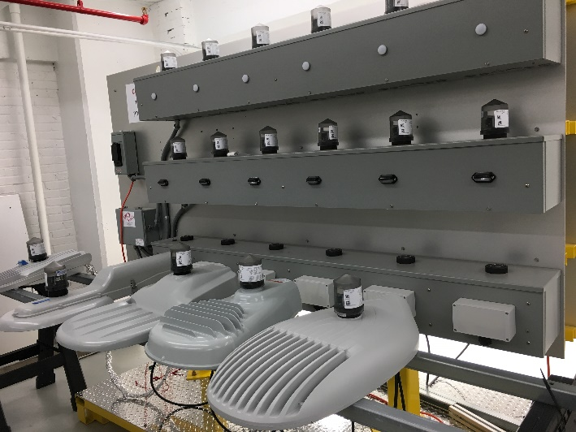
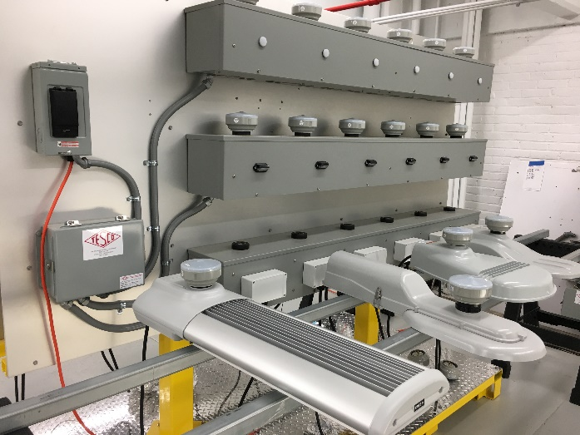
Then – Now – Tomorrow? Meters??

Slide 4
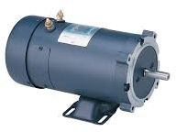
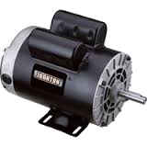
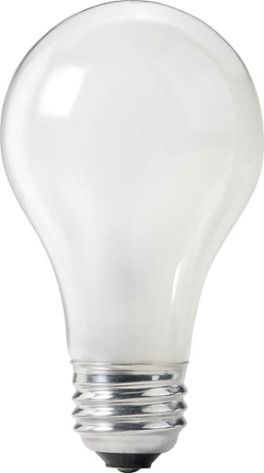
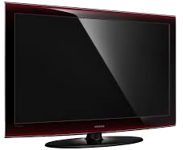
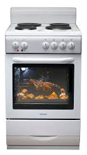
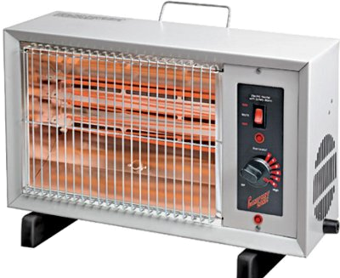
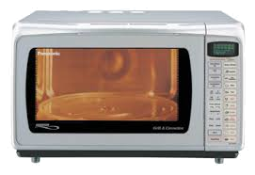
Then – Now – Tomorrow? Loads
TODAY
YESTERDAY

Slide 5
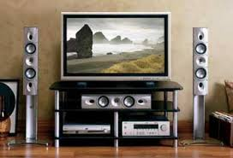
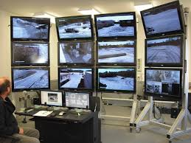
Then – Now – Tomorrow? Loads
TODAY

Slide 6
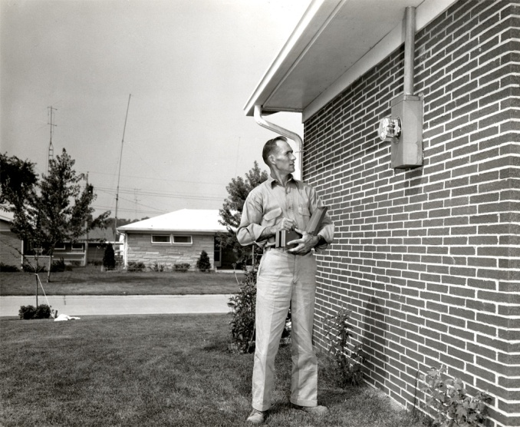
Then – Now – Tomorrow? Communications
THEN
NOW

Slide 7
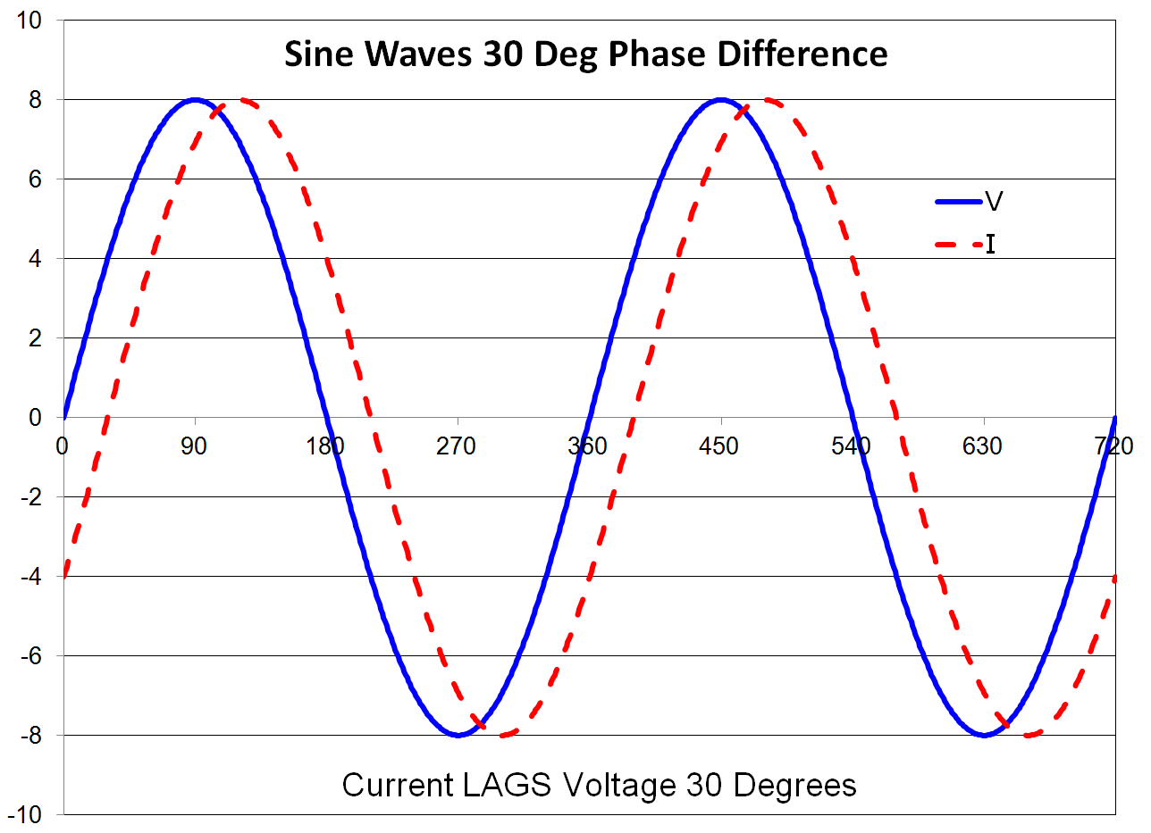
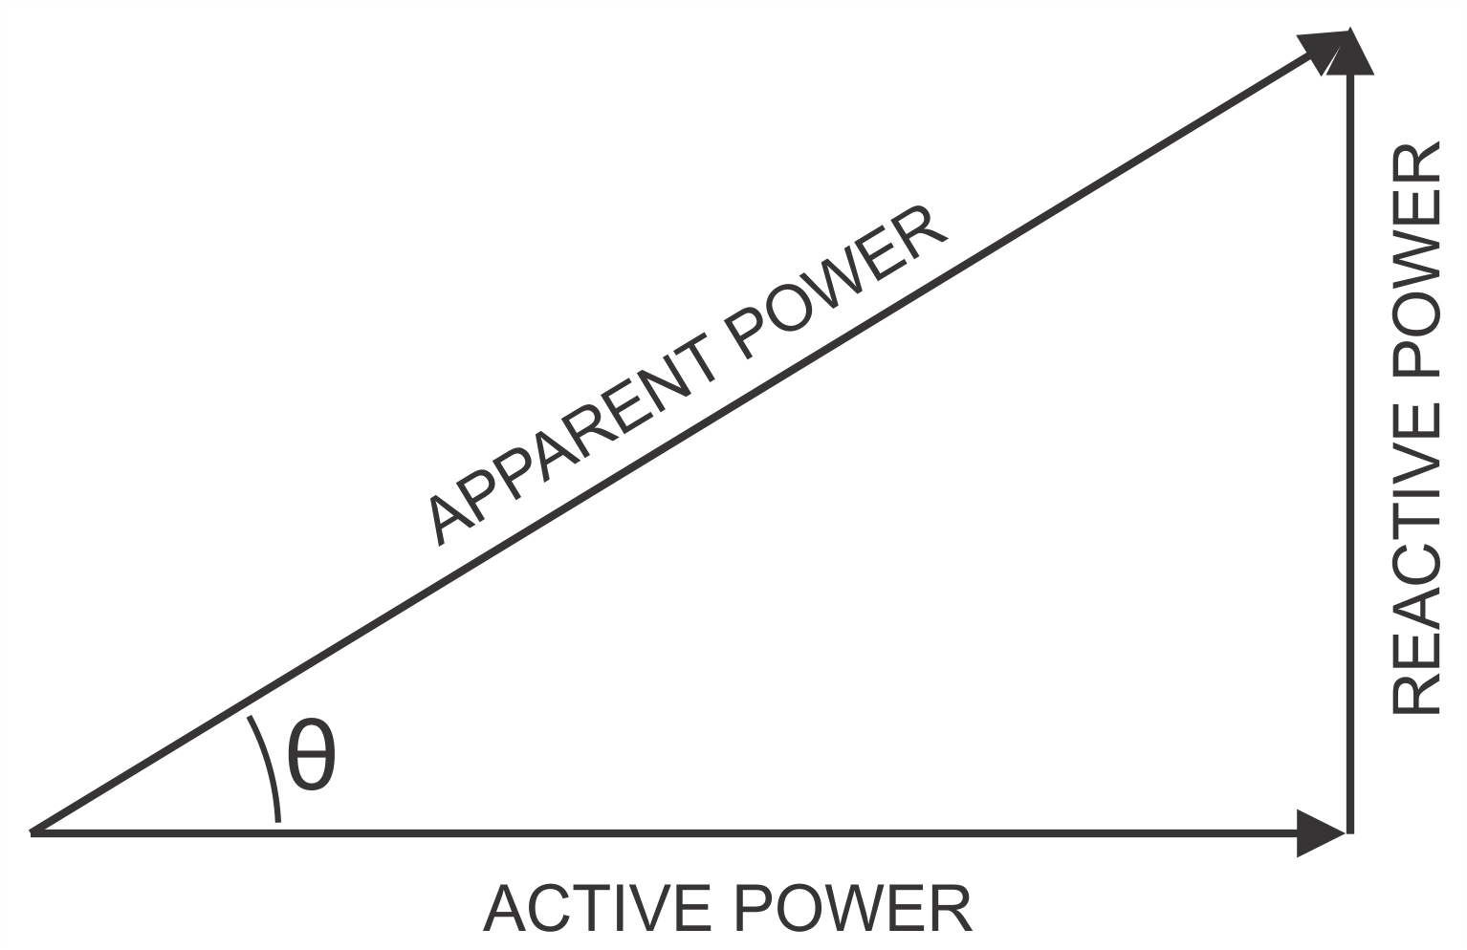
Why do these changes matter?
Changes to our loads have changed the basic computations of metering.
When loads were linear the power triangle was all we needed to know

Slide 8
Why do these changes matter?
Today’s loads look more like these

Slide 9
Why do these changes matter?
Today’s loads look more like these

Slide 10
Why do these changes matter?
Today’s loads look more like these

Slide 11
Standards Changes
New Revision of C12.20 just Published
Polyphase meters tested using polyphase
Recommended now, required 2020
Unbalanced load testing required
Full harmonic testing required
0.1% Accuracy Class added
Specific call out of Non-Blondel applications where C12.20 does not apply
Detailed requirements and specs for test outputs added

Slide 12
Harmonic Load Waveforms
ANSI C12.20 now addresses harmonic waveforms

Slide 13
Standards Changes
New Revision of C12.20 just Released
Tighter reference condition performance specifications
When using polyphase loading meters must be tested in each configuration used

Slide 14
Standards Changes
New Revision of C12.1
0.5% Accuracy Class added
Testing required for unbalanced loads
Testing required under unbalanced conditions
Tighter reference performance requirements
Bi-directional energy flow testing
Extensive update on in service testing

Slide 15
Standards Changes
New Revision of C12.10 in 2015
Accuracy tests moved here from C12.1
Much broader safety requirements
Coordinated effort with UL2735
Utilities exempt from UL2735 but only if they own and install the equipment

Slide 16
Standards Changes
New Revision of C12.9 in 2014
Full specifications for test plugs included in standard
Ensures safe operation between all switches and all plugs
previously some combinations produced safety hazards
New barrier requirements between switch elements

Slide 17
Standards Changes
Communications Standards
New C12.19 which replaces C12.18 and C12.19 is in ballot process
Major changes – major controversy has held up approval for two years
Standard will still not guarantee inter-operability

Slide 18
ANSI C12.31
At the moment there is no non-sinusoidal definition for VA
New ANSI Standard coming very soon
C12.31

Slide 19
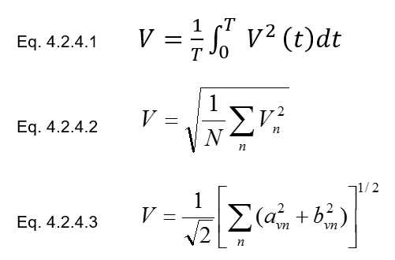
New Definitions
RMS Voltage
Waveform
Basic Definition
Time Domain
Frequency Domain

Slide 20
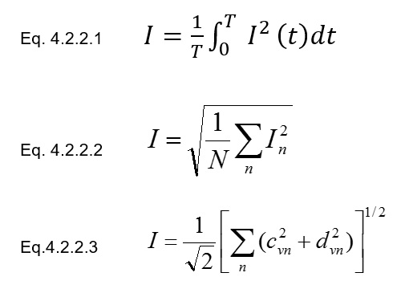
New Definitions
RMS Current
Waveform
Basic Definition
Time Domain
Frequency Domain

Slide 21
New Definitions
Active Power
Basic Definition
Time Domain
Frequency Domain

Slide 22
New Definitions
Apparent Power
Basic Definition
Time Domain
Frequency Domain

Slide 23
Next Generation Standards
ANSI C12.46
New standard in development to replace C12.1 and C12.20
Structured like OIML IR-46
A true digital age standard
Applies to ALL energy measurements
Watts, VA and VAR
Contains precise definitions for the quantities based on digitally sampled waveforms

Slide 24
Next Generation Standards
ANSI C12.46
Covers ALL waveform types
sinusoidal, harmonic, time varying
Defines the meter as everything under the cover
If there is auxiliary functions in the meter they must be fully operational during accuracy testing
If a option is added to a meter, it must be tested with the option running to remain qualified

Slide 25
Next Generation Standards
ANSI C12.46
View of accuracy changes
Currently changes with respect to reference
New approach is absolute error
Philosophy of C12.46 – When a meter is claimed to be of a specific accuracy class, for example , AC 0.2%, then it’s accuracy under all commonly occurring conditions should be within ±0.2% maximum error.

Slide 26
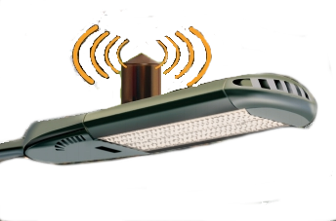
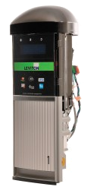
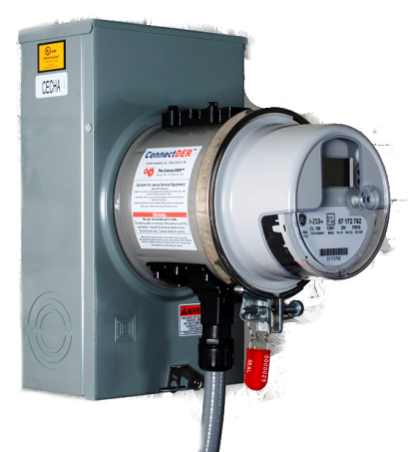
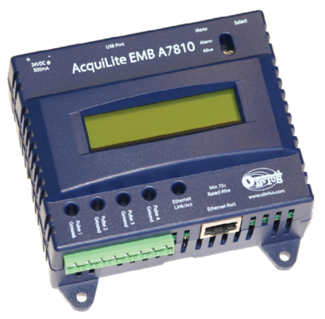
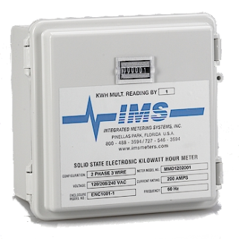
What does the Future Hold
Over the next FEW years metering may have a whole new meaning
Do these look like meters to you?

Slide 27
What does the Future Hold
Each has an embedded revenue meter
They may NOT be regulated by the PSC’s.
METER

Slide 28
Questions?
Bill Hardy
TESCO – The Eastern Specialty Company
Bristol, PA
215-785-2338
This presentation can also be found under Meter Conferences and Schools on the TESCO web site: www.tescometering.com

