Slide 1
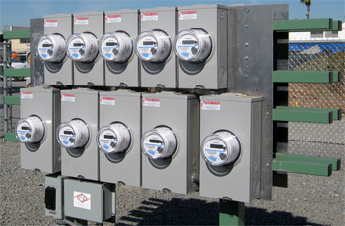
New Challenges for the Meter Shop
Prepared by Bill Hardy,TESCO
For North Carolina Electric Meter School
Tuesday, June 27, 2017 at 8:00 a.m.

Slide 2
The Past
Meters were simple energy measurement devices
Meter shops concentrated on accuracy measurements
New meter installations were “growth” related and proceeded at a “reasonable pace”
Oh my! Has that ever changed!
Slide 2

Slide 3
Today
Meters are complex communications devices
Meters have internal disconnect capability
Loads are more complex and variable
With massive AMI deployments we are installing 10’s of thousands if not 100’s of thousands of meters all at one time.
The actual meter metrology may be the least of the issues for the deployment.
Slide 3

Slide 4
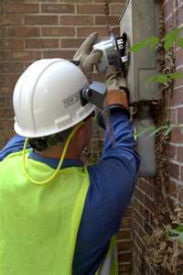
Compounding Issues
Fewer meter techs in the field and in the shop than there were 25 years ago
Acute shortage of experienced techs growing as industry experiences a wave of retirements
Experienced “METER” techs may not be “COMMUNICATIONS” techs
Significantly more features under glass in every AMR and AMI system being considered or deployed
Slide 4

Slide 5
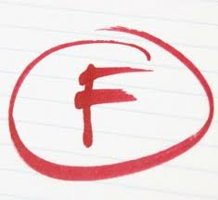
Why do AMI meters fail?
Looking back at various deployments
What are the failures that we see?
Meter functional test failures including but not limited to;
Incorrect firmware
Bad settings
Alarms and errors that do not clear
Communication test failures
Bad tables
Failed disconnect switches
Slide 5

Slide 6
What is the right approach to testing?
Testing a small random sample of meters for accuracy is not a good solution for these problems
New types of testing approaches address these issues more efficiently.
Slide 6

Slide 7
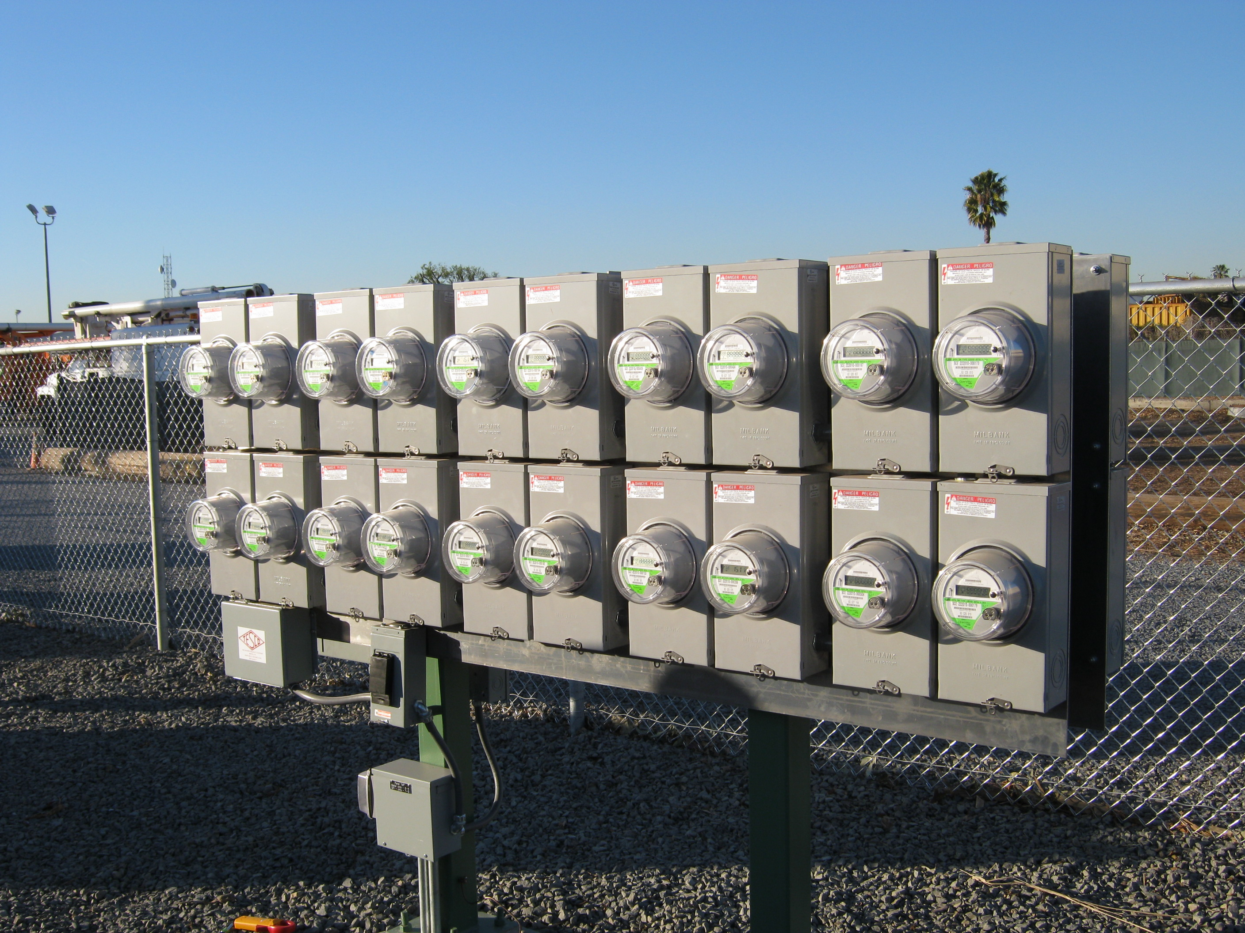
The Pendulum Starts to Move
Over the last few years these challenges have clearly come into focus.
Five years ago utilities were just starting to use “meter farms” for pre-deployment testing
Here’s a meter farm circa 2012
The industry learned that testing
significant numbers of AMI/AMR
meters in controlled
conditions was a valuable
activity.
Slide 7

Slide 8
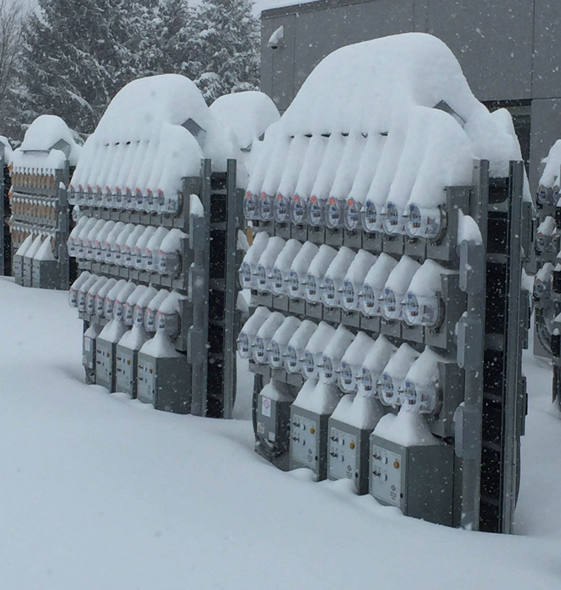
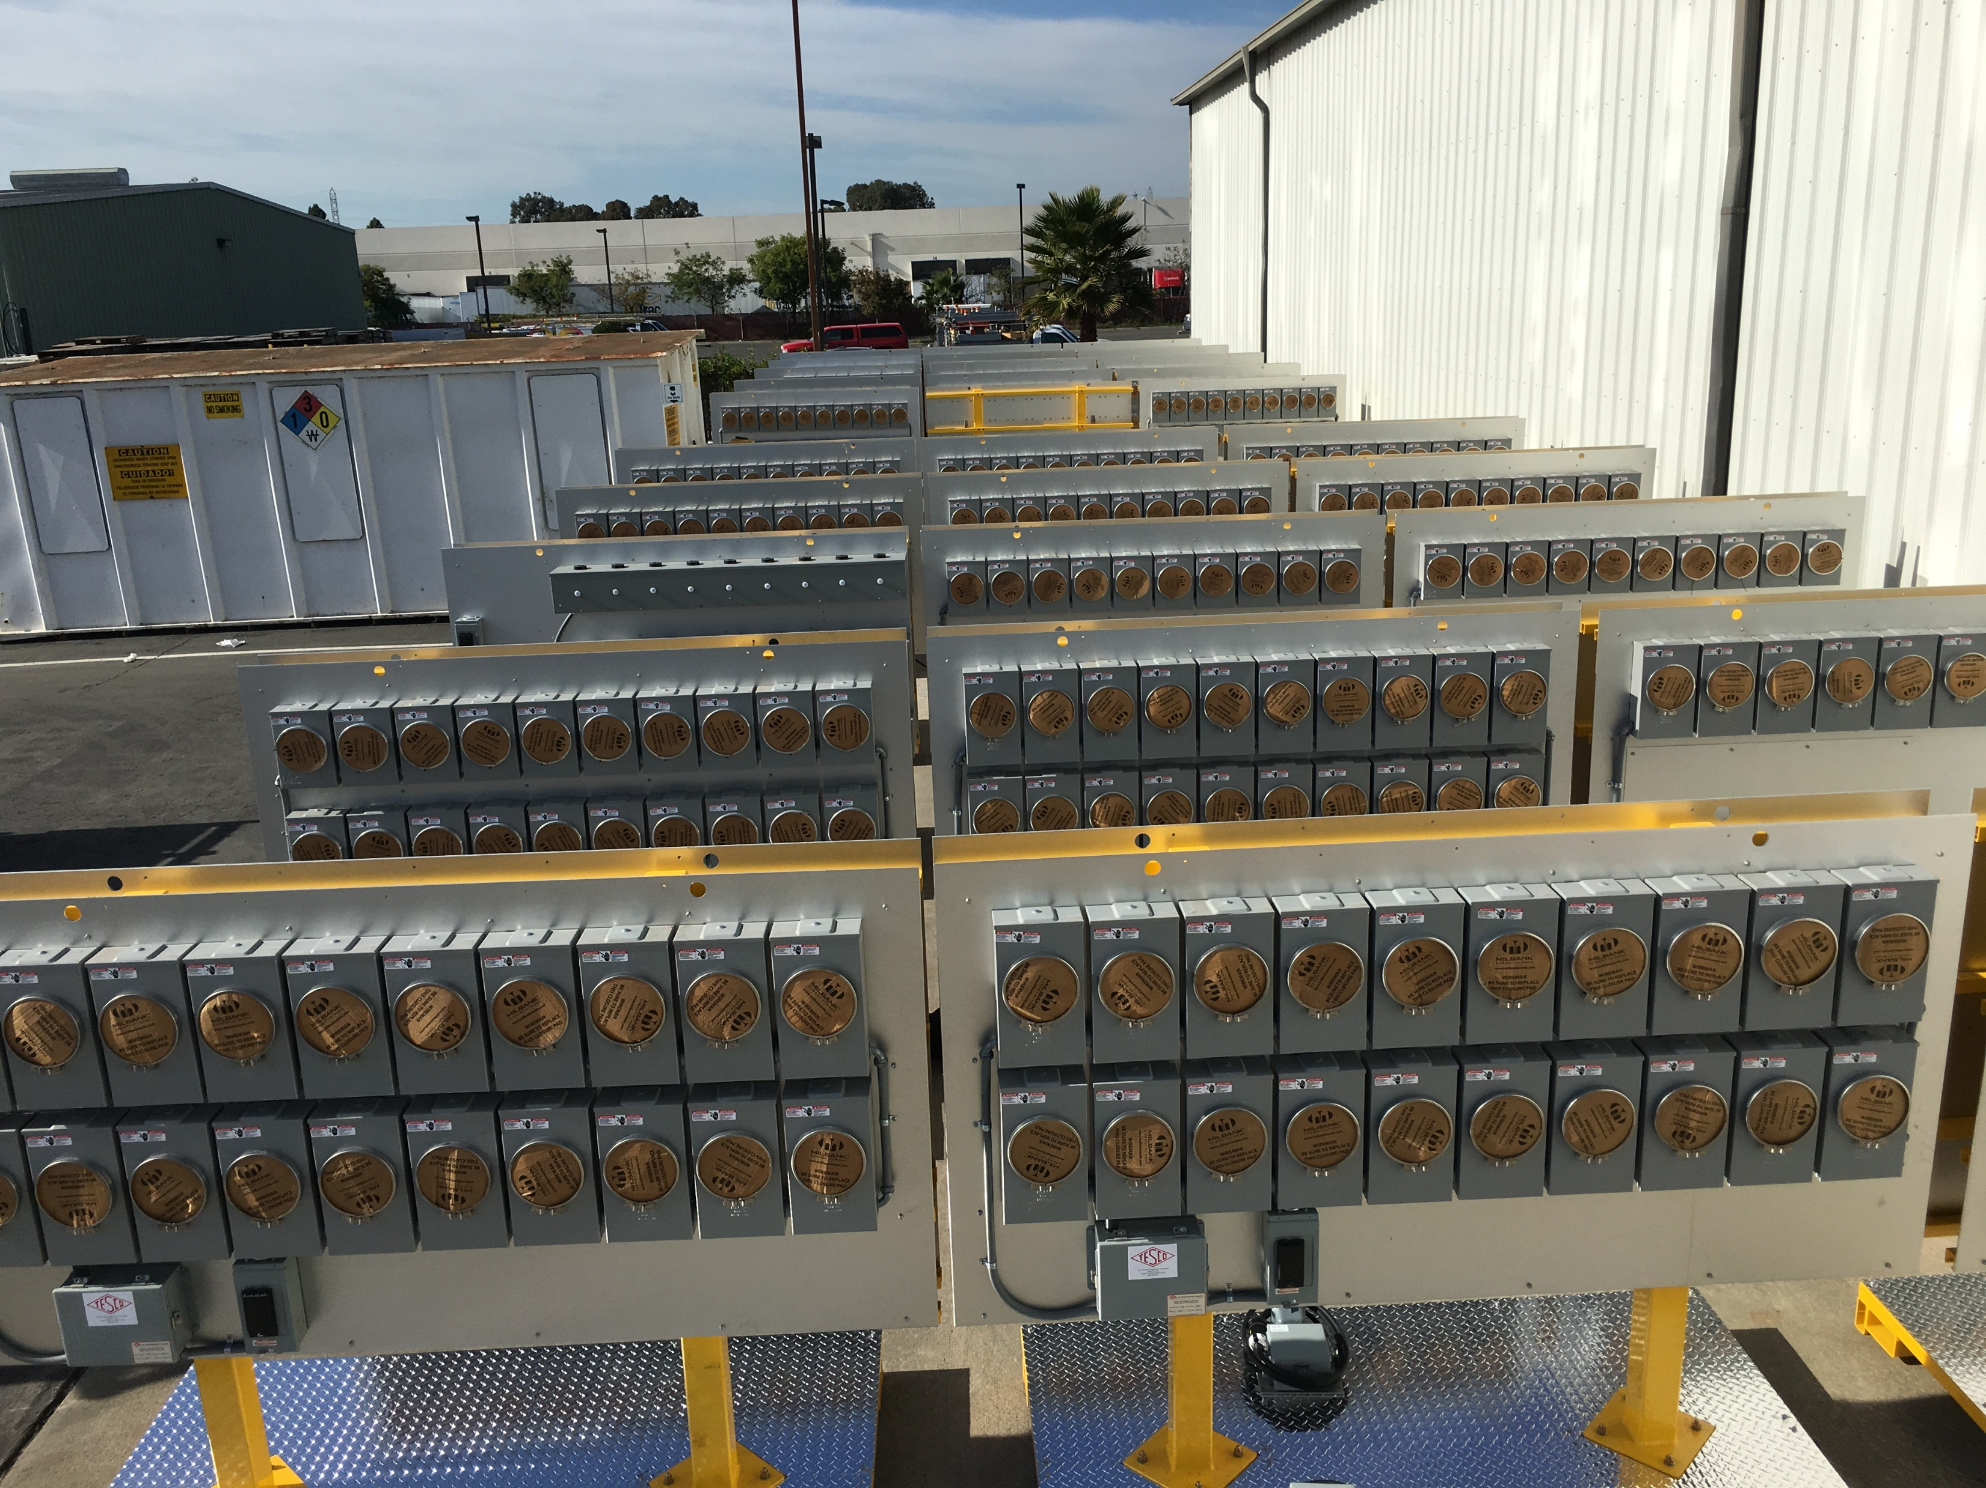
Meter Farms
Today many companies are installing truly large scale meter farm facilities
Slide 8

Slide 9
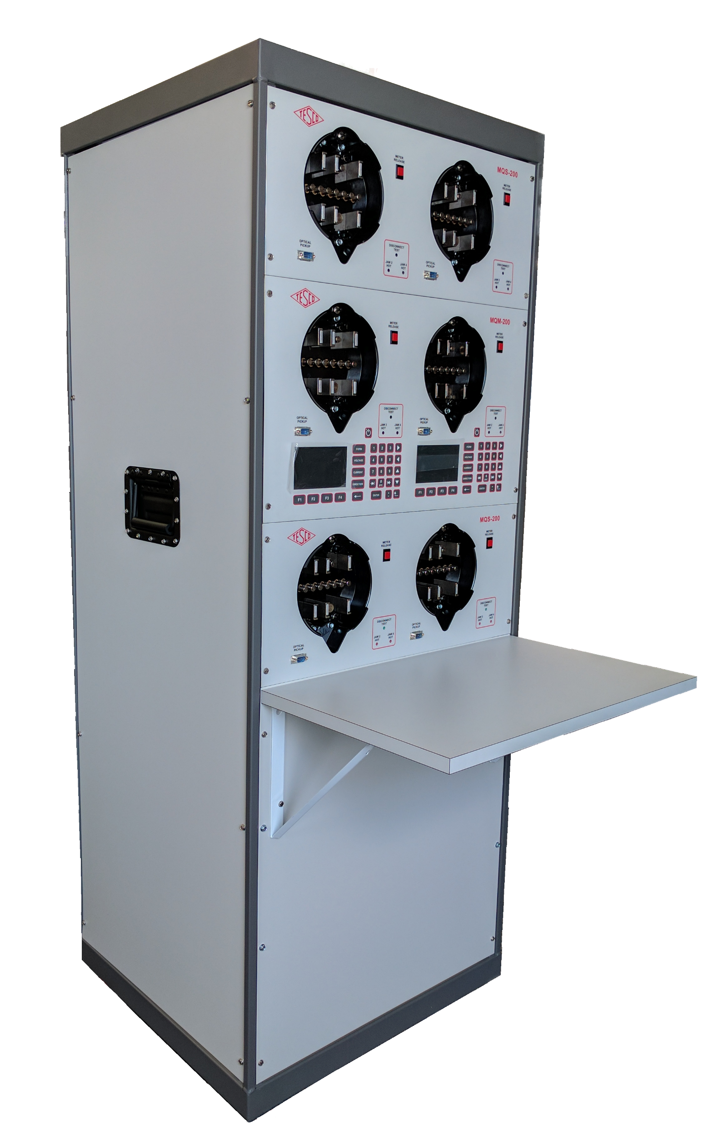
Meter Qualification Testing
While meter farms provide large volume testing, their ability to control test parameters are fairly limited.
In the real world, loads and operating conditions are growing more complex every day.
One has to be sure that not only the metrology function but also the communications capabilities of meters function through these real world conditions.
Slide 9

Slide 10
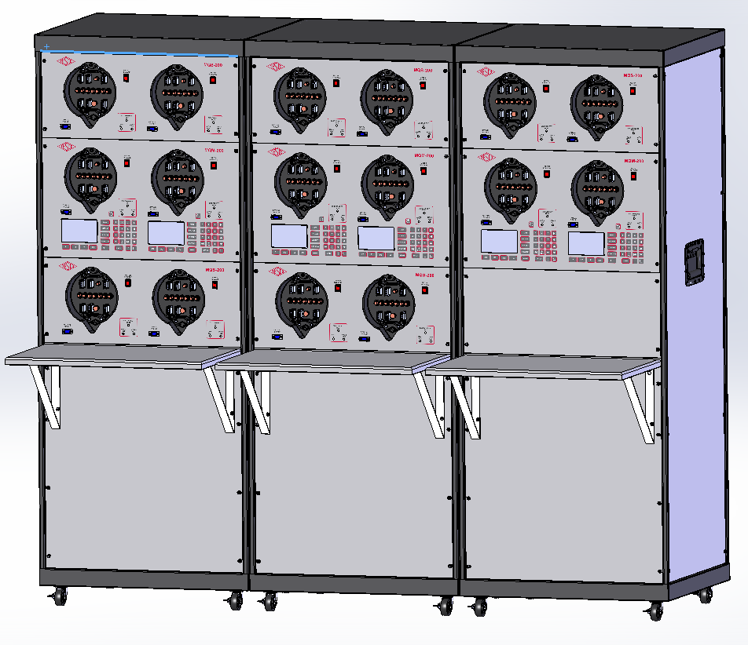
Meter Qualification Testing
What is qualification testing?
Test that the meter functions completely.
Program the meter with the latest firmware.
Validate communications functionality.
Run the meter under widely varying conditions
Vary voltage
Vary current
Generate transients
Generate dropouts
Slide 10

Slide 11
New Energy Definitions
At the moment there is no non-sinusoidal definition for VA
New ANSI Standard coming very soon
C12.31

Slide 12
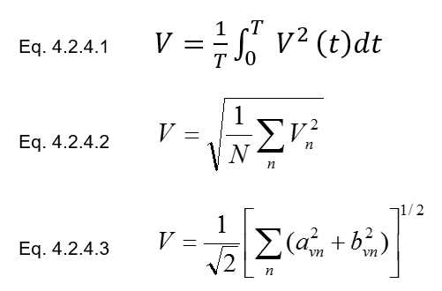
New Definitions
RMS Voltage
Waveform
Basic Definition
Time Domain
Frequency Domain

Slide 13
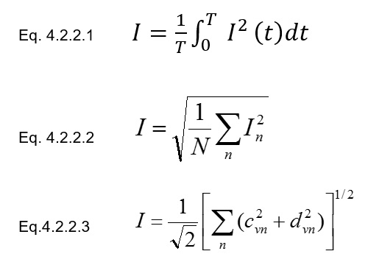
New Definitions
RMS Current
Waveform
Basic Definition
Time Domain
Frequency Domain

Slide 14
New Definitions
Active Power
Basic Definition
Time Domain
Frequency Domain

Slide 15
New Definitions
Apparent Power
Basic Definition
Time Domain
Frequency Domain

Slide 16
Harmonic Load Waveforms
ANSI C12.20 now addresses harmonic waveforms as well as sinusoidal.
Test waveforms being proposed for ANSI C12.20.

Slide 17
Questions and Discussion
Bill Hardy
TESCO – The Eastern Specialty Company
Bristol, PA
1-800-762-8211
This presentation can also be found under Meter Conferences and Schools on the TESCO web site: www.tesco-advent.com
Slide 17

