Slide 1




Introduction to Instrument Transformers
Prepared by Bill Hardy,TESCO
For North Carolina Electric Meter School
Wednesday, June 28, 2017 at 9:00 a.m.

Slide 2
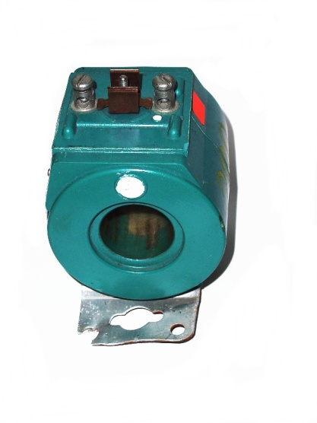

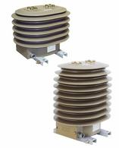
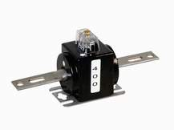
Current Transformers (CT’s)
CT’s allow the measurement of high currents at potentially high voltages.
They come in many shapes and sizes for different applications
They are potentially extremely dangerous.
They can kill you!
Slide 2

Slide 3
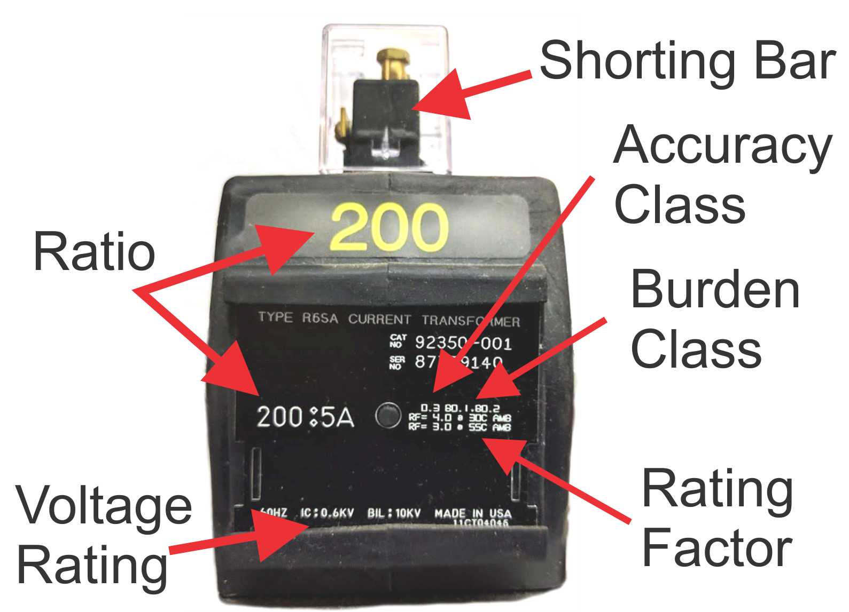
Current Transformers (CT’s)
Slide 3

Slide 4
Current Transformers (CT’s)
Basic Theory
Basic formula: Is = Ip•(Np/Ns) = Ip/Ns
Open Circuit Voltage:
Where:
  Zb = Burden Impedance
  Ip = Primary Current
  Ns = Number of Secondary Turns (Ratio to 1)
Tests have shown values ranging from 500 to 11,000 volts.
Slide 4

Slide 5
CT – Accuracy Class/Burden
Most CTs used in North America are 0.3 (0.3 percent) Class devices.
When an accuracy class is specified the maximum burden for which the device meets the class accuracy is also specified.
Slide 5

Slide 6
CT – Class 0.3
Metering error shall be less than 0.3% when the CT is used at FULL RATED LOAD and with rated burden.
Metering error shall be less than 0.6% when the CT is used between 10% and 100% of full rated load.
Error is a combination of amplitude and phase error.
Slide 6

Slide 7
CT – Accuracy – Burden - Load
No Spec
Meets 0.6 Spec
Meets Accuracy Spec
Slide 7

Slide 8
Accuracy Class 0.3
Slide Courtesy Kent Jones, GE
Slide 8

Slide 9
Accuracy Class 0.15
Slide Courtesy Kent Jones, GE
Slide 9

Slide 10
Accuracy Class 0.15S
Slide Courtesy Kent Jones, GE
Slide 10

Slide 11
What NOT to do!
Do not do “one size fits all.”
Talked to a guy yesterday whose company chose to use 500:5 CTs everywhere.
0.3% accuracy range is 250 to 2000A.
  These were extended range
  Normal range would be down to 500A
Most of the CTs were used well below 250A.
Slide Courtesy Kent Jones, GE
Slide 11

Slide 12
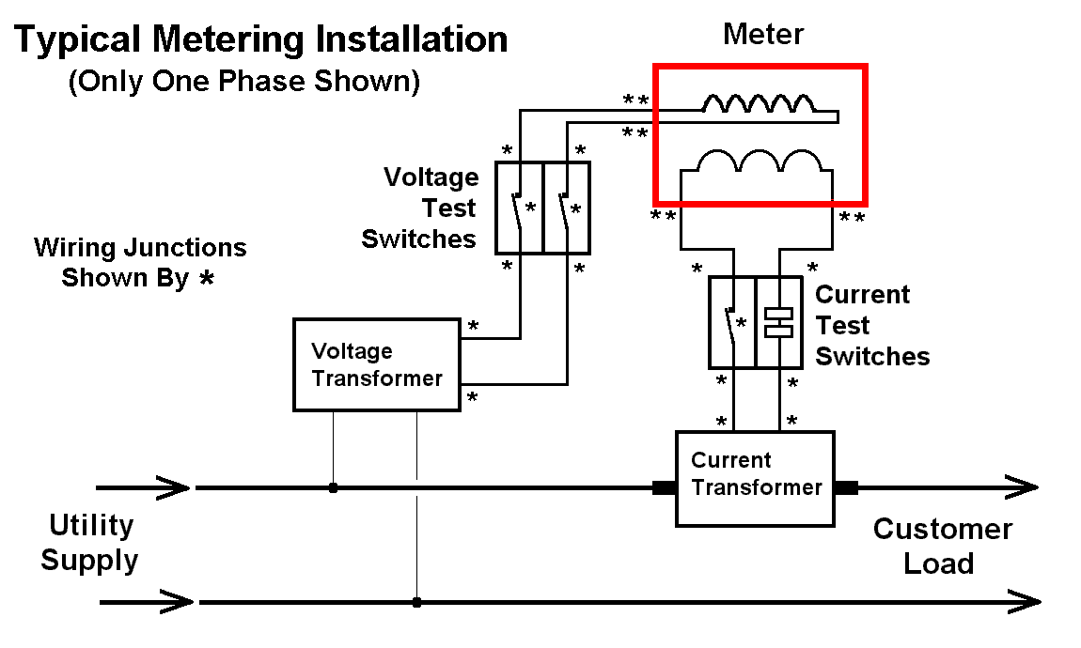
Errors with Current Transformers
Slide 12

Slide 13
Errors with Current Transformers
CTs require a lot of care to insure accurate metering.
  Burden – Over burden reduces CT accuracy.
  Wiring – Faulty or improper wiring reduces accuracy by increasing burden.
  Shunt – Failure to remove the safety shunt will not keep the CT from operating but it will reduce the readings by 50-80%
Slide 13

Slide 14
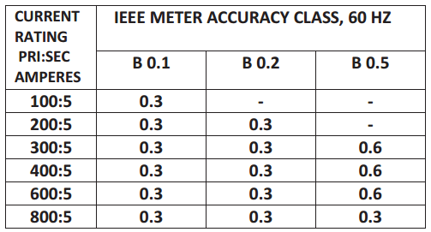
Errors with Current Transformers
When you see a CT spec sheet it will give you the burden at which the CT meets a specific accuracy Class
Slide 14

Slide 15
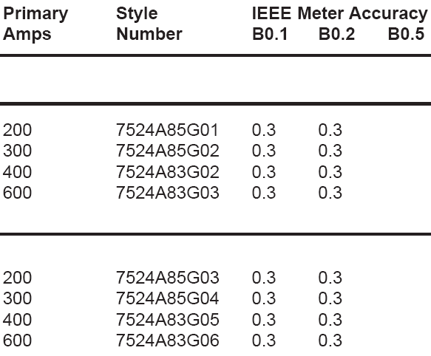
Errors with Current Transformers
Many CTs are only rated at B0.1 and B0.2
#16 wire is 4.5 mΩ/ft
#14 wire is 2.8 mΩ/ft
#12 wire is 1.8 mΩ/ft
#10 wire is 1.1 mΩ/ft
#8 wire is 0.7 mΩ/ft
50 ft of #12 wire is nearly 100 mΩ
Slide 15

Slide 16
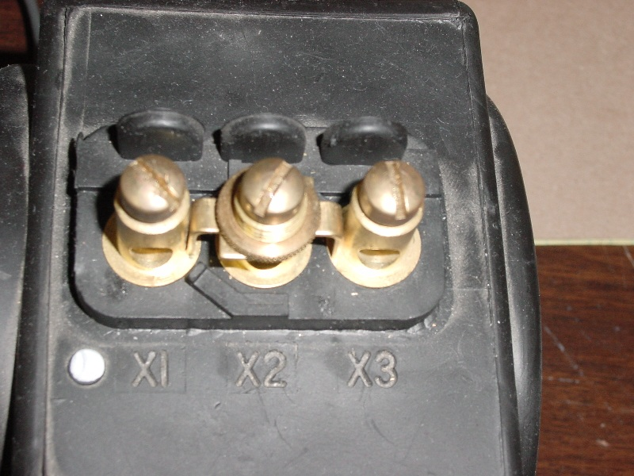
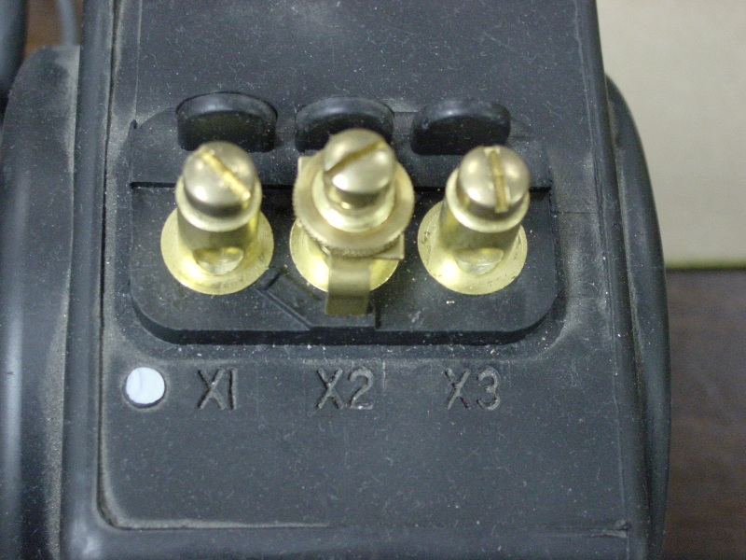
Errors with Instrument Transformers
CT - Shunt
Leaving the shunt in the wrong position produces wrong readings not no readings.
SHUNT CLOSED
SHUNT OPEN
Slide 16

Slide 17
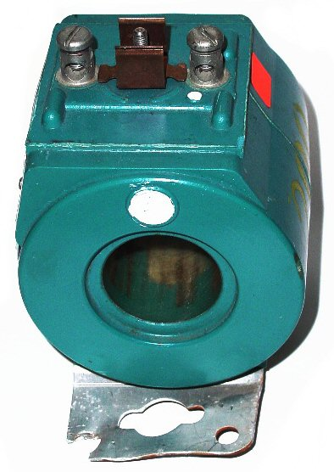
Errors with Instrument Transformers
CT - Polarity
Polarity of the connection matters.
Wrong polarity means totally wrong metering.
When PF≠0, reversed polarities may not be obvious.
Slide 17

Slide 18
CT Rating Factor
The MOST Misunderstood Spec
Rating Factor has absolutely nothing to do with burden.
If a CT has a rating factor of 4 it means that at 30°C it can be used up to 4X its label current and maintain its accuracy Class.
A CT with a label RF=4 only has an RF = 3 at 55°C
Slide 18

Slide 19
CT Rating Factor
Rating Factor is a strong function of temperature.
If a CT has a rating factor of 4 it means that at 30°C it can be used up to 4X its label current and maintain its accuracy Class.
Operating temperature affects Rating Factor significantly.
  A CT with RF=4 at 30°C is only RF=3 at 55°C
°C | 0 | 30 | 55 | 70
°F | 32 | 86 | 131 | 158
Slide 19

Slide 20
CT Testing
Three Approaches in use today
  Direct RATIO measurement with applied burden
    Most accurate approach tells us exactly what we want to know
    Measures directly the quantities we care about CT Ratio and Phase Error
    Is more complicated to perform.
Slide 20

Slide 21
CT Testing
Alternate Approaches
  Burden only
    A compromise: tells us if circuit is stable under excess burden
    Can’t give us the ratio which is what we really care about.
  Admittance Testing
    Allows us to look for changes from previous measurements.
    Doesn’t directly give ratio
    Accuracy typically ±5%
Slide 21

Slide 22
CT Testing
Other Tests
  Direct Burden Measurement
    If you measure the voltage across the CT terminals
    AND
    The current output of the CT
    Using Ohms Law you can compute the actual burden seen by the CT
    SIMPLY: Burden = Voltage/Current
    A very simple and direct way to see if a CT is overburdened, but not to test its accuracy
Slide 22

Slide 23
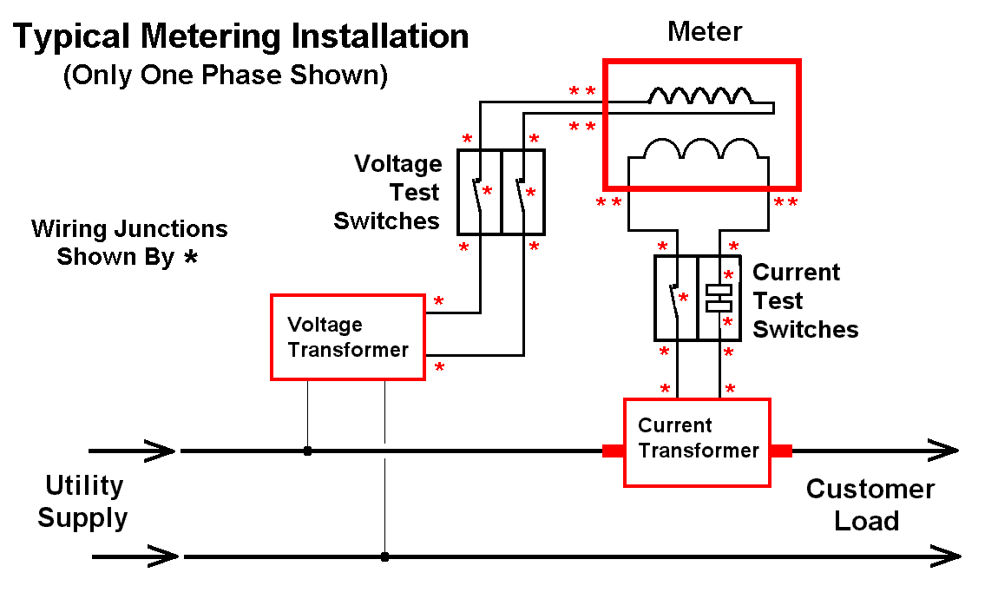
On Site CT Testing
The meter measures ONLY the voltage and current reaching the meter terminals.
To verify that the CT is working at the site we have to test the entire circuit.
Slide 23

Slide 24
CT Transformers
Field Verification – Full Ratio Measurement
Measure Here
Measure Here
Slide 24

Slide 25
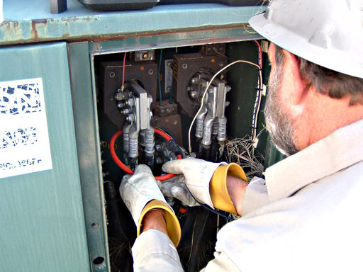
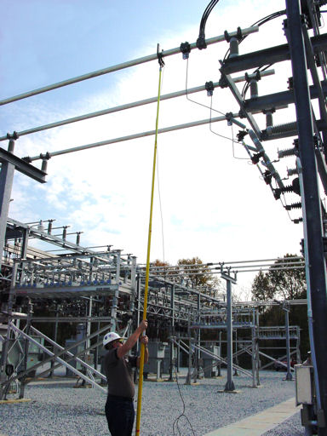
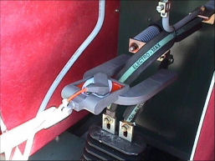
CT Ratio with Burden Testing
Ratio Testing is the preferred approach when we can gain access to the CT primary.
Various types of probes can be used for primary side.
  Flex
  HV
Slide 25

Slide 26
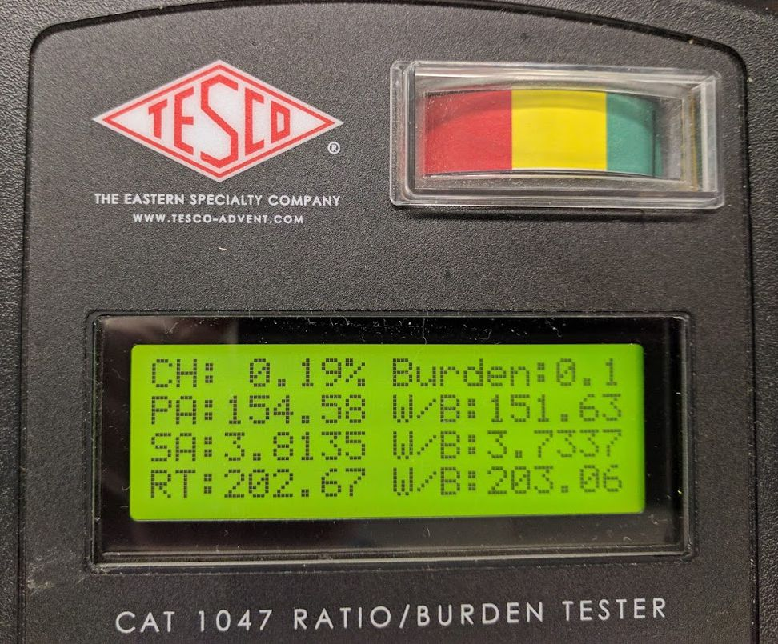
CT Testing
Direct Ratio vs Burden Only
 | Un-burdened Value | Burdened Value
Primary Amps | 154.58 | 151.63
Secondary Amps | 3.8135 | 3.7337
Ratio | 202.67 | 203.06
% Ratio Change |  | -0.19%
% Secondary Change |  | 2.14%
By simultaneously measuring primary and secondary currents we get an accurate picture of performance under load. Only measuring secondary current change can give a false picture.
Slide 26

Slide 27
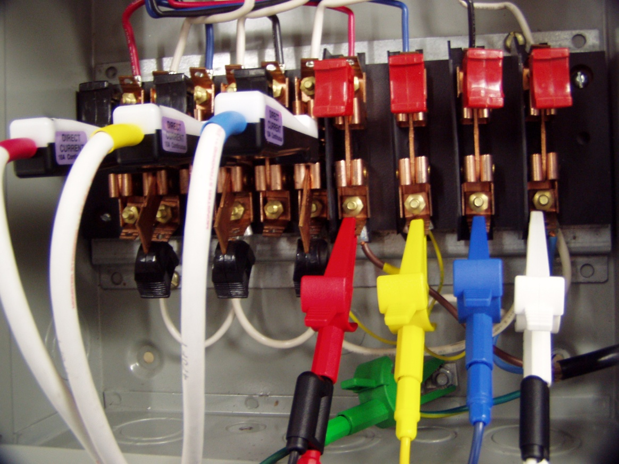
CT Ratio with Burden Testing
Secondary connection is made through the test switch
Same connection that is used for the rest of the site testing.
Disadvantage:
Requires access to the primary side if the CT to measure current.
Ratio Testing with applied burden is the most accurate and complete approach for testing at CT in service.
Slide 27

Slide 28
Testing Current Transformers
Ratio vs Applied Burden
CT testing can be done with very high accuracy
Reference CT measured using PowerMaster with 752 clamp-on probes. Essentially NO ratio error, phase shift, or change in secondary current versus applied burden.
Slide 28

Slide 29
Testing Current Transformers
Ratio vs Applied Burden
CT testing can be done with very high accuracy
Field measurement using PowerMaster with 752 clamp-on probes. Essentially NO ratio error or phase shift.
Slide 29

Slide 30
Testing Current Transformers
Ratio vs Applied Burden
Note: As additional burden is applied both ratio and phase errors increase. The direction of change is in the customer’s favor.
Slide 30

Slide 31
Testing Current Transformers
Ratio vs Applied Burden
Burden Class 0.1 CTs various issues: too small gauge wire, bad connections, high harmonic content.
Slide 31

Slide 32
Testing Current Transformers
Ratio Error – In Whose Favor?
In the phase B test we measured 35.86 amps on the primary and 1.799 secondary amps.
Ratio = 5.0 * (Primary / Secondary) = 99.68
If the ratio had been 100:5 and the primary was 35.86 amps we should have measured 1.793 amps on the secondary.
We measured 1.799 – MORE than we should have.
Therefore a tested ratio of 99.68 means that we are measuring more current than we should. This error is in our favor.
Slide 32

Slide 33
Testing Current Transformers
Ratio Error – In Whose Favor?
Suppose we add burden to the metering circuit.
Notice that the ratio increases as we apply burden. Just above 0.1 additional burden the ratio switches from less than 100:5 to greater than 100:5. This is the point where things swing to being in favor of the customer.
Slide 33

Slide 34
CT – Accuracy – Burden - Load
No Spec
Meets 0.6 Spec
Meets Accuracy Spec
Slide 34

Slide 35


Testing Current Transformers
What’s Wrong? → Power Theft
Slide 35

Slide 36
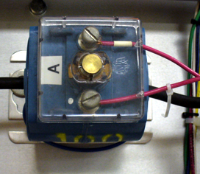
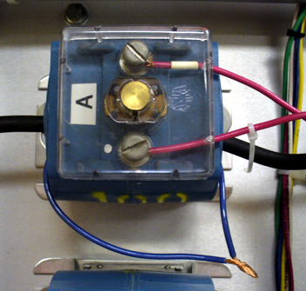
Testing Current Transformers
What’s Wrong? → Power Theft
A simple piece of wire wrapped around the CT.
Would you spot it?
Slide 36

Slide 37
Testing Current Transformers
What’s Wrong?
Phase A CT reversed.
Slide 37

Slide 38
Testing Current Transformers
What’s Wrong?
Phase A & B CTs swapped.
Slide 38

Slide 39
Potential Transformers
Another potentially low accuracy item in chain
  0.3 percent basic accuracy
Accuracy decreases rapidly with burden
Power supplies in meters may cause measurement errors.

Slide 40
Testing Potential Transformers
Ratio Test
PT’s can be tested easily in the field. Primary and secondary values can be accurately measured.

Slide 41
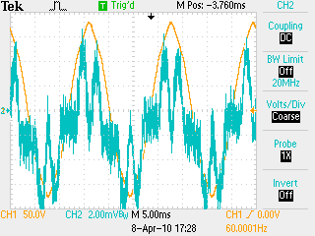
Overloaded PT
Under sized PT can lead to overburden situation and waveform distortion. Especially with high end meters.
Yellow –– PT output
Blue – Current being drawn by meter from this phase

Slide 42
Overloaded PT
Under sized PT can lead to overburden situation and waveform distortion. Especially with high end meters.
Primary waveform is undistorted vet secondary waveform shows clipped voltage on phase powering meter.

Slide 43

Questions and Discussion
Bill Hardy
TESCO – The Eastern Specialty Company
Bristol, PA
215-688-0298 (cell)
215-785-2338
This presentation can also be found under Meter Conferences and Schools on the TESCO website: www.tesco-advent.com

