Slide 1
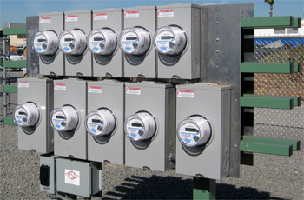
History of Electric Metering
Tom Lawton,TESCO The Eastern Specialty Company
For the North Carolina Electric Meter School 2016
10/02/2012
Slide 1
Notes:
1

Slide 2
Abstract
Circa 1870 - Prior to the Watt-Hour Meter
Early Metering nees
Like today – a small metering community
Thomas Edison
Elihu Thomson
George Westinghouse
Oliver B. Shallenberger
Robert C. Lanphier
Thomas Duncan
AC versus DC (battle of the currents)
Meter Manufacturers
The Watt-Hour Meter
How Metering Has Changed
Metering Today

Slide 3
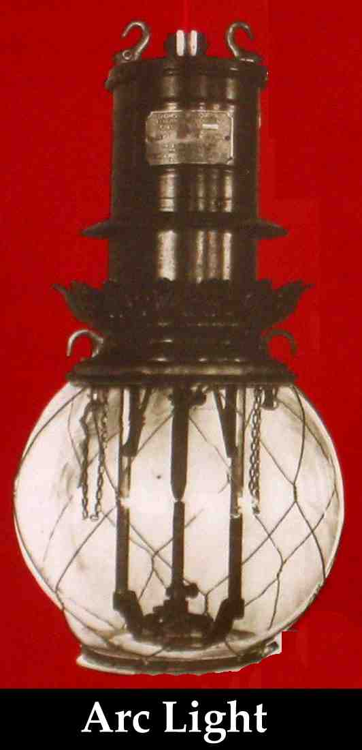
Electric Arc Lamp Invented 1802
Not practical because of lack of constant electricity supply
Practical dynamos demonstrated by Staite and Brush in 1870’s
Charles F. Brush established Brush Electric Company in 1880 to provide arc lighting. Brush was lighting Broadway two years before Edison started the Pearl Street Generating Station in New York City

Slide 4
First Meters
1872 - Samuel Gardiner takes out the first known patent on an electric meter. This was a DC lamp-hour meter that was a clock with an electromagnet that started and stopped the mechanism.
1878 - J.B. Fuller takes out a patent on an AC lamp-hour meter that was a clock operated by an armature that vibrated between two coils.

Slide 5
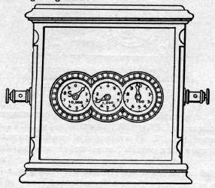
Samuel Gardiner’s Lamp-Hour Meter (1872)
This was one of the earliest meters and the first known model to be patented. It was used with the earliest DC arc-lamp systems and only measured the time energy was supplied to the load as all the lamps connected to this meter were controlled by one switch. The internal workings were nothing more than a clock that was started and stopped by a electromagnet that was connected in series with the load.
With the introduction of Edison's light bulb, subdividing lighting circuits became practical and this meter became obsolete, replaced by meters such as Edison's chemical meter and the Thomson Recording Wattmeter.

Slide 6
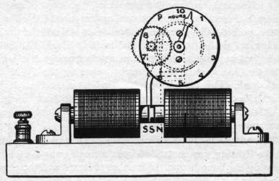
J.B. Fuller’s Lamp-Hour Meter (1878)
This meter was the first known AC meter to be patented, and like the earlier Gardiner DC lamp-hour meter, only measured the time energy was supplied to the load. The meter was simply a clock operated by the alternating fields of the two coils. Lamp-hour meters were soon abandoned as customers started adding other electrical appliances and the need arose for meters that meters that measured energy, like Shallenberger's ampere-hour meter.
One of Jim B. Fuller's assistants was James J. Wood, who would soon become one of the key people at the Ft. Wayne Electric Co.

Slide 7
Flat Rate Billing
Up to the 1870s, electricity had little use beyond the telephone and telegraph. Brush’s arc lamps began to change this but they were connected in series. Since the current was constant and the voltage required for each lamp was known, and all of the lamps were controlled by one switch, it was adequate to measure only the time current flowed in the circuit (lamp-hours). Edison’s incandescent lamps only incrementally changed this at first. These bulbs provided a softer glow closer to the familiar candle light, but he also started with a flat rate tariff that charged by the number of bulbs the user had in service. The Thomson-Houston Electric Company changed the game again with the development of arc lamps that could be independently turned off. Now we needed a meter closer to the conventional meters we know and love today. The Thomson-Houston Company was formed in 1883 in Lynn MA when Charles Coffin brought a struggling electric companies(the American Electric Company) to town that was led by the engineers Elihu Thomson and Edwin Houston. Coffin renamed the company for his two engineers.

Slide 8
Incandescent Light Bulb
October 21, 1879 – Thomas Alva Edison invents electric light bulb
Electricity originally used to provide light only
Edison system: Batteries delivered DC directly to user facilities

Slide 9
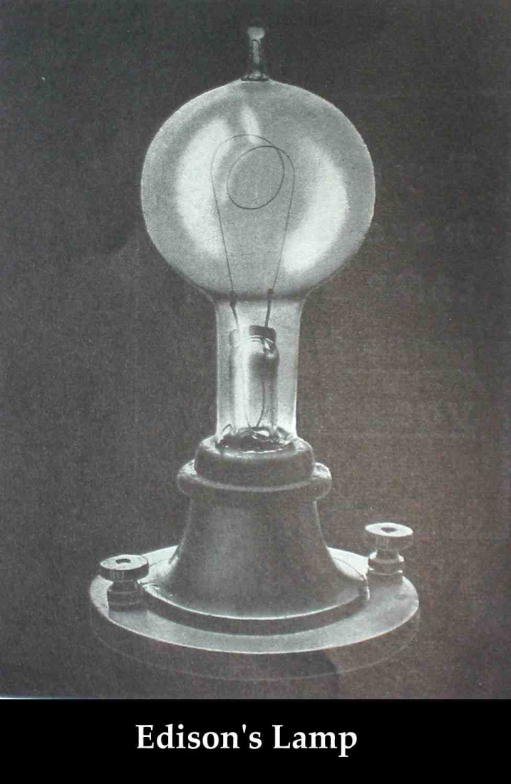
1880: Edison Illuminating Company Formed
September 4, 1882: First central power plant-Pearl Street Station in lower Manhattan
One generator produced power for 800 electric light bulbs.
In 14 months, Pearl Street Station had 508 subscribers and 12,732 bulbs.

Slide 10
First Practical Meters
After the invention of the incandescent lamp by Edison in 1879 and the subdivision of lighting circuits for individual control of the lamps, measuring lamp hours was no longer practical (although this practice continued for arc-lamp street lighting circuits into the 1890’s) 1881 – The Fort Wayne Electric Co. was incorporated to sell a dynamo and arc lamps patented by James Jenney. The company was founded by Ronald T. McDonald who was also the first President. 1882 – Edison starts up his first electric company for incandescent illumination starting first with a per lamp flat rate but then quickly moving to a chemical meter as more items were added to the circuit and lights we capable of being turned on and off.

Slide 11
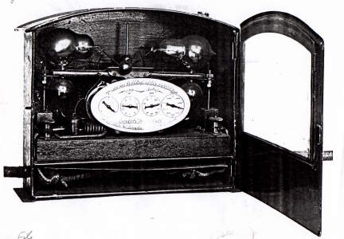
Thomson Walking Beam Meter (1889-1889)
1883 The Thomson-Houston Electric Company was organized in Lynn, MA to manufacture the inventions of Professor Elihu Thomson and Edwin Houston. Charles A Coffin was the President and one of the investors who helped establish the company.
One of their fist developments was the Walking beam meter. This meter was developed by Elihu Thomson and was so complex and delicate that the meter proved of little commercial value. A heating element was connected into the circuit and warmed the lower bottle closest to it. As the alcohol warmed, it evaporated and flowed into the opposite upper bottle. This would upset the balance, shifting the other lower bottle closer to the heater and emptying the upper bottle that was just filled. As the meter rocked, an escapement drove the register which was marked off in lamp-hours.
Thomson learned from this and later developed the far more robust and very successful Thomson Recording Wattmeter.

Slide 12
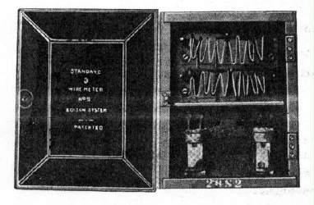
Edison Chemical Meter (1878 to late 1880s)
Edison developed the first meter that measured the amount of electricity instead of how long the circuit was energized. This meter was connected across a shunt in the load and consisted of several jars with zinc plates and a chemical solution. One set of jars was intended for the main reading while the second set was operated off a smaller shunt and was intended for comparison purposes (a primitive check on the meter's accuracy).
The monthly reading was made by removing the plates from the jars and weighing them with a laboratory balance. The change in the plates' weight between readings was a measure of electricity consumption. This meter was very inconvenient to use, and in a couple cases mishandling of the plates resulted in large billing errors. Also, as there was no ready way to indicate the usage to the customer, this also made it hard for them to trust its accuracy. These disadvantages and the fact that this meter itself had high internal losses made it unpopular enough that these meters were rapidly replaced by more reliable meters in the late 1880's, including the Thomson Recording Wattmeter.

Slide 13
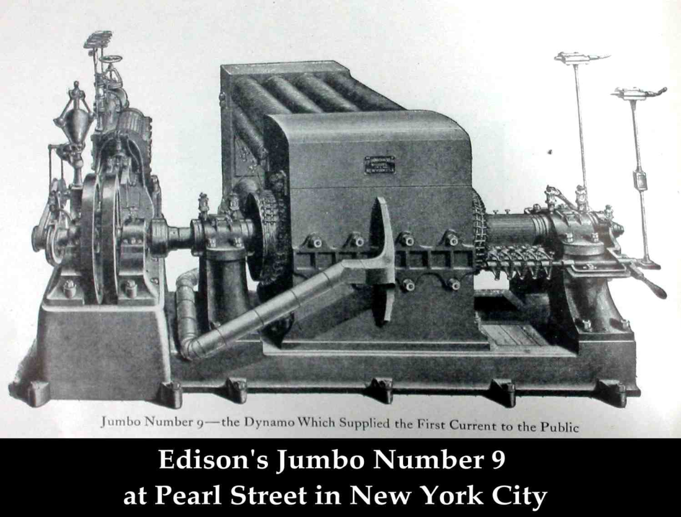
The Problem with Direct Current
High losses required generators near the loads – maximum of one mile without huge conductors.
Difficult to change voltages for transmission with DC

Slide 14
Westinghouse
1884 – George Westinghouse establishes the Union Switch & Signal Co. in Pittsburgh, PA.
Buys the US rights to a transformer patented in Europe
The Company reorganizes as the Westinghouse Electric and Manufacturing Company.
William Stanley joins the company as the chief electrical engineer and Oliver B. Shallenberger resigns as an officer in the U.S. Navy to work under him as the chief electrician.

Slide 15
AC Starts to Win
Stanley and Schallenberger They refine the transformer design and in 1886 Stanley demonstrates the first complete system of high voltage AC transmissions including generators, transformers and high voltage transmission lines).
AC had none of the issues of DC (voltage drop in long lines and a lack of an easy way to increase or decrease the voltage). However three was no meter that could accurately record the usage of electricity on AC circuits.

Slide 16
Thomas Edison - 1889
"Fooling around with alternating current is just a waste of time. Nobody will use it, ever."

Slide 17
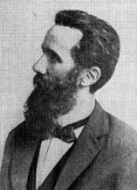
Galileo Ferraris
Tesla in 1882 identified concept of rotating magnetic field
Dr. Ferraris, in 1885, proved that torque could be produced electromagnetically by two alternating-current fluxes, which have a time displacement and a space displacement in the direction of proposed motion.

Slide 18
1893 Nikola Tesla Induction Motor Patent
Nikola Tesla takes out a patent covering Ferraris' discovery of the induction motor principle.
There was a brief patent infringement suit, but Tesla was awarded priority. This was just one of Tesla's many patents later purchased by George Westinghouse.
This discovery by Ferraris and patent by Tesla spurs the development of induction-type motors as well as paving the way for the development of the induction-type watthour meter.

Slide 19
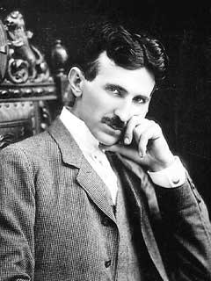
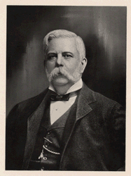
1888: A Young Serb Named Никола Тесла (Nicola Tesla) Meets George Westinghouse
Tesla
"The Wizard of The West"
Westinghouse American entrepreneur and engineer
1882: Induction Motor
1893 World’s Fair Chicago
Lighted by Westinghouse / Tesla

Slide 20
The Battle of the Currents
Edison was a shrewd businessman who wanted to profit from his inventions.
Tesla was a brilliant scientist but not a good businessman.
Edison took advantage of Tesla’s technical skills without compensating him.
Westinghouse treated Tesla with respect and funded his experiments in AC power.
Edison lobbied for AC power to be used in executions and then claimed AC was “too dangerous”.

Slide 21
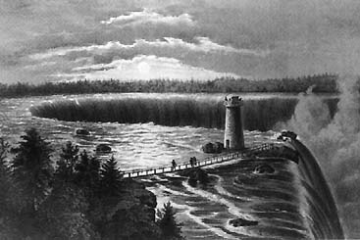
1893: Westinghouse Awarded the Contract for Powerhouse at Niagara Falls
Edward Dean Adams power station at Niagara, with ten 5,000 horsepower Tesla/Westinghouse AC generators—the culmination of Tesla's dream. (Courtesy Smithsonian Institution)

Slide 22
Types of Early Electric Meters
Electrolytic Meters are exclusively ampere-hour meters.
Chemical cells measure electricity by change of weight of cell plates.
Motor Meters
Typically ampere-hour meters. AC or DC electric motor.
Intermittent Registering Meters
Some form of ampere-meter or watt-meter registers the current or power passing into the house;
A clock makes periodic readings of the ampere-meter or watt-meter and adds to a mechanical register
Induction Meters – AC only. Predecessors of modern electricity meters

Slide 23
Fort Wayne is Bought Out
In 1888 the Fort Wayne Electric Company needed additional capital to expand. Ronald T. McDonald was a good friend of Charles A. Coffin and the Thomson-Houston company purchased a controlling interest in Fort Wayne (who was making a fairly complex lamp-hour meter at the time).
In 1890 100 Thomson-Houston electric employees move to Fort Wayne IN to work on a new arc-lighting system including Thomas Duncan

Slide 24
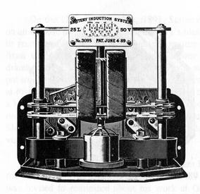
Fort Wayne
Not much is known right now about this meter, but it was a lamp-hour meter to go with the electric system developed by Marmaduke Marcelus Michael Slattery (whew!) for the Fort Wayne Electric Company. This meter was designed and sold prior to Thomas Duncan's arrival at Fort Wayne, and was discontinued after Slattery passed away in 1892 (all the equipment he had developed was quickly discontinued in favor of better equipment developed by J. J. Wood and others at Fort Wayne)

Slide 25
Mistakes and Meters
In April 1888 O.B. Schallenberger and an assistant are working on a new AC arc lamp and a spring fell out and came to rest inside the lamp. Schallenberger notices that before his assistant can pick up the spring the spring had rotated. He realized that the spring had rotated due to rotating electric fields in the lamp and designs an AC ampere-hour meter in three weeks that went to market three months later. Over 120,000 are sold by Westinghouse Electric within 10 years.

Slide 26
Elihu Thomson
1889 Thomson introduced his recording wattmeter (AC or DC – a commutator-type meter).
This was the first true watthour meter, and it was an immediate commercial success, many utilities adopting it as their "standard" model.
Although this meter was initially designed for use on AC circuits, it worked equally well with the DC circuits in use at the time.
The introduction and rapid acceptance of induction-type watthour meters in the late 1890s relegated the use of this commutator-type meter to DC circuits.

Slide 27
General Electric
In 1891 Edison General Electric Company wins the lawsuit over the light bulb patent and they start merger discussions with Thomson-Houston as their patents are highly complementary (light bulbs and AC distribution)
In 1892 the two companies merge forming General Electric.

Slide 28
Magnetic gaps vs. jewel bearings
In 1895 William Stanley returned to Great Barrington, MA to establish the Stanley Instrument Co. to sell watthour meters designed by himself and Fredrick Darlington. This meter was unique - it used a disk that was floated in the magnetic gap without using the traditional jewel bearing. This model worked at first but problems forced the company to produce a few other models with jewel bearings.

Slide 29
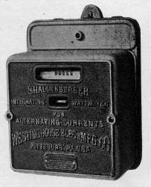
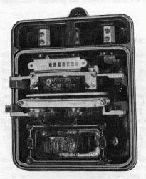
Induction Watthour Meter
1892 Thomas Duncan develops the first induction watthour meter to use a single disk for both the driving and braking element but the design never went into production.
1894: With the rapid growth of the electric industry at this time, AC was now being used to run motors, and the existing ampere-hour meters and commutator-type watthour meters were unable to take into account varying voltages and low power factors on AC circuits.
Several inventors worked to develop a new meter to meet this need, but Shallenberger hit on the most workable approach - a small induction motor with the voltage and current coils 90 degrees out of phase with each other.
This concept was refined into the first commercially produced induction watthour meter. This model was one of the heaviest ever offered at 41 pounds and one of the most expensive of its time.

Slide 30
Shallenberger Integrating Wattmeter (1894 to 1897)
By the mid-1890s, Shallenberger's ampere-hour meter was popular but because of the increasing use of motors, a true watthour meter was needed to account for varying voltages and power factors.
First commercially produced induction watthour meter.
Large and heavy (41 pounds)
More than twice as expensive as comparable meters in its time.
This meter was one of the first models to use a cyclometer register.
Depending on the customer's preference, this register was equipped with 4 drums (registering in kwh) or 7 drums (registering in watthours).
The stator was similar to ones in later meters with its voltage and current coils arranged on opposite sides of the disk and had a magnet assembly to damp the disk's speed
Becomes the modern day meter

Slide 31
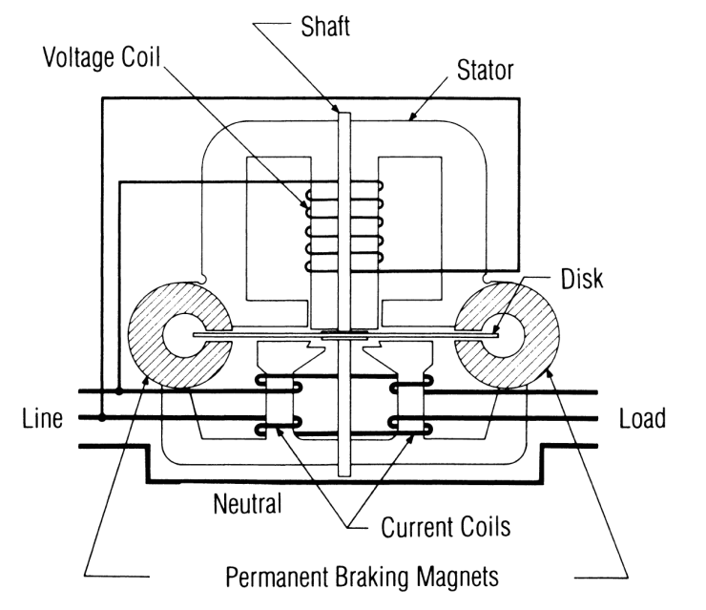
Induction Meters
Using concepts put forth by Tesla and Ferraris, several inventors created early induction watthour meters
Two coils and a conducting (usually aluminum) disk. A braking magnet.
Magnetic field from the first coil generates eddy currents in the disk
Magnetic field from the second coil interacts with the eddy currents to cause motion
Disk would accelerate without bound except for eddy currents caused by motion through fixed magnetic field which slows the disk
The end result is that each revolution of the disk measures a constant amount of energy

Slide 32
Basic Energy Formula
The essential specification of a watthour meter’s measurement is given by the value K_{h} [ Watthours per disk revolution ]
The watthour meter formula is as follows:

Slide 33
1893: Blondel’s Theorem
The theory of polyphase watthour metering was first set forth on a scientific basis in 1893 by Andre E. Blondel, engineer and mathematician. His theorem applies to the measurement of real power in a polyphase system of any number of wires. The theorem is as follows:
If energy is supplied to any system of conductors through N wires, the total power in the system is given by the algebraic sum of the readings of N wattmeters, so arranged that each of the N wires contains one current coil, the corresponding voltage coil being connected between that wire and some common point. If this common point is on one of the N wires, the measurement may be made by the use of N-1 wattmeters.

Slide 34
Shallenberger Polyphase Meter
Shallenberger modifies his meter to work on a polyphase circuit but the close spacing of the stators and the use of a solid disk resulted in the meter being less accurate than expected.

Slide 35
GE – Westinghouse Agreement
1896 – another patent war loomed between Westinghouse and GE. They “agreed” to set up a Board of Patent control that allowed them to license each other’s patents.

Slide 36
1897
Schallenberg meter is redesigned into a smaller, lighter 12 pound meter. This significantly less expensive meter is known as the “round meter”.
Duncan develops a watthour meter for the Fort Wayne Electric Co before GE buys them out completely.

Slide 37
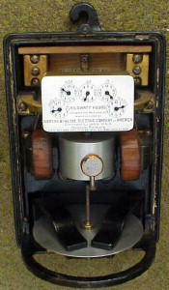
Siemens & Halske Duncan Integrating Wattmeter (1899, 1900)
After R.T. McDonald died in 1899, Duncan left Fort Wayne for a brief stint at Westinghouse before coming back to Ft. Wayne. Shortly after his return, he and several other employees were lured away by C.S. Knight (who was a manager at Ft. Wayne himself before being hired by S & H). Once at S & H, Duncan refined his watthour meter into a slimmer, top-connected version. The light load adjustment was changed to use a copper ring with an iron core. In early 1900, shortly after Duncan's arrival, there were widespread strikes in the Chicago area, and Siemens & Halske's plant was one of the affected companies. This put the company in such a bad financial position they had to sell out to GE. The strikes were soon settled and existing orders were filled. Late that year, GE closed the S & H plant and moved the tooling and many employees to Fort Wayne. However, Duncan felt the time was right to leave for Lafayette, IN to establish the Duncan Electric Mfg. Co.

Slide 38
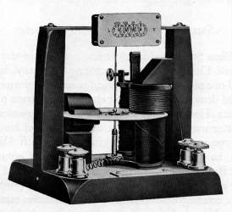
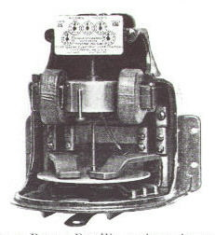
Duncan Watthour Meters (1892-1898)
The first model shown represented a landmark in watthour meter development. This model was developed by Thomas Duncan in 1892, two years before O.B. Shallenberger introduced his watthour meter. This also predated Tesla's patent on the induction motor principle - this was one of his many patents bought by Westinghouse, and the one that was invoked in 1903 against all the other manufacturers (except for GE due to a licensing arrangement). It was also the first meter to use a single disk for both the driving and braking element. For reasons unknown, Duncan never patented or adapted this model for production. If he had done so, Duncan would have had a significant advantage over GE and Westinghouse!
The second model shown is of the watthour meter Duncan later developed for the Fort Wayne Electric Corporation. The overall appearance of this meter is very similar in design to the Thomson Recording Wattmeter introduced by Thomson-Houston around that time. The main difference between this model and the T.R.W. is in the arrangement of the coils and the can-type rotor (which carried over into the K series of meters). Duncan may have been inspired to base his new meter design on the TRW as he did work there for a short time in the 1888-1889 timeframe. He worked alongside Elihu Thomson in his plant while the Ft. Wayne Electric Co. rebuilt its facility after a fire destroyed the plant in 1888.

Slide 39
1899 to 1902
Westinghouse develops a viable polyphase meter – two single phase meters in a tall case with a common shaft and register. This design remains in use until 1969.
Thomas Duncan founds the Duncan electric Manufacturing Company and starts shipping meters a year later.
Sangamo Electric ships their first electric meter.
Westinghouse releases the Type A meter with a ball bearing instead of a pivot.

Slide 40
Patent Infrigement 1903
Westinghouse sues Sangamo and Duncan over infringement of the Tesla patents and forces them out of the induction meter business until 1910.

Slide 41
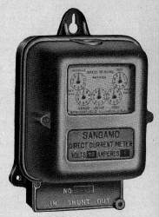
Sangamo 1899-1975
After being barred from making induction meters until the end of 1910 (following the patent lawsuit brought by Westinghouse) in 1903, Robert Lanphier sought out a design for a meter that didn't infringe on Tesla's patents (held by Westinghouse). He decided to work with the mercury-motor meter which was widely used in England at the time, and developed the first practical mercury-motor watthour meter. The design of this meter was unique, since this meter used the voltage coil to generate the braking field instead of the permanent magnets normally used for the brake. The coarse full-load adjustment was made by adjusting the resistance of a shunt inside the meter, and the fine adjustment was made by adjusting the depth of the contacts into the mercury chamber. The light load adjustment was made by varying the resistance of the voltage circuit. Unlike the later mercury-motor meters, this model depended on the disk's natural buoyancy in mercury alone. The rotation of the element was indicated by a hand on the top of the shaft assembly and was visible through a window set in top of the meter cover (which was factory-sealed just like the previous Gutmann Type B meter). This design had several major flaws, the fatal one being that the material used for the mercury chamber softened when the temperature of the surroundings got too warm and leaked. All the Type C meters were recalled and replaced with an improved version (the first version of the Type D).

Slide 42
And now a need for Standards
Safety - Standards specify minimum behavior of systems.
Accuracy - Standards can specify system accuracy.
Reliability - Standards can specify system reliability.
Security - Standards can help to ensure information and system security.
Openness - Standards give users options. Standards also give vendors the ability to specialize rather than build the entire system.
Notes:
There are lots of good reasons to use standards. The utility industry has identified - and used - many of these in the construction of our modern systems. Imagine a world in which we had not agreed on service voltage, frequency, or interface connectors. Imagine a world in which electricity meters were engineered from the ground up for each utility company.
Standards have served us well to ensure safety, accuracy, reliability, and low cost. Standards allow vendors to specialize by building niche devices which interoperate with other devices from other manufacturers without any vendor needing to “build it all”.
Standards properly deployed can also help to ensure information security by making the structure of the “lock” public knowledge but making the exact key private.

Slide 43
But the Process is Not Trivial
Inertia of existing practices
Proprietary “standards”
Defining a vision
Identifying existing standards to use as building blocks
Gaining consensus
Hammering out details, details, details, details, details…..
Notes:
The process of moving from the old to the new is not trivial. We have the inertia of existing practices, the use of private “standards” - normal for the utility industry, the need for a defining vision for the future, the identification of existing standards to use as building blocks, and the hard work of gaining consensus and working out all the details.
Sometimes it is just easier to continue with the status quo. But, as we will see, the rewards are worth it, and the end user doesn’t need, in the end, to deal with all of the details. Leave that to the experts.

Slide 44
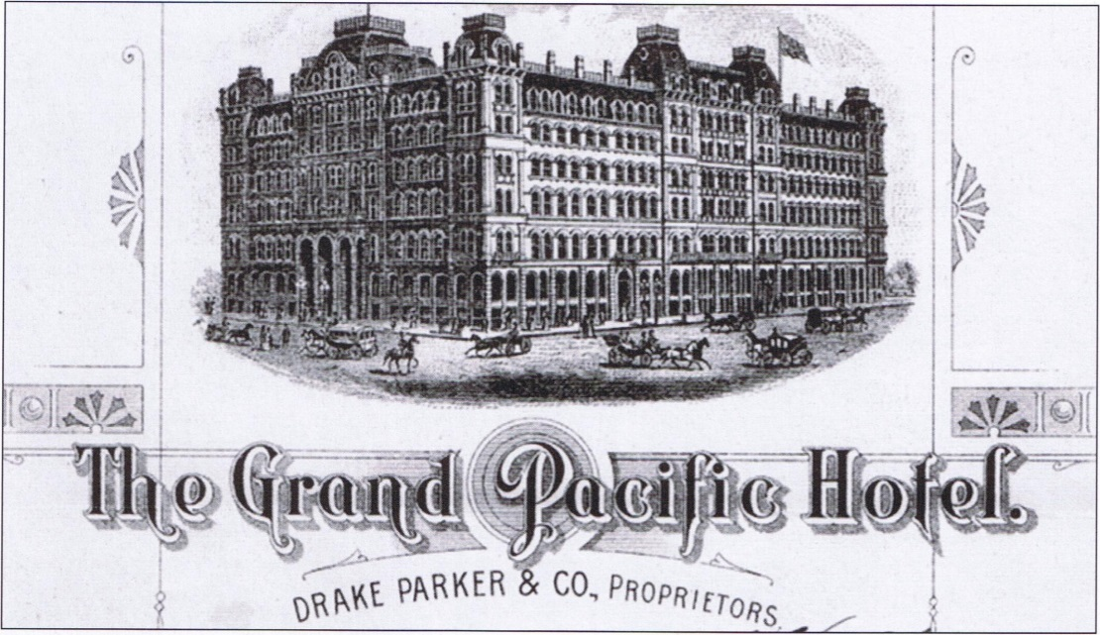
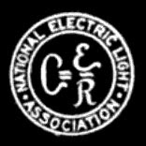
National Electric Light Association
Formed in 1885
J. Frank Morrison, Brush Company of Baltimore Baltimore, MD 1st President
Held at the Grand Pacific Hotel
Vendor Dominated
One Operating Committee
Notes:
Ref. 1885 Proceeding of the National Electric Light Association: Pg. 4 & 12: http://babel.hathitrust.org/cgi/pt?id=mdp.39015011403139;view=1up;seq=13
Incandescent lighting, particularly in regard to length of circuit upon which it can be run with profit. 2. Locating and avoiding crosses with telephone wires. 3. Power and its conversion into light. 4. Electric light globes and shades. 5. The best modes of connecting dynamos with power. 6. Electric lighting by water power. 7. Rates and rebates on electric lights by the year. 8. The use of electricity as applied to motors. 9. Where an electric light system requires No. 6 conductors,is it desirable to use No. 6 and No. 4 in the same line?
10. Will armatures become affected by frost when exposed in transportation? 11. Special insulation or guards between insulations of lines at dangerous points and places. 12. Street lighting, the best manner and modes of accomplish-ing it. Location of lights and running the circuits for the same. 13. Experience and results in the use of underground con-ductors. 14. That the fireman should receive more pay than the engineer. 15. Help generally. 16. Experience of electric light companies in the use of cop- per-coated and bare carbons.

Slide 45
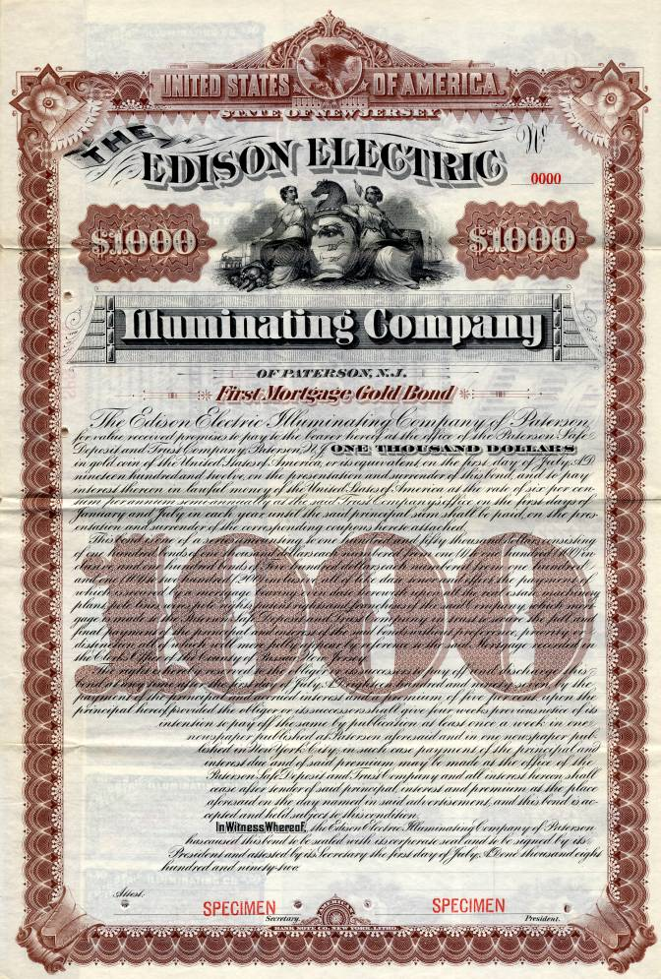
Association of Edison Illuminating Companies
AEIC was formed in 1885
James S. Humbird of Cumberland, MD, First President
Held in Harrisburg, PA at Harrisburg Edison Electric Light Co.
Only Edison Franchisees and Guests Were Invited to First Meeting

Slide 46
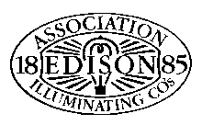
NELA vs. AEIC
Large Flashy Industry Meetings
Objective was to promote Lighting Manufacturers, Apparatus Integration, and Systems Construction
Focused On Arc-Lighting Systems Promotion
Prioritized Expansion of Electric Systems, Regardless of AC or DC
Small, Focused Utility Group Meetings
1885 By-Laws - Objectives: “Mutual Protection of (Electric System) Owner Interests; Thoughtful Information Collection and Dissemination”
Focused on Incandescent Lighting Promotion
Prioritized Standardization of electrical Systems

Slide 47
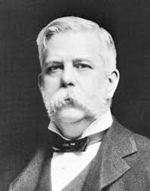
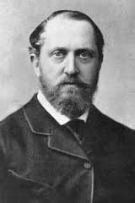
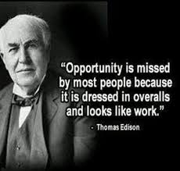
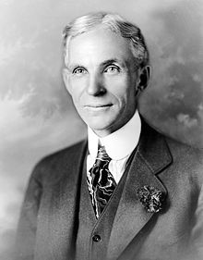
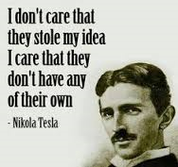
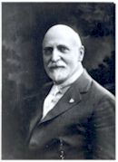
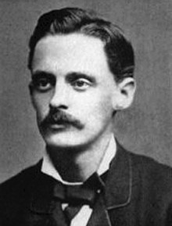
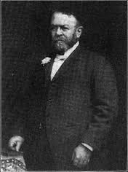
Meeting Attendance
George Westinghouse
Lord Stanly
Thomas Edison
Henry Ford
Thomson-Houston
Nikola Tesla
Alex Dow

Slide 48
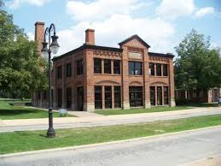
AEIC Meter Committee
The Issue of metering was discussed as early as 1887 as part of the formal meeting.
The AEIC Committee On Meters was first discussed in 1896
The committee was established in 1898, With Alex Dow, Edison Illuminating company of Detroit, Presiding as Chair.
About Alex Dow…. Scotland to Cunard Lines to Baltimore to the Brush Company to lighting for the World’s Fair in Chicago to helping Detroit to design and supervise a city owned electric company to manager of the Detroit Edison Illuminating Company (1896) which became Detroit Edison in 1903 rising from General Manager to President in 1912.

Slide 49
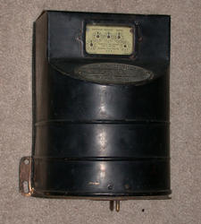
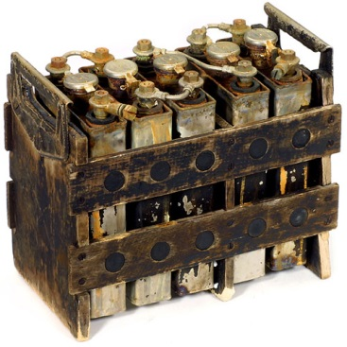
Early AEIC Meter Committee Activity
The Wright vs. Barstow Debate
Barstow – TOU
Wright - Demand
Emerging Technologies
Research and Development
Pre-Paid Metering
Battery Storage Implications

Slide 50
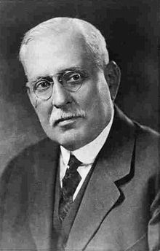
The Rise of the NELA Meter Committee
NELA Meter Committee Established in 1908, With Alex Dow, Edison Illuminating Company of Detroit, Presiding
Samuel Insull, former personal secretary to Edison, VP of GE and then the President of Commonwealth Edison and the “father” of utility and railroad holding companies. He had great influence on both the formation of the Committee and the topics covered

Slide 51
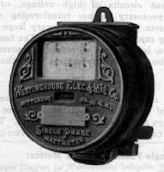
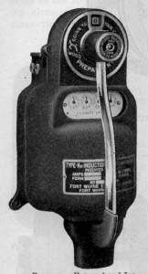
Publishing The First Works
Beginning in 1897, NELA put a focus on developing the first edition of the National Electric Code
Beginning in 1902, AEIC began work on collecting requirements from member companies for meter standardization
By 1908, the AEIC Committee began work on the Code for Electricity Meters

Slide 52
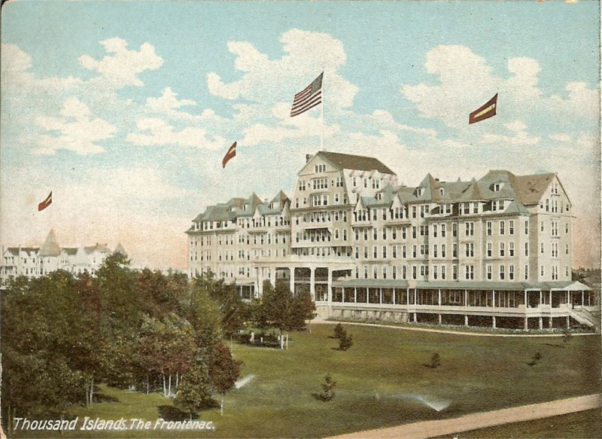
The Coming Together
The AEIC and NELA Metering Committee first Met in 1910 at the Hotel Frontenac in Thousand Islands, NY
They met for the historic publishing of the AEIC Code For Electricity Meters – The predecessor to ANSI C12
It was deemed in 1910 that all future work on the Code for Electricity Meters shall be collaborative between NELA and AEIC

Slide 53
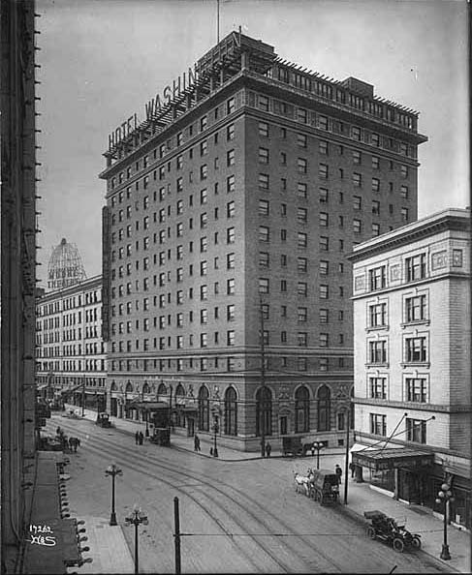
The “Handbook”
Based on the work of the AEIC Code, NELA Members began work on the first “Electric Meterman’s Handbook”
Presented at the Historic Hotel Washington in Seattle, WA
The NELA/AEIC Joint Presentation also Featured Vendors: Thomson (General Electric), Westinghouse, Fort Wayne, Sangamo, Duncan Columbia, The Eastern Specialty Company (TESCO), Cutler-Hammer, Biddle, Leeds & Northrup and The States Company

Slide 54
After the patent…
After the Tesla patents expired in December 1910, Sangamo immediately introduced a new induction-type meter known as the Type H. As with the previous Gutmann meters, the disk rotated clockwise (to the left) unlike its competitors' which all rotated to the right.
20 years after Duncan developed his single-disk meter, the Duncan Electric Mfg. Co. introduces its first induction-type meter, the Model M. This meter was not as sound as its competitors' offerings as two improved versions of this model (Models M1 and M2) came out in the next 3 years.
Notes:
There are lots of good reasons to use standards. The utility industry has identified - and used - many of these in the construction of our modern systems. Imagine a world in which we had not agreed on service voltage, frequency, or interface connectors. Imagine a world in which electricity meters were engineered from the ground up for each utility company.
Standards have served us well to ensure safety, accuracy, reliability, and low cost. Standards allow vendors to specialize by building niche devices which interoperate with other devices from other manufacturers without any vendor needing to “build it all”.
Standards properly deployed can also help to ensure information security by making the structure of the “lock” public knowledge but making the exact key private.

Slide 55
1920’s
The late 1920s saw several key advances in meter design. With the introduction of meter service cabinets to protect the meter connections, polyphase meters were redesigned to move the terminal chambers from the sides to the bottom. Also, all meters were redesigned to add two types of compensation to improve performance. Temperature compensation enabled meters to maintain accuracy over a wide range of temperatures. Before temperature compensation, the utilities were seeing seasonal fluctuations in accuracy that required readjustment of the meter. Overload compensation enabled meters to handle a broader range of loads and provide accurate metering over this range (a typical modern meter that can handle 200 amperes actually has a nominal rating of 30 amperes). Before overload compensation was added, low-capacity meters could not handle overloads well, and high-capacity meters were insensitive to light loads.
Westinghouse introduces the first socket-type meter, the OB "detachable“ – Manufactured in Newark NJ and released in 1928
Notes:
There are lots of good reasons to use standards. The utility industry has identified - and used - many of these in the construction of our modern systems. Imagine a world in which we had not agreed on service voltage, frequency, or interface connectors. Imagine a world in which electricity meters were engineered from the ground up for each utility company.
Standards have served us well to ensure safety, accuracy, reliability, and low cost. Standards allow vendors to specialize by building niche devices which interoperate with other devices from other manufacturers without any vendor needing to “build it all”.
Standards properly deployed can also help to ensure information security by making the structure of the “lock” public knowledge but making the exact key private.

Slide 56
1930’s
The National Electric Code was revised to allow the meter to be connected ahead of switches and fuses, which made it harder for dishonest customers to tap into the unmetered part of the electrical service on their property. This change along with the introduction of socket-type meters a couple years later made it possible for utilities to start moving the meters outside where they could be read without entering the customer's premises.
Up to the mid-1930s, meters made by different manufacturers (or even different models or versions of the same model) were made with little attention to consistency in design. This resulted in a problem for electric utilities. A meter change out often required rearranging the wiring to the meter. In 1934, a committee consisting of representatives from the manufacturers and the larger electric utilities came up with two new standardized designs ("S" type or socket and "A-base" or bottom-connected) for the meter enclosures. This simplified meter change-outs in the field to simply taking out the old meter and installing the new.
Notes:
There are lots of good reasons to use standards. The utility industry has identified - and used - many of these in the construction of our modern systems. Imagine a world in which we had not agreed on service voltage, frequency, or interface connectors. Imagine a world in which electricity meters were engineered from the ground up for each utility company.
Standards have served us well to ensure safety, accuracy, reliability, and low cost. Standards allow vendors to specialize by building niche devices which interoperate with other devices from other manufacturers without any vendor needing to “build it all”.
Standards properly deployed can also help to ensure information security by making the structure of the “lock” public knowledge but making the exact key private.

Slide 57
1930’s cont.
1934 - Sangamo introduces the last mechanical prepayment meter, the Type HFP. By this time, prepayment metering was falling out of favor due to fraud and decreasing costs of electricity.
The late 1930s saw another round of improvements to meter design. Polyphase meters were redesigned to incorporate a laminated disk, which allowed the stators in the meter to be placed side by side without interacting with each other. Polyphase meters made with this new design were only slightly larger than single-phase meters (Westinghouse continued with the multiple-disk design until 1954, and Duncan abandoned the laminated disk in 1950, reverting to the multiple-disk design until 1969). The other major improvement was in response to a problem that became obvious once meters were installed outdoors in rural areas. After lightning storms, some meters started running fast since the brake magnets were weakened by power surges during the storm. This was solved by replacing the chrome steel magnets with magnets that were made of Alnico, which did a much better job of holding their strength. Westinghouse took a different approach by heavily copper-plating their chrome steel magnets and continued this practice until 1954.
Notes:
There are lots of good reasons to use standards. The utility industry has identified - and used - many of these in the construction of our modern systems. Imagine a world in which we had not agreed on service voltage, frequency, or interface connectors. Imagine a world in which electricity meters were engineered from the ground up for each utility company.
Standards have served us well to ensure safety, accuracy, reliability, and low cost. Standards allow vendors to specialize by building niche devices which interoperate with other devices from other manufacturers without any vendor needing to “build it all”.
Standards properly deployed can also help to ensure information security by making the structure of the “lock” public knowledge but making the exact key private.

Slide 58
1940’s
1940 - GE begins development on a new type of bearing using the magnetic suspension principle (as attempted in the Stanley meters) but work on this was put on hold when the US entered WWII.
1948 - GE opened a new meter plant in Somersworth, NH. Also, the magnetic bearing GE had been working on was finally introduced on the I-50 singlephase meter (which was billed "The first all-new meter in 50 years").
Notes:
There are lots of good reasons to use standards. The utility industry has identified - and used - many of these in the construction of our modern systems. Imagine a world in which we had not agreed on service voltage, frequency, or interface connectors. Imagine a world in which electricity meters were engineered from the ground up for each utility company.
Standards have served us well to ensure safety, accuracy, reliability, and low cost. Standards allow vendors to specialize by building niche devices which interoperate with other devices from other manufacturers without any vendor needing to “build it all”.
Standards properly deployed can also help to ensure information security by making the structure of the “lock” public knowledge but making the exact key private.

Slide 59
1950’s
1952 - Duncan relocates its meter plant to a larger location just outside Lafayette, IN.
1954 - GE moves all remaining watthour meter production from the original Lynn, MA plant to Somersworth, NH.
1957 - Westinghouse moves meter production from Newark, NJ to a new plant in Raleigh, NC.
The mid- to late 1950s saw another fundamental evolution in meter design, which was to abandon the metal base used in socket meters in favor of compression-molded bases made of various materials. Also, an improved type of Alnico magnet was introduced which allowed the brake magnets to be incorporated into the frame, simplifying the design and improving calibration stability.
Notes:
There are lots of good reasons to use standards. The utility industry has identified - and used - many of these in the construction of our modern systems. Imagine a world in which we had not agreed on service voltage, frequency, or interface connectors. Imagine a world in which electricity meters were engineered from the ground up for each utility company.
Standards have served us well to ensure safety, accuracy, reliability, and low cost. Standards allow vendors to specialize by building niche devices which interoperate with other devices from other manufacturers without any vendor needing to “build it all”.
Standards properly deployed can also help to ensure information security by making the structure of the “lock” public knowledge but making the exact key private.

Slide 60
1960’s
Duncan, Sangamo, and Westinghouse all introduce meters using magnetic bearings.
In the late 1960s, the single-phase watthour meter underwent its final major change: The meter was redesigned for a lower profile to make the meter less obvious and less prone to damage. This redesign also had another benefit - the new models were at least one pound lighter than the older models.
Notes:
There are lots of good reasons to use standards. The utility industry has identified - and used - many of these in the construction of our modern systems. Imagine a world in which we had not agreed on service voltage, frequency, or interface connectors. Imagine a world in which electricity meters were engineered from the ground up for each utility company.
Standards have served us well to ensure safety, accuracy, reliability, and low cost. Standards allow vendors to specialize by building niche devices which interoperate with other devices from other manufacturers without any vendor needing to “build it all”.
Standards properly deployed can also help to ensure information security by making the structure of the “lock” public knowledge but making the exact key private.

Slide 61
1970’s
1975 - Landis & Gyr of Switzerland buys Duncan Electric Co. and continued operations in Lafayette, IN unchanged, relabeling the meters with the Landis & Gyr name starting in 1984.
1975 - Schlumberger of France buys Sangamo Electric Co. and moved meter production from the original facility in Springfield, IL to another one of Sangamo's plants in West Union, SC.
With the advances in electronics in the 1970s, the manufacturers (as well as a few third-party companies) started introducing electronic registers and automatic meter reading devices.
Notes:
There are lots of good reasons to use standards. The utility industry has identified - and used - many of these in the construction of our modern systems. Imagine a world in which we had not agreed on service voltage, frequency, or interface connectors. Imagine a world in which electricity meters were engineered from the ground up for each utility company.
Standards have served us well to ensure safety, accuracy, reliability, and low cost. Standards allow vendors to specialize by building niche devices which interoperate with other devices from other manufacturers without any vendor needing to “build it all”.
Standards properly deployed can also help to ensure information security by making the structure of the “lock” public knowledge but making the exact key private.

Slide 62
1980’s and 1990’s
By the mid-1980s, the manufacturers were offering hybrid meters with electronic registers mounted on induction-type meters.
1990 - ABB of Switzerland buys Westinghouse's meter and load control division and continues production unchanged except for re-labeling all the product with the ABB logo. (In 1998, the load control business was sold to Cannon Technologies.)
Late 1980’s and 1990’s Automated Meter Reading (AMR) is introduced and communication modules are introduced into meters
Notes:
There are lots of good reasons to use standards. The utility industry has identified - and used - many of these in the construction of our modern systems. Imagine a world in which we had not agreed on service voltage, frequency, or interface connectors. Imagine a world in which electricity meters were engineered from the ground up for each utility company.
Standards have served us well to ensure safety, accuracy, reliability, and low cost. Standards allow vendors to specialize by building niche devices which interoperate with other devices from other manufacturers without any vendor needing to “build it all”.
Standards properly deployed can also help to ensure information security by making the structure of the “lock” public knowledge but making the exact key private.

Slide 63
2000 to Present
The last electromechanical meters are produced. All new meters in North America are electronic
AMI is introduced and a host of new communication vendors enter the market
L&G becomes L+G
Schlumberger becomes Itron
Sensus enters the market
ABB becomes Elster
GE becomes Aclara
Notes:
There are lots of good reasons to use standards. The utility industry has identified - and used - many of these in the construction of our modern systems. Imagine a world in which we had not agreed on service voltage, frequency, or interface connectors. Imagine a world in which electricity meters were engineered from the ground up for each utility company.
Standards have served us well to ensure safety, accuracy, reliability, and low cost. Standards allow vendors to specialize by building niche devices which interoperate with other devices from other manufacturers without any vendor needing to “build it all”.
Standards properly deployed can also help to ensure information security by making the structure of the “lock” public knowledge but making the exact key private.

Slide 64
www.watthourmeters.com

Slide 65
Questions? Please feel free to call or e-mail any questions Please also feel free to share any additional information you may have on the history of metering or pictures of old meters or metering practices
Tom Lawton
Tom.Lawton@tescometering.com · 215-688-0298 (cell)

