Slide 1



Learning the Language
(Meter Testing 101)
Prepared by Tom Lawton, TESCO
For Mid-South Electric Metering Association Meter School
Monday, May 6, 2019
3:00 p.m., Group 1
10/02/2012
Slide 1
Notes:
1

Slide 2
Our Goal Today
To give you enough background to be able to understand the basic concepts being introduced or to refresh you on the basic concepts about to be introduced and in both cases give you some level of background to help better understand each of them.

Slide 3
Learning the Language
Over the next three days you will have a series of Metering 101 presentations. These will include classes on;
  Basic Electricity
  Form Numbers
  Wiring Diagrams
  AC Circuits
  Self Contained Metering
  Demand Metering
  Transformer Rated Metering

Slide 4
Basic Electricity
Direct Current (DC) – an electric current that flows in one direction.(IEEE100)
Alternating Current (AC) – an electric current that reverses direction at regularly recurring intervals of time. (IEEE100)

Slide 5
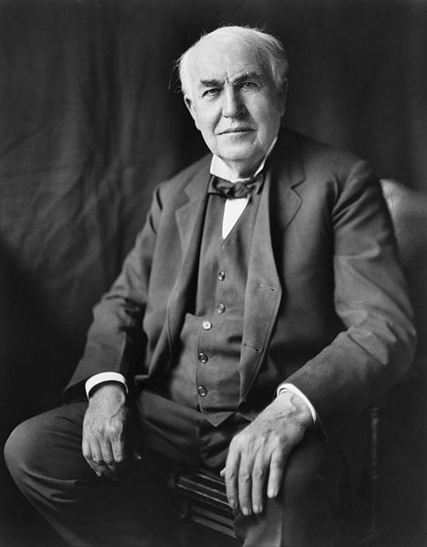
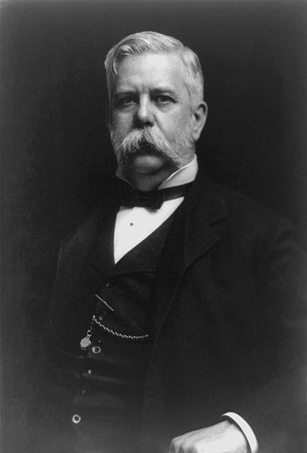
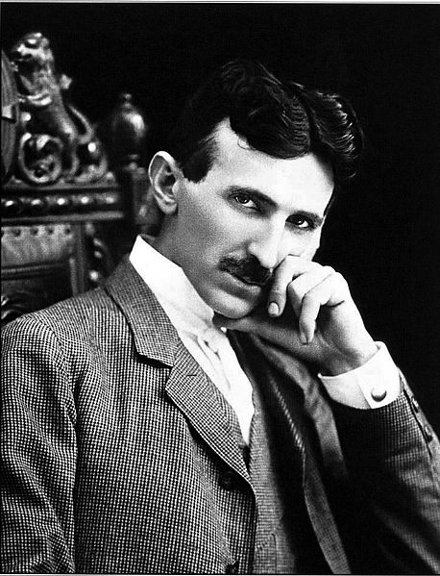
War of the Currents
Thomas Edison
George Westinghouse
Nikola Tesla

Slide 6
AC Theory - History
By 1900 AC power systems had won the battle for power distribution.
  Transformers allowed more efficient distribution of power over large areas.
  AC motors were cheaper and easier to build.
  AC electric generators were easier to build.

Slide 7
AC Circuits
An AC circuit has three general characteristics
  Value
  Frequency
  Phase
In the US, the household value is 120 Volts with other common voltages being 208, 240, 277 and 480 Volts. The frequency is 60 Hertz (cycles per second).

Slide 8
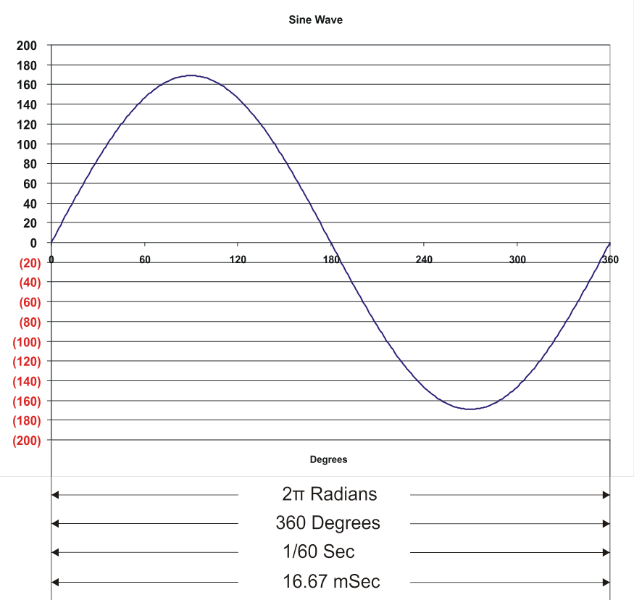
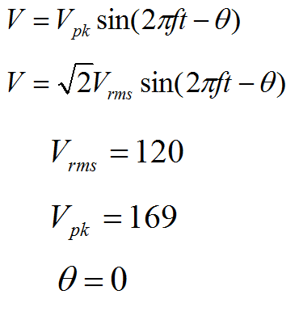
AC Theory – Sine Wave

Slide 9
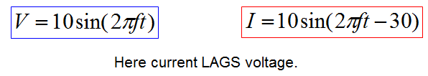
AC Theory - Phase

Slide 10
AC Theory – Active Power
Active Power is defined as P = VA
Power is a rate, i.e. Energy per unit time.
The Watt is the unit for Power
  1 Watt = 1000 Joules/sec
Since the voltage and current at every point in time for an AC signal is different, we have to distinguish between instantaneous power and average power.
Generally when we say “power” we mean average power.

Slide 11
AC Theory - Energy
Energy is power integrated over a period of time.
The units of Energy are:
  Watt-Hour (abbreviated Wh)
  Kilowatt-Hour (abbreviated kWh)
A Wh is the total energy consumed when a load draws one Watt for one hour.

Slide 12
Harmonics
Curse of the Modern World
Every thing discussed so far was based on “Linear” loads.
  For linear loads the current is always a simple sine wave. Everything we have discussed is true.
For nearly a century after AC power was in use ALL loads were linear.
Today, many loads are NON-LINEAR.

Slide 13
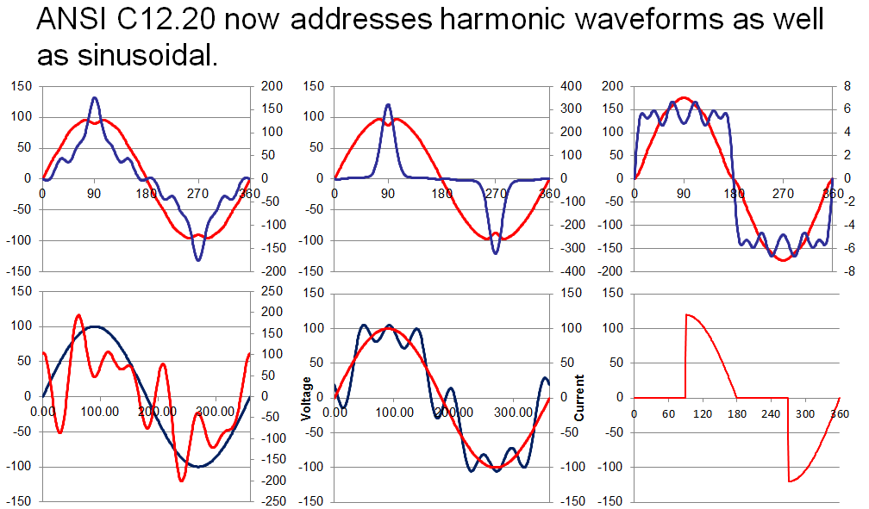
Harmonic Load Waveforms

Slide 14
Active vs. Apparent Power
Apparent Power - S
The apparent power is the power supplied to the electric circuit - typical from a power supplier to the grid - to cover the real and reactive power consumption in the loads. Measured in VA.
Active Power - P
Active - or real or true - power do the actual work in the load. Active power is measured in watts (W) and is the power consumed by electrical resistance. Measured in Watts

Slide 15
AC Theory – Phasors
An easier way to view AC data

Slide 16
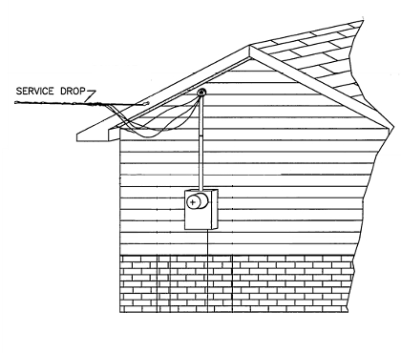
Self Contained Metering
Typically found in residential metering
Meters are capable of handling the direct incoming amperage
Meter is connected directly to the load being measured
Meter is part of the circuit
When the meter is removed from the socket, power to the customer is interrupted

Slide 17
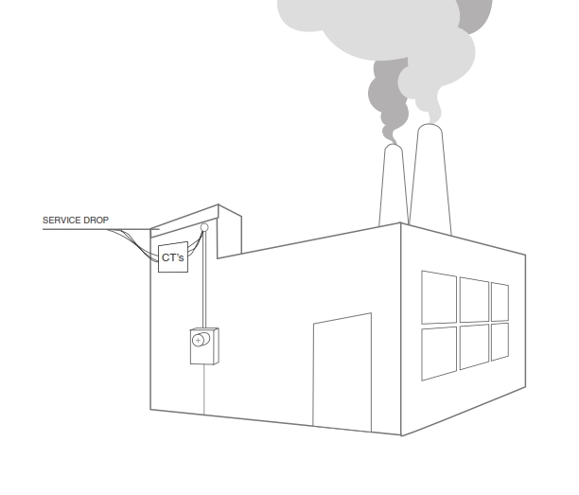
Transformer Rated Metering
Meter measures scaled down representation of the load.
Scaling is accomplished by the use of external current transformers (CTs) and sometimes voltage transformers or PTs).
The meter is NOT part of the circuit
When the meter is removed from the socket, power to the customer is not effected.

Slide 18
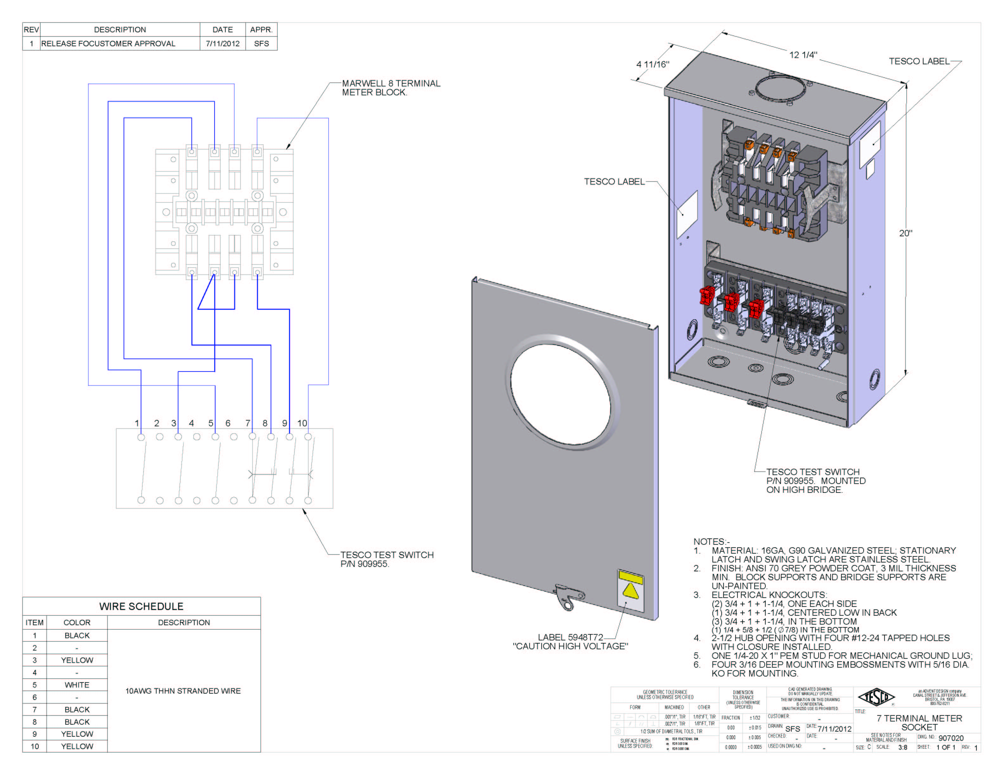
Pre-Wired Transformer Rated Enclosures
Cover Types
Wiring
Sockets

Slide 19
The Basic Components

Slide 20
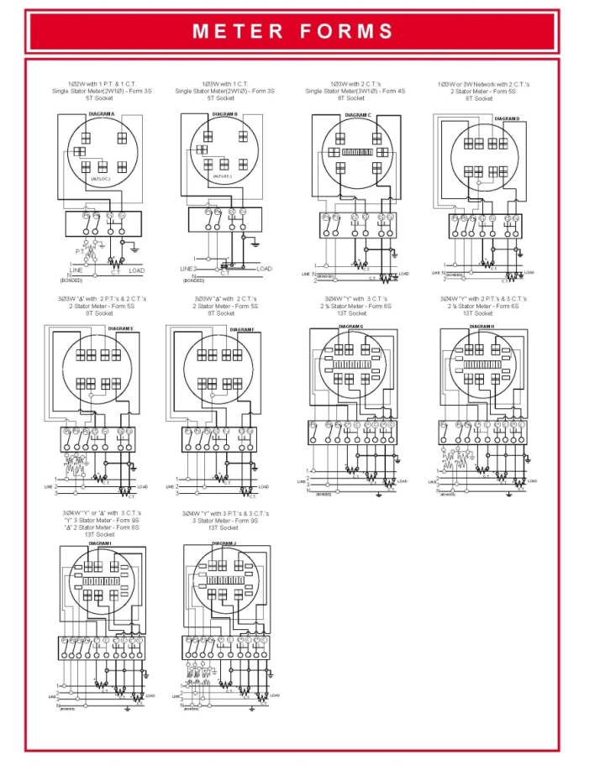
Typical Connections
Typical Connections for Common Transformer (Instrument) Rated Meter Forms

Slide 21
ANSI
American National Standard Institute, Inc.
  Not a government agency
  Standards do not have force of Law
  All compliance is voluntary
  ANSI doesn’t actually generate any standards
  Each standard is controlled by an industry organization as the “secretariat”
    For C12 NEMA (National Electrical Manufacturer’s Association) is the secretariat
    Paul Orr has been the NEMA’s secretary assigned to C12 for over ten years providing continuity to the process

Slide 22
ANSI
American National Standard Institute, Inc.
  NEMA organizes committees to propose and review standards
  Standards are republished approximately every 5 years
  Standards codify consensus approaches in common practice
  Generally, they do not break new ground or deal in controversial issues
    This is changing. Can’t avoid issues any longer.

Slide 23
ANSI C12
C12 Main Committee
  General makeup has expanded slightly over last few years
  34 voting members with representation from three groups:
    12 - Manufacturers: Meter, Socket, Test Equipment, etc.
    13 - Users: Utilities
    9 - General Interest: PUC, UL, IEEE, Consultants, etc.
  Meets twice a year in conjunction with EEI/AEIC Meter conference.

Slide 24
ANSI
C12 Main Committee
  Has final approval for all activities on any C12 family standard
  Establishes Subcommittees (SC) and Working Groups (WG) to address various standards and issues
  Sub committees and Working Groups also meet twice a year in conjunction with EEI Transmission, Distribution and Metering Conference and also hold regular or ad hoc conference calls throughout the year as members put together drafts and other technical material for consideration at the next face to face meeting.

Slide 25
ANSI
C12 Subcommittees
  Various subcommittees have been organized to review specific standards
  This is where the work is really done
  Each operates slightly differently
  Each meets on a schedule of its own choosing
  Most meet at EEI Biannual Transmission, Distribution and Metering Meetings
  Communication WG meets more often and longer
  Various subgroups meet frequently by teleconference

Slide 26
ANSI C12 – Sub-Committees
Sub-Committee | Standards
C12 SC1 | C12.1, C12.4, C12.5, C12.10
C12 SC15 | C12.6, C12.7, C12.8, C12.9, C12.11
C12 SC16 | C12.20, C12.24
C12 SC17 | C12.18, C12.19, C12.21, C12.22, C12.23, C12.26
C12 SC29 | C12.29 Standard for Field Testing of Metering Sites
C12 SC31 | C12.31 VA Measurement Standard
C12 SC46 | C12.46 American National Standard for Electricity Meters - 0.1, 0.2 and 0.5 Accuracy Classes for the Measurement of Active, Apparent and Reactive Power

Slide 27
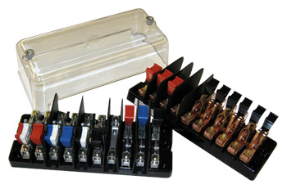
Test Switch Specifications
ANSI C12 Definitions
Test Switch Materials
Plating
Barriers
Wiring Connections
What to look for
Covers

Slide 28
ANSI C12.9 Test Switch Definitions

Slide 29
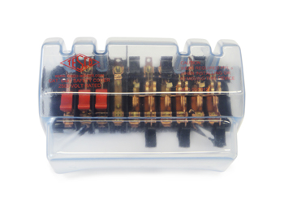
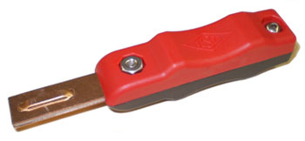
Test Switch Accessories
Test Plugs
Safety Covers
Test Switch Isolators
On installations that contain Test Switches, test leads terminated with a test switch
safety test probe (test plug) should be used for CT testing. This provides a “make-before-break” connection to prevent accidental opening of the current transformer secondary loop.

Slide 30
ANSI C12.9 Test Jack Specifications

Slide 31

ANSI C12.9 Test Plug Specifications

Slide 32
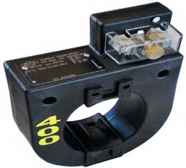
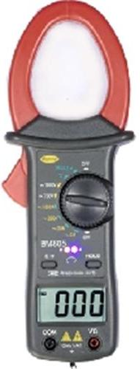
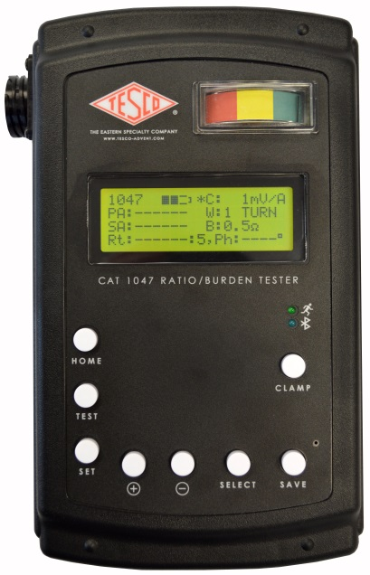
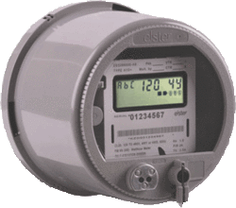
Fundamentals of Polyphase Field Meter Testing and Site Verification
Ratio of Primary Current to Secondary Current
SOURCE
LOAD
PHASE A
400A
400A
400A
5A
5A
Calculate Ratio

Slide 33
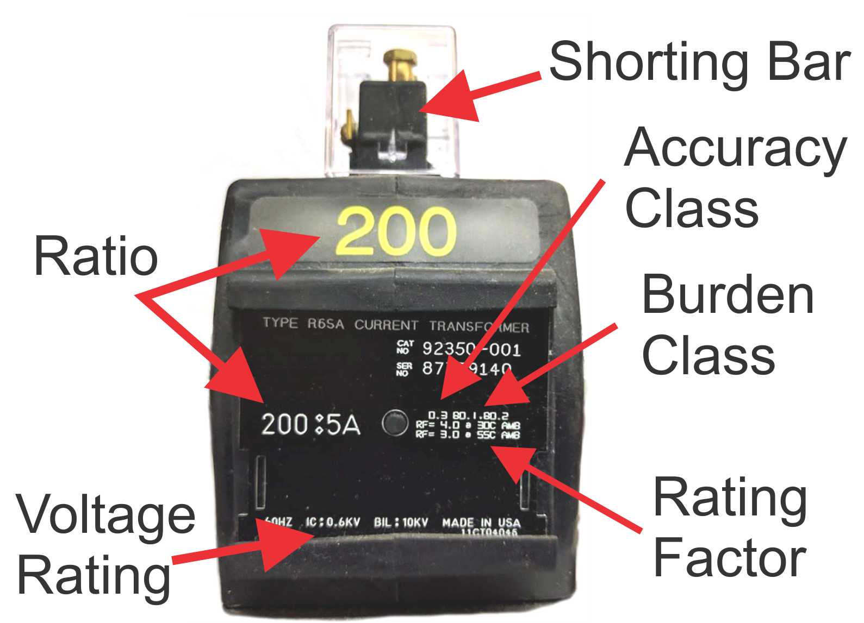
Current Transformers (CTs)

Slide 34
Fundamentals of Polyphase Field Meter Testing and Site Verification
Functionality with Burden Present on the Secondary Loop
Initial Reading = 5Amps
0.3% x 5A = 0.015A
5A – 0.015 = 4.985A
0.3% @ B0.1, B0.2, B0.5
Burden | Reading
0 | 5.0000
0.1 | 4.9999
0.2 | 4.9950
0.5 | 4.9900
1 | 4.9800
2 | 4.9500
4 | 4.0000
8 | 0.8000

Slide 35
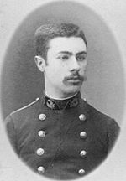
Three Phase Power
Blondel’s Theorem
The theory of polyphase watthour metering was first set forth on a scientific basis in 1893 by Andre E. Blondel, engineer and mathematician. His theorem applies to the measurement of real power in a polyphase system of any number of wires. The theorem is as follows:
  - If energy is supplied to any system of conductors through N wires, the total power in the system is given by the algebraic sum of the readings of N wattmeters, so arranged that each of the N wires contains one current coil, the corresponding voltage coil being connected between that wire and some common point. If this common point is on one of the N wires, the measurement may be made by the use of N-1 wattmeters.

Slide 36
Blondel’s Theorem
Power Measurements Handbook
Condition | % V | % I | Phase A |  |  |  | Phase B |  |  |  | non-Blondel
 | Imb | Imb | V | φvan | I | φian | V | φvbn | I | φibn | % Err
All balanced | 0 | 0 | 120 | 0 | 100 | 0 | 120 | 180 | 100 | 180 | 0.00%
Unbalanced voltages PF=1 | 18% | 0% | 108 | 0 | 100 | 0 | 132 | 180 | 100 | 180 | 0.00%
Unbalanced current PF=1 | 0% | 18% | 120 | 0 | 90 | 0 | 120 | 180 | 110 | 180 | 0.00%
Unbalanced V&I PF=1 | 5% | 18% | 117 | 0 | 90 | 0 | 123 | 180 | 110 | 180 | -0.25%
Unbalanced V&I PF=1 | 8% | 18% | 110 | 0 | 90 | 0 | 120 | 180 | 110 | 180 | -0.43%
Unbalanced V&I PF=1 | 8% | 50% | 110 | 0 | 50 | 0 | 120 | 180 | 100 | 180 | -1.43%
Unbalanced V&I PF=1 | 18% | 40% | 108 | 0 | 75 | 0 | 132 | 180 | 125 | 180 | -2.44%
Unbalanced voltages PF≠1 PFa = PFb | 18% | 0% | 108 | 0 | 100 | 30 | 132 | 180 | 100 | 210 | 0.00%
Unbalanced current PF≠1 PFa = PFb | 0% | 18% | 120 | 0 | 90 | 30 | 120 | 180 | 110 | 210 | 0.00%
Unbalanced V&I PF≠1 PFa = PFb | 18% | 18% | 108 | 0 | 90 | 30 | 132 | 180 | 110 | 210 | -0.99%
Unbalanced V&I PF≠1 PFa = PFb | 18% | 40% | 108 | 0 | 75 | 30 | 132 | 180 | 125 | 210 | -2.44%
Unbalanced voltages PF≠1 PFa ≠ PFb | 18% | 0% | 108 | 0 | 100 | 60 | 132 | 180 | 100 | 210 | -2.61%
Unbalanced current PF≠1 PFa ≠ PFb | 0% | 18% | 120 | 0 | 90 | 60 | 120 | 180 | 110 | 210 | 0.00%
Unbalanced V&I PF≠1 PFa ≠ PFb | 18% | 18% | 108 | 0 | 90 | 60 | 132 | 180 | 110 | 210 | -3.46%
Unbalanced V&I PF≠1 PFa ≠ PFb | 18% | 40% | 108 | 0 | 75 | 60 | 132 | 180 | 125 | 210 | -4.63%

Slide 37

Questions?
Tom Lawton
TESCO – The Eastern Specialty Company
Bristol, PA
215-785-2338
This presentation can also be found under Meter Conferences and Schools on the TESCO website: www.tescometering.com

